Slide 1
Readmissions Reduction Strategies: Peeling Back the Layers
Barb Petersen DNP, APRN-BC, CPHQ, CPPS
Chief Quality Officer/Exec Dir ClN
Great Plains Health

Slide 2
Learning Objectives
Define the key metrics utilized to focus on for hospital readmission reductions
Explain the readmissions current state nationally, and relative to Nebraska hospitals
Define the importance and tactics to reduce hospital patient readmissions
Define the importance of a care management team approach to reducing hospital readmissions

Slide 4
HRRP Defined
Hospital Readmission Reduction Program
CMS penalty program created as part of the ACA 2010
Reduced payments to hospitals with excess readmissions within 30 days of discharge
Conditions part of HRRP:
AMI, HF, PN, COPD, Elective Hip/Knee, CABG
Notes:
Affordable care act – signed into law by president Obama march 2010 with the intention of comprehensive health care reform law that aimed to make health insurance more affordable and available to more americans ▪
1 percent in FY 2013, 2 percent in FY 2014, 3 percent in FY 2015 and beyond
FY 2013: AMI, HF, PN ▪
FY 2015: Elective hip/knee, COPD ▪
FY 2017: CABG

Slide 5
Readmissions – Key Metric
Start with a clear definition for your facility
Patient admitted to acute care hospital within 30 days of being discharged from the same or another acute care hospital. (CMS-HRRP, 2024)
Medicare only? All payors? All ages?
Including observation patients or only inpatient?
What about specialty areas? Behavioral health or rehab units?
All cause or same diagnosis readmissions?
30 day? 14 day? 7 day?
Notes:
Random onion fact --White onion – crunchiest and sharpest of the onions – has one of the highest concentrations of sulfur-containing compounds which is more likely to make you cry. Much like readmissions can make you cry
The Centers for Medicare and Medicaid Services (CMS) defines a hospital readmission as a patient being admitted to an acute care hospital within 30 days of being discharged from the same or another acute care hospital. This definition is used in the Hospital Readmissions Reduction Program (HRRP).
CMS looks at ALL CAUSE - the cause of the readmission doesn't need to be related to the cause of the initial hospitalization
CMS includes short-term inpatient acute care hospitals, excluding critical access, psychiatric, rehabilitation, long-term care, children's, and cancer hospitals
30 day time frame CMS but can review in 14 day, 7 day etc.
What CAN you pull/review? Don’t set a metric that you are unable to pull from your EMR easily or run reports on. Look at the capabilities of your system
What matters to your board of directors? Executive team? Leaders?
Make it very meaningful – but consistent in reporting.

Slide 6
Importance of Readmissions
Impact on healthcare system-
Quality of care indicator
Increased healthcare costs
Strain on resources
Financial penalties for hospitals (ie.,CMS HRRP)
Patient impact-
Decreased quality of life
Increased risk of complications
Increased risk of HAC’s
Decreased patient satisfaction
Notes:
Random onion fact- Red onions have twice as much quercetin (core set in) as white onions 14 times more than garlic =reduce your risk of heart disease by lowering blood pressure, managing cholesterol levels and reducing inflammation. Very important onion
High readmission rates can indicate inadequate care and lead to increased healthcare costs.
Strain on home, work and social life

Slide 7
Join by Web PollEv.com​/barbarapetersen003 Join by Text Send barbarapetersen003 to 22333

Slide 8
Notes:
Poll Title: Do not modify the notes in this section to avoid tampering with the Poll Everywhere activity. More info at polleverywhere.com/support What percentage of patients are readmitted within 30 days of discharge? https://www.polleverywhere.com/multiple_choice_polls/kOIHDaBcV1nhVPs9NsXjS?state=opened&flow=Default&onscreen=persist

Slide 9
By the Numbers-Nationally
National Average:
~15-20% patients are readmitted within 30 days of discharge
Common Conditions:
Sepsis 18-26%
Heart Failure: 24-30%
Pneumonia: 18-20%
Chronic Obstructive Pulmonary Disease (COPD): 18-25%
Notes:
The Philippines onions were easily the inflation leader in 2022 and made Philippine onions the most expensive onion on Earth at 250 Pesos from their usual 90 Pesos (4.25 US dollars compared to 1.53) as much as meat
NIH Sepsis data https://pmc.ncbi.nlm.nih.gov/articles/PMC6141202/#:~:text=Recently%2C%20several%20studies%20have%20examined,greatest%20risk%20(Table%201).
Cost of readmission https://hcup-us.ahrq.gov/reports/statbriefs/sb278-Conditions-Frequent-Readmissions-By-Payer-2018.jsp#:~:text=Across%20all%20expected%20payers%20in,$16%2C400%20for%20privately%20insured%20stays.

Slide 10
Source: Agency for Healthcare Research and Quality (AHRQ), Healthcare Cost and Utilization Project (HCUP), Nationwide Readmissions Database (NRD), 2020.

Slide 11
By the Numbers-Nationally
Costs:
Average cost of a hospital readmission in the US was $16,400 (2018, HCUP)
Estimated in the U.S. to exceed $41 billion annually
In 2024, ~75% of hospitals received readmission penalties (less than 1%), 7.5% (1% or more)
The average cost of a hospital readmission is 12.4% higher than the average cost of the initial hospital stay (AHRQ)
Notes:
The Philippines onions considered the most expensive onion on Earth at 250 Pesos from their usual 90 Pesos (4.25 US dollars compared to 1.53) as much as meat in the phillipines 2023
NIH Sepsis data https://pmc.ncbi.nlm.nih.gov/articles/PMC6141202/#:~:text=Recently%2C%20several%20studies%20have%20examined,greatest%20risk%20(Table%201).
Cost of readmission https://hcup-us.ahrq.gov/reports/statbriefs/sb278-Conditions-Frequent-Readmissions-By-Payer-2018.jsp#:~:text=Across%20all%20expected%20payers%20in,$16%2C400%20for%20privately%20insured%20stays.
Average penalty source - https://www.advisory.com/daily-briefing/2023/09/18/readmission-penalties#:~:text=Overall%2C%2070.1%%20of%20hospitals%20of%20hospitals%20will,hospitals%20will%20be%20not%20assessed%20for%20penalties.
https://www.kff.org/report-section/ehbs-2024-summary-of-findings/#:~:text=The%20average%20coinsurance%20rate%20for%20a%20hospital,for%20outpatient%20surgery%20is%20lower%2C%20at%20$216.

Slide 12
Nebraska Readmission Data
Align with National Statistics
Statewide average 15-20%
Heart failure- one of the highest readmission conditions (25%)
Pneumonia and COPD follow (18-20%)

Slide 13
Notes:
Poll Title: Do not modify the notes in this section to avoid tampering with the Poll Everywhere activity. More info at polleverywhere.com/support What barriers have you encountered with reducing readmissions in your organization? https://www.polleverywhere.com/free_text_polls/DYBFp3vljyY0qW1syLLKQ

Slide 14
Factors Contributing to Readmissions
Patient-Related Factors:
Comorbidities
Mental health issues
Lack of social support
Social related issues
Healthcare System-Related Factors:
Poor discharge planning
Inadequate follow-up care
Lack of patient education
Notes:
The leek is a member of the onion family, but unlike the onion, it does not form a bulb. The thick, fleshy stalk is about the same diameter at the base and resembles a large green onion without a bulb.

Slide 15
Initial Steps
Know your organizational data
Did you receive any CMS penalties with HRRP?
What are your front line staff saying?
Review demographics of readmission data

Slide 16
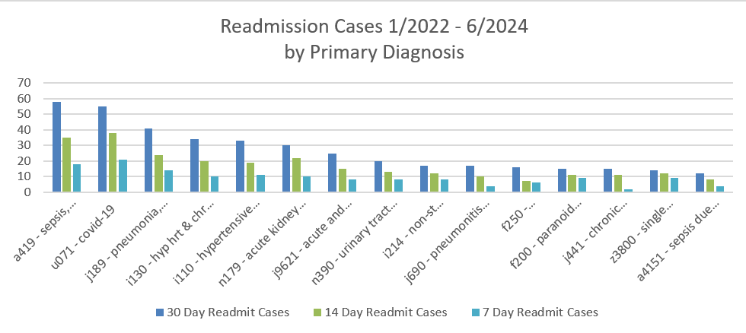
What does your data show?

Slide 18
Notes:
The number of layers in an onion depends on a number of factors, including the species, whether it's a hybrid, and the growing conditions. However, the more green leaves an onion plant has, the more layers its bulb will typically have.
Know now that medicare, men initially then closer to 30 days- women, Caucasian, sepsis, pulmonary dx, discharged on Mondays

Slide 19
PDSA Cycle
Weekly readmission review
Every Monday at 11am review past 7 day readmission patients
Report out weekly at safety huddle (Tuesdays)
Report to Executive team monthly
Initial Actions
Daily list of COPD, CHF, Pneumonia pts sent to team
Respiratory therapist used for patient education
CIN Team- Engage patients for Transitional Care Management program
Physician education on AMA discharges
Notes:
Case manager, ER manager, Respiratory therapy, transitional care team manager

Slide 20
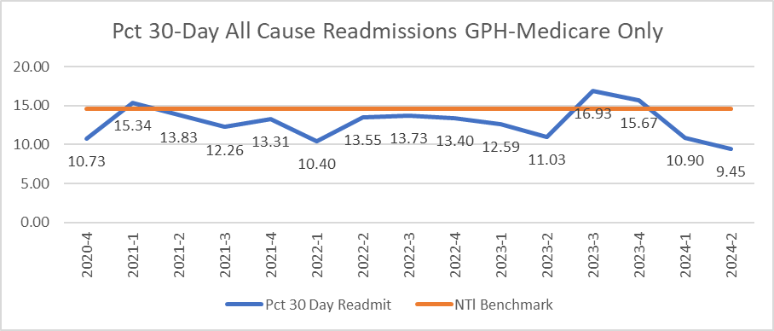
Results
Notes:
For the period of Q4-2020 through Q2-2024 the all-payor readmission rate decreased from 4.21% to 2.59%, a decrease of 38% (see Appendix B). For Medicare payor only, the rate decreased notably from 5.68% in Q1 2022 to 4.99 in Q4 2023 (a 12% decrease) and then noted a slight increase to 5.22 in Q1 2024 that is being closely monitored and analyzed (see Appendix C

Slide 21
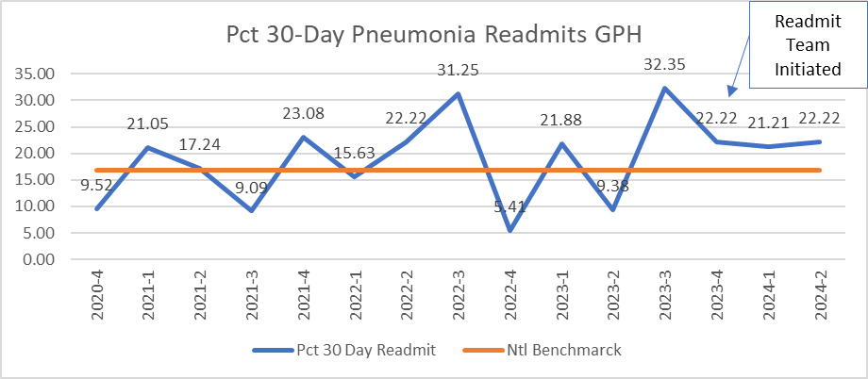
Results
Notes:
). COPD noted a significant decrease in 30-day readmissions since the inception of the readmission team of almost 50% from 30.77% to 15.38% in the past two quarters (see Appendix C). Pneumonia stayed rather flat with readmission rates near 22% (see Appendix C) and HF readmissions noted an initial decrease from 28% to 12% in two quarters, then increased again to 28%, but is being closely monitored (see Appendix D).

Slide 22
Case Study Review
James, 79- yr old male
Admit 6/9 – 6/13 COPD acute hypoxic resp failure
6/16 VA follow up appt
Zone tool given during inpt stay
6/24 CCM discharge phone call, ordered a rescue pack from VA to have on hand
7/5 F/up phone call CCM. Pt reports SOB, increased use of inhalers. No fever, cough or chills. Instructed to start rescue pack. Provider notified
7/6 F/up phone call CCM. Feeling better.
Shares he plans to attend a Tball game

Slide 23
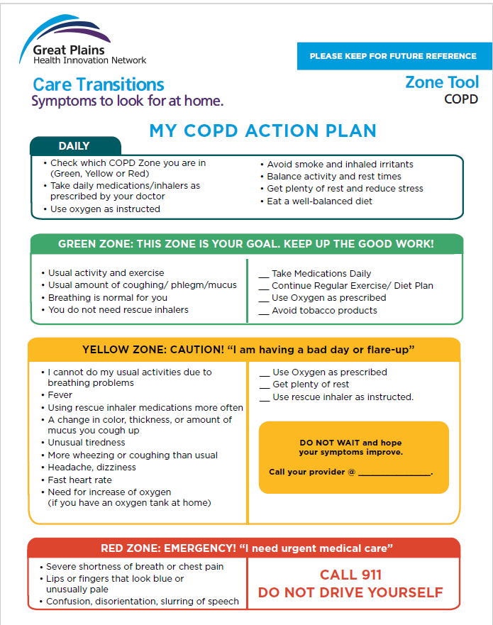

Slide 24
Case Study Cont…
Pt provided education for T-ball game:
Stay rested, sit in the shade, stay hydrated, cool towel to neck due to extreme heat, zone tool was reinforced.
7/12 pt to ER due to SOB had returned. Pt given IV solumedrol. Not admitted
7/13 f/up phone call CCM. Pt reports past three days golfing with friends in heat. Smoked friends cigarettes. Referred to pulm rehab
Assisted to move up PFT’s appointment and reinforced smoking cessation
No ER visits or admissions since

Slide 25
What’s Next ?
Continue current implemented processes
Educate physicians/providers on readmissions
Discuss patient compliance/AMA discharge status
Readmission calculators for observed/expected readmissions
Continuous review of data
Notes:
The observed-to-expected (O/E) ratio is a measure of the number of actual readmissions compared to the expected number of readmissions.
the Medicare Hospital Readmissions Reduction Program (HRRP) excludes patients who leave the hospital against medical advice (AMA) from readmission penalty calculations.
Look at what groups have highest rates

Slide 27
References-
Source: Agency for Healthcare Research and Quality (AHRQ), Healthcare Cost and Utilization Project (HCUP), Nationwide Readmissions Database (NRD), 2020.
Goodwin AJ, Ford DW. Readmissions Among Sepsis Survivors: Risk Factors and Prevention. Clin Pulm Med. 2018 May;25(3):79-83. doi: 10.1097/CPM.0000000000000254. PMID: 30237689; PMCID: PMC6141202.
Hospital Readmissions Reduction Program (HRRP) | CMS. (n.d.). https://www.cms.gov/medicare/payment/prospective-payment-systems/acute-inpatient-pps/hospital-readmissions-reduction-program-hrrp
More hospitals brace for readmission penalties in 2024. (2023, September 18). https://www.advisory.com/daily-briefing/2023/09/18/readmission-penalties#:~:text=Overall%2C%2070.1%%20of%20hospitals%20of%20hospitals%20will,hospitals%20will%20be%20not%20assessed%20for%20penalties.

