Slide 1
Swing Bed Program

Slide 2
Kimball Health Services
Kimball Health Services, a non-profit government organization, is proudly owned by the citizens of Kimball County and serves a vast rural area of the southern Nebraska Panhandle, eastern Wyoming, and northeastern Colorado steeped in agriculture tradition. Committed to providing quality, patient-centered care for the community, Kimball Health Services consists of a hospital and on-campus clinic in Kimball, a second clinic in Pine Bluffs, Wyoming, and an advanced life support ambulance service.

Slide 3
OUR MISSION
“Above all else, we are committed to patient-centered healthcare with excellence in quality, accessibility and patient experience.”

Slide 4
OUR VISION: Kimball Health Services will be an outstanding rural medical facility providing excellent patient-centered care in a modern environment.
To achieve our mission, we will be guided by these values:
Compassion: We serve each person in a caring manner
Quality: We serve each person in a caring manner
Innovation: We are creative in our approach to providing patient care
Respect: We uphold the dignity of every person
Professionalism: We put the needs of patients above all else

Slide 5
PHYSICAL PLANT
February 19, 2024 opened all services in the new facility.
Just over 60,000 sq. ft.
Larger inpatient rooms and bathrooms
Modernized surgical suites
In-house CT and MRI services
Additional services:
Mammography
Expanded surgical options
Orthopedic procedures
Physical therapy
Plans for future additions of
Chemotherapy infusions
Cardiac rehabilitation

Slide 6
Clinic Services
Kimball Rural Health Clinic
Located on hospital site
Psychiatric Nurse Practitioner
Occupational Screenings-Hearing Booth
DOT Physicals
Vaccines for Children
Pine Bluffs RHC
Located in Pine Bluffs, Wyoming
DOT Physicals
Vaccines for Children
Outpatient Specialist Services
Orthopedic
ENT
OB/GYN
Neurology
General Surgery
Cardiac
Pain Management

Slide 7
SERVICES
Licensed for 14 beds
10 patient rooms
2 Bariatric
2 Isolation
Emergency Services
Trauma bay
2 Emergency bay
Advanced Life Support Ambulance Services
Surgical Services
3 Operating Suites
Procedure/Endoscopy room
7 Bays for Prep and Recovery
Therapy Services
Occupational Therapy
Physical Therapy
Public School Services – IEP/IFSP
Concussion Protocol – SWAY
Radiology Services
Digital Radiography
3D Mammograms
CT Scan
MRI
Bone Density (DEXA)
Ultrasound
Nuclear Medicine

Slide 8
WHAT IS A SWINGBED?
“I can’t say enough for the care I received from the nurses and physical therapists. They did a great job and I got my strength back.”
Notes:
https://creativecommons.org/licenses/by/3.0/

Slide 9
ORIGIN OF SWING BEDS
“What inspired and drove Swing Beds was the patient-centered approach to care and the ability to coordinate that care at different levels.”
John Supplitt
American Hospital Association Senior Director of Rural Health Services

Slide 10
ORIGIN OF SWING BEDS
Rural hospitals are critical to the local community
Population in rural communities is older than the national average
Prior to Swing Bed designations, Skilled and Intermediate Levels of Care had to be provided in a Physically Distinct Part of the Hospital
Physical plant and staffing requirements made it difficult for rural hospitals to provide Skilled Care
Community members were being displaced from their local community to receive Skilled Level of Care
Section 904 of The Omnibus Reconciliation Act of 1980
https://www.govinfo.gov/content/pkg/STATUTE-94/pdf/STATUTE-94-Pg2599.pdf

Slide 11
SWING BEDS – THE BASICS
Certain small rural hospitals and CAHs receive approval from CMS to use their Acute Care Beds (a/k/a Hospital Beds) for both:
Acute Care
Skilled Nursing Facility (SNF) Care
The beds can be used interchangeably for acute care and post-acute care
“Swing” between acute care and post-acute care
CAHs with Swing Bed approval can use hospital beds for:
Inpatient Care
Observation Services
SNF Care
Section 1861(e) of Social Security Act, 42 U.S.C. 1395

Slide 12
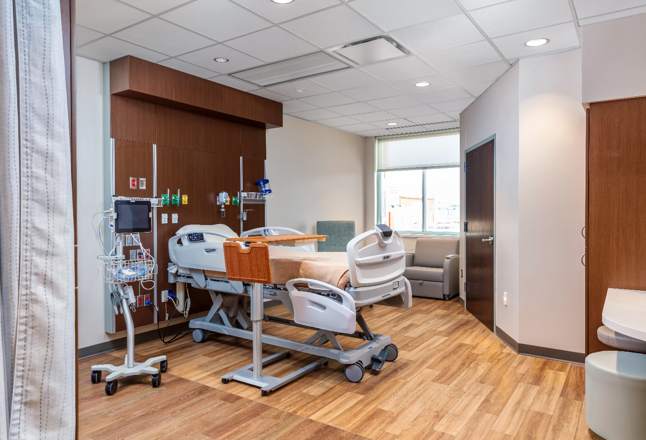
SWING BEDS – THE BASICS
When patients change from Acute Care to Skilled Care they do not have to be moved to a different room/bed.
Required to have an order and certification.
State Operation Manual Section C-1600

Slide 13
ADMITTING TO SWING BED – THE ORDER
Patient Must be “Discharged” from the Acute level of care
Discharge order (e.g. Discharge to Swing Bed; Discharge to Skilled Care; Discharge)
Discharge Summary
Patient is then “Admitted” to Skilled Swing Bed
A new Admission order is required even if the patient remains in the same hospital
Section 1861(e) of Social Security Act, 42 U.S.C. 1395

Slide 14
ADMITTING TO SWING BED – H & P
History and Physical Upon Admission to Swing Bed
Pertinent to the skilled care patient requires
Response to previously provided care
Plan for future care based on clinical rationale of prior results
Complexity of service to be provided
Admission review of all medications
Section 1861(e) of Social Security Act, 42 U.S.C. 1395

Slide 15
PHYSICIAN CERTIFICATION
Swing Bed services may only be reimbursed by Medicare if a Physician or APP certifies that the patient:
“Requires daily skilled care for an ongoing condition for which he/she was receiving inpatient hospital services (or for a new condition that arose while in the SNF for treatment of that ongoing condition); AND
Will require daily skilled care, which as a “practical matter,” can only be provided in a facility setting.
Medicare Benefits Manual, Chapter 8, Section 40

Slide 16
PHYSICIAN CERTIFICATION
Timing of Certification
At the time of admission to Swing Bed, or
“as soon thereafter as is reasonable and practicable”
The admission order is NOT a certification
There must be a separate signed statement that the patient will require daily skilled care
May be included in forms, notes or “other records that would normally be signed in caring for a patient”
May be on a separate form
Medicare Benefits Manual, Chapter 8, Section 40

Slide 18
SWING BED REGULATORY REQUIREMENTS
This Photo by Unknown Author is licensed under CC BY

Slide 19
SWING BED MEDICAL NECESSITY – MEDICARE REQUIREMENTS
Maintenance Therapy
Coverage does not turn on the presence or absence of an individual’s potential for improvement, but rather on the beneficiary’s need for skilled care to maintain the current condition or prevent or slow further deterioration.
When considering a patient for Swing Bed admission, it is important not only to look at the diagnosis or prognosis but also determine if the patient will benefit from skilled care.

Slide 20
SWING BED MEDICAL NECESSITY – MEDICARE REQUIREMENTS
Even if no improvement is expected, skilled therapy services are covered when an individualized assessment of the patient’s condition demonstrates that skilled care is necessary for the performance of a safe and effective maintenance program to maintain the patient’s current condition or prevent or slow further deterioration.
Medicare Benefits Manual, Chapter 8, Section 30.4.1.2

Slide 21
MEDICARE DEFINITION SKILLED NURSING AND SKILLED REHABILITATION SERVICES
Skilled Therapy Services
Directly related to an active treatment plan based on an initial evaluation performed by a licensed physical, occupational or speech therapist after admission to the SNF
Treatment plan is approved by a physician (or APP supervised by a physician) after consultation with the therapist
Level and complexity that requires judgment, knowledge and skills of the therapist
Considered under “accepted standards of medical practice” to be an effective treatment for the patient’s condition

Slide 22
MEDICARE DEFINITION SKILLED NURSING AND SKILLED REHABILITATION SERVICES
Skilled Nursing Services
So “inherently complex” they can be safely and effectively provided only under the supervision of an RN (or LVN when allowed by regulations)
Include an individualized assessment demonstrates specialized nursing judgment, knowledge and skills are needed
Necessary to maintain the patient’s current condition or prevent slow or further decline

Slide 23
SWING BED MEDICAL NECESSITY – MEDICARE REQUIREMENTS
The Skilled Services are Required Daily
This requirement is met when the patient receives Skilled services at least 5 Days a Week
Example: If the patient’s condition requires Physical Therapy twice per day, it must be provided at this frequency at least 5 days per week
“This requirement should not be applied so strictly that it would not be met merely because there is an isolated break of a day or two during which no skilled rehabilitation services are furnished and discharge from the facility would not be practical.”
Medicare Benefits Manual, Chapter 8, Section 30.2.1

Slide 24
SWING BED MEDICAL NECESSITY – MEDICARE REQUIREMENTS (CONTINUED)
As a practical matter, the daily skilled services can be provided ONLY on an inpatient basis in a Skilled Nursing Facility:
Take into consideration “economy and efficiency”
Part of the preadmission process should determine if the skilled services could be provided as an outpatient
Considerations for Swing Bed Medical Necessity (when the skilled services are available as an outpatient)
Transportation would be an “excessive physical hardship”
Providing the services as an outpatient would be less efficient or effective
Lack of effective home care
Skilled Services are “Reasonable and Necessary” for the treatment of the patient’s illness or injury based on “accepted standards of medical practice”.
Medicare Benefits Manual, Chapter 8, Section 30.2.1

Slide 25
EXAMPLES OF SKILLED CARE
See Exhibit Slides with Examples from Medicare Benefits Manual
Teaching and Training
Management and Evaluation of a Patient Care Plan
Observation and Assessment of the Patient’s Condition
Direct Skilled Nursing Care
Skilled Rehabilitation

Slide 26
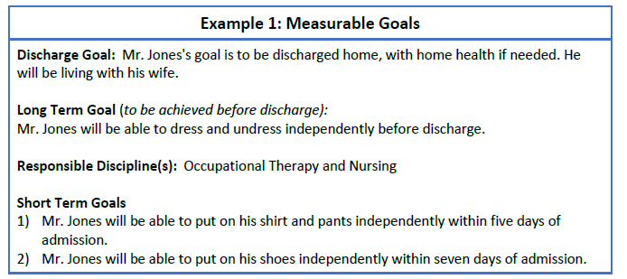

Slide 28
EXAMPLES OF NON-SKILLED CARE
Administration of routine oral medications
General maintenance care of colostomy and ileostomy
Routine services to maintain the functioning of bladder catheters
Change of dressing for uninfected post-operative or chronic conditions
Prophylactic and palliative skin are
Routine care for incontinent patients
Assistance in dressing, eating and going to the toilet
Periodic turning and positioning in bed
General supervision of exercises that have been taught to the patient
Performance of repetitious exercises that do not require skilled rehabilitation personnel for their performance

Slide 29
SWING BED – MEDICARE REIMBURSEMENT REQUIREMENTS
Patient Has a 3-Day Qualifying Stay
Patient received at least 3 Consecutive Midnights of Medically Necessary Inpatient Hospital Care
DOES NOT include time in the emergency room
DOES NOT include time receiving Observation services
Admitted to Swing Bed within 30-days of Discharge from Acute Care
Maximum Benefit of 100-days
Short Stay Goal 7-10 days
Extended Stay less than 60 days
Benefits after 60-days of no Inpatient Services
Medicare Benefits Manual, Chapter 8, Section 30.2.1

Slide 30
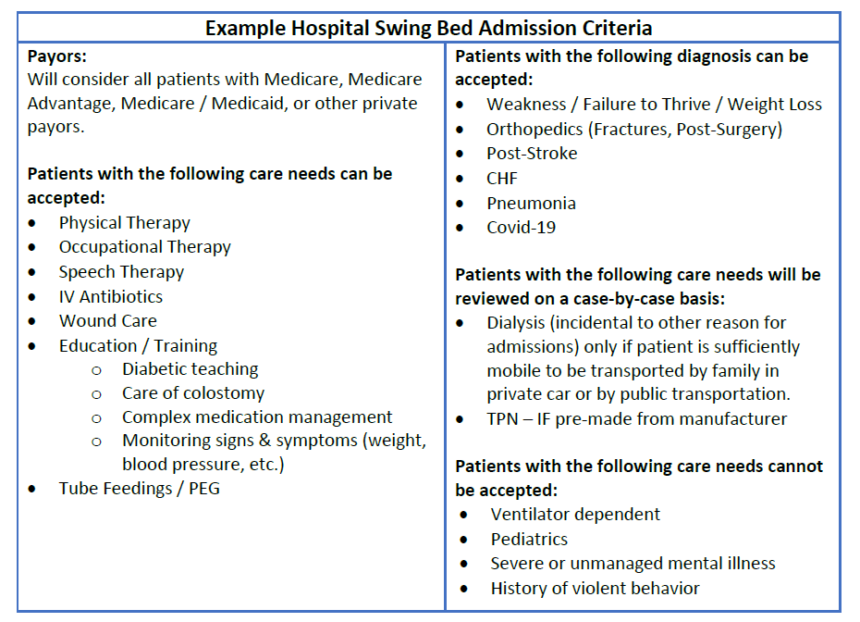

Slide 31
SWING BED DOCUMENTATION
Multi-Disciplinary Care Plan Meeting
Rounding and Care Supervision
Recertification
This Photo by Unknown Author is licensed under CC BY

Slide 32
PHYSICIAN SERVICES
The term “attending physician” or “physician” may also include an APP unless the regulations specify a task to be completed “personally” by the physician
Supervising the care of the Swing Bed Patient means:
Participating in the Assessment and Care Planning
Monitoring changes in the patient’s medical status
Providing consultation and treatment when contacted by other members of the care team
Prescribing medications and therapy
Ordering transfer to acute care, emergency department, or other acute care hospital when necessary
42 CFR 483.21(b)

Slide 33
MULTI-DISCIPLINARY CARE PLAN MEETING
Must occur “as soon as possible after admission”
Recommendation within 72 hours of admission (or sooner if possible)
Required Attendance (by CMS Regulations)
Attending Provider
Registered nurse with responsibility for the patient
CNA with responsibility for the patient
Member of the food and nutrition services staff
Others as appropriate (PT, OT, Speech, Pharmacy)
Patient or representative “to the extent practicable”
Plan of Care must include:
Include only those focused goals specific to the Swing Bed stay
Measurable objectives
Timeframes to attain or maintain the highest physical, mental and psychosocial well-being
42 CFR 483.21(b)

Slide 34
HOW OFTEN DOES THE PROVIDER HAVE TO SEE A SWING BED PATIENT?
At admission
As often as necessary to assess and evaluate treatment based on the patient’s clinical condition
Minimum Requirement
14 Days After Admission
Every 30-Days Thereafter
Best Practice Recommendation
Weekly
Medicare General Information, Eligibility, and Entitlement Chapter 4, 40.3 and 40.4

Slide 35
PROGRESS NOTE DOCUMENTATION
Must include
Pertinent aspect of patient’s condition
Any report by the staff of the change in the patient’s clinical condition and physician’s response
Current clinical status
Progress toward skilled goals
If there is a change to the patient’s plan of care (e.g., new medication ordered or change to medication):
Documentation to support reevaluation of the effectiveness of the intervention and the patient’s response
Medicare General Information, Eligibility, and Entitlement Chapter 4, 40.3 and 40.4

Slide 36
PHYSICIAN RECERTIFICATION
Timing
First recertification no later than the 14th day of Swing Bed admission
Subsequent recertification at intervals not exceeding 30 days
Adequate written record of the reasons for the continued need for Swing Bed services:
Estimated timeframe for the patient to remain in the facility
Any plans (where appropriate) for home care
Recertification statement does not have to include this entire statement IF all of the required information in included is progress notes
A statement that continued Swing Bed services are medically necessary is not sufficient
Medicare General Information, Eligibility, and Entitlement Chapter 4, 40.3 and 40.4

Slide 37
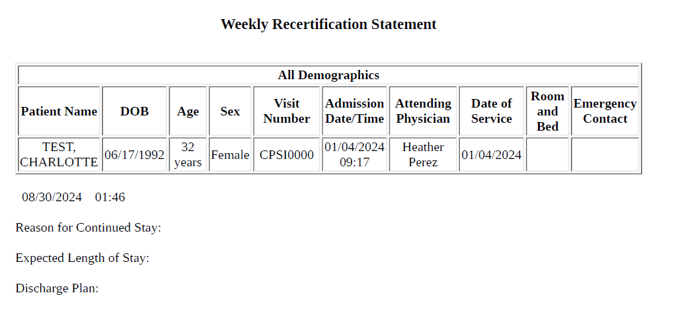
Medicare Benefits Manual, Chapter 8, Section 40

Slide 38
DISCHARGE DOCUMENTATION
Discharge Summary
Recapitulation of the patient stay that includes:
Diagnosis
Course of illness/treatment or therapy
Pertinent labs, radiology and consultation results
Post-discharge plan of care
All special instructions or precautions for ongoing care
Any other necessary information to ensure a safe and effective transition of care
42 CFR 483.15(c)(2) and 483.21(c)(2)

Slide 39
SWING BEDS – FACILITY REQUIREMENTS
Any Acute Care Bed can be used for SNF care except:
Psychiatric Distinct Part Units
Intensive Care Unit Beds
Newborn Beds
CAHs must comply with SNF Services Conditions of Participation
Residents’ Rights
Admission, Transfer and Discharge Rights
Freedom from Abuse, Neglect and Exploitation
Social Services
Comprehensive assessment, care plan, and discharge planning requirements
Specialized Rehabilitation Services
Dental Services
Nutrition
Policies and Procedures
Review Required Every 2 Years (or more frequently when required by a change in State or Federal law and regulation)
For those requirements that apply ONLY to Swing Beds, the policies should not be combined with other facility policies
42 C.F.R. §483.10-15; 42 C.F.R. § 485.645

Slide 40
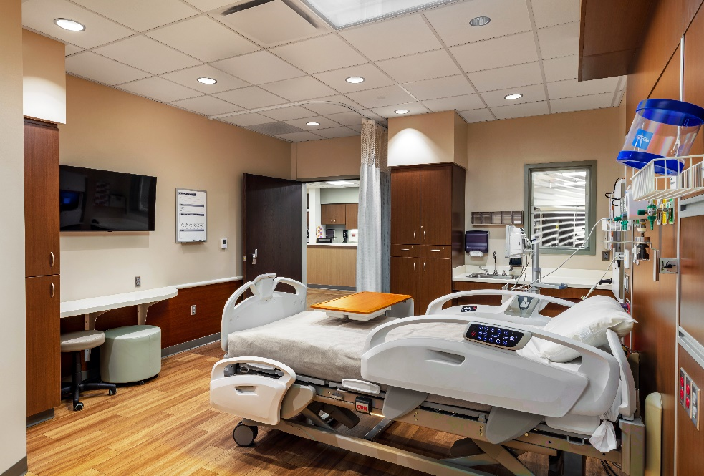
SWING BEDS – FACILITY REQUIREMENTS
Conditions of Participation Apply to ALL Payers, Including Medicare Advantage Plans, Medicaid and Third-Party Payers
Except for CoPs related to:
Admission Criteria
Continued Stay Medical Necessity
Reimbursement
State Operations Manual Section C-1600

Slide 41
SWING BEDS – FACILITY REQUIREMENTS
Patients must be given the right to choose a physician
This can include informing the patient of the availability of certain physicians during weekdays and coverage by the ER or Hospitalist on weekends
Informed of the right to choose
How to contact their physician
Option to choose an alternate physician
Facility staff that can work with the patient to choose another physician if the patient is unhappy with their current physician
State Operations Manual Section C-1600

Slide 42
EXAMPLES AND TOOLS
This Photo by Unknown Author is licensed under CC BY

Slide 45
KIMBALL MULTI-DISCIPLINARY PLAN OF CARE

Slide 46
KIMBALL MULTI-DISCIPLINARY PLAN OF CARE (CONT)

Slide 47
KIMBALL MULTI-DISCIPLINARY PLAN OF CARE (CONT)

Slide 48
Benefits of a Swingbed Program to a CAH
This Photo by Unknown Author is licensed under CC BY

Slide 49
ALLEVIATING THE FINANCIAL BURDENS CAUSED BY PATIENT VOLUME FLUCTUATIONS
CAHs reside in rural areas, where demand can fluctuate with the seasons
Illness seasons with elderly patients
Agriculture seasons
School schedules
Bringing in swingbed patients can help offset the times of low inpatient and outpatient volumes
In seasonal times of lower volumes, recruiting swingbed patients from referring facilities that don’t offer this service can help offset financial burdens

Slide 50
KEEPING PATIENTS CLOSE TO HOME
Rural areas often do not have close rehabilitation facilities
Swingbed programs allow patients to stay closer to home while they heal and strengthen
Patients can avoid transfers to another hospital for post-acute care
Family visits are more viable if patients are in swingbed programs close to their homes

Slide 51
BETTER CARE AND OUTCOME FOR PATIENTS
Reduction of the number of patients who have to be readmitted
Swingbed programs allow patients to stay in the hospital longer to ensure they are healthy and strong enough to return home
Access to staff who are trained in acute care
Nurses and providers for swingbed patients are often the same as those who care for acute patients
Lower patient-to-provider or nurse ratios
In a CAH, the ratio of providers and nursing staff to patients is lower, allowing more tailored, consistent care

Slide 52
WHAT HAS THE SWINGBED PROGRAM DONE FOR KHS
Fiscal Year Ending 6/30/24
676 Swingbed Days
55.7% of total days
4.3% of gross revenues
Success story of a heartwarming moment for a local patient.

Slide 53
A Heartwarming Moment at Kimball Health Services
Last Thursday, members of the Kimball Health Services team gathered to celebrate a truly inspiring milestone—Sally Johnson’s release from our care. Sally came to us after experiencing serious complications from surgery, and her family feared the worst. But with determination and the support of our incredible staff, Sally’s condition began to improve. She then transitioned into our Swing Bed Program, where she received 24/7 nursing care and daily rehabilitation to help her on the long road to recovery.
It was an emotional moment as Sally, surrounded by the team who helped her every step of the way, was able to leave the hospital. Tears flowed as Sally’s journey reached this important milestone—but there is still more to overcome, and we know she’ll continue to fight with the same strength that has brought her this far.
Sally is also the mother of our very own KHS Paramedic Heather Johnson, making this recovery all the more special for our KHS family.
We are so proud of Sally’s progress and will continue to support her in her recovery. Please join us in wishing Sally and her family all the best as they move forward on this journey!
https://youtu.be/017oitSdu1A

