Slide 1
Quality Residency
Capstone Project
nebraskahospitals.org
Erica Lauder MSN, RN, CNOR

Slide 2
Introduction to the Organization
Box Butte General Hospital is a Critical Access Hospital located in Alliance, Ne. We are a 25 bed facility with an abundance of outpatient services. We have a busy ED seeing on average 100+ patient’s a week. Our Surgical Department does around 160 cases per month ranging from Endoscopy to Major Orthopedics and Spine surgeries. In 2016, Box Butte General Hospital completed a new addition and renovation. The hospital is in the process of beginning another new addition and renovation including a new Dialysis Unit.

Slide 3
Introduction to the Project and Team
The Billion Pill Pledge Program is a program to support hospitals in enhancing patients’ preparation for surgery, reduce readmissions, better manage surgery-related pain, and minimize the need for opioids in the recovery period. Our CEO signed a pledge almost a year ago to begin the conversation on decreasing opioids in the hospital and community. The surgery department and the providers in clinic that see surgical patients were the main focus. This project is important because there so many alternatives to opioids post surgery and with the correct resources we can improve the outcome of patients.
The team was made up of the surgery manager, anesthesia providers, surgery APRNs and PAs. Our CEO signed the Billion Dollar Pledge in 2023 and in 2024 Nebraska accepted it and implementation began.

Slide 4
AIM Statement
The aim of this project is to decrease the number of opioids prescribed post op by 60% between October 2024 and September 2025.

Slide 5
Measuring Success
Metrics:
Total number of Opioids prescribed
Transition to OxyContin vs Percocet or Norco
Run report from EHR
Filter by provider, medication and # of pills sent to pharmacy
In order to define this as a successful project, there will be a decrease in the use of Percocet or Norco sent to pharmacy and have it replaced with OxyContin, Celebrex, and Tylenol.
A report will be ran through the EHR to track and trend for change implementation.

Slide 6
Selecting Changes
What changes will be made to work towards improving goals?
Billion Dollar Pledge Program Implementation Guide
Improvements to order sets for surgery and anesthesia to reflect ERAS protocols
Increasing blocks with anesthesia
Education provided to nursing and providers from qualified personnel
Education provided to patients
Brainstorm change options with team
Start with just a small group of surgery providers and expand out
Evaluate usefulness of blocks and medications given in blocks
Assess feasibility of implementation
Project Lead will meet with those impacted as needed for feedback and suggestions
Create a plan for education and support of change management
Presented during med staff
Present to nursing at separate meeting
Utilizing Marketing to allow for patients and families to support the movement

Slide 7
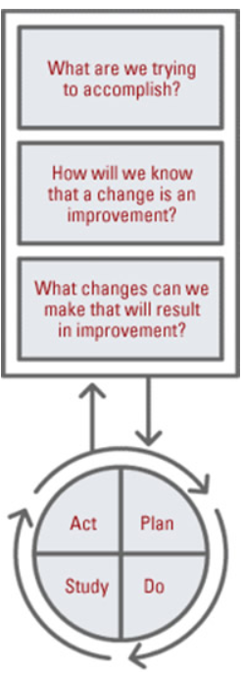
Plan ~ Do ~ Study ~ Act
Plan
I plan to: Meet with providers and nurses to improve order sets
I hope this produces: A shared mental model of ERAS program
Steps to execute: Introduce idea, set up time/day to meet with individuals and Billion Dollar Pledge program
Do
How long will you observe new changes? Monthly check ins
What did you observe? Increased conversations about change
Are the changes creating consequences – intended
Study
What did you learn? BBGH was doing 90% of recommendations, increased concerns about NSAIDs used post op
Did you meet your measurement goal? In progress
Do you need more observation time? yes
Act
What did you conclude from this cycle? Staff want what is best for patients, opportunities to better discharge instructions
Will you sustain the changes? yes
Does the change need adjusted or removed? Adjusted and additional time commitment to complete

Slide 8
Plan ~ Do ~ Study ~ Act
Plan
I plan to: Meet with Billion Pill Pledge team
I hope this produces: Resources needed to support a change for ERAS program and kits for patients to have at home
Steps to execute: Meet with team, complete ERAS guide
Do
How long will you observe new changes? Continuous check ins to see what next steps are
What did you observe? Increased conversations and support for improvements
Are the changes creating consequences – intended
Study
What did you learn? Order sets need improved, changes to blocks needed, home medication changes
Did you meet your measurement goal? In progress
Do you need more observation time? Yes
Act
What did you conclude from this cycle? Many improvements need completed but easily achievable
Will you sustain the changes? Yes, once change is complete monitoring needing done
Does the change need adjusted or removed? Adjusted as needed

Slide 9
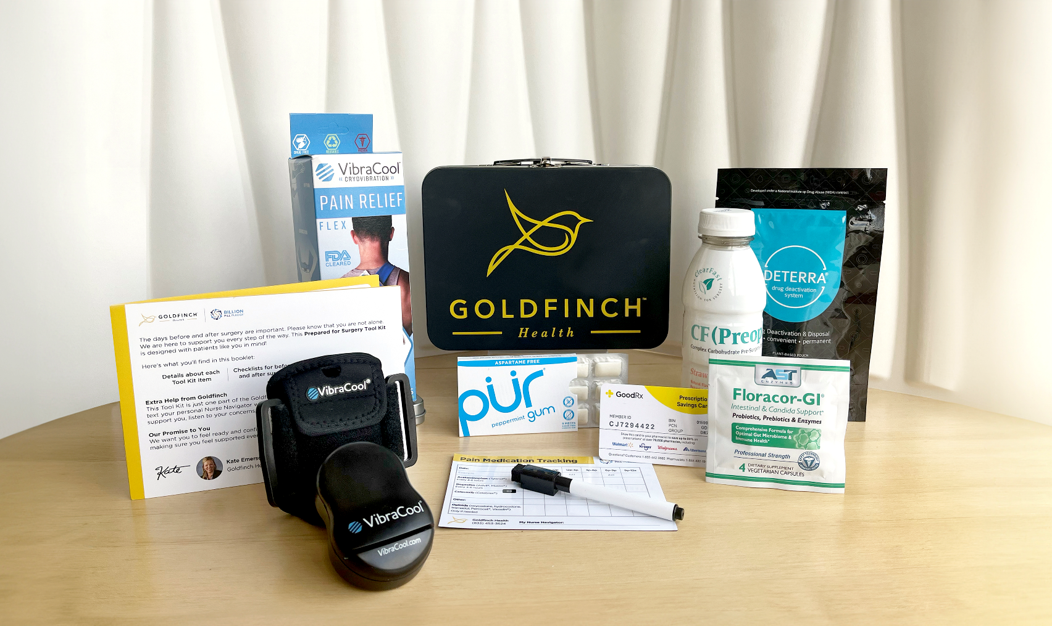
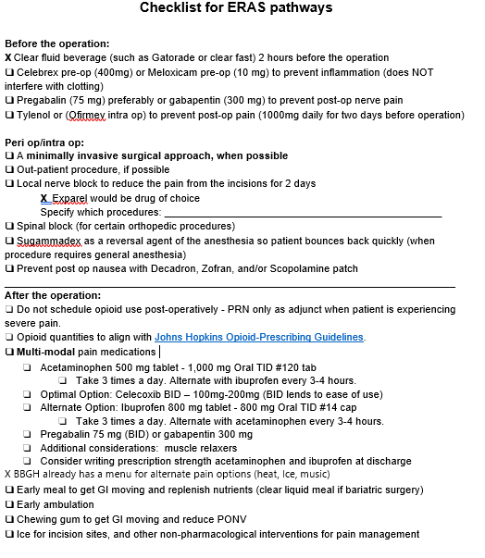
Plan ~ Do ~ Study ~ Act
Billion Pill Pledge- Prepared for Surgery Tool Kit
Vibration Therapy Device-VibraCool
Complex Carbohydrate Pre-Surgery Drink
Pain Medication Tracking Magnet
Good Rx Card
Chewing Gum
Probiotics
Opioid Disposal

Slide 10
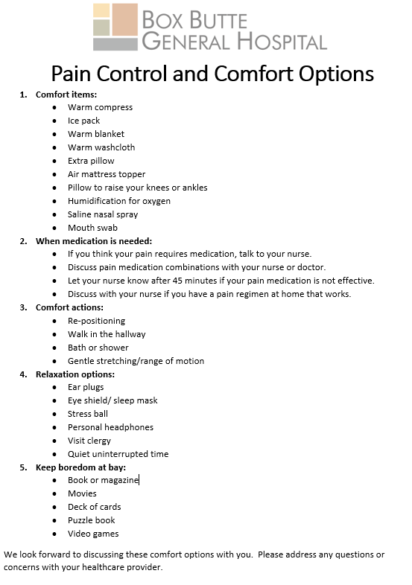
Plan ~ Do ~ Study ~ Act

Slide 11
Data and Trends September 2023-September 2024
17,000 Norco’s prescribed over 12 months to Post Surgical Patients by e-prescribe.
By October 2025 the goal is to decrease the number of pills prescribed by 60%.

Slide 12
Return on Investment (ROI)
Explore the financial implications of the project:
Will costs/expenses be incurred to make noted changes?
Additional staff? No additional staff needed to complete this, Nurse Navigator or Clinic Nurse will enroll patient in program
Additional hours? Limited time needed to invest in orders and limited information needed to complete enrollment
Equipment? Goldfinch supplies Prepared for Surgery Kit for patients
IT expense? No IT expense needed
What savings/revenue will be noted?
Decreased harms? Patients have an increased success rate by being enrolled in ERAS and a decreased risk for infection and post op complications
Increased billable codes? No Billable Codes
Decreased staff hours? Additional add on cases for I&Ds will be decreased
Total Savings/Revenue – Total Costs/Expenses = Total ROI
Positive ROI = Dollars Earned ~~ Negative ROI = Dollars Lost

Slide 13
Spreading / Sustaining / Maintaining / Replicating
Ensure successful changes is spread to all units, staff, appropriate areas
Education provided during orientation to new nursing staff, expectations to providers at onboarding and yearly review of order sets
Audits and spot checks to assess sustainability and maintenance
Once program begins it will be hardwired and the new normal for orders as well as “Prepared for Surgery” Toolkit for patients being provided
Can the program be replicated in other areas or organizations?
Other organizations can enroll in the GoldFinch Billion Pill Pledge

Slide 14
THANK YOU/Questions
Erica Lauder MSN, RN, CNOR
Box Butte General Hospital
elauder@bbgh.org
nebraskahospitals.org

