Slide 1
NHA WORKFORCE and education
EXPANDING THE WORKFORCE THROUGH CREATIVE DISRUPTION
Stacey Ocander EdD | Nebraska Hospital Association

Slide 2
Objectives
Review the 6 projects NHA has created under LB227 and hear about success
Discuss the current Scope of Practice for both licensed and unlicensed health care professional
Explore creative ideas for moving the workforce shortage from reactive to preventive

Slide 3
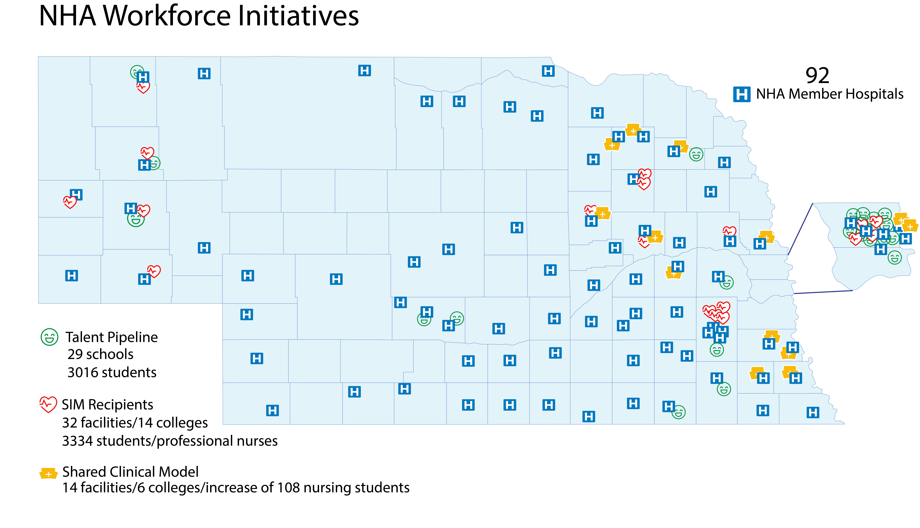

Slide 4
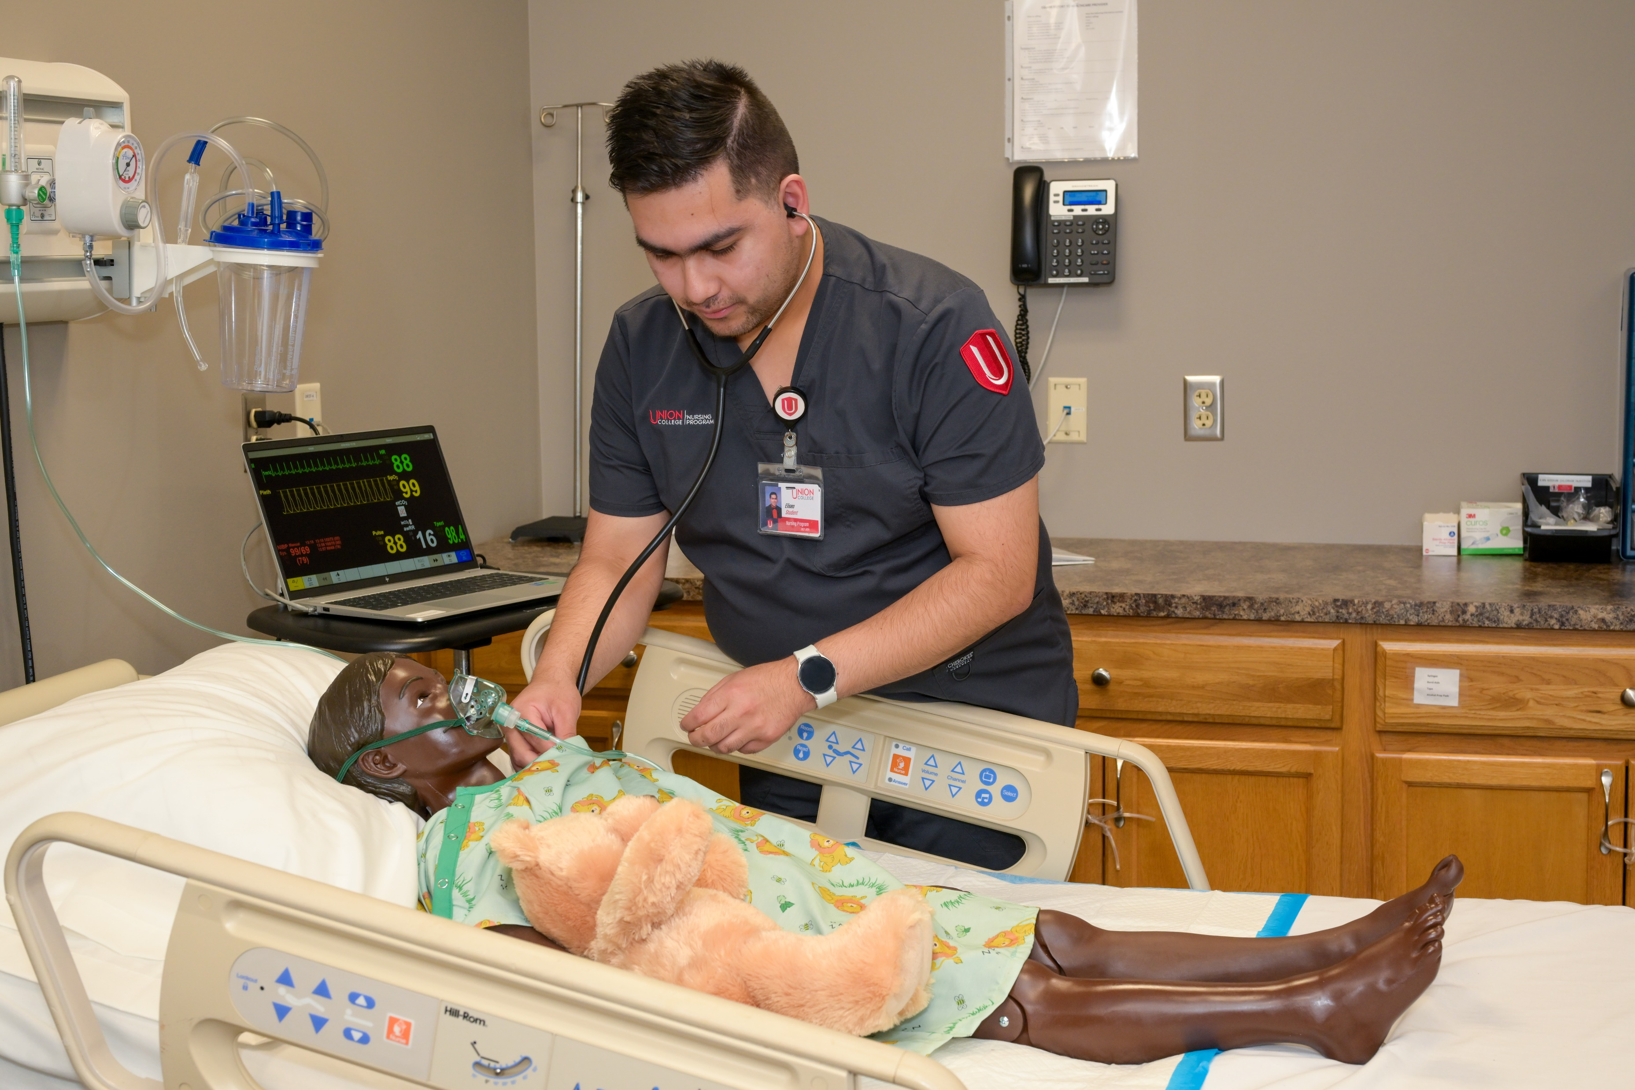
LB 227: Simulation
In year one, LB227 through the NHA and the NCN awarded $1,353,134 across 16 academic institutions and hospitals. 2400+ nursing students (unduplicated) and faculty have received training on these devices.

Slide 5
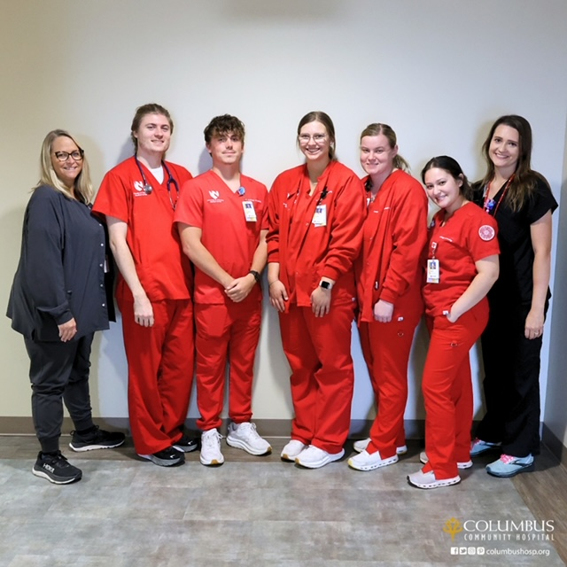
LB227: Shared Clinical Model
In year one, nine Nebraska hospitals and six Nebraska academic institutions began collaboration to pursue the CPI model. The result has been an increase of 108 additional nursing students admitted to programs in fall 2024 and multiple rural rotations for current nursing students.

Slide 6
LB227: Clinical Practice Instructor Education
CPI’s will have the three courses paid for at a maximum of $1000 per course and a $650 allowance for books per course.
Courses have been identified and approved at three Nebraska approved Schools of Nursing. The launch of this program is fall 2024.
Provide educational curriculum
for nursing faculty and identify
three target educational courses
for the clinical practice and clinical education nurses while enhancing student learning.
Partner with Nebraska four-year academic institutions who offer
the focus educational curriculum.

Slide 7
Nursing Student Travel & Housing Expenses
The launch of this program is planned for fall semester 2024. Nine new affiliated agreements have been fully executed between hospitals and academic schools of nursing. Nursing students have been placed in rural settings beginning fall 2024 who have been made aware of the benefit of receiving reimbursement for housing and travel.
To Date:
3 traveled to Syracuse Area Health and 4 traveled to Butler County Health in David City.

Slide 8
LB 227: Statewide Onboarding
Program Objectives:
Identify a vendor to buildout platform
Create competency modules meeting training requirements for all Nebraska hospital-based clinical sites.
Onboard all nursing students to platform around one centralized set of competencies
Create an environment of compliance and consistent onboarding
To DATE:
A vendor has been selected and the platform for the statewide onboarding is being built for launch in year two. It will consist of multiple micro-credentials necessary for student nurses to onboard at NHA member hospitals.

Slide 9
LB 227: Student Nurse Internship
In year one, 16 student nurses completed their internship. This resulted in 11 out of 16 being hired fulltime while completing their nursing degree.
GOAL: Place 50 Student Nurse Interns in year 2

Slide 10
Scope of Practice – Fluid Document
The information provided in this document is representative of the Scope of Practice for each profession and not reflective of an individual hospital or system allowable practice.
It is written based on entry level scope and not additional certifications professionals may earn.
When deciding the role delineation for each professional, we recommend referencing this information to ensure it is an allowable skill per the Scope of Practice and then consider your hospital or system standards of practice.
This information is shared to assist in making informed decisions but should not be considered a directive or mandate by the NHA.
Allied health professional’s competency comparison chart

Slide 11
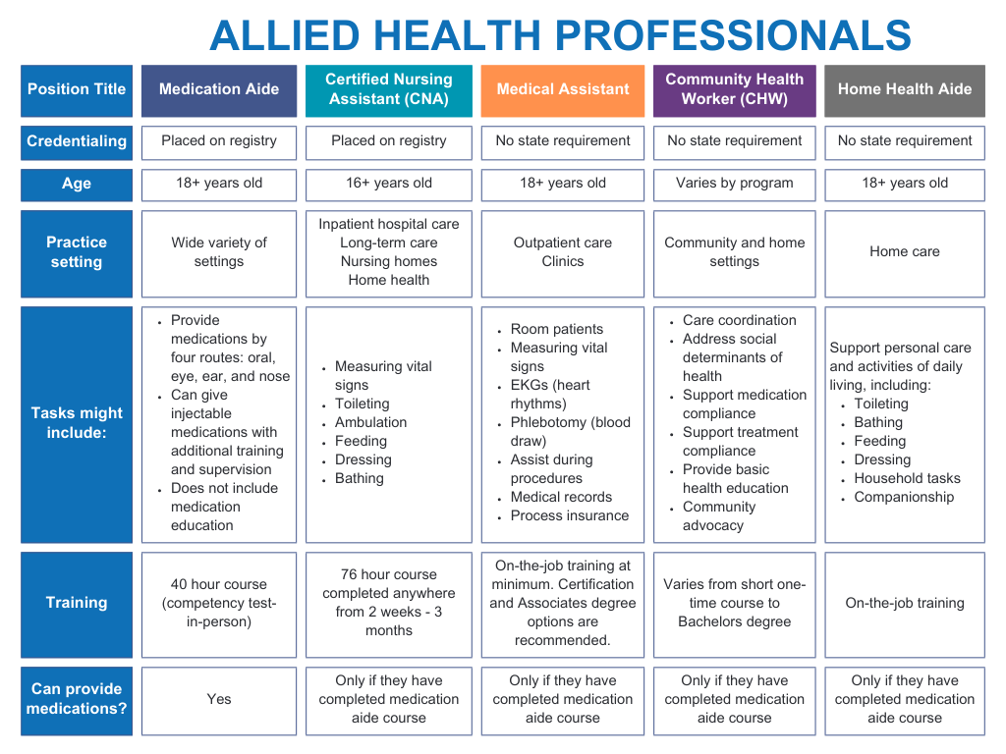

Slide 12
Additional workfoRCE Initiatives
Workforce Survey
Internships
High School
Advocacy Institute
Healthcare Heroes Program – 3-6th grade

Slide 13
Nebraska center for nursing
https://center4nursing.ne.gov/

Slide 14
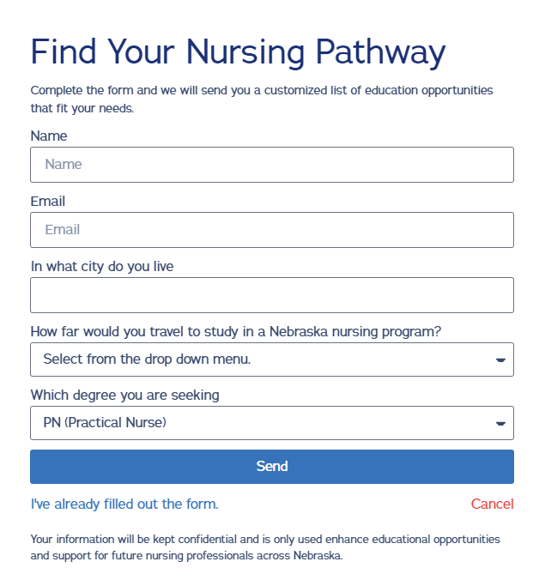
Nebraska center for nursing
https://center4nursing.ne.gov/

Slide 15
What is your creative
disruption???
This Photo by Unknown Author is licensed under CC BY-SA

