Slide 1
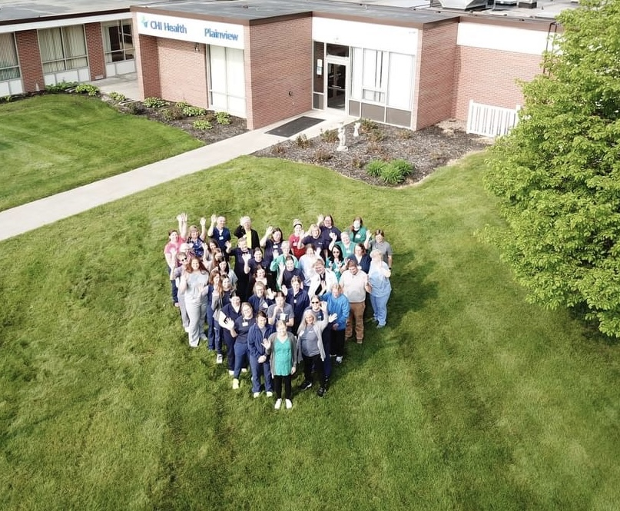
Compassion*Inclusion*Integrity*Excellence*Collaboration
Quality Residency
Capstone Project
Kaylyn Venteicher, RN, October 4, 2024, CHI Health Plainview

Slide 2
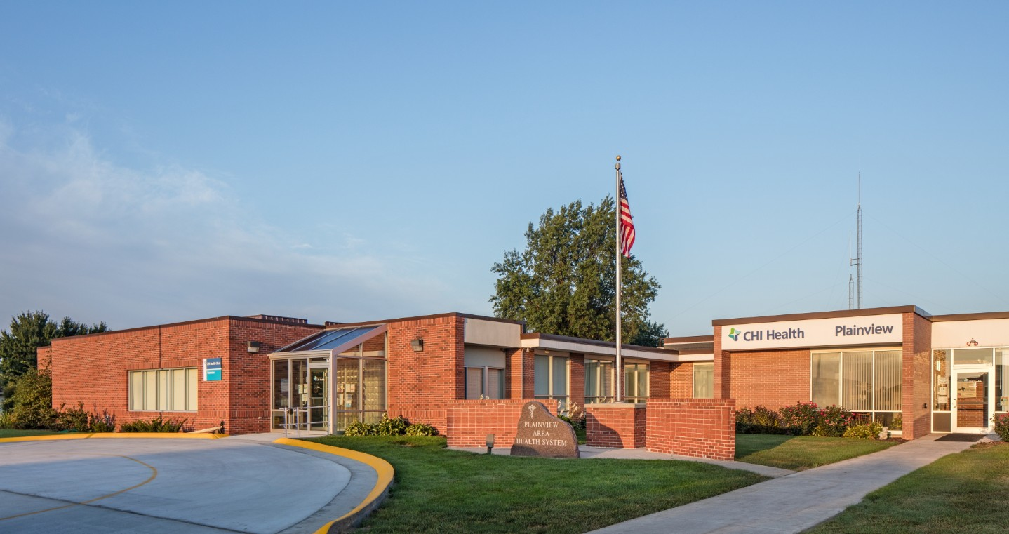
Compassion*Inclusion*Integrity*Excellence*Collaboration
Introduction
CHI Plainview
CAH in Northeast Nebraska
8 rooms – licensed for 15 beds
Acute Care – Observation – Swingbed – Outpatient Infusions – ER – Wound Care – Specialty Care
Age Friendly Health System
High geriatric population
Priority patients included swingbed patients
Mission
At CommonSpirit Health, we make the healing presence of God known in our world by improving the health of the people we serve, especially those who are vulnerable, while we advance social justice for all.

Slide 3
Compassion*Inclusion*Integrity*Excellence*Collaboration
Building the Team
Quality
Case Management
Providers
PT/OT
Nurses
Senior Leadership

Slide 4
Compassion*Inclusion*Integrity*Excellence*Collaboration
AIM Statement
By January 2025, CHI Health Plainview will consistently answer all 4Ms care and implement throughout care plans for 10 patients 65+ years old, thus focusing on patient’s wellness and strengths rather than only on their disease.
We will achieve “Age-Friendly Health System – Committed to Care Excellence” by submitting data proving our patients 65 years and older are consistently asked the 4Ms and it is implemented into their care.

Slide 5
Compassion*Inclusion*Integrity*Excellence*Collaboration
Measuring Success
Total number of “Age-Friendly” swing bed patients
Run report from EPIC to see:
if patient is being screened for delirium using the CAM-nonICU
If patient was asked the What Matters questions
If PT did an admission TUG assessment
De-prescribe high risk medications if applicable

Slide 6
Compassion*Inclusion*Integrity*Excellence*Collaboration
Selecting Changes
Brainstorm change options with team
Case manager will start asking “What Matters” questions on admission
PT will do a TUG assessment
Nurses will continue doing delirium screens
Providers will look at de-prescribing medications if applicable
Age-Friendly leader will attend care rounds to assess the 4Ms are being provided and carried out in their plan of care.
Study how this is working and make changes accordingly.

Slide 7
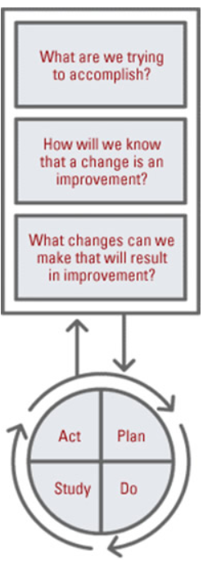
Compassion*Inclusion*Integrity*Excellence*Collaboration
Plan ~ Do ~ Study ~ Act
Getting Age Friendly Implemented at CHI Health Plainview
Plan
Assemble and Prepare the Team
Matt came to CHI Plainview to review the project with key stakeholders
Describe care consistent with the 4Ms
Design or adapt your workflow
Case Manager to ask What Matters questions on admission.
PT will complete TUG assessment
Nursing will complete delirium screening on admission and every shift
Providers will de-prescribe unnecessary medications as seen applicable.
Do
Provide education to staff
Provide the 4Ms Care
Study
What did you learn?
Case Manager was not charting the What Matters questions being asked.
PT was forgetting to do the TUG assessment on admission.
Nursing was doing the delirium screening on admission and every shift. This is routine for the nurses and was not a change to their normal practice.
Nurses and providers do a medication reconciliation on admission and prior to discharge. This continues to be done with conscious thought of what high risk medications can be de-prescribed.
Act
Case Manager needed to update her template for admissions to include what matters as a topic so it wouldn’t get omitted. She did this and it is working better and capturing “what matters” answers
PT leader made a spreadsheet for Age Friendly patients so they can check off that TUG was done on admission. This has shown improvement.

Slide 8
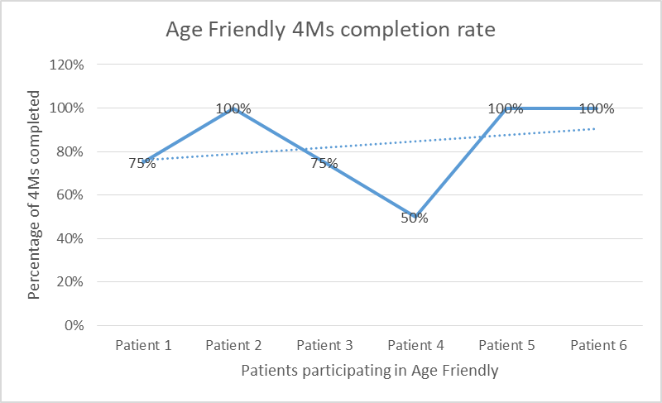
Compassion*Inclusion*Integrity*Excellence*Collaboration
Data and Trends
Data from August - September:
What matters questions have been asked 67%
TUG assessment was completed 67%
Delirium screening was completed every shift 100%
Providers reconciling meds at admission and de-perscribing as seen necessary 100%. *Note baseline data – This is a new process for CHI Health Plainview so there is no baseline data to go by.

Slide 9
Compassion*Inclusion*Integrity*Excellence*Collaboration
Return on Investment (ROI)
When comparing data of facilities in Nebraska in 2023, Age-Friendly facilities:
Had a 20% lower readmission rate
25% lower total ADE rate
40% lower glycemic ADE rate
In total, Age-Friendly facilities prevented almost 300 extra patient days compared to non-Age-Friendly facilities. (Patient day data from Agency for Healthcare Research and Quality)

Slide 10
Compassion*Inclusion*Integrity*Excellence*Collaboration
Spreading / Sustaining / Maintaining / Replicating
Ensure the 4Ms are being done consistently for swingbed patients
Spread successful changes to all units - clinic, home health, and community
Age-Friendly Lead will continue submitting data to obtain “Age-Friendly Health system – Committed to Care Excellence” status
Continue with audits and spot checks to assess sustainability and maintenance and overall improve patient outcomes.

Slide 11
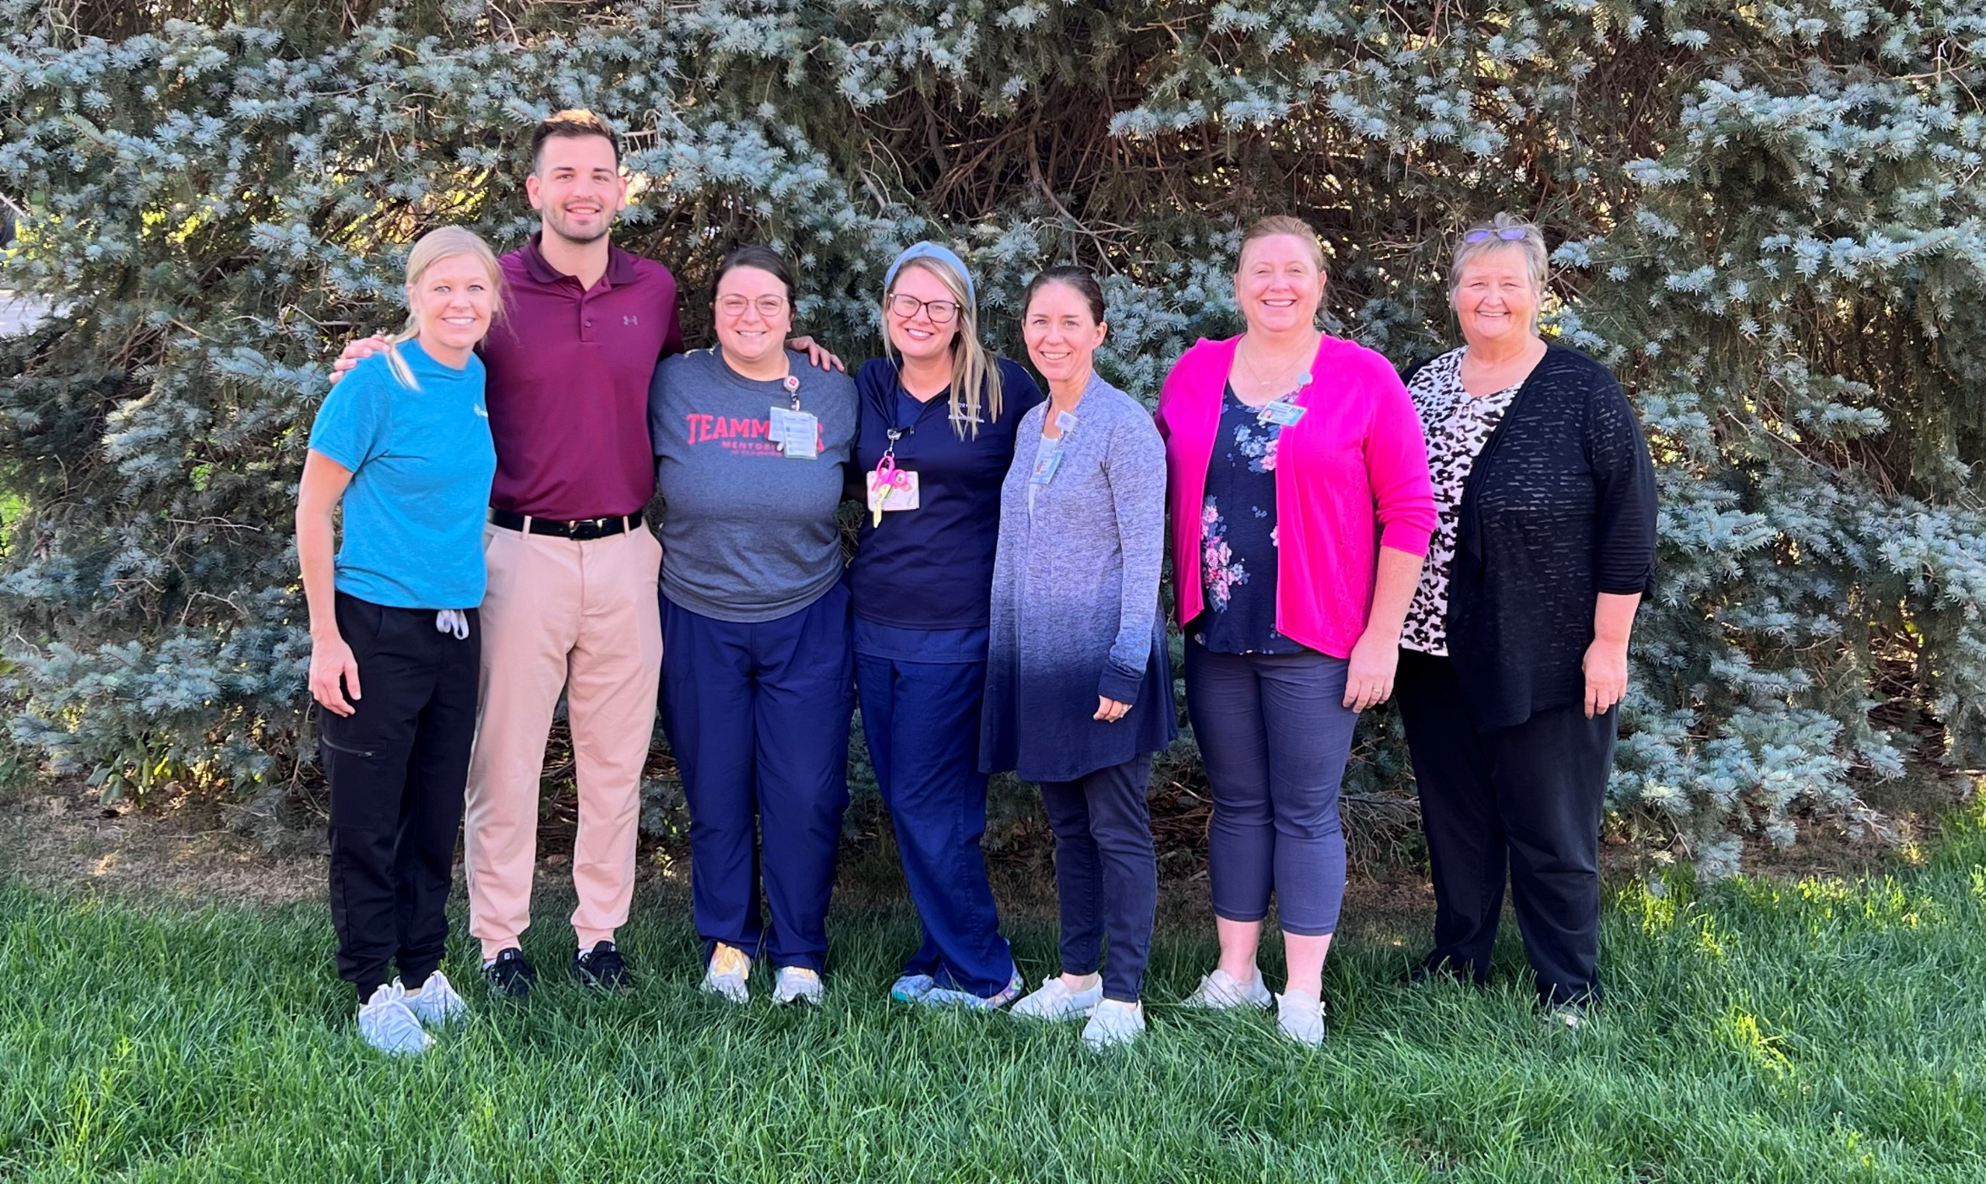
Compassion*Inclusion*Integrity*Excellence*Collaboration
THANK YOU/Questions
Kaylyn Venteicher, BSN, RN
Kaylyn.venteicher@commonspirit.org
402-582-4245 ext. 1355 (w)
402-640-8990 (c)
nebraskahospitals.org

