Slide 1
Patient & Family Engagement
nebraskahospitals.org
Module I

Slide 2
Learning Objectives
State key principles of the principle of excellence: creating value for the customer
Identify strategies for engaging patient and care partners into all levels of a system

Slide 3
Creating Value for the Customer

Slide 4
Operational Excellence
A mindset that embraces certain principles and tools to create sustainable improvement within an organization

Slide 5
Operational Excellence: 10 Core Principles
1. Respect Every Individual 2. Lead with Humility 3. Seek Perfection 4. Embrace Scientific Thinking 5. Focus on the Process 6. Assure Quality at the Source 7. Flow and Pull Value 8. Think Systematically 9. Create Constancy of Purpose 10. Create Value for the Customer

Slide 6
Value Equation
Quality
Cost
Value =
Value can be increased by increasing quality while maintaining cost or by reducing cost while maintaining quality.

Slide 7
Value Equation
Quality + Service
Cost
Value =

Slide 8
Value Attributes
Accessibility: “Can I get what I need or want from you?”
Service: “Is dealing with you a pleasant experience?”
Effectiveness: “Will your services satisfy my needs or wants?
Costs: “What’s the cost to me and my family? Is it worth it?”

Slide 9
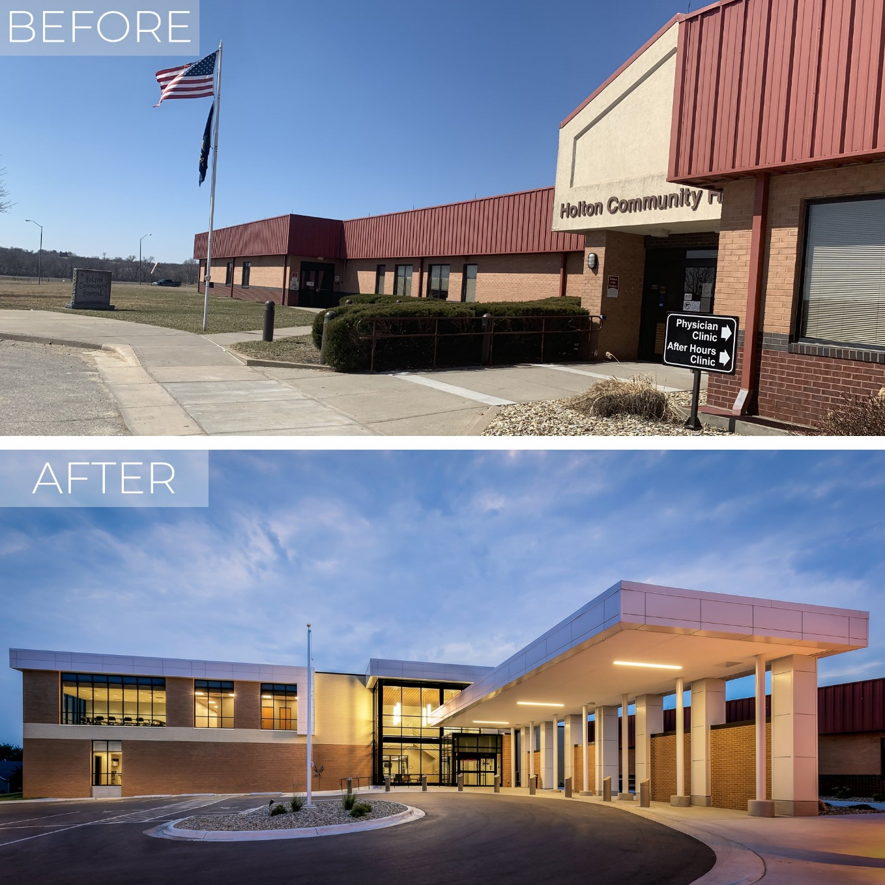
Identifying Value Drivers
Location and Demographics of the Community
Age and Appearance of the Facility
Medical Staff Composition
Competition
Contracting Strength

Slide 10
Understanding Consumers

Slide 11
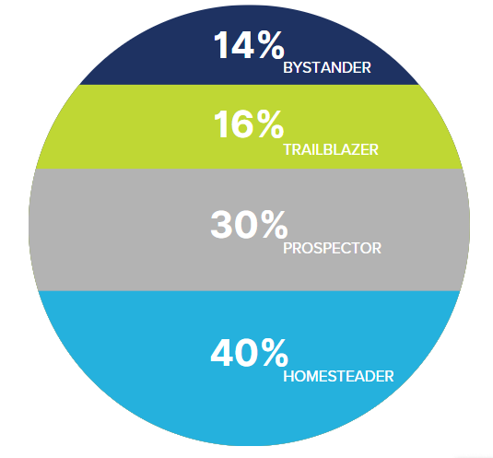
Customer Segmentation
Trailblazers: tech-savvy, self-directed, engaged in wellness, willing to share data
Prospectors: rely on recommendations from friends/family, use providers as trusted advisors, willing to use technology
Homesteaders: reserved, cautious, traditionalists
Bystanders: complacent, tech-reluctant, resistant to change, unengaged

Slide 12
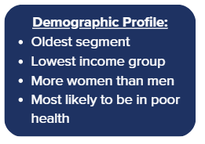
Key differentiators:
Least likely to share tracked health info with a doctor
Least willing to share data from an EHR or a wearable device
Least likely to use technology for healthcare or consider virtual care visits
Least likely to follow a healthy diet or exercise plan
Shopping Behavior:
Least likely to look up quality ratings
When choosing a doctor, most likely to consider out-of-pocket costs and convenient hours
Least likely to change doctors or health plans even if dissatisfied
Bystanders
14%

Slide 13
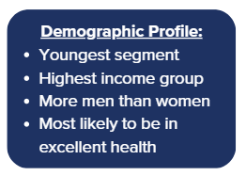
Key differentiators:
Most willing to share their tracked health information with a doctor
Tech savvy, use technology more than any other segment for health purposes
Most have had a virtual visit with a doctor and are likely to do so in the future
Most likely to follow a healthy diet and exercise plan according to their doctor’s recommendations
Shopping Behavior:
Most likely to look up report cards/ scorecards
Most likely to change doctors if dissatisfied with communication
Trailblazers
16%

Slide 14
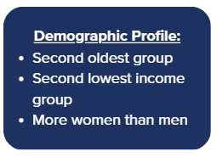
Key differentiators:
Willing to share wearable/tracked health data with their doctors and willing to share EHR data
Second most likely to use technology to monitor health and measure fitness
Willing to try virtual care visits
In the middle when it comes to following a healthy diet and exercise plan
Shopping Behavior:
When looking for a new physician, they prefer to ask their PCP for a recommendations – also rely heavily on word of mouth from friends/family
Second most likely to look up quality ratings
Prospectors
30%

Slide 15
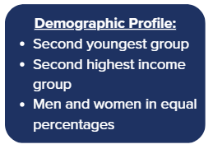
Key differentiators:
Less likely to share tracked health information with a doctor – least willing of any segment to share EHR or wearable data with any organization
Second lowest segment to use technology to monitor fitness and health, and less interested in virtual visits
Close to average when following a healthy diet and exercise plan
Shopping Behavior:
Less likely to look up quality ratings
When choosing a doctor, convenient location and hours/access are key considerations
Less likely to change doctors when dissatisfied
Homesteaders
40%

Slide 16
Who Am I?
Ryan is an avid cyclist and runner who recently ruptured his Achilles tendon during a pick-up basketball game with other overly competitive 30-year-olds. Although there is a hospital just 3 blocks away from the rec center, a quick internet scan turned up several negative reviews from former patients. Ryan identified a small suburban hospital on the other side of town that had excellent scores. His friends suggested calling an ambulance, but Ryan opted for the ridesharing app on his phone instead. While researching the injury during the ride, he determined that surgery would probably be needed, so he went to his insurer’s website to make sure the hospital was in-network. An ER doctor told him about the hospital’s new app that gives patients access to their medical records along with information about post-op care. It also sends reminders to patients about upcoming virtual and in-person appointments. Ryan downloaded the app so that he could share health information with his regular doctor and with his new physical therapist. Ryan also likes the hospital’s virtual-care option because he travels quite a bit for work. He had several online physical therapy appointments in his hotel room.

Slide 17
Trailblazer

Slide 18
How to Connect Effectively with a Trailblazer
Offer high-quality virtual office visits
Create a seamless and integrated technology experience
Engage them in data collection initiatives

Slide 19
Who Am I?
It has been nearly a year since Natalie and Nick rushed their 6-year-old daughter to the ER. The pediatrician diagnosed her with asthma, prescribed an inhaler, and recommended a clinic that specializes in pediatric asthma. One of their daughter’s friends is also a patient at this clinic, and her parents have been happy with the level of care. While Natalie likes meeting with clinicians in person, the clinic is more than an hour’s drive away, and her daughter prefers meeting the doctor at home via her tablet. Natalie’s health plan covers both in-person and virtual visits. Natalie has also joined a Facebook group for parents of asthmatic children, and she finds it helpful to see how other parents manage the condition. She recently read about smart inhalers with a sensor that communicates with a smart phone app via Bluetooth and helps track her inhaler usage. This piqued Natalie’s interest because both she and the doctor could view the data and make sure her daughter is taking her medication correctly. She needs to check if this device is covered by her health insurance.

Slide 20
Prospector

Slide 21
How to Connect Effectively with a Prospector
Tap into social and patient-advocacy groups
Promote wearables
Leverage the patient-clinician relationship

Slide 22
Who Am I?
Dana is a married 50-year-old manager of a downtown retail store. She tries to eat healthy and exercise, but with two children in high school, she often doesn’t have time to go to the gym and lunch tends to be takeout. She is overweight, has diabetes, and has been seeing the same physician since she started her job six years ago. The doctor’s office is just two blocks away and offers evening appointments once a week. She doesn’t always agree with her doctor or understand the prescribed treatment, but she is reluctant to look for someone new. She gets health insurance through her job, and she chose her health plan over two other options because an in-network medical practice was close to work. The premiums are higher, but Dana sees value in convenience. Her doctor suggested she wear a device that can track her glucose levels and transmit the information to the office, but she is comfortable neither with the device nor with sharing personal information. She doesn’t mind the idea of virtual care, but for now she prefers meeting with her doctor in person. The stress of balancing her home life and job and managing her diabetes sometimes leaves her feeling depressed. She thinks this is probably normal and doesn’t want to ask her doctor about it.

Slide 23
Homesteader

Slide 24
How to Connect Effectively with a Homesteader
Offer more convenient appointments
Collaborate with patients on treatment options
Use care assistants and case managers to engage patients and potentially technology
Enhance member experiences

Slide 25
Who Am I?
Willard is a 71-year-old retired high school teacher with a Medicare supplemental policy. While most of the premium cost is covered by the school system, he has heard that budget reductions might result in cuts to retiree benefits. He hopes his son will sign him up for similar coverage if that happens. Willard has been with the same carrier for the last six years and hasn’t had any problems with his health coverage. Although he hasn’t been to a doctor in two years, he is pretty sure his cholesterol level is too high. During his last visit, his doctor wrote prescriptions for drugs to bring his cholesterol and blood pressure under control, but Willard stuffed the prescriptions in a drawer and forgot about them. He worries about the potential side effects of the drugs and is not willing to alter his diet. Willard knows he is overweight, but other than walking his dog, he doesn’t exercise. He has a computer that his son gave him as a birthday present, but he only uses it to look at pictures of his grandkids. He is not interested in learning how to navigate the internet.

Slide 26
Bystander

Slide 27
How to Connect Effectively with a Bystander
Involve a caregiver
Leverage the community
Tailor solutions for unique barriers to medication adherence
Treat them with respect

Slide 28
Who is the Customer in Healthcare?
Healthcare consumers are customers first and patients occasionally
Healthcare is a business
Customers make choices to purchase or use services from companies
Savvy consumers are attracting big brands
Retailers understand how to cultivate customers
Healthcare revenue is at risk

Slide 29
Voice of the Customer

Slide 30
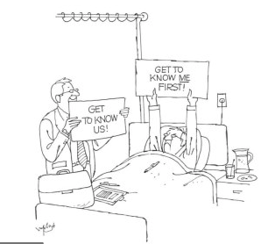

Slide 31
Strategies for Patient and Family Engagement
Engage leaders
Enlist patients and families as partners
Empower and energize staff
Encourage family participation in care
Equip, enable, and support patients to engage
Emphasize patient and family engagement in all initiatives

Slide 32
Guide to Patient and Family Engagement in Hospital Quality and Safety - AHRQ
Strategy 1: Working with Patients and Families as Advisors
Strategy 2: Communicating to Improve Quality Strategy 3: Nurse Bedside Shift Report Strategy 4: IDEAL Discharge Planning

Slide 33
Strategy 1: Working with Patients and Families as Advisors
Recruit new patients and family advisors
Identify and screen potential patients and family advisors
Notify advisory council applicants of their acceptance or rejection
Conduct an informational session and help people become interested
Introduce clinicians and hospital staff to the idea of working with advisors
Help clinicians and hospital staff partner effectively with advisors

Slide 34
Strategy 2: Communicating to Improve Quality
Establish a multidisciplinary team Assess family presence or visitation policies
Assess existing admission materials and current views on communication between the patient, family, and clinicians
Recognize challenges in changing behaviors for staff, patients and families
Set aims to improve communication
Inform staff of changes

Slide 35
Strategy 3: Nurse Bedside Shift Report
Standardize the process of nurse bedside shift report
Give the patient and family an opportunity and an invitation to take part in the care
Explain to the patient and family what bedside shift report is and what they can expect
List the critical elements of bedside shift report that nurses should carry out
Address common challenges and nurse concerns regarding bedside shift report

Slide 36
Strategy 4: IDEAL Discharge Planning
Include patient and family as partners
Discuss areas to prevent problems at home
Educate the patient and family
Assess patient and family knowledge and understanding
Listen and honor patient and family wishes

Slide 37
The Five PFE Best Practices
Implementation of a planning checklist for patients who have a planned admission
Implementation of a discharge planning checklist
Conducting shift change huddles and bedside reporting with patients and families
Designation of a PFE leader in the hospital
PFAC or representatives on hospital committee

Slide 38
Planning Checklist for Planned Admissions
Definition: At least one unit at the hospital has a physical planning checklist that is discussed with every patient prior to or at the time of any scheduled admission (e.g., surgery, procedure, test, delivery). The checklist can be a stand-alone document or integrated into other materials, for example, a patient handbook.

Slide 39
Discharge Planning Checklist
Definition: At least one unit at the hospital has a physical discharge planning checklist that is discussed with every patient prior to discharge. The checklist can be a stand-alone document or integrated into other discharge papers.

Slide 40
Shift Change Huddles and Bedside Reporting
Definition: In at least one unit at the hospital, patients and/or their care partners are included in nurse shift change huddles or conversations with clinicians about their care, treatment, and tests.

Slide 41
Designation of a PFE Leader in the Hospital
Definition: At least one person is recognized across all hospital staff and administration as responsible for the leadership, coordination, support, and reporting of PFE activities throughout the hospital.

Slide 42
PFAC or Representatives on Hospital Committee
Definition: The hospital has at least one active Person and Family Engagement Committee, Patient and Family Advisory Council (PFAC), or other committee (e.g., Patient Safety) with full membership positions for patient or family representatives. These councils or committees should report directly to the Board.

Slide 43
Best Practices for Hospital Leaders
Communicate the hospital’s vision and values related to patient and family engagement
Serve as role models for partnering with patients and family members
Provide the necessary infrastructure and resources
Involve and support clinicians and hospital staff in patient and family engagement initiatives
Integrate patient and family engagement into personnel policies and practices

Slide 44
Putting it into Practice
Step 1: Plan
Identify key members of your team
Development of a patient and family engagement plan
Establish rules of engagement for the team
Identify interview questions and potential candidates for patients/families
Select applicants
Build an AIM Statement
Timeline
Measurable Outcomes

Slide 45
Putting it into Practice
Step 2: Do
Carry out small tests of change
Collect data and begin analysis

Slide 46
Putting it into Practice
Step 3: Study
What was learned with this small test of change?
Did you meet the desired outcome?
What worked well?
What did not work well?
Were there any barriers to implementation?
What could be done better?

Slide 47
Putting it into Practice
Step 4: Act
Adapt: make necessary adjustments based on the data and information collected in order to refine the process and achieve success
Adopt: fully implement your change process
Abandon: if the small test of change was not successful and there is no way to adjust in order to make it successful then it is time to move on to new ideas

Slide 48
Successful Implementation of PFE Practices = Improved Outcomes
Reductions in hospital-acquired infections and conditions including falls with injury
Reductions in preventable 30-day readmission rates
Improved patient experiences and higher HCAHPS scores
Improved patient outcomes and reduced length of hospital stay
Lower cost of healthcare delivery
Increased employee satisfaction
Reductions in health and healthcare disparities

Slide 49
Health Equity and PFE
The of PFE requires co-designing more equitable systems by working with vulnerable populations
Develop organizational policies and practices that promote intentional diversity and inclusion
Engage persons and families who truly reflect the communities in which healthcare organizations are located
Use race, ethnicity, age, and language (REAL) data to inform day-to-day operations and quality improvement work
Direct systems changes and tailor other organizational change efforts and resources to groups that are most likely to face disparities in their health and healthcare

Slide 50
Concept to Reality
Hear how a robust Patient Family Advisory Council got started at Franciscan Healthcare in West Point

Slide 51
The Beginning
Identify a willing employee to lead the committee.
Use HRET/HIIN resources to educated ourselves about the importance of PFAC, membership, activities, policies, procedures, and best practices.
Educate leadership team as to why we should start a PFAC
After obtaining leadership support, began selecting possible PFAC members using suggestions from providers and leadership team
Tried to obtain a diverse group of patients

Slide 52
The First Meeting
Invited potential members to an evening meeting and meal to learn about PFAC, what they do, and what our expectations would be.
Then took them on a tour of the hospital asking 3 questions:
What do we do well?
What do we do not so well?
What services would you like to see Franciscan Healthcare provide that we are not currently?
Reconvened as a group to discuss findings

Slide 53
Selection of PFAC Members
First meeting was our interview process.
Sister and I were able to determine who would be a good fit for this committee based on their comments and interactions.
Not only looking for positive feedback, but a respectful, useful way of sharing negative feedback or experiences.
Before members left, they were asked to complete a form that included their demographics, preferred way to contact them, if they would be interested in serving on the PFAC and which hospital committee they were most likely to be interested in serving on.

Slide 54
Selection of PFAC Members
Contacted members following the meeting and formally asked them to join the PFAC.
HIPAA training provided for them at the next meeting
Spoke with hospital committee team leads and provided them with a PFAC member’s contact information so they could invite them to their next committee meeting.

Slide 55
How to Maintain PFAC
Hold quarterly meetings in addition to the committee meetings the PFAC members attend.
Meetings include a feedback activity for example reviewing OB literature given to patients, new website, tour of the ED remodel.
PFAC members hare what is happening on their hospital committees.
Suggestions from walk-arounds/tours are placed in a stop light style excel spreadsheet and reviewed at the following meeting.
Three columns: Green: suggestions that were addressed by Franciscan Healthcare. Yellow: suggestions that are in progress. Red: suggestions that cannot be accomplished at this time and explain reason.

Slide 56
Lessons Learned
Some committee take time to learn the language (QPI), consider at least a 2-year term for those members.
Easy to find willing members over age 65- retired, difficulty to find younger members with so many dual income households.
Evening meetings are not preferred by this group either as it is their family time.
Most members choose to come over their lunch period.

Slide 57
Lessons Learned
Finding a meeting time that works for everyone is difficult, even if it is only quarterly.
Not all staff are excited to have a PFAC member serve on their hospital committee.
Some staff will need additional education about the purpose of a PFAC and leadership support to make this happen. Letting members know their feedback is taken seriously and forwarded to leadership is a key to PFAC members feeling valued.
Our CEO attends the meetings.

Slide 58
Breakthrough
Hired new employees with a Hispanic background.
They shared ideas they had to make our organization more culturally friendly to the Hispanic population.
Sister Joy spoke to them about barriers.
Hispanic employees reached out to their family and friends and convinced them to attend a meeting.

Slide 59
Spanish speaking PFAC
These meetings are held in the evenings to better accommodate their schedules.
Meeting agenda is different, more educational based on what their needs are.
Different group of people in attendance every time.

Slide 60
Starting… Again

Slide 61
Current State
Our English speaking PFAC has been re-energized with new members.
Our Spanish speaking PFAC has struggled to reengage members who participated previously.
We invited our bilingual employees to a meeting
Why did they choose to work at Franciscan Healthcare?
What can we do to encourage their friends and families to work for Franciscan Healthcare?
What can we do to encourage their friends and families to use Franciscan Healthcare for their care?
Our new COO is bilingual, and we hope he will assist us with engaging this demographic again.
Notes:
Employees mentioned the addition of a bilingual provider would be beneficial as patient’s don’t always feel comfortable with our translators.

Slide 62
HCAHPS and Patient Satisfaction
nebraskahospitals.org
Module I Anne Timmerman, MLS (ASCP); CPHQ Franciscan Healthcare West Point, NE

Slide 63
HCAHPS
Hospital Consumer Assessment of Healthcare Providers and Systems.
29 question survey of hospital patients with an acute or inpatient stay.
Developed by Agency for Healthcare Research and Quality (AHRQ) for CMS.

Slide 64
HCAHPS
Can be administered by and “approved” survey vendor (Press Ganey, National Research Corporation/NRC Health, Rural Comprehensive Care Network/RCCN, PRC) or can be self-administered.
Results are publicly reported on Care Compare.

Slide 65
3 Goals of HCAHPS
Produce data about patients’ perspective of care allowing objective and meaningful comparisons of hospitals on topics that are important to patients and consumers.
Public reporting of the survey results creates incentives for hospitals to improve quality of care.
Public reporting enhances accountability in healthcare by increasing transparency of the quality of hospital care provided in return for public investment.

Slide 66
Participating Hospitals
IPPS (Inpatient Prospective Payment System)
IPPS hospitals penalized if don’t participate.
Short-term, acute care hospitals that are not IPPS hospitals such as Critical Access Hospitals, Veterans Affairs hospitals, or Department of Defense hospitals may voluntarily report.

Slide 67
Why are HCAHPS Important?
Studies linking HCAHPS to quality and patient safety.
More patients are choosing hospitals based on patient experience.
View scores on Care Compare
Questions focus on “what matters” to the patient, not just “what is the matter.”

Slide 68
Four Survey Modes Available
Mail only
Telephone only
Mail with telephone follow-up (mixed mode)
Active interactive voice recognition (IVR)

Slide 69
Changes to Survey Modes in 2025
Allowing 3 new modes of survey administration (web-mail, web-phone, and web-mail-phone).
Allowing a proxy to complete the survey on a patient’s behalf.
Extending the data collection period from 42-49 days.
Limiting the number of supplemental questions to 12.
Requiring hospitals to collect patients’ preferred languages.
Removing the Active Interactive Voice Response (IVR) Survey administration mode.
Removing the “Hospitals Administering HCAHPS for Multiple Sites” option for HCAHPS Survey administration.

Slide 70
Available Languages
English
Spanish
Chinese
Russian
Mail Only
Vietnamese
German
Portuguese
Tagalog
Arabic

Slide 71
Other CAHPS
CG-CAHPS
Clinician and Group
Hospice
HH-CAHPS
Home Health
Surgical Care
American Indian
Tribal facilities

Slide 72
Patient Experience with Condition-Specific Care
Cancer Care
Mental Health Care (Experience of Care and Health Outcomes (ECHO)

Slide 73
Patient Experience with Facility-Based Care
Emergency Department
Children’s Hospital
In-Center Hemodialysis
Nursing Home
Outpatient and Ambulatory Surgery (OAS)

Slide 74
Survey Process
Survey administered to a random sample of adult patients across medical conditions between 48 hours and six weeks after discharge.
Both Medicare and Non-Medicare
Typically, in CAH’s all eligible patients will be surveyed

Slide 75
Identify Initially Eligible Patients
All Initially Eligible Patients
18 years or older at the time of admission
Admission includes at least one overnight stay in hospital
Non-psychiatric MS-DRG/principal diagnosis at discharge
Alive at the time of discharge

Slide 76
Exclusions
Ineligible Patients Exclusions
“No-Publicity” patients
Court/Law enforcement patients (i.e., prisoners)
Patients with a foreign home address
Patients discharged to hospice care
Patients who are excluded because of state regulations
Patients discharged to nursing homes and skilled nursing facilities

Slide 77
De-Duplication
Note: De-duplication must be performed using the sample frame, not the sample, within each calendar month, utilizing address information (or telephone number for Telephone, Mixed, and IVR modes) and the patient’s medical record number (or other unique identifier).

Slide 78
Survey Scoring
Top Box
The percentage of patients who answered “Always”
For the Overall Rating of Care question “9 or 10”
Mean Score
Good for benchmarking improvements internally

Slide 79
Composition of HCAHPS Survey
HCAHPS contains 29 items:
Items 1-22: Core of HCAHPS (19 questions)
Beginning of survey; do not alter; keep together
19 substantive questions
3 “screener” items
Items 23-29: “About You” (7 questions)
Place later, keep together, do not alter

Slide 80
Roles and Responsibilities
Hospitals
Comply with all HCAHPS Survey protocols (whether self-administering or contracting with an approved survey vendor)
Produce patient discharge list with complete administrative data in timely manner
Use survey version in language of patient’s preference
Review data warehouse reports
Do not influence patients about HCAHPS Survey
Communication with patients
Concurrent surveys

Slide 81
Roles and Responsibilities (cont’d)
Hospitals Using a Survey Vendor
The Vendor’s role in data collection and submission:
Create sample frame of eligible discharges
Draw sample of eligible patients and administer survey
Submit HCAHPS data in standard format via the Quality Net Secure Portal
Monitor submission reports
Including review and correction reports
Comply with oversight process, including site visits
Conduct ongoing quality assurance activities
Including data quality checks
Monitor HCAHPS website for updates

Slide 82
Communication with Patients about the HCAHPS Survey
Cannot show the HCAHPS survey or cover letter to patients prior to discharge from the hospital.
Cannot mail any pre-notification letters or postcards after discharge informing patients about the HCAHPS survey

Slide 83
Guidelines for using other Hospital Inpatient Surveys with HCAHPS
HCAHPS should be the first survey patients receive about their hospital experience.
Questions must not resemble any HCAHPS items or their response categories.
Refer to HCAHPS Bulletin Number 2009-01 Revised which is posted on the HCAHPS website.
Section III Quality Assurance Guidelines V16.0 and Appendix Y
Examples provided of not permissible and alternate questions

Slide 84
Unofficial use of HCAHPS
The HCAHPS Survey results are not intended to be used for marketing or promotional activities
Only the HCAHPS scores published on the Care Compare website are the “official” scores
Scores derived from any other source are “unofficial” and must be labeled as such.

Slide 85
Advertising Guidelines
The Care Compare website is the official source of HCAHPS results
Reports created by survey vendors or others that mention anything other than the official HCAHPS scores, such as estimates or predictions, must note that such scores or results are “unofficial.” This is done in two ways:
1. The introduction or executive summary of such reports must include the following statement: “This report has been produced by [Survey Vendor] and does not represent official HCAHPS results, which are published on the Care Compare website http://www.medicare.gov/care-compare
2. Each page of the report where unofficial results are displayed (print or electronic) must contain the following statement: “This report has been produced by [Survey Vendor] and does not represent official HCAHPS results.”
CMS does not endorse hospitals or survey vendors
Or commercial Hospital VBP tools, etc.

Slide 86
HCAHPS Website and Technical Support
http://www.hcahpsonline.org
Official website for content, announcement, HCAHPS Bulletins, updates, reminders
Monitor weekly for “What’s New”
Quick links to current news, background, participation, etc.
Access to survey instruments

Slide 87
HCAHPS Technical Support
Email: hcahps@hsag.org
Telephone: 1-888-884-4007
Hospital Name
Hospital 6-digit CMS Certification Number (CCN)
Contact information

Slide 88
Measures
Results updated on a quarterly basis
Composite measures
Communication with nurses
Communication with doctors
Responsiveness of hospital staff
Communication about new medicines
Discharge information
Care transitions

Slide 89
Measures (cont’d)
Individual items
Cleanliness of hospital environment
Quietness of hospital environment
Global items
Rating of hospital
Willingness to recommend hospital

Slide 90
Data Adjustment
Purpose
Differences in hospital ratings should reflect differences in quality only
To permit valid comparison of all hospitals regardless of the mode
Will adjust the results to “level the playing field”
That is, adjust for factors not directly related to hospital performance
Adjusted as needed for data comparability:
Patient-mix
Mode of administration

Slide 91
Adjust for Patient-Mix
Purpose
Certain patient characteristics impact how someone might respond to the survey
Patient-Mix Adjuster Variables
Type of Service (Medical, Surgical, and Maternity Care)
Gender
Age
Education
Self-reported general health status
Language – English, Spanish, Chinese, RVPO (Russian, Vietnamese, Portuguese, Other)
Response Percentile (All completed surveys for a given month by hospital are ranked by lag time)
Adjustments updated quarterly and published on http://www.hcahpsonline.org

Slide 92
Requirement
Obtain at least 300 completed HCAHPS Surveys in a rolling four-quarter period.
Small hospitals- if cannot obtain 300 completed surveys, sample all eligible discharges
Why 300?
For statistical precision of the ratings, based on a reliability criterion
At least 300 completes ensures that the reliability for the publicly reported measures will be 0.80 or higher
Calculate sample size based on target of 335 completes
To ensure attaining 300 completes most of the time

Slide 93
HCAHPS Response Rate by Survey Mode - Average
(April 2023 Public Reporting: Patients discharged from July 2021 to June 2022)
Mail Only: 21%
Telephone Only: 25%
Mixed Mode: 33%

Slide 94
Reporting HCAHPS Results
Official HCAHPS Scores are publicly reported on Care Compare https://www.medicare.gov/care-compare/
Also available in the Downloadable Data Base (DDB) located on https://data.cms.gov/provider-data/
Results are reported for the 6 composites, two individual items and two global items
Number of completed surveys and response rate also reported
HCAHPS scores are reported
Top-box, middle-box, bottom-box
HCAHPS Star Ratings
10 HCAHPS measures
HCAHPS summary Star Rating
Linear mean scores

Slide 95
Reporting HCAHPS Results (cont’d)
Results aggregated into rolling 4 quarters (12 months) by hospital
Hospital’s results are displayed with national and state averages
Results are updated quarterly

Slide 96
Public Reporting Periods
Reporting is based on 12 months of discharges
Public Reporting occurs in January, April, July, and October
HCAHPS PUBLIC REPORTING: July 2023
QUARTERS INCLUDED: 4Q21, 1Q22, 2Q22, 3Q22
Preview Reports available July 27, 2023, through August 25, 2023, for October release.

Slide 97
Hospitals with Five or Fewer HCAHPS Eligible Patients in a Given Month
Hospitals are not required to collect and submit HCAHPS data for that month.
A header record must be submitted to the Quality Net Secure Portal through the HCAHPS Online Data Entry Tool or XML file submission.
These hospitals can voluntarily collect and submit data for these months.

Slide 98
Suppression of Results: IPPS Hospitals
IPPS hospitals cannot suppress their results from Hospital Compare
Must withdraw from Hospital Inpatient Quality Reporting (IQR) program to suppress

Slide 99
Suppression of Results: CAHs
CAHs may suppress their results
Must suppress complete set of HCAHPS results
Will receive Footnote 5
Results are not available for this reporting period
To suppress results, a CAH must complete the appropriate pledge form and submit it to Quality Net Help Desk

Slide 100
HCAHPS Oversight
A participating hospital should:
Work closely with its survey vendor (if using one)
Monitor HCAHPS Warehouse Feedback Reports including Review and Correct Period
Read the HCAHPS QAG (Question/Answer Guide)
Visit the HCAHPS website for news, updates, and announcement
Comply with all HCAHPs oversight activities

Slide 101
More Information and Resources
Registration, applications, background information, reports, and HCAHPS Executive Insight can be found on the official HCAHPS Survey website: https://hcahpsonline.org
Publicly reported HCAHPS results: https://www.medicare.gov/care-compare/

Slide 102
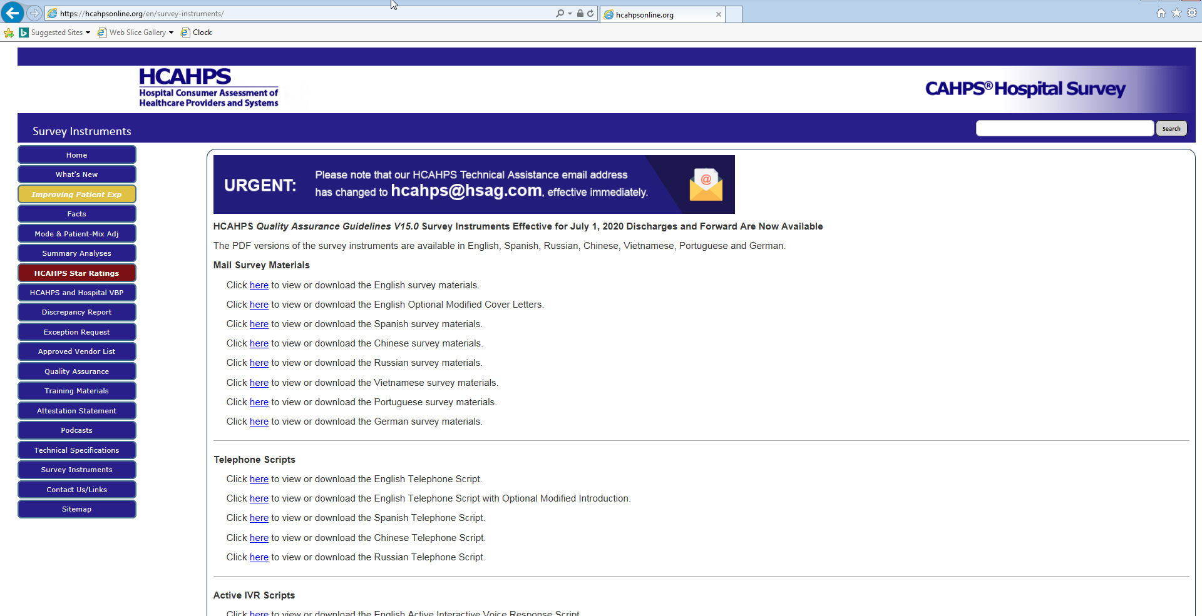
Where to Find Survey Tools and Information

Slide 103
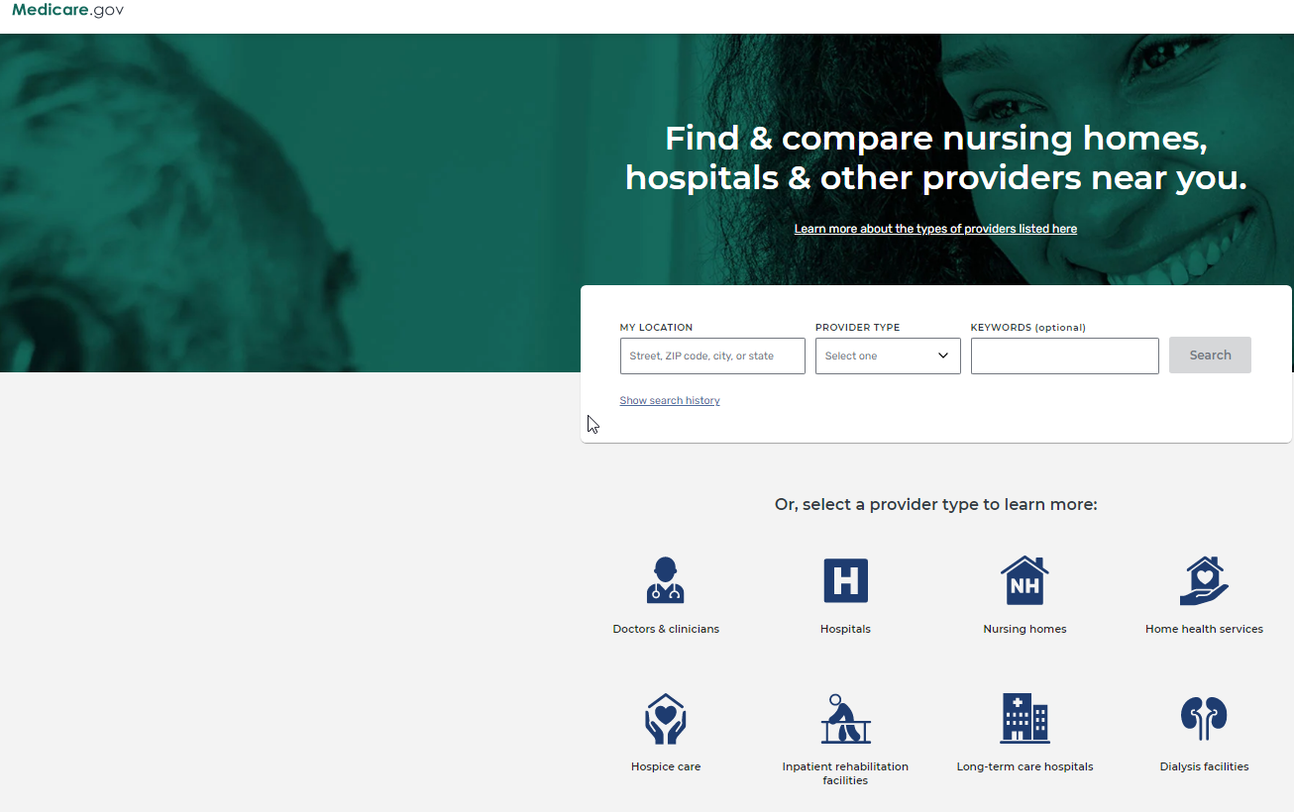
Care Compare

Slide 104
This Photo by Unknown Author is licensed under CC BY-NC

Slide 105
Response Options
Most questions are answered in terms of:
Always, Usually, Sometimes, or Never
One Overall Rating Question
Rate hospital stay from 1-10

Slide 106
Survey Questions
Your Care from Nurses
1. During this hospital stay, how often did nurses treat you with courtesy and respect?
2. During this hospital stay, how often did nurses listen carefully to you?
3. During this hospital stay, how often did nurses explain things in a way you could understand?
4. During this hospital stay, after you pressed the call button, how often did you get help as soon as you wanted it?
Your Care from Doctors
5. During this hospital stay, how often did doctors treat you with courtesy and respect?
6. During this hospital stay, how often did doctors listen carefully to you?
7. During this hospital stay, how often did doctors explain things in a way you could understand?

Slide 107
Survey Questions (cont’d)
The Hospital Environment
8. During this hospital stay, how often were your room and bathroom kept clean?
9. During this hospital stay, how often was the area around your room quiet at night?

Slide 108
Survey Questions (cont’d)
Your Experiences in this Hospital
10. During this hospital stay, did you need help from nurses or other hospital staff in getting to the bathroom or in using a bedpan?
11. How often did you get help in getting to the bathroom or in using a bedpan as soon as you wanted?
12. During this hospital stay, were you given any medicine that you had not taken before?
13. Before giving you any new medicine, how often did hospital staff tell you what the medicine was for?
14. Before giving you any new medicine, how often did hospital staff describe possible side effects in a way you could understand?

Slide 109
Survey Questions (cont’d)
When you Left the Hospital
After you left the hospital, did you go directly to your own home, to someone else’s home, or to another health facility?
During this hospital stay, did doctors, nurses or other hospital staff talk with you about whether you would have the help you needed when you left the hospital?
During this hospital stay, did you get information in writing about what symptoms or health problems to look out for after you left the hospital?

Slide 110
Survey Questions (cont’d)
Overall Rating of the Hospital
18. Using any number from 0 to 10, where 0 is the worst hospital possible and 10 is the best hospital possible, what number would you use to rate this hospital during your stay?
19. Would you recommend this hospital to your friends and family?

Slide 111
Survey Questions (cont’d)
Understanding your Care when you Left the Hospital
20. During this hospital stay, staff took my preferences and those of my family or caregiver into account in deciding what my health care needs would be when I left.
21. When I left the hospital, I had a good understanding of the things I was responsible for in managing my health.
22. When I left the hospital, I clearly understood the purpose for taking each of my medications.

Slide 112
Survey Questions (cont’d)
About You
23. During this hospital stay, were you admitted to this hospital through the Emergency Room?
24. In general, how would you rate your overall health?
In general, how would you rate your overall mental or emotional health?
What is the highest grade or level of school that you have completed?
27. Are you of Spanish, Hispanic or Latino origin or descent?
28. What is your race? Please choose one or more.
29. What language do you mainly speak at home?

Slide 113
Working with your Results
What does your organization do currently with their HCAHPS results?

Slide 114
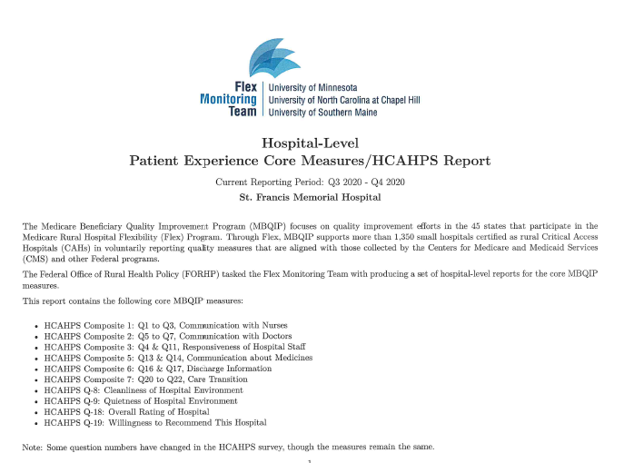
Benchmarking

Slide 115
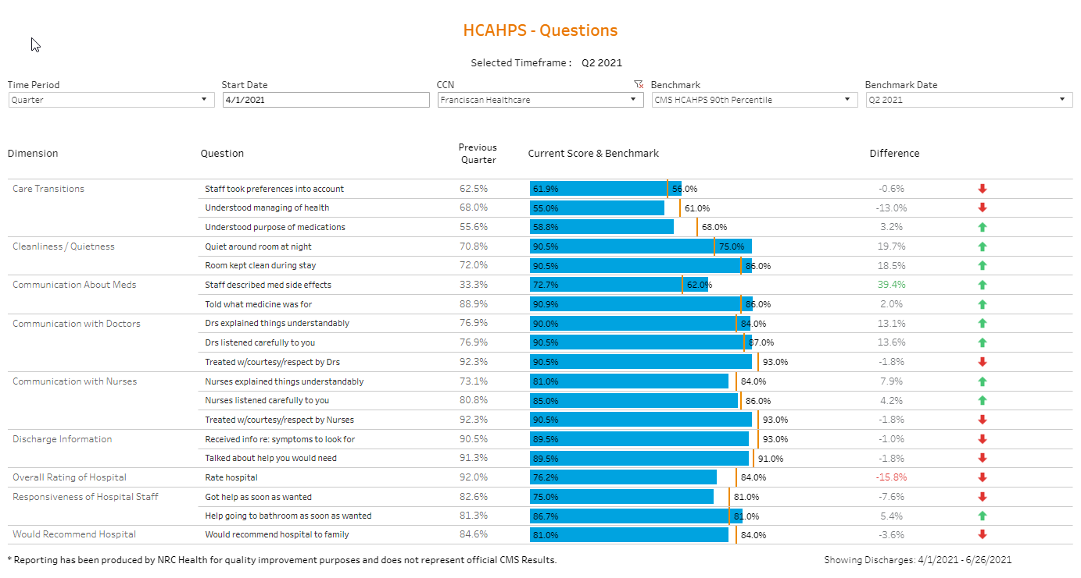
Reporting Results

Slide 116
Reporting Results

Slide 117
Real Time Surveys
Sent to all patients discharged from one of our service lines (excluding Inpatient and Home Health).
Receive a short 9 question survey either via e-mail, SMS text or IVR.
Allows the departments to receive “real time” feedback as results are posted to our survey portal within 24 hours.

Slide 118
Real Time Surveys
Department Managers can follow up with patient’s concerns directly as survey responses are confidential, but not anonymous.
Tools are embedded within the vendor’s software to measure the effectiveness of our service recovery.

Slide 119
Benchmarking
Able to benchmark departments.
Can set goals based on what percentile you would like the department to be in.
Physicians are e-mailed personalized scorecards which incorporates an education video (2-3 minutes) on a topic has demonstrated improved satisfaction scores.

Slide 120
Thank You!
Anne Timmerman, MLS (ASCP); CPHQ
Director of Quality and Safety
Franciscan Healthcare
402-372-4016
atimmerman@franhealth.org

