Slide 1
Implementation of a Carb Count Insulin Protocol in the Critical Access Hospital Setting
Jake Siel, PharmD
Community Medical Center
Falls City, NE

Slide 2
Objectives
Discuss planning and implementation of a carbohydrate count insulin protocol
Review Diabetes Care in the Hospital: Standards of Care in Diabetes – 2023

Slide 3
Inspiration

Slide 4
Planning
Project formally started September 2022
Formation of an interdisciplinary work group
Pharmacy
Nursing
Nursing Administration
Physicians
Information Technology
Diabetes Education
Dieticians
Dietary staff
Quality Director

Slide 5
Results
Insulin Protocol Order Set
Basal insulin guidance
Orderable insulin to carbohydrate ratio for mealtime insulin
Varying levels of correction insulin
Level 1 – Low intensity
Level 2 – Moderate intensity
Level 3 – High Intensity
EMR integrated insulin calculator for nurse administration
Integration of hypoglycemia protocol

Slide 6
The Process
Provider places Insulin Orders via Order Set
Pre-meal blood glucose recorded
Patient eats
Total grams of carbs in meal & percent eaten recorded by CNA
Carb count & correction insulin determined via calculator and given as a single injection.

Slide 7
ADA Guidelines

Slide 8
ADA Guidelines
16.1 Perform an A1C test on all patients with diabetes or hyperglycemia (blood glucose >140 mg/dL [7.8 mmol/L]) admitted to the hospital if not performed in the prior 3 months. B

Slide 9
ADA Guidelines
16.3 When caring for hospitalized patients with diabetes, consult with a specialized diabetes or glucose management team when possible. C

Slide 10
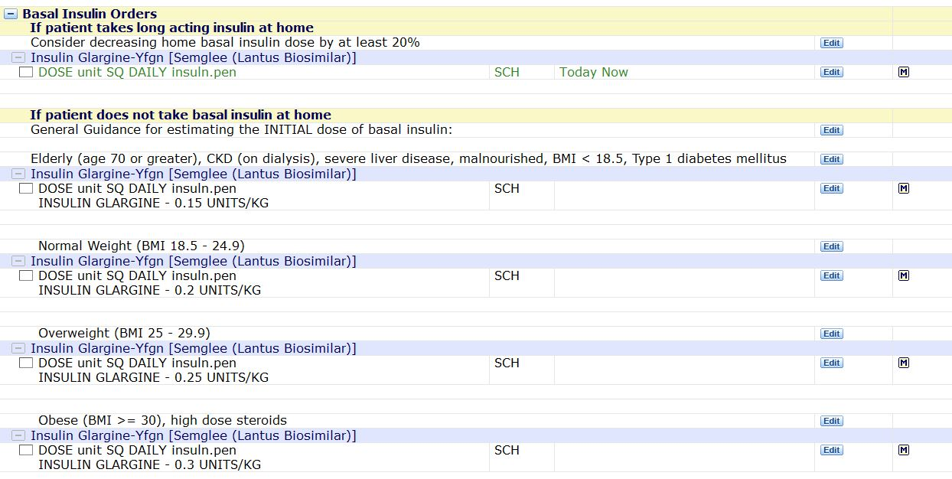
ADA Guidelines
16.6 Basal insulin or a basal plus bolus correction insulin regimen is the preferred treatment for noncritically ill hospitalized patients with poor oral intake or those who are taking nothing by mouth. A

Slide 11
ADA Guidelines
16.7 An insulin regimen with basal, prandial, and correction components is the preferred treatment for noncritically ill hospitalized patients with good nutritional intake. A
16.8 Use of only a sliding scale insulin regimen in the inpatient hospital setting is strongly discouraged. A

Slide 13
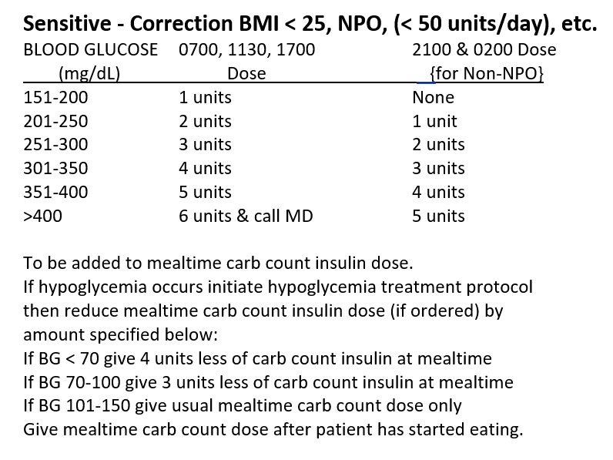
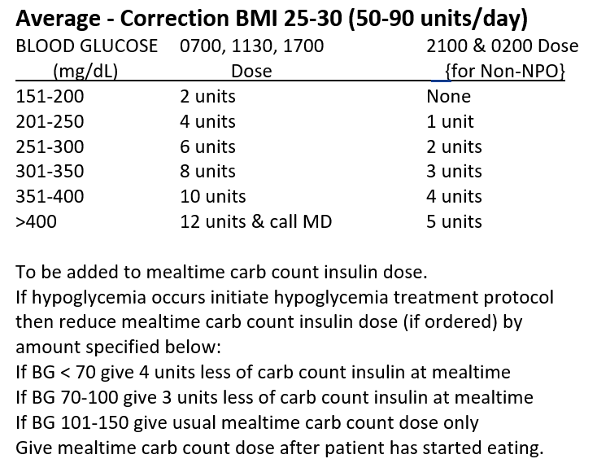
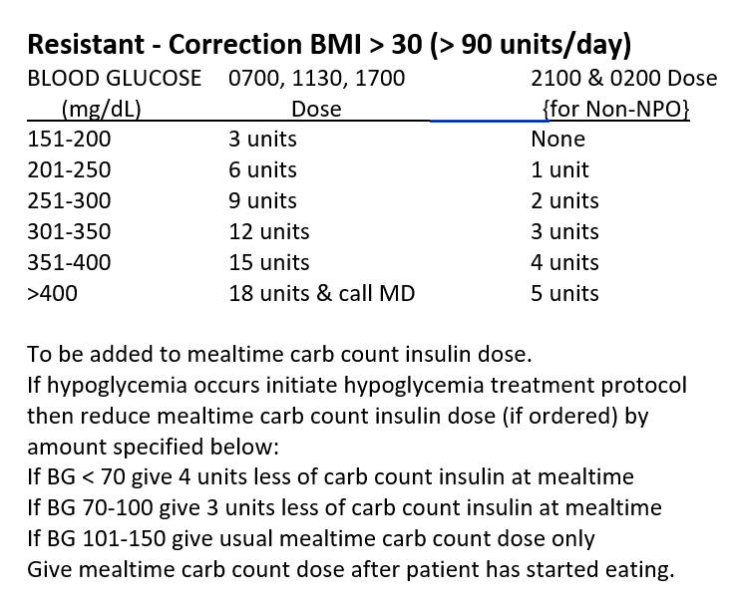
ADA Guidelines
16.2 Insulin should be administered using validated written or computerized protocols that allow for predefined adjustments in the insulin dosage based on glycemic fluctuations. C

Slide 14
Demonstration

Slide 16
ADA Guidelines
16.4 Insulin therapy should be initiated for treatment of persistent hyperglycemia starting at a threshold ≥180 mg/dL (10.0 mmol/L) (checked on two occasions). Once insulin therapy is started, a target glucose range of 140–180 mg/dL (7.8–10.0 mmol/L) is recommended for the majority of critically ill patients and noncritically ill patients. A
16.5 More stringent goals, such as 110–140 mg/dL (6.1–7.8 mmol/L), may be appropriate for selected patients if they can be achieved without significant hypoglycemia. C

Slide 18
ADA Guidelines
16.9 A hypoglycemia management protocol should be adopted and implemented by each hospital or hospital system. A plan for preventing and treating hypoglycemia should be established for each individual Episodes of hypoglycemia in the hospital should be documented in the medical record and tracked for quality improvement/quality assessment. E
16.10 Treatment regimens should be reviewed and changed as necessary to prevent further hypoglycemia when a blood glucose value of < 70 mg/dL is documented. C

Slide 19
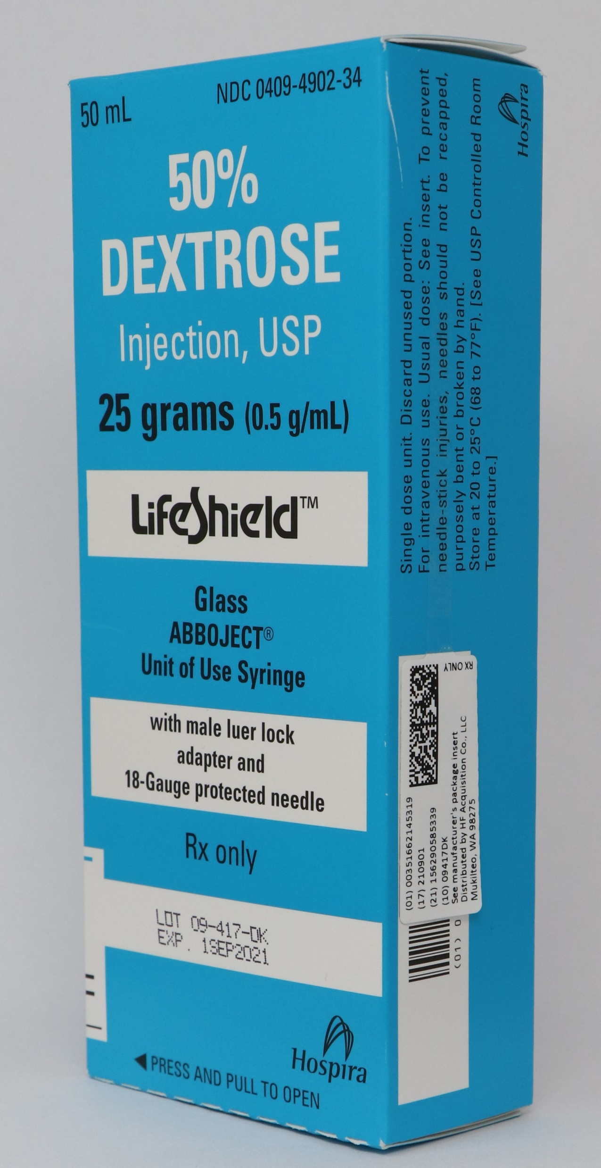
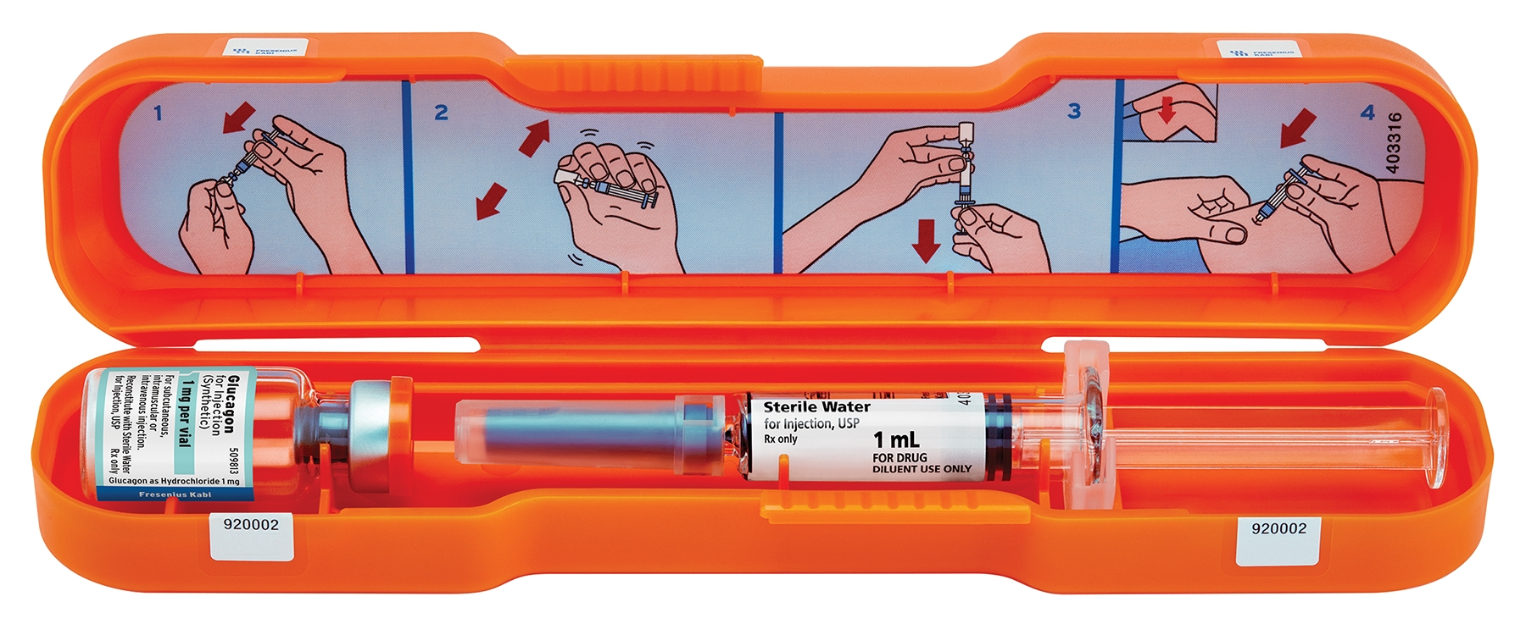
ADA Guidelines

Slide 20
ADA Guidelines
16.11 A structured discharge plan should be tailored to the individual with diabetes. B
Resuming oral medications
Using dashboard to help dose home insulin
Collaboration between physician, pharmacy, nursing, diabetes educator etc.

Slide 21
Approval
First presented at P&T December 2022
Approval through medical staff April 2023
Physician buy-in
Clear plan
Additional options, not fewer

Slide 22
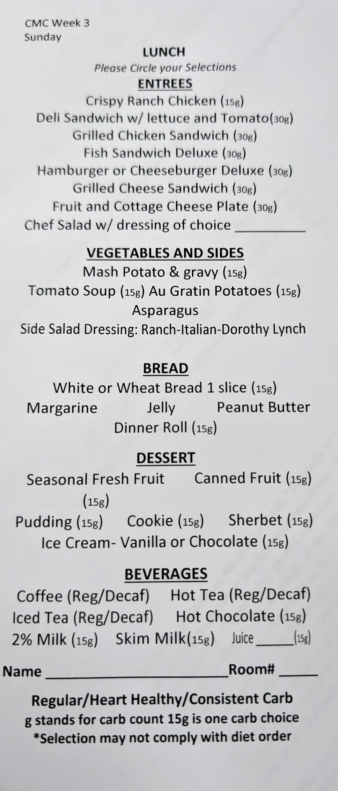
Training
2-month timeline
Nurses’ meeting demonstrations
Changes to menu
Carb counting practice
Training Video
Real patients in test environment
Physician training

Slide 23
Go-live & Monitoring
Went live June 1, 2023
7 months from start of project to go-live
Low use initially, steadily increasing
Pharmacy FY 2024 quality project
New insulin protocol vs. sliding scale
Data will be presented at medical staff meeting

Slide 24
Sources
Nuha A. ElSayed, Grazia Aleppo, Vanita R. Aroda, Raveendhara R. Bannuru, Florence M. Brown, Dennis Bruemmer, Billy S. Collins, Marisa E. Hilliard, Diana Isaacs, Eric L. Johnson, Scott Kahan, Kamlesh Khunti, Jose Leon, Sarah K. Lyons, Mary Lou Perry, Priya Prahalad, Richard E. Pratley, Jane Jeffrie Seley, Robert C. Stanton, Robert A. Gabbay; on behalf of the American Diabetes Association, 16. Diabetes Care in the Hospital: Standards of Care in Diabetes—2023. Diabetes Care 1 January 2023; 46 (Supplement_1): S267–S278. https://doi.org/10.2337/dc23-S016

