Slide 1
What’s My Type? Traits at Work
June 9, 2021
Mike Freel, PhD
Mike.Freel@bellevue.edu

Slide 2
Review
How did your 360 turn out? Anything surprising?
How can the Keirsey Temperament Sorter impact your 360 or your goals?
What’s the role of traits in evaluating leadership effectiveness?

Slide 3
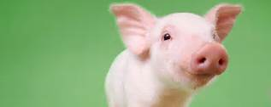
A Quick ASSESSMENT

Slide 4
A Review of TRAITS
What’s the VALUE of TRAIT-BASED assessments?
What ASSESSMENTS have you taken in the PAST?
Affirmations? Surprises?
What’s the value of your KEIRSEY TEMPERAMENT SORTER results?
What’s a TRAIT? What’s a STATE?

Slide 5
The Jim Twins: State or Trait?
Jim Lewis and Jim Springer met for the first time at age 39. Both grew up just 50 miles from each other in Ohio.
Both married twice. First to Linda, then to Betty.
Both had sons named James Allan.
Both owned a dog named Toy.
Both made dollhouse furniture, smoked the same brand cigarettes, drank the same brand beer, drove Chevy, been sheriff deputies, vacationed at the same Florida beach, had similar brain waves and handwriting.
Both scored exactly the same on personality tests. So much so, it was like the same person took the test twice.

Slide 6
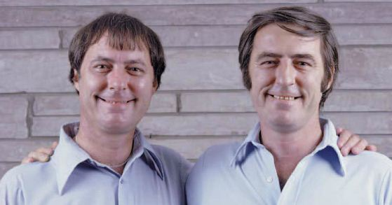
The Jim Twins: State or Trait?
https://youtu.be/HbNVIWMC7fU
Minnesota Center for Twin & Family Research
www.mctfr.psych.umn.edu
Notes:
Start 2:35
End 6:00

Slide 7
About LEADERSHIP: The Effects of CHARACTER TRAITS on LEADERSHIP
https://www.youtube.com/watch?v=tl6T08b-E60
https://www.youtube.com/watch?v=Dn8Raentmt4

Slide 8
More TRAITS:
Drive
Leadership motivation
Honesty and integrity
Self-confidence
Cognitive ability
Knowledge of business

Slide 9
The BIG 5 Personality Test
OPENNESS – imagination, adventurous and curiosity. High scorers tend to have a broad range of interests
CONSCIENTIOUSNESS – thoughtfulness, good impulse control and goal-oriented behaviors. Organized and mindful of details
EXTRAVERSION – excitability, sociability, talkativeness, assertiveness and high expressiveness
AGREEABLENESS – trust, altruism, kindness, affection and prosocial behaviors
NEUROTICISM (Emotional Stability) – Individuals high in this trait demonstrate more anxiety, moodiness, irritability and sadness
http://www.outofservice.com/bigfive/

Slide 10
Active, fast-paced, assertive, dynamic, bold
WALK
Around
Questioning, logic-focused, objective, skeptical, challenging
Accepting, people-focused, empathizing, receptive, agreeable
Thoughtful, moderate-paced, calm, methodical, careful

Slide 11
TEMPERAMENT as a PREFERENCE

Slide 12
TEMPERAMENT as a PREFERENCE
Introversion
Extroversion
SOCIAL STYLE
Sensing
Intuition
THOUGHT PROCESS
Thinking
Feeling
DECISION MAKING
Perceiving
Judging
ORGANIZATIONAL PREFERENCE

Slide 13
Types SUMMARY
ARTISAN
ISFP, ISTP, ESFP, ESTP
GUARDIAN
ISTJ, ISFJ, ESTJ, ESFJ
RATIONAL
INTP, INTJ, ENTP, ENTJ
IDEALIST
INFP, INFJ, ENFP, ENFJ
Which one are you?
http://keirsey.com/4temps/overview_temperaments.asp

Slide 14
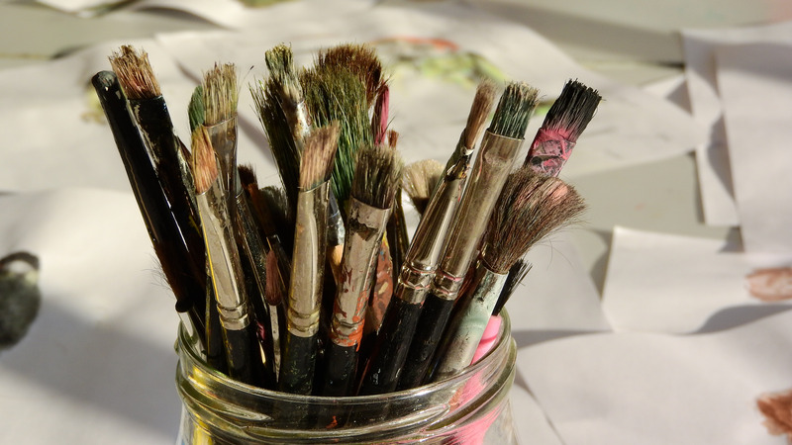
ARTISAN
Typically optimistic, focused on immediacy and the present.
Pride themselves in being unconventional, bold and spontaneous.
Highly adaptable to change, craves excitement and new experiences.
Prone to impulsive action and/or risk-taking.
Desires recognition of talent and/or accomplishments
Strength - Tactical

Slide 15
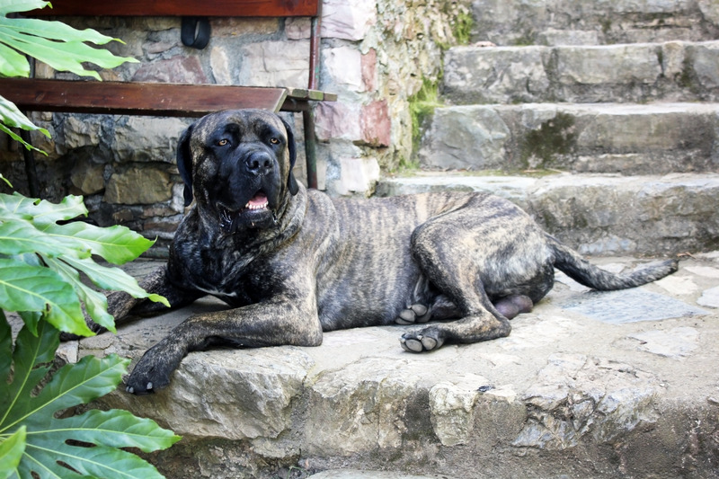
GUARDIAN
Pride themselves on being dependable, helpful and hard working.
Put emphasis on schedules, deadlines, and respect for established procedure.
Cautious in action, usually preferring stability and routine to innovation.
Function well within bureaucracies.
Identify strongly with authority and tradition.
Strength - Logistical

Slide 16
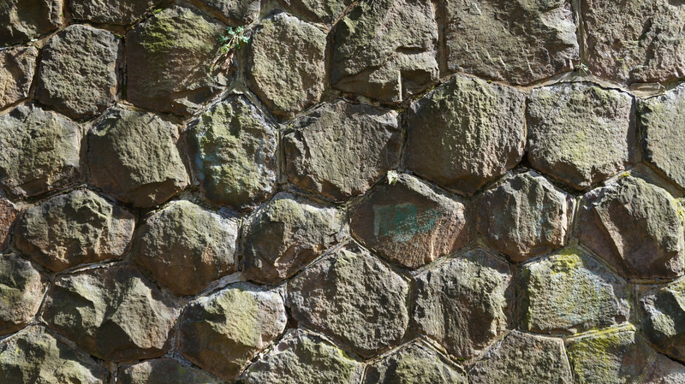
RATIONAL
Pragmatic, skeptical and focused on problem solving and analysis.
Value ingenuity, independence and self-control.
Impatient with redundancy, inefficiency or tradition for tradition’s sake.
Excel at long-range vision and strategy; drawn to innovation and technology.
Strength - Strategic

Slide 17
IDEALIST
Enthusiastic, trusting and passionate in explaining their beliefs.
Pride themselves on authenticity, sensitivity to others and intuition.
Generous and driven to bring out the best in those around them.
Dislikes conflict and disagreements, usually preferring to avoid them.
Strength - Mediator

Slide 18
TYPES and TEAMS
Teams with similar types …
Teams with diverse types …
IN YOUR GROUPS, discuss how a leader with EACH PARTICULAR TEMPERAMENT TYPE might:
Communicate
Deal with Conflict
Problem solve and make decisions
Lead organizational change
What are the strengths and challenges faced by each type in a team setting?
How does LEADERSHIP DEVELOPMENT incorporate TEMPERAMENT?

Slide 19
What else?
Temperament may affect many different areas within an organization.
WHAT OTHER ORGANIZATIONAL OR OPERATIONAL FUNCTIONS ARE IMPACTED BY TEMPERAMENT ?

Slide 21
What’s MORE Important…
Knowing YOUR type or your EMPLOYEES’ types?
What about your BOSS?

Slide 22
Case Study
How does individual temperament affect interactions in a team environment?
How does Stephen’s temperament, specifically, affect the potential outcomes of the implementation?
What are some of the strengths and challenges that are facing the team, both from an individual and group perspective? These may include communication, conflict, and decision-making processes.
What task(s) might you assign each team member in order to get the best results from the team?

Slide 23
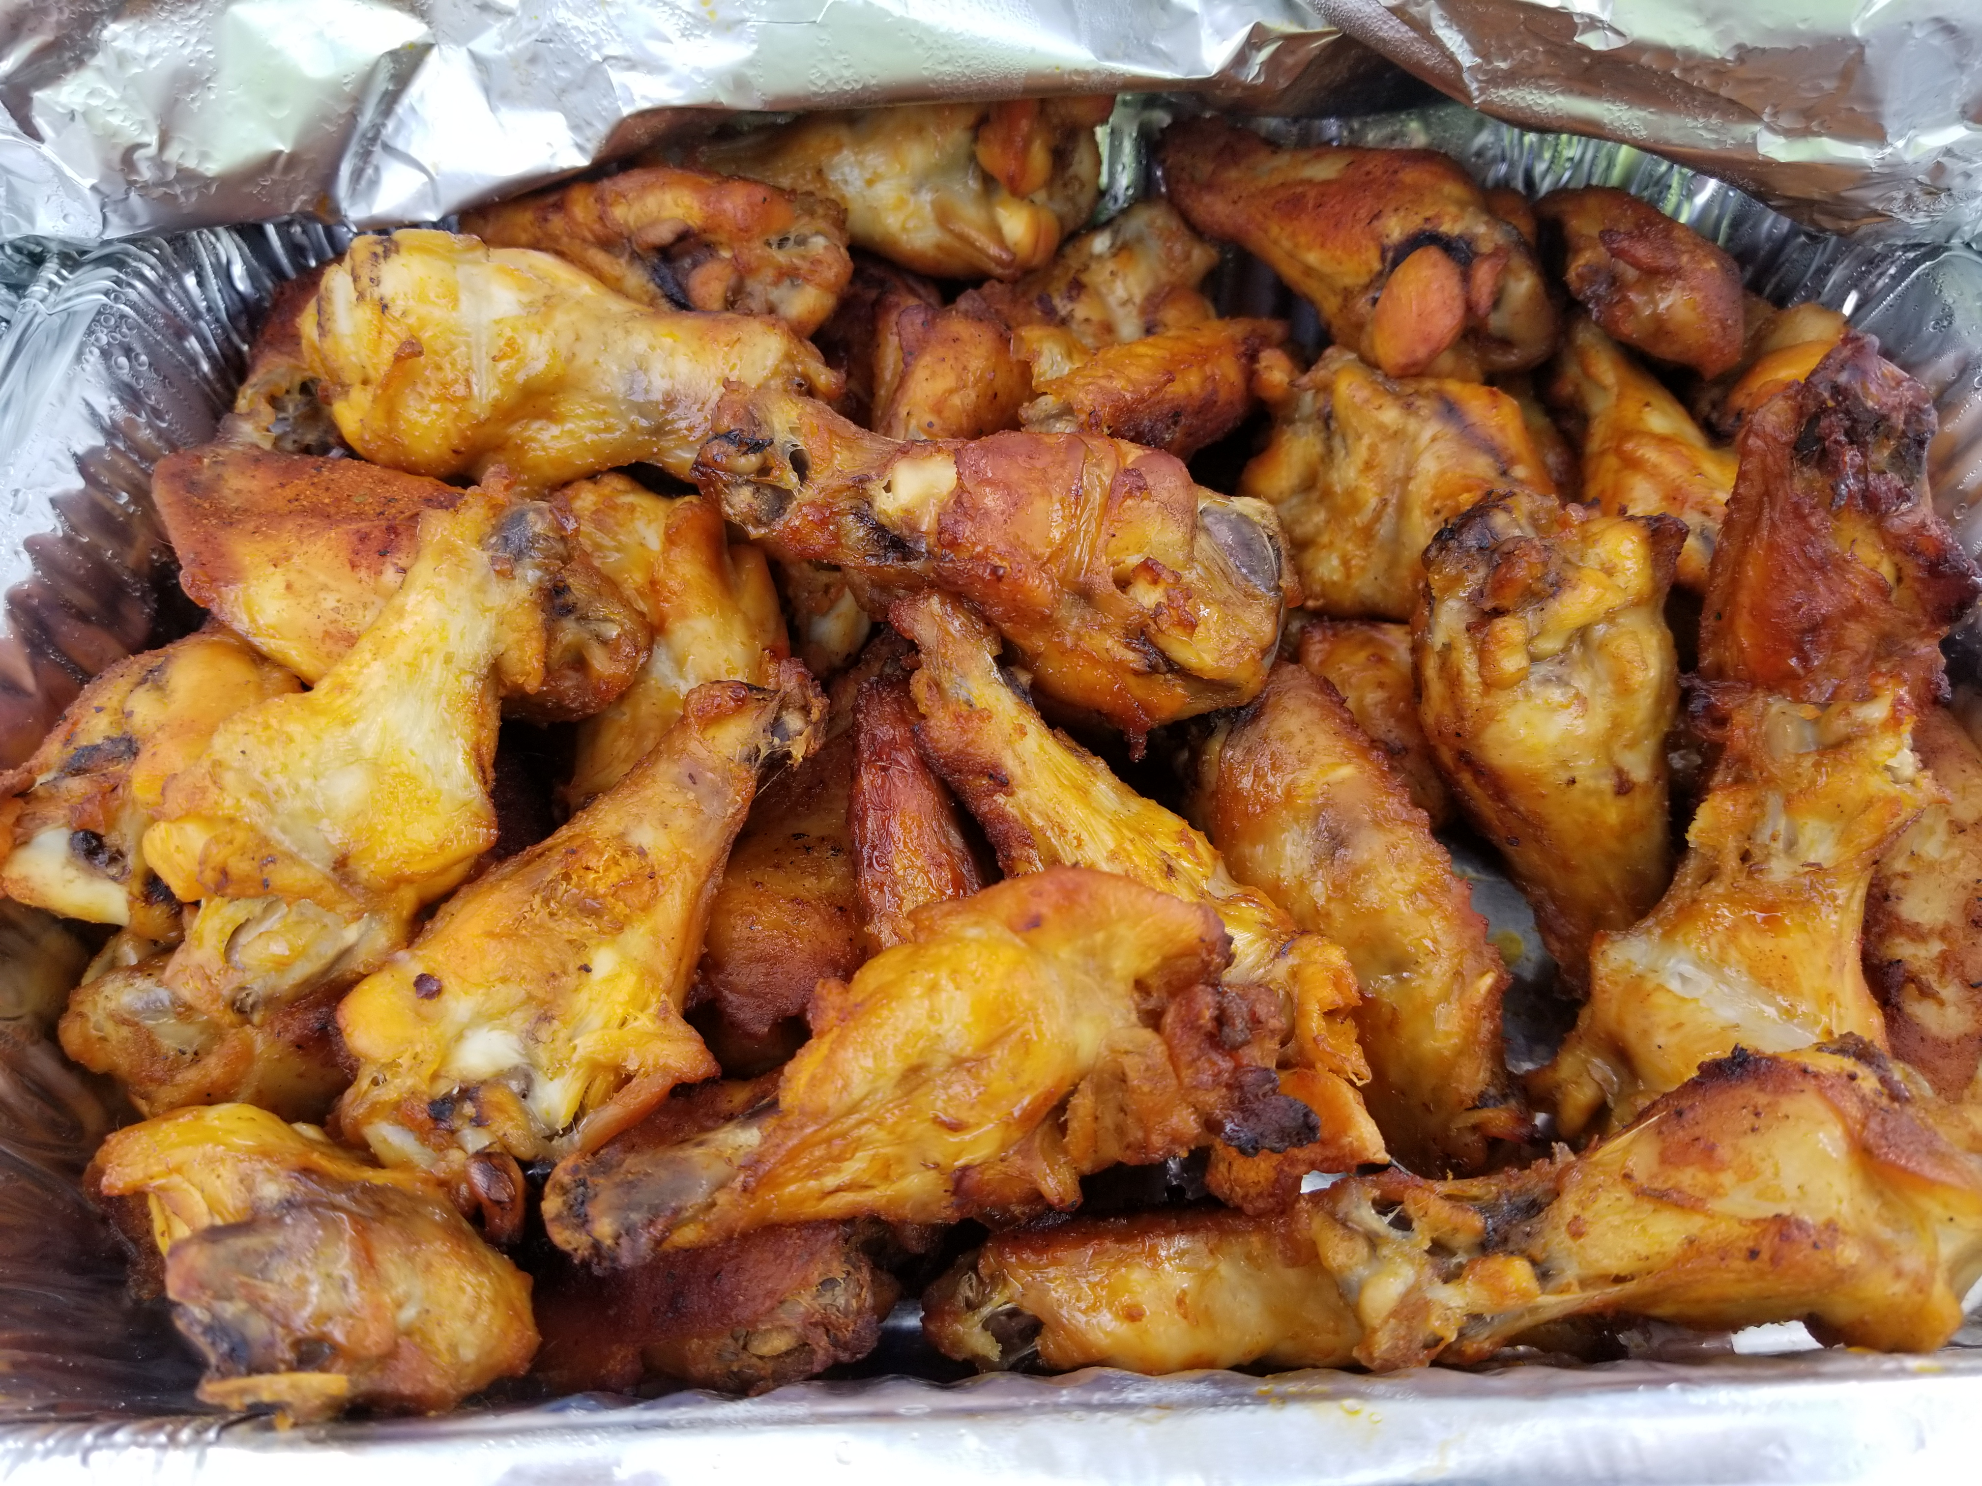
Questions on TRAITS and TYPES?

Slide 24
A private, non-profit institution founded in 1966, Bellevue University is accredited by the Higher Learning Commission through the U.S. Department of Education. For general information, please call 800.756.7920. Faculty Phone: 402.557.7121 Faculty Email: mike.freel@bellevue.edu bellevue.edu

