Slide 1
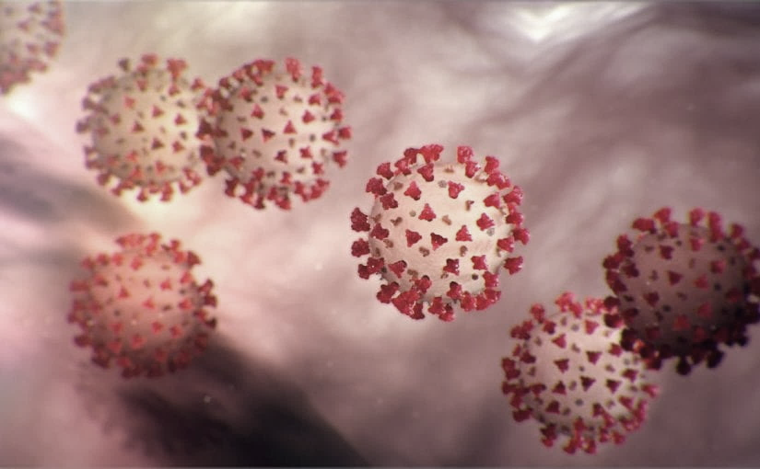
Covid-19 Webex Update 6-17-20
Tom Safranek, MD, State Epidemiologist
Louis Safranek, MD, PhD,
Board certified specialist, Infectious Disease

Slide 2
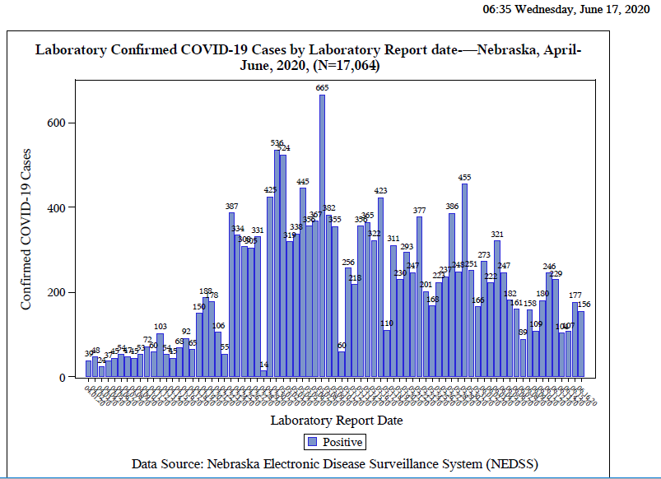

Slide 3
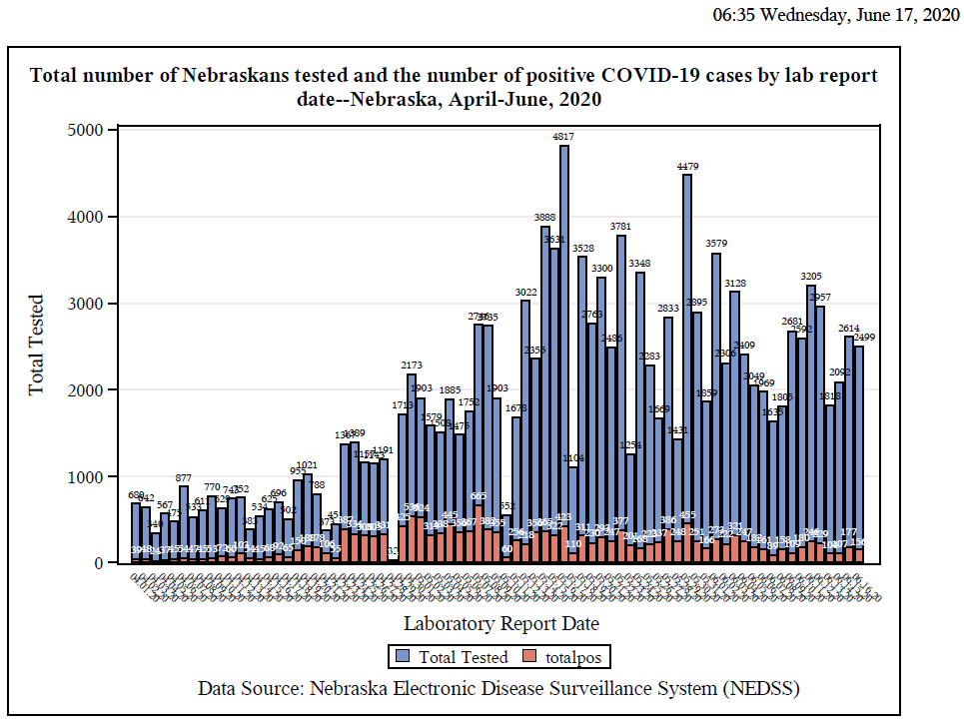

Slide 4
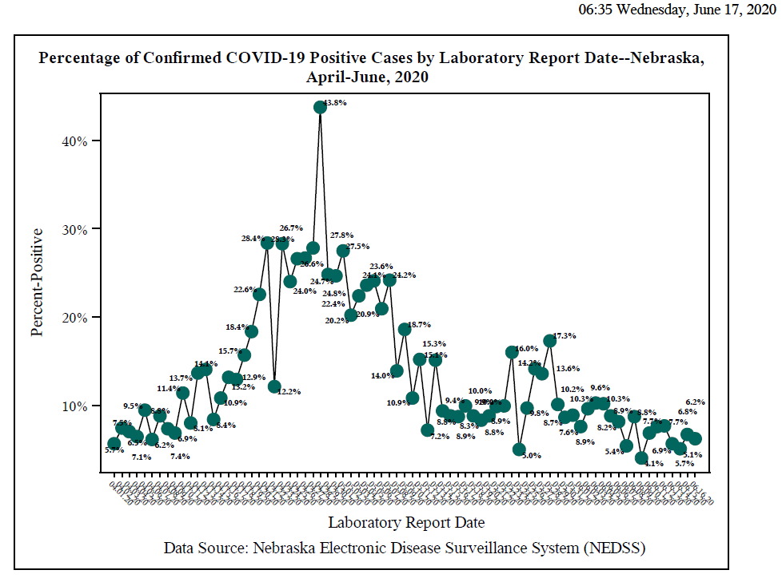

Slide 5
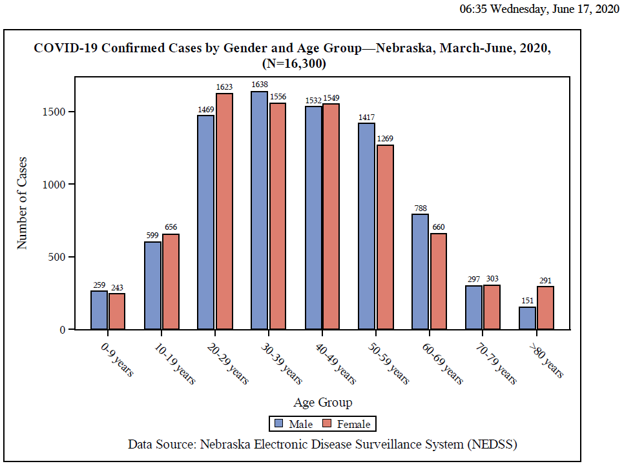

Slide 6
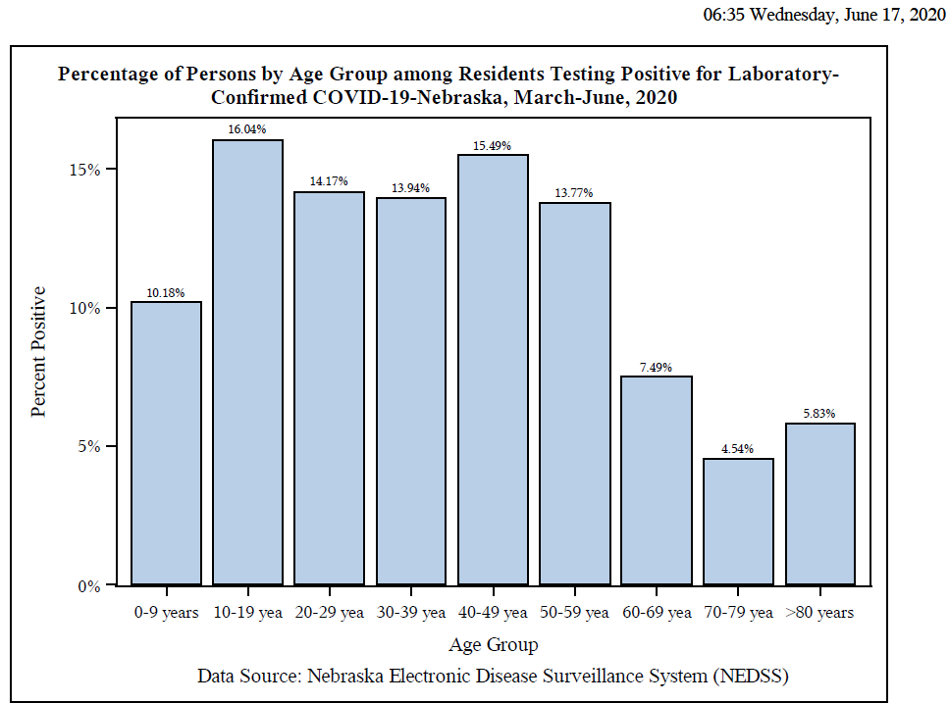

Slide 7
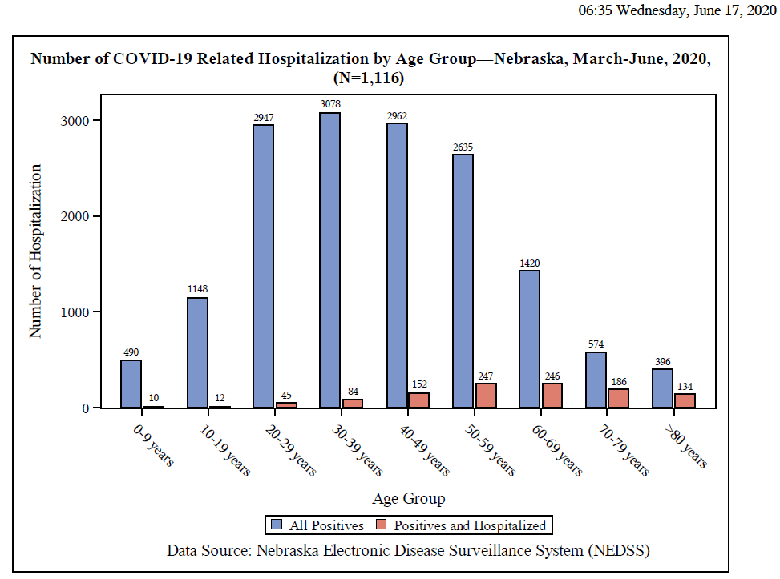

Slide 8
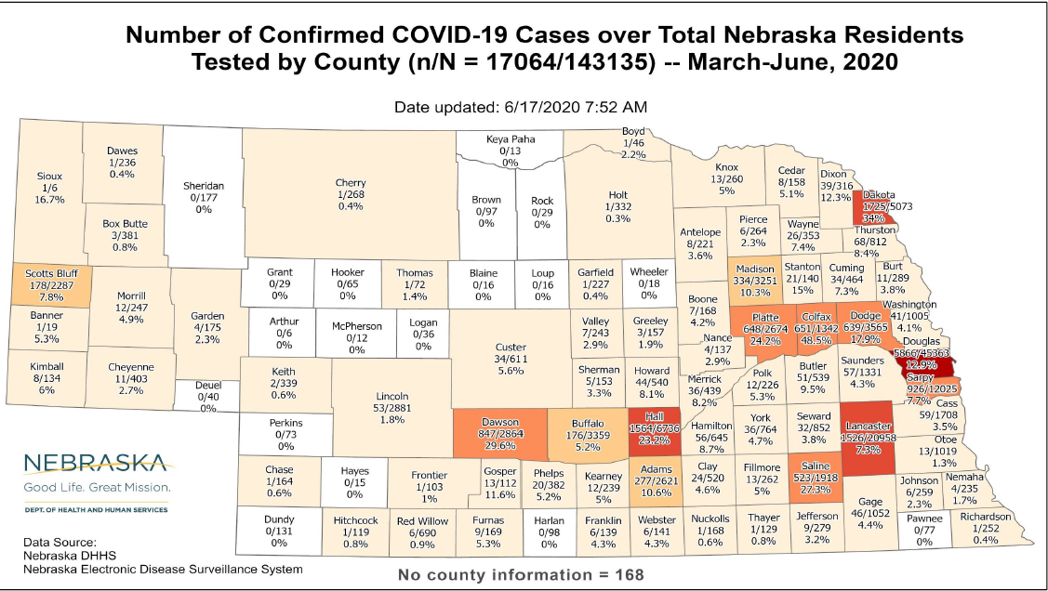

Slide 9
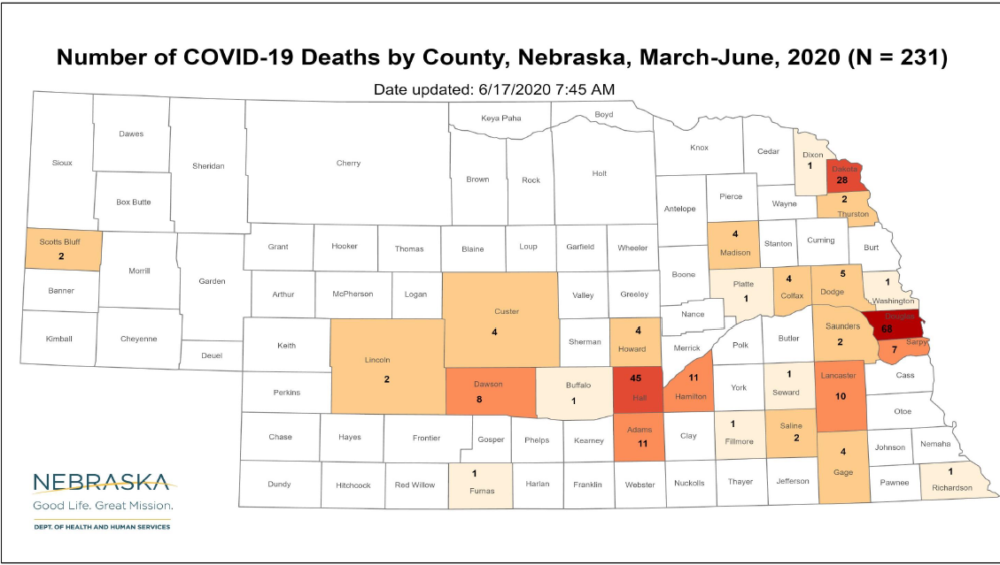

Slide 10
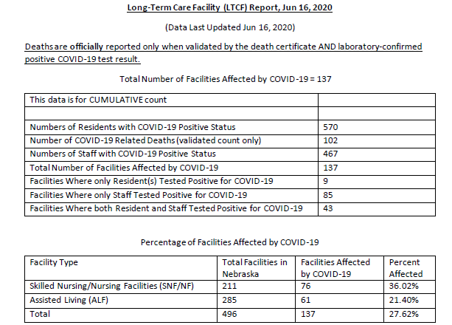
Long Term Care Facility Data

Slide 11
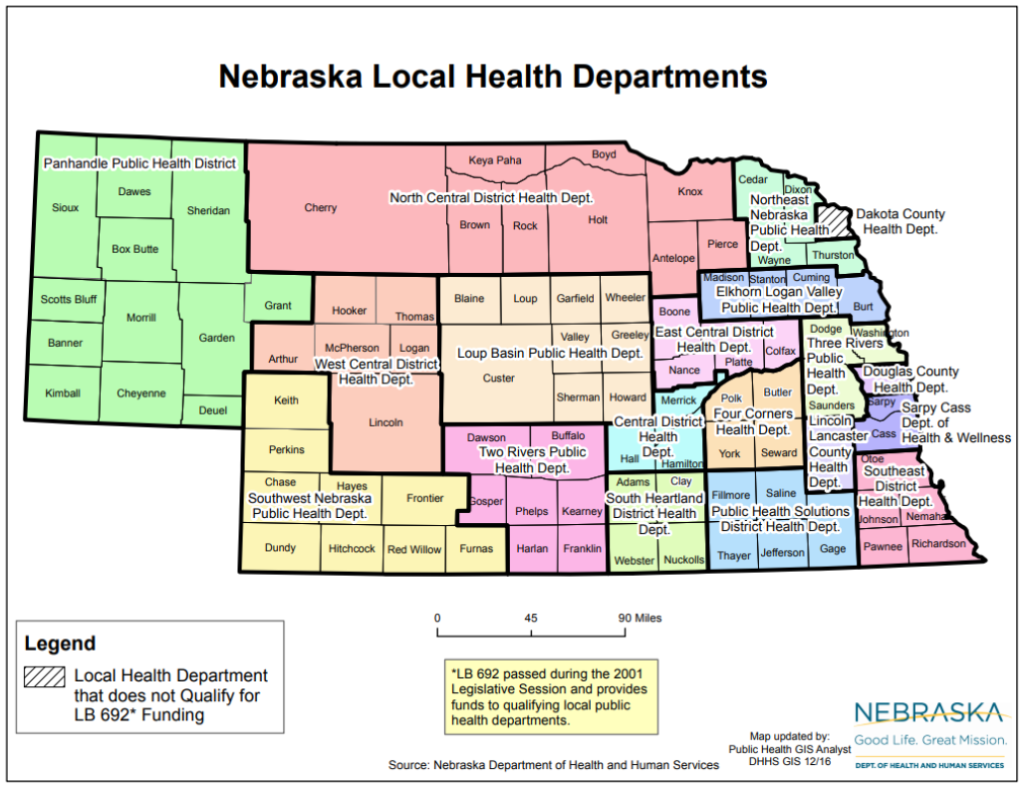

Slide 12
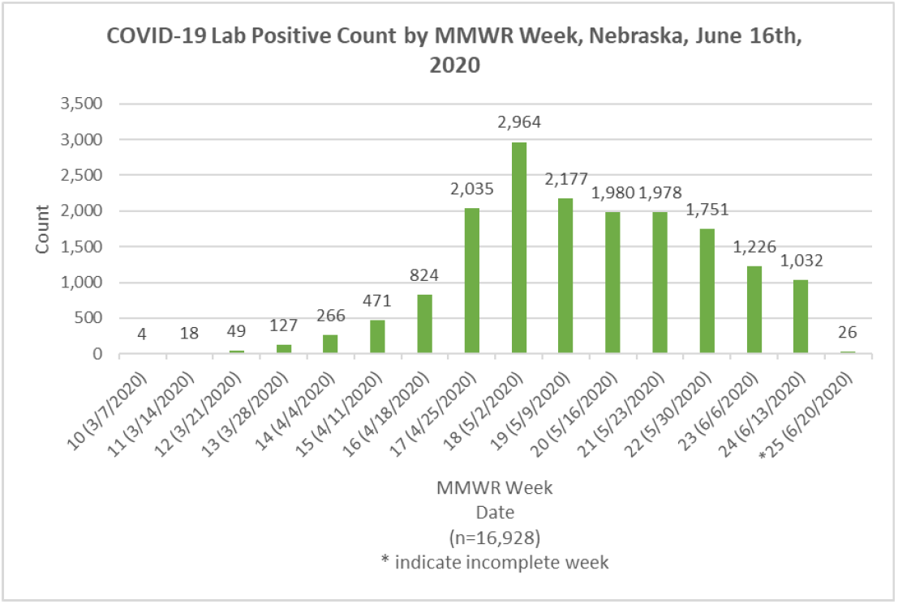

Slide 13
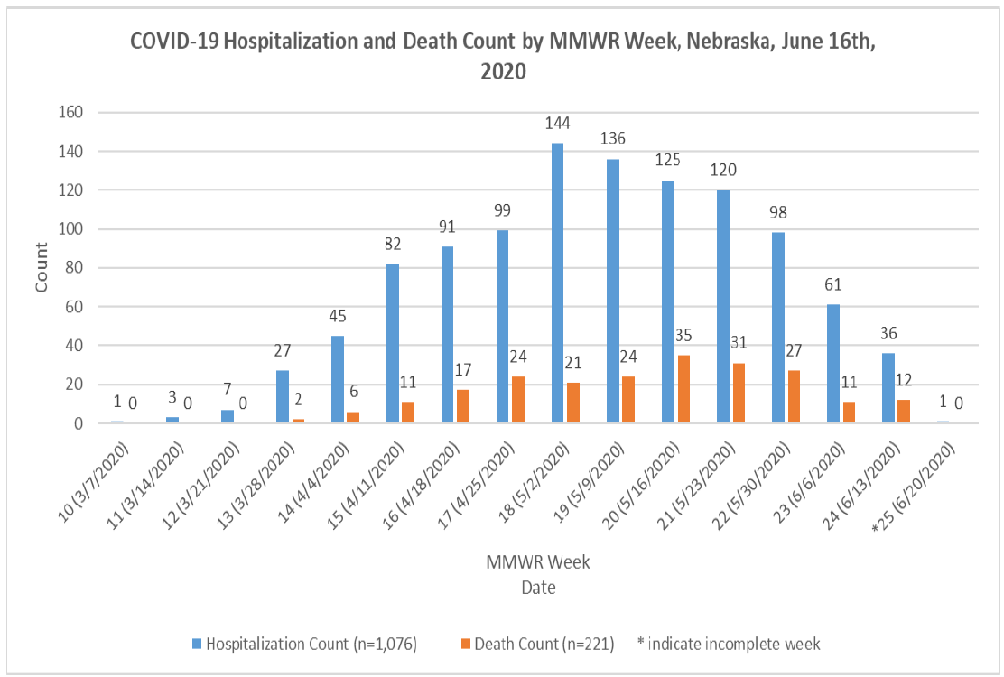

Slide 14
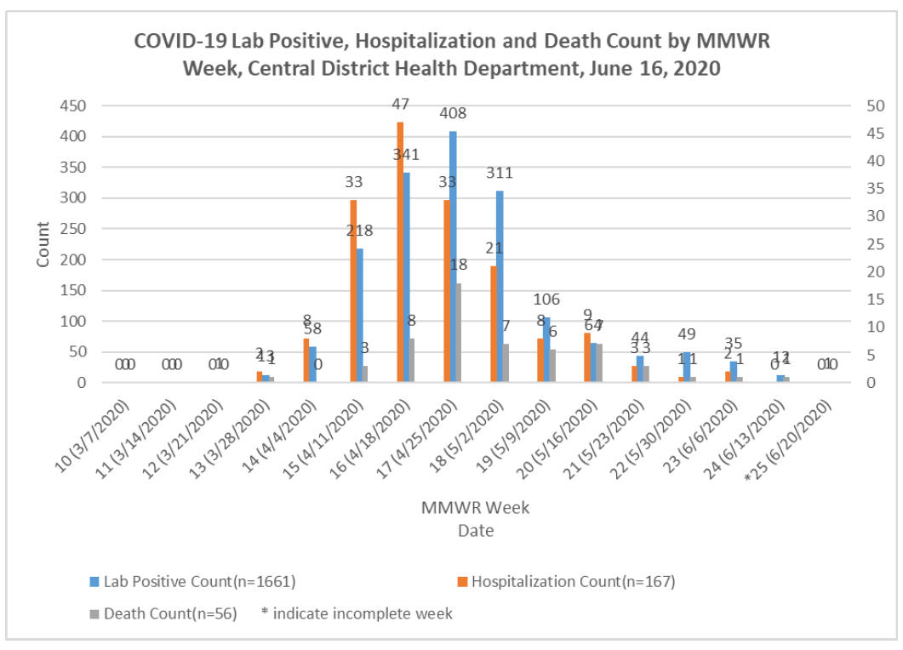

Slide 15
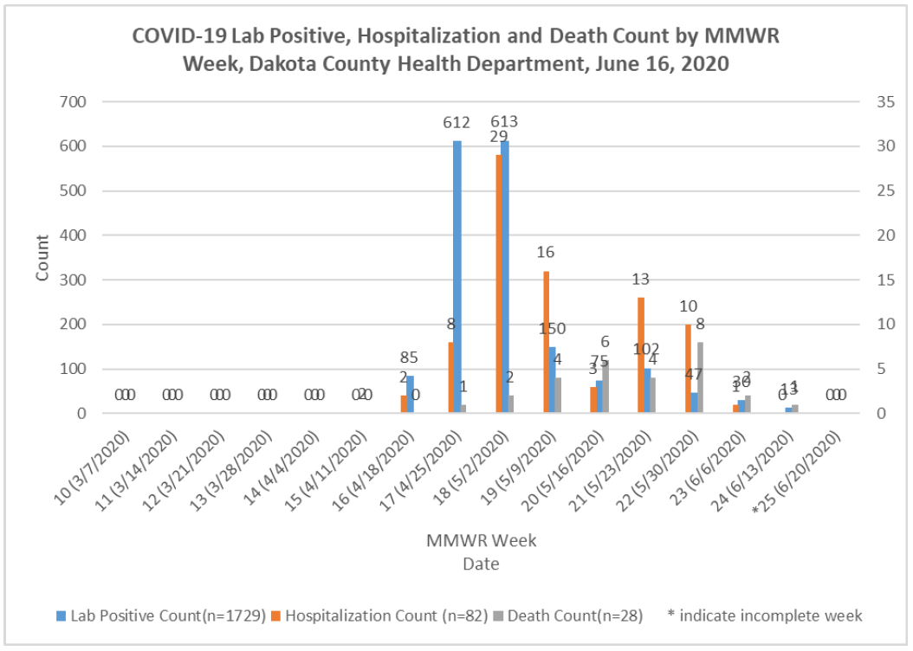

Slide 16
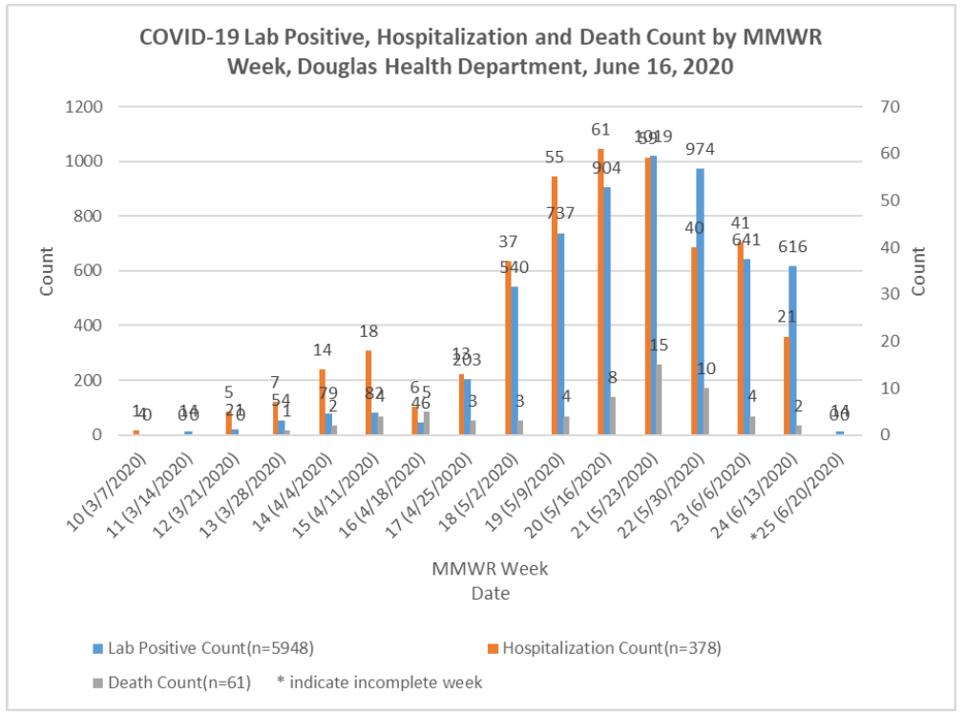

Slide 17
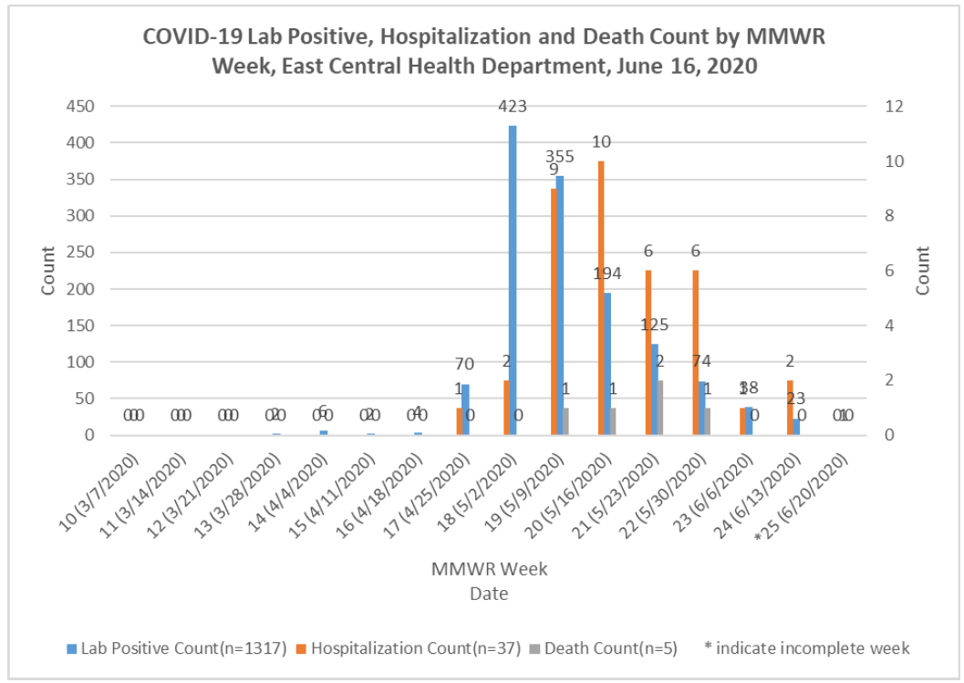

Slide 18
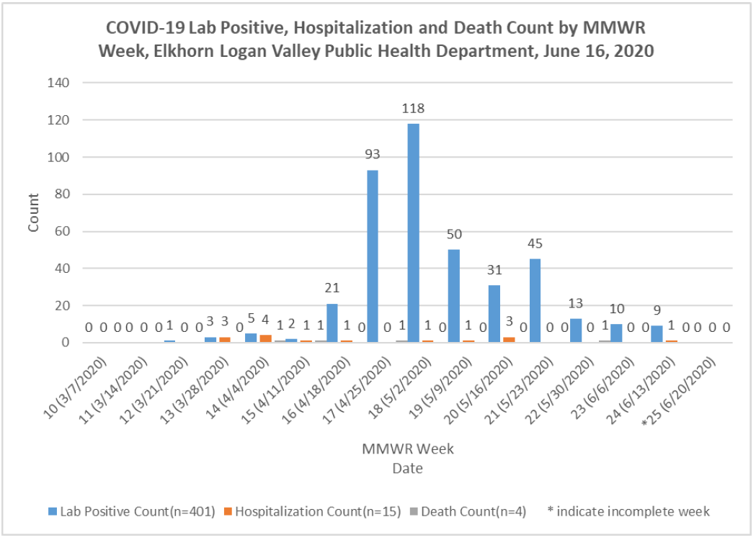

Slide 19
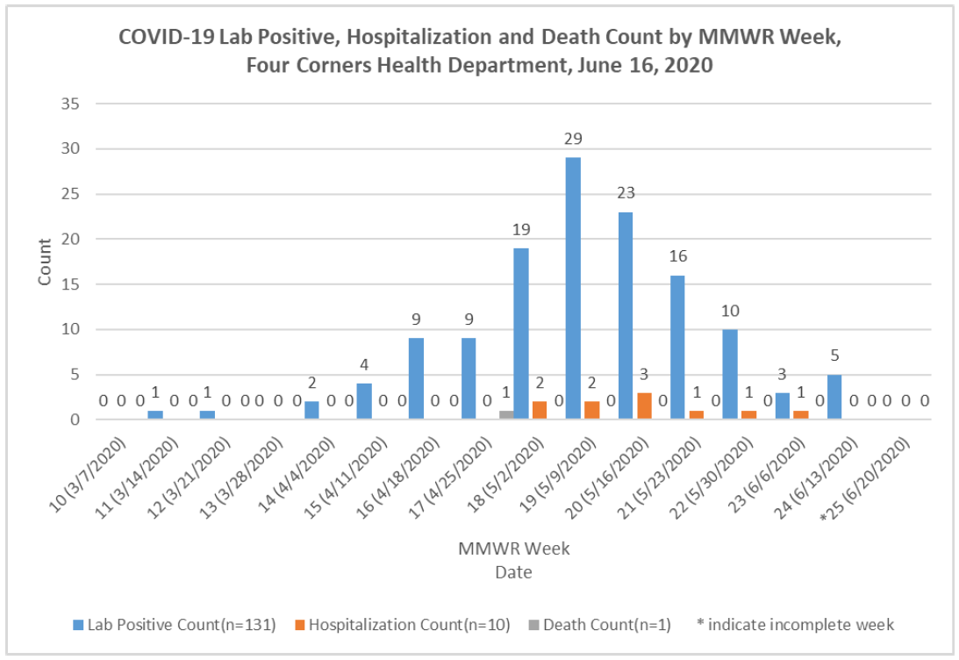

Slide 20
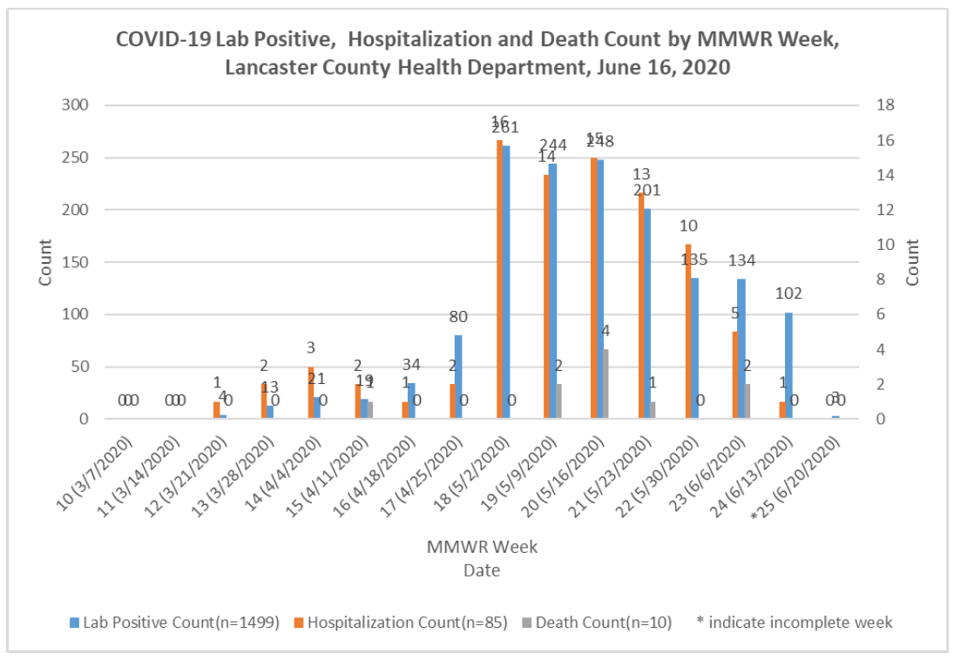

Slide 21
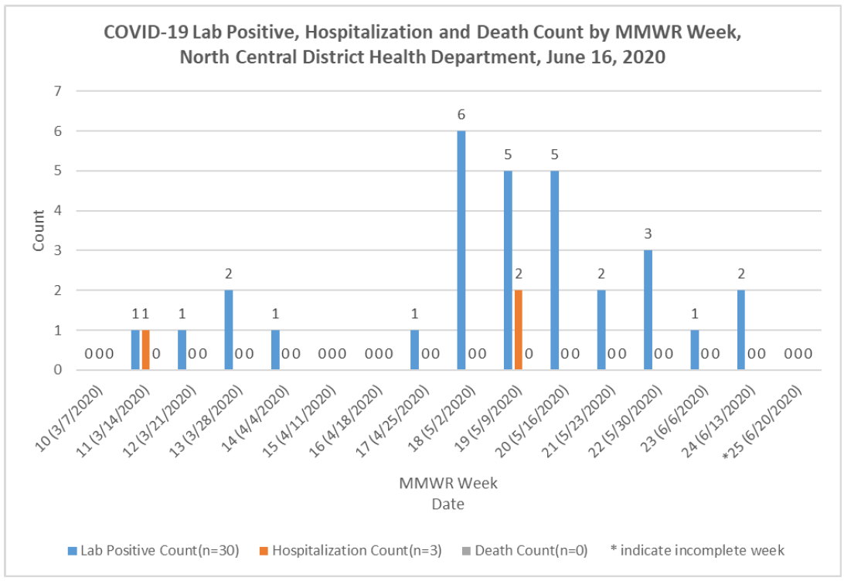

Slide 22
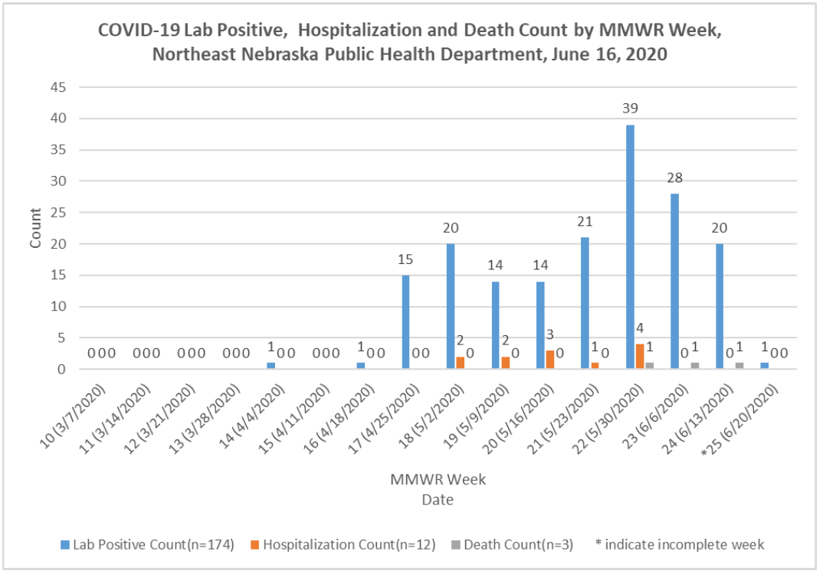

Slide 23
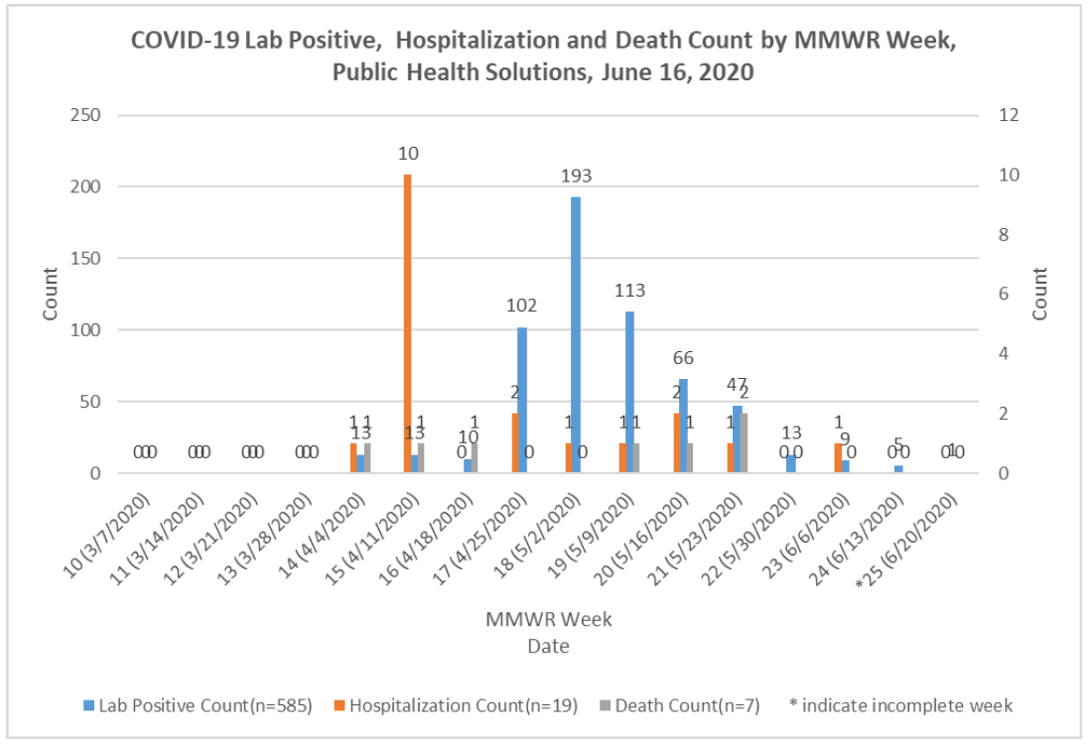

Slide 24
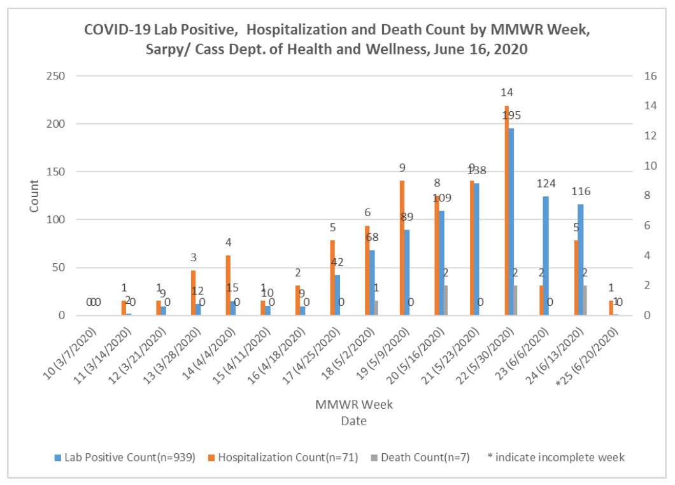

Slide 25
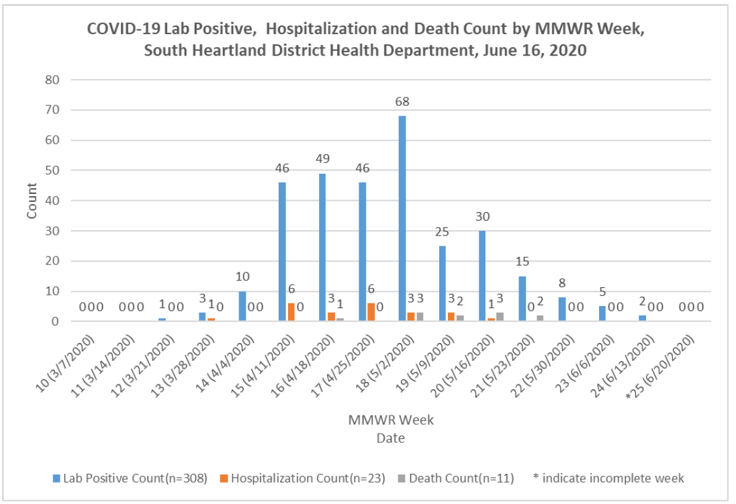

Slide 26
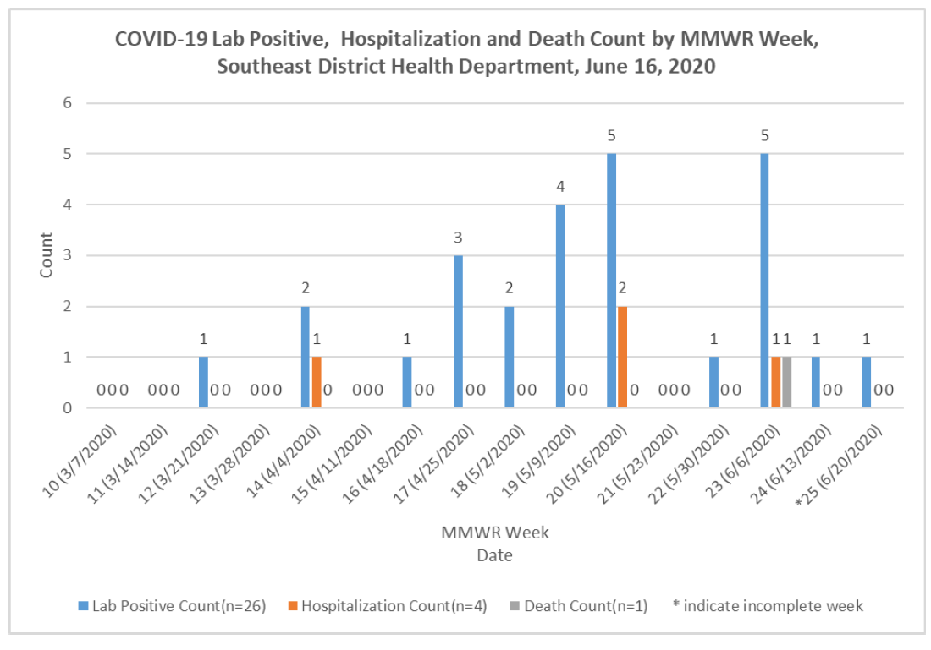

Slide 27
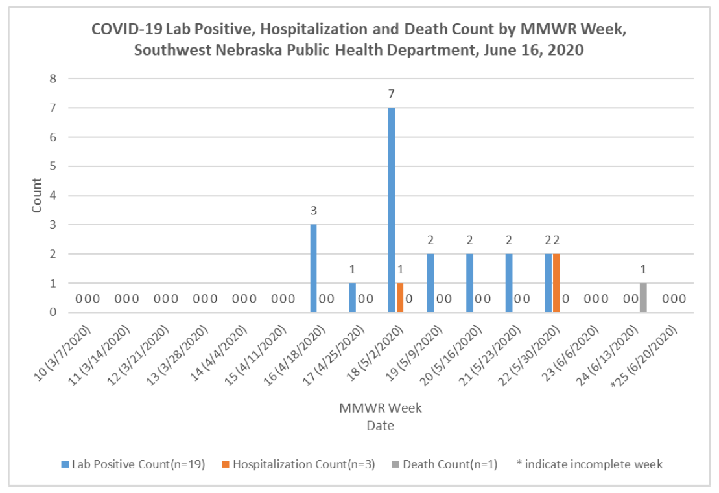

Slide 28
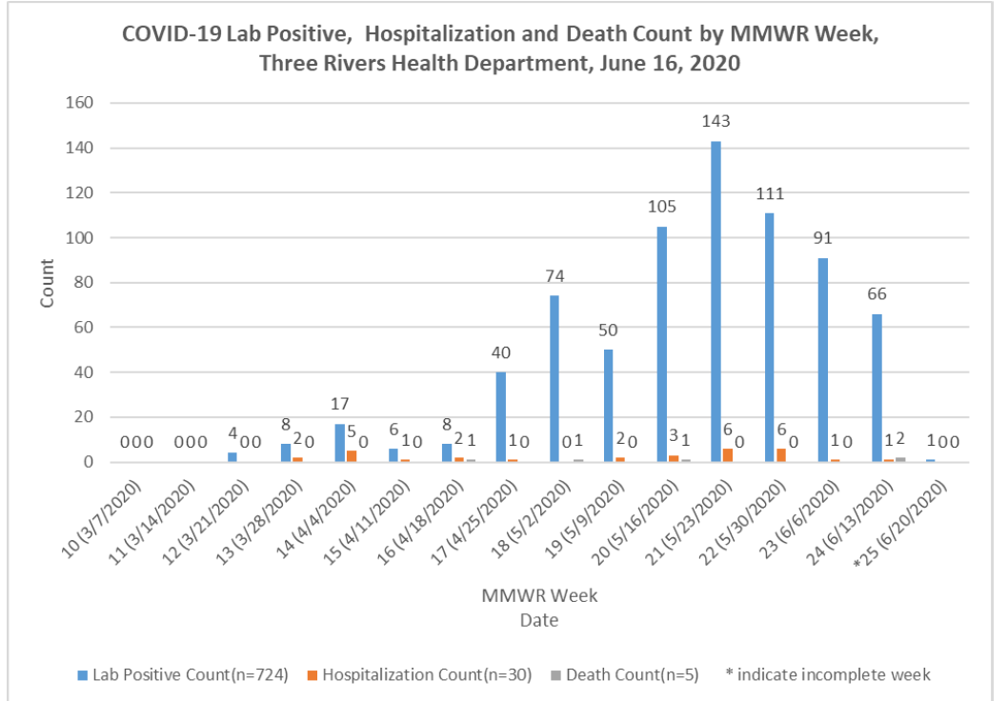

Slide 30
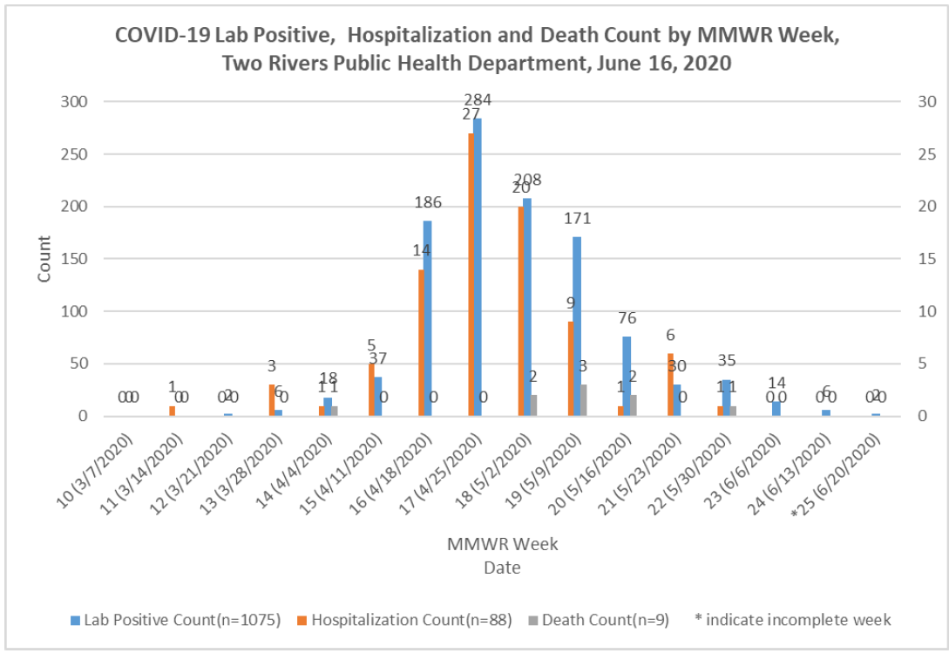

Slide 31
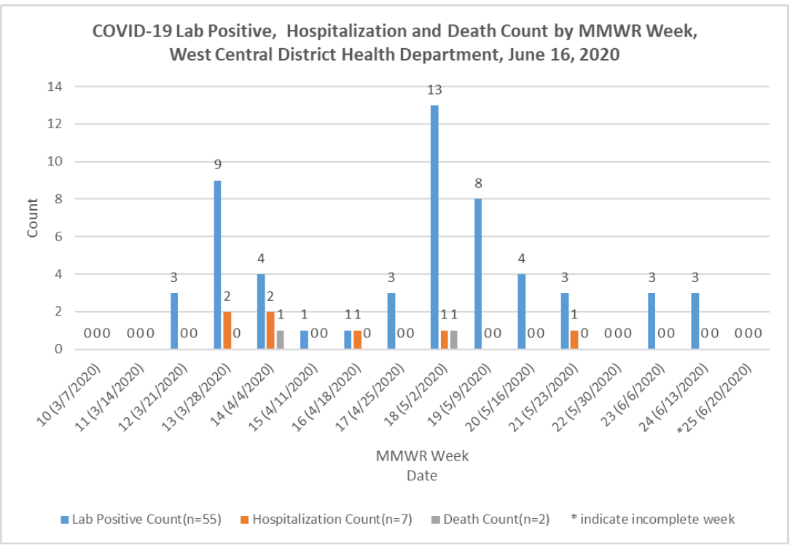

Slide 32
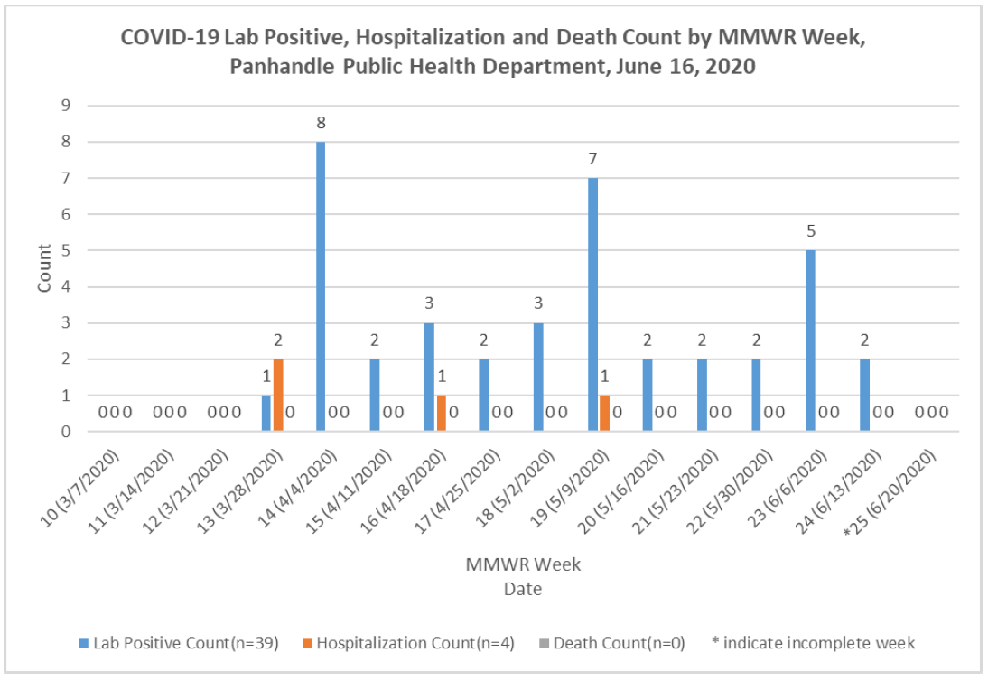

Slide 33
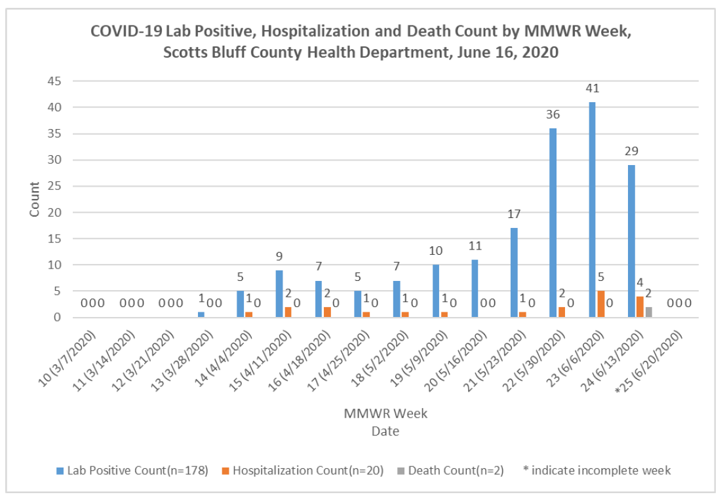

Slide 34
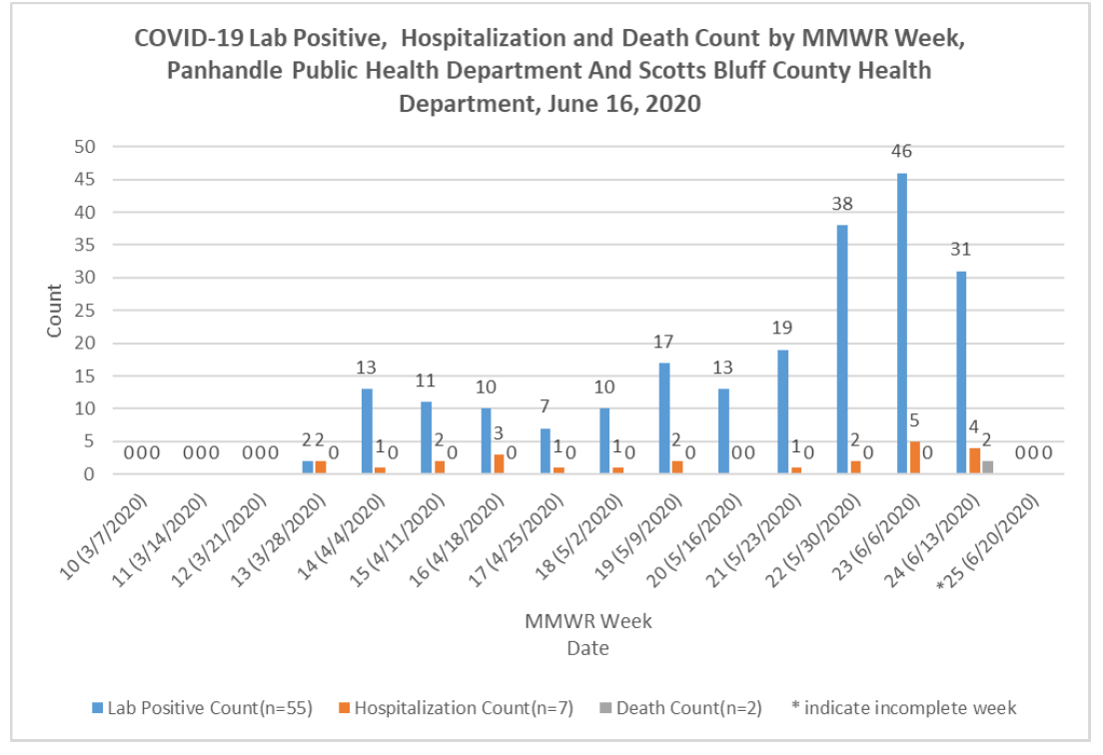

Slide 35
Face Masks
Continue to recommend face masks in the community.
Any type of mask is better than none.
Masks may provide the wearer with protection, but in addition…
Masks may protect others in the vicinity by reducing their level of viral exposure.
Low intensity exposures may lead to milder disease.

Slide 36
Face masks
High SARS-CoV-2 Antibody Prevalence Among Healthcare Workers Exposed to COVID-19 Patients
Many who were sick did not seroconvert;of those who did seroconvert, less than a quarter were sick; nasal swab testing was negative for all.
“Our data support an essential need to wear face mask, including the disposable non-surgical face mask…”
https://pubmed.ncbi.nlm.nih.gov/32504745/
DOI: 10.1016/j.jinf.2020.05.067

Slide 37
Face masks
Identifying airborne transmission as the dominant route for the spread of COVID-19
https://www.pnas.org/content/early/2020/06/10/2009637117
Our analysis reveals that the difference with and without mandated face covering represents the key determinant in shaping the trends of the pandemic. This protective measure significantly reduces the number of infections.
Social distancing, quarantine, and isolation are insufficient by themselves.

Slide 38
Should we do repeated testing?
Patients with a high clinical suspicion or exposure setting should undergo laboratory testing; it is appropriate to repeat the test the same day or on subsequent days if the results are initially negative and there is high suspicion or prevalence of COVID-19.

Slide 39
When should we retest positives?
For patients with a positive SARS-CoV-2 molecular assay result, a repeat test earlier than 15 days after the first test is unlikely to yield a negative result.
Whether patients who continue to be positive remain infectious is unknown, but seemingly not.
Notes:
Add the title of your presentation, your division, name, etc.

Slide 40
Treatments
For patients with a positive SARS-CoV-2 molecular assay result, a repeat test earlier than 15 days after the first test is unlikely to yield a negative result.
Whether patients who continue to be positive remain infectious is unknown, but seemingly not.

Slide 41
Hydroxychloroquine
Of little benefit to those critically ill or those at low risk of serious disease.
Unknown benefit for those at risk over age 60-65.
Unknown if hydroxychloroquine or other agents administered to asymptomatic, low risk, or mildly ill persons after significant exposure or a positive test reduce transmission within the community?

Slide 42
Not Just Peanuts
Anaphylaxis with peanuts, bee stings, etc.
Bruton's Tyrosine Kinase Inhibition Effectively Protects Against Human IgE-mediated Anaphylaxis
PMID: 32484802
DOI: 10.1172/JCI138448

Slide 43
BTK inhibitors and Covid-19
Inhibition of Bruton tyrosine kinase in patients with severe COVID-19
Science Immunology 05 Jun 2020: DOI: 10.1126/sciimmunol.abd0110

Slide 44
Preexisting immune protection
Here, we describe an assay that allows direct detection and characterization of SARS-CoV-2 spike glycoprotein (S)-reactive CD4+ T cells in peripheral blood. We demonstrate the presence of S-reactive CD4+ T cells in 83% of COVID-19 patients, as well as in 34% of SARS-CoV-2 seronegative healthy donors (HD).
https://www.medrxiv.org/content/10.1101/2020.04.17.20061440v1.full.pdf

Slide 45
Serology

Slide 46
Serologic tests: increasingly available
serologic assays have not yet been demonstrated to be useful in making clinical decisions for individual patients
should not be ordered for this purpose.

Slide 47
Detect the presence of antibodies against SARS-CoV-2
Detect presence or absence of COVID-19 antibodies, or
Specifically detect IgM or IgG COVID-19 antibodies.

Slide 48
develop approximately 6 to 10 days after infection
IgM appears to peak approximately 12 days post- infection
Persists for as long as 35 days then declines rapidly
IgG observed in patients two weeks after symptom onset
Peaks approximately 17 days after infection
Persists for at least 49 days
IgG has been found in patients infected with SARS-CoV-1 (SARS) up to 2 years after recovery.

Slide 49
Nebraska most likely has a low prevalence of persons who have actually had COVID-19 infection
Varies across different segments of the state’s population
Overall is most likely less than 5 %.

Slide 50
Given current limitations:
serologic tests should not be used to diagnose acute or prior SARS-CoV-2 infection
should not be used in an attempt to establish immune status to SARS-CoV-2
Depending on the sensitivity and specificity of a particular test, they may produce false-negative or false- positive results
mislead individuals and incline them to abandon useful practices such as physical distancing or protective equipment such as face masks.
for a test with 99% specificity used in a population like Nebraska with less than 5% prevalence, 1 in every 6 positive tests will represent a false-positive result.

Slide 51
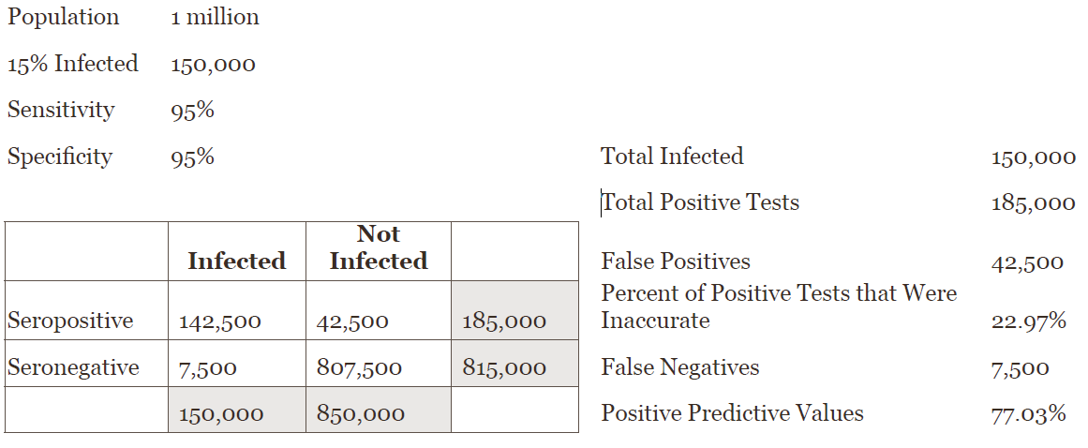

Slide 52
A positive serology: prior infection with SARS-CoV-2, OR
Nonspecific, false-positive reaction to an antigen unrelated to SARS-CoV-2, (past or present infection with a coronavirus other than SARS-CoV-2)
Negative antibody test does not rule out SARS-CoV-2 infection (exposed individuals within estimated incubation period or the window period of illness prior to generating an antibody response (false-negative).

Slide 53
presence of COVID-19 antibodies implies some level of immunity
uncertainty remains: does detection (or a certain titer) of SARS-CoV-2 antibodies provides immunity to future COVID-19 infections??
Does detection of antibodies prevent carriage/shedding of COVID-19

Slide 54
Laboratories and providers must be aware of FDA requirements regarding appropriate settings where specific tests can be performed.
Many require moderate- or high-complexity CLIA laboratory setting,
should not be deployed as point-of-care tests.
Review the manufacturer’s instruction/package insert to determine if the test is intended for use by a laboratory approved to perform moderate- or high-complexity tests.

Slide 56
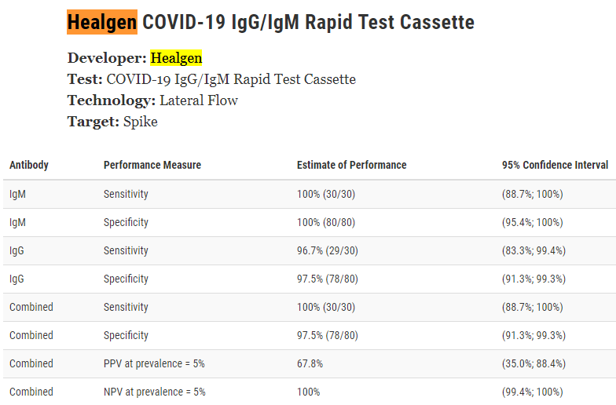

Slide 57
Health care providers and clinical laboratories must carefully review any SARS-CoV-2 serology test kits now on the market.
Some FALSELY advertise Food and Drug Administration (FDA) approval and sufficient reliability for use in routine clinical practice.

Slide 58
risks of inaccurate tests are high:
false-positive COVID-19 antibody test might wrongly suggest that individuals have immunity against the virus when in fact they don’t
Leading to inappropriate and misguided behavior -- could endanger the patient and their close contacts.

Slide 59
resources
Review of the COVID serology issues from Johns Hopkins:
https://www.centerforhealthsecurity.org/our-work/publications/developing-a-national-strategy-for-serology-antibody-testing-in-the-US
CDC COVID Serology page:
https://www.cdc.gov/coronavirus/2019-ncov/lab/serology-testing.html
Currently 16 COVID-19 serology tests with Emergency Use Authorization are listed on the FDA website:
https://www.fda.gov/medical-devices/emergency-situations-medical-devices/eua-authorized-serology-test-performance
NYC Health Advisory on Role of COVID-19 Serology Tests:
https://www1.nyc.gov/assets/doh/downloads/pdf/han/alert/2020/covid-19-status-of-serologic-testing.pdf

