Slide 1

PREVENTING FALLING STARS
FALL PREVENTION EDUCATION

Slide 2
Introduction
Stephanie Moody, RN
Quality Coordinator at Thayer County Health Services in Hebron, NE
Personal:
  Married for 33 years with 7 children, and 3 grandchildren.
Experience:
  6 Years of CAH nursing –ED, OB, Med Surg, and a little with minor surgical procedures.
  11 years in Long Term care – Night Charge nurse, MDS Coordinator, Interim DON, ADON.
  4 years in Quality with Thayer County Health Services.
Notes:
Good afternoon. My name is Stephanie Moody. I am from the Thayer County Health Services in Hebron, Ne where I work as the Quality Coordinator. I thought I would begin by giving a little background of myself. I have 6 years of experience in Critical Access Hospital. This includes ED, OB, Med Surg, and some minor procedure surgeries. I also have 11 years of long term care working as a night charge nurse, MDS Coordinator, Interim DON, and ADON. It was in long term that I discovered my desire for Quality and Patient Safety. This long term care experience is what led me back into the Critical Access Hospital at Thayer County Health Services as the Quality Coordinator.

Slide 3
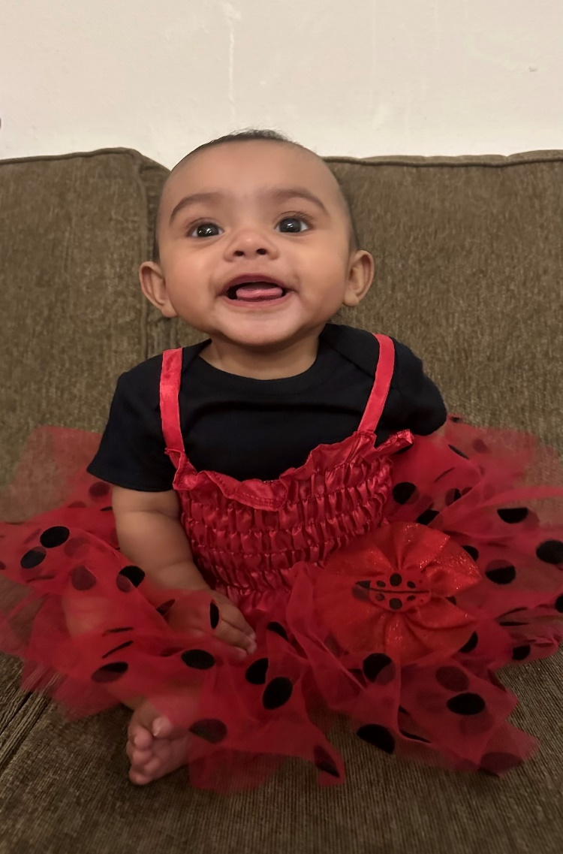
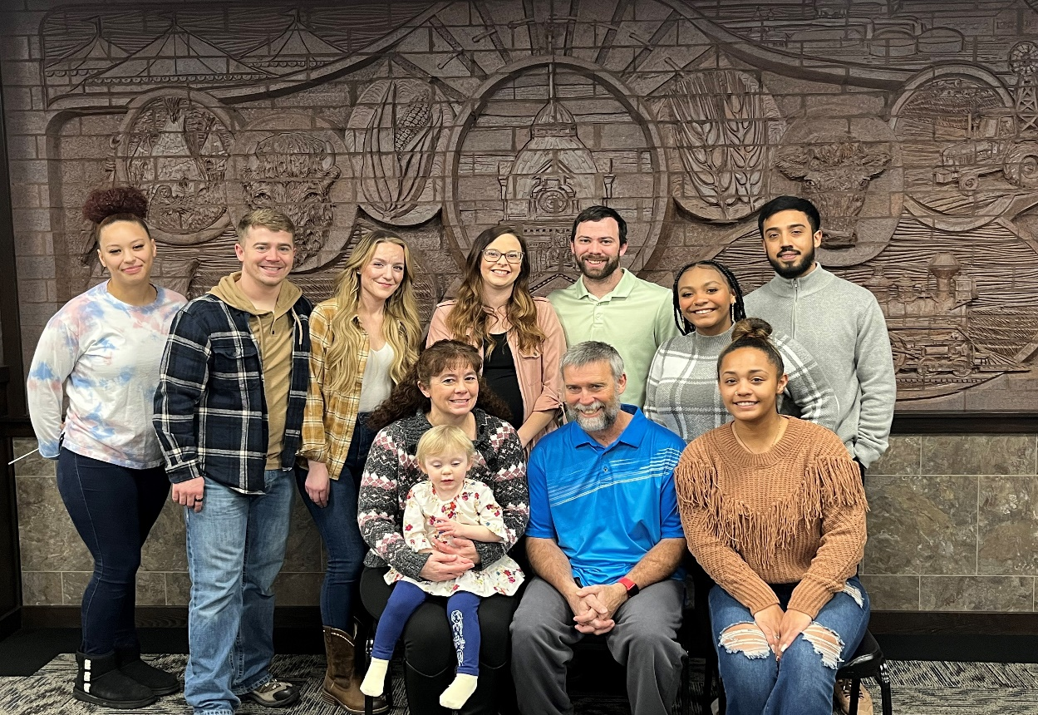
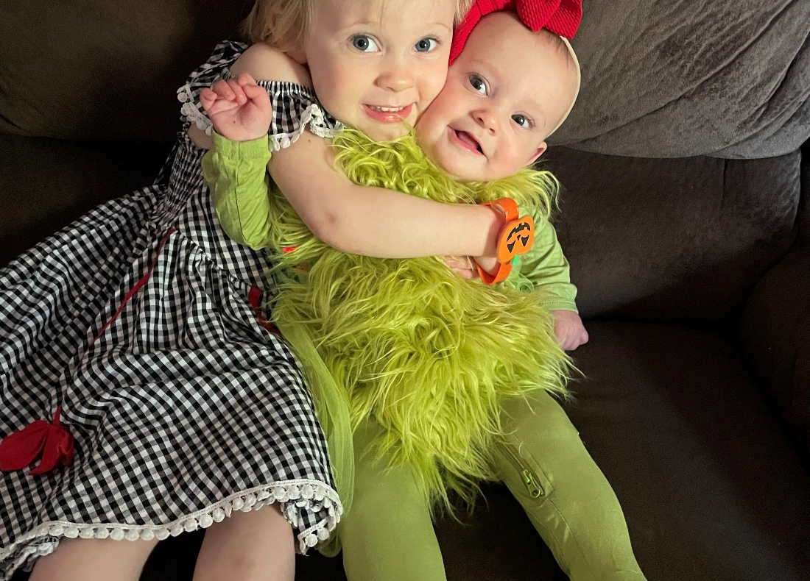
My Family
Isabella Ann , Julianna Eloise, and Talicia Alma Marie
Notes:
My family and 3 of grandchildren

Slide 4
OBJECTIVES
Explain what a root cause analysis is and a simple way to do a root cause analysis.
Evaluate the effectiveness of interventions.
Evaluate the effectiveness of process change.
Explain the purpose and goals of a fall prevention team.

Slide 5
THE STORY
Thayer County Health Services
  Critical access hospital with 17 beds includes ED, L&D, Inpatient, Observation, and Swing Bed
  Mission-To improve the lives of those we serve by providing exceptional, patient-centered health care.
  Vision-To be the region’s provider and employer of choice for comprehensive health care and wellness.
Notes:
Thayer County Health Services is a 17 bed critical access hospital that serves Hebron, Deshler, Bruning, and Davenport communities and surrounding areas. TCHS mission and vision is to improve the lives of those we serve by providing exceptional, patient –center health care and to be the region’s provider and employer of choice for comprehensive health care and wellness. It is this mission and vision that led to the recognition of a process improvement for patient safety.

Slide 6
Early 2020 noted increase in falls over the past few years.
Root cause analysis of all falls in the inpatient area to discover where the issues were.
Collected data regarding prior years fall numbers.
Evaluation of interventions that were utilized.
Call Don’t Fall, Fall Stars, Fall huddles.
Defined a fall according to IHI.
Notes:
In early 2020, TCSH began the journey of decreasing the fall rate of the inpatient population. Over the past several years, there had been an increasing number of falls. In 2019, falls in the inpatient setting were at 9.
Through investigation of past falls, it was noted that root cause analysis was not consistently completed, the definition of a fall was unclear, and interventions were used after a fall took place.
There was collection of data from past years in regards to injurious falls and non-injurious falls. Evaluation of interventions used were also collected and reviewed.
The first steps that was taken was education of the definition of a fall according to IHI to all staff working with patients. New ceiling tiles and plaques were placed in all patients rooms with “CALL, DON”T FALL. This is an idea that came from one of the staff members in our finance department who observed these tiles in another hospital.
These first steps seems to not make a difference, instead the number of falls increased due to the education of what a fall really was. Staff were not counting a fall when patient was lowered to floor by staff.

Slide 7
Notes:
As you can see in this graph, the falls in 2020 went up as did in 2021

Slide 8


Slide 9
What is a root cause analysis?
National Institute of Health definition
  A process for identifying the causal factors underlying variations in performance. In the case of medical error, this variation in performance may result in a sentinel event.
In Layman’s terms
  The process in finding out what has happened and how it happened in an event.
https://www.ncbi.nlm.nih.gov/books/NBK570638/#:~:text=Root%20cause%20analysis%20(RCA)%20is,result%20in%20a%20sentinel%20event.
Notes:
Root Cause Analysis definition is>>>>>. In laymans terms>>>>>>>
By 2021, all falls had root-cause analysis completed, and interventions were in place prior to falls with use Morse fall scale. There was also fall huddles with the staff involved and the fall prevention team had been created. It was felt that we had the right process in place although the falls were continuing.
In August of 2021, TCHS became involved in the Capture Falls cohort through UNMC. It was at this point that there was a break though.
TCHS went from July of 2021 through July of 2022 without a single fall in the inpatient portion of the hospital for a total of 368 fall free days.
TCHS continues to strive to provide a safe and patient-center environment for all patients and families.
Preventing falls is a continuous challenge. TCHS’s story is not over. It continues each day with every staff member and Senior Leader.
It is the consist use of interventions, continuous process improvement, and evolving of the process to be specific for each patient that helps TCHS continue to strive to provide patient safety to all patients.

Slide 10
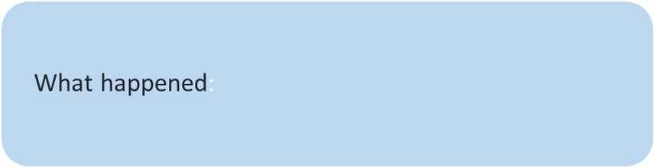
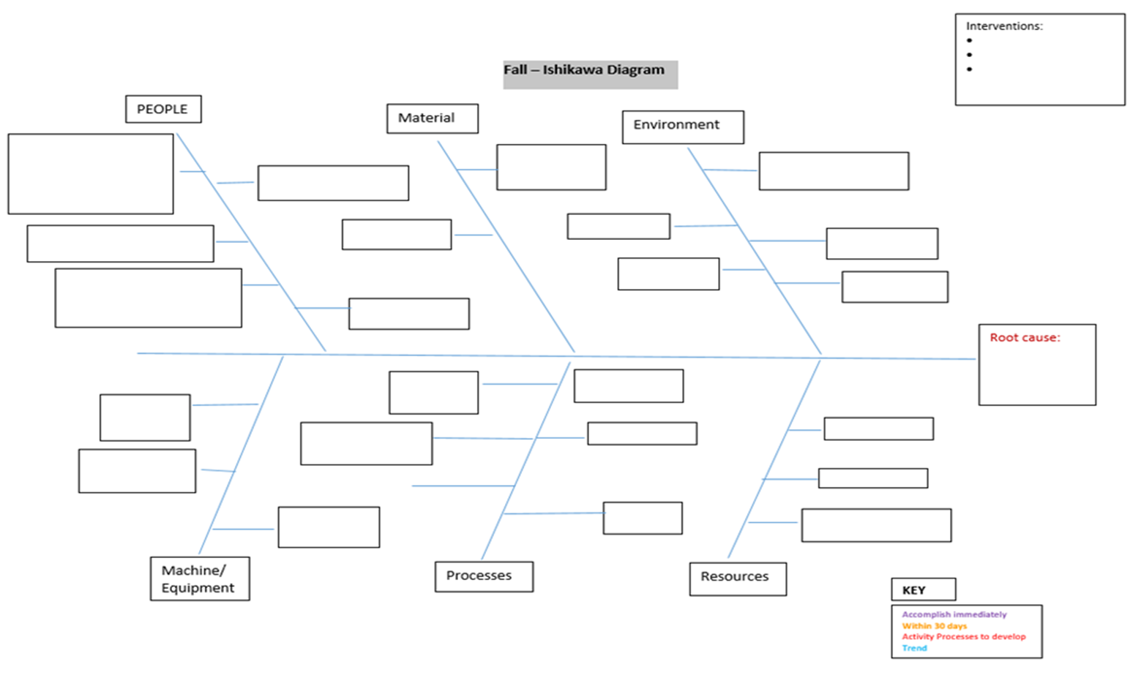
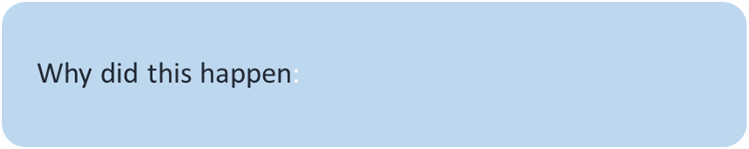
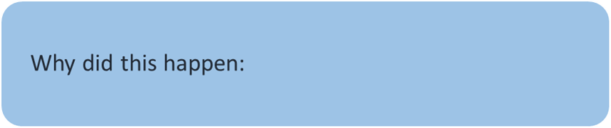
Types of root cause analysis tried
5 whys
Ishikawa Diagram
Notes:
One of the areas that was challenging for me as the Quality Coordinator was to find a way to do root cause analysis that was easy to see what the root cause was. As well as understand what a root cause analysis was. I tried two different root cause analysis. The 5 WHYs and the Ishikawa. These are the two types of root cause analysis that was utilized. 5 whys – What happen to begin with? Why did this happen? Why did this happen?.... so forth until you come to the cause.—This did not come easy to me. TCHS had a Quality Consultant come in and one of the things she taught me was how to do the Ishikawa diagram also known as the fishbone diagram. I like the sound of Ishikawa better than fishbone. This is what I found to be the easiest and made it easy for the staff to see the root cause as well. I liked the Ishkawa.

Slide 11
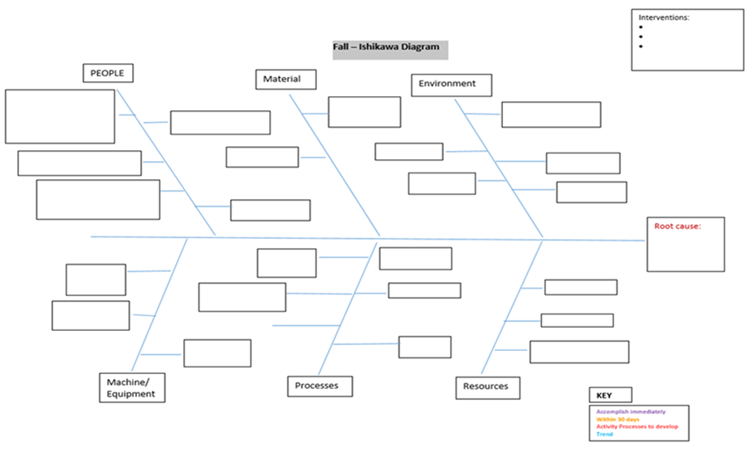
Notes:
This is a big picture of it. What you do is start with the patient and tell the story of what happen it includes history and events prior to the fall.
Machines and equipment that was utilized for the patient Process that were or were not completed. Materials is where I would place medications that was given before and after a fall. Environment surrounding the patient’s falls as well as census and staff available at the time. Resources could be sitters, other staff involved that can shred information to the root cause.

Slide 12
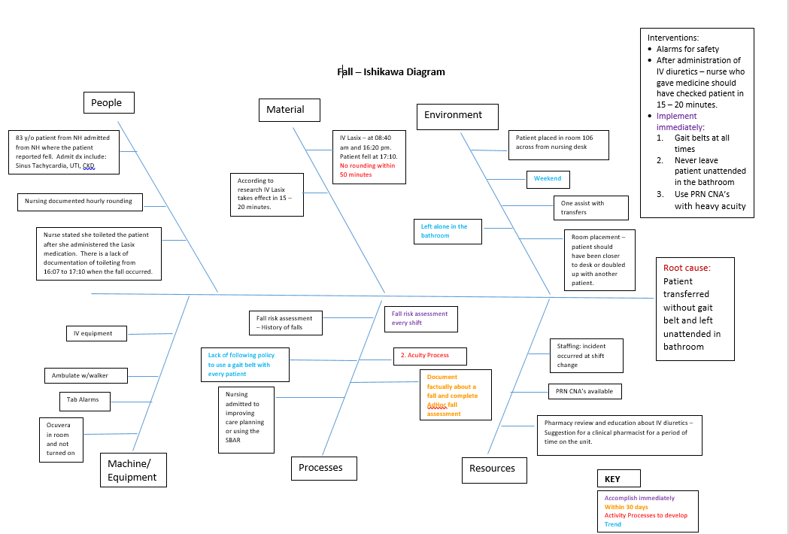
Notes:
After filling it out, step back and see what seems to stand out most. As you can see, there is a key at the bottom. This is to help color code the interventions used or needed. It also helps to trend areas that have occurred in other falls as well.

Slide 13
EVALUATION OF INTERVENTIONS: What works?
Notes:
Once the root cause analysis is completed, evaluating interventions that were in place and the ones not in place helps to plan and implement change and hopefully prevent other falls.

Slide 14
Interventions:
Standardized Fall Definition
Initiated a fall prevention team
Initiated new process at admission to identify high risk patients utilizing the Morse Fall Scale
Utilized Morse Fall Scale to determine interventions to put into place at admission
Completed Morse Fall Scale every shift and adjusted interventions as needed
Conducted audits to ensure process was working. Audits led to increased compliance with process as Nursing Supervisor went directly to nurse regarding interventions needed
Initiated Ocuvera Camera System - new upgrades to system enabled better monitoring
Entered into the Fall cohort for HQIC with CAPTURE FALLs through UNMC
Initiated Wipe off boards for therapy communication/nursing communication
Notes:
Once the staff understood the definition of a fall, we saw that the falls went up because we were capturing all falls not just the ones that happened without being witnessed.
The fall prevention team became a good avenue for developing new fall prevention ideas.
It was determined that the Morse Fall Scale was completed at admission but nothing was done with the information. The Nurse Champion took it and developed interventions for each level. This provided a guide for possible interventions to put in place for a patient upon admission.
The Morse fall scale was then to be completed at the beginning of each shift and interventions adjusted according to the score.

Slide 15
Morse Fall interventions
Notes:
This is an example of how to apply the Morse Fall score to interventions. We encourage our nurses to make this more personal for each patient. This was also re-evaluated each shift and interventions adjusted according the Morse Fall Score.

Slide 16
Evaluation of process change
Auditing of each fall for interventions put into place and review of each fall in fall huddle
Audit fall interventions of all patients
Visit with staff regarding interventions that weren’t in place when audited
Ocuvera Camera updated to better alert staff when patient was moving to get out of bed or chair
Fall prevention team met after each fall
Notes:
To ensure that the process was in place and working, Quality and the Nursing Supervisor completed daily audits of all patients to ensure that all portions of the process were completed. If not completed, it was taken to the nurse at that time to correct.
In 2021, TCHS was able to obtain Ocuvera cameras and in 2022 a new update allowed for better monitoring of the patient

Slide 17
Fall prevention team
Team Members:
  Quality Coordinator
  Nursing Supervisor
  Therapy Representative
  Care Management
  Nursing Representative
  Patient Family Advisory Council Member
  Pharmacy Representative
Notes:
The Fall Prevention Team was created in early 2021. This team was created with an interdisciplinary focus. It included Therapy, Nursing, Social Services, Quality, and a Representative from our Patient Family Advisory Council. This team met after every fall to discuss the interventions that were in place and ones that were not.

Slide 18
Goals of fall Prevention team
Identify preventative strategies
Identify resources needed- equipment, ect.
Develop process to ensure proactive interventions
Review all fall root analysis for consistencies
  Positive
  Negative
Notes:
The goal of the team was to proactive in identifying interventions and resources to assist in providing a safe environment for patients.
During team meetings, not only was interventions discussed but all root cause analysis were reviewed for consistencies whether negative or positive in nature.

Slide 19
Culture change:
  Nurses are more aware of patient safety
  Interventions are put into place upon admission
  Morse Fall Scale is completed every shift and interventions adjusted
  Staff are eager to develop new interventions to protect patients- toilet alarm
  Request need for new cushions, non-slip mats, and other equipment needed for patients
Notes:
By the end of 2021, there was a different atmosphere (change in Culture) among the staff regarding falls and fall prevention. With this change in the culture, the number of falls decreased. Data showed that interventions were now put in place at admission, Morse Fall Scores were completed every shift and interventions were being adjusted. Staff became more involved in fall prevention with providing ideas and recommendations to help keep patients safe.

Slide 20
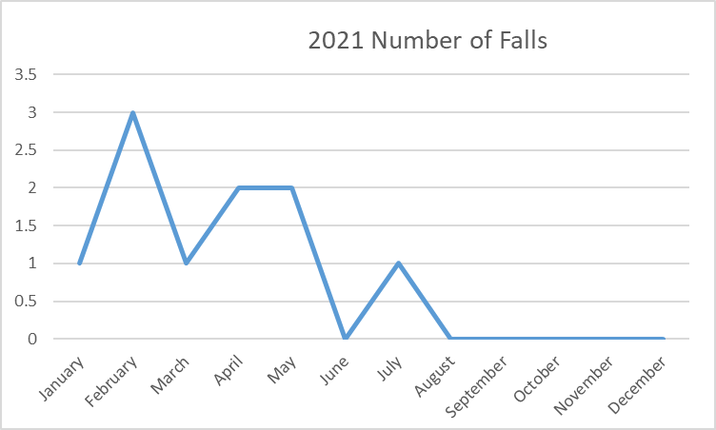
Data for 2021 and 2022
Notes:
As the data shows, TCHS went for over 365 days with a fall in the inpatient setting.

Slide 21
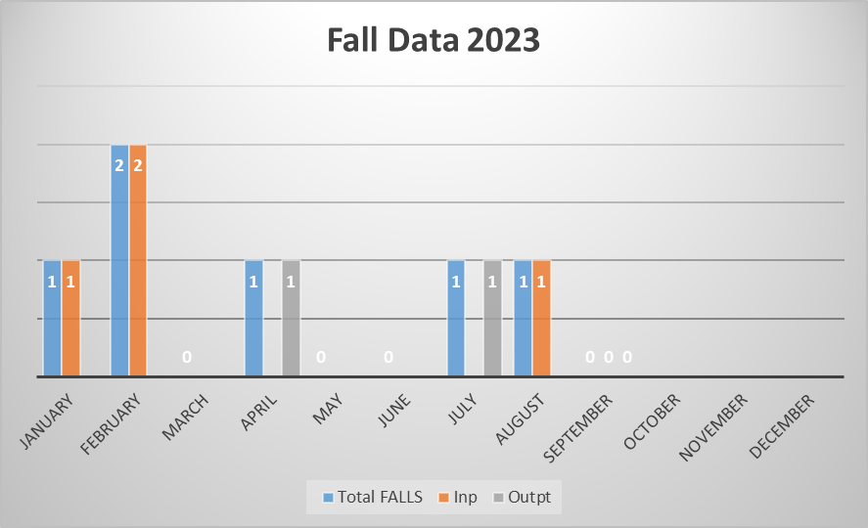
Notes:
When we addressed the falls with the staff, Nurses indicated that they had slid back into not following the process. They recognized that the process works when it is followed. We then started doing more audits and training with the staff on the process to help get back on track. This is the data for 2023. We are now tracking all falls including outpatient/visitor falls.

Slide 22
What is next to continue the story of fall prevention ?
Age Friendly—What matters to the patient, Safe Mobility, Medications, Mentation
  These all can impact the risk of a patient falling
  Addressing these also reduces the risk of “Falling Stars”
Pharmacy rounding/counseling of all patients
Interdisciplinary team meetings with all patients
Ensuring patient safety and quality of care is everyone’s responsibility.
Notes:
As we continue to strive to keep our patients safe, we look to other process to help in that endeavor such as Age Friendly- Safe mobility, Medications, Mentation, and What really matters to the patient. Age Friendly assists in fall prevention by encouraging safe mobility, ensuring medications are appropriate for the patient. Often times sides effects of medications can cause falls when not appropriately taken. A Patient’s mentation can also affect their ability to understand their surroundings. A lack of understanding of surrounding could lead to a fall.
Pharmacy is now rounding with all patients that are admitted to the inpatient area to assist in medication education and ensuring the patient is on the correct medication.
IDT meetings for all patients that are in the facility for more than 48 hours. This assist in a better understand of the patient and their needs as well as in discharge planning and safety of the patient.
Continued education of all staff and new hire staff to ensure that all understand that patient safety and quality of care is everyone’s responsibility.

Slide 23
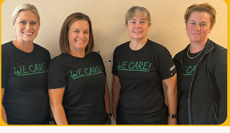
Quality department:
Safety Coordinator
Infection Preventionist
Quality Coordinator
Quality Liaison
We are passionate about improving processes facility wide so that TCHS continues to provide care that is safe, efficient, and patient-centered.
Notes:
This project would not have been successful if it wasn’t for the amazing staff at TCHS and the Quality department that provided support and encouragement to the staff. The Quality department has expanded in the last 3 years from 2 to 4 individuals who are passionate about improving processes, ensuring patient safety, and providing quality care through ensuring process improvement. I want to thank this amazing team and staff of TCHS for the support and assistance they have given over the last 3 years in the fall prevention project.

Slide 24
Questions or Comments?

Slide 25
resources
CAPTURE FALLS with UNMC
Morse Fall Score
Intervention List-TCHS

Slide 26
Stephanie Moody, RN
Quality Coordinator
Thayer County Health Services
120 Park Ave.
Hebron ,NE 68370
402-768-4629
smoody@tchsne.org

