Slide 1
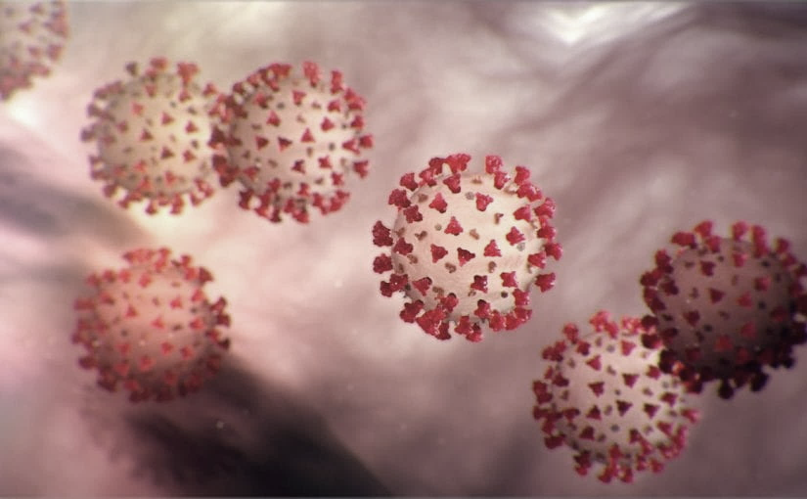
Covid-19 Webex Update 7-8-20
Tom Safranek, MD, State Epidemiologist
Louis Safranek, MD, PhD,
Board certified specialist, Infectious Disease

Slide 2
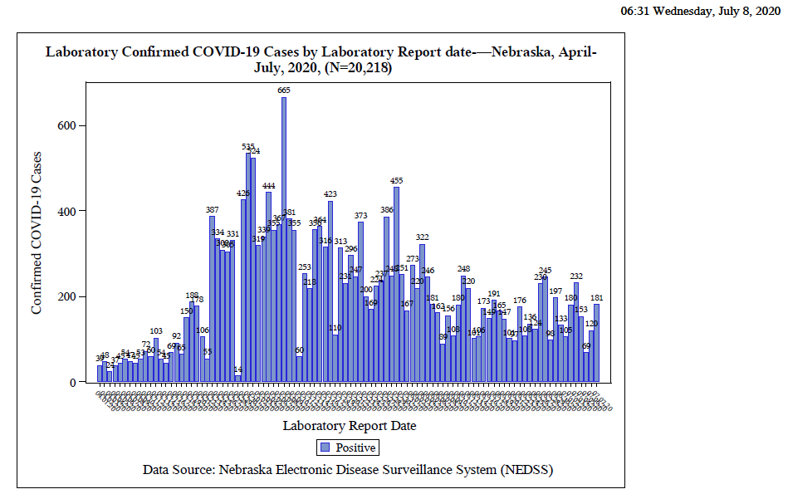
Notes:
Add the title of your presentation, your division, name, etc.

Slide 3
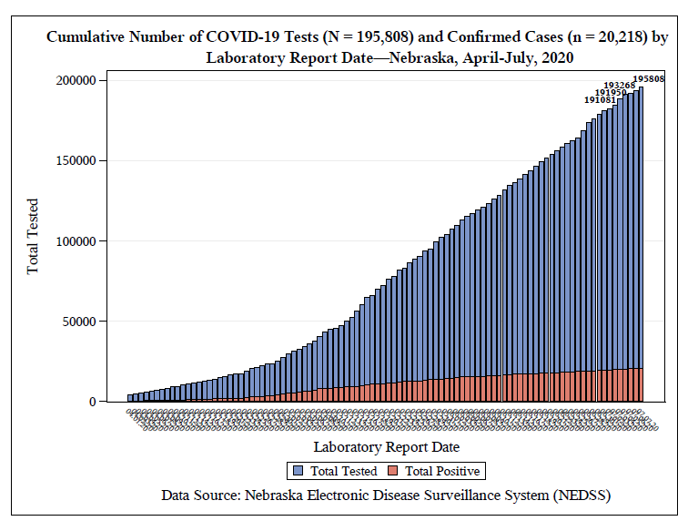
Notes:
Add the title of your presentation, your division, name, etc.

Slide 4
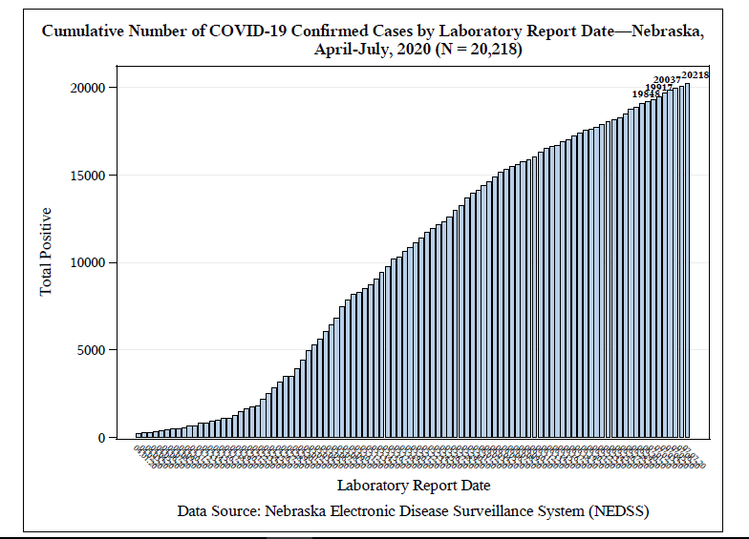
Notes:
Add the title of your presentation, your division, name, etc.

Slide 5
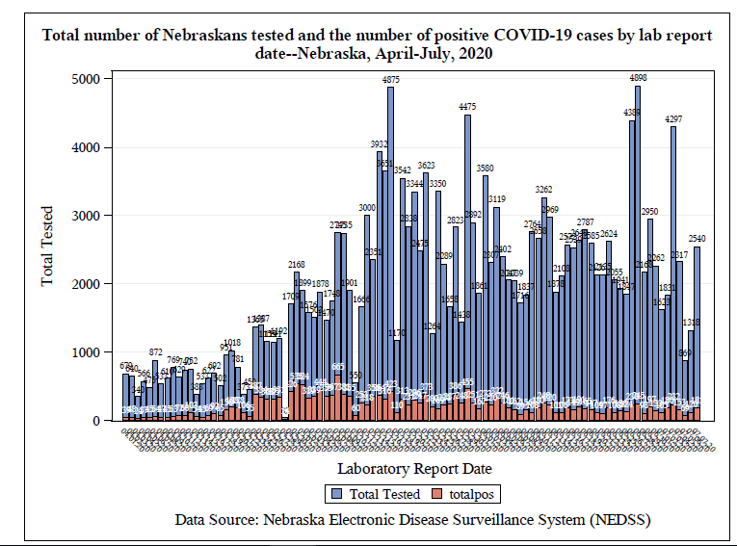
Notes:
Add the title of your presentation, your division, name, etc.

Slide 6
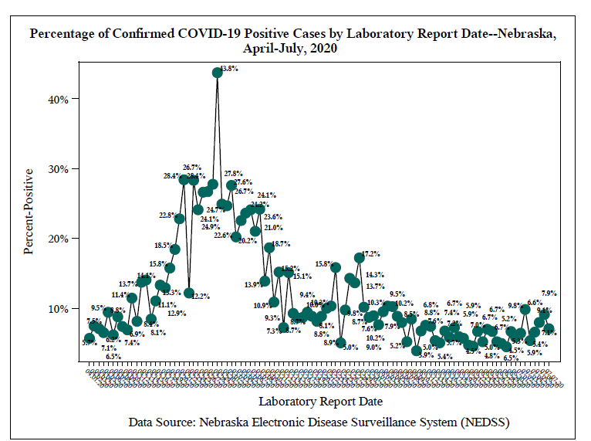
Notes:
Add the title of your presentation, your division, name, etc.

Slide 7
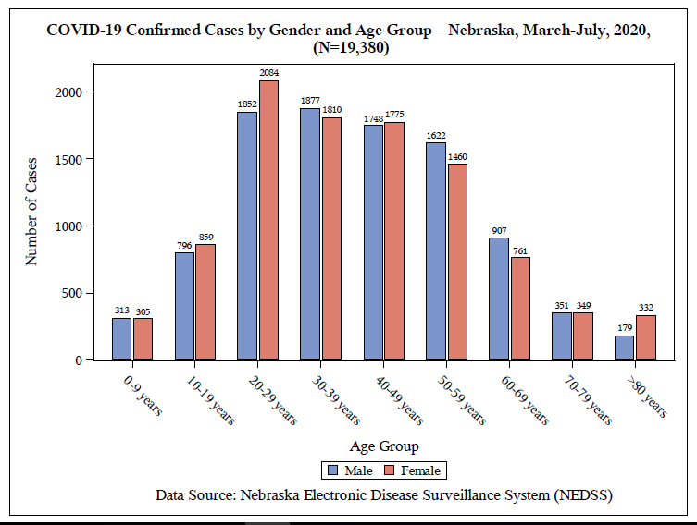
Notes:
Add the title of your presentation, your division, name, etc.

Slide 8
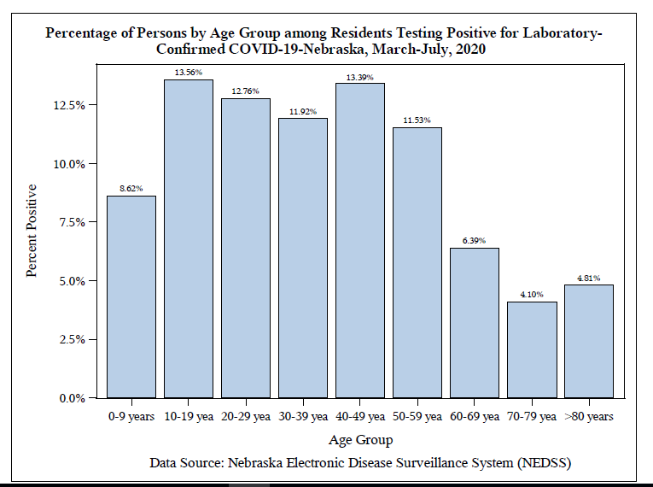
Notes:
Add the title of your presentation, your division, name, etc.

Slide 9
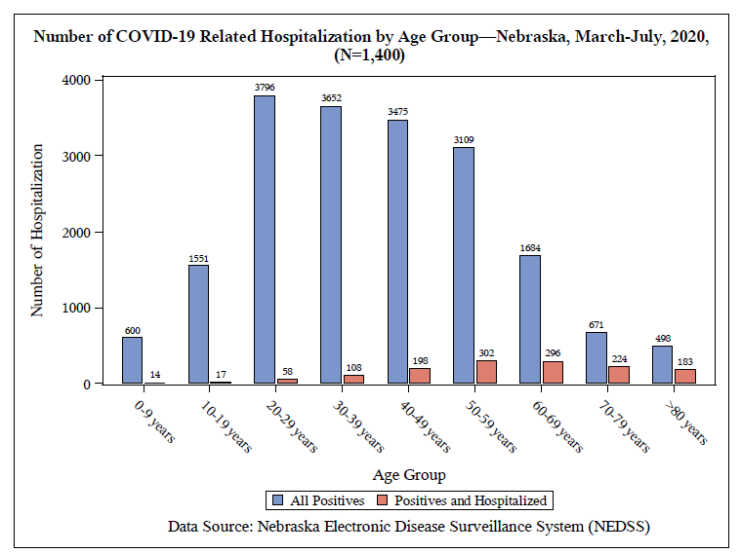
Notes:
Add the title of your presentation, your division, name, etc.

Slide 10
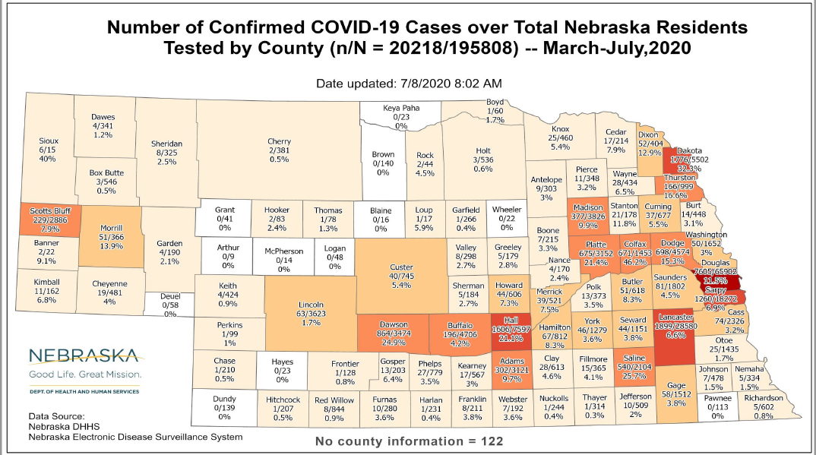
Notes:
Add the title of your presentation, your division, name, etc.

Slide 11
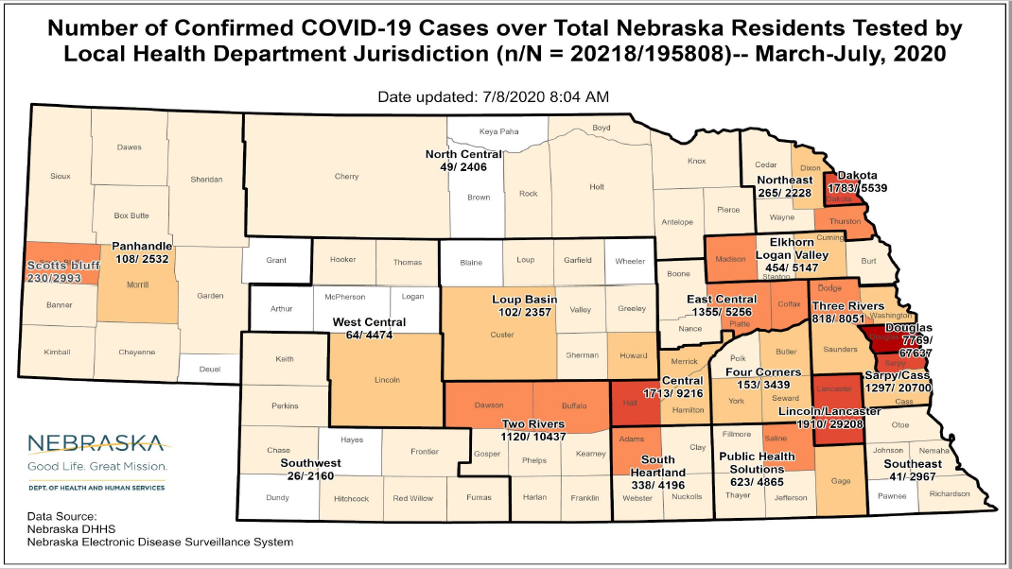
Notes:
Add the title of your presentation, your division, name, etc.

Slide 12
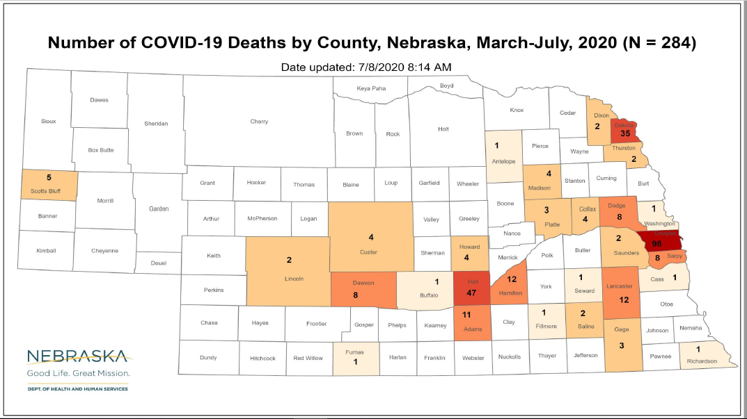
Notes:
Add the title of your presentation, your division, name, etc.

Slide 13
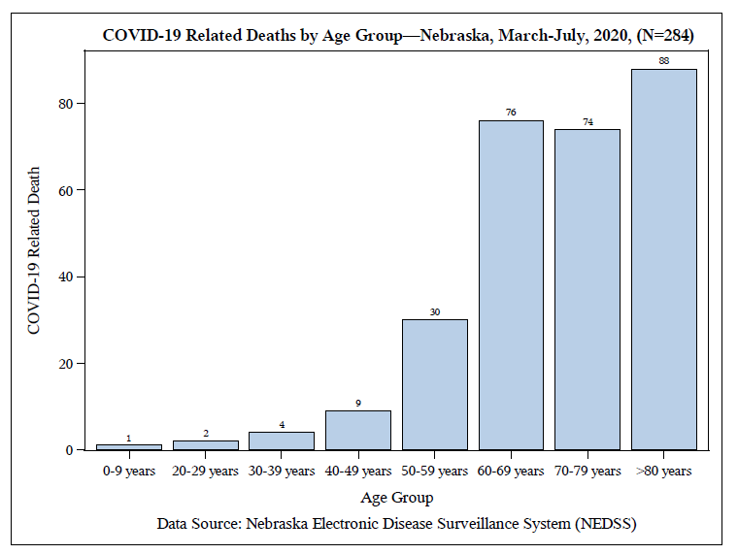
Notes:
Add the title of your presentation, your division, name, etc.

Slide 14
Long Term Care Facilities
Notes:
Add the title of your presentation, your division, name, etc.

Slide 15
Face masks, etc.
Papers continue to argue for the efficacy of face masks, as we have discussed over the past month
Identifying airborne transmission as the dominant route for the spread of COVID-19
“"Our analysis reveals that the difference with and without mandated face covering represents the determinant in shaping the pandemic trends in the three epicenters.”

Slide 16
Other measures less helpful
This protective measure [wearing face masks] alone significantly reduced the number of infections, that is, by over 78,000 in Italy from April 6 to May 9 and over 66,000 in New York City from April 17 to May 9.
Other mitigation measures, social distancing, quarantine, and contact tracing, while helpful, are insufficient by themselves to protect the public.
https://doi.org/10.1073/pnas.2009637117 https://www.pnas.org/content/early/2020/06/10/2009637117

Slide 17
Returning to School
COVID-19 Planning Considerations: Guidance for School Re-entry
The AAP strongly advocates that all policy considerations for the coming school year should start with a goal of having students physically present in school.
Policy makers must also consider the mounting evidence regarding COVID-19 in children and adolescents.
SARS-CoV-2 appears to behave differently in children and adolescents than other common respiratory viruses. Although children and adolescents play a major role in amplifying influenza outbreaks, to date, this does not appear to be the case with SARS-CoV-2.
https://services.aap.org/en/pages/2019-novel-coronavirus-covid-19-infections/clinical-guidance/covid-19-planning-considerations-return-to-in-person-education-in-schools/

Slide 18
Transmission in schools
Novel Coronavirus 2019 Transmission Risk in Educational Settings [Singapore]
Our investigations, especially in preschools, could not detect SARS-CoV-2 transmission despite screening of symptomatic and asymptomatic children. The data suggest that children are not the primary drivers of SARS-CoV-2 transmission in schools and could help inform exit strategies for lifting of lockdowns.
https://doi.org/10.1093/cid/ciaa794

Slide 19
How will we test?
Batch testing if the prevailing incidence is low.
Oropharyngeal testing:
Saliva is a reliable tool to detect SARS-CoV-2 by nCoV-DK.
The nCoV-DK effectively detects SARS-CoV-2 in all types of samples including saliva, while reducing time required for detection, labor, and risk of human error.
nCoV-DK halves SARS-CoV-2 detection time by eliminating RNA extraction and purification.
nCoV-DK detects SARS-CoV-2 as effectively as the direct PCR.
doi: 10.1016/j.ijid.2020.06.074

Slide 20
Oropharyngeal/saliva testing
Oropharyngeal Secretion as Alternative for SARS-CoV-2 Detection
Results of the present study are supportive of the notion that OS sampling improves the accuracy of SARS-CoV-2 nucleic acid testing.
https://doi.org/10.1177/0022034520940292

Slide 21
Saliva testing may be useful
Deep throat saliva as an alternative diagnostic specimen type for the detection of SARS-CoV-2
The rates of detection for DTS (53.7%) and NPS (47.4%) samples were comparable (P = 0.13).
https://onlinelibrary.wiley.com/doi/epdf/10.1002/jmv.26258
DOI: 10.1002/jmv.26258

Slide 22
Treatments
Hydroxychloroquine may be efficacious.
Treatment with Hydroxychloroquine, Azithromycin, and Combination in Patients Hospitalized with COVID-19
Hydroxychloroquine provided a 66% hazard ratio reduction, and hydroxychloroquine + azithromycin 71% compared to neither treatment (p < 0.001).
Our results suggest that hydroxychloroquine may have an important role to play in reducing COVID-19 mortality.
Int J Infect Dis. 2020 Jul 2 ,doi: 10.1016/j.ijid.2020.06.099
PMID: 32623082

Slide 23
Dexamethasone
Corticosteroid in use since the early 1960’s.
30x active as cortisone, about 5x as active as prednisone or methylprednisolone.
Used in other infections, e.g., meningitis due to tuberculosis.
It may be of some benefit in covid-19
Effect of Dexamethasone in Hospitalized Patients with
COVID-19 – Preliminary Report
6 mg per day
https://www.medrxiv.org/content/10.1101/2020.06.22.20137273v1.full.pdf
Dexamethasone for the Treatment of Tuberculous Meningitis in Adolescents and Adults N Engl J Med 2004; 351:1741-1751 DOI: 10.1056/NEJMoa040573 0.4 mg/kg/day for 1 week, then taper slowly

Slide 24
Preexisting immune protection
Here, we describe an assay that allows direct detection and characterization of SARS-CoV-2 spike glycoprotein (S)-reactive CD4+ T cells in peripheral blood. We demonstrate the presence of S-reactive CD4+ T cells in 83% of COVID-19 patients, as well as in 34% of SARS-CoV-2 seronegative healthy donors (HD).
https://www.medrxiv.org/content/10.1101/2020.04.17.20061440v1.full.pdf

Slide 25
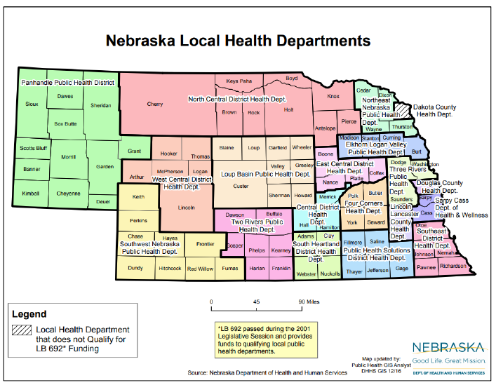

Slide 26
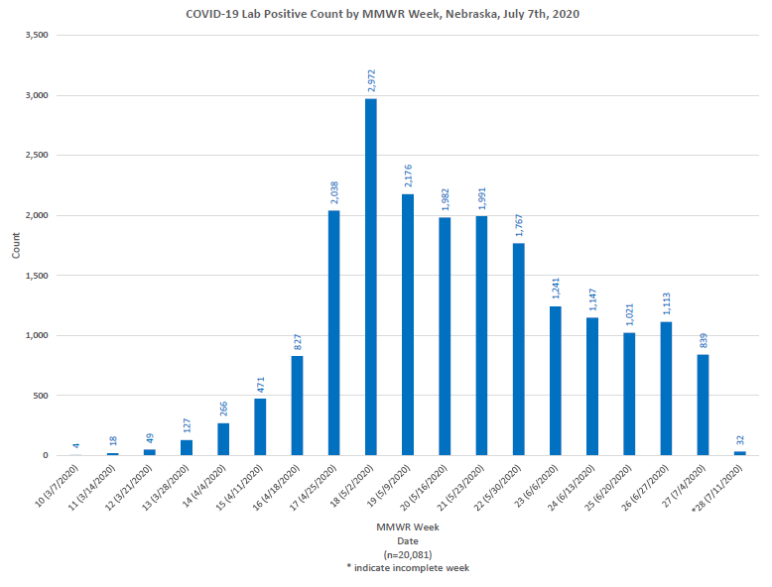
Notes:
Add the title of your presentation, your division, name, etc.

Slide 27
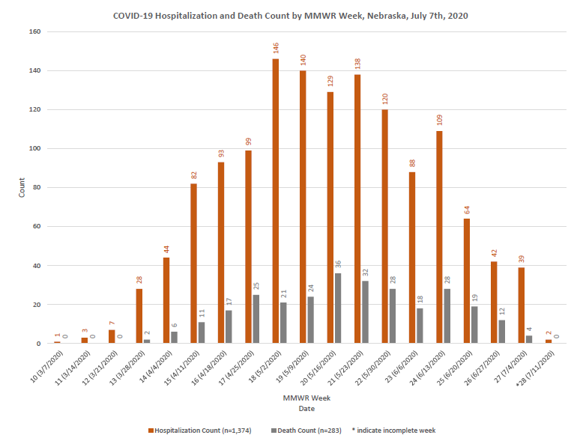
Notes:
Add the title of your presentation, your division, name, etc.

Slide 28
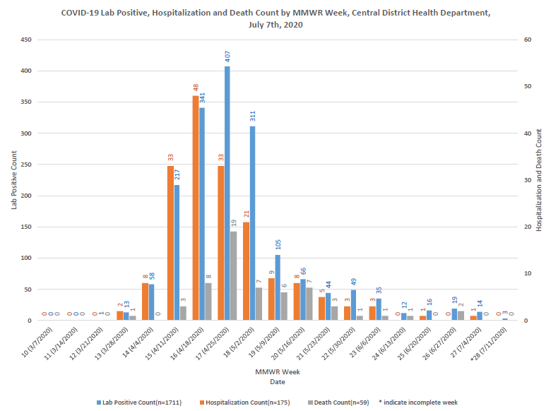
Notes:
Add the title of your presentation, your division, name, etc.

Slide 29
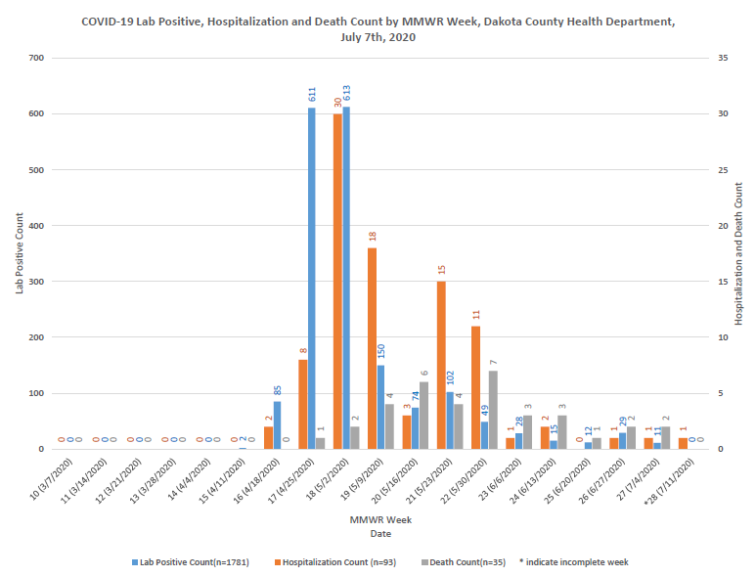
Notes:
Add the title of your presentation, your division, name, etc.

Slide 30
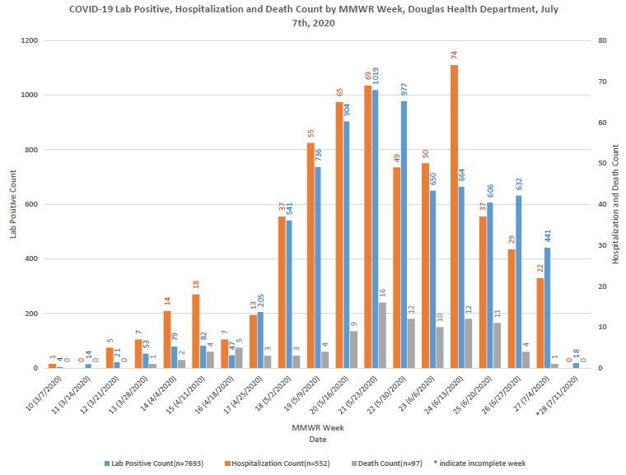
Notes:
Add the title of your presentation, your division, name, etc.

Slide 31
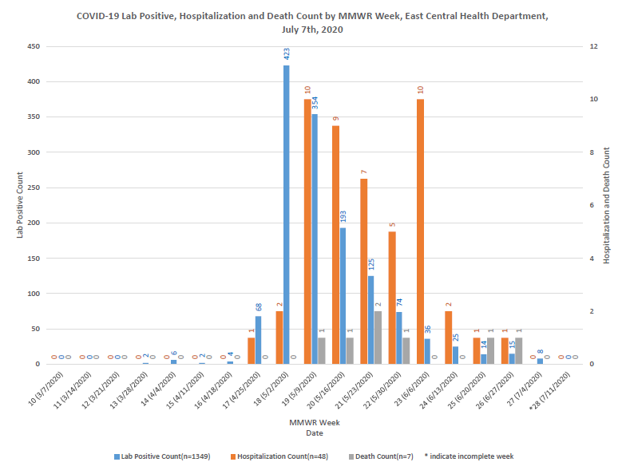
Notes:
Add the title of your presentation, your division, name, etc.

Slide 32
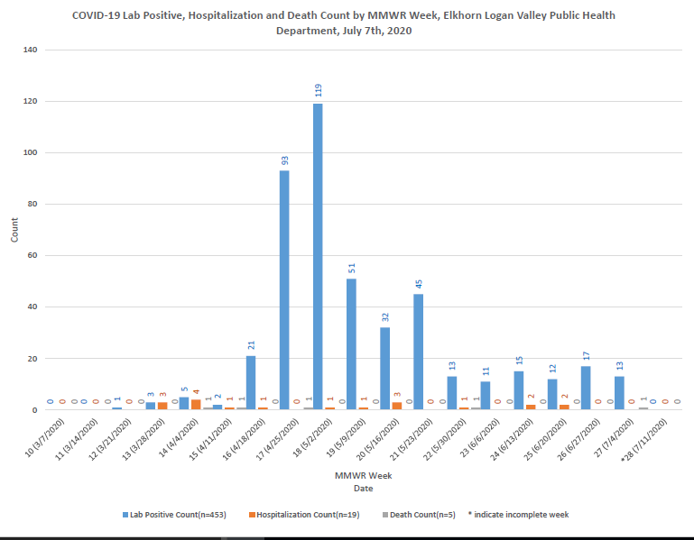
Notes:
Add the title of your presentation, your division, name, etc.

Slide 33
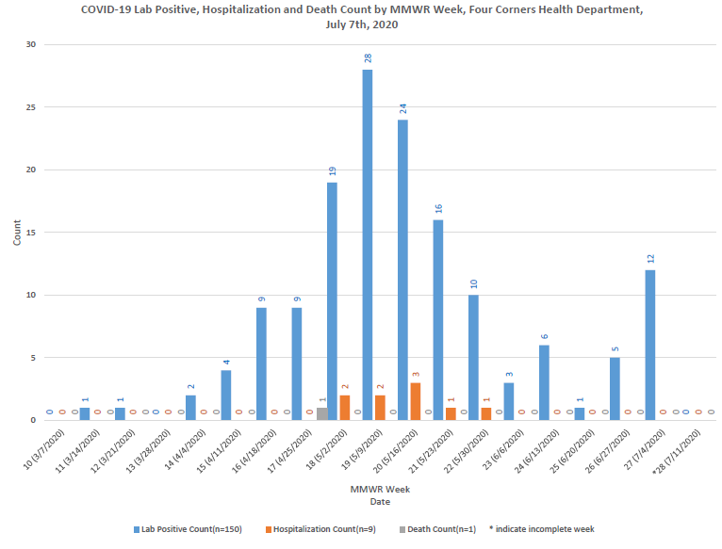
Notes:
Add the title of your presentation, your division, name, etc.

Slide 34
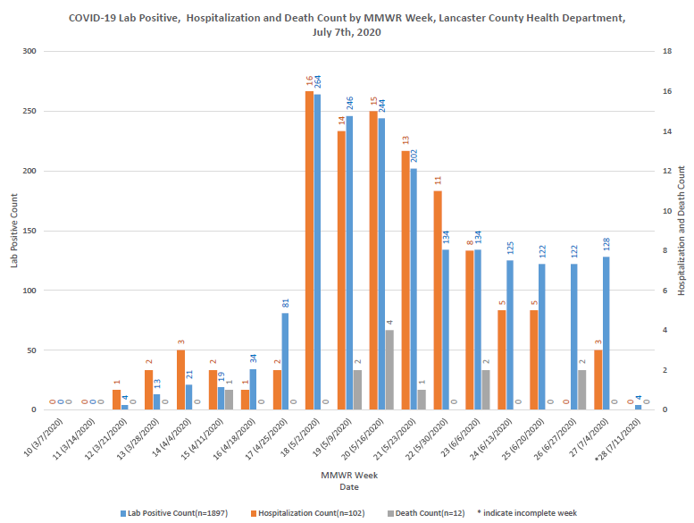
Notes:
Add the title of your presentation, your division, name, etc.

Slide 35
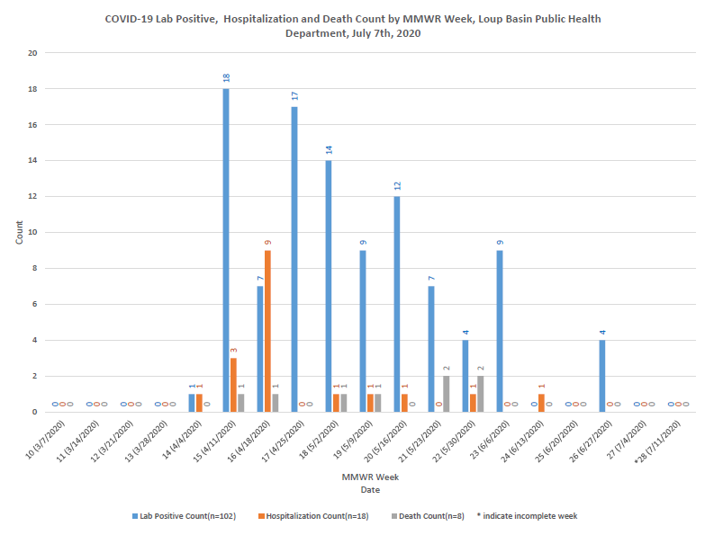
Notes:
Add the title of your presentation, your division, name, etc.

Slide 36
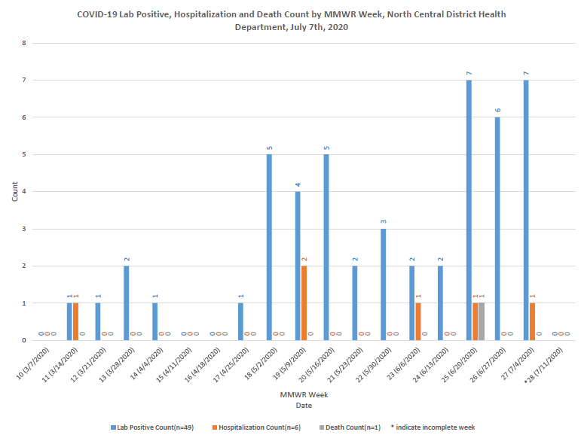
Notes:
Add the title of your presentation, your division, name, etc.

Slide 37
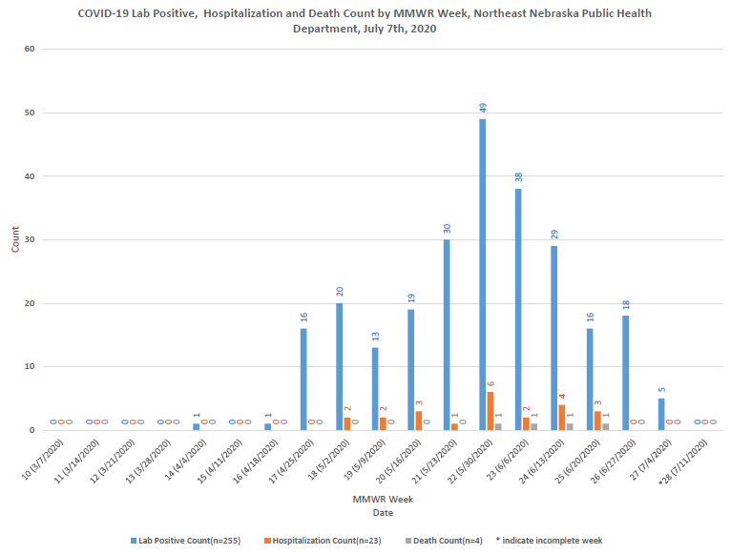
Notes:
Add the title of your presentation, your division, name, etc.

Slide 38
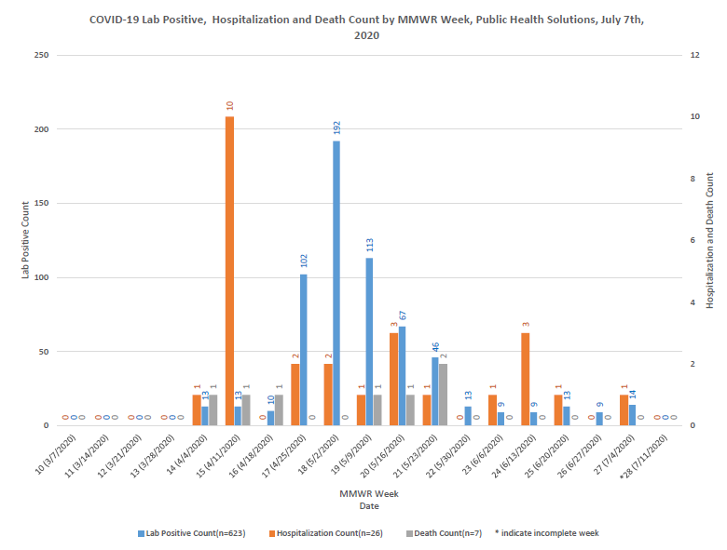
Notes:
Add the title of your presentation, your division, name, etc.

Slide 39
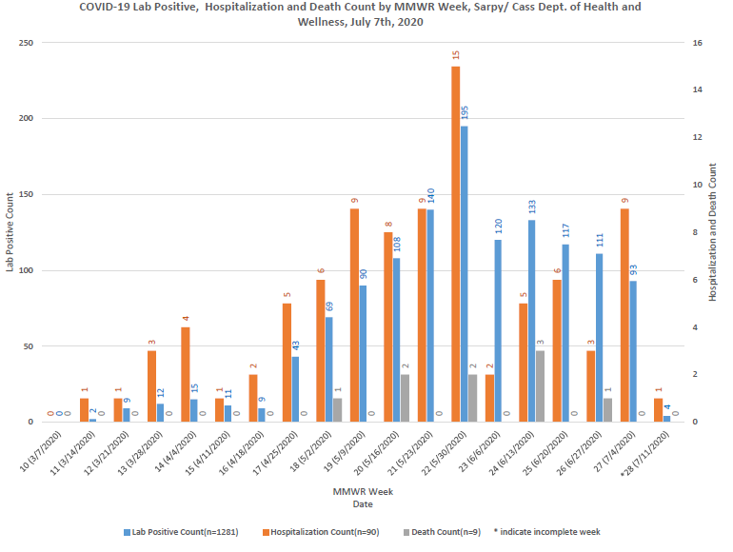
Notes:
Add the title of your presentation, your division, name, etc.

Slide 40
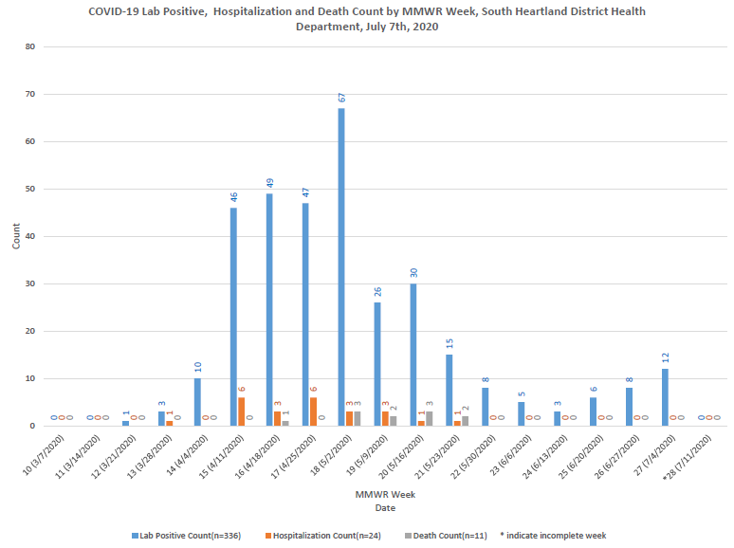
Notes:
Add the title of your presentation, your division, name, etc.

Slide 41
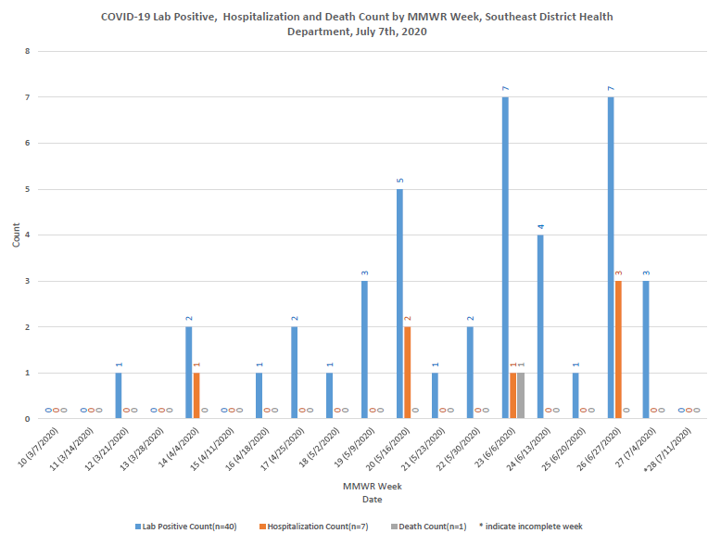
Notes:
Add the title of your presentation, your division, name, etc.

Slide 42
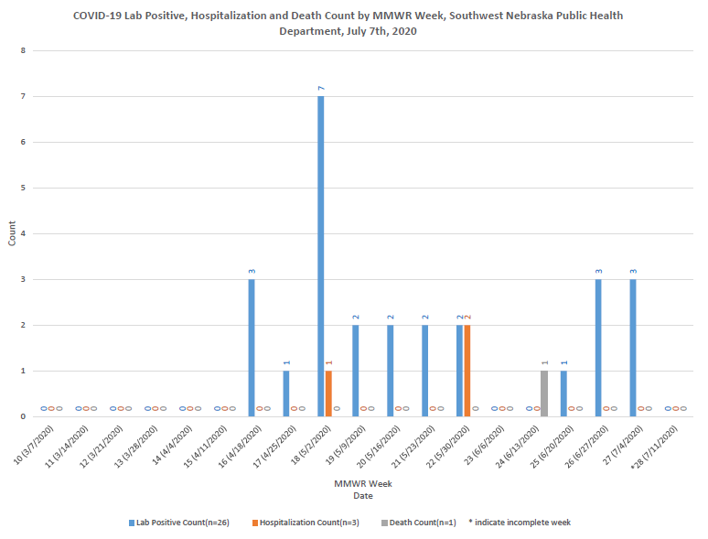
Notes:
Add the title of your presentation, your division, name, etc.

Slide 43
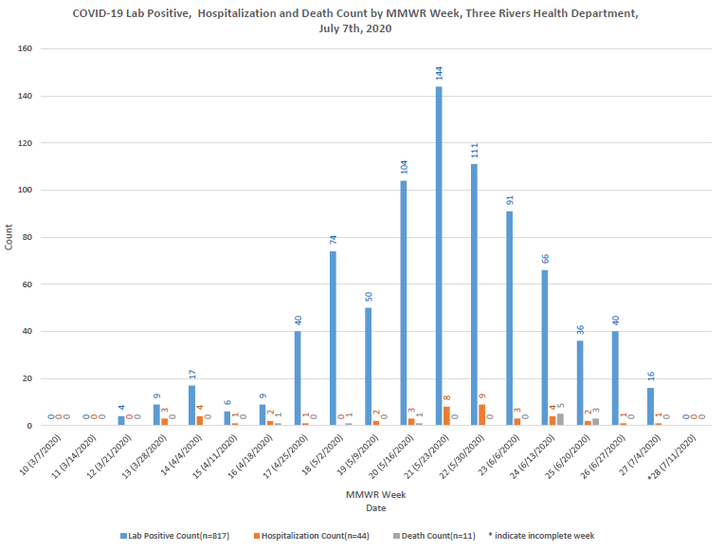
Notes:
Add the title of your presentation, your division, name, etc.

Slide 44
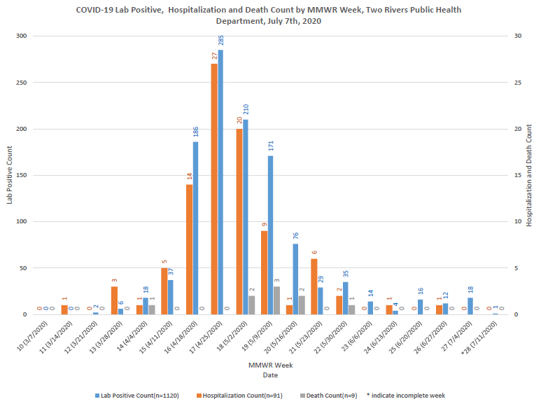
Notes:
Add the title of your presentation, your division, name, etc.

Slide 45
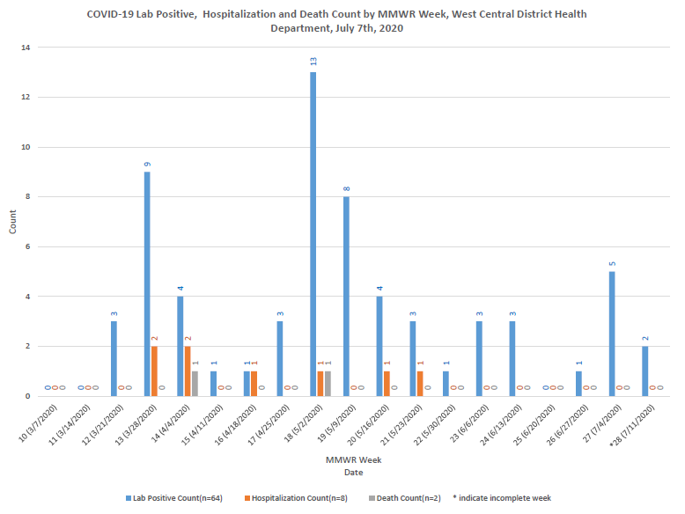
Notes:
Add the title of your presentation, your division, name, etc.

Slide 46
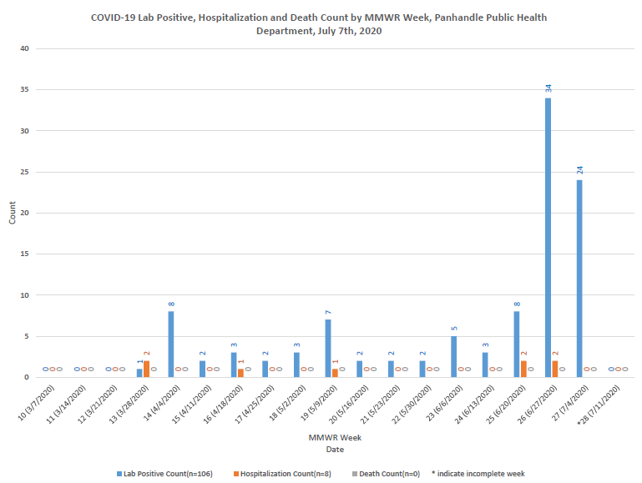
Notes:
Add the title of your presentation, your division, name, etc.

Slide 47
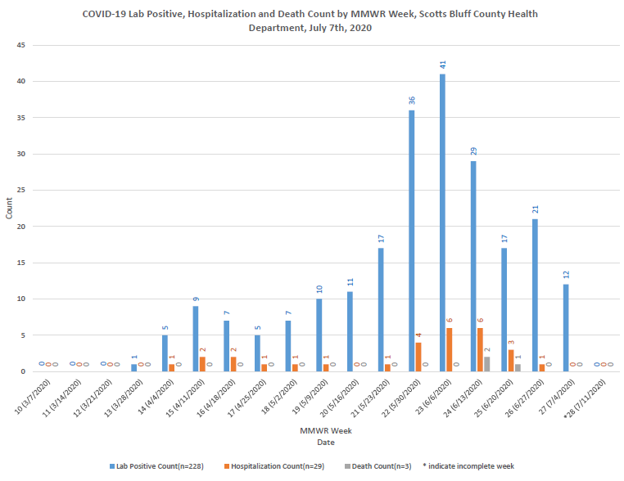

Slide 48
