Slide 1



June 4, 2024
John F. Burns, CPMA, CPC, CEMC, CH-CBS, RH-CBS
Vice President, Audit & Compliance, Arch Pro Coding
jburns@ArchProCoding.com

Slide 2


Instructor
John F. Burns, CPMA, CPC, CEMC, CH-CBS, RH-CBS
Vice President, Audit & Compliance, Arch Pro Coding
jburns@ArchProCoding.com

Slide 3

Coding and billing are not the same!
Coding turns medical documentation into useable data regardless of whether it generates revenue or not.
Professional coding guidelines related to CPT and ICD-10-CM codes apply equally to all types of medical facilities.
Just because you got paid doesn’t mean you get to keep the money.
+
Just because you didn’t get paid doesn’t mean you did it wrong.
Predicting varying commercial insurance and Medicaid billing rules is very tricky especially since some payers see us as traditional physician offices rather than a RHC.
We will, therefore, focus on CMS/Medicare RHC billing rules since they can be taught at a national level. Expect variations and different billing codes and reimbursement rules!

Slide 4





Our Common Path
GREET THE PATIENT:
How does insurance type impact which claim form we use, patient cost sharing, and our revenue?
CODE THE FULL ENCOUNTER:
Manage the links between the medical record and “encounter form” using “line by line” HCPCS reporting, regardless of whether it generates revenue or not
.
TREAT AND DOCUMENT THE VISIT:
Understand the guidelines described in CPT, HCPCS-II, ICD-10-CM manuals and payer documentation requirements
CONFIRM DOCUMENTATION AND BILL:
Bill based on payer specifics and quality reporting standards.
PREPARE FOR PATIENT VISITS:
Are you truly ready to handle the advanced issues of operating in a RHC?

Slide 5

Section Overview
RHC Foundations
HIPAA Required Code Sets
Which HIPAA-approved code sets do we need to be aware of working in a RHC?
How RHCs/FQHCs are Different
Why do some insurance companies enroll us as a regular FFS “office” while Medicare/Medicaid expect us to operate under the very different billing requirements of RHCs?
Key CMS Resources to Monitor
Being fully aware of the content of key CMS manuals such as Chapter 13 of the Benefits Policy Manual and Chapter 9 of the Claims Processing manual is crucial!
CMS Valid Encounters
In order to generate a RHC’s All-inclusive Rate (AIR), it is vital to know how the billing rules differ from traditional commercial insurance.
Qualifying Visit List
In RHCs the QVL is intended to be used as a guide. It is NOT an exhaustive list of services the trigger AIR payments

Slide 6

HIPAA Required Code Sets
Using the manuals vs. software
AMA’s Current Procedural Terminology (CPT) Level I code set has 3 categories
CPT Category I codes identify services performed in all medical settings that are 5-digit numeric codes (99214) or 2-digit modifiers (ex. -59).
CPT Category II codes are used for performance measurement (ex. xxxxF) and are often required by managed care companies to report “quality reporting.”
Category III codes for emerging technologies (ex.xxxxT) that may one day become CPT I code and are not typically associated with RHC/FQHC.
Per the CPT Introduction section - Just because there is a code in the CPT it “does not imply any health insurance coverage or reimbursement policy.”

Slide 7

CPT Category I Codes
CPT Category II Codes
Introduction
Evaluation and Management (99xxx)
  Know the rules and new E/M guidelines!
Anesthesia (0xxxx)
Surgery (1xxxx – 6xxxx)
  Varying surgical package definitions change billing!
  For the Billing section – be prepared to review Ch.13 CMS Benefits Policy Manual, Section 40.4
Radiology (7xxxx)
Pathology and Laboratory (8xxxx)
Medicine (9xxxx)
Appendix A-O – check out A for modifiers and B for changes
Alphabetic Index – never code from the index!
  Ex. Appendix A = Modifiers
  Ex. Appendix B = 2024 changes and updates
  There are several more!
Modifiers – 1P, 2P, 3P, 8P
Composite Measures 0001F – 0015F
Patient Management 0500F – 0575F
Patient History 1000F – 1220F
Physical Examination 2000F – 2050F
Diagnostic/Screening Processes/ Results 3006F – 3573F
Therapeutic, Preventive, or Other Interventions 4000F – 4306F
Follow-Up or Other Outcomes 5005F – 5100F
Patient Safety 6005F – 6045F
Structural Measures 7010F – 7025F

Slide 8




Access your CMS Fact Sheets to get the basics
Also - go to www.CMS.gov >
Medicare> Provider Type>
scroll down to RHC or FQHC and bookmark it for periodic updates and access to wonderful resources all in one place!
Last known update – September 2023
Last known update – August 2023

Slide 9
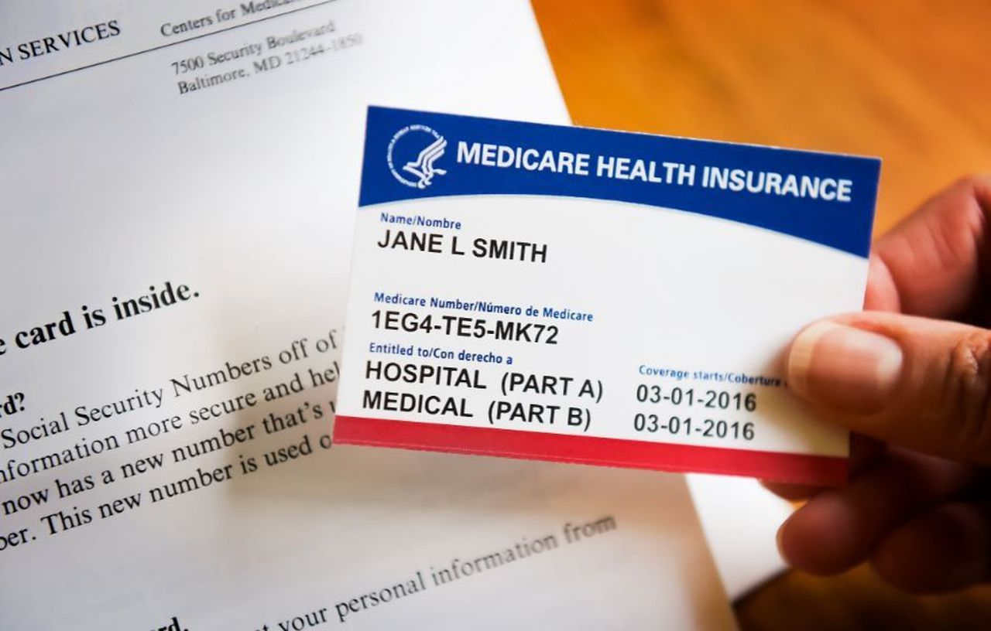
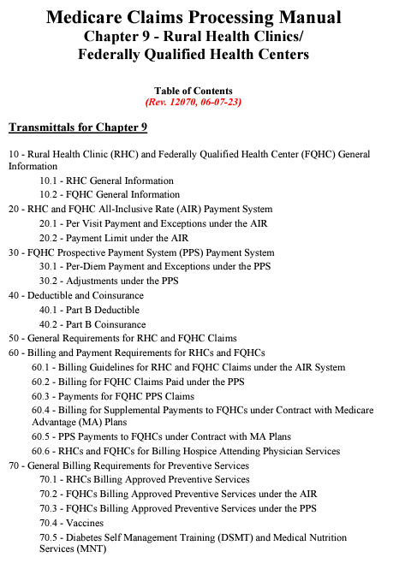
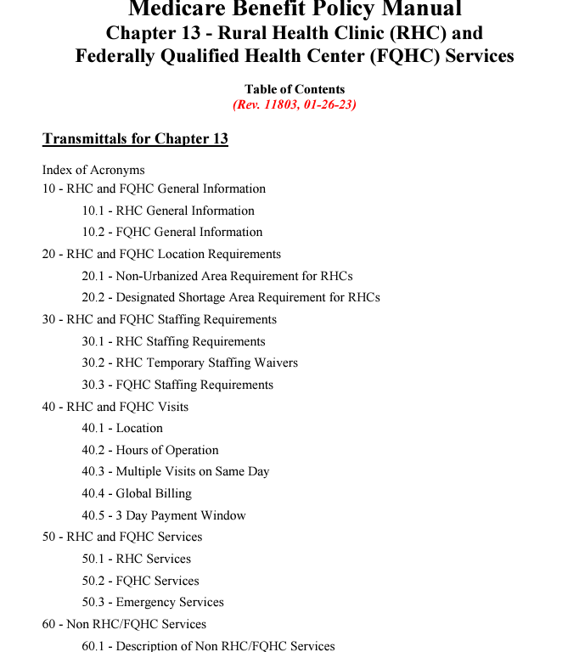


Key CMS References for RHCs
Chapter 9 - CMS Claims Processing Manual
Chapter 13 - CMS Benefits Policy Manual

Slide 10

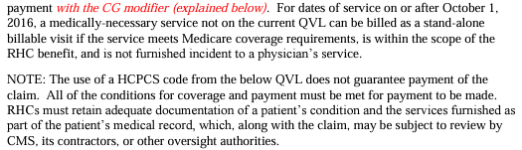
Rural Health Clinic
Medicare Facts
Medicare does not have a RHC “qualifying visit list” officially active that identifies all possible services that are allowable to be billed in a RHC to get your AIR. Several versions were released throughout 2016, but effective October 2016 the newest version indicates the following:
Always follow the NCDs/LCDs of your Part B MAC.
  Are you familiar with the Medicare Coverage Database?
SOURCE: https://www.cms.gov/Medicare/Medicare-Fee-for-Service-Payment/FQHCPPS/Downloads/RHC-Qualifying-Visit-List.pdf

Slide 11
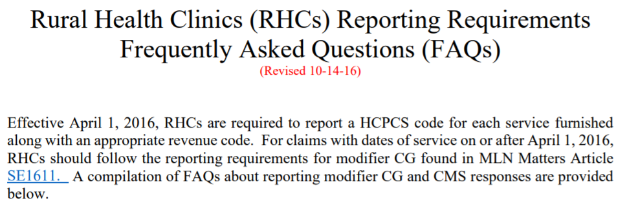
RHCs -
Medicare Billing Requirements
RHC Reference: https://www.cms.gov/Medicare/Medicare-Fee-for-Service-Payment/FQHCPPS/Downloads/RHC-Reporting-FAQs.pdf

Slide 12
CMS Valid Encounters Defined for RHCs
01
02
03
04
Authorized Qualified Health Professional (QHP)?
“Medically Necessary”?
Face-to-Face Visit?
Authorized location?
Exceptions?
Slight differences for
RHC vs. FQHC with DSMT and medical nutrition therapy.
Added Mental Health Counselor and Marriage and Family Therapist in ‘24
Familiar with
NCDs vs. LCDs and
where to get them?
Try this hyperlink
Office, Part A SNF, patient’s residence, where else?
“An RHC visit is a medically-necessary medical or mental health visit, or a qualified preventive health visit. The visit must be a face-to-face (one-on-one) encounter between the patient and a physician, NP, PA, CNM, CP, or a CSW during which time one or more RHC services are rendered.” – CMS Benefits Policy Manual, Chapter 13, Section 40

Slide 13
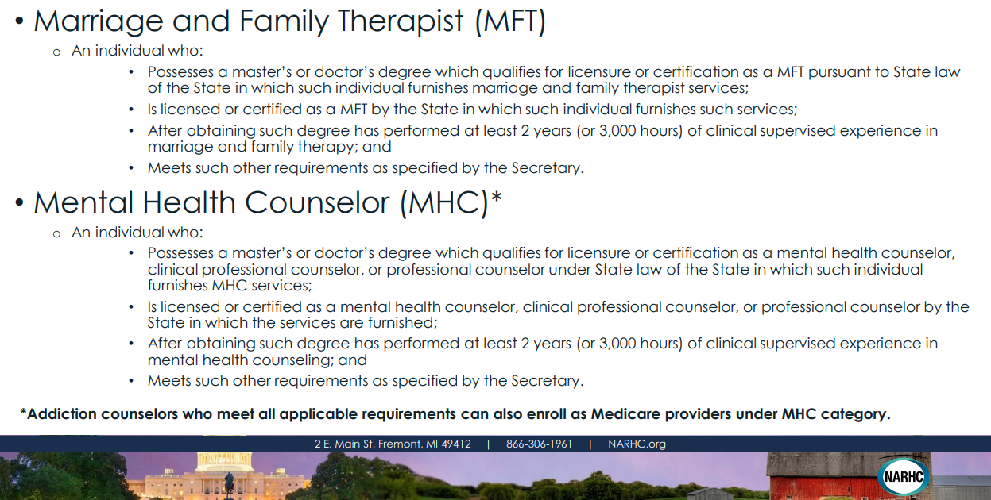
New Approved CMS Providers in RHCs for 2024
Source: National Association of Rural Health Clinics 2024 Medicare Updates Webinar (12-11-23)

Slide 14
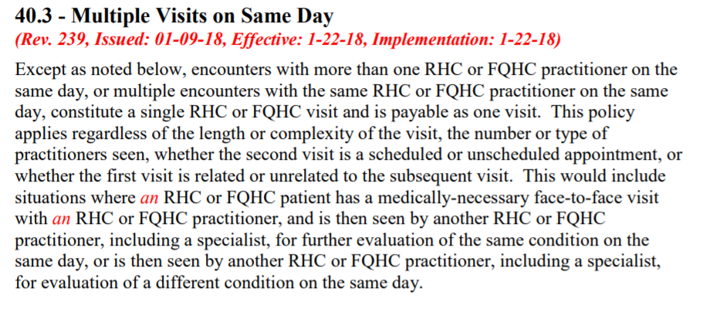
CMS exceptions to the one encounter per day rule Ch. 13
What are the 3 exceptions?
What modifier(s) should I add to identify an exception?

Slide 15
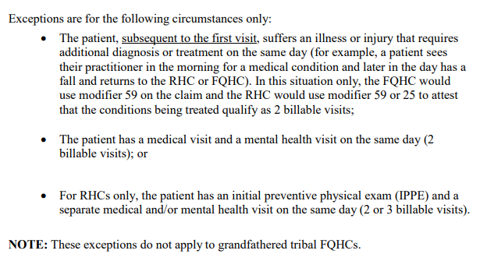
Sample information from
Chapter 13 for RHC Visits
Check with Medicaid or any payer who pays encounter rates if they have the same exceptions and methods of identifying them on claim forms?

Slide 16
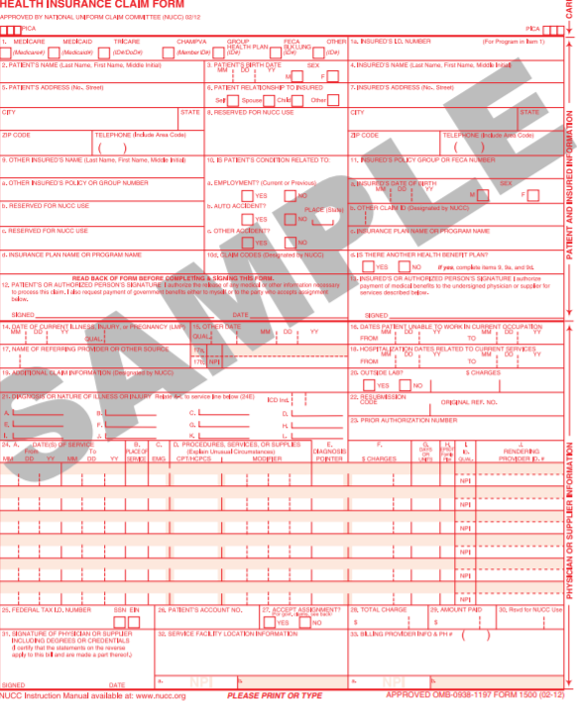
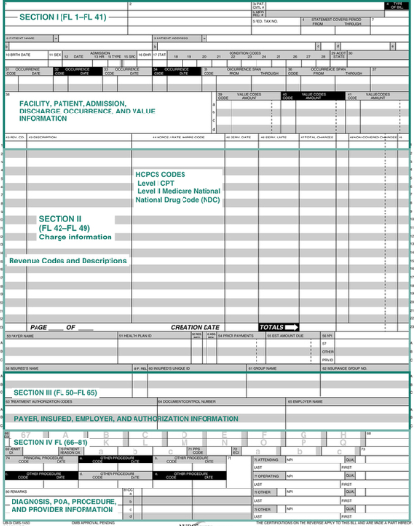
Be prepared to use both claim forms for some carriers
CMS 1500 Form
CMS 1450 Form
vs.
Used by RHCs to most all commercial and non-Medicare carriers expecting to receive Fee-for-Service (FFS) payments and/or reporting non-RHC/FQHC services such as labs, hospital visits, and technical component of diagnostic tests, for example, on Medicare Part B patients that also require POS codes from the beginning of the CPT.
Used by RHCs submitting claims to Medicare (and some Medicaid carriers) for “valid encounters” when expecting the AIR/PPS rate.
Unlike the CMS1500, the CMS1450 also requires
Type of Bill (TOB) and Revenue Codes.

Slide 17

Rural Health Clinic
Patient Cost Sharing
The 2024 RHC Part B patient deductible ($240) is the same as they have in traditional doctor’s offices.
For valid AIR encounters the RHC patient coinsurance is 20% of your TOTAL ALLOWABLE CHARGES from the first line on the CMS1450 form that carries modifier –CG.
  Line #1 on the UB claim also should include your charges for that code as well as the allowable charges for all allowable codes below it - all totaled on the Line #1’s code carrying –CG.
Independent and provider-based RHCs in a hospital with 50 or more beds the AIR upper limit is capped at $139 for 2024 with ~ $13 annual increases to up to $190 in 2028 as per the RHC Modernization Act of 2021.
  If you are a provider-based RHC owned by a hospital with less than 50 beds, you likely get paid an AIR based on your recent cost report rather than at “cost” as in the past.
  “Grandfathered” RHCs adds 4.6% to the upper limit or $139 whichever is greater.
Most covered preventive medicine services have $0 coinsurance or deductible.
For more details see: https://www.cms.gov/newsroom/fact-sheets/2024-medicare-parts-b-premiums-and-deductibles?mod=ANLink

Slide 18
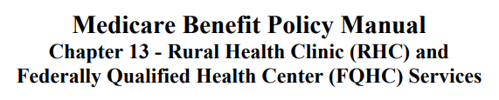


Billing incident-to services when nurses perform Medicare visits on their own
If any of the services on the previous slide occur without a CMS-authorized RHC/FQHC provider seeing the Medicare patient face-to-face, the services should be documented, coded, and stored in your EHR/IT environment but should not go on a claim form for AIR/PPS payments.
Once the patient returns in a medically reasonable timeframe (ex. 30 days), you should list the incident-to services performed in the past on the next claim form.
Page
18

Slide 19
Sample Revenue Codes for the CMS1450/837i
A revenue code needs to be applied to each line item(s) on claims submitted on the “UB” claim form. It is vital that they match in terms of the type of service or where it was provided. Check with your EHR/IT/Billing system to see if these are automatically added or must be added by billing staff.
0521
Clinic visit by beneficiary to the RHC/FQHC
0300
0780
Visits held through telephone - Telehealth visits
0522
Home visit by the RHC/FQHC practitioner
0528
Visit by RHC/FQHC practitioner to other non-RHC/FQHC site
0525
0527
RHC/FQHC Visiting Nurse Service to a member’s home when in a home health shortage area
Visit by RHC/FQHC practitioner to beneficiary in a SNF (not covered Part A), NF, ICF/MR or other residential facility
0519
0524
Visit by RHC/FQHC practitioner to beneficiary in covered Part A stay at a Skilled Nursing Facility (SNF)
0900
Behavioral Health Treatment Services
Visit by a beneficiary in a Medicare Advantage Plan
0636
Visit for general labs
Drugs requiring detailed coding
2 sample websites for further detail
Noridian MAC
+
National Uniform Billing Committee

Slide 20
Medicare does not just pay RHCs via AIR payments
Lab services are paid on the lab fee schedule and aren’t on the AIR/PPS claim, rather they are likely billed on a CMS1500/837p.
Hospital services and surgeries performed outside of your RHC/FQHC are paid via fee-for-service (FFS) based on RBRVS and the Medicare Physician Fee Schedule just like other Part B providers since you are not in your RHC/FQHC.
Care Management codes G0511/G0512 are paid at 80/20% of the average Medicare pays FFS for all the codes that are bundled into them (ex. Principal/chronic care, chronic pain management, RPM, RTM, CHI, PIN, BHI, and Psych CoCM)
  New 2024 rate for G0511 = $71.69
  New 2024 rate for G0512 = $144.07
Originating site telehealth using Q3014 is paid via a new 2024 flat fee around $29.96
As of 2024 – IOP services will pay as though they were provided in a hospital setting - - $284.00 per day
Distant site medical telehealth using G2025 is paid via at the new 2024 rate of $95.37 split 80/20%.
Some vaccines get “paid” via your cost report (e.g. influenza, HepB, pneumo codes G0008-G0010) and/or via periodic “roster billing”.
And more…

Slide 21
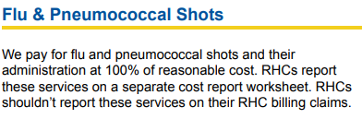
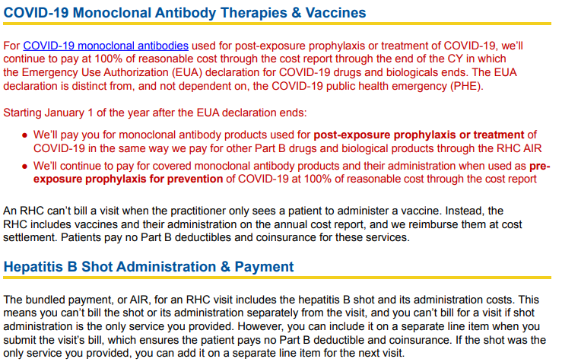
Vaccine Billing Tips for RHCs
Make a bookmark for this wonderful resource that has a couple tips for vaccines plus a ton of general info for RHCs. See pages 9-10 of the CMS RHC Fact Sheet.

Slide 22
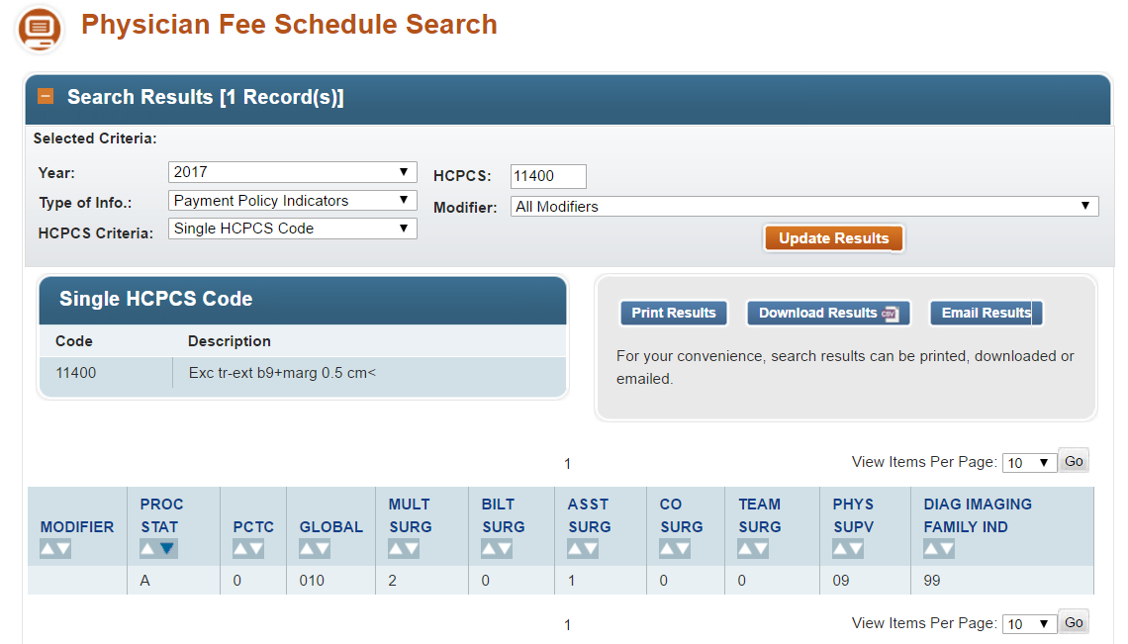
Access RBRVS code status, global days, and modifier information
Access the hyperlink, access instructions of how to use the tool, and utilize the info depending on who you are billing and where. You can also access RVU info!
2024

Slide 23
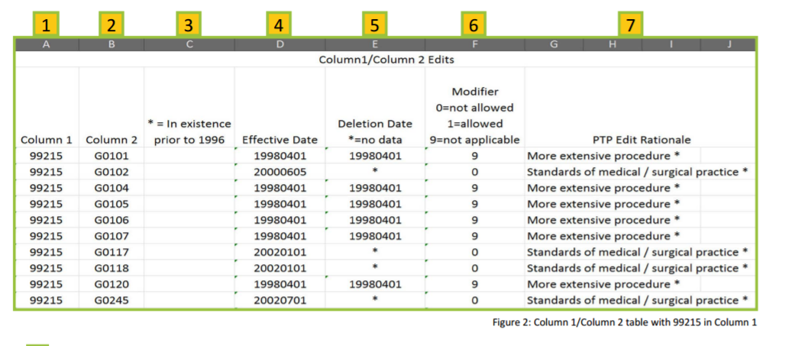
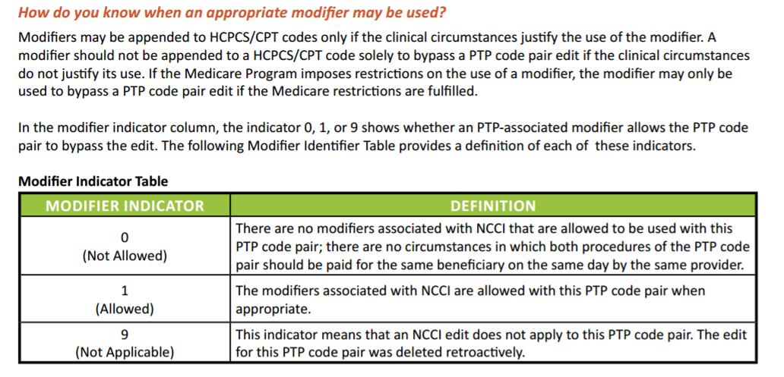
Medicare’s bundling information (i.e., NCCI) determines possible modifiers and can reduce claim denials
Are you using a Medicare claim scrubber on commercial plans? What policies do you have on using modifiers to overturn a likely denial, for example, using modifier -59.

Slide 24

Modifier -59 Basics
Overused and Misunderstood
Refer to the NCCI (or other carrier’s bundling system) and reference the Modifier Indicator to determine if a modifier can overcome the billing edit.
This is a “modifier of last resort” and should be used carefully based on available documentation, not just to get that item paid!
Be aware of possible best uses of the similar modifiers –XE, XS, -XP, and –XU. Check out this CMS document!
Medicare’s NCCI can be different than non-Medicare bundling rules!

Slide 25
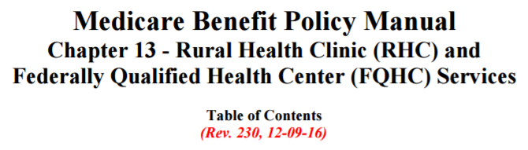
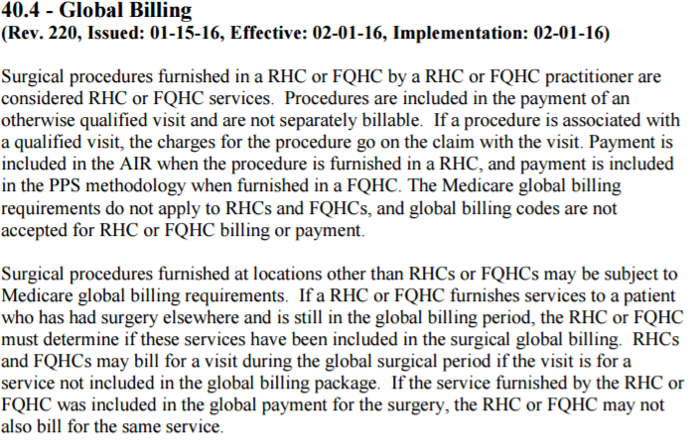
Medicare global billing rules do not apply to RHC services
How does this issue impact the possible need for an E/M to require a modifier -25 to get reimbursed for a visit and a procedure in a RHC/FQHC?

Slide 26

CMS’ Surgical Package definition to use for a Medicare patient if the procedure is performed outside of your RHC/FQHC
Pre-operative
Intra-operative
Post-operative
$
$
$
Minor
E/M day of surgery included
(use modifier -25?)
Major
E/M day of and day before surgery is included (use modifier -57?)
Minor
Adds either 0 or 10 days of follow-up
Major
Adds 90 days of follow-up
(Use modifiers -24 or -79 for unrelated services?)
BE CAREFUL! 1 day of pre-op + the day of the procedure + 90 days of post-op
= 92 TOTAL global days
ALSO! If a code in RBRVS shows as having “XXX” global days – there is NO surgical package!

Slide 27
Goals for Each Note
Legible
Complete
Authenticated
Dated
Timed
Though the items above are found in HHS/CMS’ Conditions of Participation for Hospitals CFR Section 482.24(c)(1) and we recommend them for all visits, treatments, and orders created in a RHC/FQHC

Slide 28
It all starts with the Chief Complaint
How can these be improved to show that they support a problem-oriented service rather than a preventive medicine service which could change who pays?
Patient returns for follow-up
Return to clinic for re-check or check up
Annual wellness screening
Routine follow-up with no complaints
New to town establishing with provider
There may be a difference between a patient coming in with a symptom/sign for an acute illness/injury – compared to a patient getting ongoing care for the management of chronic conditions already being treated.
Note that each day’s documentation must be able to
“stand on its own” to meet documentation guidelines!

Slide 29

E&M: New Versus Established Patients (per CPT)
A new patent is one who has not received any face-to-face professional service from the physician/qualiﬁed healthcare professional or
another physician/qualiﬁed healthcare professional of the exact same specialty/subspecialty who belongs to the same group practice within the past 3 years.
RHC-patient seen by any provider in the past 3 years billed on RHC NPI

Slide 30
E/M Key Components –
Past (1992-2020) vs.
Present (2021-now)
01
02
03
04
HISTORY
EXAM
MEDICAL DECISION
MAKING
Nature of Presenting Problem
When does the “mid-point” concept apply?
Counseling
Coordination of Care
TIME

Slide 31
Clinical provider’s historical complaints with complicated documentation rules has been heard!
In 2020, the Patient’s Over Paperwork initiative “CMS’ internal process to evaluate and streamline regulations” winds up and sweeping changes took effect January 2021 for office/outpatient E&M codes and in January 2023 for hospital, observation, nursing facility and home visits.
  Reduce documentation burden for qualified providers – check!
  Eliminate “note bloat” and need to “re-document” certain aspects of the record – check!
  Reduce professional dissatisfaction and provider “burnout” – hopefully!
  Encourage more time with patients and less time with unnecessary paperwork – it is literally in the definition now!

Slide 32
Summary of Major E/M Revisions from 2021-2024
AMA’s CPT: Continue to provide a “medically appropriate history and/or physical exam, when performed…(which) is not an element in selection of the level” of E/M codes.”
Use either MDM level or Total Time on the date of the encounter whichever gets you to the highest level of service.
Eliminated history and examination as key components
Established components for code selection
01
02
Deleted code 99201 and revised codes 99202-99215
Guidelines hadn’t really changed in almost 30 years!
Specific only to E/M office visits in 2021 but expanded to inpatient care (and beyond) in 2023.
99211 and Incident-to
This code is still only used for most non-Medicare nurse services that don’t already have a code (e.g. vaccine admins)
04
03

Slide 33
Updated for 2024 - minimum times associated with Office/Outpatient E/M codes – do not “round up”
01
02
04
04
New Patient
99202
15 minutes
New Patient
99203
30 minutes
New Patient
99204
45 minutes
New Patient
99205
60 minutes
Est. Patient
99212
10 minutes
Est. Patient
99213
20 minutes
Est. Patient
99214
30 minutes
Est. Patient
99215
40 minutes

Slide 34
Time spent on the below items is counted if on the date of service
preparing to see the patient (e.g., review of tests)
obtaining and or reviewing separately obtained history
performing a medically appropriate examination and/or evaluation
counseling and educating the patient/family/caregiver
ordering medications, tests, or procedures
referring and communicating with other health care professionals (when not separately reported)
documenting clinical information in the electronic or other health record
independently interpreting results (not separately reported) and communicating results to the patient/family/caregiver
care coordination (not separately reported)
See pg. 13-14 in the AMA’s CPT Professional Edition for items NOT included in time calculations in 2024

Slide 35


Updated Terms
Medical Decision Making (MDM) Elements
Study the Medical Decision Making!
Please review and study pages 8-13 of your AMA Professional Edition CPT manual to find helpful updates and information that clinical providers should be familiar with when documenting in the medical record.
Number and Complexity of Problems Addressed at the Encounter
Amount and/or Complexity of Data to be Reviewed and Analyzed
Risk of Complications and/or Morbidity or Mortality of Patient Management

Slide 36
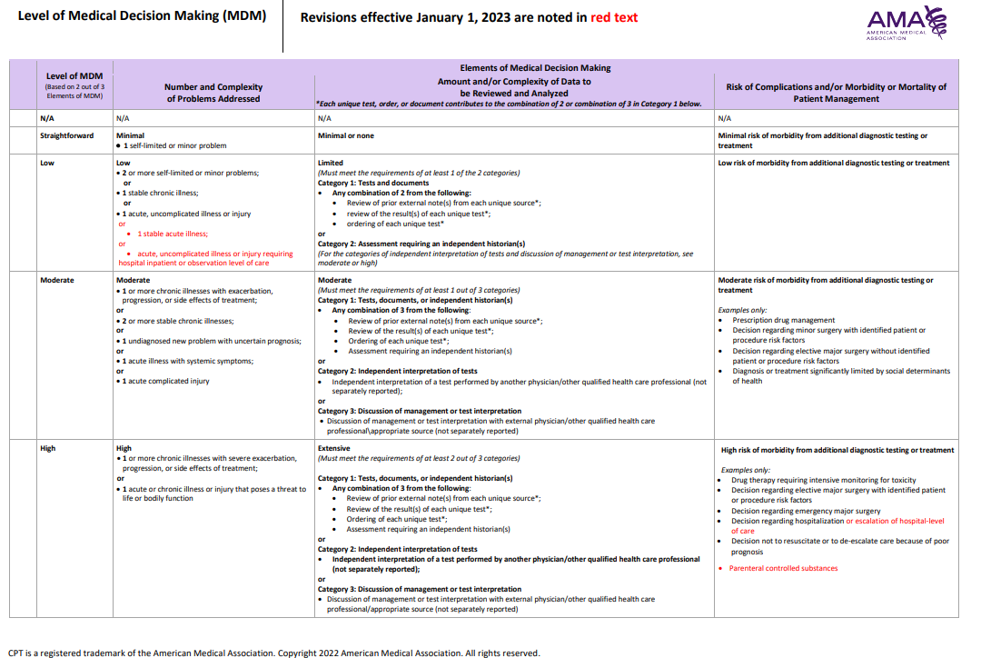
Updated AMA 2024 MDM Table
99211
99202/99212
99203/99213
99204/99214
99205/99215

Slide 37
Evaluation and Management Code (E&M Level) | Number and Complexity of Problems Addressed at the Encounter | Complexity/Level of Medical Decision Making (MDM)
99202 99212 | 1 self-limited or 1 minor problem | Straightforward
99203 99213 | 2+ self-limited or minor problems 1 stable chronic illness 1 stable acute illness 1 acute uncomplicated illness/injury requiring hospital inpatient or observation level of care | Low
99204 99214 | 1 or more chronic issues with exacerbation, progression, or side effects of treatment 2+ stable chronic illnesses 1 Undiagnosed problem with uncertain prognosis 1 Acute illness with systemic symptoms 1 Acute complicated illness | Moderate
99205 99215 | 1+ chronic illnesses with severe exacerbation/progression or side effect of treatment 1 acute or chronic illness or injury posing a threat to life or bodily function | High

Slide 38
Evaluation and Management Code (E&M Level) | Amount and/or Complexity of Data to be Reviewed and Analyzed (Each unique test, order, or document contributes to the combination of 2 or 3 in Category 1 below!)* | Complexity/Level of Medical Decision Making (MDM)
99202 99212 | Minimal or none | Straightforward
99203 99213 | Limited (Must meet at least 1 of the following 2 categories) Category 1: Tests and Documents* Any combination of 2 from the following: 1. review prior external notes, 2. review results of EACH unique test, 3. order of EACH unique test Category 2: Assessment requiring “Independent Historian(s)” | Limited
99204 99214 | Moderate (Must meet at least 1 of the following 3 categories) Category 1: Tests, Documents and Independent Historian(s) Any combination of 3 of the following: 1. review of prior external note(s) from each unique source, 2. Review results of each unique test, 3. order of each unique test, 4. Assessment requiring independent historian(s) Category 2: Independent interpretation of test performed by another provider (not billed) Category 3: Discussion of Management or test interpretation with outside provider (not billed) | Moderate
99205 99215 | Extensive (Must meet at least 2 of the following 3 categories) Category 1: Tests, documents, or independent historian(s) • Any combination of 3 from the following: 1. Review of prior external note(s) from each unique source*; 2. Review of the result(s) of each unique test*; 3. Ordering of each unique test*; 4. Assessment requiring an independent historian(s) or Category 2: Independent interpretation of tests 1. Independent interpretation of a test performed by another physician/other qualified health care professional (not separately reported); or Category 3: Discussion of management or test interpretation 1. Discussion of management or test interpretation with external physician/other qualified health care professional/appropriate source (not separately reported) | High
How does your EHR “capture” that you reviewed prior labs?

Slide 39
Evaluation and Management Code (E&M Level) | Risk of Complications and/or Morbidity or Mortality of Patient Management (Based on risks associated with diagnostic/therapeutic procedures) | Complexity/Level of Medical Decision Making (MDM)
99202 99212 | Minimal risk of morbidity from additional diagnostic testing or treatment Ex. Rest, gargles and bandages | Straightforward
99203 99213 | Low risk of morbidity from additional diagnostic testing or treatment Ex. OTC | Low
99204 99214 | Moderate risk of morbidity from additional diagnostic testing or treatment • Prescription drug management (rx) • Decision for minor surgery with identified patient or procedure risk factors (0, 10 days) • Decision for elective major surgery without identified patient or procedure risk factors (90 days) • Diagnosis or treatment significantly limited by social determinants of health (SDoH) | Moderate
99205 99215 | High risk of morbidity from additional diagnostic testing or treatment Drug therapy requiring intensive monitoring for toxicity (e.g., warfarin/chemo agents. etc.) Decision regarding elective major surgery with identified patient or procedure risk factors Decision regarding emergency major surgery Decision regarding hospitalization or escalation of hospital level of care Decision not to resuscitate or to de-escalate care because of poor prognosis Parenteral controlled substances | High

Slide 40
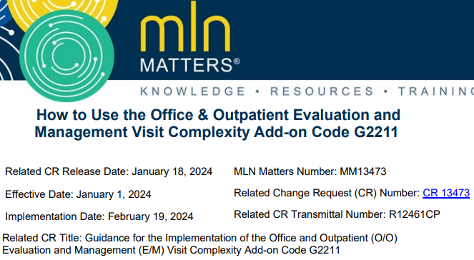
NEW Evaluation & Management Codes for 2024!
New CPT code #+ 99459: Pelvic Examination (List separately in addition to the code for the primary procedure)
  Use code in conjunction with 99202-99205, 99212-99215, 99242-99245, 99383-99387, 99393-99397) This should not be listed along with a documented G0101 since it duplicates the pelvic exam.
New HCPCS-II code + G2211 – New complex Condition Add-on Code
  “This add-on code will better recognize the resource costs associated with evaluation and management visits for primary care and longitudinal care.”
  “Can be reported in conjunction with E/M visit to better account for additional resources associated with the primary care, or similarly ongoing medical care related to a patient’s single, serious condition, or complex condition.
  Can be performed via telehealth and the code is on the CMS-approved list of covered MEDICAL telehealth services using G2025 as a potential for 2x payment of telehealth (we are awaiting future guidance on this issue).

Slide 41
Preventive Medicine E&M Services (per CPT)
99381-99387 (new), 99391-99397 (established)
Medicare DOES NOT pay for an “annual physical”
According to CPT, modifier -25 may be used for “significant” E&M
These codes do not require a “chief complaint”
Rural Health Clinic (RHC) Preventive Services Chart
CPT code’s 5th digit | Patient’s age
1 | < 1
2 | 1-4
3 | 5-11
4 | 12-17
5 | 18-39
6 | 40-64
7 | 65+

Slide 42
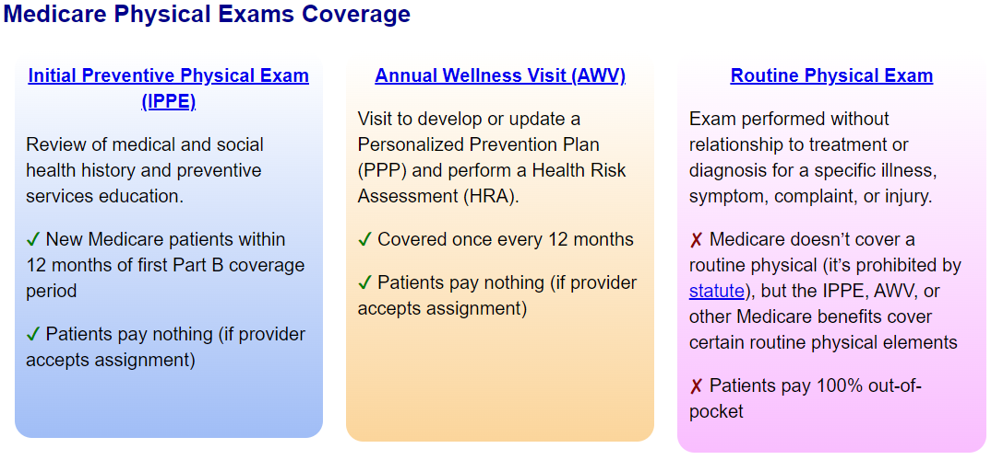
Access the CMS Interactive website on Initial/Periodic Comprehensive Preventive Medicine Services vs. IPPE/AWV

Slide 43
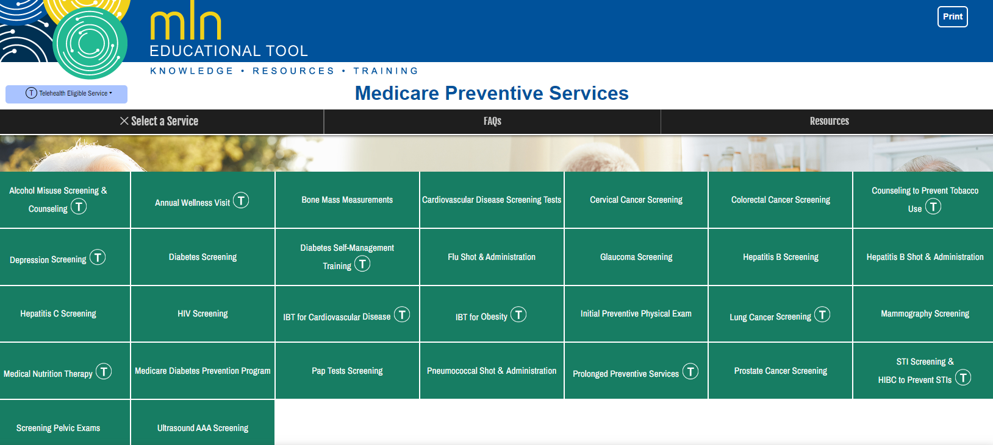
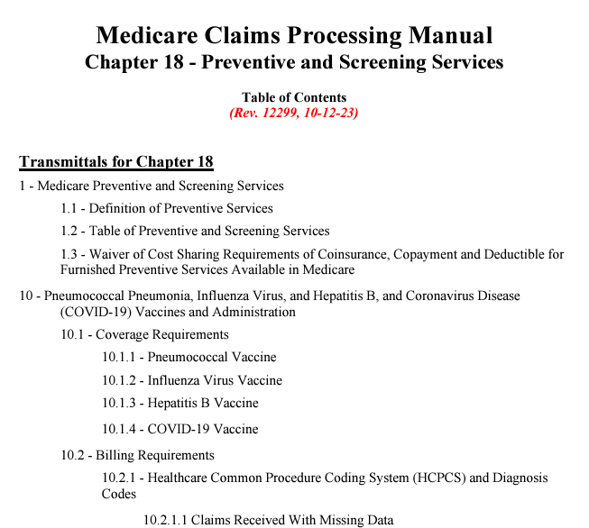
Please review the key details around each CMS sometimes-covered G-code in Chapter 18 and via a new interactive CMS tool
Use caution as this document is not written specifically for RHC or FQHC. It will, however, contain the key documentation guidelines for providers as well as helpful coverage information for coders/billers.

Slide 44
Initial Preventive Physical Exam (IPPE)
Medicare Covers: Patients with Medicare Part B once within the first 12 months of their Medicare Part B coverage period
Frequency: Once per lifetime, must occur no later than 12 months after effective date of first Medicare Part B coverage period
Patient Pays:
G0402: No copayment, coinsurance, or deductible
G0403, G0404, and G0405: Copayment or coinsurance, and deductible apply

Slide 45
Annual Wellness Visit (AWV)
Medicare Covers: Patients with Medicare Part B who:
Aren't within 12 months after effective date of their first Medicare Part B coverage period
Haven't had an Initial Preventive Physical Exam (IPPE) or AWV within the past 12 months
Frequency:
Once per lifetime G0438 (first AWV)
Annually G0439 (subsequent AWV) and G0468 (AWV in FQHC)
Annually optional 99497, 99498
Patient Pays:
G0438 and G0439:
No copayment, coinsurance, or deductible
99497 and 99498:
No copayment, coinsurance, or deductible for Advance Care Planning when provided as optional AWV element
  Bill using modifier –33 (Preventive Service) on same AWV claim
  Must deliver on same day by same AWV provider

Slide 46



Sample billing code options for screening for SUD/OUD
G2011: Alcohol and/or substance (other than tobacco) misuse structured assessment (e.g. audit, dast) and brief intervention, 5 to 14 minutes.
99408/G0396: Alcohol and/or substance misuse (other than tobacco) structured assessment and brief intervention; 15 to 30 minutes
99409/G0397: Alcohol and/or substance abuse structured screening and intervention services; greater than 30 minutes
H0049: for Alcohol and/or drug screening + H0050: for Alcohol and/or drug screening, brief intervention, per 15 minutes
G0442: Annual alcohol misuse screening, 5-15 minutes
G0443: Brief face-to-face behavioral counseling for alcohol misuse, 15 minutes
G0444: Annual depression screening, 5-15 minutes

Slide 47
Care Management
Documentation for Clinical Providers
Info on the main Care Management services are located at: https://www.cms.gov/Medicare/Medicare-Fee-for-Service-Payment/PhysicianFeeSched/Care-Management
AMA CPT Guidelines
According to the CPT these are “management and support services provided by clinical staff, under the direction of a physician or other qualified health care professional….(that) include”
TIPS: Develop templates in your EHR, track monthly time,
document care plan updates and get credit for the clinical work you do in between patient visits. Consider external care managers to help with the workload.
“Establishing, implementing, revising, or monitoring the care plan
Coordinating the care of other professionals and agencies
Educating the patient or caregiver about the patient's condition, care plan, and prognosis”

Slide 48

Care Management
Coding/Billing information for consideration
  G0511 = Rural Health Clinic or Federally Qualified Health Center only, general care management services 20 minutes or more of clinical staff time for chronic care management services directed by RHC or FQHC practitioner (MD, NP, PA, or CNM), per calendar month. In 2024 it pays $71.68 (down from 2023’s $77.94) split 80/20% between Medicare and the patient.
  “General care management” = principal/chronic care management, monthly chronic pain management, assorted remote monitoring services, community health integration, principal illness navigation, OR behavioral health integration.
  G0512 = Rural Health Clinic or Federally Qualified Health Center only, Psychiatric Collaborative Care Model, 60 minutes or more of clinical staff time for psychiatric CoCM services directed by a RHC/FQHC practitioner (physician, NP, PA, or CNM) and including services furnished by a behavioral health care manager and consultation with a psychiatric consultant, per calendar month.
  In 2024 it pays $144.07 (down from 2023’s $146.73) split 80/20% between Medicare and the patient.
Medicare asks RHC/FQHC to report the unique G0511 or G0512 codes that now encompass chronic/principal care management, chronic pain management, BHI, various remote monitoring services, CHI, PIN, and the Psych CoCM
▲

Slide 49
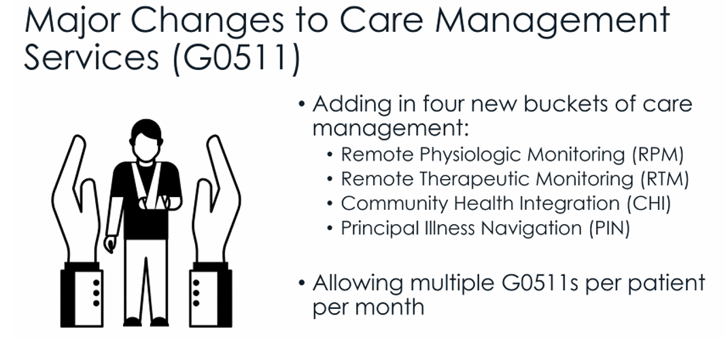
Source: National Association of Rural Health Clinics 2024 Medicare Updates Webinar (12-11-23)
Per CMS Final Rule: "multiple times in a calendar month, as long as all of the requirements are met and resource costs are not counted more than once."

Slide 50
Documentation Basics of
Transitional Care Management (TCM)
AMA CPT Guidelines
The goal of TCM is to lower preventable hospital readmissions by establishing the smooth transition from an inpatient stay between a patient's various care providers and their designated primary care manager.
Establish direct patient contact with the patient within 2 days of the discharge to determine what happened in the inpatient stay.
Based on those findings (i.e., med reconciliation and treatment referrals) schedule a face-to-face visit within either 7 or 14 days.
If the patient is readmitted by anyone for that same condition in the 30 days following the discharges, TCM should likely not be paid/reported.

Slide 51

Coding for
Transitional Care Management (TCM)
99495
  Medical Decision Making of at least moderate complexity
  Face-to-face visit within 14 calendar days of discharge
99496
  Medical Decision Making of at least high complexity
  Face-to-face visit within 7 calendar days of discharge
See the AMA CPT documentation guidelines for codes 99495 and 99496
NOTE: Only one qualified clinical provider may report TCM services on a patient following a discharge. The same provider who discharged the patient may report TCM services, but the required face-to-face visit cannot take place on the same day as the actual discharge day management services.

Slide 52

Telehealth vs.
Virtual Communication Services (VCS)
Telehealth services are usually pre-scheduled and can be audio only under certain circumstances, such as many mental health visits.
  What is the difference between “distant” and “originating” site telehealth
  Medicare clarifies that in 2024 RHC/FQHC telehealth services must be performed during your posted hours of operation!
VCS are “virtual check-in services” and/or “store-forwarding of audio/video” that are usually patient-initiated and can include phone or other electronic means, such as an online patient portal where patients are reaching out to see if they need to come in for an immediate visit or can be taken care of virtually.

Slide 53
RHC Telehealth
Key Thoughts for Billing
PRIVATE INSURANCE – For non-Medicare carriers it is likely that the payer just wants the CPT/HCPCS-II code performed (99213 or 90832) plus a modifier -93/-95/-FQ/-FR and/or Place Of Service code 02 or 10 on the CMS1500 claim.
RHC MEDICAL SERVICES – For Medicare patients, RHCs are instructed to use code G2025 for in to receive the flat fee of $95.37 (split 80/20%) if the code is on the CMS approved services list.
RHC MENTAL HEALTH SERVICES – For Medicare patients, RHCs are instructed to report a code on the CMS approved services list as if performed in-person and billing should add a modifier -93/-95 to receive your payment.

Slide 54
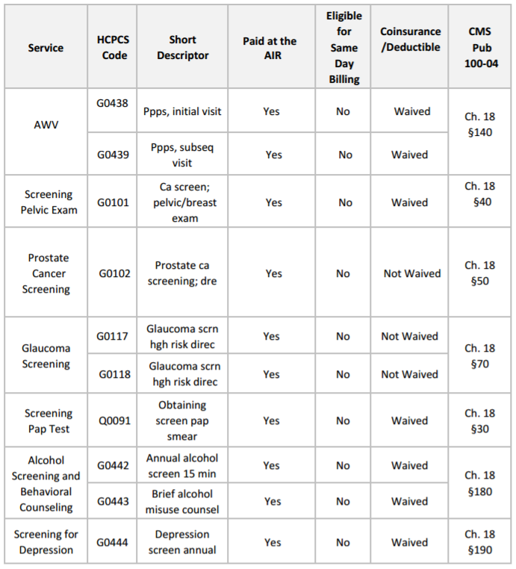
Snippet From CMS’ RHC Preventive Service Chart

Slide 55
Basic Case Study
Assessment:
Essential hypertension (I10), controlled on current prescription regimen (Lisinopril, 10mg, once orally per day). Refill rx order sent to CVS pharmacy for 60-day supply. Current BP 128/76. Patient to continue checking BP at home. Follow up 3 months.
Neuropathy (G62.9), currently under good control. Refill Gabapentin, 100mg, 3x orally per day.

Slide 56
Evaluation and Management Code (E&M Level) | Number and Complexity of Problems Addressed | Complexity/Level of Medical Decision Making (MDM)
99202 | 1 self-limited issue | Straightforward
99212 | 1 minor problem
99203 | 2+ self-limited problems | Low
99213 | 2+ minor problems 1 stable chronic illness
 | 1 acute uncomplicated illness/injury
99204
1 or more chronic issues with exacerbation
Moderate
99214 | 2+ stable chronic illnesses 1 Undiagnosed problem with uncertain prognosis 1 Acute illness with systemic symptoms 1 Acute complicated illness
99205 | 1+ chronic illnesses with sever exacerbation/progression or side effect of | High
99215 | treatment 1 acute or chronic illness or injury posing threat to life/function

Slide 57

Amount and/or Complexity of Data to be Reviewed and Analyzed
Complexity/Level of
Medical Decision Making (MDM)
Evaluation and Management Code (E&M Level)
99202
99212
Minimal or none
Straightforward
99203
99213
Limited (Must meet at least 1 of the following 2 categories)
Low
Category 1: Tests and Documents
Any 2 of the following:
1. review prior external notes, 2. review results of EACH unique test, 3. order of EACH unique test
Category 2: Assessment requiring “Independent Historian(s)”
99204
99214
Moderate (Must meet at least 1 of the following 3 categories)
Moderate
Category 1: Tests, Documents and Independent Historian(s)
Any combination of 3 of the following:
1. review of prior external note(s) from each unique source, 2. Review results of each unique test, 3. order of each unique test, 4. Assessment requiring independent historian(s)
Category 2: Independent interpretation of test performed by another provider (not billed)
Category 3: Discussion of Management or test interpretation with outside provider (not billed)
99205
99215
Extensive
High
Category 1: Tests, documents, or independent historian(s) • Any combination of 3 from the following: 1.
Review of prior external note(s) from each unique source*; 2. Review of the result(s) of each unique test*; 3.
Ordering of each unique test*; 4. Assessment requiring an independent historian(s) or
Category 2: Independent interpretation of tests 1. Independent interpretation of a test performed by another
physician/other qualified health care professional (not billed); or
Category 3: Discussion of management or test interpretation 1. Discussion of management or test
interpretation with external physician/other qualified health care professional/appropriate source (not billed)

Slide 58
Risk of Complications and/or Morbidity or Mortality of Patient Management
Complexity/Level of
Medical Decision Making (MDM)
Evaluation and Management Code (E&M Level)
99202
99212
Minimal risk of morbidity from additional diagnostic testing or treatment
Rest, gargles and bandages
Straightforward
99203
99213
Low risk of morbidity from additional diagnostic testing or treatment
OTC
Low
99204
99214
Moderate risk of morbidity from additional diagnostic testing or treatment
Prescription drug management (rx)
Decision for minor surgery with identified patient or procedure risk factors (0, 10 days)
Decision for elective major surgery without identified patient or procedure risk factors (90 days)
Diagnosis or treatment significantly limited by social determinants of health (SDoH)
Moderate
99205
99215
High risk of morbidity from additional diagnostic testing or treatment
Drug therapy requiring intensive monitoring for toxicity (e.g., warfarin/chemo agents. etc.)
Decision regarding elective major surgery with identified patient or procedure risk factors
Decision regarding emergency major surgery
Decision regarding hospitalization
Decision not to resuscitate or to de-escalate care because of poor prognosis
High

Slide 59

Case #1: DETERMINE THE FINAL LEVEL OF MEDICAL DECISION MAKING
Final MDM is determined by 2 of the 3 elements from the table below:
Number and Complexity of Problems Addressed |  |  | 2 Stable Chronic Conditions
Amount and/or Complexity of Data to be Reviewed and Analyzed
Risk of Complications and/or Morbidity or Mortality of Patient Management |  |  | Prescription Drug Management
LEVEL OF DECISION MAKING | Straight Forward | Low Complexity | Moderate Complexity | High Complexity
MODERATE COMPLEXTY FOR EST PATIENT = 99214

Slide 60
Instructor
John F. Burns, CPMA, CPC, CEMC, CH-CBS, RH-CBS
Vice President, Audit & Compliance, Arch Pro Coding
jburns@ArchProCoding.com

