Slide 1
Post Discharge Phone Call Process Improvement
Amy Meyers, RN, BSN

Slide 2
Objectives
Participants will be able to identify importance of post discharge phone calls.
Participants will be able to identify potential barriers and ways to determine site specific barriers.
Participants will be able to identify ways to mitigate barriers.

Slide 3
Importance of Post Discharge Phone Calls
Notes:
Everyone is busy. Why is this important enough to do it?

Slide 4
Scholarly Article Review
Reviewed 28 scholarly articles
12 regarding ED discharge phone calls
14 regarding Hospital discharge phone calls
2 regarding unspecified discharge phone calls
1 systematic review
3 articles based on sited research
Patient Needs
Clarifying/going over discharge instructions
Including symptom expectations and management
Ensuring prescription medications obtained & understood
Scheduling follow-up appointments
And referrals to services
Reassurance
Effects
Understanding of discharge instructions
Consistently improved
Patient Satisfaction
Consistently improved
Identification of patients at risk
Improved
Readmissions
Inconclusive or slightly improved (not statistically significant)
Follow-up Adherence
Inconclusive or slightly improved (not statistically significant)
Notes:
We reviewed 28 scholarly articles. Based on that, we identified 4 patient needs that our post discharge phone calls were going to target. These were areas that were shown to have the most impact in the literature.
Understanding of discharge instructions and Patient satisfaction were consistently improved. Identifying patients at risk was improved. Readmissions and Follow-up adherence were not improved enough to be statistically significant.

Slide 5
Other Considerations
Transitional Care Management (TCM) billing
“Within 2 business days after the patient’s discharge from the inpatient or partial hospitalization setting, you (or clinical staff under your direction) must contact the patient or their caregiver via phone, email, or face-to-face…You may report the service if you make 2 or more unsuccessful separate contact attempts in a timely manner…Document your attempts in the patient’s medical record.” (Medicare Learning Network, 2022, p. 5-6)
Accountable Care Organization (ACO) QI requirement
Post Acute Initiatives and Care Management Quality Improvement – based on improved ability to bill TCM
Effects Shared Savings
Post Acute Care Stroke Care Collaborative requirement
Requirement of funds received by Post Acute Care Stroke Care Collaborative to improve post acute care stroke
Safe Sleep Hospital Champion & Abusive Head Trauma Prevention Hospital Champion
Requirements include incorporating certain questions into post-discharge follow-up phone call to patients
QI project – reducing ambulatory ED visits
$$$$$
Notes:
We also have a rural clinic associated with and in the same building as our hospital. The same providers care for patients at the hospital and in the clinic.
These phone calls count for one component of TCM as “Interactive contact” that requires at least 2 attempts within 2 business days of discharge by “clinical staff.” This project was chosen for a Quality improvement with our ACO directly because of TCM. We also are part of a Post Acute Care Stroke Care Collaborative to improve care of stroke patients post acute care with our Swing Bed. Post discharge phone calls within 2 days of discharge from our swing bed is one of the requirements with that program. We are also designated as a Safe Sleep Hospital Champion and an Abusive Head Trauma Prevention Hospital Champion. Part of these designations require certain questions be asked with post discharge phone calls. And this ties nicely in with another Quality Improvement project to reduce ED visits that could have been seen in our clinic.

Slide 6
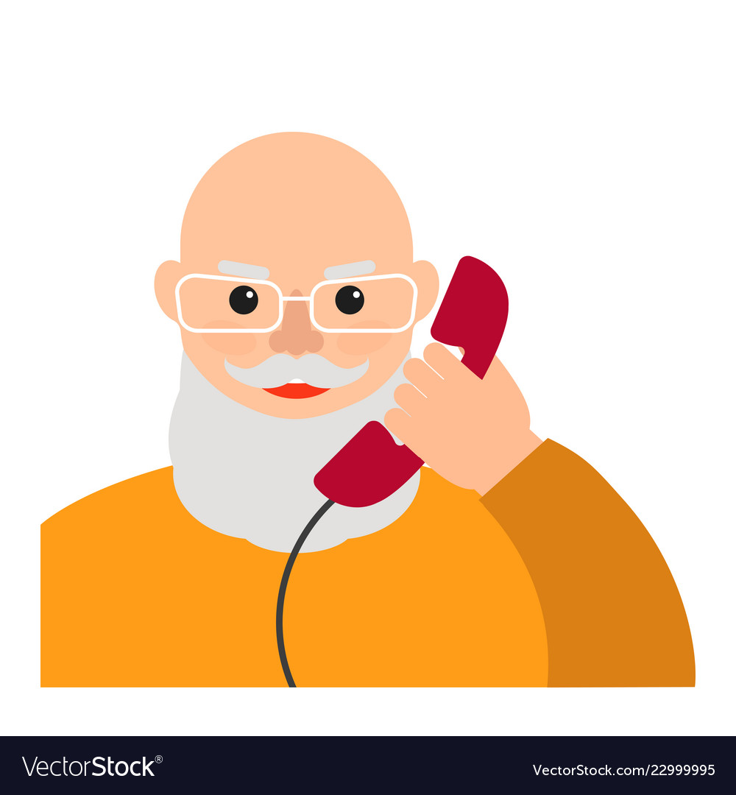
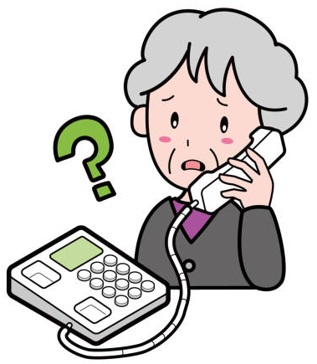
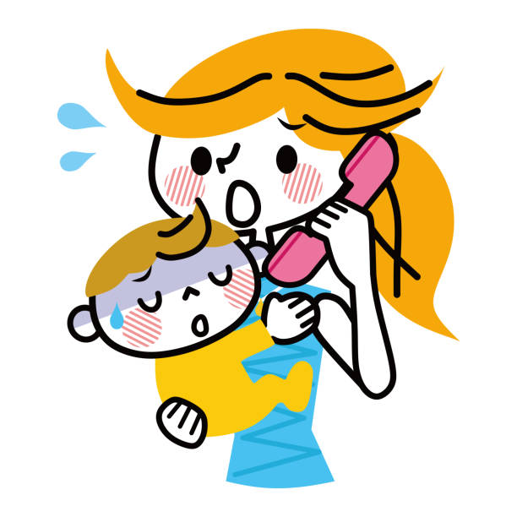
Who should be called
Reviewed 28 scholarly articles
12 regarding ED discharge phone calls
14 regarding Hospital discharge phone calls
2 regarding unspecified discharge phone calls
1 systematic review
3 articles based on sited research
Both Hospital and ED patients benefit from post discharge phone calls
Notes:
The programs requiring post discharge phone calls only involved hospital patients. However, according to the literature, ED patients also benefit from post discharge phone calls. And the phone calls also became an intervention for our other QI project to prevent ambulatory ED visits. Quality Improvement projects. We decided to call hospital and ED patients discharged to “home.”

Slide 7
Potential Barriers
Universal and Site-Specific

Slide 8
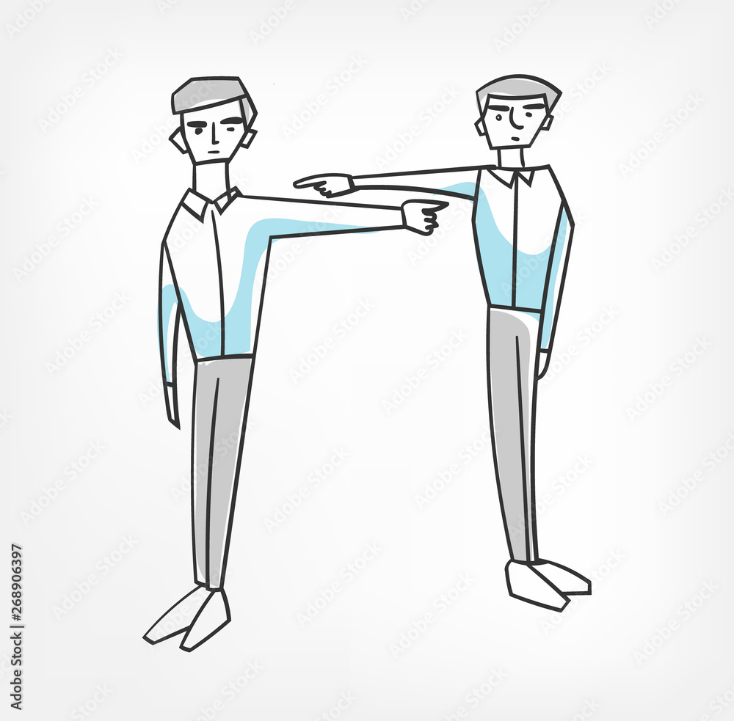
Potential Barriers
Nobody wants to
Notes:
Have you heard this?
“I don’t have time to call these people! I have patients here, now, to take care of. They probably won’t answer and probably don’t want us to call anyway. And even if they do, I don’t know how to help them. Why do we have to do this?!?”
That complaint is a list of potential barriers.
Previously, these calls were assigned to be done by our hospital nursing staff. First we evaluated if these would continue to be assigned to them, or if they should be assigned to someone else.

Slide 9
Who makes the calls
Scholarly Article Review
Reviewed 28 scholarly articles
12 regarding ED discharge phone calls
14 regarding Hospital discharge phone calls
2 regarding unspecified discharge phone calls
Other Considerations
Majority of studies had nurses call
Some used nurses in call centers, specifically hired nurses, PCP nurses
Other personnel used: “ED personnel,” pharmacist, nurse practitioners, volunteers
Automated calls that forwarded to Nurse if needs were identified
ALL had the ability to refer to appropriate departments
Scheduling
Providers – PCP or ED
Pharmacy
Case management
Transitional Care Management (TCM) requires “The interactive contact must be performed by a clinical staff who can address patient status and needs beyond scheduling follow-up care.” (Medicare Learning Network, 2022, p. 5)
“…one hospital or department can’t coordinate care by itself.”
(HCPro, 2015, p. 8)
Notes:
We looked at the literature and requirements for the programs. Most of the programs cited in the literature used clinical staff of some sort and most used nurses. The requirements for TCM had the most impact for us: clinical staff and interactive contact.

Slide 10
Who makes the calls
Why Acute/ED/L&D/Postpartum nurses and ED paramedics make the calls
This has always been part of the duties for nurses
Added to paramedic duties
Same staff that cared for patients
Know where to find information in EMR
May have first-hand knowledge of patient
TCM requires clinical staff perform the phone calls
Can be worked into workflow
Presented census numbers for each department for 12 months previous to implementation; broken down by number of calls per staff member and time frame for each.
i.e. 16 calls with 4 staff members = 4 calls each in 12 hours = 1 call every 3 hours
Call duration range from 1-20 minutes, depending on patient talkativeness and questions to be worked through
Most calls take less than 3 minutes to complete
Notes:
The phone calls were already assigned to the Acute/ED/Postpartum nurses, but we added it to the paramedic duties as well.
This is the same staff that take care of these patients so they may have first-hand knowledge of the patient and, at the very least, they are the most familiar with the EMR.
We needed to have clinical staff that could have interactive contact.
We needed to determine that these calls could be worked into daily workflow. I took the census information for the previous 12 months and broke it down to how many phone calls per day would be expected. I further broke it down to show that if the calls were split equally between every staff member working on day shift (usually 4-6) and calls were made every day, the number of calls one staff member would be required to make during their 12 hour shift was between 2-5. And then broke it down further to show it would mean 1 call every 2-6 hours. When broken down like this, making time for these seems much more attainable.
We timed how long each call took for a few days to establish the amount of time each call could be anticipated to take. Preparation for each call took about 1 minute to pull up and review discharge information. Once in a while there would be a patient with a lot of questions or very talkative, but most calls took less than 3 minutes. Staff can determine when to plan the calls by anticipating how much time they will need for each call.

Slide 11
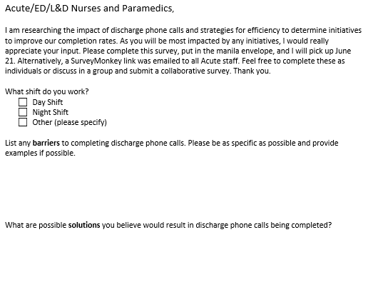
Determine site specific barriers
Ways we determined site specific barriers at Crete Area Medical Center
Process improvement project overseen by RN experienced in previous process and experience administering phone calls.
Staff Survey administered
SurveyMonkey and Paper surveys distributed in multiple locations where staff can easily find/fill out
Anonymous
Day Shift had more weight because they make majority of calls
See what staff believes keeps them from making the calls.
Specifics help us understand and get to root cause.
Staff know more about workflow.
Feedback why some ideas won’t work - staff education, listening/involved
More & different ideas!
Notes:
Here is my How to determine site specific barriers – We asked the staff that do it.
I created a survey that staff had easy access to and could complete anonymously to understand what staff believed were barriers and to solicit potential solutions. As a former member of that staff, I understood the workflow and many of the barriers already. We found it valuable to have staff think about and suggest solutions. This helped minimize just complaining and fostered interactive cooperation. I grouped many similar suggestions, but no suggestion was dismissed offhand or ignored. When I reviewed the results with staff, I explained why it was decided not to implement ideas that had been suggested.

Slide 12
Barriers identified by staff
Themes based on Staff and Provider Surveys
#1 – Other responsibilities / Time / Too Many Questions / Large Stack
Nurses and Paramedics working shifts are also responsible for patient care and various other side work
#2 – Language Barrier
40.95% of Crete residents speak a language other than English; 38.63% speak Spanish (Crete, Nebraska Population 2023, 2023)
Interpreter availability – facility vs. tele-interpreter
#3 – Redundancy / Too Many Questions
Patient Satisfaction surveys also mailed to patients post discharge
#4 – Buy-in - “Why”
#5 – Incorrect Phone Numbers
#6 – Time of Day
#7 – “Patients don’t want calls”
#8 – Handling a “problem”
Notes:
These are the staff-identified barriers based on the surveys.
Some of these are probably barriers other facilities have as well.

Slide 13
Employee Identified Site Specific Barrier #1
Other Responsibilities/Time/Too Many Questions/Large Stack
Staff Suggestions
Automation/Outsource - not implemented
Automation:
Impersonal – small hospital should have personal touch
Added expense – Management requires census numbers to show need
Presented patient census data
Outsource:
Other departments are No less busy
Would require more individual staff time for some departments
EMR did not have way to prompt calls – would have to be developed
EMR navigation training would be required
Target Specific Patients – not implemented (already in place)
TCM eligible includes all Inpatients, Observation, Swing Bed discharged to “Community Setting”
ACO QI includes all Inpatients, Observation, Swing Bed discharged to “Community Setting”
Previous process included all hospital and ED patients discharged to “Home”
Notes:
“We don’t have time.” “We have patients in house to take care of” “There are too many questions” “The large stack is daunting”
This indicates a need for efficiency - with each call taking as little time as possible from each staff member. And avoiding the “large stack” by requiring it daily.
It was suggested by staff that we utilize an automated system. This would lose the personal, small-town hospital “personal touch.” It would also add an expense that we would have to endorse with census data.
We presented staff with patient census data for the various departments: Clinic nurses, Nurse Triage (with clinic), and Care Management (with clinic), Acute/ED. Showing that other departments are not any less busy. Triage and care management departments each have less staff members than Acute/ED so it would actually require more time from each staff member and would be a heavier burden to add to their existing duties. Our EMR system does not have a way to prompt any other department (other than Acute/ED) to make the calls and even though we have the same EMR system for clinic and hospital, they look very different depending on department so other departments would not be as familiar with the charting.
It was also suggested that we target specific patients. The suggestions included asking patients at discharge if they wanted to be called or only calling patients with certain diagnosis. But based on the requirements of the programs, we couldn’t target patients in that way. The programs require we attempt to call patients discharged into the community or “home.” Our previous program also specified these patients so we didn’t make any change.

Slide 14
Employee Identified Site Specific Barrier #1
Other Responsibilities/Time/Too Many Questions/Large Stack
Less attempted calls - implemented
1 successful attempt or 2 failed attempts (previously 3 attempts)
Split the work / More people – implemented
All Acute and ED nursing and paramedics will make calls – assigned by charge nurse at beginning of shift
Night shift involvement when census increases
Designate Time – implemented
Calls to be made 8am to 8pm, preferably 8am to 5pm for department transfers
Alternately or with high census: Night shift call before 7pm shift change report; Day shift call after 7pm shift change report
Notes:
We anticipated this barrier and had already looked at the feasibility of another department. So we concentrated on efficiency.
The previous program has only nurses making up to 3 attempts in 7 days. TCM requirements stated 1 interactive contact or at least 2 attempts. So we cut down the number of attempts.
There was a pattern of only a few specific nurses completing these phone calls so when those specific nurses didn’t do it, it just wasn’t done. This led to low numbers of call attempts and large stacks that needed to be called or “timed out.” So leaders determined that the responsibility needs to be shared by everyone on shift, including paramedics. Charge nurses were empowered to assign phone calls at the beginning of the shift and require staff to have them completed before leaving at the end of the shift, similar to other sidework duties like stocking.

Slide 15
Timing (days) of post discharge phone call attempts
Scholarly Article Review
Reviewed 28 scholarly articles
12 regarding ED discharge phone calls
14 regarding Hospital discharge phone calls
2 regarding unspecified discharge phone calls
Other Considerations
No article found that specifically researched best time
Majority of studies calls occurred 1 to 3 days post discharge
Others: within 4 days, 5 days, 9 days, 3 months
Some required multiple completed telephone calls at stages
TCM requires call(s) within 2 business days
ACO requires call(s) within 2 business days – corresponding with TCM
PAC Stroke Collaborative requires call(s) within 2 days
Calls needed before follow-up appointments at clinic
Identify patients at risk
TCM (Transitional Care Management) billing eligible
Notes:
When deciding the timing of phone calls, we looked at literature and the requirements for all the programs this effected. Unfortunately we didn’t find any articles that specifically looked at the timing, though most of the studies had calls occurring 1-3 days post discharge. The programs that are directly effected by the timing of calls required calls within 2 days or 2 business days. Most of the time, follow up appointments are recommended for 3-7 days post discharge; some are as early as next day but those generally have further follow up within 30 days as well.

Slide 16
Timing of post discharge phone call attempts
Time from discharge
Time of day
CAMC chose to make calls between 8am and 8pm (12 hours)
Patient demographics consideration
3 factories in town – 2nd & 3rd shift workers
Wanted wide time frame to accommodate patient care needs
Shift change 7am & 7pm
Night shift involvement if needed
Alternative: Night shift call before report and Day shift call after report
CAMC chose 2 attempts within 2 days
TCM, ACO, and PAC require interactive contact or at least 2 attempts within 2 business days of discharge
Acute/ED/L&D/Postpartum nurses and ED Paramedics on staff 24/7/365
Consistency
TCM component of “Face-to-Face Visit” included contact within 2 business days with provider visit within 7 or 14 days, depending on complexity
Most follow up visits are generally scheduled 3-7 days post discharge
Notes:
The decision was really based on what TCM required, except we determined the calls needed to occur within 2 days, not 2 business days. We wanted consistency since there is staff every day, not just business days.
Additionally, we looked at times of day call attempts would be made to have the biggest impact with patients. We did not want to be calling too early, waking patients up, and we didn’t want to interfere with bedtimes. We wanted to accommodate when patients would be available, considering our patients work a variety of shift times.
Other departments, such as clinic scheduling, billing, and other patient needs like pharmacies and specialists are often only available during the day on week days. In order to best help patients with problems, it would be best to be able to transfer the patient or call right away. However, that same time frame tends to be the busiest times in ED and on the floor with patient care and ambulatory surgicals in addition to admitted patients. We couldn’t really pre-plan specific times for staff to be taken off the floor in order to make these calls. So we determined to go past the evening shift change as a “back up.” If absolutely necessary, night shift can make calls before getting report and day shift can make calls after giving report, doubling the staff making calls and each staff member would have less burden.

Slide 17
Site Specific Barrier #2
Language Barrier
Coordinate with Interpreters – implemented, adjusted
Contact in-house interpreters to coordinate time
Interpreters and floor staff both have unpredictable patient needs – cannot “schedule” a time
Bundle use of tele-interpreter for as many as possible - implemented
Assign patients requiring same language to staff member when possible; rotate staff assigned to non-English language calls
Additional barrier identified – in process
Currently generated report does not identify patients needing interpretation
Notes:
The second dominant barrier was language. Crete is a diverse community with several spoken languages & dialects, Spanish is the most common non-English language, but there is also Konjabol, Marshallese, Samoan, and more. Crete has in-house Spanish interpreters shared by all departments as well as tele-interpreters. It can be difficult for staff to get the necessary interpreter in the short time frames they have available to make phone calls in, if at all.
To mitigate language barrier problems, we tried to coordinate with our in-house interpreters. They are shared for all departments in the facility, including the clinic and only work during clinic hours. Staff are supposed to coordinate with interpreters when possible and use tele-interpreters when in-house interpreters are not available. Using the tele-interpreter line sometimes requires a several-minute long process to acquire an interpreter, making calls to non-English patients requiring longer than the anticipated 3 minutes/call. Staff are encouraged to attempt to contact as many patients needing that same language as possible while they have the tele-interpreter. One additional barrier we have encountered is that the generated list of patients to contact does not list preferred language so it takes extra time for staff to identify patients that need interpretation. We are still working with our IT/Analysts to address this.

Slide 18
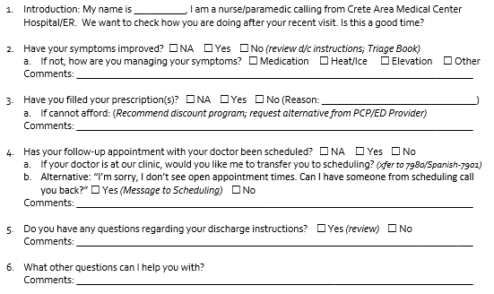
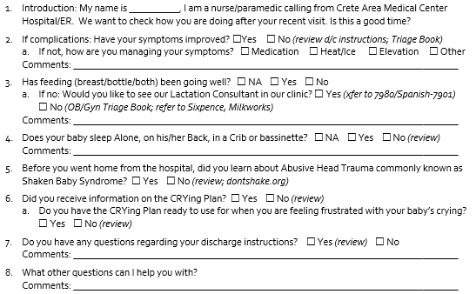
Site Specific Barrier #3
Redundancy/Too Many Questions
Eliminate Redundancy - implemented
All “satisfaction” questions repeated in mailed survey removed
Minimize Questions - implemented
Standardize questions
Limit questions to needs/themes identified through research and requirements of programs:
ED, Inpatient, Observation, and Swing Bed Postpartum
Notes:
The previous list of questions asked included 10 questions for ED patients and was 2 pages long for Acute patients. We had identified the 4 patient needs as the focus of these calls. Included were questions that could be classified as satisfaction indicators. Our facility utilizes a third party to administer surveys regarding patient satisfaction. Those were removed as they were addressed elsewhere and didn’t align with the focus.
We standardized the questions for all ED, Inpatient, Observation, and Swing Bed patients for consistency.
Due to our Safe Sleep Hospital Champion & Abusive Head Trauma Prevention Hospital Champion designations, certain additional questions are required for Postpartum follow up.

Slide 19
Site Specific Barriers
#4 Buy-in / “Why”
Staff Education - implemented
Before implementing process improvement, staff meeting included: Research presentation, ACO requirement, TCM billing requirement
#5 Incorrect phone numbers
Training - implemented
Staff Education/Training how to perform demographic check on admission/before discharge
Notes:
Staff Buy-in was lower on the list of barriers according to the staff survey, but I believe it was actually one of the bigger barriers and we still struggle with some staff. I gathered the scholarly articles and presented my research. I explained TCM billing requirements and the other programs that are effected by the phone calls.
Some staff identified that some patients have incorrect phone numbers. Some patients have to “allow” calls from us in order for them to go through. Demographic data has always been on the checklists for Acute admission and ED Discharge. We implemented staff education/training for how to verify and update telephone numbers in EMR. Our ED instruction sheets have a section notifying patients to expect a phone call. We added staff education to include that in their verbal discharge instructions both in ED and Acute as well.

Slide 20
Site Specific Barriers
#6 Time of Day – Staff suggestions:
Designate Time – implemented
Calls made 8am to 8pm: This accommodates 2nd & 3rd shift workers as well, both shifts involved
7pm shift change may be used for both shifts to finish calls before & after shift reports
Day Shift Only – implemented, modified
Day shift has 11 hours and night shift has 1 hour; the majority of calls will be made by day shift
Ask patient during discharge what time they want to be called – not implemented
This would further limit the time frame nurses have to call patients and would add a step to check before making a call.
#7 Patients don’t want calls – Staff suggestions:
Ask during discharge if patient wants to be called - not implemented
Per TCM and ACO requirements – even if a patient prefers not to be called, that patient’s discharge would still be included in the denominator and count against us as unattempted.
Notes:
I went over this earlier as well. What I want to point out here is the suggestion that we ask the patient what time of day they prefer to be called. We decided not to implement that because it would further limit the time frame staff could attempt the call.
Staff pointed out that some patients may not want to be called. We provided staff education/training on how to explain the purpose of the phone call. For reporting, if we don’t attempt, it counts against us. Patients can decline answering the questions when we call them, that still counts as an interactive encounter, or patients can choose to not answer when we attempt twice.

Slide 21
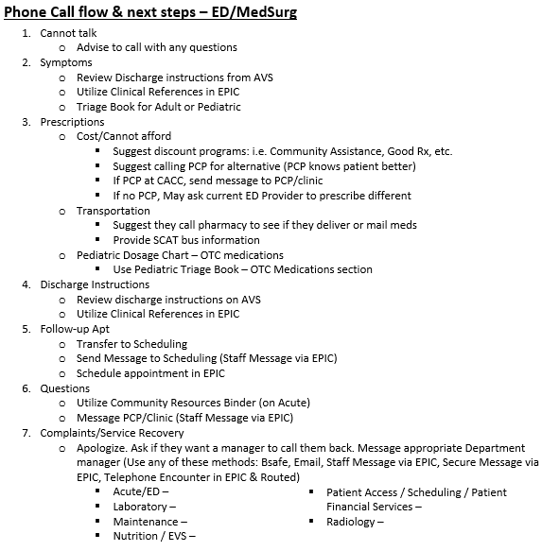
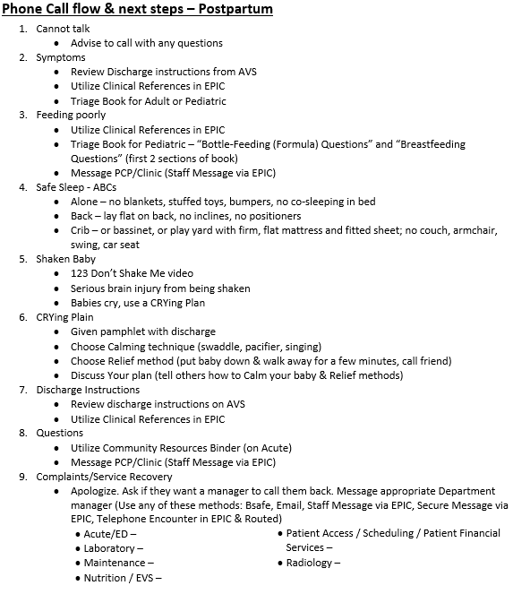
Site Specific Barrier #8
Handling a “problem”
Automation/Outsource – not implemented
Site reasons previously
Automated systems were still forwarded to nurses when needs were identified
Quick Reference Resources – implemented
Developed Discharge Phone Call Resources sheet detailing steps to take in common scenarios
Education/Training – implemented
Service Recovery / Patient Complaints
Transferring Calls
Sending Messages in EPIC
Scheduling Follow-up/clinic appointments after hours
Community Resources Binder
Phone Triage Books
Notes:
Staff identified that sometimes they don’t know how to help the patients. It is much easier to help patients when staff can transfer them to departments to handle it.
It was suggested that we utilize an automated system. This was addressed with time issues as well, but in the scholarly articles it was stated that the automated systems would refer patients to clinical staff when a need was identified. So the automated system would not help for this.
We developed a quick reference resources sheet for common scenarios
We provided staff education/Training and reference tip sheets for identified tasks

Slide 22
Charting for effective communication
Result of call - Hospital and Clinic provider access
Need a way for ED providers, Hospitalists, and PCPs to easily see the result of the post discharge call
Complications / Progress
Discharge instruction compliance
Medication compliance
Documentation Options
Paper
EMR Flowsheet
EMR “Note”
Need to track call attempts
TCM audits
ACO Quality Improvement tracking
Post Acute Care Stroke Care Collaborative
Safe Sleep Hospital Champion & Abusive Head Trauma Prevention Hospital Champion
Notes:
Communication with care team members is always a consideration and potential barrier. Tracking call attempts and access to the results needed to be accessible by several departments within our system. Additionally, the information from the phone calls is time sensitive. We needed to look at the fastest, most effective way to chart the phone call attempts and outcomes so all the involved departments could see them. Thankfully, we all use the same EMR system, but the different entities don’t necessarily see the same things. This particular barrier has had the most changes as the project has continued and continues to be a focus to create a more efficient process.

Slide 23
Charting for effective communication
CAMC Documentation Options
Paper –scanned into EMR
PROS | CONS
Easy for staff to document | Providers cannot see = Lag time to be scanned into EMR; scan/transcribe requiring more staff/time
Prompt for staff | Lost papers
Easy to split up | Paper stack – difficult to locate = paper filing system; More difficult to find in EMR
 | Manual input tracking from paper
EMR Flowsheet (EPIC)
PROS | CONS
Easy for staff to document | PlanView to edit existing flowsheet used by other entity
Can start with existing flowsheet template used by other entity | Not visible to other departments & disciplines
Potential for automated tracking | Need to develop list to prompt staff/split up
Digital record in EMR for reference | Manual input tracking – PlanView for automated tracking
Directly in EMR = no scanning/transcribing
EMR “Note” (EPIC)
PROS | CONS
Easily found by providers | Difficult for staff to document
Visible to all care providers and patients | Need to develop list to prompt staff/split up
Digital record in EMR for reference | Manual input tracking digital in chart
Directly in EMR = no scanning/transcribing
Notes:
The process before this project was all paper. There were several complications with that process.
However, anything that included our EMR (Epic) required us to work with IT/Analysts and required time and compromise. In the end, Epic had a process already built for a different entity that we were able to adjust. We are using a combination flowsheet (for staff ease) and Note (for provider ease). The flowsheet lists the answers and staff record the answers on it then create a Note that pulls information from that flowsheet so providers can see it. We are still working to develop something more fluid.

Slide 24
Barrier – Keeping Staff Engaged
Initial improvement can be predicted but maintaining and building on that improvement can be tricky
Strategies to keep staff engaged
Seeking staff feedback
Asked staff how the process was going; soliciting improvement suggestions
Responding to communicated problems and suggestions in a timely manner
Regular involvement and updates
Attend staff meetings quarterly
Charts of metrics posted in Report Room monthly
Positive Outcomes/Close saves communicated
Positive reinforcement
Bought all staff ice cream sandwiches when they got over 99% of patients with at least 1 call attempt
Regular verbal recognition
Contests
Staff member that made the most phone calls in a month won a fun badge reel
Notes:
This project has been ongoing for almost 1 ½ years. It is hard to keep staff attention for that long. These are some of the strategies to keep staff engaged. Being interactive with staff – reacting and adjusting as issues arise or suggestions are made help staff feel like you are in it with them.
Monthly, I post graphs for staff, update the unit manager, CNO, and Quality council. I attend unit staff meetings quarterly. I verbally recognize staff and we give rewards. I have gave prizes to staff that made the most calls. I communicate Positive outcomes/Close saves that have come from calls.

Slide 25
CAMC Progress after over 1 year implementation
Notes:
I wanted to give our staff props for how great they have done! We implemented interventions with this Process improvement in July, 2022 – see the big jump initially. They surpassed my initial goal of 90% of patients being attempted and have reached 100% in the last several months! Now we are focused on getting those calls within the 2 days and are making great progress!

Slide 26
CAMC Progress
Positive results
Increased revenue from TCM eligible visits
Accountable Care Organization
Meeting goal of call attempts
Working toward goal for call attempt timing
Patient benefits
Improved Patient Satisfaction:
Reduced Ambulatory ED visits:
Positive Outcomes/Close saves:
Potential infection back to clinic for follow-up
Caught Cardiac follow-up that wasn’t scheduled
Pharmacy change – avoid repeat ED d/t pain
 | Willingness to Recommend
Quarter | 2022 Q3 | 2022 Q4 | 2023 Q1 | 2023 Q2
ED Percentage | 72.5% | 74.8% | 73.2% | 74.8%
Acute Percentage | 86.7% (7) | 87.5% (13) | 88.6% (15) | 72.2% (7)
 | Ambulatory ED visits
Year | 2020 Avg | 2021 Avg | 2022 Avg | 2023 Jan-Jun Avg
Average | 33.6% | 18.5% | 22.6% | 18.0%
New cardiac symptoms caught
Caught & corrected prescriptions sent to wrong pharmacy
Notes:
I wanted to include some of the positive effects these phone calls have had. Some of these measures have many other variables as well, but it is great to see positive results from all the hard work! And I wanted to share just some of the Positive Outcomes/Close saves directly associated with calls.

Slide 27
References
Abusive head trauma prevention hospital campaign // <![CDATA[ _spbodyonloadfunctionnames.push(“setuppagedescriptioncallout”); // ]]>. Abusive Head Trauma Prevention Hospital Campaign. (n.d.). https://dhhs.ne.gov/Pages/Abusive-Head-Trauma-Campaign.aspx
Adams, H. S., Staten, R. R., & Coty, M. B. (2020). Initiating Telephone Follow Up After Hospital Discharge From an Inpatient Psychiatric Setting to Reduce Recidivism. Journal of psychosocial nursing and mental health services, 58(5), 25–31. https://doi.org/10.3928/02793695-20200221-01
Auger, K. A., Shah, S. S., Tubbs-Cooley, H. L., Sucharew, H. J., Gold, J. M., Wade-Murphy, S., Statile, A. M., Bell, K. D., Khoury, J. C., Mangeot, C., Simmons, J. M., & Hospital-to-Home Outcomes Trial Study Group (2018). Effects of a 1-Time Nurse-Led Telephone Call After Pediatric Discharge: The H2O II Randomized Clinical Trial. JAMA pediatrics, 172(9), e181482. https://doi.org/10.1001/jamapediatrics.2018.1482
Biese, K. J., Busby-Whitehead, J., Cai, J., Stearns, S. C., Roberts, E., Mihas, P., Emmett, D., Zhou, Q., Farmer, F., & Kizer, J. S. (2018). Telephone Follow-Up for Older Adults Discharged to Home from the Emergency Department: A Pragmatic Randomized Controlled Trial. Journal of the American Geriatrics Society, 66(3), 452–458. https://doi.org/10.1111/jgs.15142
Boonyasai, R., et al. (2014). Improving the Emergency Department Discharge Process: Environmental Scan Report. In Agency for Healthcare Research and Quality (AHRQ Publication No. 14(15)-0067-EF). https://www.ahrq.gov/sites/default/files/wysiwyg/professionals/systems/hospital/edenvironmentalscan/edenvironmentalscan.pdf
Brooks, D. (2022, August). Call Patients to Reinforce Discharge Instructions, Stress Need for Follow-Up Care. Nursing Reference Center Plus. https://web.p.ebscohost.com/nup/pdfviewer/pdfviewer?vid=2&sid=ef21f8f9-74a0-4a19-a60c-bc664231fd3b%40redis
Chen, CJ, Cochon, L., Tat, S., & Green-Hopkins, I. (2019). Telephone Follow-Up After Pediatric Emergency Department Discharge – Does It Impact the Likelihood of Return Visits? Western Journal of Emergency Medicine: Integrating Emergency Care with Population Health, 20(5.1). Retrieved from https://escholarship.org/uc/item/6qg1n3ph
Crete, Nebraska Population 2023. (2023). Worldpopulationreview.com. Retrieved October 2, 2023, from https://worldpopulationreview.com/us-cities/crete-ne-population
Dent B. (2020). PRACTITIONER APPLICATION: Time-Driven Activity-Based Costing of Emergency Department Postdischarge Nurse Calls. Journal of healthcare management / American College of Healthcare Executives, 65(6), 428–429. https://doi.org/10.1097/JHM-D-20-00266
Dudas, V., Bookwalter, T., Kerr, K. M., & Pantilat, S. Z. (2001). The impact of follow-up telephone calls to patients after hospitalization. The American journal of medicine, 111(9B), 26S–30S. https://doi.org/10.1016/s0002-9343(01)00966-4
Guss, D. A., Leland, H., & Castillo, E. M. (2013). The impact of post-discharge patient call back on patient satisfaction in two academic emergency departments. The Journal of emergency medicine, 44(1), 236–241. https://doi.org/10.1016/j.jemermed.2012.07.074
Guss, D. A., Leland, H., & Castillo, E. M. (2013). The impact of post-discharge patient call back on patient satisfaction in two academic emergency departments. The Journal of emergency medicine, 44(1), 236–241. https://doi.org/10.1016/j.jemermed.2012.07.074

Slide 28
References
Harrison, J. D., Auerbach, A. D., Quinn, K., Kynoch, E., & Mourad, M. (2014). Assessing the impact of nurse post-discharge telephone calls on 30-day hospital readmission rates. Journal of general internal medicine, 29(11), 1519–1525. https://doi.org/10.1007/s11606-014-2954-2
Hughes, P. I. J., Zabielska, J., & Moran, C. A. (2021). Improving Discharge Phone Call Compliance. Journal of PeriAnesthesia Nursing, 36(4), e32. https://doi.org/10.1016/j.jopan.2021.06.093
Knights, E., Gorman, V. B., Mitra, B., & Gray, R. (2021). Emergency department nurse call back: A quality improvement project. International Emergency Nursing, 56, 101001. https://doi.org/10.1016/j.ienj.2021.101001
Lewis, E., Samperi, S., & Boyd-Skinner, C. (2017). Telephone follow-up calls for older patients after hospital discharge. Age and ageing, 46(4), 544–546. https://doi.org/10.1093/ageing/afw251
Luciani-Mcgillivray, I. (2017). EMERGENCY DEPARTMENT POSTDISCHARGE PHONE CALLS: LESSONS LEARNED. Journal of Emergency Nursing, 43(6), 581–583. https://doi.org/10.1016/j.jen.2017.07.015
Luciani-McGillivray, I., Cushing, J., Klug, R., Lee, H., & Cahill, J. E. (2020). Nurse-Led Call Back Program to Improve Patient Follow-Up With Providers After Discharge From the Emergency Department. Journal of patient experience, 7(6), 1349–1356. https://doi.org/10.1177/2374373520947925
Medicare Learning Network. (2022, August). MLN908628 – Transitional Care Management Services. CMS. https://www.cms.gov/outreach-and-education/medicare-learning-network-mln/mlnproducts/downloads/transitional-care-management-services-fact-sheet-icn908628.pdf
Ojeda, P.I., & Kara, A. (2017). Post discharge issues identified by a call-back program: identifying improvement opportunities. Hospital Practice, 45, 201 - 208
Osei, M. (2017). The Impact of Telephone Follow-Up Calls on 30-Day Readmissions in Older Adults Post Total Joint Replacement Surgery. In Doctors of Nursing Practice. https://www.doctorsofnursingpractice.org/wp-content/uploads/project_form/complete_091117042236.pdf
Poncia, H. D., Ryan, J., & Carver, M. (2000). Next day telephone follow up of the elderly: a needs assessment and critical incident monitoring tool for the accident and emergency department. Journal of accident & emergency medicine, 17(5), 337–340. https://doi.org/10.1136/emj.17.5.337
HCPro. (2015). Prevent ED discharge failures. Case Management Monthly, 12(2), 5–8. https://web.p.ebscohost.com/nup/detail/detail?vid=7&sid=b56b322c-ccfc-494b-9454-8024dda3df99%40redis&bdata=JnNpdGU9bnVwLWxpdmUmc2NvcGU9c2l0ZQ%3d%3d#AN=100855868&db=ccm
Renner, L., Beaver, C., & Veicelli-Fowler, R. (2022). A DEDICATED DISCHARGE CALL NURSE TEAM CAN REDUCE READMISSION RATES...47th Annual Oncology Nursing Society Congress, April 27–May 1, 2022, Anaheim, CA. Oncology Nursing Forum, 49(2), E42. https://doi.org/10.1188/22.ONF.E2
Roth, M. (2020). HOW RUSH USES ROBOCALLS TO REDUCE READMISSIONS. Health Leaders. https://www.healthleadersmedia.com/innovation/how-rush-uses-robocalls-reduce-readmissions

Slide 29
References
Schuller, K. A., Kash, B. A., & Gamm, L. D. (2017). Enhanced Transitions of Care: Centralizing Discharge Phone Calls Improves Ability to Reach Patients and Reduces Hospital Readmissions. Journal for healthcare quality : official publication of the National Association for Healthcare Quality, 39(2), e10–e21. https://doi.org/10.1097/JHQ.0000000000000063
Soong, C., Kurabi, B., Wells, D., Caines, L., Morgan, M. W., Ramsden, R., & Bell, C. M. (2014). Do post discharge phone calls improve care transitions? A cluster-randomized trial. PloS one, 9(11), e112230. https://doi.org/10.1371/journal.pone.0112230
Tang, N., Fujimoto, J., & Karliner, L. (2014). Evaluation of a primary care-based post-discharge phone call program: keeping the primary care practice at the center of post-hospitalization care transition. Journal of general internal medicine, 29(11), 1513–1518. https://doi.org/10.1007/s11606-014-2942-6
Thomas, M. B. (2018). Interactive Post-discharge Calls Improve Outcomes, Save Time for Case Managers. Hospital Case Management. https://www.reliasmedia.com/articles/142476-interactive-post-discharge-calls-improve-outcomes-save-time-for-case-managers.
Vaillancourt, S., Seaton, M. B., Schull, M. J., Cheng, A. H. Y., Beaton, D. E., Laupacis, A., & Dainty, K. N. (2017). Patients' Perspectives on Outcomes of Care After Discharge From the Emergency Department: A Qualitative Study. Annals of emergency medicine, 70(5), 648–658.e2. https://doi.org/10.1016/j.annemergmed.2017.05.034
van Loon-van Gaalen, M., van Winsen, B., van der Linden, M. C., Gussekloo, J., & van der Mast, R. C. (2021). The effect of a telephone follow-up call for older patients, discharged home from the emergency department on health-related outcomes: a systematic review of controlled studies. International journal of emergency medicine, 14(1), 13. https://doi.org/10.1186/s12245-021-00336-x
Yang, C., & Chen, C. M. (2012). Effects of post-discharge telephone calls on the rate of emergency department visits in paediatric patients. Journal of paediatrics and child health, 48(10), 931–935. https://doi.org/10.1111/j.1440-1754.2012.02519.x

