Slide 1
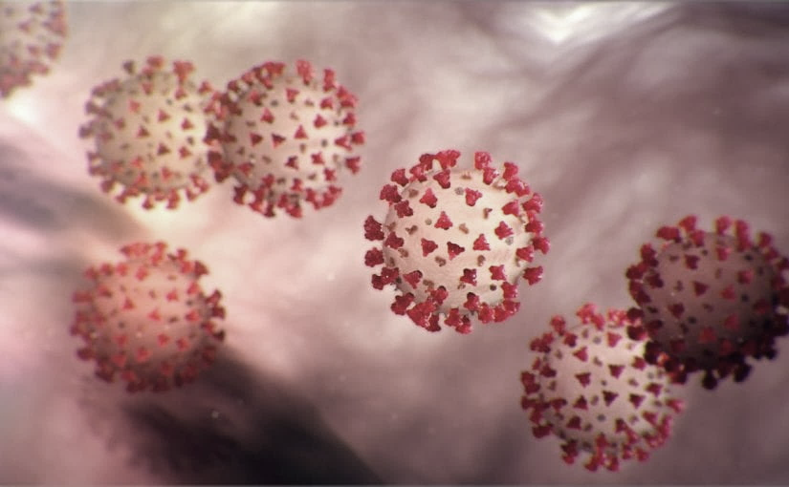
Covid-19 Webex Update 7-22-2020
​​
Tom Safranek, MD, State Epidemiologist
Louis Safranek, MD, PhD
Board certified specialist, Infectious Disease

Slide 2
Face masks
Association Between Universal Masking in a Health Care System and SARS-CoV-2 Positivity Among Health Care Workers.
JAMA. 2020 Jul 14.
doi: 10.1001/jama.2020.12897. PMID:32663246
Drop off in Covid cases among health care workers after universal masking.

Slide 3
How do face masks work?
Modeling the role of respiratory droplets in Covid-19 type pandemics
Physics of Fluids 32, 063309 (2020);
https://doi.org/10.1063/5.0015984
Evaporation, droplet size, humidity, temperature all affect

Slide 4
Masks, face shields
Efficacy of Face Shields Against Cough Aerosol Droplets from a Cough Simulator
doi: 10.1080/15459624.2013.877591
The amount of influenza virus inhaled by the breathing simulator was substantially reduced by the use of a face shield.

Slide 5
Saliva testing
Saliva as a diagnostic specimen for detection of SARS-CoV-2 in suspected patients: a scoping review.
Despite limitations of this study, the findings of this review suggest that the use of self-collected saliva as a non-invasive specimen has proper accuracy and reliability regarding detection of SARS-CoV-2 based on RT-PCR technique.
https://idpjournal.biomedcentral.com/articles/10.1186/s40249-020-00728-w

Slide 6
Saliva testing
Saliva as a Noninvasive Specimen for Detection of SARS-CoV-2
DOI: 10.1128/JCM.00776-20
Here, we demonstrate the feasibility, acceptability, and scalability of prospectively collecting saliva from ambulatory patients in a busy screening clinic and further demonstrate the value of saliva as a noninvasive specimen for the detection of SARS-CoV-2.

Slide 7
Sputum
SARS-CoV-2 detection in different respiratory sites: A systematic review and meta-analysis
DOI:https://doi.org/10.1016/j.ebiom.2020.102903
Compared to nasopharyngeal swab sampling, sputum testing resulted in significantly higher rates of SARS-CoV-2 RNA detection while oropharyngeal swab testing had lower rates of viral RNA detection.

Slide 8
Sputum testing availability
Rutgers coronavirus saliva test with 48 hour results to increase N.J.’s daily capacity by 30K starting Monday
Sorrento Therapeutics Licenses 30-Minute Spit Test for Covid-19

Slide 9
Treatment
Corticosteroids
Hydroxychloroquine
Individual, community benefits?
India
https://www.lifesitenews.com/opinion/this-indian-slum-contained-a-possible-covid-19-disaster-with-hydroxychloroquine
https://www.icmr.gov.in/pdf/covid/techdoc/V5_Revised_advisory_on_the_use_of_HCQ_SARS_CoV2_infection.pdf

Slide 10
Schools
School openings across globe suggest ways to keep coronavirus at bay, despite outbreaks
https://www.sciencemag.org/news/2020/07/school-openings-across-globe-suggest-ways-keep-coronavirus-bay-despite-outbreaks

Slide 11
Schools
A large COVID-19 outbreak in a high school 10 days after schools’ reopening, Israel, May 2020
https://www.eurosurveillance.org/content/10.2807/1560-7917.ES.2020.25.29.2001352#html_fulltext
Most student cases presented with mild symptoms or were asymptomatic.
One emergency room visit was recorded and no hospitalisations.

