Slide 1
Fillmore County Rural Transit Service

Slide 2
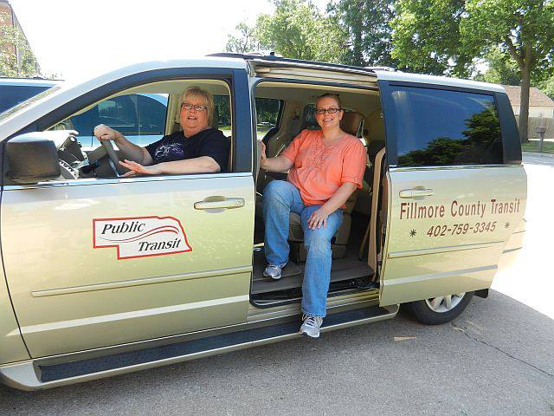
Fillmore County Rural Transit Service
Founded in 1981
Funded by Federal dollars, State (NDOT), and Fillmore County
Operated by Blue Valley Community Action Partnership
$176,000 annual budget
Provides transport service to an average of 40 people daily

Slide 3
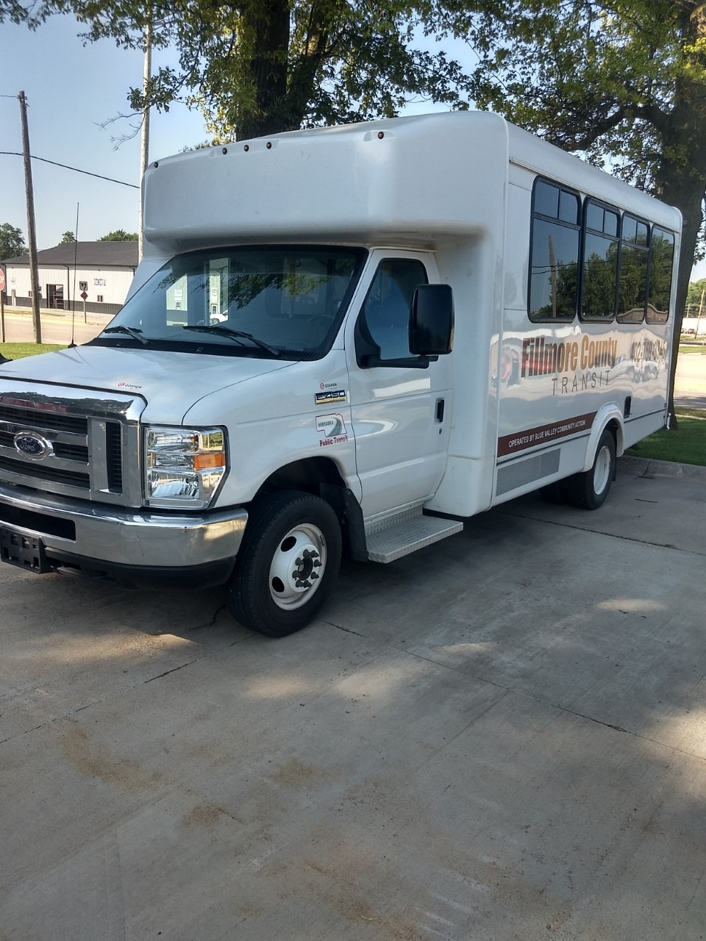
Fillmore County Rural Transit Service
Four drivers, one of whom is the Transit Manager
Four vehicles, all on the road daily
Operates 8am-4pm, Monday through Friday
Provides rides within Fillmore County
County-wide rides every day per availability
Once per week to Lincoln
Once per month to Hastings, Grand Island, and York

Slide 4
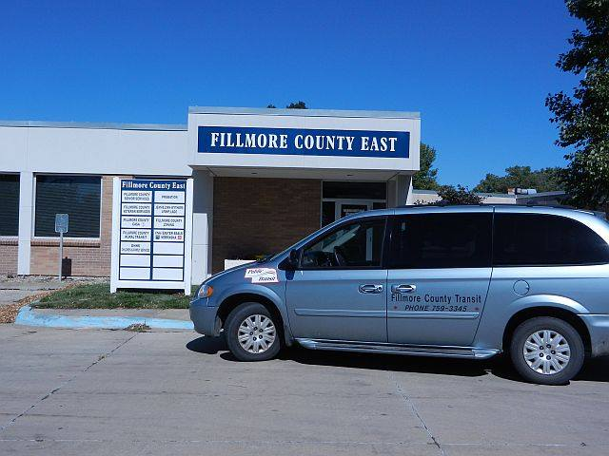
Fare Schedule/Price
Local – within Geneva City Limits: $1.00
Offered Daily
County – town to town or rural to town: $2.00
Offered Daily
Lincoln, Hastings, Grand Island, York
Lincoln – once per week $10.00
Hastings, Grand Island – once per month $10.00
York – once per month $6.00

Slide 5
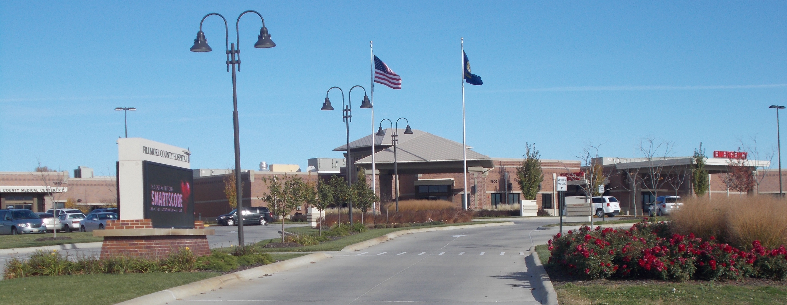
Program Benefits
No age or income restrictions
Plays a huge role for vulnerable kids – school attendance
Plays a huge role for the elderly – medical appointments, bank, store, etc.
Offers food deliveries once per month
Easy to schedule and door to door service
Great benefit to Fillmore County Hospital and Medical Clinic

Slide 6
Program Restrictions
Weekday only – no evenings, nights, weekends
Closed on Governmental-observed Holidays – 12 days/year
Sometimes restricted to the number of drivers available
Way more benefits than restrictions!

Slide 7
Summary
Fillmore County is BLESSED to have this service!
It’s a lifeline to many residents and a benefit to the hospital.
Low no-show and rescheduling rates with these patients.
The drivers are the reason the program shines!
They are exceptional people and go above and beyond.
They are kind, compassionate, and look out for the passengers.
They are on a first name basis with almost every passenger.
It’s more than a drop-off and pick-up service.
Overall, it is an exceptional program!

