Slide 1
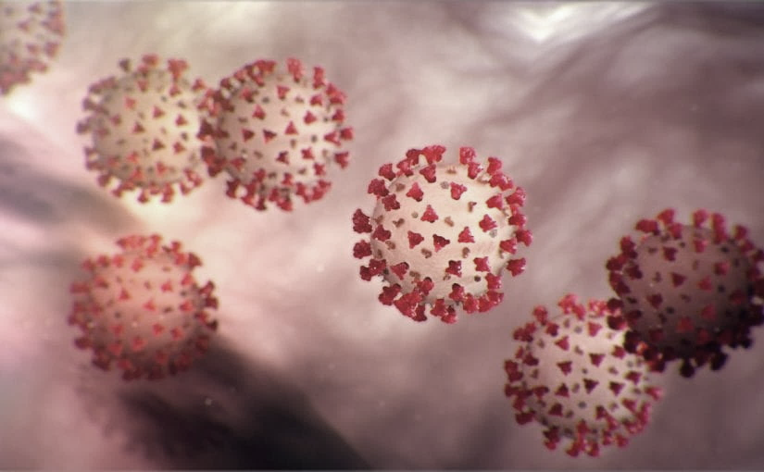
Covid-19 Webinex Update on ACH for COVID-19 3-23-20
Maureen Tierney, MD, MSc.
Healthcare Associated InfectionsMedical Director
Tom Safranek, MD, State Epidemiologist
Matthew Donahue, MD, EIS Officer, NE DHHS

Slide 2
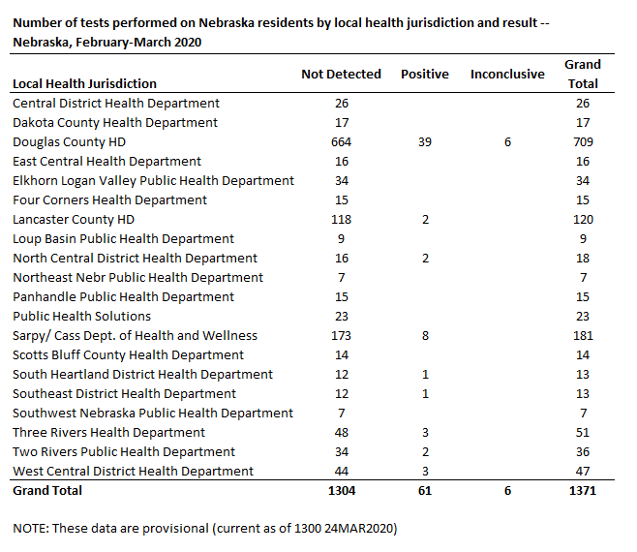
NE COVID Epi

Slide 3
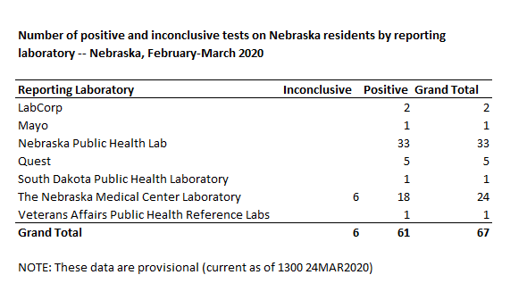
Totals and Positives by lab
Totals by lab
NPHL 491
UNMC 504
Lab Corp 135
Quest 132
Mayo 82
ARUP 8

Slide 4
Risk Factors
Travel—50-60%
UK, Italy, Singapore, WA, CA, FL, CO, NY
Contact-25-35%
Community Acquired-4
Selection/Testing Bias
Models from other cities likely 15-20 cases for every positive we see.

Slide 5
Recommendations to Returning Out-of-State Travelers
HAN March 23, 2020

Slide 6
Out of State Travel
Public health surveillance continues to identify significant numbers of COVID-19 infections in out-of-state travelers, with spread to other Nebraskans (>80% of lab-confirmed cases to date).
The best way to minimize COVID-19 virus introduction/spread in Nebraska is to:
limit unnecessary travel
Upon return from out-of-state travel:
maximize self-quarantine
social distancing,
non-pharmaceutical interventions e.g.
washing hands often
staying home if you are ill
covering your cough/sneezes
cleaning frequently touched surfaces
www.cdc.gov/nonpharmaceutical-interventions

Slide 7
Out-of-State Travelers--When to Self-monitor, Self-quarantine or Self-isolate
Returning international travelers from regions with widespread sustained transmission (e.g., CDC Level 3 countries –
https://wwwnc.cdc.gov/travel/notices#alert
should self-quarantine for 14 days following return.
Widespread local transmission is occurring in many regions of the U.S., and may be unrecognized and underreported due to the lack of testing.
Returning travelers from regions of the U.S. with widespread transmission should self-quarantine for 14 days following return
e.g., Santa Clara County, CA; New York City, NY; Seattle, WA; etc.
Please note with continued widespread transmission across the U.S., the listed areas above are an example and may change over time.

Slide 8
Out-of-State Travelers--When to Self-monitor, Self-quarantine or Self-isolate
Returning international travelers from regions with widespread sustained transmission (e.g., CDC Level 3 countries –
https://wwwnc.cdc.gov/travel/notices#alert
should self-quarantine for 14 days following return.
Widespread local transmission is occurring in many regions of the U.S., and may be unrecognized and underreported due to the lack of testing.
Returning travelers from regions of the U.S. with widespread transmission should self-quarantine for 14 days following return
e.g., Santa Clara County, CA; New York City, NY; Seattle, WA; etc.
Please note with continued widespread transmission across the U.S., the listed areas above are an example and may change over time.

Slide 9
Every health care worker who returns from out-of-state travel
Should consult with a trained medical professional at their facility (e.g., infection preventionist or physician)
Establish a specific infection control protocol (e.g., PPE while at work, self-monitoring, self-quarantine) that mitigates patient and co-worker exposures.
Special considerations should be taken for those working with high-risk patients e.g.
patients in long-term care
chronic heart or lung conditions
diabetes
pregnant women

Slide 10
Discontinuation from self-monitoring and self-quarantine:
Discontinuation from self-quarantine and self-monitoring may cease if after 14 days there has been NO development of respiratory illness symptoms. Symptoms may include: fever, cough, shortness of breath, sore throat, runny nose.
CDC guidance (www.cdc.gov/coronavirus/2019-ncov/if-you-are-sick/steps-when-sick.html)states that an individual can stop self-isolation if:
It has been at least 7 days since symptoms first appeared
AND
No fever for at least 72 hours (fever-free for 3 full days off fever-reducing medicine) AND
All other symptoms have improved (e.g., cough has improved)

Slide 11
Definitions
Social distancing: Minimize interactions in crowded spaces by working from home, closing schools/switching to online classes, cancelling/postponing conferences and large meetings, and keeping individuals spaced 6 feet apart.
Self-monitor: Monitor yourself for symptoms consistent with COVID-19 infection, including cough, shortness of breath, fever, and fatigue. Persons with known exposure to COVID-19 infection are asked to check for symptoms including fever twice daily (e.g., 8 am and 8 pm). Persons with COVID-19 infection should document symptoms to enable accurate determination of duration of isolation (see above).
Self-quarantine: Persons with known exposure to a person with COVID-19 infection should remove themselves from situations where others could be exposed/infected should they develop infection, and self-monitor to identify if COVID-19 infection develops.
Self-isolate: Persons with clinical or lab-confirmed for COVID-19 infection should eliminate contact with others as detailed above.
Commuters crossing state borders (e.g., Council Bluffs to Omaha, Sioux City to South Sioux City, and Cheyenne to Scotts Bluff), travelers passing through the state/moving within the state, and transportation service workers are not considered special at-risk groups and are not addressed in these our-of-state returning traveler recommendations.

Slide 12
Discontinuation of Isolation
Test-based strategy (simplified from initial protocol) Previous recommendations for a test-based strategy remain applicable; however, a test-based strategy is contingent on the availability of ample testing supplies and laboratory capacity as well as convenient access to testing. For jurisdictions that choose to use a test-based strategy, the recommended protocol has been simplified so that only one swab is needed at every sampling.
Persons who have COVID-19 who have symptoms and were directed to care for themselves at home may discontinue home isolation under the following conditions:
Resolution of fever without the use of fever-reducing medications and
Improvement in respiratory symptoms (e.g., cough, shortness of breath) and

Slide 13
Discontinuation of Home Isolation
Time-since-illness-onset and time-since-recovery strategy (non-test-based strategy)* Persons with COVID-19 who have symptoms and were directed to care for themselves at home may discontinue home isolation under the following conditions:
At least 3 days (72 hours) have passed since recovery defined as resolution of fever without the use of fever-reducing medications and improvement in respiratory symptoms (e.g., cough, shortness of breath); and,
At least 7 days have passed since symptoms first appeared.
Negative results of an FDA Emergency Use Authorized molecular assay for COVID-19 from at least two consecutive nasopharyngeal swab specimens collected ≥24 hours apart** (total of two negative specimens).

Slide 14
Discontinuation of Isolation
Individuals with laboratory-confirmed COVID-19 who have not had any symptoms may discontinue home isolation when at least 7 days have passed since the date of their first positive COVID-19 diagnostic test and have had no subsequent illness.
Footnote
*This recommendation will prevent most, but may not prevent all instances of secondary spread. The risk of transmission after recovery, is likely very substantially less than that during illness.

Slide 15
HCP Return to work
Wear a facemask until all symptoms are resolved or 14 days after symptom onset whichever is longer
Be restricted from contact with severely immunocompromised patietns
Adhere to HH and respiratory etiquette as recommended for control of COVID-19 in the interim guidance
Self monitor for worsening or recurrence of symptoms and notify employee health/occupational health/supervisor if occurs

Slide 16
Updates-When should HCPs Self Quarantine
Other than travel-see previous slide
Any respiratory symptoms or fever of greater than 99.9F.
If there is a household member who is positive for COVID-19, or highly suspected of having COVID-19.
They have been caring for a person who was documented as having COVID-19
and were not wearing necessary PPE –please see next slide for what to do based on different exposures.

Slide 17
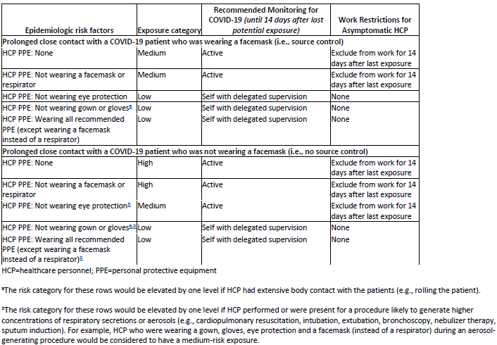
Interim U.S. Guidance for Risk Assessment and Public Health Management of Healthcare Personnel with Potential Exposure in a Healthcare Setting to Patients with COVID-19

Slide 18
Monitoring and Work Restrictions
HCP in the high- or medium-risk category should undergo active monitoring, including restriction from work in any healthcare setting until 14 days after their last exposure.
HCP in the low-risk category should perform self-monitoring with delegated supervision until 14 days after the last potential exposure.
HCP in the no identifiable risk category do not require monitoring or restriction from work.

Slide 19
Clinical Diagnosis
Given the consequences of widespread transmission, public health authorities nationally are broadening the range of clinical syndromes warranting self-isolation:
Possible case (not clear definition)
• Temperature ≥100.4°F (HCP-100.0)
• Cough often dry
• Shortness of breath and/or CP
• +/- Sore throat (more prominent in recent cases)
To limit potential transmission, if any of these symptoms are present, alone or in combination (in the absence of a known alternative diagnosis): patients should self-isolate.
Seeing asymptomatic cases in contacts of known COVID-19 patients that is why we all need to social distance

Slide 20
UPDATED TESTING RECOMMENDATIONS
Evidence suggests >80% of COVID-19 infections are mild (fever is variable with COVID-19 infection and may be absent), might not warrant a healthcare visit or lab test, and do not require hospitalization. Telephone triage and appropriate self-isolation can suffice in most cases.
Capacity and supplies for COVID-19 laboratory testing cannot meet current demand. A simple clinical diagnosis of COVID-19 infection warrants self-isolation, and should be the norm, even in the absence of a positive COVID-19 lab result. This could change if testing capacity expands.
Rapid influenza tests and multiplex PCR respiratory pathogen panel (RPP) tests are still available at in-state laboratories, and if positive, should usually preclude the need for COVID-19 testing (co-infections appear to be uncommon). Also now in short supply; more arriving tomorrow

Slide 21
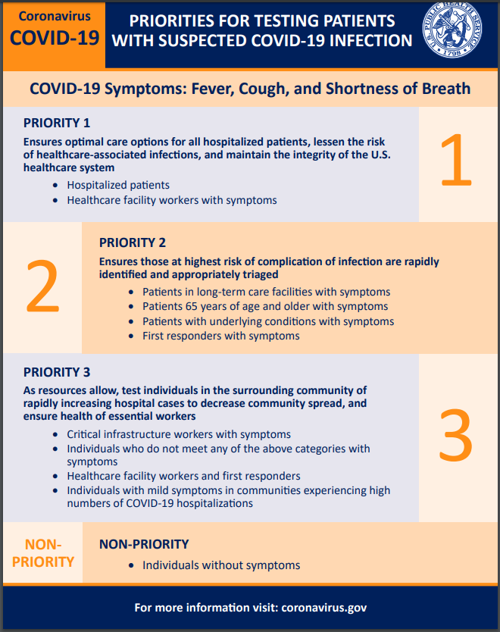
https://www.cdc.gov/coronavirus/2019-ncov/downloads/priority-testing-patients.pdf
Notes:
This is just a new infographic I saw this morning. It is a nice, easy to view summary of the testing priorities.

Slide 22
Call In Lines; Facility Screening
1. NM-Info hotline and referral -400-922-0000; Evaluated over the phone
referred one of their outpatient clinics, Can do their own test
2. CHI-CHIhealth.com 8am to 8pm; after hours virtual care (for CB, IMM, Lakeside St. Es, St. Francis and Good Sam )
Virtual Screening referred to MD or ANP; free.
Methodist 402-815-7425 24/7
Doing testing on main campus
4. Bryan -24/7 hotline-402-481-0500; also website from their Bryan Health homepage
ezVisit-if for coronavirus questions will be provided free of charge
5. Great Plains Health-no hotline-ask people to call their PCP.

Slide 23
Call In Lines; Facility Screening
1. NM-Info hotline and referral -400-922-0000; Evaluated over the phone
referred one of their outpatient clinics, Can do their own test
2. CHI-CHIhealth.com 8am to 8pm; after hours virtual care (for CB, IMM, Lakeside St. Es, St. Francis and Good Sam )
Virtual Screening referred to MD or ANP; free.
Methodist 402-815-7425 24/7
Doing testing on main campus
4. Bryan -24/7 hotline-402-481-0500; also website from their Bryan Health homepage
ezVisit-if for coronavirus questions will be provided free of charge
5. Great Plains Health-no hotline-ask people to call their PCP.

Slide 24
Reporting to LHD
Reporting to LHD should primarily be by providers not patients. The LHD staff screening for who to test need the providers to have done some clinical screening/evaluating first (which may all be by phone)
Any general questions by the public can be answered by the general COVID 19 hotlines at various LHDs
Douglas Co Help Line is the following.
Listing of the local health departments and contacts:
http://dhhs.ne.gov/CHPM%20Documents/contacts.pdf

Slide 25
Minimizing Spread
The best way to minimize COVID-19 virus introduction/spread in Nebraska is to:
minimize out- of-state travel;
maximize the amount of self-quarantine, social distancing, and non-pharmaceutical interventions among travelers returning to Nebraska.
Maximize the use of social distancing, frequent hand washing or use of hand sanitizer, and covering cough and sneezes
Self isolation of contacts of cases, and family members of those with respiratory illness.
At this time we have clear but limited evidence of local transmission of COVID-19 (i.e., persons with no travel history and no identifiable exposure to a likely source of COVID-19

Slide 26
Strategies for Optimizing the Supply of PPE

Slide 27
PPE Supply
Previous calls have identified the issues with limited supply
Any new PPE gets distributed to LHDs who distribute based on need in theor jurisdictions, aggressive efforts underway to get more PPE
CDC strategies are tier-based and facilities should be utilizing all the listed strategies including:
Conventional
Contingency
Crisis
https://www.cdc.gov/coronavirus/2019-ncov/hcp/ppe-strategy/index.html
Regarding use of homemade masks:
https://www.cdc.gov/coronavirus/2019-ncov/hcp/ppe-strategy/face-masks.html
Notes:
Regarding facemasks- especially- just some caution about the use of homemade masks.
CDC notes regarding the use of homemade masks: “n settings where facemasks are not available, HCP might use homemade masks (e.g., bandana, scarf) for care of patients with COVID-19 as a last resort. However, homemade masks are not considered PPE, since their capability to protect HCP is unknown. Caution should be exercised when considering this option. Homemade masks should ideally be used in combination with a face shield that covers the entire front (that extends to the chin or below) and sides of the face.”

Slide 28
Registration link: https://unmc.zoom.us/webinar/register/WN_9jB8mb2CQmWeuD82yxbJ2g

Slide 29
https://repository.netecweb.org/exhibits/show/ncov/ncov
Notes:
NETEC offers excellent training resources on COVID-19 PPE use, as well as conservation

Slide 30
Updates from Interim Guidance for IP in HC
For care other than aerosol generating procedures a face mask can replace an N-95 if an N-95 is not available
If gowns become scarce gowns should be reserved for
Aerosol generating procedures
Care where splashes and sprays anticipated
High contact care activities
In extreme scarcity-
Moving between patients with same confirmed diagnosis and eye protection and mask
not soiled by spray etc
remove only gloves and gowns and perform HH
replace gowns and gloves for next patient

Slide 31
Extended Use versus Re-use
Extended use refers to the practice of wearing the same N95 respirator for repeated encounters with several patients, without removing the respirator between the encounters. Extended use may be implemented when multiple patients are infected and patients are placed together in dedicated waiting rooms, clinics or hospital units. o
Eye protection may be left in place with the N95 respirator for extended use. •
Reuse refers to the practice of using the same N95 respirator for multiple encounters with patients but removing it (‘doffing’) between at least some of the encounters. The respirator is stored in between encounters and reused. o
Re-use of full face shields will be permitted.
Face shields will be dedicated for use by individual healthcare personnel.
Disinfection of the face shield will be required between uses.

Slide 32
Extended Use of N-95s
Discard N95 respirators following use during aerosol generating procedures.
Discard N95 respirators contaminated with blood, respiratory or nasal secretions, or other bodily fluids from patients.
Discard N95 respirators following close contact with, or exit from, the care area of any patient co-infected with an infectious disease requiring contact precautions.
Consider use of a cleanable face shield (preferred³) over an N95 respirator and/or other steps (e.g., masking patients, use of engineering controls) to reduce surface contamination.
Perform hand hygiene with soap and water or an alcohol-based hand sanitizer before and after touching or adjusting the respirator (if necessary for comfort or to maintain fit)

Slide 33
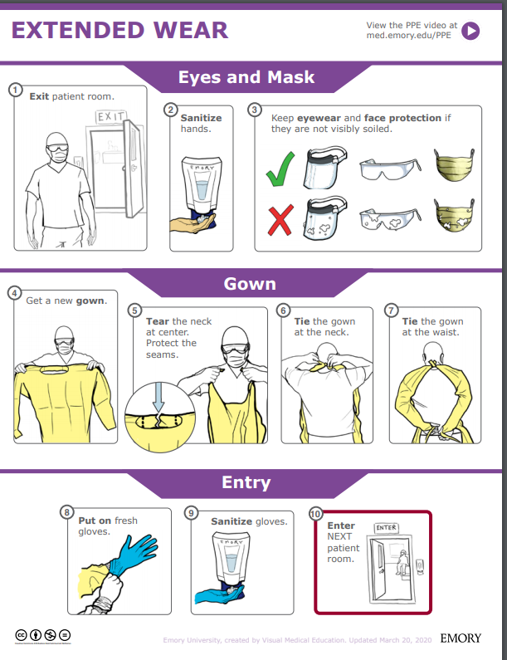
Extended Wear:
Exit room
Sanitize hands
Keep eye wear and face protection if they are not visibly soiled.
Get a new gown
Tear the neck at the center. Protect the seams
Ties the gown at the neck
Ties the gown at the waist
Put on fresh gloves
Sanitize gloves
Enter the next patient room
https://med.emory.edu/departments/medicine/divisions/infectious-diseases/serious-communicable-diseases-program/pdf/extended-wear.pdf
Notes:
This infographic could be posted at the point of PPE Donning. Another infographic is available for doffing, of course.
We think the graphic and the video really need to be paired for clarity- and just want to make you aware of these resources.

Slide 34
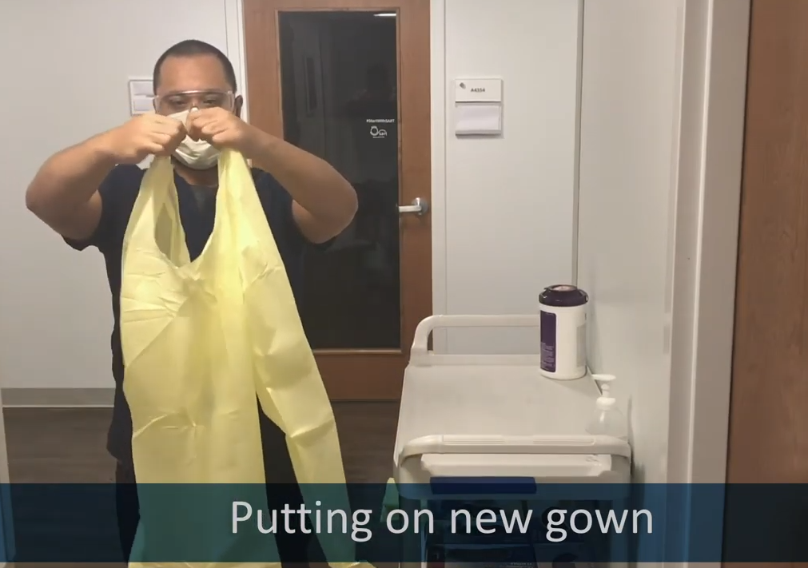
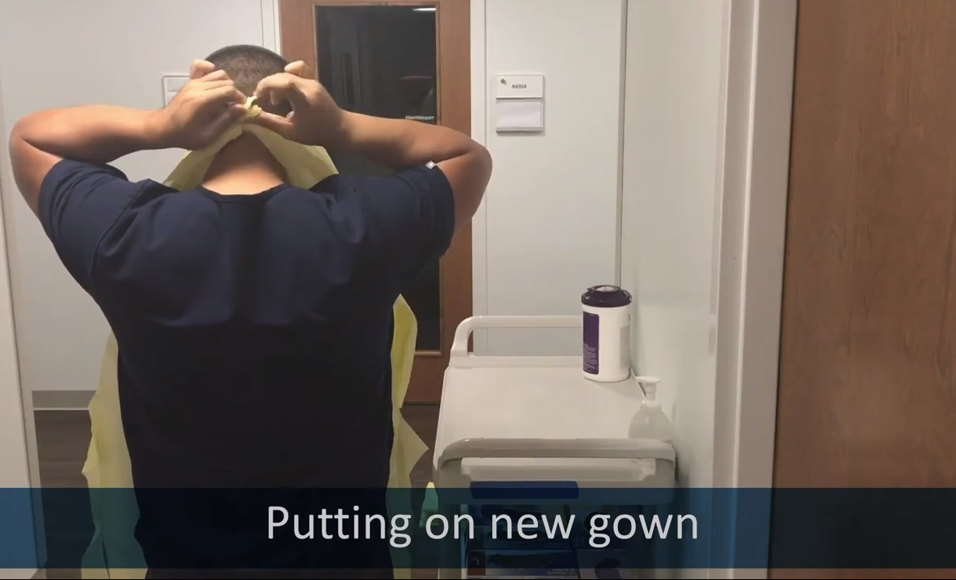
https://med.emory.edu/departments/medicine/divisions/infectious-diseases/serious-communicable-diseases-program/covid-19-resources/conserving-ppe.html
Notes:
The infographics are at the top of this page, but the better place to start is towards the bottom of the page with the instructional video series. In this set clips from the video, you see the HCW donning PPE as part of a conservation strategy to extend the use of eye protection and mask. Highlighted here is the strategy to tear the gown at the neck so that there is no reason to pull the gown over the head/ over the PPE which is still in use.

Slide 35
Re-use of N-95s
Discard N95 respirators following use during aerosol generating procedures.
Discard N95 respirators contaminated with blood, resp. or nasal secretions, or other bodily fluids
Discard N95 respirators following close contact with any patient co-infected with an infectious disease requiring contact precautions.
Use a cleanable face shield (preferred) or a surgical mask over an N95 respirator and/or other steps (e.g., masking patients, use of engineering controls), when feasible
Hang used respirators in a designated storage area or keep them in a clean, breathable container such as a paper bag between uses. To minimize potential cross-contamination, store respirators so that they do not touch each other and the person using the respirator is clearly identified.
Clean hands with soap and water or an alcohol-based hand sanitizer before and after touching or adjusting the respirator (r to maintain fit). Avoid touching the inside of the respirator.
Use a pair of clean (non-sterile) gloves when donning a used N95 respirator and performing a user seal check. Discard gloves after the N95 respirator is donned and any adjustments are made to ensure the respirator is sitting comfortably on your face with a good seal.

Slide 36
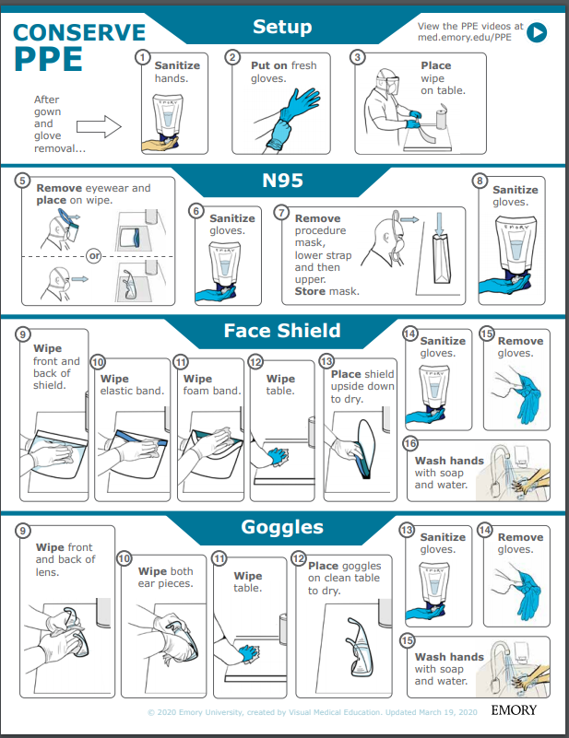
Face shield Re-Use
Sanitize hands
Put on fresh gloves
Place wipe on table
Remove eye wear and place on wipe
Sanitize gloves
Remove procedure mask; Store mask
Sanitize gloves
Wipe front and back of shield
Wipe elastic band
Wipe foam band
Wipe table
Place shield upside down to dry
Sanitize gloves
Remove gloves
Wash hands with soap and water
https://med.emory.edu/departments/medicine/divisions/infectious-diseases/serious-communicable-diseases-program/pdf/ppe-conserve-process-v3.pdf

Slide 37
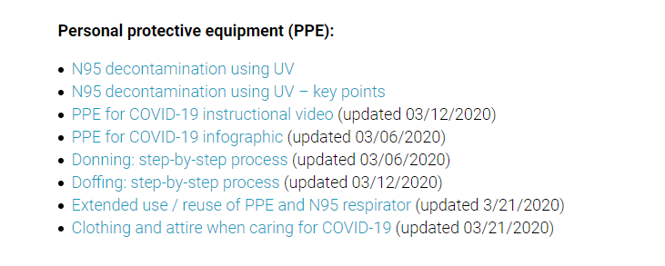
https://www.nebraskamed.com/for-providers/covid19
Notes:
As we’ve noted on previous calls, Nebraska Medicine’s COVID-19 website is public facing, and we encourage users to check out those complete resources and see if those can be implemented or used in conjunction with what your facilities are creating.
Nebraska Medicine has particularly good resources for bagging and processing used PPE.

Slide 38
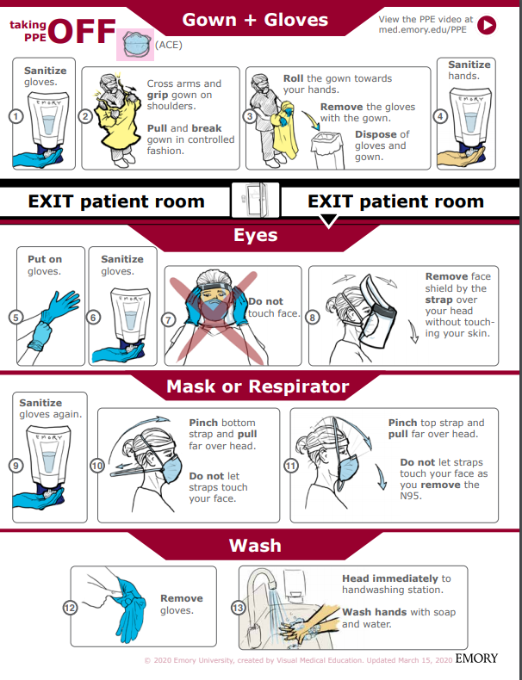
Taking off PPE: Gown
1. Sanitize Gloves
2. Cross arms and grip gown on shoulders. Pull and break gown in a controlled manner
3. Roll the gown towards your hands. Remove the gloves with the gown. Dispose of the gloves and gown.
4. Sanitize hands
https://med.emory.edu/departments/medicine/divisions/infectious-diseases/serious-communicable-diseases-program/pdf/taking-off-ace-conserve-2.pdf
Notes:
We really encourage you to go to the source for both the poster and matching videos. We want to highlight them here. The proper use for your facility, would be to go to the Emory website and use the resources as they have intended. This is just a summary.

Slide 39
Taking off PPE: Eye Protection
Put on gloves
Sanitize gloves
Do NOT touch face
Rove the face shield by the strap over head without touching our skin
https://med.emory.edu/departments/medicine/divisions/infectious-diseases/serious-communicable-diseases-program/pdf/taking-off-ace-conserve-2.pdf

Slide 40
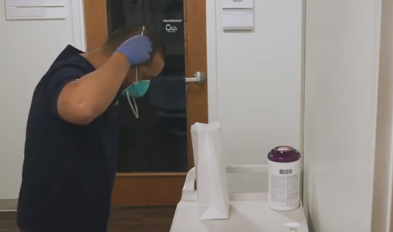
Taking off PPE: Mask
Sanitize hands
Pinch loops and pull them back and off your ears.
Do not let loops touch your face
Pull loops off without touching your face with them or your hands
Remove the mask
WASH
https://med.emory.edu/departments/medicine/divisions/infectious-diseases/serious-communicable-diseases-program/pdf/taking-off-ace-conserve-2.pdf
Notes:
AGAIN, we really encourage you to go to the source for both the poster and matching videos. We want to highlight them here. The proper use for your facility, would be to go to the Emory website and use the resources as they have intended. This is just a summary.

Slide 41
Regarding PPE use
Training must be provided anytime new equipment or new protocols are introduced
Personnel should be required to demonstrate competency: correct technique is observed by a trainer following each training
Posters and educational resources should be readily available; such as posters at the point of PPE donning and doffing
Audits of use with real-time education/feedback are very helpful to ensure proper protection of frontline personnel

Slide 42
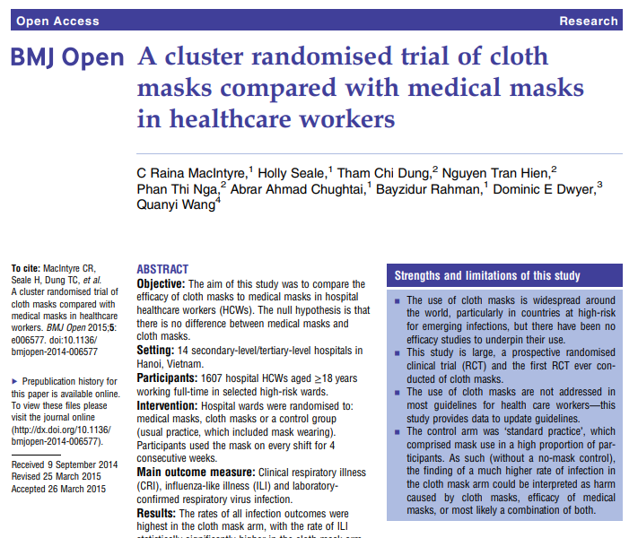
https://bmjopen.bmj.com/content/bmjopen/5/4/e006577.full.pdf
Notes:
This study is from the British Medical Journal, published in 2015.
Conclusion This study is the first RCT of cloth masks, and the results caution against the use of cloth masks… Moisture retention, reuse of cloth masks and poor filtration may result in increased risk of infection. Further research is needed to inform the widespread use of cloth masks globally. However, as a precautionary measure, cloth masks should not be recommended for HCWs, particularly in high-risk situations...
I think we can use this to inform decisions about cloth mask use for HCW- as a stand alone, they are inadequate. Regarding use of cloth masks over N-95, for example, caution should be used to ensure that the wearer can breathe comfortably.

Slide 43
Crisis Capacity When N-95s are running low
HCP planned proximity to the case patient during encounter | Facemask or respirator determination
 | Patient masked for entire encounter (i.e., with source control) | Unmasked patient or mask needs to be removed for any period of time during the patient encounter
HCP will remain at greater than 6 feet from symptomatic patient | HCP remaining at this distance from the patient should not need to enter the patient care area; if entry required: no facemask or respirator | HCP remaining at this distance from the patient should not need to enter the patient care area; if entry required: no facemask or respirator
HCP will be within 3 to 6 feet of symptomatic patient | HCP remaining at this distance from the patient should not need to enter the patient care area; if entry required: facemask | HCP remaining at this distance from the patient should not need to enter the patient care area; if entry required: facemask
HCP will be within 3 feet of symptomatic patient, including providing direct patient care | Facemask | N95 respirator/ elastomeric /PAPR, based on availability
HCP will be present in the room during aerosol generating procedures performed on symptomatic persons | N95 respirator/ elastomeric /PAPR, based on availability | N95 respirator/ elastomeric /PAPR, based on availability

Slide 44
PPE Extended and Re-use at NM
Nebraska Medicine has posted how they are extending PPE use on the Nebraska Medicine COVID page- open access.
https://www.nebraskamed.com/sites/default/files/documents/covid-19/COVID-Extended-Use-Reuse-of-PPE-and-N95.pdf?date=03182020

Slide 45
UV Disinfection of PPE
“A team led by John Lowe, PhD, UNMC assistant vice chancellor for inter-professional health security training and education has developed a safe and effective method to decontaminate N95 respirators so they can be used multiple times, instead of just once. It involves using ultraviolet light towers to irradiate high numbers of N95 respirators.
The decontamination of these items works like this: groups of N95s are safely bagged and transported to a room inside Nebraska Medical Center, which is equipped with two ultraviolet light towers. The N95 respirators are hung on wires stretching the length of the room and then decontaminated when the lights are powered on. They are then removed and returned to the original owners for reuse.”
This is public facing now on the NETEC site.
https://repository.netecweb.org/files/original/fe9a813e5643ab774a62b4b1778117e0.pdf

Slide 46
From the CDC –ABHR Shortages
If “severe shortages of ABHR (and have exhausted supply chain access to efficacious products) may consider local production of formulations as described by the FDA Policy for Compounding of Certain Alcohol-Based Hand Sanitizer Productsexternal icon. This policy remains in effect through April 30, 2020. Formulations included in the FDA guidance are consistent with World Health Organization production guidance. These locally produced products are intended for routine healthcare personnel hand cleaning, must not contain active ingredients other than those specified in the FDA guidance, and should not take the place of other regulated skin antiseptics (e.g. surgical hand rub). To avoid contamination with spore-forming organisms, WHO formulations require a 72-hour post-production quarantine. Organizations should revert to the use of commercially produced, FDA-approved product once such supplies again become available.”
Here is the link to The World Health Organization's hand rub directions:https://www.who.int/gpsc/5may/Guide_to_Local_Production.pdf
Here is the FDA one:https://www.fda.gov/news-events/press-announcements/coronavirus-covid-19-update-fda-provides-guidance-production-alcohol-based-hand-sanitizer-help-boost

Slide 47
Resources
CDC is updating guidance frequently and should be considered the best authority for most situations
https://www.cdc.gov/coronavirus/2019-ncov/index.html (main)

Slide 48
Presentation prepared by: Dr. Maureen Tierney and Dr. Tom Safranek; Kate Tyner and Margaret Drake
HAI/AR Epidemiologist
Ishrat.kamal-ahmed@Nebraska.gov
402-471-2937

