Slide 1
Updates on the NHSN Antibiotic Use and Resistance Module
Jenna Preusker, PharmD, BCPS, BCIDP
Pharmacist, Healthcare Associated Infections and Antibiotic Resistance
Lacey Pavlovsky, RN, MSN, CIC, CIC-LTC
Infection Preventionist, Healthcare Associated Infections and Antibiotic Resistance and NHSN Coordination Lead
11.9.2023
Notes:
(Rebecca notes from 2/6) Jeanna will send some script. Stay tuned for webinar 3/8 for more information. If there are questions, then let us know but the webinar would be great to bring your pharmacist.

Slide 2
Disclosures
The presenters today do not have any relevant disclosures to report related to this presentation.
Disclaimer – neither presenter works for the CDC or CMS!

Slide 3
Objective 1
Recognize the purpose and benefits of reporting to the NHSN AUR module.

Slide 4
What is NHSN?
National Healthcare Safety Network (NHSN). (cdc.gov)
Notes:
CDC’s National Healthcare Safety Network is the nation’s most widely used healthcare-associated infection (HAI) tracking system. NHSN provides facilities, health departments, tracking system, states, regions, and the nation with data needed to identify problem areas, measure progress of prevention efforts, and ultimately eliminate healthcare-associated infections.
In addition, NHSN allows healthcare facilities to track blood safety errors and important healthcare process measures such as healthcare personnel influenza vaccine status and infection control adherence rates. NHSN provides medical facilities, states, regions, and the nation with data collection and reporting capabilities needed to:
identify infection prevention problems by facility, state, or specific quality improvement project
benchmark progress of infection prevention efforts
comply with state and federal public reporting mandates, and ultimately,
drive national progress toward elimination of HAIs.

Slide 5
Benefits for Medical Facilities: NHSN Reporting
Data security, integrity, and confidentiality
Data in real-time
Clinicians
Facility leadership
Partners (health departments or quality improvement organizations)
Analytic tools to assess facility progress
Identify where additional efforts are needed
NHSN is the conduit for facilities to comply with Centers for Medicare and Medicaid Services (CMS) requirements
About | NHSN | CDC

Slide 6
Benefits of NHSN Antimicrobial Use
and Resistance Reporting
Insights and Data Benefits
Regulatory and Payment Benefits
Benchmarks for antimicrobial stewardship
Benchmarks for antimicrobial quality improvement activities
Compare with antimicrobial use trends across the nation and in Nebraska (SAAR)
Identify problem areas within a facility to target interventions
Antibiotic Stewardship guidance from Nebraska ASAP
Meet the CMS Promoting Interoperability requirement added for CY 2024
Satisfy the Joint Commission’s antimicrobial stewardship standard for tracking and reporting
Added to the CDC Priorities for Hospital Antibiotic Stewardship Core Element Implementation in 2022
Priorities for Hospital Core Element Implementation | Antibiotic Use | CDC

Slide 7
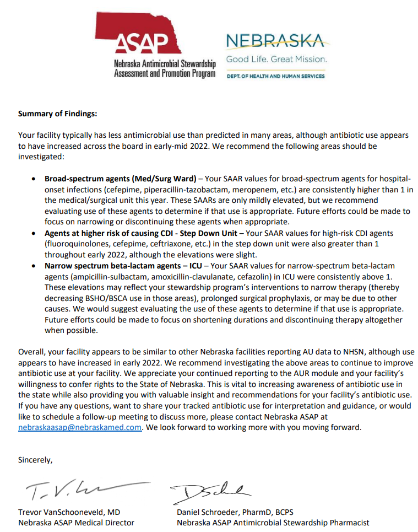
Example annual Nebraska ASAP letter
(fictitious hospital for example only)

Slide 8
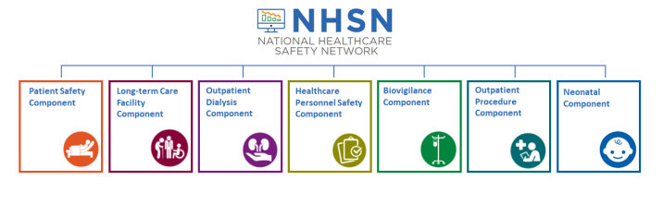
CDC NHSN Reporting Structure
Device-associated Module:
Bloodstream Infection (CLABSI – Central line-associated bloodstream infection)
Central line insertion practices (CLIP) adherence
Urinary Tract Infection (CAUTI – Catheter-associated urinary tract infection)
Ventilator-associated events (VAE) and Pediatric VAE (PedVAE)
Ventilator-associated Pneumonia (VAP)
Procedure-associated Module:
Surgical Site Infection (SSI)
Antimicrobial Use and Resistance Module (AUR)
Multidrug-Resistant Organism and Clostridioides difficile Infection (MDRO/CDI) Module
NHSN Overview (cdc.gov)

Slide 9
NHSN Antibiotic Use and Antibiotic Resistance
The AUR Module allows hospitals to electronically report & analyze antibiotic-related data
AU Option: Used to assess use of specific antimicrobial agents
AR Option: Used to assess patient isolates that test resistant to specific antimicrobial agents
Primary objective = provide risk adjusted intra-and inter-facility benchmarking of antimicrobial usage and resistance
Secondary objective = evaluate trends of antimicrobial usage & resistance over time
Facility
State
National

Slide 10
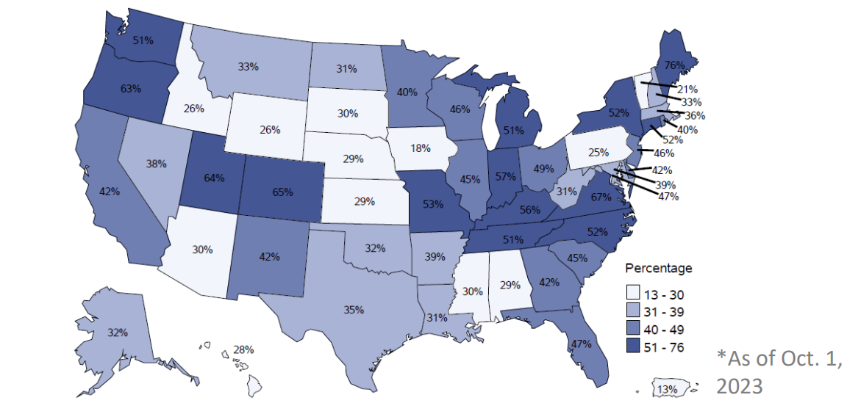
Percentage of facilities submitting at least one month of antibiotic use data
Source: CDC AU Users Office Hours Call, October 17, 2023

Slide 11
Standardized Antimicrobial Administration Ratio (SAAR)
NHSN calculates predicted antimicrobial days by risk-adjusting for location- and facility-level factors found to be statistically significantly associated with differences in AU rates among the SAAR referent population
SAAR >1.0 indicates more antimicrobial days were observed than predicted
SAAR = 1.0 indicates the number of antimicrobial days observed = predicted SAAR
SAAR < 1.0 indicates fewer antimicrobial days were observed than predicted

Slide 12
Inpatient Antibiotic Use
Inpatient Antibiotic Use | A.R. & Patient Safety Portal (cdc.gov)

Slide 13
Standardized Resistant Infection Ratio (SRIR)
The Standardized Resistant Infection Ratio (SRIR) is a metric developed by CDC to enable facilities to compare their rates of hospital-onset (HO) drug-resistant infection events to the national benchmarks.
The SRIR adjusts for various facility level factors that contribute to AR risk within each facility.
Includes 3 specimen sources (blood, urine, and
lower respiratory
Carbapenem-resistant Enterobacterales
Extended-spectrum cephalosporin-resistant Enterobacterales
Fluoroquinolone-resistant Enterobacterales
Vancomycin-resistant Enterococcus
Fluoroquinolone-resistant Pseudomonas aeruginosa
Multi-drug-resistant Pseudomonas aeruginosa
Methicillin-resistant Staphylococcus aureus
Number of hospital-onset AR Events that meet NHSN-specific resistance definitions
NHSN Antimicrobial Use and Resistance (AUR) Module Protocol (cdc.gov)

Slide 14
Objective 2
Use NHSN Antibiotic Use Option data for action in your facility.
Note: all scenarios shared in this objective are hypothetical and data is fictitious (they do not represent any Nebraska hospital’s data!)

Slide 15
Case #1 – Potential Antibiotic Overuse identified by high SAAR Values
Your facility has started to participate in NHSN AU module, and you now have access to a year’s worth of DOT and SAAR data
You are looking to utilize the NHSN AU data to decide on the next targeted intervention your antimicrobial stewardship program will implement
SAAR Metric | Q1 2022 | Q2 2022 | Q3 2022 | Q4 2022
All Antibacterial Agents (FACWIDEIN) | 1.13 | 1.15 | 1.16 | 1.13
Antifungal (ICU) | 0.92 | 0.98 | 1.01 | 1.34
Antifungal (Ward) | 1.21 | 0.82 | 0.67 | 0.73
Broad-Spectrum Hospital Onset (ICU) | 1.15 | 1.24 | 1.07 | 1.04
Broad-Spectrum Hospital Onset (Ward) | 1.17 | 1.09 | 1.08 | 1.13
Resistant Gram positives (ICU) | 1.22 | 1.36 | 1.31 | 1.41
Resistant Gram positives (Ward) | 1.47 | 1.36 | 1.21 | 1.56
Narrow Spectrum beta-lactams (ICU) | 0.89 | 0.91 | 0.90 | 1.01
Narrow Spectrum beta-lactams (Ward) | 1.08 | 0.97 | 0.99 | 1.22
Fictitious data for illustrative purposes only

Slide 16
Case #1
DOT / 1000 Patient Days can be useful to determine which antimicrobial is driving the elevation in SAAR
Based on the available DOT data, vancomycin is the most commonly used anti-MRSA agent
Based on this data, the hospital decides to implement a pharmacy-driven MRSA nares PCR screening for patients on empiric anti-MRSA therapy
Antimicrobial | Days of Therapy per 1,000 Patient Days
 | Q1 2022 | Q2 2022 | Q3 2022 | Q4 2022
Vancomycin | 109 | 104 | 115 | 101
Daptomycin | 10 | 9 | 9 | 10
Linezolid | 5 | 3 | 2 | 5
Fictitious data for illustrative purposes only

Slide 17
Case #2 – SIR data + SAAR data
The hospital’s infection preventionist has shared at the antibiotic stewardship committee meeting that the hospital’s C diff SIR has been trending upward over the last 6 months.
In addition to other hospital-wide efforts (including changes in environmental cleaning, hand hygiene, and C diff testing strategies), are there potential ASP initiatives related to antibiotic use that can be identified by the hospital’s NHSN AUR data?

Slide 18
Case #2
Fictitious data for illustrative purposes only

Slide 19
Case #2
Community-acquired pneumonia was chosen as the target for interventions
Order sets: Long durations of therapy pre-populated (10 days of therapy for community-acquired pneumonia) for both ceftriaxone and levofloxacin
Order set durations were adjusted
Education was sent to providers recommending shorter courses of 5 days per IDSA guidelines
Lower CDI-risk antibiotics (such as ampicillin-sulbactam) were added to the order set
Education given to providers on higher CDI-risk antibiotic choices
DOT / 1000 Patient Days can be useful to determine which antimicrobial is driving the elevation in SAAR
Antimicrobial | Days of Therapy per 1,000 Patient Days
 | Q1 2021 | Q2 2021 | Q3 2021 | Q4 2021
Ceftriaxone | 103 | 89 | 96 | 101
Cefepime | 19 | 22 | 24 | 26
Levofloxacin | 44 | 39 | 40 | 47
Fictitious data for illustrative purposes only

Slide 20
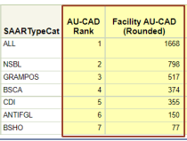
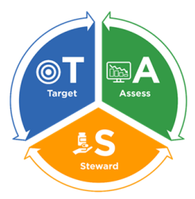
Case #2 – Goal Setting
The Antibiotic Stewardship Committee at your institution hopes that these interventions would result in a 20% reduction in the High-Risk CDI SAAR in the 12 months following implementation
The TAS (Target, Assess, Steward) report within NHSN can help the committee determine how much change is needed in prescribing numbers to achieve their 20% SAAR reduction goal
To get a SAAR of 1.2 (~20% reduction) your facility would have needed to reduce the use of antimicrobials in the High-Risk CDI antibiotics category by 355 antimicrobial days over the last 12 months
NHSN AU TAS Webinar (cdc.gov)
Fictitious data for illustrative purposes only

Slide 21
Case #3 Evaluate Antimicrobial Use Appropriateness
Your antimicrobial stewardship committee is completing their annual review of SAAR data to meet the CDC Core Elements of Tracking and Reporting
You notice that your facility’s usage in the category of narrow spectrum beta-lactam agents was on average 60% higher than your predicted usage in 2022
You remember that the SAAR is not a measure of appropriateness and decide to investigate
Are we using antibiotics for surgical prophylaxis appropriately?
SAAR Metric | Q1 2022 | Q2 2022 | Q3 2022 | Q4 2022
All Antibacterial Agents (FACWIDEIN) | 1.13 | 1.15 | 1.16 | 1.13
Narrow Spectrum beta-lactams (ICU) | 1.23 | 1.33 | 1.26 | 1.29
Narrow Spectrum beta-lactams (Ward) | 1.68 | 1.55 | 1.63 | 1.72
Fictitious data for illustrative purposes only

Slide 22
Case #3
Are we using antibiotics for surgical prophylaxis appropriately?
No!
An EHR usage report shows that post-op antibiotics are commonly prescribed for > 24 hours.
400/1,450 patients (28%) received durations of cefazolin >24 hours postop. This likely contributed up to 1,200 excess cefazolin doses in 2022
Further investigation into patient charts showed some surgeons have a higher rate of >24-hour post-op prescribing than others
(Surgeon 1: 15% vs Surgeon 2: 50%)
Fictitious data for illustrative purposes only

Slide 23
Summary - NHSN Antibiotic Use Option
data for action
SAAR data can highlight deviations from expected use
Clinical context is crucial when evaluating any antimicrobial utilization data
NHSN AU module can identify which antimicrobials and hospital locations are driving elevations in SAAR data

Slide 24
Objective 3
Review the Centers for Medicare and Medicaid Services requirements for Promoting Interoperability participation beginning calendar year 2024, including reporting exclusions.

Slide 25
CMS Requirement in CY 2024
AUR Module Data
Beginning in CY 2024, AUR Module data are required under the Public Health and Clinical Data Exchange Objective of the CMS Promoting Interoperability Program
Measure includes submission of both AU and AR Option data
Applies to eligible hospitals and critical access hospitals that participate in the CMS PI Program
How do I know if my facility is participating in CMS PI?
Most facilities participate in the CMS PI Program
Reach out to the person(s) in change of quality reporting
Facilities not paid under the CMS Hospital Inpatient Prospective Payment System (IPPS) are NOT included in the CMS PI Program
Includes but is not limited to
Inpatient rehab hospitals
Inpatient psych hospitals
Long term acute care hospitals
Promoting Interoperability Programs | CMS

Slide 26
For CY 2024, facilities attest to either:
Being in active engagement with NHSN to submit AUR data
Claim an applicable exclusion

Slide 27
What does active engagement mean?
Option 1
Pre-production and validation
Option 2
Validated data production
Registration within NHSN
Testing & validation of CDA files
Submitting production AU & AR files to NHSN
CY 2023 – 90 continuous days of AUR data submission
CY 2024 – 180 continuous days of AUR data submission
Note: Beginning in CY 2024, facilities can only spend one calendar year in Option 1 (pre-production and validation)

Slide 28
For CY 2024, facilities attest to either:
Being in active engagement with NHSN to submit AUR data
Claim an applicable exclusion

Slide 29
Reporting Exclusions
1) The hospital or CAH does not have any patients in any patient care location for which data are collected by NHSN during the EHR reporting period
2) The hospital or CAH does not have electronic medication administration records/barcoded medication administration records or an electronic admission discharge transfer (ADT) system during the EHR reporting period
3) The hospital or CAH does not have an electronic laboratory information system or electronic ADT system during the reporting period
It is anticipated that these exclusions will be re-evaluated for future EHR reporting periods!
CMS is currently in its FY2024 rule making cycle, so it is possible some things will change FY 2024 Hospital Inpatient Prospective Payment System (IPPS) and Long-Term Care Hospital Prospective Payment System (LTCH PPS) Proposed Rule - CMS-1785-P | CMS
FY 2023 Hospital Inpatient Prospective Payment System (IPPS) and Long-Term Care Hospital Prospective Payment System (LTCH PPS) Final Rule — CMS-1771-F | CMS

Slide 30
Does CDC or NHSN provide data to CMS?
No – AUR Measure is attestation based
CDC/NHSN does not provide any data to CMS for this reporting measure
Goal of CMS PI Program is to increase interoperable healthcare data exchange
Facilities must attest to CMS that they are in active engagement with NHSN or are claiming an exclusion
Attest via CMS Hospital Quality Reporting (HQR) system:
https://hqr.cms.gov/hqrng/login
NHSN provides documentation to facilities to use as proof when in active engagement

Slide 31
Data Submission
Requirements
AUR Data Submission
Electronic data submission is a requirement for the AUR module
Requires HL7 Clinical Document Architecture (CDA) format
NHSN AUR does NOT allow manual data entry
All modules other than AUR allow manual data entry

Slide 32
Data Submission Requirements
Electronic Medication Administration Record (eMAR) or Bar-Coding Medication Administration (BCMA) system
Capturing antimicrobial administrations
Electronic Laboratory Information System (LIS)
Capturing antimicrobial susceptibility results
Electronic Admission, Discharge, Transfer (ADT)
Capturing patient movement within the facility
Ability to collect and package data using HL7 standardized format:
CDA (Clinical Document Architecture)
Commercial software vendors
Part of your current EHR
“Homegrown” vendors (facility’s internal IT/informatics resources)
NHSN AUR Promoting Interoperability Guidance (cdc.gov)

Slide 33
Software Vendors
As a facility, begin evaluating software vendors
Cost considerations
Using hospital’s EHR vs. third party
Additional features (prospective audit and review capabilities)
Implementation timeline
IT involvement
Demonstrations
C-suite/IT services approval
Always use a vendor that has passed SDS validation
Contact the Nebraska Hospital Association or DHHS
AU SDS Vendors | NHSN | CDC
Quality Education : Quality and Safety : Nebraska Hospital Association (nebraskahospitals.org)
AR SDS Vendors | NHSN | CDC

Slide 34
Registration of Intent to Submit Data
The eligible hospital must first register the facility’s intent to submit AU and AR data into NHSN.
Facilities should NOT register intent to submit data until they have verified that the vendor being used is ready (or almost ready) to submit testing data. There is a 60-day response clause.
Failure to respond twice within an EHR reporting period would result in the facility not meeting the measure
Note: Only the NHSN Facility Administrator can view and complete this task.
NHSN AUR Promoting Interoperability Guidance (cdc.gov)

Slide 35
Nebraska DHHS HAI/AR Support Project for reimbursement of AUR implementation costs

Slide 36
NHSN AUR Implementation in Nebraska –
Funding Assistance
Nebraska DHHS HAI/AR program currently has funding available to dedicate towards assisting hospitals with implementing NHSN Antibiotic Use and Resistance module
Funding distributed by reimbursing at least part of their expenses for program implementation incurred between February 2022 – July 2024
Facilities meeting all requirements for funding may request reimbursement for related eligible expenses up to the maximum amount allowed for their facility based on licensed bed size as follows:
<100 licensed beds: maximum of $10,000 in reimbursement
101-200 licensed beds: maximum of $15,000 in reimbursement
≥201 licensed beds: maximum of $20,000 in reimbursement
Healthcare Associated Infections (ne.gov)

Slide 37
Eligible Expenses
Technology enhancements necessary for successful data submission to the Antibiotic Use and/or Antibiotic Resistance Module in NHSN.
Purchasing add-on software
Updating the hospital’s existing electronic health record
Staff time spent on implementation activities. Relevant staff includes, but is not limited to, pharmacists, hospital administrators, infection preventionists, information technologists, quality improvement personnel, and physicians.
Other related expenses (subject to HAI/AR Program Approval)
Healthcare Associated Infections (ne.gov)

Slide 38
Needed Documentation for Reimbursement
Facilities have completed a baseline Antibiotic Stewardship Program self-assessment through the Nebraska Antimicrobial Stewardship Assessment and Promotion Program (ASAP) at least once since Feb 1, 2022.
Baseline ASP Assessment for ACH
The facility should complete the online survey below to participate in the reimbursement process:
Nebraska DHHS NHSN AUR Facility Reporting Capacity Survey
At least one month of data successfully submitted to NHSN and available for review by Nebraska DHHS
Submission of receipts, invoices, and forms for eligible expenses via DHHS Redcap Survey (still in development)
Healthcare Associated Infections (ne.gov)

Slide 39
How will Nebraska DHHS use our Antibiotic Use and Antibiotic Resistance Data?
Antibiotic use and resistance data from your facility will be aggregated at the state level to identify and study trends
Nebraska DHHS will not communicate identified trends with regulatory bodies
Nebraska DHHS may reach out to your facility to offer guidance
Nebraska Antimicrobial Stewardship Assessment and Promotion Program (ASAP) sends an annual summary letter to each participating facility describing their Antibiotic Use data
Healthcare Associated Infections (ne.gov)

Slide 40
What if we still have questions?
AUR Module Resources
NHSN Helpdesk: NHSN@cdc.gov
AUR Module Website: https://www.cdc.gov/nhsn/psc/aur/index.html
AUR Trainings: https://www.cdc.gov/nhsn/training/patient-safety-component/aur.html
CMS-related Questions
QualityNet help desk: QnetSupport@cms.hhs.gov or 1-866-288-8912
Nebraska DHHS Contacts
Jenna Preusker (jenna.preusker@nebraska.gov) or
Lacey Pavlovsky (lacey.pavlovsky@nebraska.gov)

Slide 41
Thank you!
Questions?
Jenna Preusker (jenna.preusker@nebraska.gov)
Lacey Pavlovsky (lacey.pavlovsky@nebraska.gov)

