Slide 1
Convenient Access to Primary Care Improved Patient Outcomes and Staff Satisfaction

Slide 2
What we will learn:
Impact of extended hour and walk-in scheduling on patient outcomes
Accessibility changes to improve equitable access and reduce impact of new market competitors
How to utilize automation and technology to reduce wait times, staff burn out and improve staff retention
Learn the “Value Added Model”

Slide 3
Video Credit: Aaron Jensen @heygranty via TikTok

Slide 4
Video Credit: @alabamamortgageguy via TikTok

Slide 5
Competition through Customers’ Eyes
Why do people choose alternatives?
How do we keep our customers?
RHC
Other Clinics
Tele-doc Services
Urgent Care / ER
Notes:
Live in a an era of right her, right now. When people can book flights online, order groceries to their door, and stream movies and TV instantly they begin to expect similar experience everwhere

Slide 6
Extended Hours: Banks beat Banking Hours
24-hour ATM
Mobile Deposit
Online Banking
Banking Apps
Virtual Tellers
DocuSign / Remote Docs
Photo Credit: Dall-E Generative AI

Slide 7
Extended Hours: Benefits Data
Reduced ER Visits
Reduce hospitalization and improve outcomes
Bring in new patients
Improve word of mouth / virtual image
1. Journal of Pediatrics 2. Journal of General Internal Medicine 3 & 4. Medical Economics

Slide 8
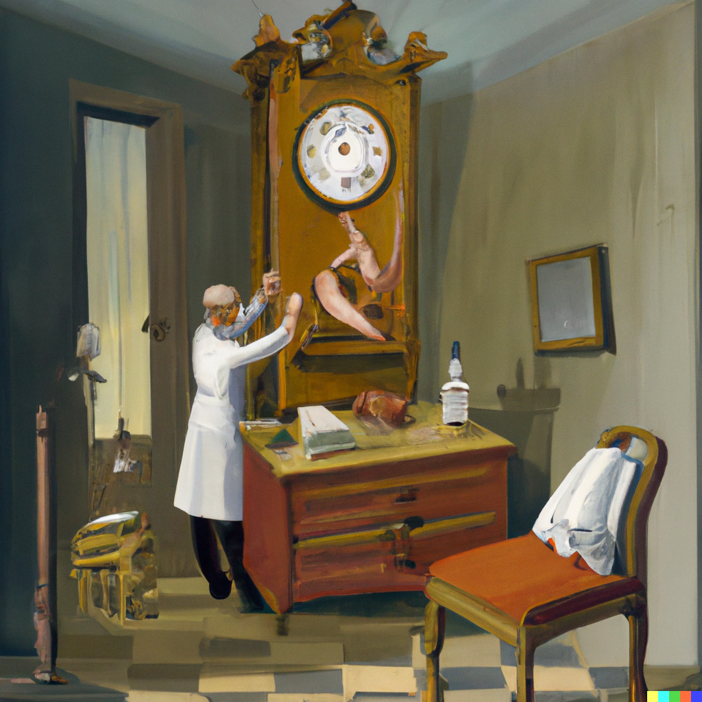
Extended Hours: How to Implement
Rotating 12 hour Shifts
Staggered Shifts
Weekend Hours
Incentives for Staff
Shift Differentials
Photo Credit: Dall-E Generative AI

Slide 9
Extended Hours: Real World
44% increase in mid-level visits
32% average increase in new patients seen per month
27% of all mid-level visits occur during extended hours

Slide 10
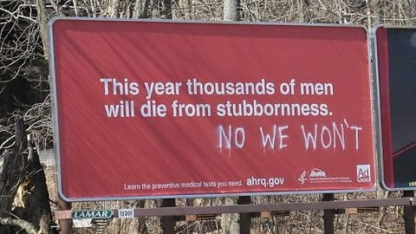
Ease of Access
Photo Credit: reddit.com u/rumble_the_jungle

Slide 11
Ease of Access
Time Constraints
Trust Issues
Lack of Transportation / Mobility
Brownandtoland.com

Slide 12
Accessibility: Time Constraints
9% of people surveyed reported lack of time* as primary reason for avoiding medical care
Walk-In Availability
Self Registration
Optimize workflow and registration
Photo Credit: Dall-E Generative AI *NCBI PMCID: PMC4351276

Slide 13
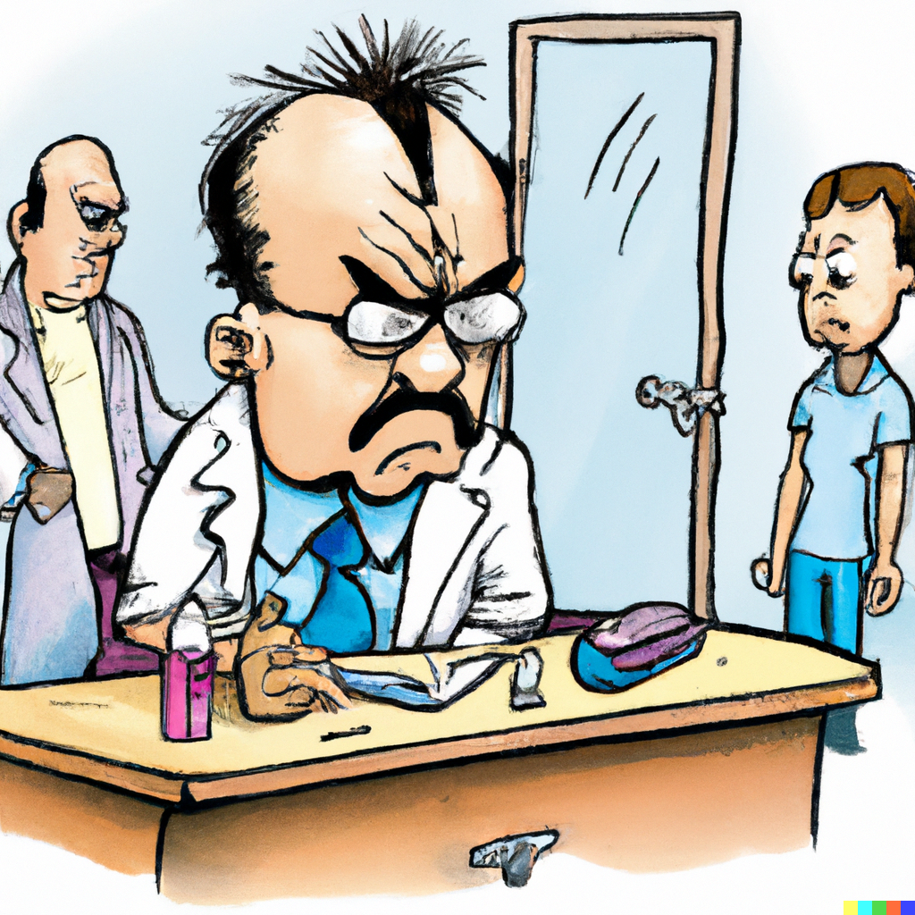
Accessibility: Trust Issues
33.3%* of people surveyed reported unfavorable interactions with providers or medical systems as a reason for avoiding care
Manage Expectations
Immediately address problems
COMMUNICATE
Be Involved in your Community
Photo Credit: Dall-E Generative AI *NCBI PMCID: PMC4351276

Slide 14
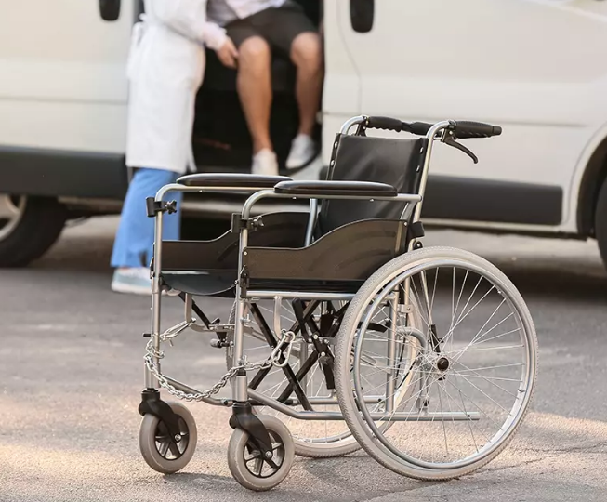
Accessibility: Transportation and Mobility
Utilize Patient Care Advocates
Learn and Understand Medicaid Transportation guidelines
Assign Accountability for Access
Speak with your Patients
Photo Credit: RouteGenie

Slide 15
What do these people have in common?
Photo Credit: Study.com

Slide 16
Photo Credit: NPR

Slide 17
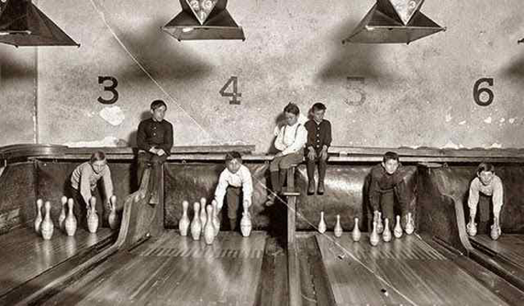
Photo Credit: WordPress.com

Slide 18
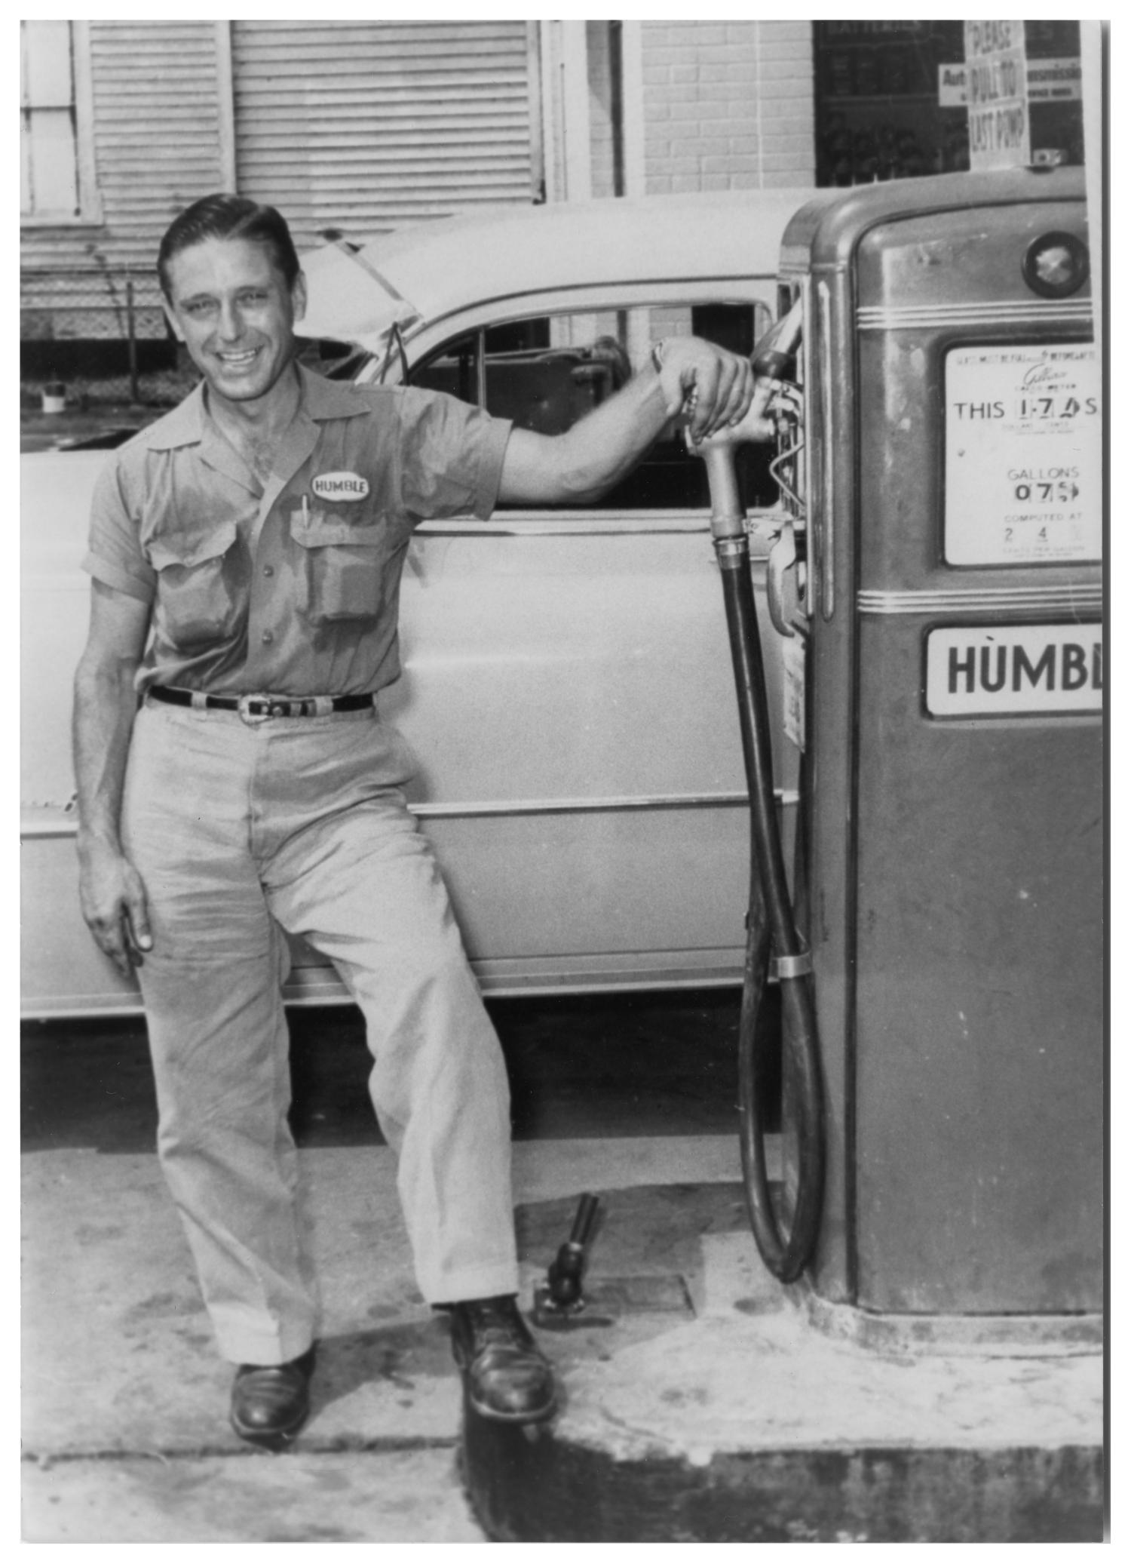
Photo Credit: UNT Texas History Department

Slide 19
Technology: Join or Be Replaced
Photo Credit: Dall-E Generative AI
Notes:
Every job above was replaced by technology or self-service technology

Slide 20
Technology: Join or Be Replaced
Utilize Text Message and Email Campaigns
Text Message / Phone reminders
Text Message Communication for Staff
Online Appointment Request
Patient Portal
Self Registration
Photo Credit: Reddit u/fannypackmcb
Notes:
Every job above was replaced by technology or self-service technology

Slide 21
Technology: Real World Impact
49% increase in wellness visits per year
22% increase in Flu Vaccinations administered per year
42% increase top box satisfaction rating
Average wait time reduced by 26%
33% of all patients self register

Slide 22
AI Charting
Product shown for demonstration purposes only. I do not endorse or recommend any brand specific AI service
Notes:
Every job above was replaced by technology or self-service technology

Slide 23
Value Added Model
Core is the essential product offering
Value Added is supplemental Services
i. Use to differentiate and improve satisfaction
CORE
Primary Care
Value Added
Customer Service
CCM
Friendly staff
RPM
Short Wait times
Broad Services
Ease of Access
Patient Advocates
Convenient Hours
Visiting Specialist

Slide 24
One Warning: Be Old Spice not New Coca-Cola
Photo Credit: Atlanta Magazine, redheadmom.com

Slide 25
Questions?
Convenience is King!
Michael.Tackitt@brownfield-rmc.org

