Slide 1

Building a healthier Nebraska with Health Equity
Ada K. Walker, JD
Vice President, Chief Inclusion and Diversity Officer
November 9, 2023

Slide 2

01
02
Defining Health Equity
Examining the Issues
03
04
TJC and CMS Requirements
Applying tools to your practice – Q&A
Clear definitions of health equity, health disparities and social determinants of health
Data review and strategy development
Examining the emerging context of health equity
Time to reflect and apply concepts from today’s session

Slide 3
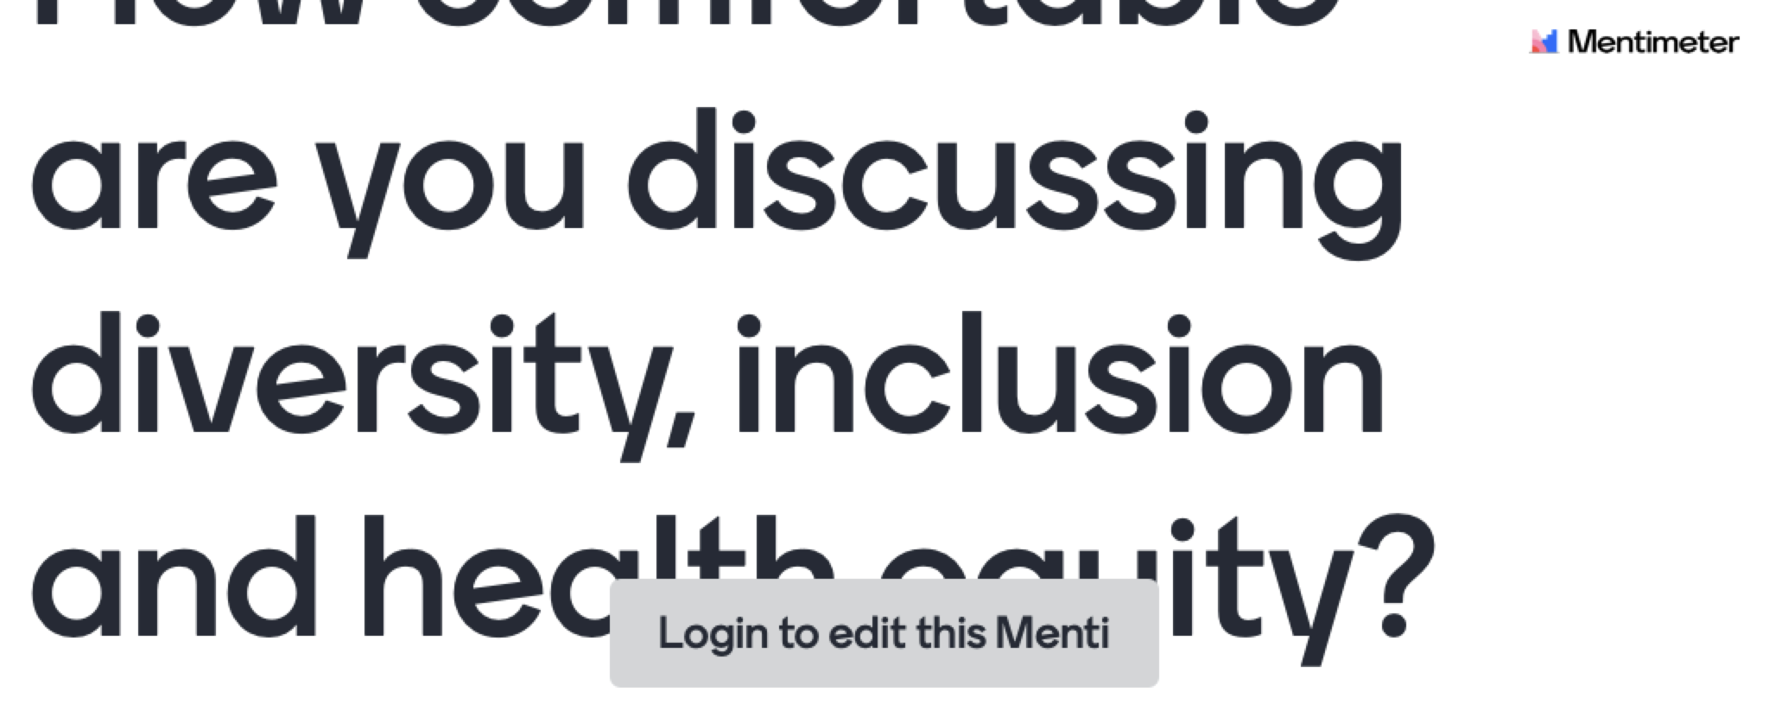

Slide 4
Group Agreements
Speak Respectfully
Practice the platinum rule
Without shaming, blaming or fixing
Treat others the way they want to be treated
Take the lessons
Take space, make space
What’s said here stays here
Be here now and engage
Use “I” statements
Lean into discomfort
Speak your truth
Take breaks as needed

Slide 5
What are your cultural groups?
Pure Barre Enthusiast
Wife
Dog Mom
African American Woman
Southerner

Slide 6

Common Language
Setting the stage with a common language allows us to set SMART DEI-goals and establish a meaningful common ground.

Slide 7
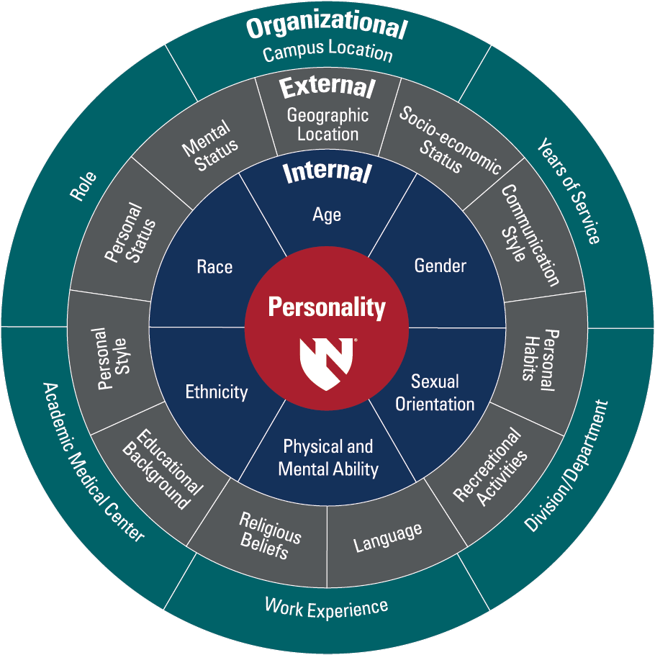
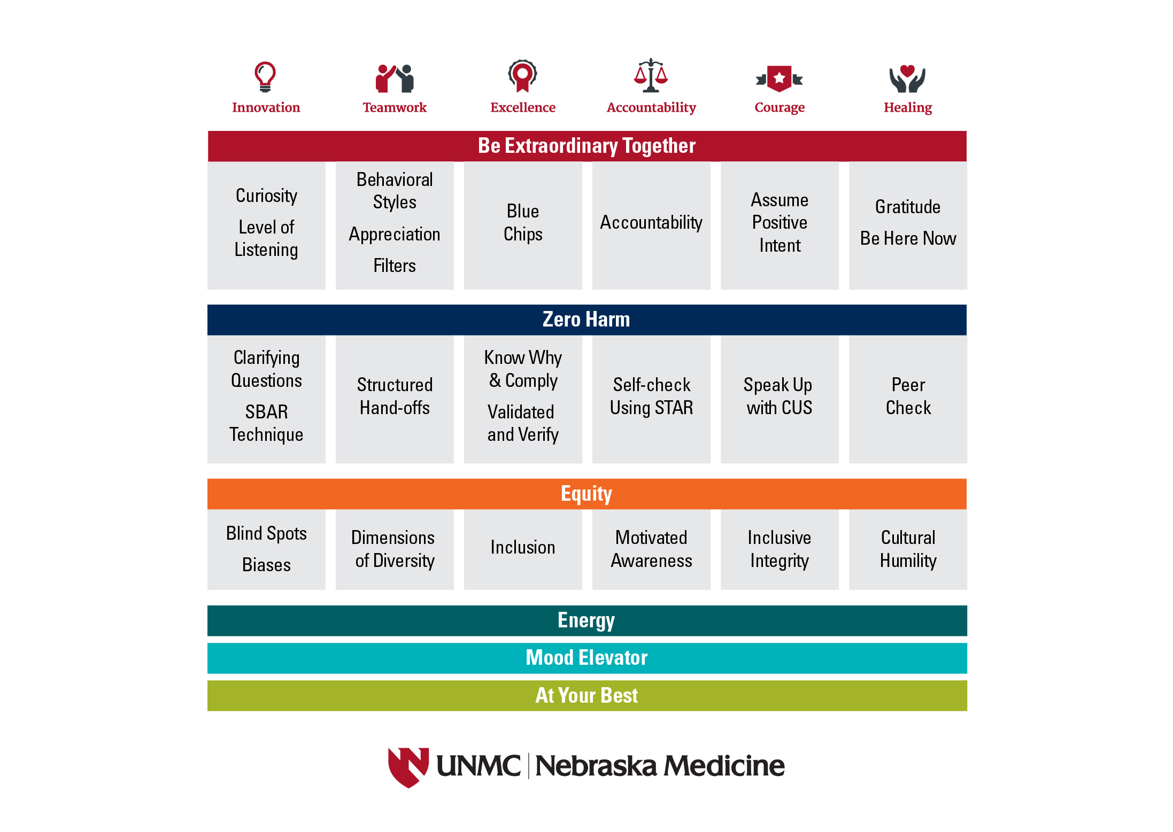
Mission, Vision & Values

Slide 8
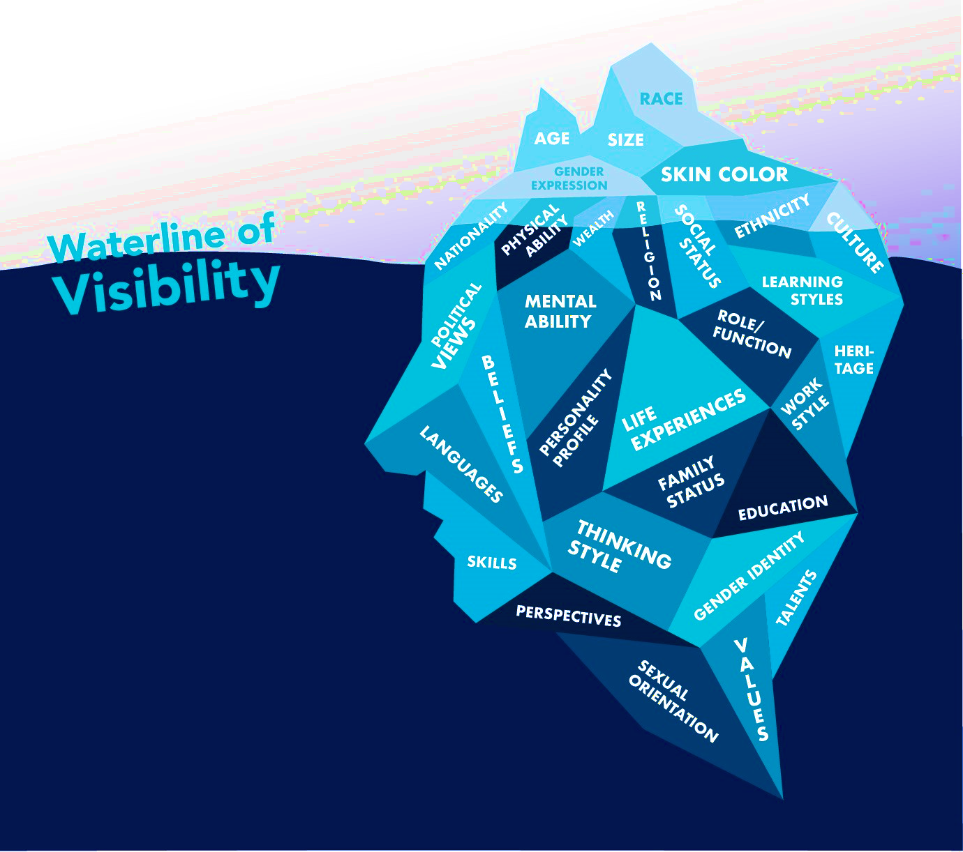
Just because it is not visible does not mean it is not valuable.
Notes:
Call out physical and mental ability
Gender identity (dead naming, misgendering)

Slide 9
HEALTH DISPARITIES
defined
Preventable health differences among various population groups resulting from unequal treatment and unequal health outcomes.

Slide 10
HEALTH EQUITY
is achieved
when every person can attain “full health potential" and no one is "disadvantaged from achieving this potential because of social position or other socially determined circumstances.” (CDC)

Slide 11
SOCIAL DRIVERS
OF HEALTH
reflect
reflect a broad range of economic and social conditions and are downstream from structural discrimination (racism, sexism, ableism, classism) and are reflected in the following domains: economic stability, education access & quality, health care access & quality, neighborhood & built environment, and social & community context.

Slide 12
Health equity operates at the intersection of interactions.
Intrapersonal
Interpersonal
Institutional
Our set of individual lived experiences – requires critical self-reflection
An examination of how we communicate with others
Policies and practices that have a direct impact on individuals

Slide 13
–Harriet A. Washington, Medical Apartheid: The Dark History of Medical Experimentation of African-Americans
Of all forms of inequality, injustice in health is the most shocking and most inhumane.
-SOMEONE FAMOUS

Slide 14

4.6x
2x
Workforce is demanding a commitment to health equity
More likely to accept an outside offer
Unlikely to stay when DEI scores were low
https://www.fiercehealthcare.com/

Slide 15
Commitment to Inclusivity
Financial Commitment
McKinsey & Company predicts that the $7.5 Billion currently invested in Employee Resource Groups will increase to $15.4 Billion by 2026
151
160m
Years
Women
To close the global economic gender gap, particularly for Black Women
May need to change jobs due to automation in 2030

Slide 16
Data tell the story of disparities . . .

Slide 17
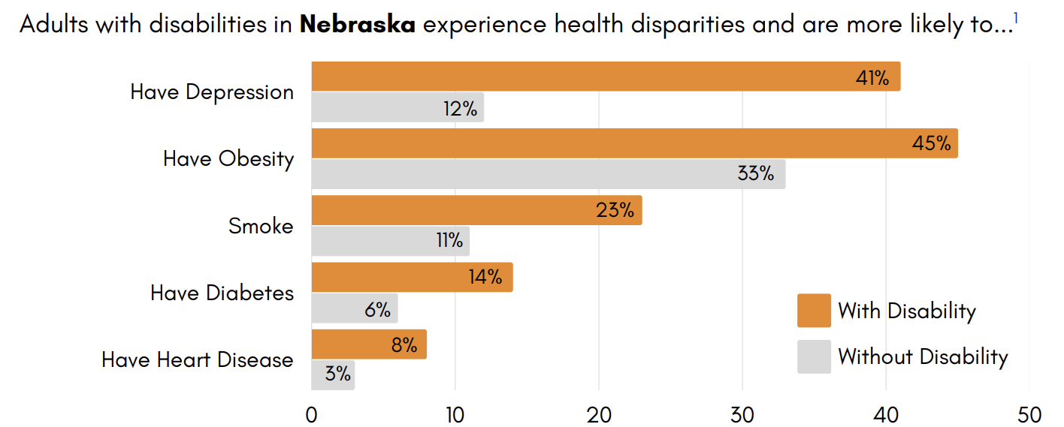
Disparities in health exist for Nebraskans living with a disability . . .

Slide 18
Severe Maternal Morbidity
Focusing on Maternal and Infant Health
Maternal Mortality
Infant Mortality
Pre-Term Birth Weight
Notes:
SMM: unexpected outcomes of labor and delivery that result in significant short- or long-term consequences to a woman's health
Maternal mortality: the death of a woman during pregnancy or within one year of the end of pregnancy
MMRC Report from 2021 – greatest barrier; collection of race data at birth, harder to track SMM in NE

Slide 19
National Data: Infant Mortality
Non-Hispanic Black/African Americans have 2.3 times the infant mortality rate as non-Hispanic Whites.
Non-Hispanic Black/African American infants are four times as likely to die from complications related to low birthweight as compared to non-Hispanic White infants.
Non-Hispanic Black/African American infants had twice the sudden infant death syndrome mortality rate as non-Hispanic Whites, in 2018.
In 2018, Non-Hispanic Black/African American mothers were twice as likely to receive late or no prenatal care as compared to non-Hispanic White mothers.
Source: Office of Minority Health
Notes:
SMM unexpected outcomes of labor and delivery that result in significant short- or long-term consequences to a woman’s health.
The infant mortality rate is the number of infant deaths for every 1,000 live births in first year

Slide 20
Nebraska Data: Infant Mortality
Infant Mortality Rate: 5.5
Infant Mortality Rate, Non-Hispanic White: 3.7
Infant Mortality Rate, Non-Hispanic Black: 12.7
Infant Mortality Rate, Hispanic: 6.2
Source: KFF; 2019

Slide 21
National Standards
hold us accountable

Slide 22
TJC Health Care Disparities
Standard LD.04.03.08: Reducing health care disparities for the organization's patients is a quality and safety priority.
EP 1: The organization designates an individual to lead activities to reduce health care disparities for the organization's patients (Note: leading the activities to reduce health care disparities may be an individual's primary role or part of a broader set of responsibilities.)
EP 2: The organization assesses the patient's health-related social needs and provides information about community resources and support services.
EP 3: The organization identifies health care disparities in its patient population by stratifying quality and safety data using the sociodemographic characteristics of the organization's patients

Slide 23
TJC Health Care Disparities
Standard LD.04.03.08: Reducing health care disparities for the organization's patients is a quality and safety priority.
EP 4: The organization develops a written action plan that describes how it will address at least one of the health care disparities identified in its patient population
EP 5: The organization acts when it does not achieve or sustain the goal(s) in its action plan to reduce health care disparities
EP 6: At least annually, the organization informs key stakeholders, including leaders, licensed practitioners, and staff, about its progress to reduce identified health care disparities

Slide 24
CMS Health Equity Measures
Domain | Equity Elements
1: Equity is a strategic priority Your hospital has a strategic plan for advancing healthcare equity that: | Identifies priority populations who currently experience health disparities
 | Establishes healthcare equity goals and discrete action steps to achieving these goals
 | Outlines specific resources which have been dedicated to achieving your equity goals
 | Describes your approach for engaging key stakeholders, such as community partners
2: Data collection Your hospital is actively engaged in 3 key data collection activities: | Collecting demographic information, including self-reported race and ethnicity and/or social determinant of health (SDoH) information on the majority of your patients
 | Training staff in culturally sensitive collection of demographic and/or SDoH information
 | Inputting demographic and/or SDoH information collected from patients into structured, interoperable data elements using a certified EHR technology
3: Data Analysis | Your hospital is stratifying key performance indicators by demographic and/or SDoH variables to identify equity gaps and including this information on hospital performance dashboards
4: Quality Improvement | Your hospital participates in local, regional, or national quality improvement activities focused on reducing health disparities
5: Leadership Engagement Your senior leadership, including your chief executives and your entire hospital board of trustees, demonstrates a commitment to equity through 2 activities: | Annual reviews of your strategic plan for achieving health equity
 | Annual reviews of key performance indicators stratified by demographic and/or social factors

Slide 25
Strategy Framework
Building a roadmap

Slide 26
Health Equity Strategy
Strategy
Collect REaL & SOGI Data
Identify and Report Disparities in Care
Implement Solutions to Eliminate Disparities
Evaluate Effectiveness of Solutions

Slide 27
Preparing to Plan: The “Why”
Telling Your Story
Advocating for Resources
Understanding the “WHY” – individual, departmental, organizational, and community
Bridging gap between goals and company culture/context
Defined needs lead to a more refined budget
Forward-thinking and longitudinal strategies
Initial Considerations
Nuanced data review
Connection to Mission, Vision and Values
Qualitative data and story telling
Listen and reflect
Organizational imperative
Connects to business case
Accountability in structure and action

