Slide 1
The Rural Landscape
Nebraska Rural Health Association
bslabach@ruralhealth.us Twitter: @bslabach
#ruralhealth
June 4, 2024
Brock Slabach, MPH, FACHE
Chief Operations Officer

Slide 2
Why rural?
Rural areas make up 80% of the land mass in USA
Rural areas have roughly 17% of the US Population
Rural areas provide the food, fuel and fiber to power our nation
Access to high-quality health care is a requirement to keep these important resources available
An exchange between urban and rural that must not be overlooked
Historically, public policy has disadvantaged health care in rural communities

Slide 3
What We Fight for on Behalf of Rural
Addressing Rural Declining Life Expectancy and Inequality
Investing in a Strong Rural Health Safety Net
Reducing Rural Healthcare Workforce Shortages
Addressing Rural Declining Life Expectancy and Inequality
Reducing Rural Healthcare Workforce Shortages
Invest in a Strong Rural Health Safety Net
Notes:
Again, we are thankful to have you all as partners in taking our fight for rural health to Capitol Hill to:
Invest in a Strong Rural Health Safety Net
Reducing Rural Healthcare Workforce Shortages
Addressing Rural Declining Life Expectancy and Inequality

Slide 5
The Road to 270
Source: https://www.270towin.com/

Slide 6
Senate Map Projections
Source: https://www.270towin.com/

Slide 7
House of Representatives
Source: https://www.270towin.com/

Slide 8
“What Liberals Get Wrong About ‘White Rural Rage’ — Almost Everything”
Response to Schaller and Waldman’s book: White Rural Rage, Feb. 2024
What rural communities desire:
Empowering strategies that allow them to shape their own future
Support that bolsters local leadership
Encourages community-driven initiatives
Provides the tools and resources necessary for them to address their specific challenges in a manner consistent with their values
To understanding rural resentment:
Acknowledge the profound geographic inequities that exist in the U.S.
These inequities are a powerful motivator of political behavior
They are not the same as rage, racism, xenophobia and nationalism
It is distinctive
This isn’t rage, nor is it a threat to democracy.
Source: https://www.politico.com/news/magazine/2024/04/05/white-rural-rage-myth-00150395

Slide 9
The Rural Health Context
Notes:
Chartis Data
CDC MMR
MedPAC data

Slide 10
Rural Hospital Closures
Source: UNC Sheps
Center for Rural Health
149 Closures since 2010

Slide 11
REH Conversion Map
27 Conversions Since Program Started
https://www.shepscenter.unc.edu/programs-projects/rural-health/rural-emergency-hospitals/

Slide 12
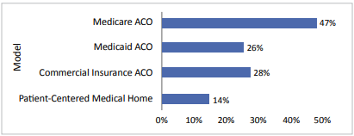
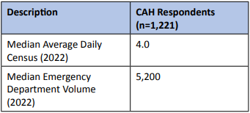
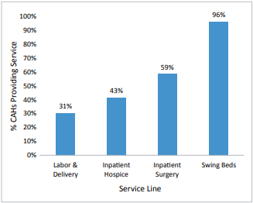
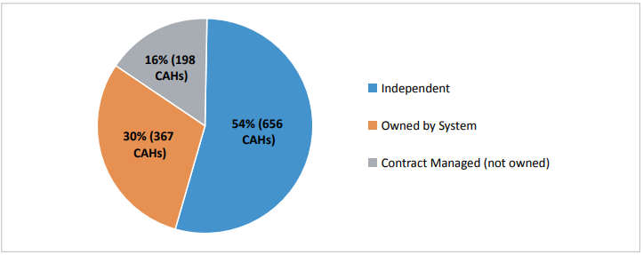
National CAH Quality Inventory & Assessment National Report
Quality Payment Model Participation
CAH System Affiliation
CAH Volume Measures
CAH Inpatient Services
Flex Monitoring Team (FMT) National Report on CAH Quality Inventory, Released April 8, 2024

Slide 13
Half of all Rural Hospitals Now in the Red
ME
WA
VT
Overall, 50% of America’s rural hospitals are operating in the red.**
MT
ND
NH
MA
OR
MN
NY
ID
WI
RI
SD
MI
PA
NJ
CT
WY
NE
IA
OH
DE
IL
IN
WV
MD
Highest percentage ever calculated in Chartis’ annual analysis.
NV
VA
CA
UT
CO
KY
KS
MO
NC
TN
SC
AZ
NM
OK
AR
AL
GA
In non-expansion states, 55% of rural hospitals are in the red.
MS
AK
TX
LA
FL
HI
State-level percentage of rural hospitals with negative operating margin.
Source: The Chartis Center for Rural Health,
NA
0-20
21-40
41-60
61-80
81-100
**CMS Healthcare Cost Report Information System (HCRIS) Q3 2023. Operating margin is computed in accordance with Flex Monitoring Team guidance. Outliers are excluded. Hospitals for which data are unavailable are excluded. Reported Covid-19 PHE Funds (Worksheet G-3 line 24,50) excluded from operating margin. Adjustments made to operating margin to reflect full 2% sequester.

Slide 14
Nearly 420 Hospitals Vulnerable to Closure
ME
418 rural hospitals across America are vulnerable to closure.
WA
VT
MT
ND
NH
MA
OR
MN
NY
ID
WI
RI
SD
MI
PA
NJ
CT
WY
NE
IA
OH
DE
IL
IN
WV
MD
NV
VA
Across 16 states, the percentage of rural hospitals vulnerable to closure is 26% or higher.
CA
UT
CO
KY
KS
MO
NC
TN
SC
AZ
NM
OK
AR
AL
GA
MS
AK
TX
LA
Non-expansion states are home to nearly 200 vulnerable rural hospitals.
FL
HI
0
1%—9%
10%—15%
16%—20%
21%—25%
26%—30%
31%—40%
41%+
Source: The Chartis Center for Rural Health, January 2024
Percentage of State Rural Hospitals Determined to be Vulnerable

Slide 15
Enrollment in Medicare Advantage Surges Percentage Growth in Rural Communities 2019-2023*
ME
WA
VT
MT
ND
NH
MA
OR
MN
NY
ID
WI
RI
Medicare Advantage enrollment in rural communities jumped 46% nationally since 2019.
SD
MI
PA
NJ
CT
WY
NE
IA
OH
DE
IL
IN
WV
MD
NV
VA
CA
UT
CO
KY
KS
MO
NC
TN
SC
In 10 states, Medicare Advantage enrollment increased by more than 100% between 2019 and 2023.
OK
AR
AZ
NM
GA
MS
AL
AK
TX
LA
FL
HI
Percentage growth of Medicare Advantage enrollees in rural communities between 2019 and 2023.
Source: The Chartis Center for Rural Health, December 2023. Rural Communities defined as county in which a rural hospital is located.
0
20%-40%
41%-60%
61%-80%
81%-100%
>101%

Slide 16
Rural America’s Widening OB Deserts
ME
WA
VT
MT
ND
NH
MA
States with highest number of rural OB closures are MN (22), IA (20), TX (17), WI (16) and KS (14).
OR
MN
NY
ID
WI
RI
SD
MI
PA
NJ
CT
WY
NE
IA
OH
DE
IL
IN
WV
MD
NV
VA
UT and WY, states with 20 and 16 rural hospitals offering OB respectively have not seen any losses during the review period.
CA
UT
CO
KY
KS
MO
NC
TN
SC
AZ
NM
OK
AR
AL
GA
MS
AK
TX
LA
FL
HI
Number of rural hospitals that stopped offering OB between 2011 and 2021.
0
1-5
6-10
11-15
16-20
21+
Source: The Chartis Center for Rural Health, October 2023.
Notes:
States such as Alabama, Mississippi and Tennessee all saw more than 40% of their rural hospitals drop chemo. In Texas, 57 rural hospitals stopped offering chemo during our review period.

Slide 17
“Rural hospitals and the rural economy rise and fall together”
“Three years after a rural hospital community closes, it costs about $1000 in per capita income.”
Mark Holmes, professor, University of North Carolina
On average, 14% of total employment in rural areas is attributed to the health sector. Natl. Center for Rural Health Works. (RHW)
The average CAH creates 107 jobs and generates $4.8 million in payroll annually. (RHW)
Health care often represent up to 20 percent of a rural community's employment and income. (RHW)
Medical deserts form in rural communities where hospitals close.

Slide 18
Weakening Community Health Status
Our rural communities are increasingly older, less affluent, less healthy, have less access to care and suffer worse outcomes than their more urban peers.
33
69
Adults Over 65
40
61
Premature Death
33
63
Access/Primary Care
32
62
Access/Mental Health
Percentile Rankings
Rural
Urban

Slide 19
Notes:
Overall, the percentage of preventable early deaths in the United States increased during 2010–2022 for unintentional injuries and stroke, decreased for cancer and chronic lower respiratory disease (CLRD), and remained stable for heart disease.
• However, the percentage of preventable early deaths from these five leading causes of death (heart disease, cancer, unintentional injury, chronic lower respiratory disease, and stroke) remained higher in rural counties than in urban counties during 2010–2022.

Slide 20
Legislative Review
Notes:
Hospital closures

Slide 21
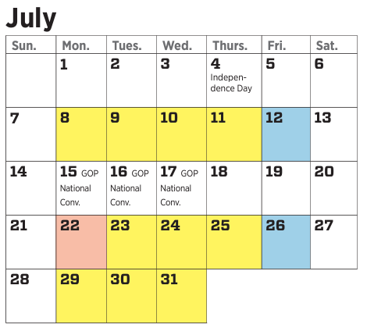
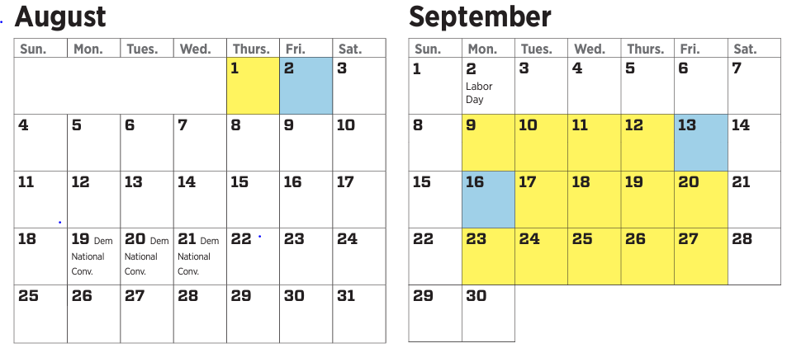
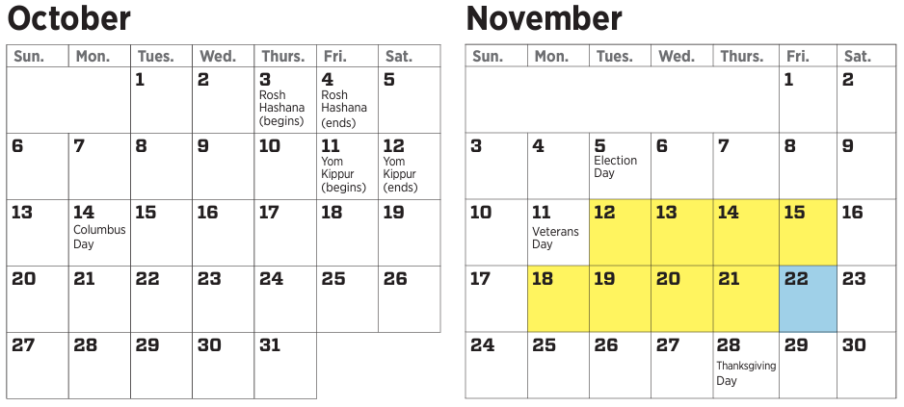
Remaining Congressional Work Days in 118th
Notes:
Fewer than 40 days remaining between now and November where both Chambers are in session. Not a lot of time. But a lot of work to get done.
Fiscal year 2025 appropriations process kicked off in March- Will remain a focus for the next couple of months
August recess
After August – sprint to pass FY 2025 appropriations bills- FY 2024 ends September 30, 2024
November 5: Election day
November – January: “lame duck” session- Congress usually passes appropriations + other legislation in “omnibus package” in December

Slide 22
Lame Duck Congressional Session
“Must Dos”
“Wanna Dos”
PHE Telehealth Extensions
Rural Medicare extenders: MDH, LVH, Ambulance,
Safety Program extenders: NHSC, CHC, THCGME
Eliminate/postpone: DSH/physician cuts, site neutrality payments
340B SUSTAIN Act
Key program authorizations: Flex, RRPD, RCORP, CDC
RHC Burden Reduction Act
Rural Emergency Hospital 2.0
Rural Obstetric Access
Notes:
Senate finance hearing
Finance maternal health bill
Ways and Means mark up 5/7; new bills- Extenders (telehealth, LDH/MDH, ambulance), REH, GME, Stablization program, PEAK Act
REH: 340b bill, 2.0, W&M, location bill
340b: June package
Farm bill
Briefings: AACOM, RNs,

Slide 23
FY 2025 Appropriations Update
House Appropriations Committee Chairman Tom Cole (R-OK) releases proposed FY2025 Topline Numbers:
Non-defense programs may be cut effectively by 6%, but cuts are not evenly distributed.
Labor-Health and Human Services- Education (LHHS) Subcommittee may be cut by up to 10-11%.
FY2025 LHHS allocation is set at $184,564,000,000.
FY2024 total budget authority was 195,231,000,000, with total outlays at 260,863,000,000.
Notes:
House Appropriations Committee Chairman Tom Cole (R-OK) previewed interim subcommittee allocations for Fiscal Year 2025 with Committee Members, which were developed using the caps outlined in the Fiscal Responsibility Act of 2023. These 302(b)s are subject to change with evolving information, including anticipated scoring of the President’s Budget Request and offsetting receipts by the Congressional Budget Office.

Slide 24
FY25 NRHA Appropriations Priorities
2025 appropriation priorities areas include:
Cybersecurity readiness through the Small Hospital Improvement (SHIP) Program
Rural Hospital Stabilization Program
Rural Residency Planning and Development (RRPD)
Rural Maternal Obstetric Management Strategies (RMOMS)
Rural Communities Opioid Response Program (RCORP)
Mark up for LHHS bill is June 27th and July 10th for full committee.

Slide 25
Senate Finance Rural Health Hearing
On May 16, the Senate Finance Committee held a hearing, “Rural Health Care: Supporting Lives and Improving Communities”
Senators focused questions on:
Hospital closures
Obstetric deserts
Medicare Extenders: MDH/LVH, telehealth
GME and workforce innovations
Medicare Advantage
SNF minimum staffing rule
Notes:
This bill reauthorizes grants and requires other activities to improve mental and behavioral health among health care providers from FY2025 to FY2029.
Specifically, the Department of Health and Human Services (HHS) must award grants to hospitals, medical professional associations, and other health care entities for programs to promote mental health and resiliency among health care providers. In addition, HHS may award grants for relevant mental and behavioral health training for health care students, residents, or professionals.

Slide 26
In the Hopper…
House Ways and Means Committee passage of rural health package:
Telehealth
Medicare Extenders
Rural Emergency Hospitals
GME
CAH Ambulance payment
Rural Hospital Stabilization
Senate Finance Committee Hearing on Rural Health Care:
Hospitals
Workforce, esp. GME
Telehealth
Disparities, esp. maternal care

Slide 27
2024 Farm Bill
House Agriculture majority introduced bill, the Farm, Food, and National Security Act.
NRHA summary
Markup held May 23, 2024
Passed out of Committee by 33-21 vote
Includes:
Rural Hospital Technical Assistance Program Act
Rural Healthcare Facilities Stabilization Act
Expanding Childcare in Rural America Act
Combines ReConnect Program and Rural Broadband Program into one
Reauthorizes Farm and Ranch Stress Assistance Network

Slide 28
2024 Farm Bill
Senate Agriculture majority outline of Rural Prosperity and Food Security Act released. No bill text or markup scheduled
NRHA summary
Major differences between current House and Senate versions will need to be reconciled
Includes:
$50 million in mandatory funding for RD title, $200 million mandatory funding for Community Facilities program
Rural Partnership Program Grants for public and private partnerships. Rural healthcare facilities would be eligible grantees
Reauthorizes ReConnect, Community Connect Grant, Distance Learning and Telemedicine Programs
Expanding Childcare in Rural America Act
Reauthorizes Farm and Ranch Stress Assistance Network at $15 million/year

Slide 29
340B Reform Policy Principles
NRHA 340B Reform Policy Principles document
Unlimited and unrestricted use of contract pharmacies.
No PBM, payer, manufacturer discrimination.
End of orphan drug exclusion for CAHs, SCHs, and RRCs.
Maintaining child site access.
No more reporting burdens.
Codifying HRSA’s 1996 patient definition + telehealth.
Legislative efforts:
Pass H.R. 2534 PROTECT 340B Act.
Protect contract pharmacy arrangements.
DSH waiver extension – letter to Senate and House leadership
Notes:
Guiding principles for NRHA’s stance on any future 340B reform efforts.
Working on second cosponsors push for PROTECT 340B Act
Working with a couple of offices on K pharmacy protections to allow for unlimited arrangements
DSH problem – go through what this is.

Slide 30
Rural Obstetric Readiness Act
Introduced April 3, 2024 by Sens. Hassan, Collins, Britt and Smith
Creates training programs to help non-specialists respond to emergencies like labor and delivery
Providing federal grants for rural facilities to buy better equipment to train for and handle these emergencies
Develop a pilot program for teleconsultation services, so that a doctor at a rural facility helping an expecting or postpartum mother facing an emergency can quickly consult with maternal health care experts
Press release from Sen. Hassan’s office

Slide 31
Focus on Rural Health Clinics
RHC Modernization Policies
S. 198/H.R. 3730: Rural Health Clinic Burden Reduction Act. Removes laboratory requirements, modernizing physician, PA and NP utilization requirements, and a fix for the "urbanized area" Census Bureauterm.
RHC Telehealth
S. 2016/H.R. 4189: CONNECT for Health Act includes RHCs as permanent distant site providers and payment parity.
Provider-Based RHCs
NRHA is working to find a long-term fix to address challenges that came about through passage of Section 130 of the Consolidated Appropriations Act, 2021.
Notes:
PB RHC fix – enhanced payment in exchange for optional quality reporting. Then CMS has data on RHCs that they’ve never had and RHCs get more money

Slide 32
Focus on Critical Access Hospitals
96-hour average length of stay
Longer waits for tertiary transfer
PAC placement more difficult due to staffing shortages
Increased Obs. Status by commercial insurance/Medicaid MCOs
Solutions:
Remove requirement altogether
Raise the average to 120 hours, for example
Other ideas?
72-hour qualifying length of stay for Swing Bed placement
Solution: Remove requirement altogether or lower the threshold to 36 hours, for example. Other?

Slide 33
Rural Emergency Hospital 2.0 legislation
Potential changes to the program:
340B eligibility
Allowing of swing beds to retain access to post-acute care
Authorizing psychiatric and rehabilitation distinct part units
5% add on to apply to non-OPPS services paid under the Clinical Laboratory Fee Schedule and Physician Fee Schedule services.
Hospitals that closed prior to December 27, 2020, should be eligible to convert to an REH.
Hospitals that are designated as rural by their state but did not have an active reclassification under 42 C.F.R. § 412.103 by December 27, 2020.
Ability to revert back to NP CAH status.
Notes:
Working with Senator Moran on this. should see introduction sometime early this summer

Slide 34
Innovation

Slide 35
CMS Updates Quality and VBC Specialty Care Strategies
Launched week of April 1: a new quality pathway to evaluate patient-centered quality goals in design and evaluation of APMs.
CMMIs Specialty Care Strategy:
Data transparency
Continued episodic payment models
Financial incentives for primary care and specialist coordination and engagement
Provision of “shadow bundles” data
Extension of BPCI Advanced Model
Specialist engagement incentives in MCP Model
CMMI signaling exploring options for embedding subpopulation targets within ACO models for high-volume or high-cost conditions.

Slide 36
Transforming Maternal Health (TMaH)
TMaH is a new CMMI model designed to focus on improving maternal health care for people enrolled in Medicaid/CHIP
Model will focus on three main pillars:
Access to care, infrastructure, and workforce capacity
Quality improvement and safety
Whole-person care delivery
State Medicaid Agency (SMA) lead applicant
NRHA with CMMI TMaH leadership hosting a listening session on April 18, 2024, 12:30-1:30 pm ET. Register here

Slide 37
The ACO Primary Care Flex
Released March 19, 2024, CMS Infographic
Request for Applications (RFA) portal opened May 30, 2024
Layers primary care capitation on top of the existing Medicare Shared Savings Program (MSSP)
New Shared Savings Program deadline June 17, 2024
RHC and FQHCs are eligible
May not participate in both AIP and PC Flex
Webinar on PC Flex June 6, 2024, 2:00 to 3:30 ET
Application deadline: August 1, 2024 Start Date: Jan. 1, 2025
Financial
One-Time Advanced Shared Savings Payment: All selected ACOs will receive an upfront Advanced Shared Savings Payment of $250,000 to support startup and infrastructure costs.
Monthly Prospective Primary Care Payments (PPCPs): This replaces the traditional fee-for-service payment system; ACOs will receive predictable monthly payments based on county-average primary care spending and specific patient population characteristics

Slide 38
Executive Branch
Notes:
End of an administration:
SNF Staffing regulation
MA data collection
IPPS

Slide 39
Recent Activities
Submitted response to CMS’ Request for Information on Medicare Advantage Data
Submitted comment on HRSA’s Proposed Inclusion of Terrain Factors in Rural Definition
Submitted comment on CMS’ FY 2025 Skilled Nursing Facilities Prospective Payment System proposed rule

Slide 40
Current Activities
FY 2025 Inpatient Prospective Payment System proposed rule
Comments due June 10, 2024
2.6% payment increase overall, 1.9% for rural hospitals
Separate IPPS payment for small hospitals to maintain buffer of essential medicines
Low wage index policy extended for 3 years
Distribution of 200 new GME slots, half to psychiatry
Clarifying definitions for new residency programs
TEAM model for coordinated, accountable care post-surgery
Notes:
CMS is proposing a new, separate IPPS payment to small, independent hospitals to help establish and maintain a buffer stock of essential medicines. Qualifying hospitals have 100 beds or less and are not associated with a chain organization.
Low wage index policy. NRHA is pleased to see that CMS proposes to continue its low wage index policy for at least three more years. This policy increases the wage index for hospitals with a value below the 25th percentile.
CMS proposes to implement and administer the 200 new GME slots created by the Consolidated Appropriations Act (CAA) of 2023. At least half of the slots must go to psychiatry or psychiatry subspecialties and 10% of slots must go to the 4 qualifying categories outlined below. Hospitals located or treated as being located in a rural area. Request for information.

Slide 41
Minimum Staffing Standards for LTC Facilities
Final rule released April 22, 2024
2 main provisions for nursing homes/SNFs:
Must have RN on site 24/7
Rural facilities must comply by May 10, 2027
Must meet total nurse staffing ratio of 3.48 hours per resident day (HPRD), including 0.55 for RNs and 2.45 for nurse aides
Remaining 0.48 HPRD can be met with any nursing staff mix
Rural facilities must comply by May 10, 2028
For implementation phase-ins, CMS is using OMB definition of rural
Notes:
OMB says any county that is not an MSA is rural so that’s opening it to more counties than the definition proposed in the proposed rule

Slide 42
Minimum Staffing Standards for LTC Facilities
Hardship exemption for HPRD and 24/7 RN requirement:
Active until next survey recertification, can be continually renewed if eligibility is met
Eligibility depends on location, documenting good faith effort to hire, financial commitment to hiring
Existing waiver (483.35(f)) for RN standards can also be used for 24/7 RN requirement, renewed annually:
For rural SNFs in area where SNF services do not meet demand, has RN on duty 40 hours/week
Patients do not need RN/physician for a 48-hours period or has RN/physician to provide care when regular RN is not on duty
Notes:
Hardship exemption:
The facility is at least 20 miles from another long-term care facility or the RN or NA supply is below the national average;
The facility demonstrates that it is making a good faith effort to hire and retain staff;
The facility provides documentation of its financial commitment to staffing;
The facility has not failed to submit Payroll Based Journal (PBJ) data in accordance with the proposed regulations, is not a Special Focus Facility, and has not been cited for widespread insufficient staffing with resultant resident harm or cited at the “immediate jeopardy” level of insufficient staffing within the preceding 12 months.

Slide 43
Minimum Staffing Standards Update
Congressional Review Act can be used by Congress/next Administration to overturn final rules
Reps. Fischbach and Pence introduced a resolution to begin the process to potentially block the final rule
Last week the American Health Care Association joined by the Texas Health Care Association (THCA) and several Texas long term care facilities filed a lawsuit against CMS to challenge the rule

Slide 44
Advocate With Us!

Slide 45
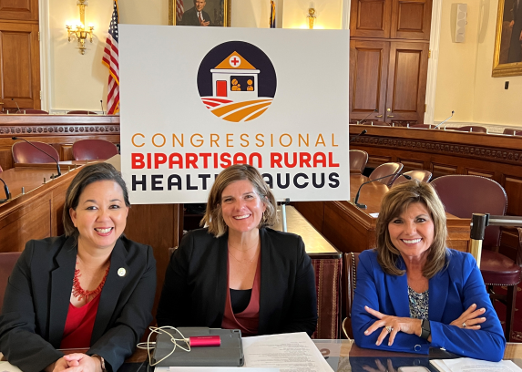
House Rural Health Caucus
Officially relaunched last Fall!
Co-chaired by Reps. Tokuda (D-HI) and Harshbarger (R-TN).
52 bipartisan members and growing.
Working on briefing and event schedule for upcoming year.
Listing of current members
From Nebraska:
Adrian Smith (R-NE-03)
Notes:
The Caucus provides a forum for Members of Congress to advocate for legislation and policy actions that improve access to quality, affordable health care and mental health services for people living in rural and remote communities across the country.
Will allow Members to interact with patients, providers, and health advocates.
Another great legislative vehicle to help move NRHA’s rural health priorities.

Slide 46
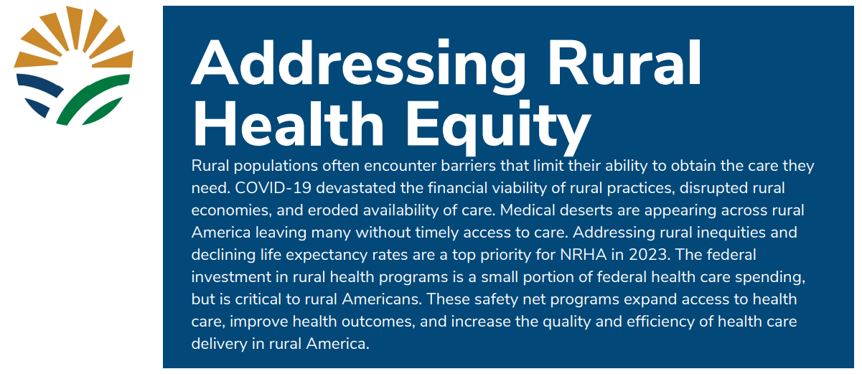
NRHA Legislative Agenda

Slide 47
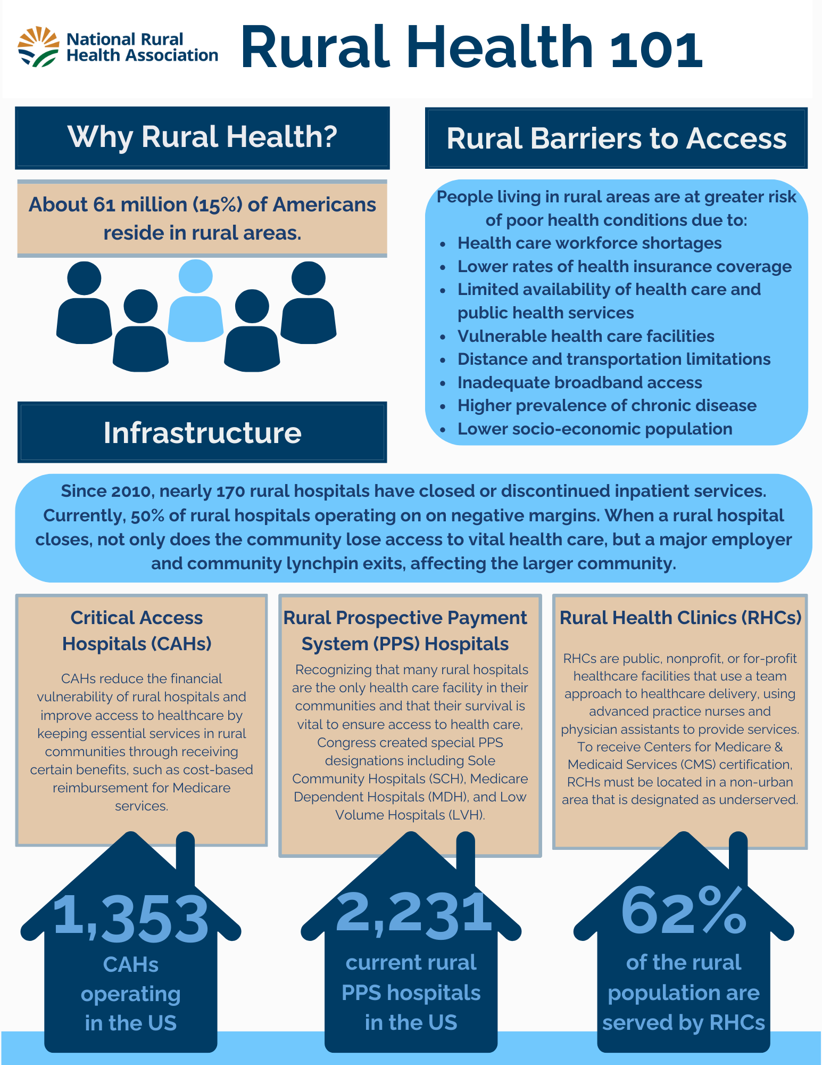
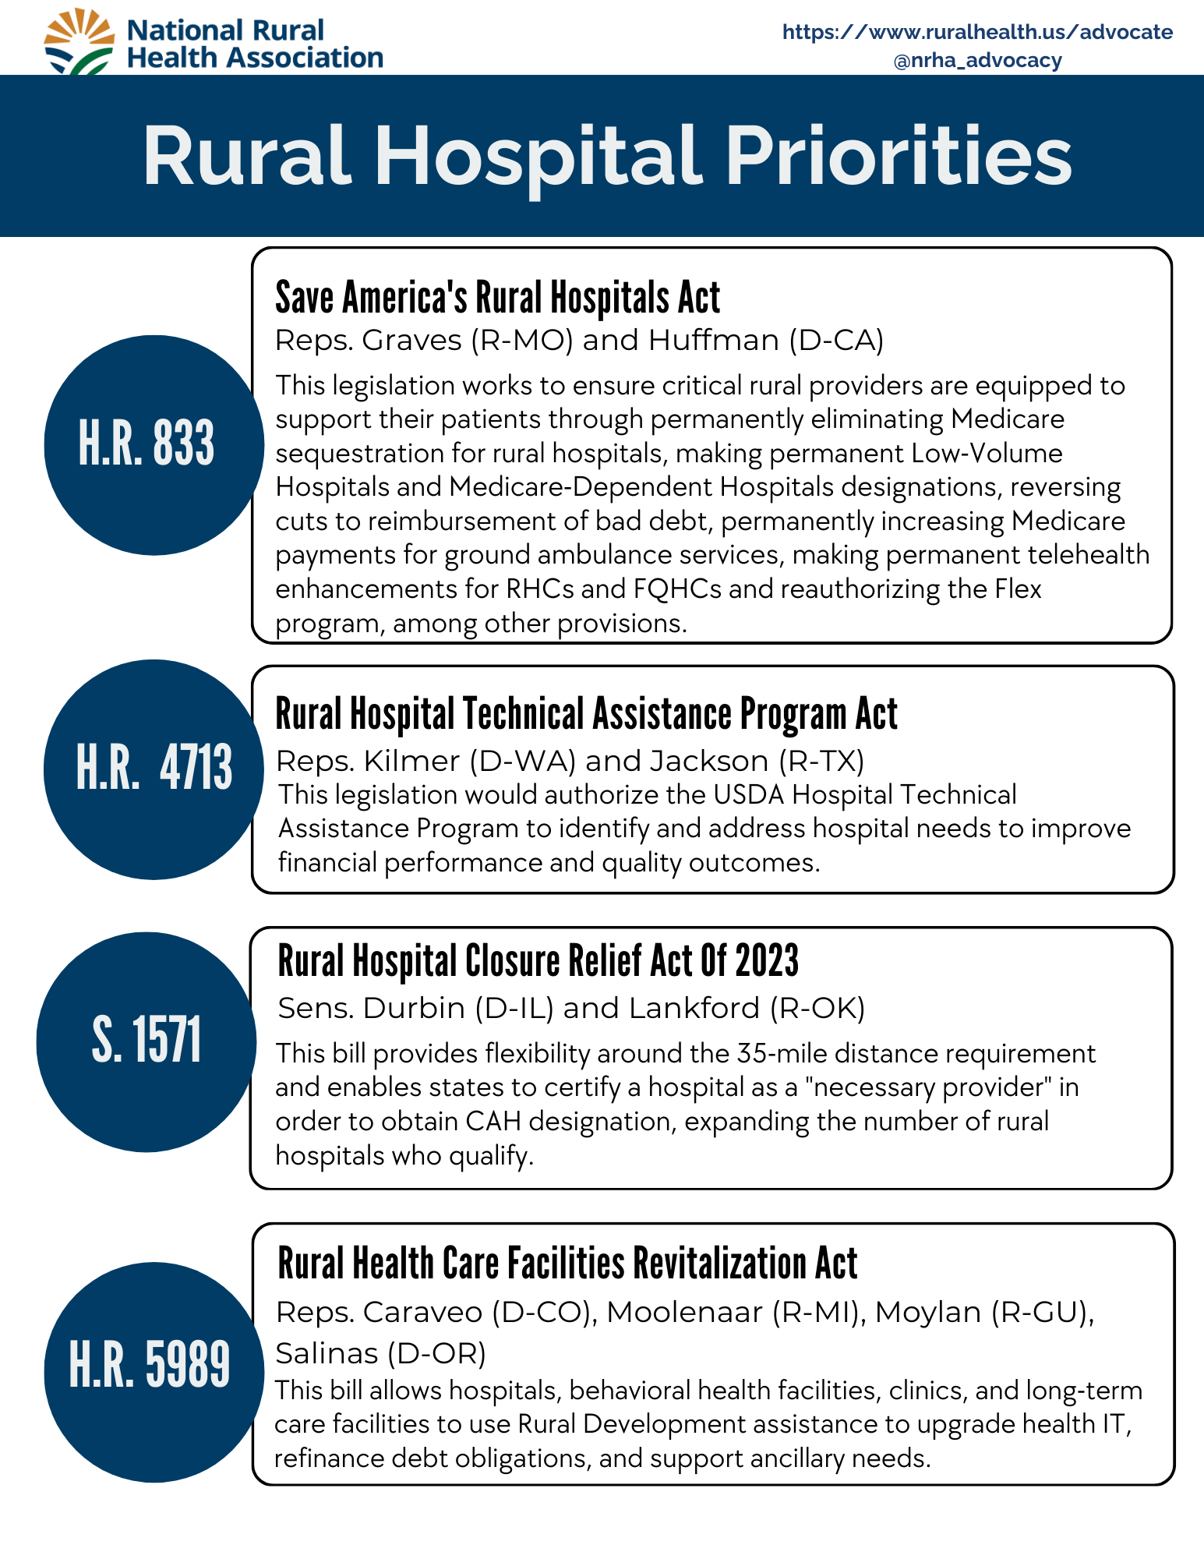
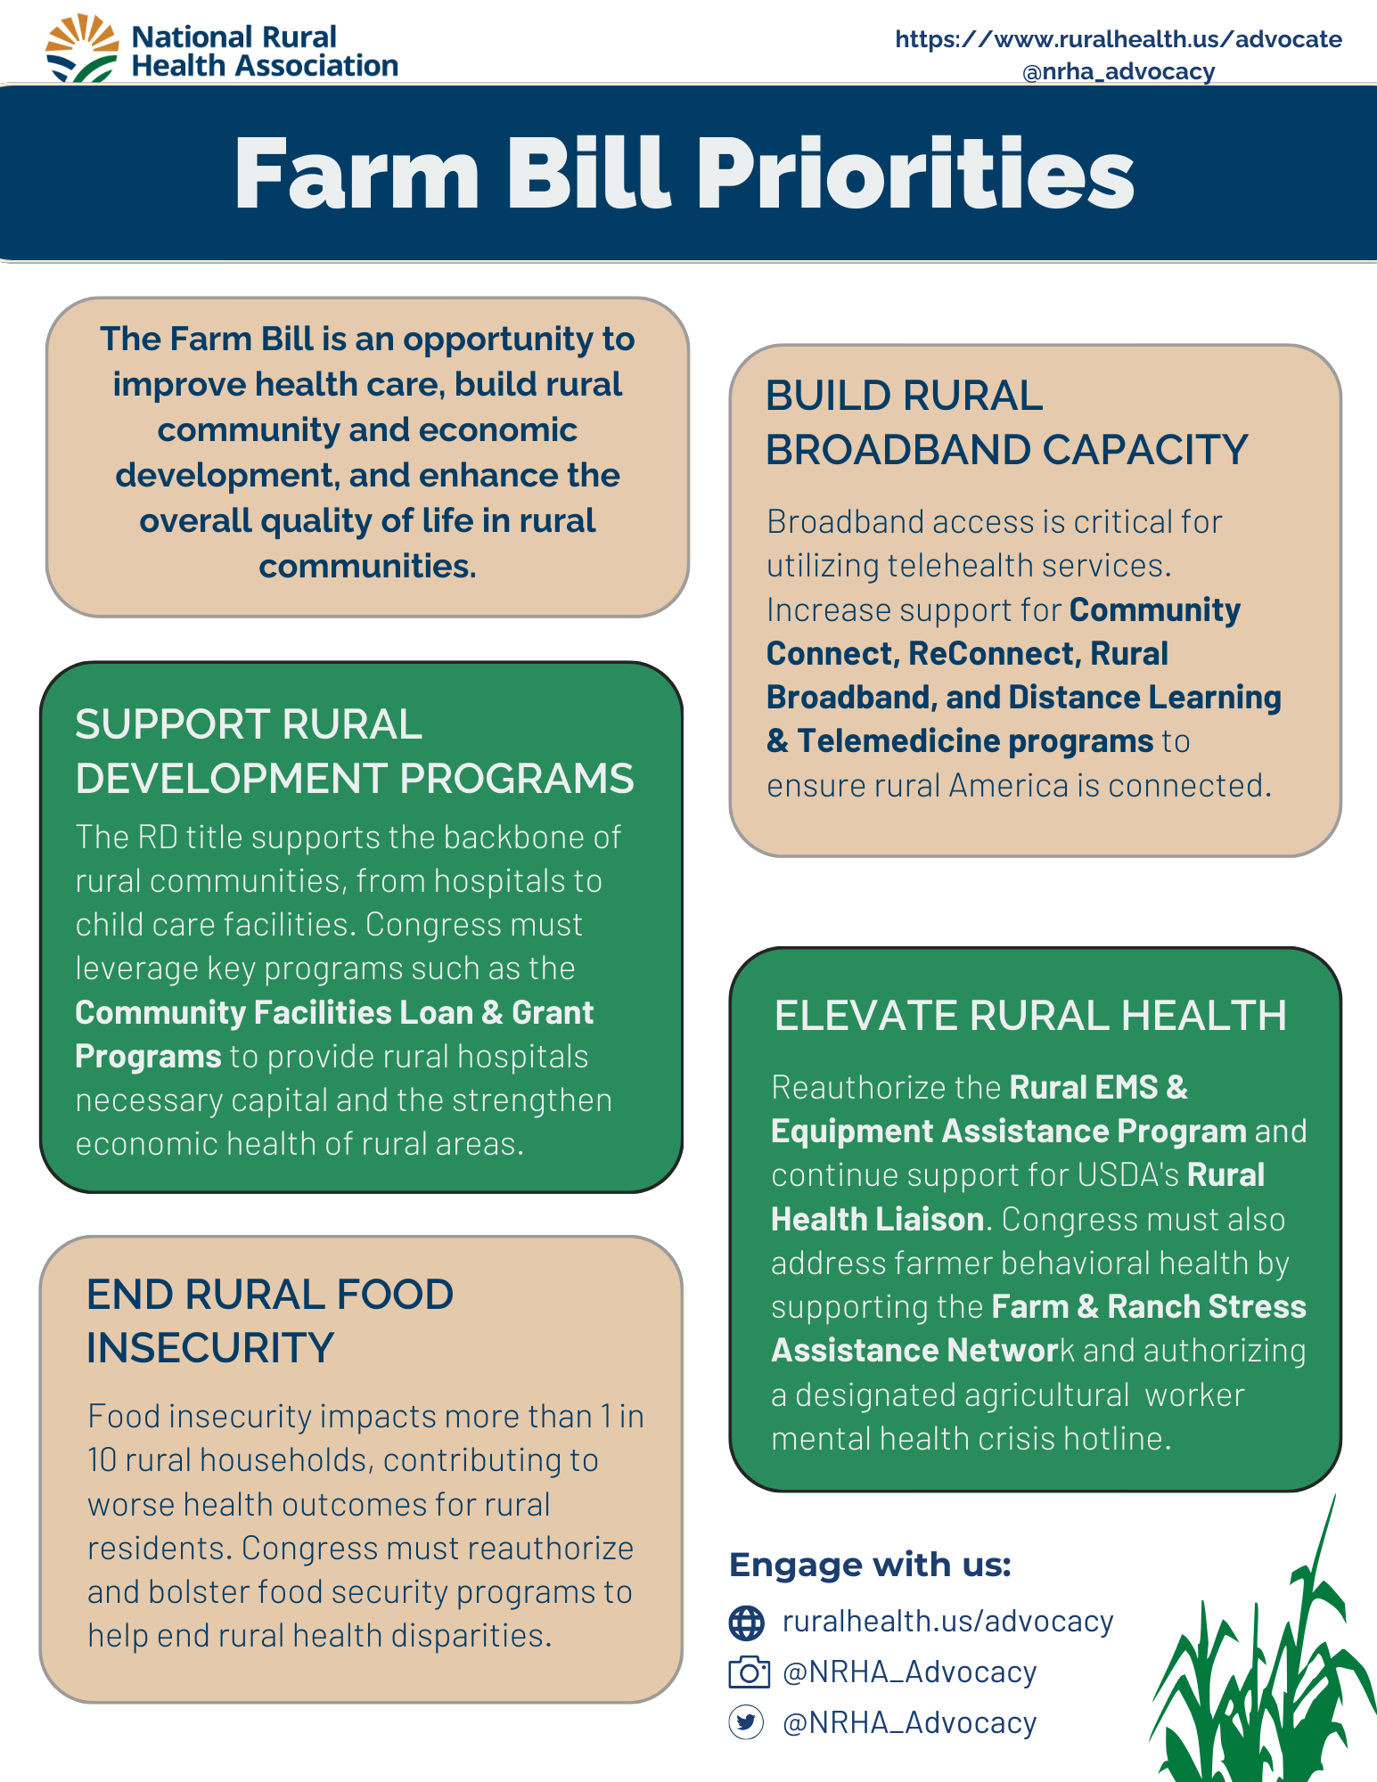
Advocacy Priorities
Core Advocacy Materials:
NRHA 2024 Legislative Agenda
NRHA 2025 Appropriation Priorities
NRHA Rural Hospital Legislative Priorities
2024 Rural Medicare Extender Priorities
NRHA Farm Bill Legislative Priorities
NRHA Rural Health 101
Rural Health Advocacy 101

Slide 48
Advocacy Materials!
Topic specific 1-pager leave behinds:
Includes background information and NRHA supported legislation & programs
340B Program
REH
Rural Health Clinics
Rural Hospitals
Rural Community Health Centers
Rural Maternal Health
Rural Telehealth
Rural Behavioral Health
Rural Oral Health
Rural EMS
Rural Veteran’s Health
Rural Public Health

Slide 49
Questions?
bslabach@nrharural.org
@bslabach
#ruralhealth
Notes:
NRHA is a national nonprofit membership organization with more than 21,000 members, made up of a diverse collection of individuals and organizations with the common goal of ensuring all rural communities have access to quality, affordable health care.
Our mission is to provide leadership on rural health issues.

