Slide 1
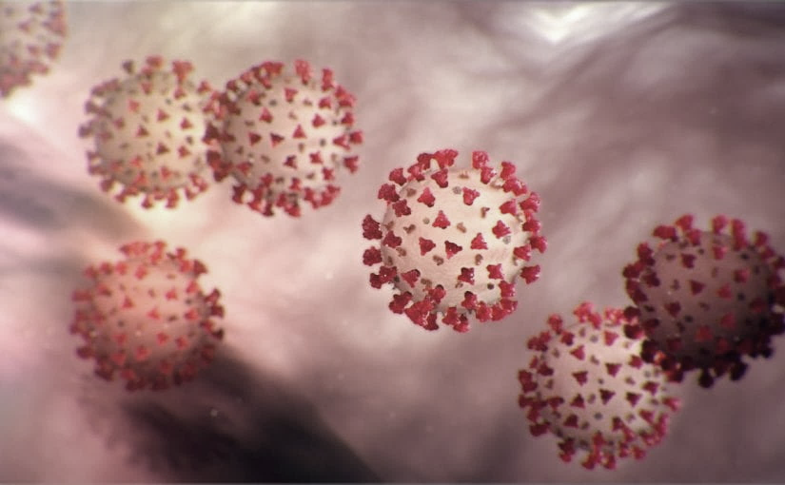
Covid-19 Webex Update 5-4-20
Maureen Tierney, MD, MSc.
Healthcare Associated Infections Medical Director
Tom Safranek, MD, State Epidemiologist

Slide 2
We are one in this fight
Frontline Heroes
Public Health Heroes
First Responder Heroes

Slide 3
Cowboy George

Slide 4
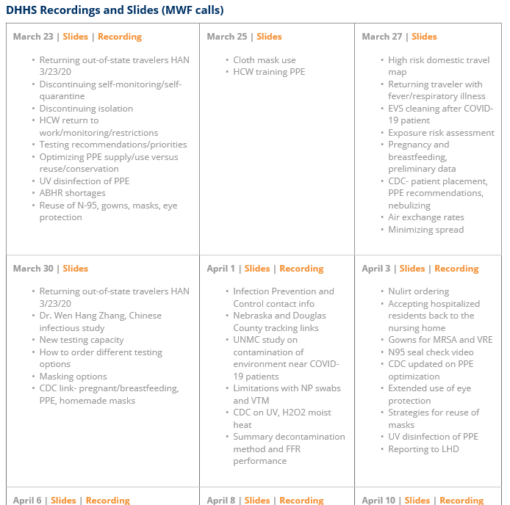
Thank you for joining us!
Slides and recording of today’s presentation will be available at
https://www.nebraskahospitals.org/coronavirus-covid-19-information.html
Scroll to the bottom of the page

Slide 5
Links to Nebraska webinars
Nebraska Acute Care Call every M,W, F at noon
previous calls can be found Nebraska Hospital Association
https://www.nebraskahospitals.org/coronavirus-covid-19-information.html
Nebraska ICAP Long Term Care Webinars every Thursday at noon
previous webinars and questions and answers found on ICAP website
NEW
https://icap.nebraskamed.com/
Nebraska ICAP Combined Critical Access and Outpatient Webinars every Tuesday at non
previous webinars and questions and answers found on ICAP website
https://icap.nebraskamed.com/

Slide 6
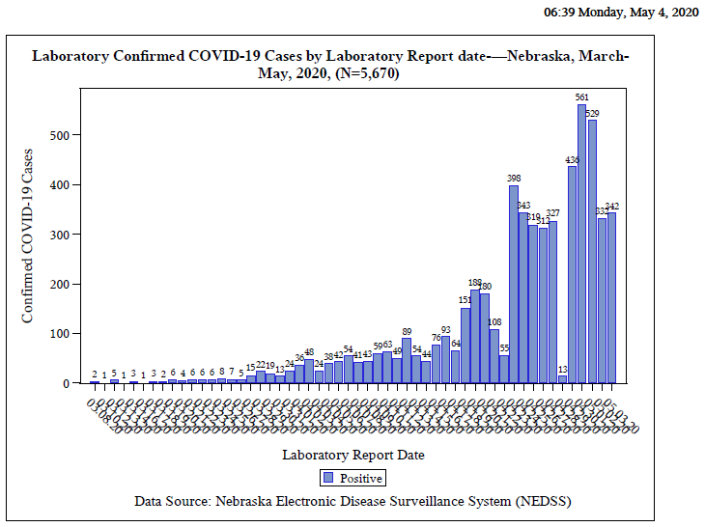
Notes:
Add the title of your presentation, your division, name, etc.

Slide 7
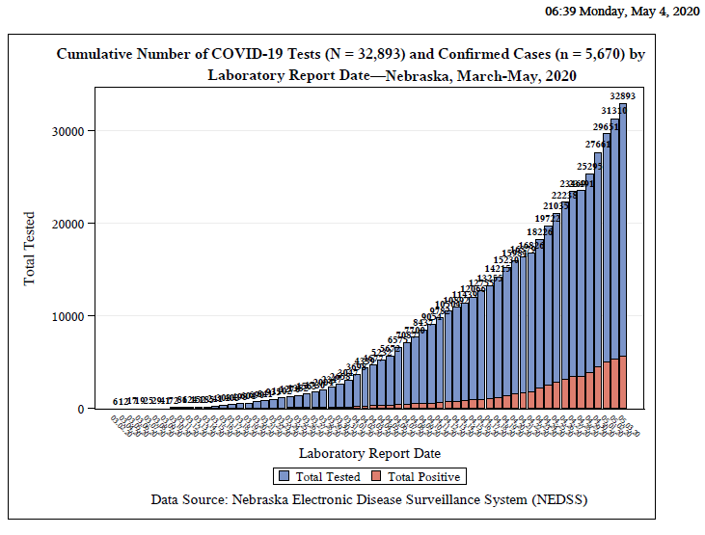

Slide 8
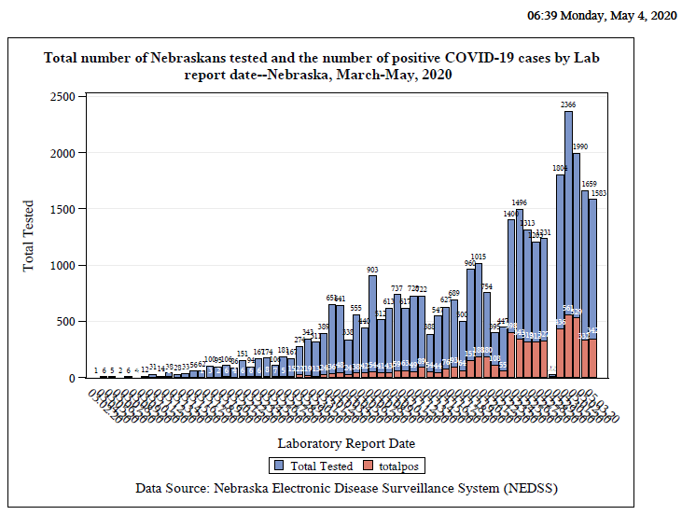

Slide 9
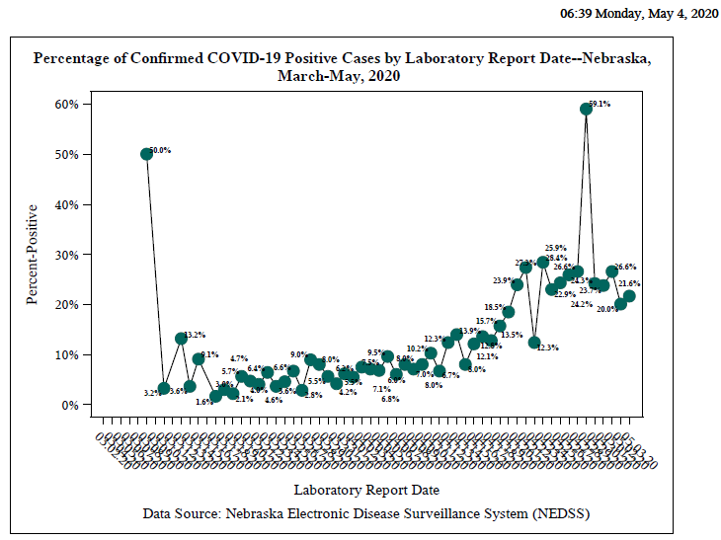

Slide 10
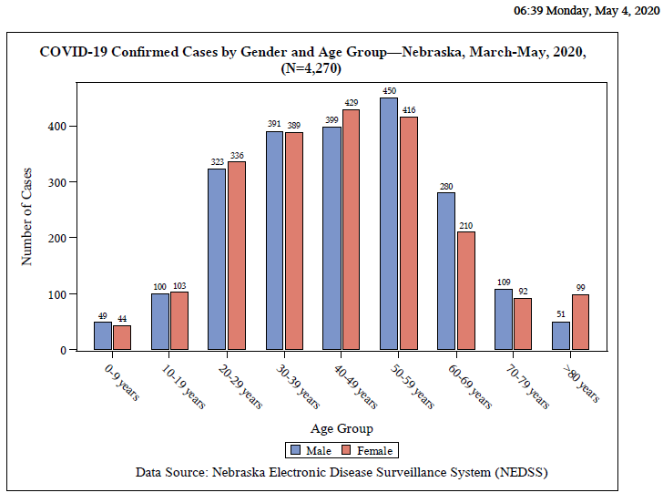

Slide 11
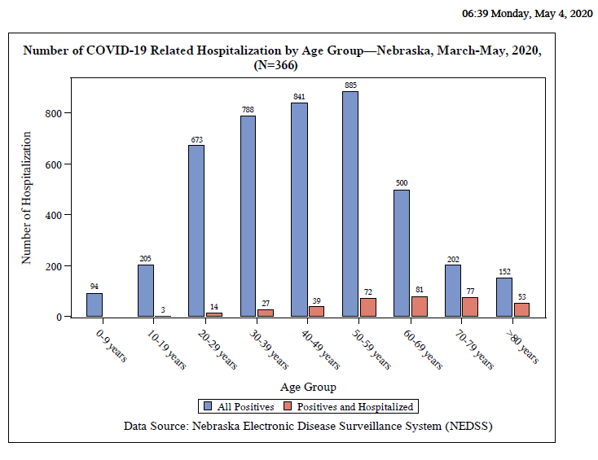

Slide 12
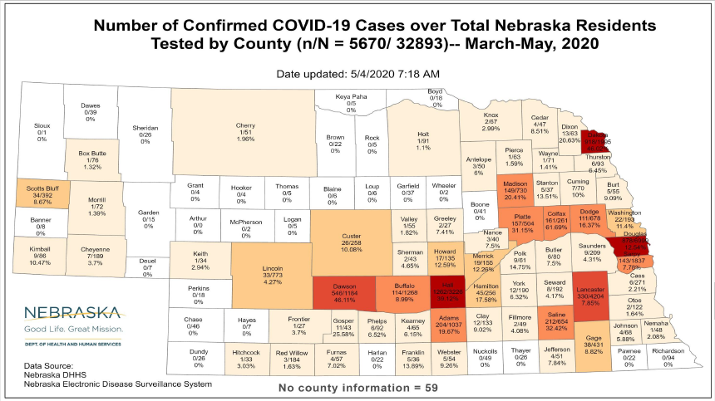

Slide 13
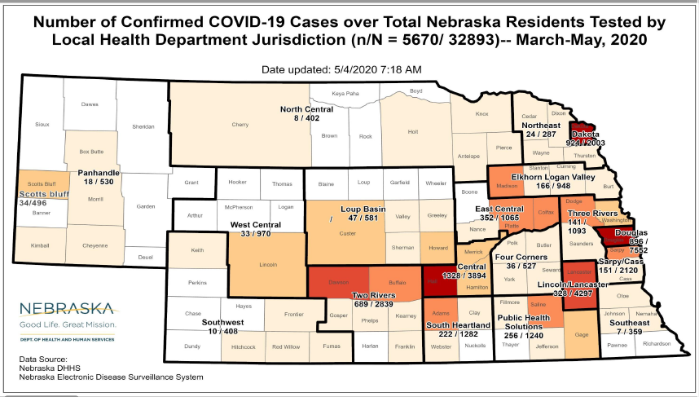

Slide 14
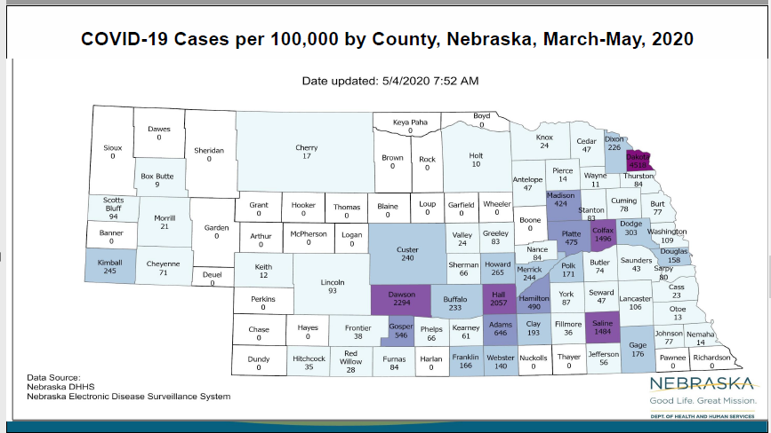

Slide 15
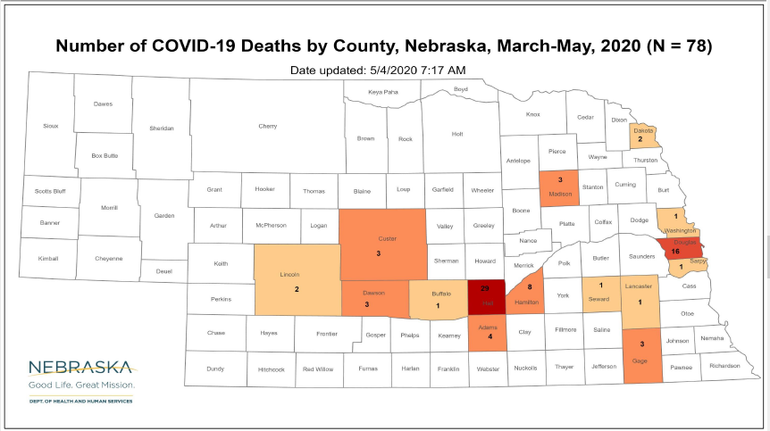

Slide 16
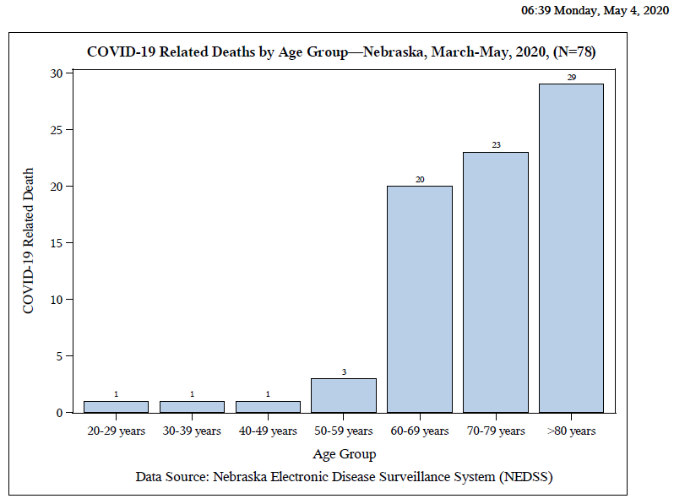

Slide 17
Bed and Vent Availability as of 5-4-20
https://nebraska.maps.arcgis.com/apps/opsdashboard/index.html#/4213f719a45647bc873ffb58783ffef3
50% hospital beds available
40% ICU beds available
78% ventilators available
In hardest hit communities, the hospitals still some ICU bed and Vent availability, Systems in place to transfer if necessary

Slide 18
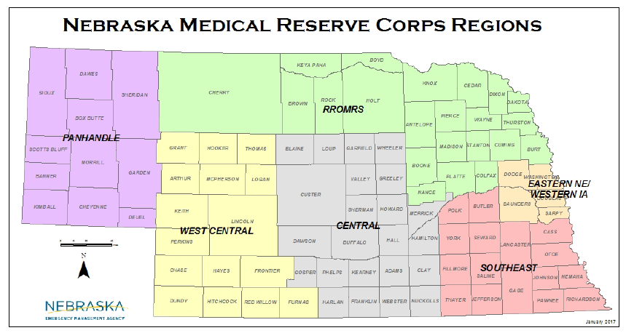

Slide 19
CDC Race Data-CDC MMWR
Of individuals for whom race or ethnicity data was available in NYC:
45% were white, compared to 55% of individuals in the surrounding community.
However, 33% of hospitalized patients were black compared to 18% in the community and
8% were Hispanic, compared to 14% in the community.
Death rates among
Black/African American persons (92.3 deaths per 100,000 population)
Hispanic/Latino persons (74.3)
White (45.2) or
Asian (34.5) persons. Studies are underway to confirm these data and understand and potentially reduce the impact of COVID-19 on the health of racial and ethnic minorities.

Slide 20
Local Race Data
Douglas-last week
45.5% White
23% Hispanic
18% African American
13% Asian
0.5% Native American
Hospitalizations in Central District disproportionately Hispanic
Virtual Town Hall: COVID-19 and the Black Community Dial-in May 6th at 6:30 PM ET as AMA President Patrice A. Harris, M.D., M.A., joins NABJ President Dorothy Tucker to discuss how the pandemic is impacting the Black community, health equity, the importance of science, data collection, testing, and more.

Slide 21
Meat Packing Plants and Their Communities
Hall County, Dakota County, Dawson
Conditions lead to close contact
Home conditions often lead to close contact
Higher community prevalence leads to staff for other environments being at risk
For example, entrance into LTC via employee family contacts of meat packing workers
Shelly Schwedhelm and Dr. James Lawler and others-have visited 11 Meat Packing Plants so far
Continuing multiple a week
Recommendations on Best Practices, a Checklist and A Survey

Slide 22
Major Issues/Recommendations in Meat Packing
Engineering
Air Flow
Physical barriers work-stations, break rooms, hallways
Administrative Controls
Universal Masking
Comm. In multiple languages-HH, social distancing,
Environmental Cleaning
high touch differences, hand sanitizer available, common use tools
Social Distancing
staggered breaks, staggered shifts, more break areas
Flexible sick leave

Slide 23
COVID-19 and Thrombotic or Thromboembolic Disease: Implications for Prevention, Antithrombotic Therapy, and Follow-up
ournal of the American College of Cardiology
April 2020 DOI: 10.1016/j.jacc.2020.04.031PDF Article
JACC State-of-the-Art Review
Just Accepted
Behnood Bikdeli, et al.
Abstract
Coronavirus disease 2019 (COVID-19), ..., may predispose patients to thrombotic disease, both in the venous and arterial circulations, due to excessive inflammation, platelet activation, endothelial dysfunction, and stasis. .... Herein, we review the current understanding of the pathogenesis, epidemiology, management and outcomes of patients with COVID-19 who develop venous or arterial thrombosis, and of those with preexisting thrombotic disease who develop COVID-19, or those who need prevention or care for their thrombotic disease during the COVID-19 pandemic.

Slide 24
Continued
From International Society of Thrombosis and Haemostasis
Consider for all low dose molecular heparin
UNC at Chapel Hill D dimer> 2500ng/ml-intermediate dose
If high suspicion of VTE full dose anticoagulation
Who to discharge-oral anticoagulation vs LMWH

Slide 25
COVID-19 Serology Tests EUAs
EUA Date Issued | Company | Type of Test | comments
4/15 | Mt. Sinai Lab NYC | COVID-19 ELISA IgG Ab Test | Qualitative
4/14 | Chembio Diagnostic System, Inc. | DPP COVID-19IgM/IgG system | Qualitative IgG / IgM reported separately FS 20-30 min
4/14 | Ortho Clinical Diagnostics | VITROS Total Ab Immunodiagnostic Anti-SARS-CoV-2 Total Reagent Pak | Qualitative Total IgG and M
4/1 | Celley Inc. | SARS-CoV-2 IgG/IgM Rapid Test | 20 min Yes/No IgG or IgM

Slide 26
Other Serology
Roche lab just received EUA for serology testing
LabCorp home test-EUA approved
Many other serology tests without EUA-be very wary, unknown accuracy
https://www.idsociety.org/globalassets/idsa/public-health/covid-19/idsa-covid-19-antibody-testing-primer.pdf
Should have EUA approved tests available possible as early as next week in NE

Slide 27
Donating Plasma and Convalescent Plasma
Donating Plasma
People who have fully recovered from COVID-19 for at least two wks are encouraged to consider donating plasma, which may help save the lives of other patients. COVID-19 convalescent plasma must only be collected from recovered individuals if they are eligible to donate blood. Individuals must have had a prior diagnosis of COVID-19 documented by a lab test and meet other donor criteria. Individuals must have complete resolution of symptoms for at least 28 days before they donate, or alternatively have no symptoms for at least 14 days prior to donation and have a neg lab test for active COVID-19 disease.
~American Red Cross
~Innovative Blood resources (IBR) which is based out of the twin cities (MN) in con partnership with Nebraska Community Blood Bank NPCC
Convalescent Plasma
CHI facilities involved in Mayo Clinic Protocol-convalescent plasma

Slide 28
ACTT (Adaptive COVID-19 Treatment Trial)
REMDESIVIR
RCT- Remdesivir 200mg x 1, 100mg daily for an additional 9 days VERSUS Placebo Treatment arm: 31% faster time to recovery (11 days versus 15 days) p< 0.01 Mortality 8% vs 11.6% (p 0.059) EUA approved 5.1.20
Gilead to donate all doses to fed govt
5 day vs 10 day no difference

Slide 29
Testing Performance
Probably over 90% SE/SPEC??
Are there false negatives? If high suspicion, get a second test
Rapid 15 min test-60% to 70% sensitivity;
?Saliva test from Rutgers??-see next slide 60 test concordance
Cepheid testing
Can use saline if out of VTM, must be refrigerated , can be frozen
List of all the drive thru sites inc. present sites, NG sites, Test NE coming soon
Test Nebraska.com-in partnership with private corporations
Risk assessment questionnaire
Starting in GI, Kearney and Omaha today

Slide 30
CDC'S CURRENT LIST OF CORONAVIRUS SYMPTOMS
Fever
Cough
Shortness of Breath
Chills
Repeated shaking with chills
Muscle pain
Headache
Sore throat
New loss of taste or smell
In US more GI-25% diarrhea, 10% vomiting
New info about neurologic effects, including stroke, GB

Slide 31
UV Disinfecting Stations around Nebraska
TRIMRS: CHI Good Samaritan, Kearney
PRIMRS: Region West, Scottsbluff
OMHCC: OrthoNE, Omaha
RROMRS: Avera, O’Neill
NPHCC: Chase County, Imperial
SENHCC: City of Lincoln / Transportation & Utilities, Lincoln

Slide 32
Home Healthcare Guidances
https://www.nahc.org/resources-services/coronavirus-resources/

Slide 33
Off Site Quarantine and Convalescence
HCPs and First Responders who wish to Q away from family in hotels- call 833 220 0018
(NEDHHS) will be expanding its pilot program to provide temporary accommodations to residents exposed to coronavirus disease (COVID-19) who need to quarantine or isolate. The program, coined NAP the Nebraska Accommodation Project, (on NE DHHS COVID 19 website)
The goal of this program is to offer temporary housing to Nebraskans that have been exposed to COVID-19 or are positive for COVID-19 and do not need any assistance with ADL and can mange their own health issues and are in need of a quarantine and/or isolation location outside of the normally defined household due to a high-risk household member. These accommodations will be available in a dormitory room setting and are open to anyone that meets the application criteria. Applications must be completed online at http://dhhs.ne.gov/Pages/Coronavirus look for the Nebraska Accommodation Project (NAP) header.
Initially, the University of Nebraska Omaha (UNO) will be used for NAP. UNL, UNK, and other campuses may come onboard later.

Slide 34
When Home Quarantine can be discontinued
Discontinuation of self-monitoring and self-quarantine:
Self-quarantine and self monitoring may stop if after 14 days from most recent exposure, there has been NO development of respiratory illness symptoms. Symptoms may include: cough, shortness of breath, fever, sore throat, and fatigue, myalgias, diarrhea.
Discontinuation of quarantine for household members of a person with COVID-19 who is under self-isolation:
Individuals who are at home with someone that has (or is suspected of having) COVID-19 should continue self-quarantine for 7 days after patient has been released from isolation AND then continue 7 more days with self-monitoring (total of 14 days).
These guidelines may not always pertain decisions regarding admission/discharge and transfer to/from healthcare facilities.

Slide 35
Changes in CDC Guidance regarding Isolation
Extended the home isolation period from 7 to 10 days since symptoms first appeared for the symptom-based strategy in persons with COVID-19 who have symptoms and from 7 to 10 days after the date of their first positive test for the time-based strategy in asymptomatic persons with laboratory-confirmed COVID-19. This update was made based on evidence suggesting a longer duration of viral shedding and will be revised as additional evidence becomes available. This time period will capture a greater proportion of contagious patients; however, it will not capture everyone.
Also extended the transmission-based precaution in healthcare settings based on a symptom or time based approach to be 10 days from symptom onset or test results in an asymptomatic person

Slide 36
When home quarantine and isolation are over
• Discontinuation from self-isolation for a symptomatic case (confirmed or probable):
CDC guidance (https://www.cdc.gov/coronavirus/2019-ncov/hcp/disposition-in-homepatients.html) states that an individual can stop self-isolation if it has been at least 10 days since symptoms first appeared AND No fever for at least 72 hours (fever-free for 3 full days off fever-reducing medicine) AND All other symptoms have improved (e.g., cough has improved).
• Discontinuation from self-isolation for an asymptomatic laboratory-confirmed case.
•Persons with laboratory-confirmed COVID-19 who have not had any symptoms may discontinue isolation when at least 10 days have passed since the date of their first positive COVID-19 diagnostic test and have had no subsequent illness provided they remain asymptomatic. For 3 days following discontinuation of isolation, these persons should continue to limit contact (stay 6 feet away from others) and limit potential of dispersal of respiratory secretions by wearing a covering for their nose and mouth whenever they are in settings where other persons are present. In community settings, this covering may be a barrier mask, such as a bandana, scarf, or cloth mask. The covering does not refer to a medical mask or respirator.

Slide 37
Return to Work Criteria for HCP with Confirmed or Suspected COVID-19
Symptomatic HCP with suspected or confirmed COVID-19:
Symptom-based strategy. Exclude from work until:
At least 3 days (72 hours) have passed since recovery defined as resolution of fever without the use of fever-reducing medications and improvement in respiratory symptoms (e.g., cough, shortness of breath); and,
At least 10 days have passed since symptoms first appeared
Test-based strategy. Exclude from work until:
Resolution of fever without the use of fever-reducing medications and
Improvement in respiratory symptoms (e.g., cough, shortness of breath), and
Negative results of an FDA Emergency Use Authorized COVID-19 molecular assay for detection of SARS-CoV-2 RNA from at least two consecutive nasopharyngeal swab specimens collected ≥24 hours apart (total of two negative specimens

Slide 38
Return to Work Criteria for HCP with Confirmed or Suspected COVID-19 (Continued)
HCP with laboratory-confirmed COVID-19 who have not had any symptoms:
Time-based strategy. Exclude from work until:
10 days have passed since the date of their first positive COVID-19 diagnostic test assuming they have not subsequently developed symptoms since their positive test. If they develop symptoms, then the symptom-based or test-based strategy should be used. Note, because symptoms cannot be used to gauge where these individuals are in the course of their illness, it is possible that the duration of viral shedding could be longer or shorter than 10 days after their first positive test.
Test-based strategy. Exclude from work until:
Negative results of an FDA Emergency Use Authorized COVID-19 molecular assay for detection of SARS-CoV-2 RNA from at least two consecutive nasopharyngeal swab specimens collected ≥24 hours apart (total of two negative specimens). Note, because of the absence of symptoms, it is not possible to gauge where these individual are in the course of their illness. There have been reports of prolonged detection of RNA without direct correlation to viral culture.
Note that detecting viral RNA via PCR does not necessarily mean that infectious virus is present.Consider consulting with local infectious disease experts when making decisions about discontinuing Transmission-Based Precautions for individuals who might remain infectious longer than 10 days (e.g., severely immunocompromised).
If HCP had COVID-19 ruled out and have an alternate diagnosis (e.g., tested positive for influenza), criteria for return to work should be based on that diagnosis.

Slide 39
Return to Work Practices and Work Restrictions
After returning to work, HCP should:
Wear a facemask for source control at all times while in the healthcare facility until all symptoms are completely resolved or at baseline. A facemask instead of a cloth face covering should be used by these HCP for source control during this time period while in the facility. After this time period, these HCP should revert to their facility policy regarding universal source control during the pandemic.
A facemask for source control does not replace the need to wear an N95 or higher-level respirator (or other recommended PPE) when indicated, including when caring for patients with suspected or confirmed COVID-19.
Of note, N95 or other respirators with an exhaust valve might not provide source control.
Self-monitor for symptoms, and seek re-evaluation from occupational health if respiratory symptoms recur or worsen
https://www.cdc.gov/coronavirus/2019-ncov/hcp/return-to-work.html

Slide 40
Testing Exposed HCWs
Overall Recommendation is not to do so
ICSA, SHEA do not routinely recommend
Understand individual situations may require a different approach
Outbreaks in LTC

Slide 41
When a Testing-Based Strategy is Preferred
Hospitalized patients may have longer periods of SARS-CoV-2 RNA detection compared to patients with mild or moderate disease. Severely immunocompromised patients (e.g., medical treatment with immunosuppressive drugs, bone marrow or solid organ transplant recipients, inherited immunodeficiency, poorly controlled HIV) may also have longer periods of SARS-CoV-2 RNA detection and prolonged shedding of infectious recovery. These groups may be contagious for longer than others. In addition, placing a patient in a setting where they will have close contact with individuals at risk for severe disease warrants a conservative approach.
Hence, a test-based strategy is preferred for discontinuation of transmission-based precautions for patients who are
Hospitalized or
Severely immunocompromised or
Being transferred to a long-term care or assisted living facility
If testing is not readily available, facilities should use the non-test-based strategy for discontinuation of Transmission-Based Precautions or extend the period of isolation beyond the non-test-based-strategy duration, on a case by case basis in consultation with local and state public health authorities.
From CDC updated IP Guidance 4/15/20

Slide 42
LTCF Support by DHHS HAI/ICAP
Collecting LTC epi data including death by facility and LHD
Continuing 1:1mentoring and support for each LTCF with a COVID-19+ resident or staff (thru ICAP office or Dr. Kamal-Ahmed arranges thru
Following Up on Tele-ICAR by CDC
Developing our own preemptive Tele-Icar to expand on CDC efforts
Weekly webinars on Thursdays at noon-ICAP site
Creating guidances and resources on Nebraska ICAP site.
NETEC teams doing onsite visits onsite visits
Expanding testing with NG and CDC.

Slide 43
LTC COVID 19 Data (as of 5.1.20)
51 Facilities with at least one resident or staff positive for COVID-19
22 LTCF have at least one resident positive
6 have 1 only
10 have 10 or more
43 facilities have a staff member positive
13 facilities have both staff and residents positive
8 have only residents positive
30 only staff positive no residents

Slide 44
LTC Accepting Patients
When should a nursing home accept a resident who was diagnosed with COVID-19 from a hospital?
A nursing home can accept a resident diagnosed with COVID-19 and still under Transmission-Based Precautions for COVID-19 as long as the facility can follow CDC guidance for Transmission-Based Precautions. If a nursing home cannot, it must wait until these precautions are discontinued. CDC has released Interim Guidance for Discontinuing Transmission-Based Precautions or In-Home Isolation for Persons with Laboratory-confirmed COVID-19. Information on the duration of infectivity is limited, and the interim guidance has been developed with available information from similar coronaviruses. CDC states that decisions to discontinue Transmission-based Precautions in hospitals will be made on a case-by-case basis in consultation with clinicians, infection prevention and control specialists, and public health officials. Discontinuation will be based on multiple factors (see current CDC guidance for further details).

Slide 45
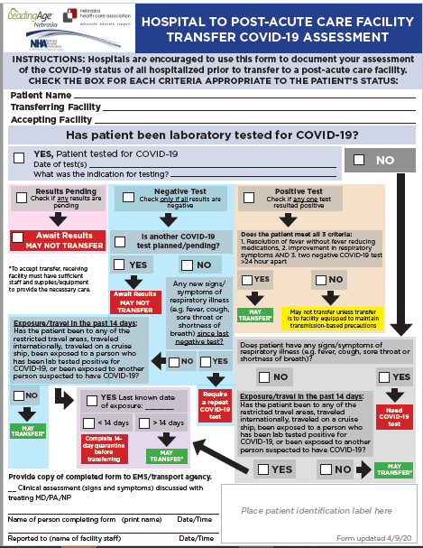

Slide 46
Figure: Cohorting Residents in the Long-Term Care Facilities
Red Zone (Isolation zone) | Dark Red | Residents with Positive COVID-19 test
 | Light Red | Symptomatic residents suspected of having COVID-19
Yellow Zone (Quarantine zone) |  | Asymptomatic residents who may have been exposed to COVID-19
Green Zone (COVID-19 free zone) |  | Asymptomatic residents without any exposure to COVID-19
Gray Zone (Transitional zone) |  | Residents who are being transferred from the hospital/outside facilities (but have no known exposure to COVID-19) are usually kept in this zone for 14 days and if remains asymptomatic at the end of 14 day will be moved to Green zone
https://icap.nebraskamed.com/wp-content/uploads/sites/2/2020/04/Cohorting-Plan-for-LTCF-4.16.20.pdf.

Slide 47
Post Mortem Guidance
Https://www.cdc.gov/coronavirus/2019-ncov/hcp/guidance-postmortem-specimens.html
Guidance for post-mortem specimens (NP swabs)
Guidance for Funeral Directors

Slide 48
Infection Prevention and Control Office Hours
Monday – Friday
7:30 AM – 9:30 AM Central Time
2:00 PM -4:00 PM Central Time
Call 402-552-2881

Slide 49
STOP Here

Slide 50
ICS* Guidance on Prone Positioning in COVID
Theoretical Benefits to Prone Positioning in the Conscious COVID 19 Patient
• Improved VQ matching and reduced hypoxaemia (secondary to more homogeneous aeration of lung and ameliorating the ventral-dorsal transpulmonary pressure gradient)
• Reduced shunt (perfusion pattern remaining relatively constant while lung aeration becomes more homogenous)
• Recruitment of the posterior lung segments due to reversal of atelectasis
• Improved secretion clearance
One local expert-try and lay prone for 1 hour-4 to 5 times a day, stretching, deep breaths.
*Intensive Case Society

Slide 51
Strategies to Mitigate Healthcare Personnel Staffing Shortages
Maintaining appropriate staffing in healthcare facilities is essential to providing a safe work environment for HCP and safe patient care. As the COVID-19 pandemic progresses, staffing shortages will likely occur due to HCP exposures, illness, or need to care for family members at home. Healthcare facilities must be prepared for potential staffing shortages and have plans and processes in place to mitigate them, including considerations for permitting HCP to return to work without meeting all return to work criteria above. Refer to the Strategies to Mitigate Healthcare Personnel Staffing Shortages document for information. As part of this, asymptomatic HCP with a recognized COVID-19 exposure might be permitted to work as a crisis capacity strategy to address staffing shortages if they wear a facemask for source control for 14 days after the exposure. This time period is based on the current incubation period for COVID-19 which is 14 days.
From CDC 4.30.20

Slide 52
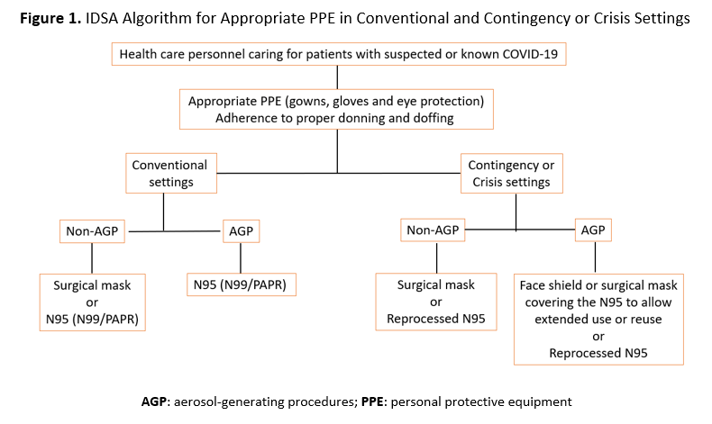

Slide 53
PPE Request Form
https://form.jotform.com/NebraskaDHHS/PPERequestForm

Slide 54
How to determine PPE needs
PPE Burn Rate Calculator
Personal Protective Equipment Burn Rate Calculator excel icon[XLS – 39 KB]
This spreadsheet can help healthcare facilities plan and optimize the use of personal protective equipment (PPE) for response to coronavirus disease 2019 (COVID-19). Get the Instructions
PPE Requests need to go to LHD, shipments go out to LHD and then from LHD to facilities as soon as possible. Often don’t know when shipments are arriving.

Slide 55
Staffing Needs
NE DHHS COVID Staffing Support Program
Caryn N Vincent, MPH | Interim Deputy Director, Public Health | Nebraska Department of Health and Human Services
Email: Caryn.Vincent@nebraska.gov
Phone: 402-471-1595 or 402-613-2377
Please provide facility name, type of professional support needed, and contact information. Someone will contact you regarding your request within 24 hours.

Slide 56
Remdesivir Trials
Severe Disease 2400 at 132 sites
Moderate Disease 1600 at 169 sites
Clinical benefit of remdesivir in rhesus macaques infected with SARS-CoV-2
Conclusions Therapeutic remdesivir treatment initiated early during infection has a clear clinical benefit in SARS-CoV-2-infected rhesus macaques. These data support early remdesivir treatment initiation in COVID-19 patients to prevent progression to severe pneumonia.
Early Results from Study in China
13.8 vs 12.9 (?) results mortality; small trial, late in course

Slide 57
Tissue Plasminogen Activator (tPA) Treatment for COVID-19 Associated Acute Respiratory Distress Syndrome (ARDS): A Case Series.
J Thromb Haemost. 2020 Apr 8. doi: 10.1111/jth.14828. [Epub ahead of print]
Wang J¹, Hajizadeh N¹, Moore EE^{2,3}, McIntyre RC³, Moore PK⁴, Veress LA⁵, Yaffe MB^{6,7}, Moore HB³, Barrett CD^{6,7}.
Abstract
A hallmark of severe COVID-19 is coagulopathy, with 71.4% of patients who die of COVID-19 meeting ISTH criteria for disseminated intravascular coagulation (DIC) while only 0.6% of patients who survive meet these criteria (1). Additionally, it has become clear that this is not a bleeding diathesis but rather a predominantly pro-thrombotic DIC with high venous thromboembolism rates, elevated D-dimer levels, high fibrinogen levels in concert with low anti-thrombin levels, and pulmonary congestion with microvascular thrombosis and occlusion on pathology in addition to mounting experience with high rates of central line thrombosis and vascular occlusive events (e.g. ischemic limbs, strokes, etc.) observed by those who care for critically ill COVID-19 patients (1-7). There is evidence in both animals and humans that fibrinolytic therapy in Acute Lung Injury and ARDS improves survival, which also points to fibrin deposition in the pulmonary microvasculature as a contributory cause of ARDS and would be expected to be seen in patients with ARDS and concomitant diagnoses of DIC on their laboratory values such as what is observed in more than 70% of those who die of COVID-19 (8-10).

Slide 58
What to Do When Large Numbers of Staff Exposed (Mostly LTC Issue, but also SCAH)
Evaluation including LHD, DHHS Epi, NE CMS, ICAP, to help determine level of exposure, staffing needs, support needed for staff and infection prevention.
When feasible keep HCPs who have been exposed at home for 14 days if staffing permits.
If cannot do #2, assess level of exposure, if can triage medium risk HCPs back to work but keep out high risk exposures in Q do so;
If #3 not possible, according to CDC and CMS “facilities could consider allowing asymptomatic HCP who have had an exposure to a COVID-19 patient to continue to work after options to improve staffing have been exhausted and in consultation with their occupational health program (or LHD, CMD, DHHS and/or ICAP)
These HCP should still report temperature and absence of symptoms each day prior to starting work. Facilities should have exposed HCP wear a facemask while at work for the 14 days after the exposure.
If HCP develop even mild symptoms consistent with COVID-19, they must cease patient care activities, don a facemask (if not already wearing), and notify their supervisor or occupational health services prior to leaving work.

Slide 59
Registration link: https://unmc.zoom.us/webinar/register/WN_9jB8mb2CQmWeuD82yxbJ2g

Slide 60
Thanks to NM procedure sharing
https://www.nebraskamed.com/sites/default/files/documents/covid-19/surgical-mask-policy-and-faq-nebraska-med.pdf
For pictures on how to lay out mask on a paper towel go to above website

Slide 61
Resources (as of 8:00am 3/30/20)
Exposure Risk Assessment
https://www.cdc.gov/coronavirus/2019-ncov/hcp/guidance-risk-assesment-hcp.html
Guidance for pregnant and breastfeeding mothers
https://www.cdc.gov/coronavirus/2019-ncov/need-extra-precautions/pregnancy-breastfeeding.htmll
Guidance for PPE
https://www.cdc.gov/coronavirus/2019-ncov/hcp/ppe-strategy/index.html
Regarding use of homemade masks
https://www.cdc.gov/coronavirus/2019-ncov/hcp/ppe-strategy/face-masks.html

Slide 62
Presentation prepared by: Dr. Maureen Tierney and Dr. Tom Safranek
HAI/AR Epidemiologist
Ishrat.kamal-ahmed@Nebraska.gov
402-471-2937

