Slide 1
Swing Bed Quality Program
Every patient deserves exemplary care.

Slide 2
Kate Hill, RN
Vice President Client Success The Compliance Team

Slide 3
Why Swing Bed Certification
3rd party validation of your quality
Differentiate yourself from other Post-Acute Care Providers
Provide transparency about your program
Make you Swing Bed program stronger
Decrease out migration
Demonstrate that bigger is not always better
Quantify and Qualify the value of your swing bed program
Set yourself up for success

Slide 4
Why Swing Bed Certification
Critical Access Hospitals are exempt from Quality reporting for their swing bed program.
Organizations who want to level the playing field, must quantify, and qualify the services they provide.
This why we created the Swing Bed Quality Certification.
Swing beds are a vital resource to the hospitals financial well being.

Slide 5
Testimonial
“An effective Swing Bed Strategy and process will have a significant impact on the number of patients in your Swing Bed program.”
“The Swing bed Certification Program Ensures and validates that CAH's are meeting all required policies and procedures and implementing best practice for transitional care.”
Leslie Marsh CEO Lexington Regional Health Center and current President of NRHA

Slide 6
Thoughts
With a limited number of Swing Bed patients, Hospitals need to actively pursue patients to increase swing bed volumes.
Hospitals must establish relationships with larger hospitals and actively pursue Swing Bed patients whenever beds are available.
The goal is to establish a relationship with the other hospital so that you are the first hospital call when they have a patient needing Swing Bed services.
When transferring patients for Acute services elsewhere, work to ensure the return to your facility if the patient needs Swing Bed services.

Slide 7
EPP Quality Standards & Evidence of Compliance (EOC)
Transparency Standards
Care and Services Standards
Safety and Security
Medical Oversight
Patient/Family Rights
Staffing Types and amounts
Patient/Family Expectations Met
Patient/Family Engagement and Education
Cleanliness/Environment
Team Approach and Coordination
Medication Management
Infection Prevention
Quality of Life
Transitional Management
Rehabilitative Services
Fall Prevention
Surrounding and belongings secure

Slide 8
TP 1.0
TP 1.0 — The CAH Swing Bed Quality Program ensures all patients received care and treatment as ordered upon admission and throughout the stay.
Evidence of Compliance:
The facility has a process that ensures the patient receives care ordered, as evidenced by:
All patient care orders, including verbal orders are reflected in the patient healthcare record.
All orders are reviewed and signed off by the ordering physician.
All treatments, activities, etc. are documented in the patient notes (i.e., if PT ordered 3 times a week, do the notes reflect treatment was provided as ordered.)

Slide 9
TP 2.0
TP 2.0 — The CAH Swing Bed Quality Program protects patient and family rights and responsibilities.
Evidence of Compliance:
The facility ensures every patient is notified of his/her rights (i.e., free choice, privacy, advance directives, involvement in planning of care, visitation rights).
The facility has a process that ensures information provided to patients contains individual rights under State law to make decisions concerning medical care, which includes:
Attaining written consent to treat
The right to accept or refuse care concerning medical or surgical treatment
Acknowledging advanced directive as required by the State
The right to receive information in a manner the patient understands
A privacy notice is posted publicly and made available to all patients upon request.
The facility ensures all staff is trained on the patient rights and responsibilities document.

Slide 10
TP 3.0
TP 3.0 — The facility ensures the healthcare staff is sufficient to provide the services essential for the operation of the swing bed program.
Evidence of Compliance:
The facility utilizes an acuity-based staffing process to ensure there is enough staff available to meet the healthcare needs of the patients (i.e., responds in a timely manner to requests for assistance in getting dressed, taking a shower or using the bathroom.)
The facility has a process to complete a self-assessment that considers resident numbers, acuity, and diagnoses to ensure it has sufficient nursing staff, with appropriate competencies and skill sets, for the patient population.
The facility posts, or makes available upon request, the number of nursing staff, including Certified Nursing Assistants, available each shift.
The facility staff responds to all requests for assistance in a polite, respectful, and caring manner, and in a timely fashion.

Slide 11
TP 3.0 (continued)
TP 3.0 — The facility ensures the healthcare staff is sufficient to provide the services essential for the operation of the swing bed program.
Evidence of Compliance:
The facility provides access to the necessary behavioral health care and services to ensure each patient attains the highest level of function possible.
The facility employs sufficient staff, with appropriate competencies, to address dietary needs, including ensuring meals meets certain religious or dietary preferences of patients.
The facility has a process to look at staff turnover and employs methods such as increased communication avenues, opportunities to share knowledge, and on the job training to reduce staff turnover.

Slide 12
CS 1.0
CS 1.0 — The CAH Swing Bed Quality Program meets patient and family expectations.
Evidence of Compliance:
The facility has a process, with clear goals to measure patient/family satisfaction, that includes interviews, one on one conversations with patients and family about their care and treatment provided.
The facility ensures all patients receive a TCT patient satisfaction survey.
The results of the patient satisfaction surveys are collected, evaluated, and presented at QI/staff meetings.
The clinic has a process to develop and implement corrective action if the result of the patient satisfaction evaluation reveals possible issues.

Slide 13
CS 1.0 (continued)
CS 1.0 — The CAH Swing Bed Quality Program meets patient and family expectations.
Evidence of Compliance:
The clinic has a written policy and procedure for defining, handling, reviewing, and resolving complaints.
When a complaint is received, the facility provides notice to the patient and their family that it is being investigated within the timeframe identified in policy.

Slide 14
CS 3.0
CS 3.0 — The premises of the CAH Swing Bed Quality Program are clean and orderly.
Evidence of Compliance:
The facility has written policies for a clean and orderly environment that address the following:
Techniques for cleaning and disinfecting environmental surfaces, furniture, etc.
Disposal of regulated waste
Interior spaces of the facility meet the needs of the patient population and are safe and suitable to the care, treatment and services provided.
Lighting is suitable for care, treatment, and services.
Areas used by patients are clean and free of offensive odors.
The facility keeps furnishings and equipment safe and in good repair.
The temperature in the facility is comfortable for the patients.
The facility is free of clutter and other hazards.
8) Noise levels are low

Slide 15
CS 4.0
CS 4.0 — The CAH Swing Bed Quality Program uses a team-based approach for the services, care and treatment it provides.
Evidence of Compliance:
The facility can provide evidence of care coordination with the treatment team (i.e., team meeting notes, comprehensive assessment/team huddles).
The facility has a process to ensure all team members are aware of each patient’s individual needs, concerns, and specialized care.
The facility employs a unified treatment approach (i.e., plan of care) to focus on what matters most to the patient.

Slide 16
CS 5.0
CS 5.0 — Medication Management is sufficient to meet the needs of the patient and the prescribing physician’s order.
Evidence of Compliance:
To ensure medication is given as prescribed, the facility has a written medication policy that defines the required elements of a complete medication order.
The facility has a process to safely dispense medications to the patients. This process includes but is not limited to:
Verifying that the medication selected matches the medication ordered
Verifies the medication has not expired
Verifies that the medication is stored and administered according to manufacturer guidelines
Verifies that the medication is being administered at the proper time, in the prescribed dose, and by the correct route
Educating the patient and/or caregiver on medication prescribed, the purpose of the medication, and methods of obtaining and taking each medication

Slide 17
CS 5.0 (continued)
CS 5.0 — Medication Management is sufficient to meet the needs of the patient and the prescribing physician’s order.
Evidence of Compliance:
Before administering a new medication, the patient and family is informed about any potential side effect or other concerns regarding the new medication
Provides clear written medication instructions using health literacy concepts to ensure patient understanding (i.e., easy to understand text and/or pictures are used when appropriate)
If patient is discharged home, a follow-up phone call within 48 hours is made to ensure the patient understands any medication(s) prescribed and discharge instructions.
The CAH swing bed quality program assures that patients are following medication instructions and management of any potential side effects.

Slide 18
CS 6.0
CS 6.0 — The organization follows infection control techniques that relate to the type of patient served, service provided and staff risk for exposure, and to protect the patient and staff from the spread of infection.
Evidence of Compliance:
The organization has a written infection control policy and procedure.
The organization practices infection control techniques by utilizing the following:
Hand washing before and after each patient contact or use of alcohol-based gel
Utilization of gloves while handling or cleaning dirty equipment or touching the patient.
Utilization of Standard Precautions when at risk for exposure to blood-borne pathogens
Proper disposal of gloves
All staff has documented training on proper use of PPE and infection control prevention.

Slide 19
CS 6.0
CS 6.0 — The organization follows infection control techniques that relate to the type of patient served, service provided and staff risk for exposure, and to protect the patient and staff from the spread of infection.
Evidence of Compliance:
PPE used is dependent on service being provided and adheres to scope of practice within the state governing the licensed professional.
The infection prevention polices of the facility, including but not limited to the use of PPE, will be followed by family, visitors, and vendors.

Slide 20
CS 7.0
CS 7.0 — The Quality of life is enhanced in the CAH Swing Bed Quality Program.
Evidence of Compliance:
The facility provides specialized rehabilitative services (physical therapy, occupational therapy, and/or speech language pathology) either directly or thru contract to meet patient needs.
The facility provides an ongoing program of activities designed to meet the interests, physical, mental, and psychological well-being of each resident.
The facility posts or provides patients with an activity calendar that is available.
The facility ensures activities are offered at hours that meets the need of patients.
The facility ensures all activities offered occur as planned.
The facility helps patients to participate in social and recreational activities according to their abilities and interests.

Slide 21
CS 8.0
CS 8.0 — The CAH Swing Bed Program provides continuity of medical oversight through transition of care provided at multiple health care settings (i.e., Acute Care admission to swing bed and then to Home Health or outpatient Services).
Evidence of Compliance:
The facility has a process to coordinate the patient’s care, treatment and services based on the patient’s needs. Note: Coordination involves resolving conflicts and duplication of care, treatment, and services.
The facility can provide evidence that the patient and/or its caregiver have been involved in all transitions of care.
To provide a safe and seamless transition thru multiple heath care settings, the facility ensures the following:
A process to support a reconciled medication list at each transition point.
A process that ensures the timely transfer of essential transitions of patient care information (e.g., diagnosis, co-morbidities, chronic condition, medications, labs and other tests, cognitive or functional impairments, behavioral health issues) to key stakeholders, including the care giver and care manager in the next healthcare setting.
Before the patient is discharged or transferred, the facility informs and educates the patient and patient’s family about follow-up care, treatment, and services.

Slide 22
SS 1.0
SS 1.0 — CAH Swing Bed Quality Program Provides.
Evidence of Compliance:
The facility develops and implements a system that prevents mistreatment, neglect or abuse of patients and misappropriation of resident’s property to include:
Background checks on staff members
The CAH Swing Bed program has a process to identify individuals entering its facility, such as identifying all staff members with name tags and/or security badges
There is a process to protect the patient’s possessions, including lockable cabinets and closets
Families are encouraged to take valuables home
Doors are locked where appropriate

Slide 23
SS 2.0
SS 2.0 — CAH Swing Bed Quality Program Provides a safe and secure environment.
Evidence of Compliance:
The facility develops and implements a system that prevents mistreatment, neglect or abuse of patients and misappropriation of resident’s property to include:
Background checks on staff members
The CAH Swing Bed program has a process to identify individuals entering its facility, such as identifying all staff members with name tags and/or security badges
There is a process to protect the patient’s possessions, including lockable cabinets and closets
Families are encouraged to take valuables home
Doors are locked where appropriate

Slide 24
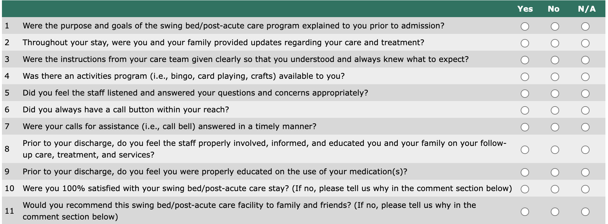
TCT – Patient Satisfaction Survey

Slide 25
Swing Bed Compare
Gather and gauge individual patient satisfaction of their experience and care.
Aggregate your patients’ feedback and benchmark your facility against other swing bed facilities.
Consistent evaluation of patient satisfaction and benchmarking enables you to implement quality improvements within your facility.
Operational excellence leads to clinical excellence, increasing both staff and patient satisfaction.
Become a facility of choice and join as a charter member of Swing Bed Compare at no charge for all of 2024.

Slide 26
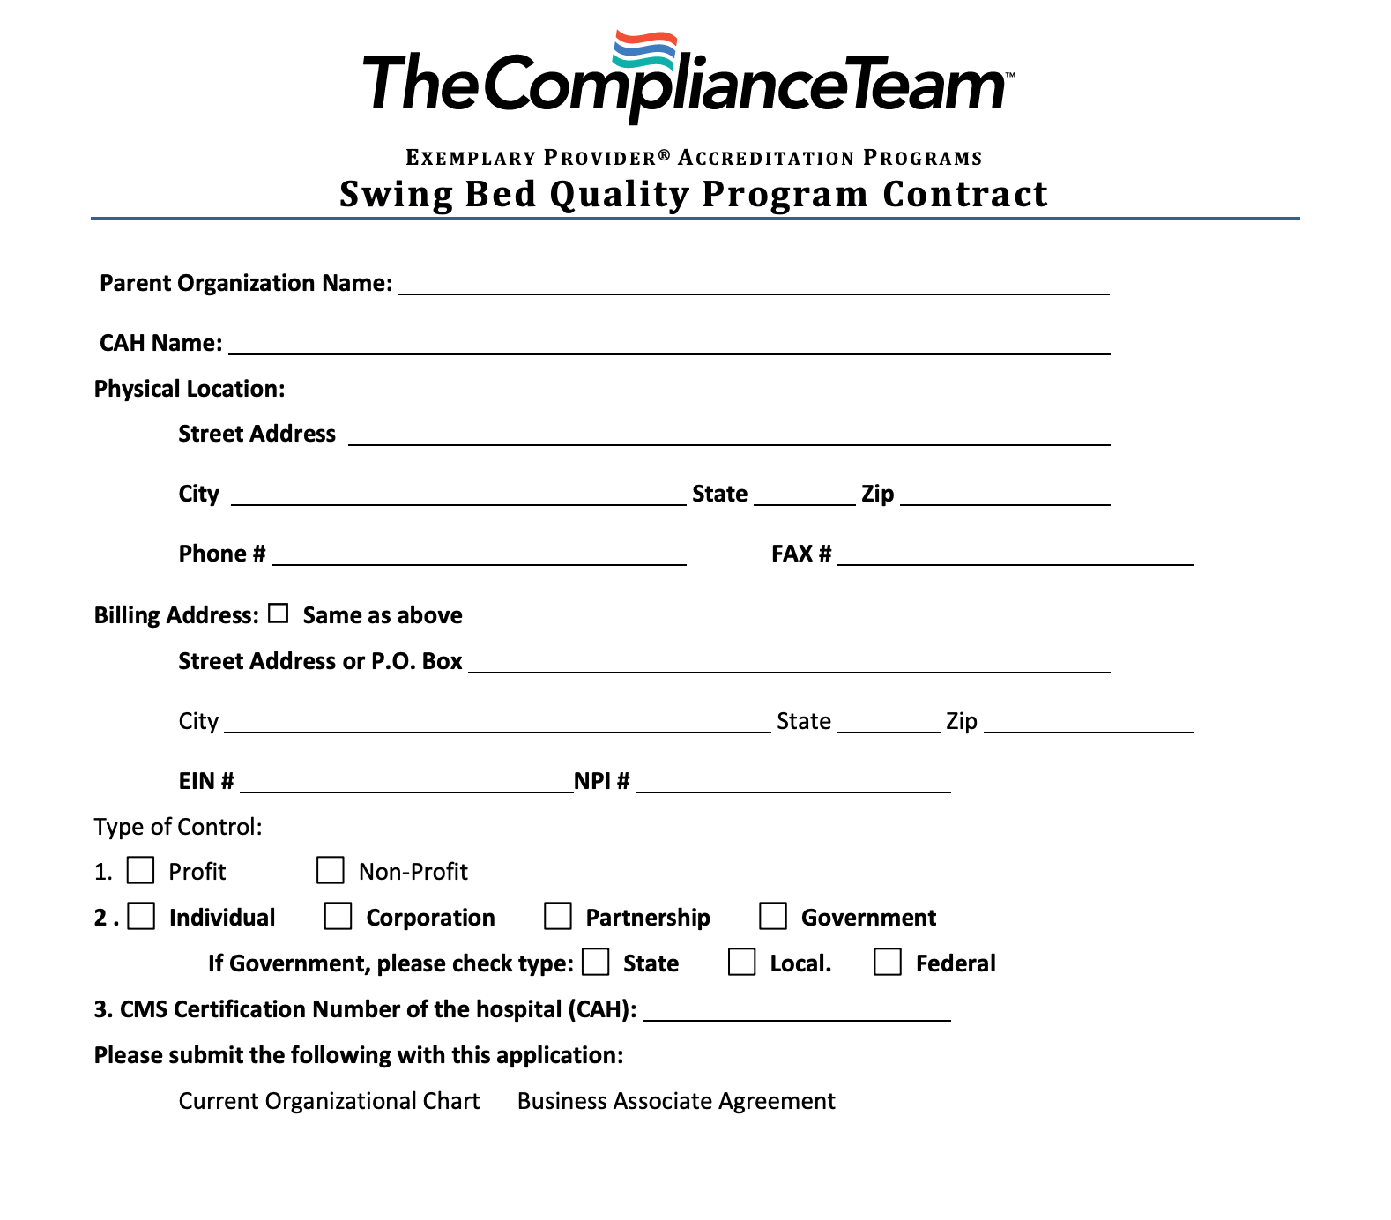
TCT – Application

Slide 27
Final Take Aways
Important to build a high-quality swing bed program and use it to differentiate our services from others offering post-acute care
Swing bed quality certification and tracking swing bed outcomes
High quality swing bed services provide a tailwind for swing bed program growth
Developing a Care Spectrum and using Active Solicitation techniques
Improves financial position of the hospital through volume growth, which drives revenue growth and dilutes fixed costs resulting in service efficiency

Slide 28
Questions
Kate Hill, R.N. VP of Clinical Division
khill@thecomplianceteam.org
215-654-9110
© 2023 The Compliance Team. All rights reserved.

