Slide 1
Workplace Diversity

Slide 2
Workplace Diversity
We are living and working in a time of transformation

Slide 3
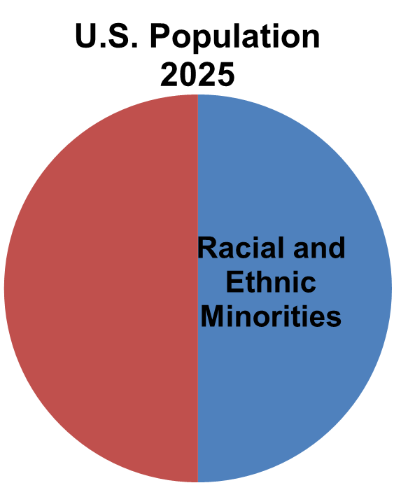
Workplace Diversity

Slide 4
Workplace Diversity
Source: Bureau of Labor Statistics, 2017

Slide 5
Workplace Diversity
U.S CEO’s By Race
Source: Bureau of Labor Statistics, 2017

Slide 6
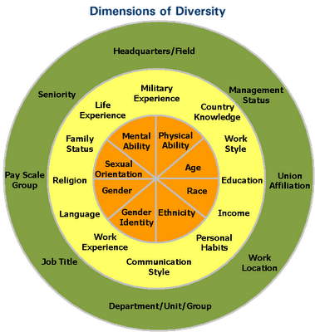
Internal
Organizational
Personality
External

Slide 7
What types of changes have you experienced at your workplace as well as with client base that you serve?

Slide 8
Events that led the way for Diversity and Inclusion
Timeline – evolution of events
Norris-LaGuardia Act,
Wager Act,
Taft-Harley Act
Civil Rights Act of 1964
Civil Rights Act of 1991
1920
1930
1940
1950
1960
1970
1980
1990
2000
2010
Equal Pay Act of 1963
Title VII of the Civil Rights Act: it is illegal to discriminate based on an individual’s race, color, religion, sex or nation origin…

Slide 9
Events that led the way for Diversity and Inclusion
Age Discrimination in
Employment Act
1920
1930
1940
1950
1960
1970
1980
1990
2000
2010
Americans with Disability Act
Current and “Unresolved”: Equal rights of sexual orientation.

Slide 10
Workplace Diversity
Personal and Organizational Assessment

Slide 11
Workplace Diversity: Advantages
Enhanced perspective of business and customer issues
Increased recruitment and retention
More positive organizational culture
Less discrimination based lawsuits
Notes:
Majority were born before 1945, lived during the Great Depression, World War II
Approximately 2% of the workforce
Values/Ethics: Sacrifice, Collectivism vs. Individualism, Patriotic
Workplace Attributes: Hard working, loyal, often have extensive knowledge and experience to draw from, “punch the timeclock mentality
Workplace preferences: Chain of Command

Slide 12
Workplace Diversity: Barriers
Limited perceptions
Ethnocentrism
Stereotypes and predjudice lead to discrimination
- “Covering”
Notes:
Majority were born before 1945, lived during the Great Depression, World War II
Approximately 2% of the workforce
Values/Ethics: Sacrifice, Collectivism vs. Individualism, Patriotic
Workplace Attributes: Hard working, loyal, often have extensive knowledge and experience to draw from, “punch the timeclock mentality
Workplace preferences: Chain of Command

Slide 13
How do we move from equality to respecting people for their differences in order to lead a new workforce?

Slide 14
Strategic Context Goals
Diversity and Inclusion
Action Planning

Slide 15
Strategic Context Goals
Alignment with applicable departments and employment brand
Drive down to operational planning, followed by individuals planning
Spread message regarding culture to volunteer groups, recruitment sources and community as a whole
Reach out to groups we haven’t before and be conscious of representation of your organization relative to the “applicable labor market”

Slide 16
Talent Management Goals
“Meet Them Where They Are” Mentality
Management-in-Training/Preparation Programs
Rotational programs to increase organizational/functional exposure (i.e. cross-functional knowledge)
Have fair and transparent recruitment/promotion processes
Training managers on diversity related issues

Slide 17
Inclusive Work Environment Goals
Consider visuals, internet advertising, messaging and social media
Re-work policies, procedures and practices as necessary
Educating the workforce on “identity” related issues as well as the value of diversity
Help employees regulate emotions

Slide 18
Self-Assessment Goals
Measurement, measurement and measurement (focused on results and outcomes)
Self Identification (i.e. LGBTQ, Veteran, Disabled, Pregnant, Minority, Ethnicity, etc.)
Tracking to assess movement (i.e. improvement, stagnation, decline)

Slide 19
Strategic Context Resources
Reaching out to various community groups
Cultural Awareness
Closeness with others who don’t have similar backgrounds
Employee Resource Groups, specifically when the group isn’t your demographic
Incorporate real, human, personal aspects into work – what you are looking forward to, what are you celebrating outside of work

Slide 20
Talent Management Resources
Internal:
- Data on workforce demographics/diversity
- Proactive Recruitment
IDP’s
Skills Inventory
Employee Resource Groups
- Fair and Equitable Process

Slide 21
Talent Management Resources
External:
- Data on area demographics/diversity
- Proactive Recruitment
Targeted College Recruitment
Affinity Groups
“Cast a Wide Net” Mentality
- Fair and Equitable Process

Slide 22
General Development Resources
Training Options:
Internal
Leadership Development
On the Job
Cross Training
Job Enlargement
Job Enrichment
Mentoring
External
Educational Degree
Certifications
E-Resources: Free
Khan Academy: https://www.khanacademy.org/
MOOC’s: https://www.edx.org/course
E-Resources-Minimal Cost:
- Lynda.com:https://www.lynda.com/

Slide 23
Inclusive Work Environment Resources
All of the above – any and all of the resources listed in the Strategic Context, Talent Management and Self-Assessment areas would apply to creating and maintaining an Inclusive Work Environment!

Slide 24
Evaluation and Metrics
How will we know if we reached our goals?

Slide 25
Evaluation and Metrics
Strategic Context
Feedback from employee surveys, community groups and “shareholders” in general
Employee relations issues that relate to diversity issues
Representation of women and minorities throughout all levels of the organization
Turnover specific to various demographic groups
Representation of women and minorities in Leadership Development Programs (LDP’s)
Tracking upward mobility of women and minorities (in general, as well as LDP participants)
Percentage of diversity goals met

Slide 26
Evaluation and Metrics
Talent Management
Feedback from employee surveys
Employee relations issues that relate to diversity issues
Representation of women and minorities throughout all levels of the organization
Turnover specific to various demographic groups
Representation of women and minorities in Leadership Development Programs (LDP’s)
Tracking upward mobility of women and minorities (in general, as well as LDP participants)
Yield ratios at various points in the selection process for women and minorities (applied, interviewed, hired and stayed for a given time period)
- Percentage of recruiting goals met relative to diversity
Self-Awareness

Slide 27
Evaluation and Metrics
Inclusive Work Environment
Feedback from employee surveys, cultural surveys
Employee relations issues that relate to diversity issues
Representation of women and minorities throughout all levels of the organization
Turnover specific to various demographic groups
Representation of women and minorities in Leadership Development Programs (LDP’s)
Completion of diversity training

Slide 28
Evaluation and Metrics
Self-Assessment
Feedback from employee surveys, cultural surveys
Pre and post diversity/cultural training scores

Slide 29
Making the Business Case
Diversity Statistics
Less diverse organizations, experience higher levels of turnover on average ( Korn Ferry, 2015)
40% of U.S. based businesses expect to have an increase in global sales in 2018 (Deloitte, 2017)
Companies in the top 25th percentile for women and minorities in the workplace outperform competitors financially by 15-21% (Forbes, 2018)

Slide 30
Workplace Diversity
Q&A?
Notes:
Majority were born before 1945, lived during the Great Depression, World War II
Approximately 2% of the workforce
Values/Ethics: Sacrifice, Collectivism vs. Individualism, Patriotic
Workplace Attributes: Hard working, loyal, often have extensive knowledge and experience to draw from, “punch the timeclock mentality
Workplace preferences: Chain of Command

Slide 31
References:
https://www.americanprogress.org/issues/economy/news/2012/07/12/11900/the-top-10-economic-facts-of-diversity-in-the-workplace/
https://www.forbes.com/sites/karstenstrauss/2018/01/25/more-evidence-that-company-diversity-leads-to-better-profits/#1f4fd5911bc7
https://www.slideshare.net/kacarter/kacarter-diversity-and-inclusion-leadership-assessment-tool
https://www2.deloitte.com/us/en/pages/deloitte-growth-enterprise-services/articles/private-company-globalization.html
https://www.kornferry.com/press/executive-survey-finds-a-lack-of-focus-on-diversity-and-inclusion-key-factor-in-employee-turnover/

Slide 32
A private, non-profit institution founded in 1966, Bellevue University is accredited by the Higher Learning Commission through the U.S. Department of Education. For general information, please call 800.756.7920.

