Slide 1
Nebraska Rural Health Clinics
Utilizing Data to Grow Service Lines
Alisa Crown, Gothenburg Health
Gregory Wolf, Lilypad

Slide 2
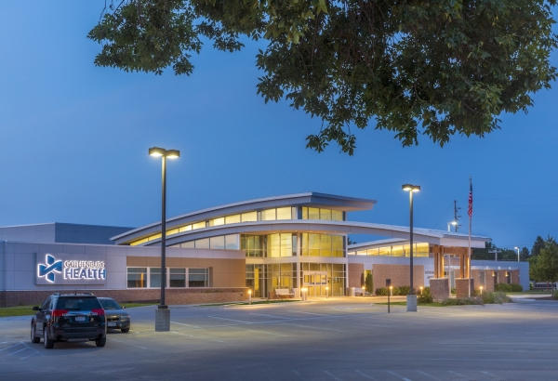
Gothenburg Health
Vision
Gothenburg Health leverages our Innovative Culture to optimize Health Communities
12 Licensed Beds
4 Nursery Beds
27 RHC clinic rooms
4 Active Medical Staff
2 Active Advanced Practice Registered Nurse
3 Active Physician Assistants
2 Active CRNA
1 Pharmacists, 1 Clinical Pharmacist
20+ Courtesy Medical Staff
Slide 2
2023 Nebraska Quality Conference

Slide 3
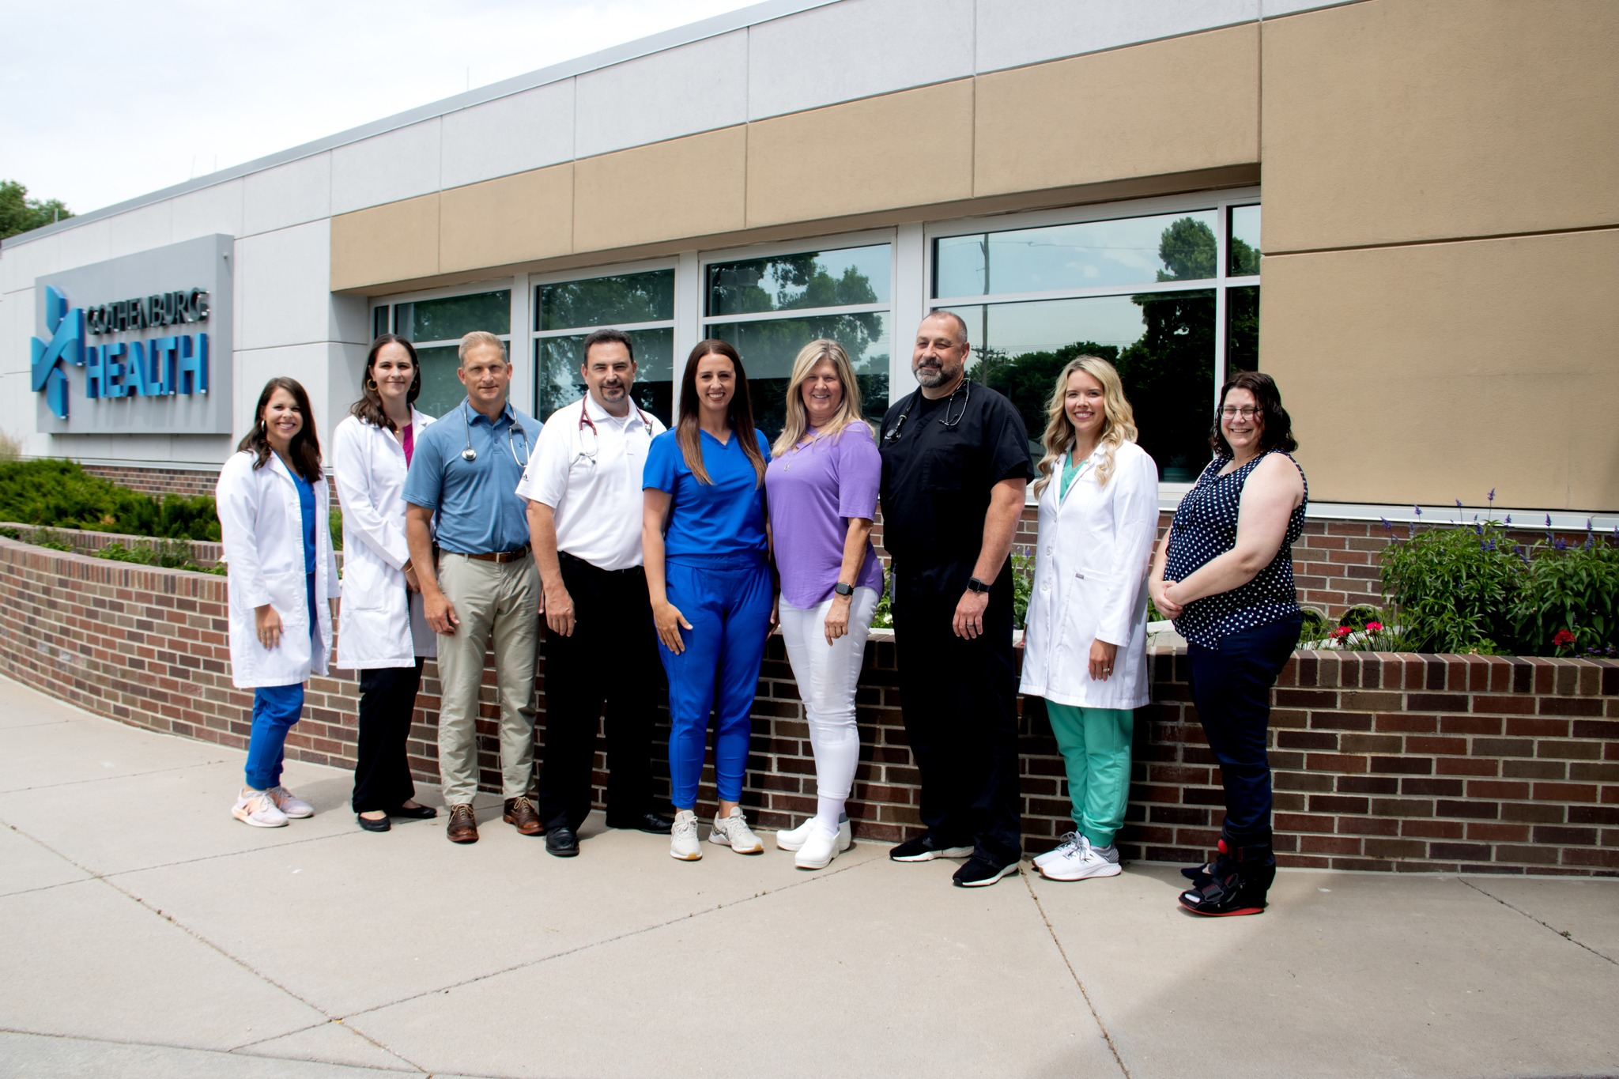
Gothenburg Clinic
Mission
We exist to be healthcare leaders with unparalleled passion, helping people to live their best lives because we care and we can.
RHC programs
RHC
PCMH
CCM
TCM
Value based health plans
Hospital Programs
Diabetes Education
Smoking cessation classes
Prevent diabetes classes
Clinical pharmacy
Slide 3
2023 Nebraska Quality Conference

Slide 4
Context
The typical Rural Health Clinic is challenged by its lack of resources, broad scope of practice, chronic staff turnover and poor financial performance relative to other provider organizations.
Yet RHCs often represent the key strategic and operational assets in most rural healthcare delivery systems.
Slide 4
2023 Nebraska Quality Conference

Slide 5





Quality Improvement Challenges
Voluntary Reporting
Until public reporting exemptions are eliminated, RHCs will continue to push back on data collection
Rural Relevance
MIPS and ACO primary care measures were not developed for small volume, rural practices
Lack of Integration
Too often PB-RHCs are not fulsome members of CAH-based quality improvement programs
Staff Shortages
COVID and other market forces continue to make it difficult to build and maintain bench strength
Value-Based Payments
Until linkages between finance and quality are ratified, quality measurement will be subordinated
Slide 5
2023 Nebraska Quality Conference

Slide 6



What Should RHCs Do?
Make Hay
Improve
Think Value
RHC should collect, report, benchmark and use data to drive performance
Focus on provider throughput, scheduling, operations and revenue cycle
Demonstrate performance to succeed under new VBP models
Slide 6
2023 Nebraska Quality Conference

Slide 7
Service Line Growth
Gothenburg Health

Slide 8
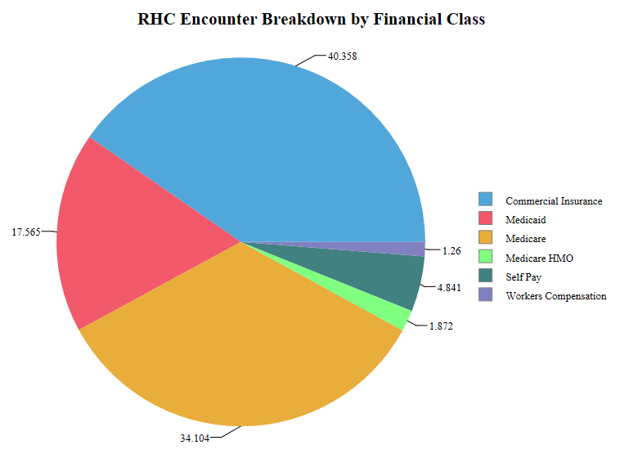
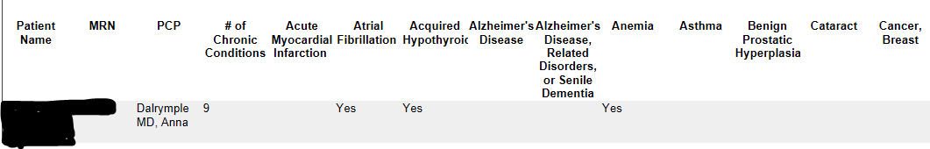
Gothenburg Clinic- Using data to grow service lines
The beginning
2016: RHC’s were able to bill for CCM services
This was our starting point for collecting data at the population level and creating services for specific populations.
We started with our diabetic population.
1/1/2016-12/31/2016
Slide 8
2023 Nebraska Quality Conference

Slide 9
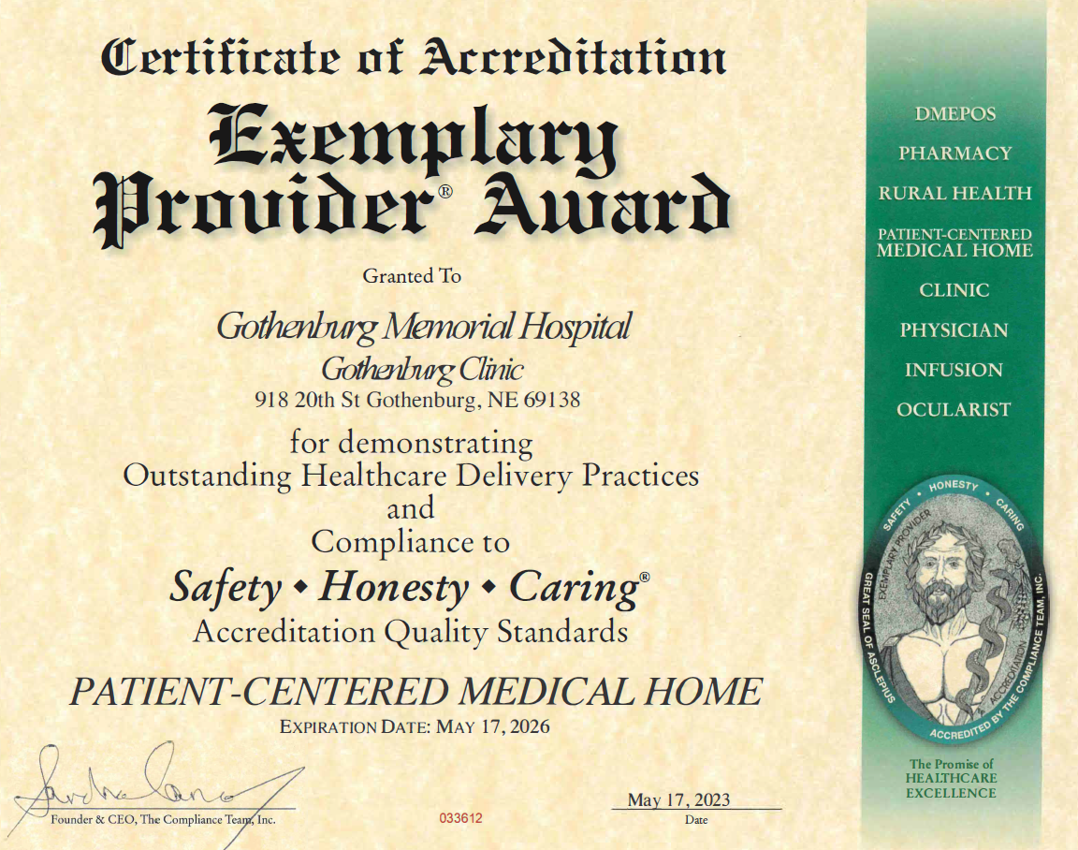
PCMH Accreditation
2019
Became a PCMH clinic
This opened the doors to value-based contracts
PCMH had allowed us to focus on quality improvement for the patient. By putting the patient first in their care and creating services to meet the needs where the patient is at.
Along with this is allowed us to participate in contracts with insurance companies to make additional money on the care the patient is already receiving.
Slide 9
2023 Nebraska Quality Conference

Slide 10

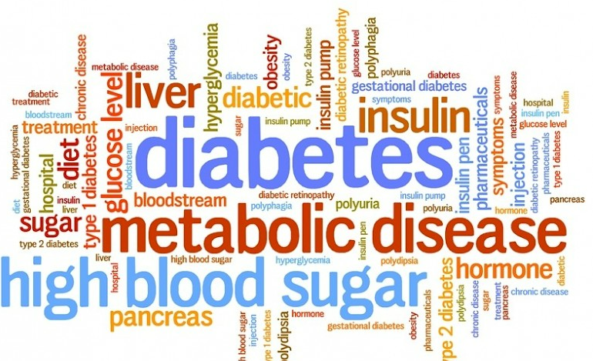
COVID
Although this brought about a decrease in preventative care and program growth Covid did help to bring the provider group together and work on setting clinic wide care standards.
During Covid we took a deep dive into our diabetic population. My CCM nurse completed her diabetes education training and we started our diabetes accreditation process. We were able to use the PDSA cycle to track and keep progress on this project. We also used this time to create our TCM program.
Slide 10
2023 Nebraska Quality Conference

Slide 11
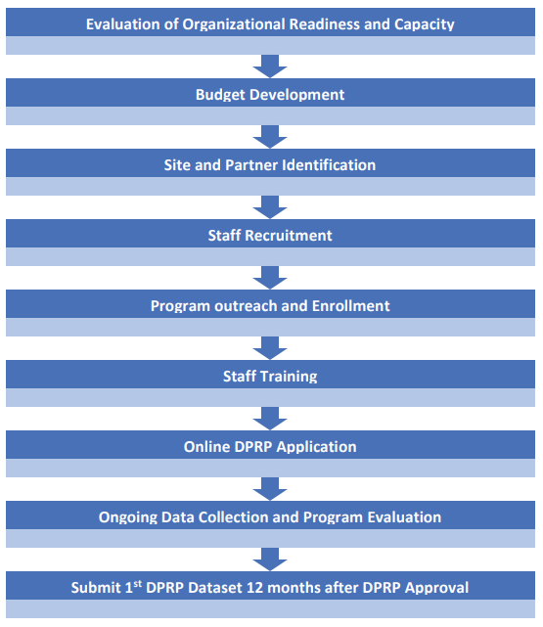
National DPP Program
Our program
Sent staff to be trained
Held our first class as covid was beginning
Had to put on hold due to unknown
Loss of staff who were trained
  Back to the drawing board to reimplement this program
  Not all programs are an immediate success, sometimes
Slide 11
2023 Nebraska Quality Conference

Slide 12
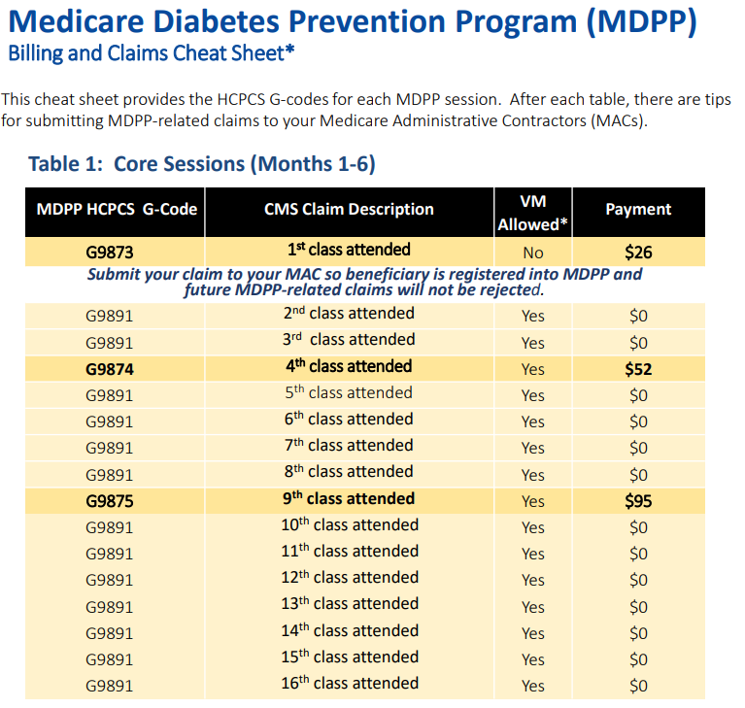
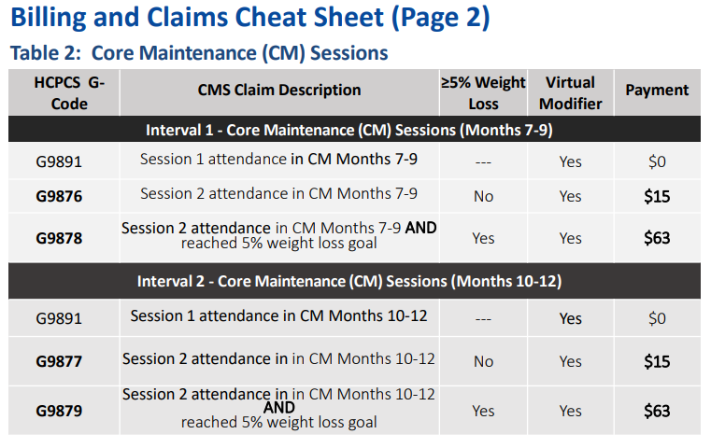
National DPP Program
Slide 12
2023 Nebraska Quality Conference

Slide 13
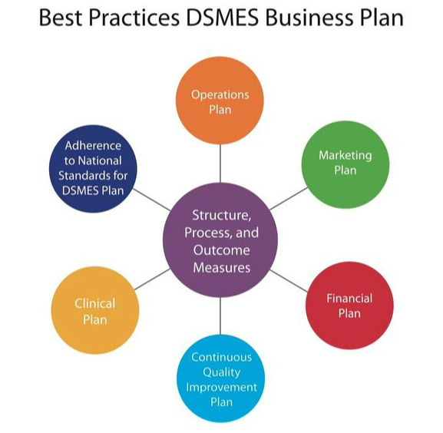
Diabetes Service Line
Identify diabetic population
  All medicare patients are eligible for 2 hours each year
  Commerical plans are all different
Develop a QI plan for yearly required reporting (PDSA)
What is the ROI
Seek accreditation for DSMES program
Educate your staff and market your program
Slide 13
2023 Nebraska Quality Conference

Slide 14
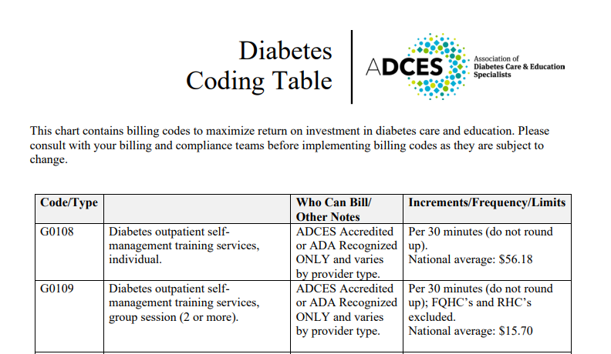
Diabetes Service Line
Slide 14
2023 Nebraska Quality Conference

Slide 15
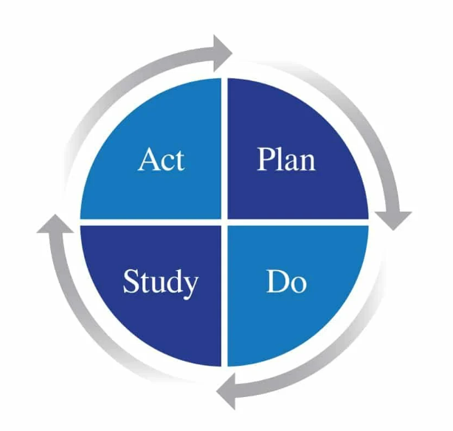
TCM and beyond
2022
Finally saw the implementation of TCM. Hired additional help for CCM as this program had grown!
Diabetes education is growing
Adding in more value-based plans each year
Classes available for smoking cessation, pre-diabetes, and OB
Created a specific clinic quality team to look at workflows and program needs based off our data
  Have used this team to align the well child visits and medicare annual wellness workflows for the clinic.
  Utilize a PDSA cycle for each of the workflow changes to document the process and study our change
Using an improvement plan has set our clinic up for success when implementing new programs and allows us to report on our progress and interventions.
Slide 15
2023 Nebraska Quality Conference

Slide 16
PDSA Concepts
Purpose and practical application

Slide 17





Change how you spend your time
Search
Sort
Report
Analyze
Rinse & Repeat
The typical reporting process leaves little time for actual performance improvement
Slide 17
2023 Nebraska Quality Conference

Slide 18
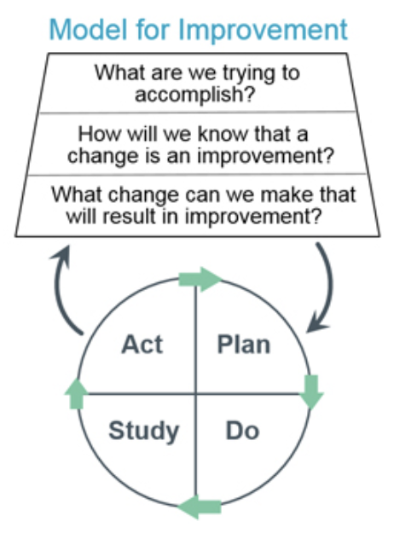

Quality Improvement Model
The Plan-Do-Study-Act (PDSA) cycle tests changes in real work settings. The PDSA cycle guides the test of a change to determine if the change is an improvement.
https://www.ihi.org
Slide 18
2023 Nebraska Quality Conference

Slide 19


Technology and Tools
Learning and Knowledge Exchange
Practice Operations National Database
Performance improvement tools for rural primary care practices with a core web application designed to help clinics create and manage PDSA initiatives
Data collection, reporting and benchmarking of the most rural relevant financial, quality, staffing, productivity and compensation metrics
Slide 19
2023 Nebraska Quality Conference

Slide 20
Diabetes Hemoglobin A1c
Initiative Documentation: Background, Goal, Data Collection Plan, Measurement
Plan
NQF # 0059 Diabetes Hemoglobin A1c (monitored monthly)
PDSA 1
Chartering
PDSA 2
Training
PDSA 3
Outreach
PDSA 4
Intervention
Convene multidisciplinary team
Interview staff
Develop marketing materials
Harmonize EMR scheduled reminders
Acquire executive sponsorship
Adopt standing orders
Distribute marketing materials
Apply interview techniques
Create data wall
Provide training to staff and clinicians
Implement pilot recall and reminder system
Do and Study
Validate baseline data integrity
Ensure staff proficiency
Identify target patient populations
ACT DECISION
ACT DECISION
ACT DECISION
ACT DECISION
PDSA Tests
% accuracy with EMR
% staff competency
Slide 20
2023 Nebraska Quality Conference

Slide 21
Your Head Start
Inside LAKE we have created an Initiative Library where clinics can review and “go shopping” for PDSA templates. When you find a template that suits your goals, you can activate the template and move it to your account as an active initiative. At that point you can modify, add or delete content and establish deadlines and accountabilities specific to your team
Activate
We’ve created PDSA templates for all five (5) measures that include initiative descriptions, tasks and measure suggestions
Slide 21
2023 Nebraska Quality Conference

Slide 22
Medicare Diabetes Program
The Medicare Diabetes Prevention Program (DPP) expanded model is a structured intervention with the goal of preventing type 2 diabetes in individuals with an indication of prediabetes. The clinical intervention consists of a minimum of 16 intensive “core” sessions of a Centers for Disease Control and Prevention (CDC) approved curriculum furnished over six months in a group-based, classroom-style setting that provides practical training in long-term dietary change, increased physical activity, and behavior change strategies for weight control.
Slide 22
2023 Nebraska Quality Conference

Slide 23
Diabetes Hemoglobin A1c with DPP
Initiative Documentation: Background, Goal, Data Collection Plan, Measurement
Plan
NQF # 0059 Diabetes Hemoglobin A1c (monitored monthly)
PDSA 1
Chartering
PDSA 2
Training
PDSA 3
Outreach
PDSA 4
Intervention
Convene multidisciplinary team
Interview staff
Develop marketing materials
Harmonize EMR scheduled reminders
Acquire executive sponsorship
Adopt standing orders
Distribute marketing materials
Apply interview techniques
Create data wall
Identify clinic DPP capacity
Identify DPP-eligible patient population
Launch initial DPP cohort
Do and Study
Validate baseline data integrity
Provide training to staff and clinicians
Implement pilot recall and reminder system
Evaluate reimbursement integrity
Finance and Revenue Cycle Involvement
Identify target patient populations
Ensure staff proficiency
ACT DECISION
ACT DECISION
ACT DECISION
ACT DECISION
PDSA Tests
% accuracy with EMR
% staff competency
Slide 23
2023 Nebraska Quality Conference

Slide 24
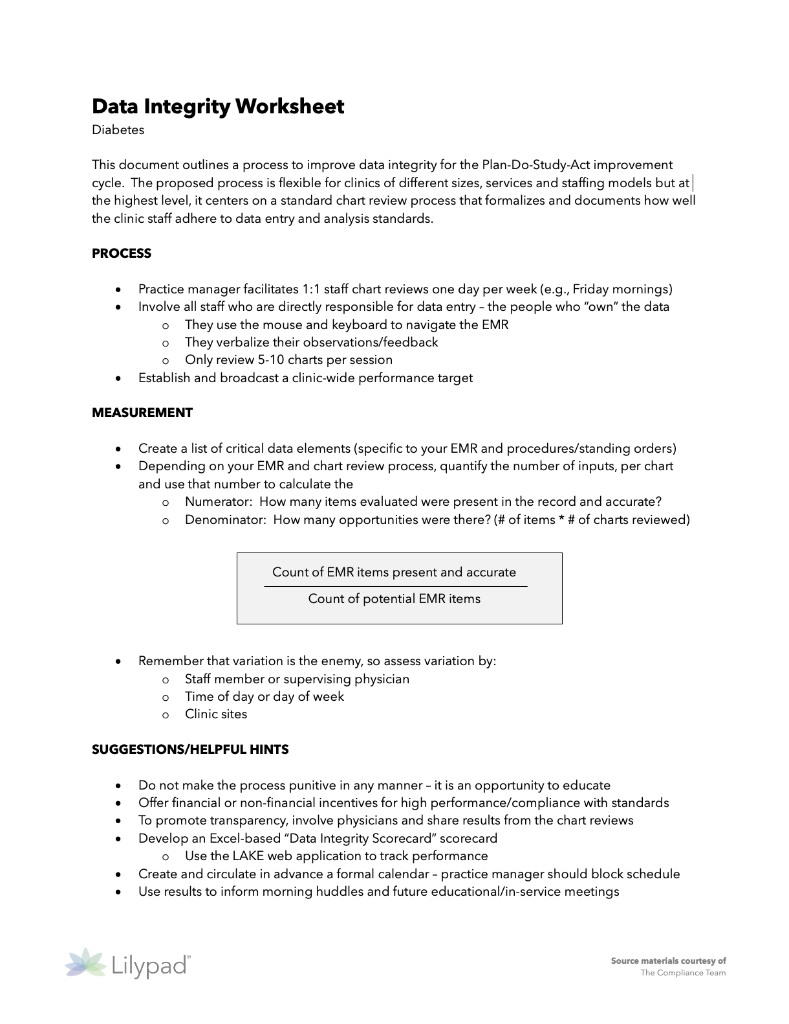
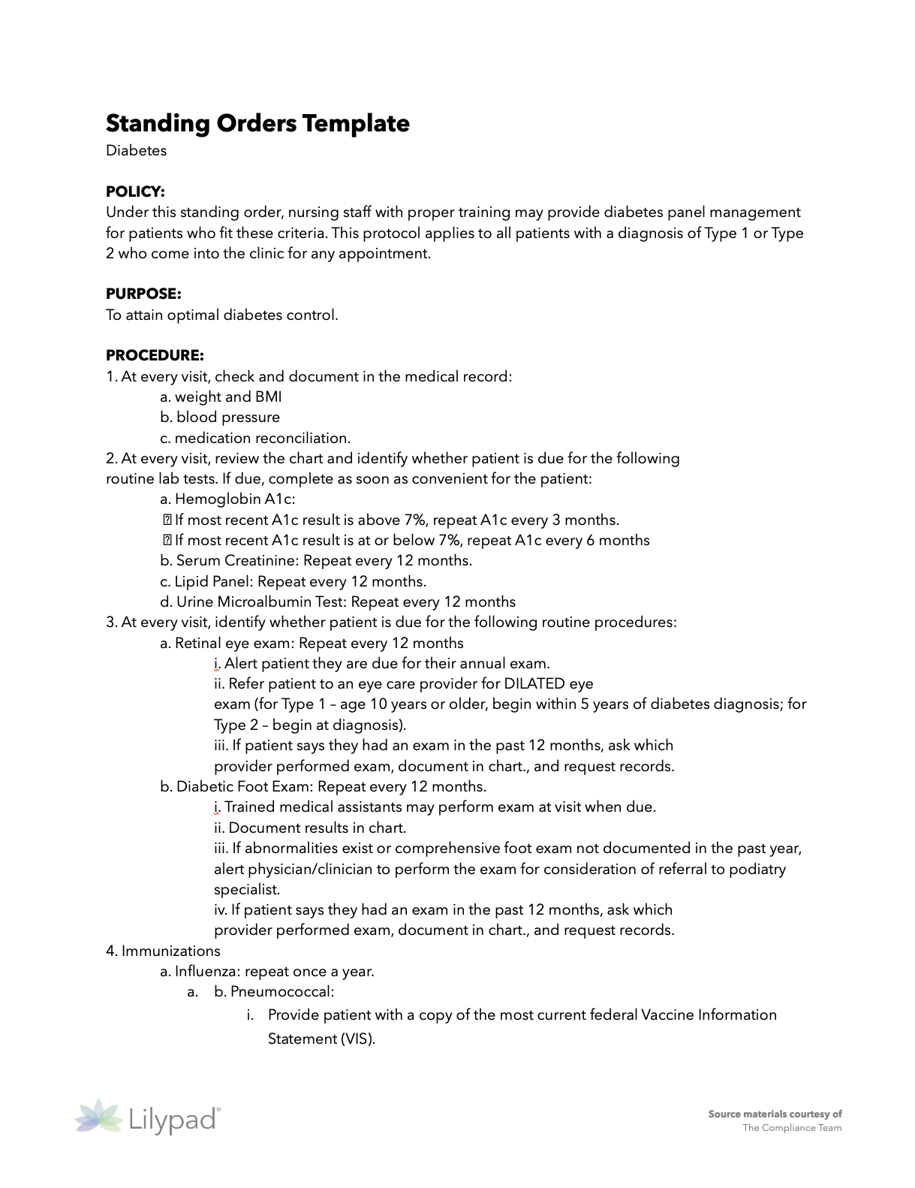
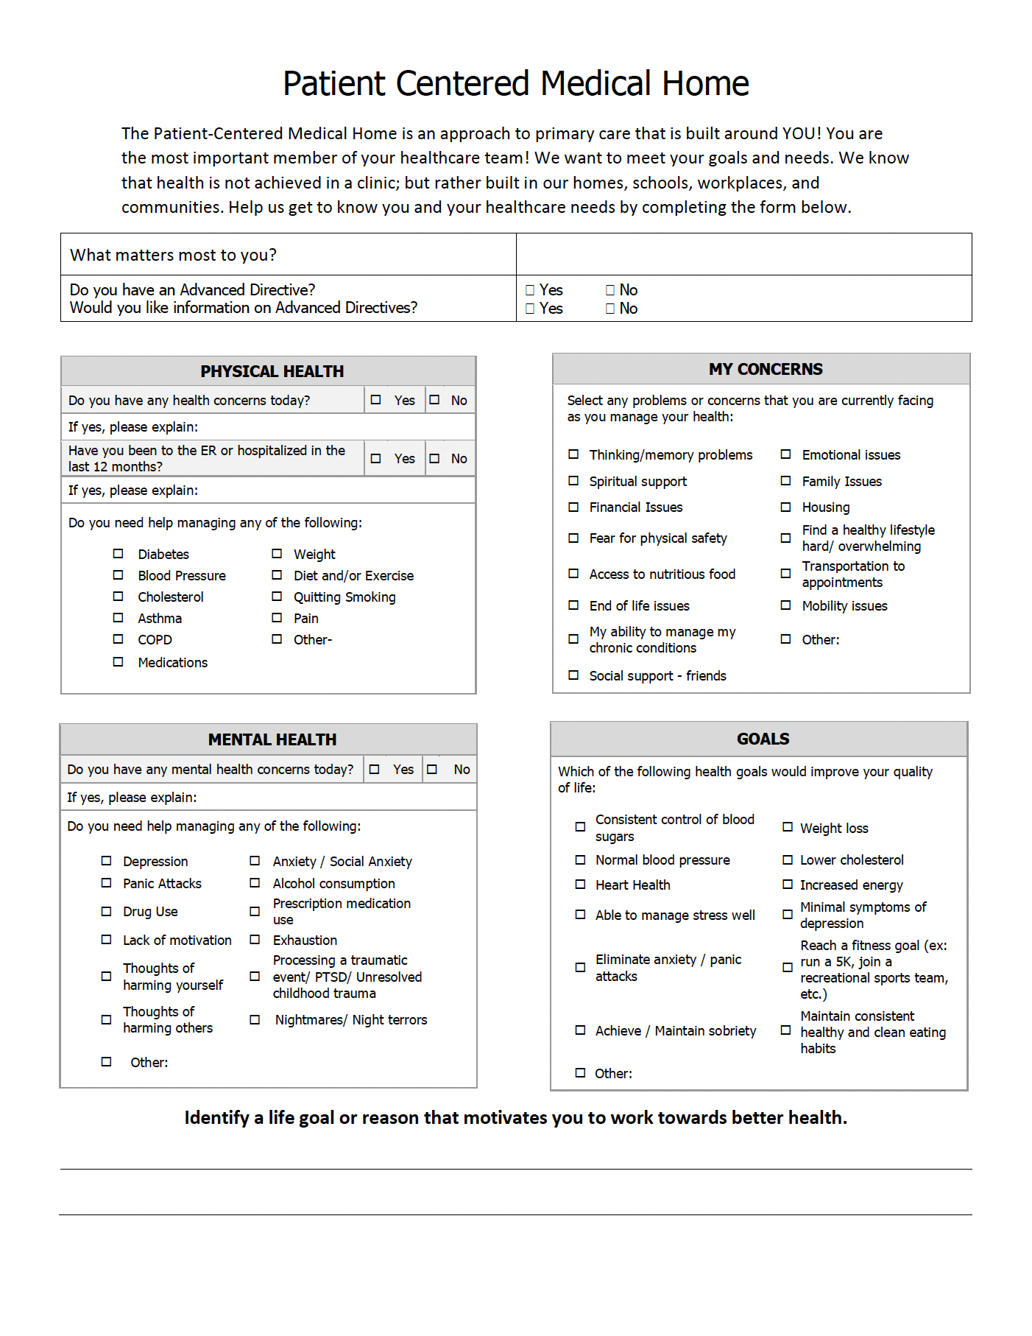
Resources and Tools
Data Integrity Worksheet
Overview of a suggested method for ensuring your clinic can effectively capture the data related to the quality measure.
Standing Orders Template
Sample document outlining the structure and content that may be suitable for standing orders in your clinic related to the specific quality measure.
TCT Needs Assessment
PDF tool that can be used as part of the patient intake process; it was developed for clinics pursuing or maintaining PCMH accreditation.
Slide 24
2023 Nebraska Quality Conference

Slide 25
Lilypad is a Maine-based analytics firm that provides mobile and web-based applications for rural primary care practices. We adhere to a core business principle that accountable physicians/clinical leaders and administrators require sound data and simple, innovative tools to be successful in their roles within the emerging value-based care delivery environment.
Gregory Wolf, President
gwolf@lilypad207.com

