Slide 1
What’s the Return On Investment for Emergency Management and Business Continuity in Healthcare?
Determining Your Program’s ‘Worth’, in Dollars and Cents
Lance Lynch – MBA, CHEP, CBCP
June, 2024

Slide 2
Agenda
Intro’s and Overview
Objectives Review
FTE & Budgetary
Leadership Support
Participation

Slide 3
Introductions
Hospital Em. Mgmt. & Bus. Cont.
Enterprise Program Manager covering 11 hospitals
3 Adult & 2 Pediatric Trauma Centers, 1 Burn Centers
SME – TJC, CMS Accreditation Standards
Multiple FEMA courses & certifications including the National EM Academy
Paramedic
911 Response, FTO
Ground Critical Care Transport – Neonatal and Adult
NY & NJ Certified Paramedic, CT Licensed Paramedic, CCEMT-P (NYP)
Educator
FEMA CDP Contract Instructor
FEMA CDP Indirect Instructor
Fire Instructor 1, ProBoard Certified
AHA Instructor
NAEMT Instructor (Former)
Arthur B. Ditzel, Jr, EMT-P, PCP
Program Manager, Emergency Management Operations & Logistics

Slide 4
Introductions
Hospital Em. Mgmt. & Bus. Cont.
Coordinator, Manager, and Director
Regional Level 1 Trauma / Burn Centers
SME – TJC, CMS Accreditation Standards
Heavily Involved-With/Chaired various Healthcare Coalitions
Multiple CDP courses & certifications
Paramedic
911 Response, FTO
Air & Ground Critical Care Transport
NRP, FP-C, CCEMTP/PNCCT (Former)
Invasive Cardiology
Educator
AHA Regional Faculty – NC, SC, GA (Former)
Community College & University
CoAEMSP, CAAHEP Accreditation
Lance Lynch, MBA, CBCP, CHEP
Healthcare Lead, Veoci
Owner, Principal Consultant, Adaptiv Consulting Solutions

Slide 5
Objectives
Explain your impact…
Calculate the cost of downtime…
Relate a quantified value…
Develop a strategy…

Slide 6
Polling Question # 1:
Describe the maturity of your
Emergency Management Program

Slide 7
Polling Question # 2:
Describe the maturity of your
Business Continuity Program

Slide 8
Financial Impacts…

Slide 9
“No Margin, No Mission…”
Sister Irene Kraus
Notes:
Insert DOB, DOD, a few words about her background:
She joined the Daughters of Charity in 1941, following her high school graduation in Baltimore. After receiving a nursing degree from Catholic University in 1952, she quickly became an operating room supervisor. Three years later, she became administrator at Our Lady of Lourdes Hospital in Binghamton, N.Y., the first of several hospitals nationwide she ran for the order.
When the five autonomous American provinces of the Daughters of Charity decided to consolidate their hospital systems in 1986, Sister Irene was chosen to run the operation, which included 36 hospitals and 19 other facilities in 17 states with a combined annual budget of more than $3 billion.
https://www.washingtonpost.com/archive/local/1998/08/29/sister-irene-kraus-dies/7b5585a0-f62a-448d-8975-d5a3ab50573f/

Slide 10
Value, Quantified
Healthcare is a business.
Like it or not, stewardship and fiscal responsibility are required.
Think through a leadership or board lens.
Where can we fit in and highlight our largest impact?
What’s the most striking to quantify/prove?
Loss of Life?
Reputational Impact?
Regulatory Impact?
Notes:
Photo: Fabian Blank, via unsplash… https://unsplash.com/photos/pink-pig-figurine-on-white-surface-pElSkGRA2NU

Slide 11
Polling Question # 3:
Do you know your primary facility’s
cost of a full-stop IT downtime?

Slide 12
Value, Quantified
Financial Costs?
$740,357 / Incident (Interbit)
$7,900 / Minute (Ponemon)
$140,000 - $540,000 / hour (Gartner)
$4.45 million (data breach; Ponemon)
Full-Stop Downtime:
$14/bed/minute
Notes:
Photo: Fabian Blank, via unsplash… https://unsplash.com/photos/pink-pig-figurine-on-white-surface-pElSkGRA2NU

Slide 13
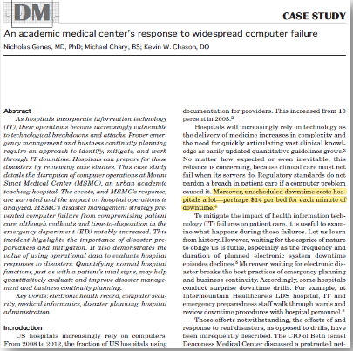
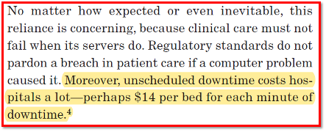
Value, Quantified
Genes, Charry, Chason. Academic Journal of Disaster Medicine (2013)
“$14/bed/minute…”
Notes:
https://doi.org/10.5055/ajdm.2013.0121
Photo: Fabian Blank, via unsplash… https://unsplash.com/photos/pink-pig-figurine-on-white-surface-pElSkGRA2NU

Slide 14
Value, Quantified
$14/bed/minute - example: (300 bed hospital)
$14 x (300) = $4,200 / minute
($4,200) x 60 = $252,000 / hour
6-hour downtime: $1.5-million
12-hour downtime: $3-million
2024 Figures: $1.998-mil - $3.996-mil
Notes:
https://www.bls.gov/data/inflation_calculator.htm
Photo: Fabian Blank, via unsplash… https://unsplash.com/photos/pink-pig-figurine-on-white-surface-pElSkGRA2NU

Slide 15
Value, Quantified Cost of IT Downtime
Business Continuity’s Value:
Decreasing the time it takes for us to get back to ‘effective’ operations.
Notes:
Photo: Fabian Blank, via unsplash… https://unsplash.com/photos/pink-pig-figurine-on-white-surface-pElSkGRA2NU

Slide 16
Polling Question # 3 (again):
Do you know your primary facility’s
cost of a full-stop IT downtime?
Example: (x bed hospital)
$14 (x) = $x / minute
($x-per-minute) 60 = $x per hour

Slide 17
Investments in Resources

Slide 18
Polling Question # 4:
Describe Your Em. Mgmt. or BC
team size…

Slide 19
Investments - Resources
FTE Resources
Number of beds
Square Footage (Life Safety, etc.)
Compare with other local (and otherwise) programs
Budgetary Resources
Formulas, best practices for team size
Technology
Implementation Time
“Every EM is a PM…” Justin Kates
Our budget or Yours?
Funding Support:
Targeted Violence Grant (Security)
HHS
Internal Budgetary Support
Notes:
Photo: Photo by Agefis on Unsplash

Slide 20
EM Department Staffing Comparison
Staffing comparison of healthcare systems Emergency Management programs
Location | NYC Hospital A | NYC Hospital B | NYC Hospital C | NYC Hospital D | NYC Hospital E | NYC Hospital F
Licensed Beds | 4,223 | 3,808 | 4,093 | 1500 | 4,737 | 1600
# of Hospitals | 11 | 8 | 21 | 5 | 11 | 6
# of EM FTEs | 3.5 | 13 | 6 | 3 | 7 | 11
Location | Atlanta, GA | Ft. Lauderdale, FL | Allentown, PA | Grand Rapids, MI
Licensed Beds | 953 | 1,579 | 1,000 | 2,538
# of Hospitals | 1 | 4 | 5 | 14
# of EM FTEs | 2 | 4 | 5 | 15

Slide 21
EM Department Staffing Comparison
Staffing comparison against other, internal departments.
Department Name | # of FTEs | Areas Not Covered
Security (Management team only) | 19
Facilities Operations (Management team only) | 45 | 2 Regional Hospitals & Psych Facility
IT Security | 25
Infection Prevention & Control | 46 | 3 Regional Hospitals & 2 Psych Facilities
Office of External Relations | 72
Environmental Health & Safety | 23 | 2 Regional Hospitals & Psych Facility
Quality & Regulatory Affairs | 64
Emergency Management | 3.5 | None

Slide 22
Leadership Support

Slide 23
Leadership Support
Executive Champions
Go-to guy, leverage, etc.
C-Suite Champions
Departmental SME’s, etc.
Time Investment
Risk Matrix
High/Low stakes and Frequencies
Disc. Time vs. Non-Discretionary Time
In Developing External Relationships
External Relationships
Value?
Notes:
Photo by Scott Graham on Unsplash

Slide 24
Stakes vs. Frequencies
High Stakes / Low Frequency
High Stakes / High Frequency
Catastrophic Storms
Active Assailant
Mass Casualty Incidents
Cyber Security Incidents
Extreme Weather - Geography
Internal Medical Emergencies
IT System Failures
Low Stakes / Low Frequency
Low Stakes / High Frequency
Theft
Refusal of care / Elopement
High volume / Surge
Planned IT outages / updates
Generator Tests

Slide 25
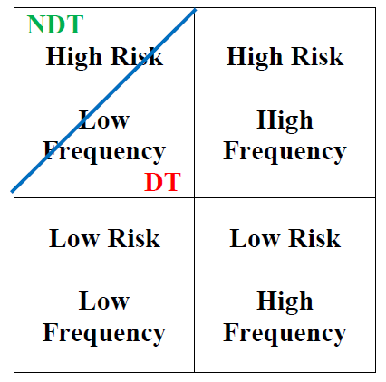
Recognition Primed Decision Making
Where does our organizational liability rest?
Critical for Leadership Understanding and Support
Who are your Stakeholders, here?
Enterprise Risk Management?
IT Disaster Recovery? CTO? CTIO?
Notes:
https://onlinedegrees.sandiego.edu/gordon-graham-risk-management-reading-list/

Slide 26
Participation - A Time Investment

Slide 27
Program Participation - A Time Investment
Find Champions - At Every Level
C-Suite
Divisional Leadership
Departmental Leadership
Staff and Supervisory
Ex Planning Committee for FSE’s or Large Functionals
Consider an HSEEP application
Ops, Planning, Logs, and Finance
Who better to write goals and anticipate gaps than the boots on the ground?
FSEs are great for EM, but rarely include BCP’s
No-Notice Exercise design
Notes:
Photo by Scott Graham on Unsplash

Slide 28
Fairy Tale Operational Interruption Timeline
What time interval(s) can we control, here?
Badness
Recognition
Activation
“Ready”
Handling
Demobilization
The thing happens…
We note - or are notified - that the thing has happened.
Panic, “Who do I call?”, “What’s the plan?”
We’ve developed our game plan, made our notifications, and have assembled, we’re ‘ready’.
Systems in motion, things getting done, working toward resolution.
Resolved, Returning to normal, ready state.

Slide 29
No-Notice Exercises?
Brief Exercises, Targeted Improvement
“Micro” (Functional) Exercises
Generally <15 Minutes
Primarily focused on ‘spinning up’ activities
The ‘name’ is a misnomer…
Requirements?
Generally 3-4 participants
Provider, Nursing, Clerical or Tech. Leadership, etc.
Departmental Leadership’s always aware
Team members are briefed, at start of ex.
Departmental Impact?
Minimal <30 minutes
Instant Process Champions for EM and BC
Decrease in Reflex Interval for activation
(Face time for EM)
Notes:
Photo by Scott Graham on Unsplash

Slide 30
Revisiting
Explain your impact…
Calculate the cost of downtime…
Relate a quantified value…
Develop a strategy…

Slide 31
Questions?

Slide 32
‘Return on Investment’ is tough to quantify…
Understand your ‘quantifiables’ (and intangibles)
Resources are needed to be effective…
Participation is key… Treat it like gold.
Summary

Slide 33
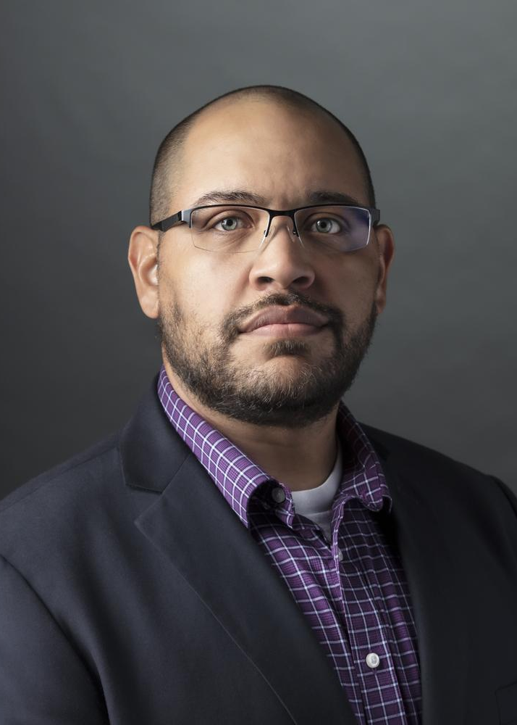
What’s the Return On Investment for Emergency Management and Business Continuity in Healthcare?
Determining Your Program’s ‘Worth’, in Dollars and Cents
Lance Lynch – MBA, CHEP, CBCP
June, 2024

