Slide 1
Securing Rural Hospitals:
How to Build Cyber Resiliency with Limited Resources
Matt Weir & Ben Ballard
4 June 2024

Slide 2

Together with government and public private partnerships, we work to improve the safety, stability, and well-being of our nation.
65+
LOCATIONS
WORLDWIDE
9,000+
60+
EMPLOYEES
YEARS
260+
PATENTS
We apply systems thinking to solve complex national and global problems, bringing an interdisciplinary perspective to R&D.
We operate six federally funded R&D centers, as well as MITRE Labs and an independent research program to enable innovative solutions.
© 2023 THE MITRE CORPORATION. ALL RIGHTS RESERVED. FOR GOVERNMENT AND INTERNAL USE ONLY.

Slide 3
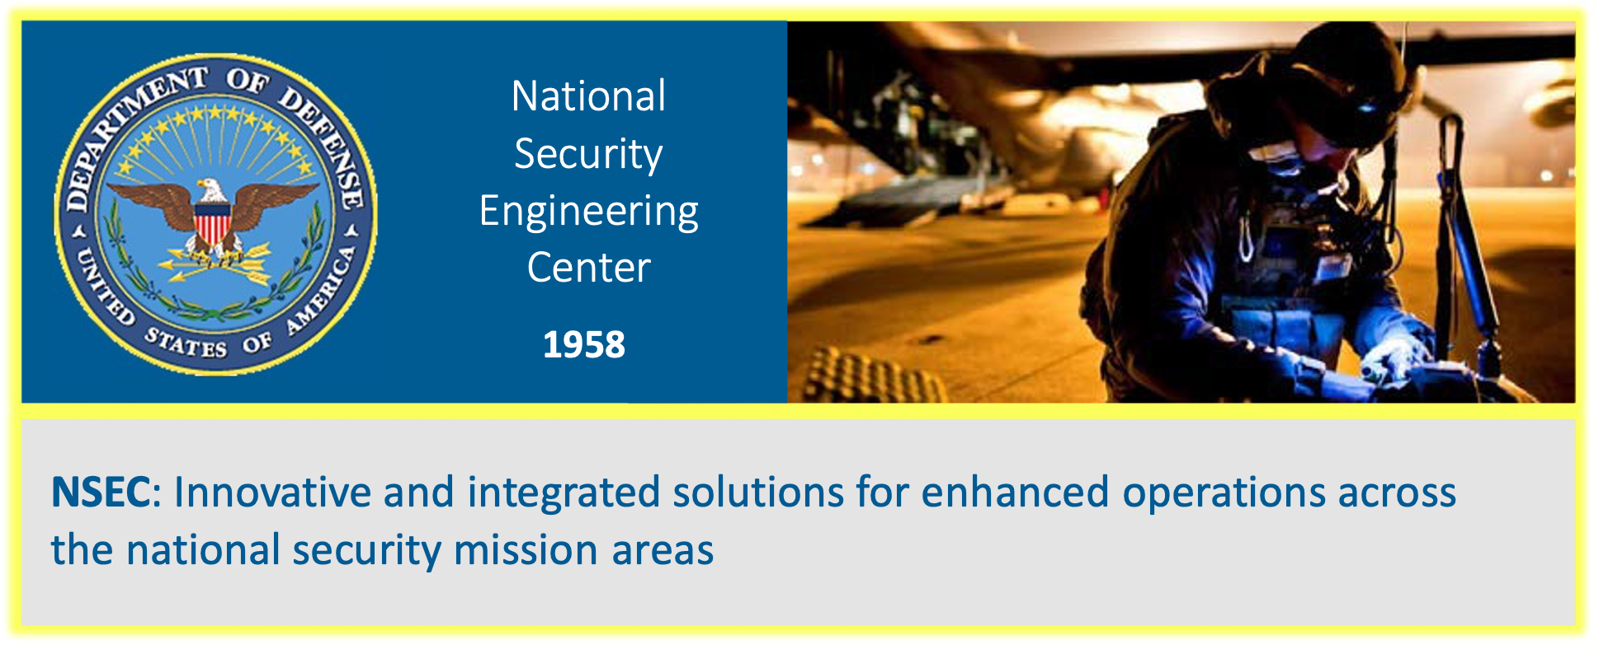
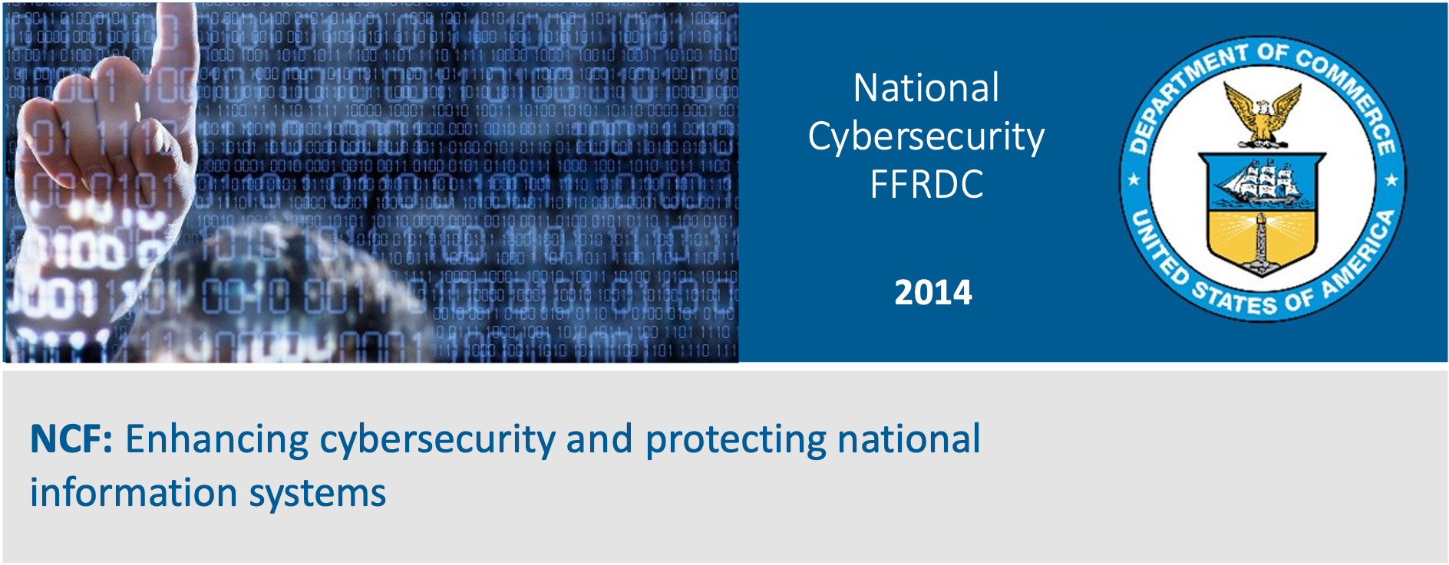
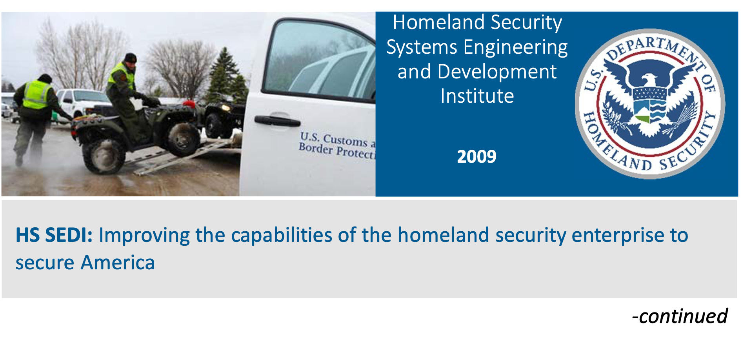
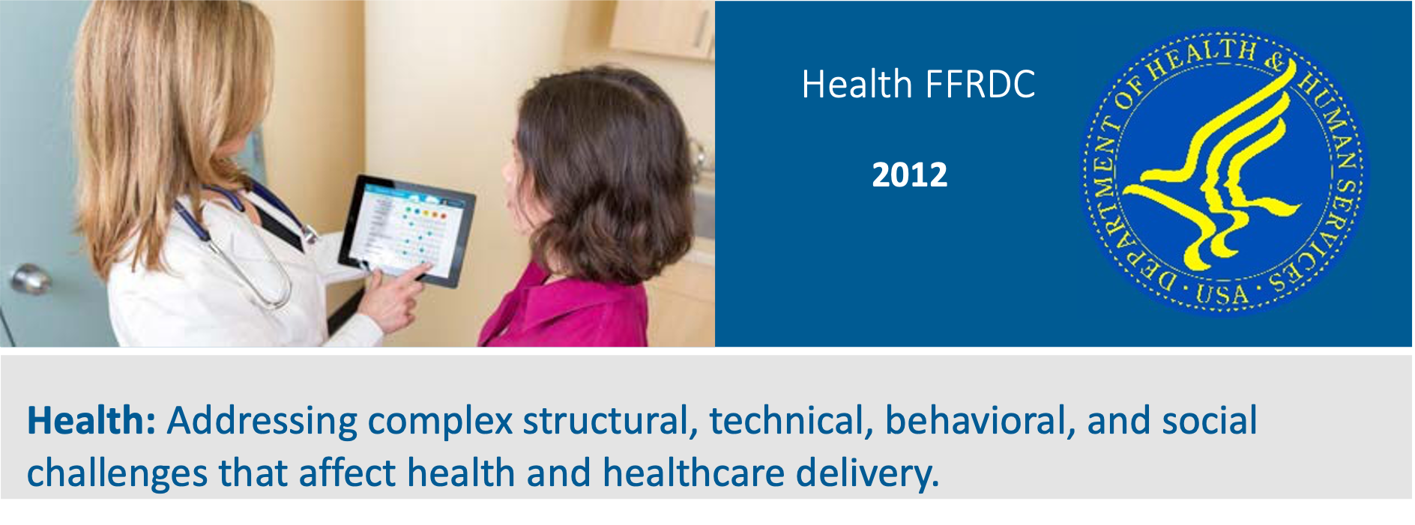

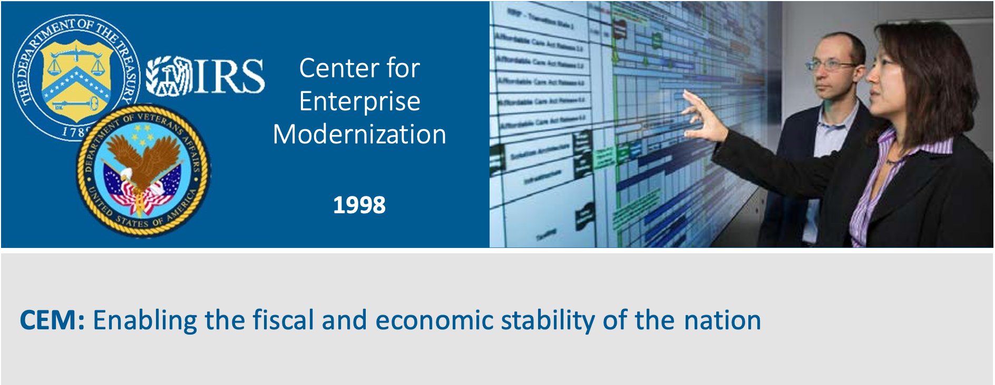
Operating Six FFRDCs

Slide 4
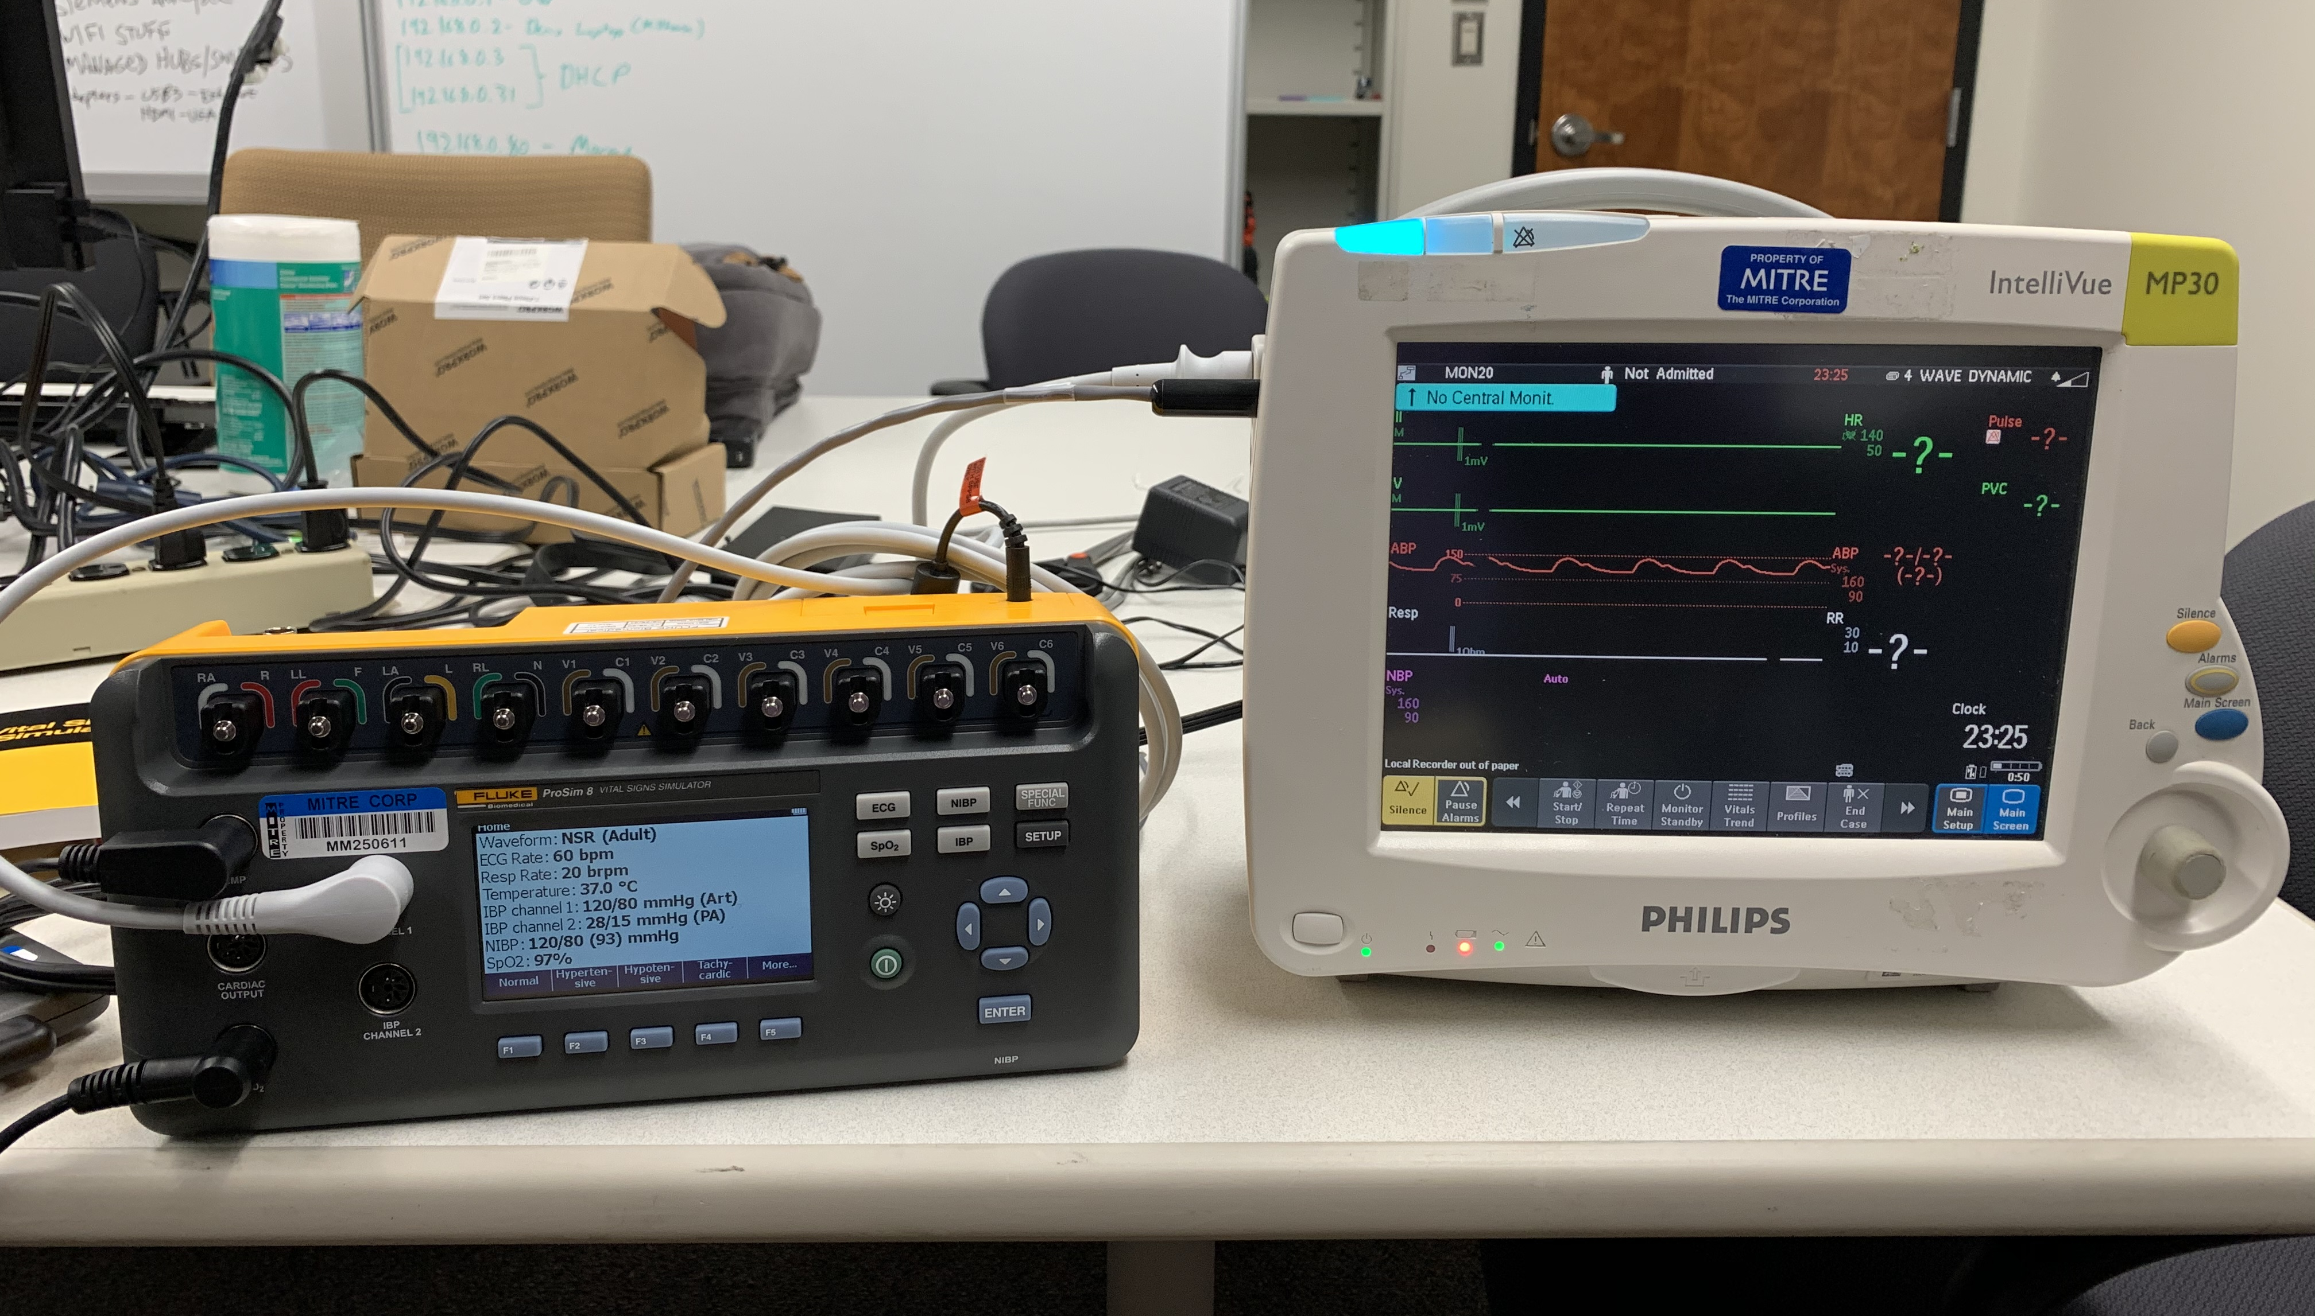
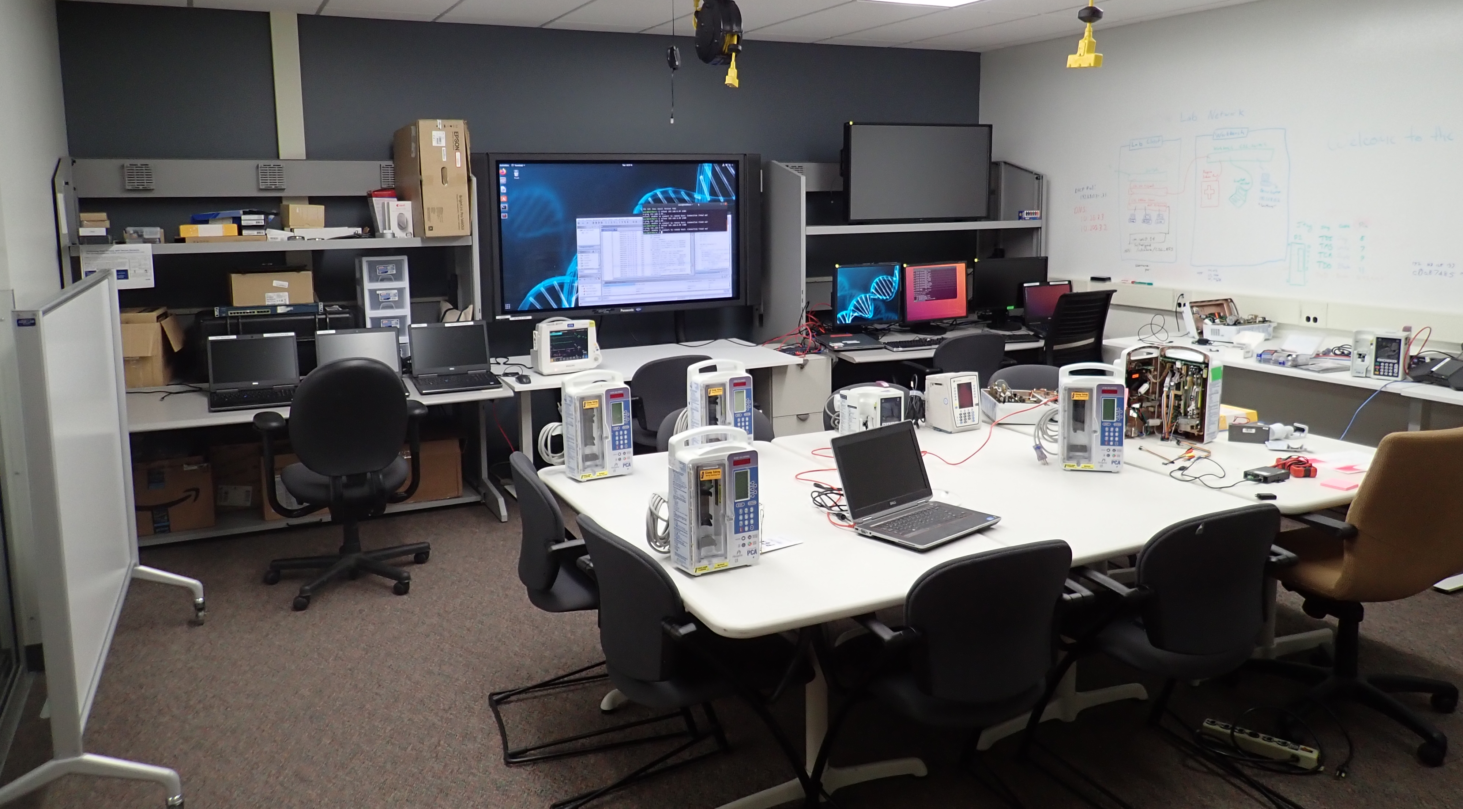
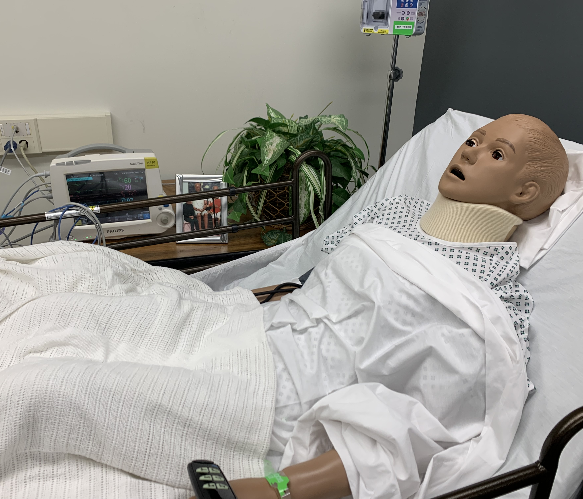
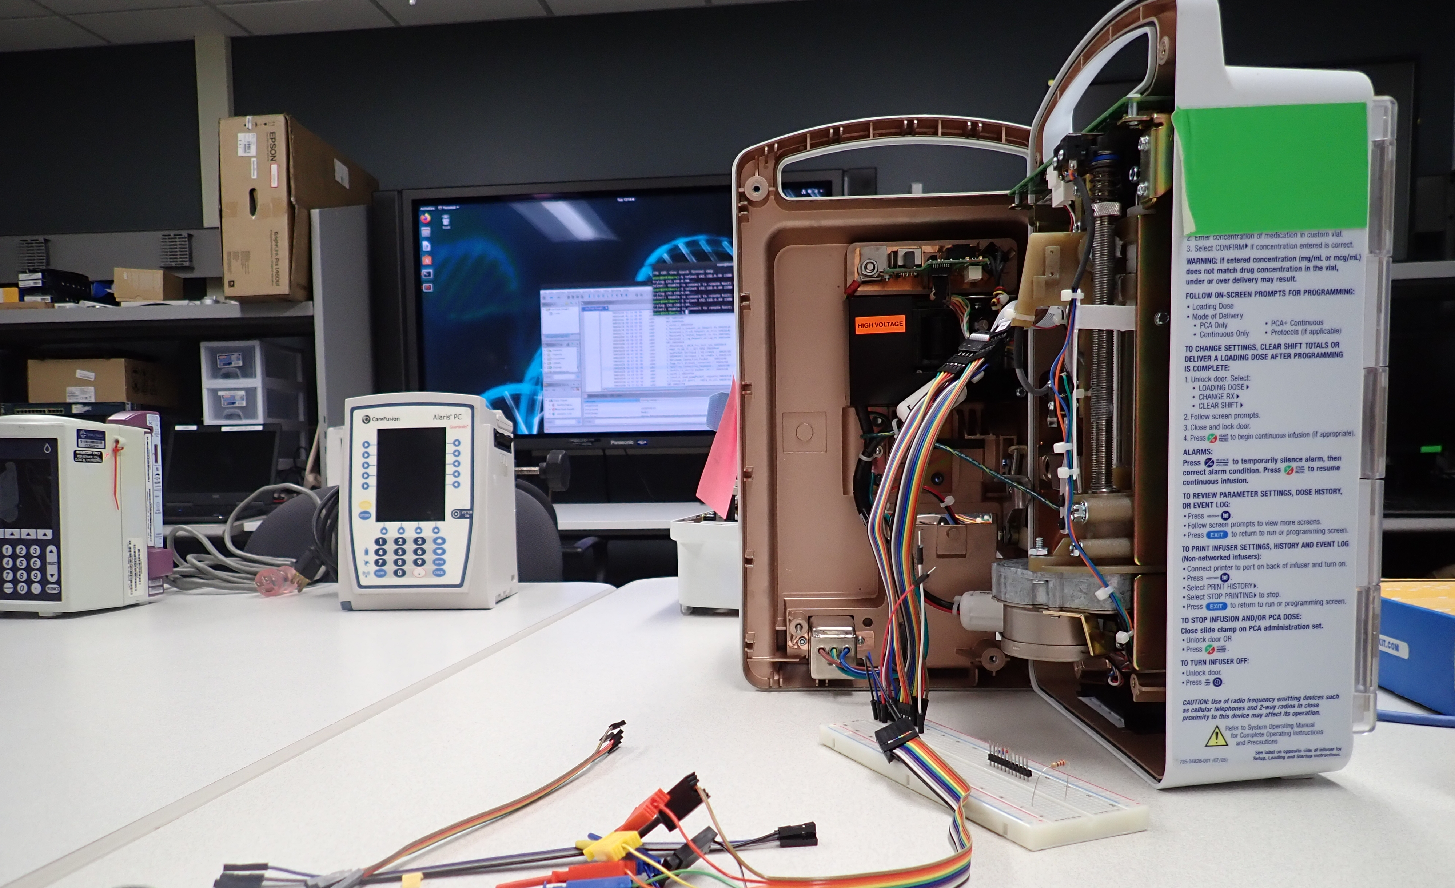
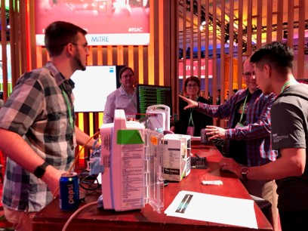
MITRE HealthCARE Lab
Health Cybersecurity and Resiliency Experimentation

Slide 5
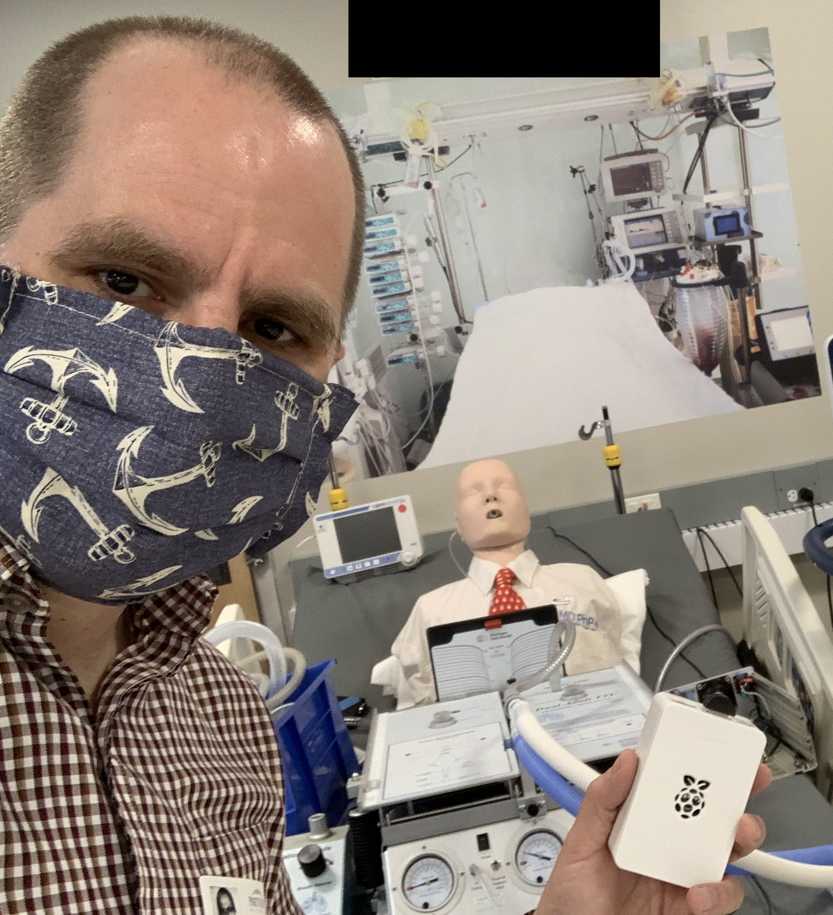
Matt
Weir, PhD
MITRE
© 2024 THE MITRE CORPORATION. Approved for public release; distribution unlimited. Public release case number 24-1708.

Slide 6

Ben Ballard
MITRE
© 2024 THE MITRE CORPORATION. Approved for public release; distribution unlimited. Public release case number 24-1708.

Slide 7



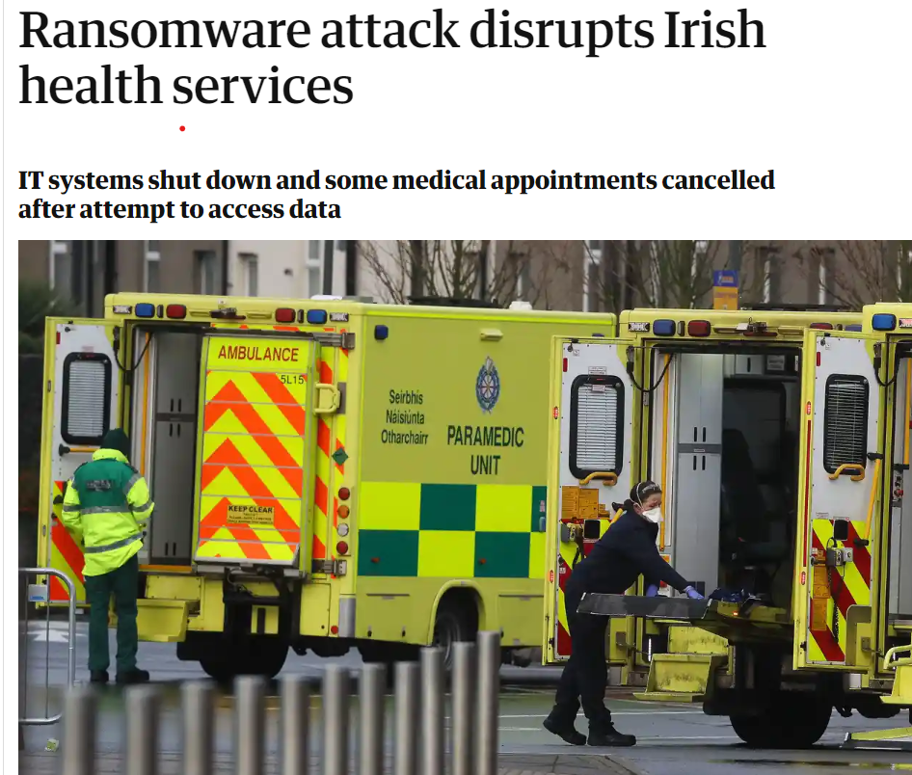
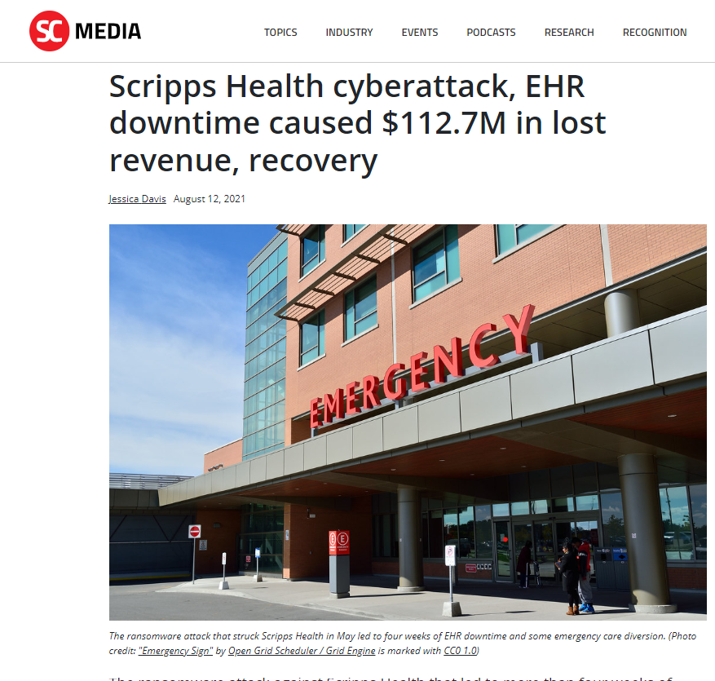

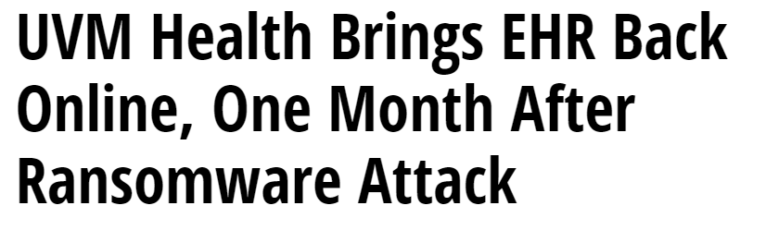
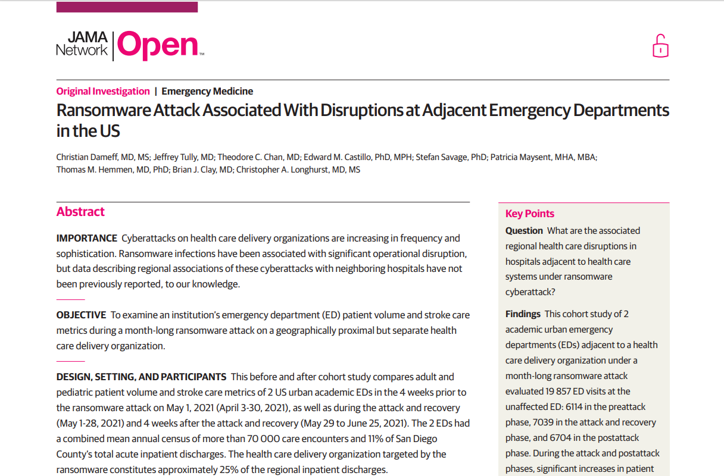

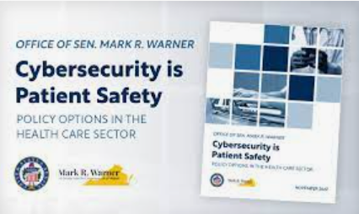
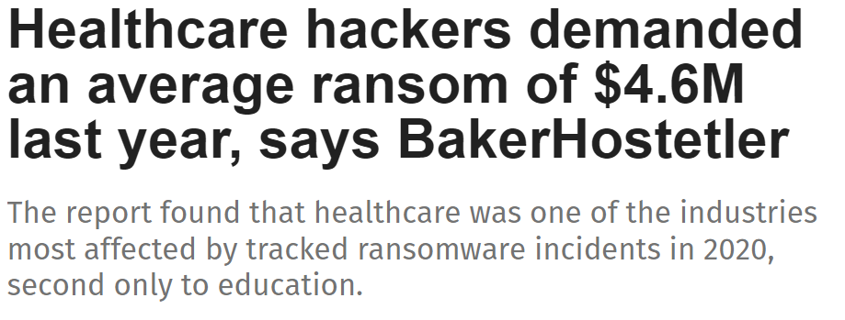
Healthcare Cyber Attacks are Increasingly Common
© 2024 THE MITRE CORPORATION. Approved for public release; distribution unlimited. Public release case number 24-1708.

Slide 8


Putting Numbers Into Perspective
6146 hospitals in the United States
141 hospitals impacted by ransomware in 2023*
That’s over 2% of hospitals in the US
  *Source: https://www.emsisoft.com/en/blog/44987/the-state-of-ransomware-in-the-u-s-report-and-statistics-2023/
© 2024 THE MITRE CORPORATION. Approved for public release; distribution unlimited. Public release case number 24-1708.

Slide 9
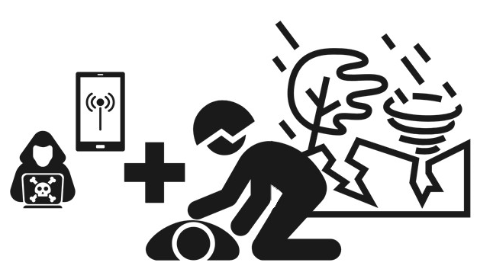
Cyber Attacks Compared To Other Disasters
Differences
Cyber attacks tend to take longer to fully recover from
Attackers can subvert backup and recovery processes
Cyber attacks against other orgs can impact you
A tornado isn’t going to sell patient data on the dark web
Similarities
Preparedness requires close coordination between IT, Operations, and Emergency Preparedness teams.
Regional relationships are important to be able to respond and continue to provide care
Developing plans and practicing your response can help your facility to weather the storm
© 2024 THE MITRE CORPORATION. Approved for public release; distribution unlimited. Public release case number 24-1708.

Slide 10
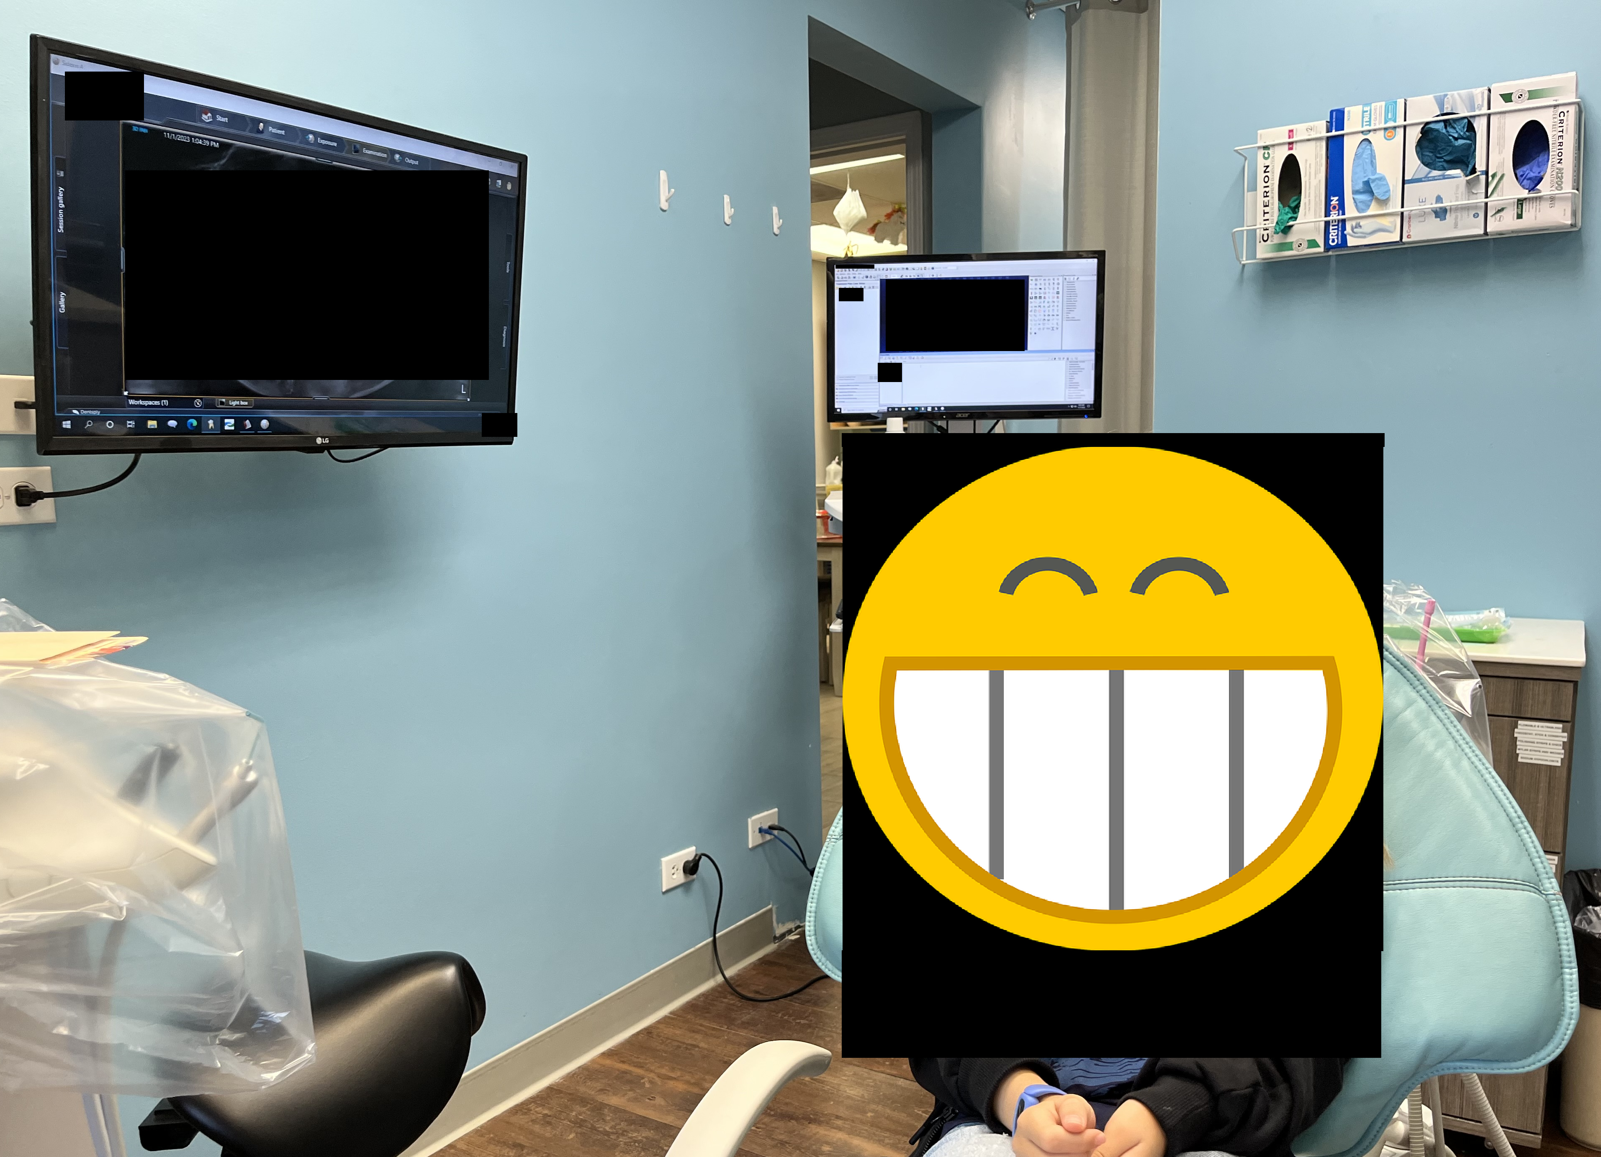
Example of Medical Systems Being Attacked
© 2024 THE MITRE CORPORATION. Approved for public release; distribution unlimited. Public release case number 24-1708.

Slide 11
Example of Medical Systems Being Attacked
© 2024 THE MITRE CORPORATION. Approved for public release; distribution unlimited. Public release case number 24-1708.

Slide 12
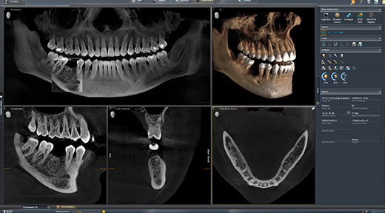
Example of Medical Systems Being Attacked
Sidexis 4 Dentsply Service (Lightweight PACS)
© 2024 THE MITRE CORPORATION. Approved for public release; distribution unlimited. Public release case number 24-1708.

Slide 13
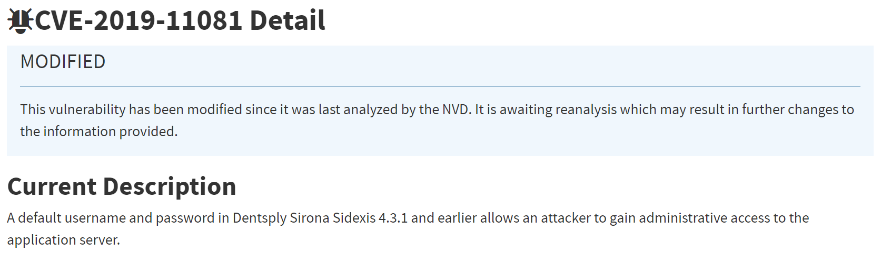
Example of Medical Systems Being Attacked
CVE –Common Vulnerabilities and Exposures
Sidexis 4 Dentsply Service (Lightweight PACS)
Default Username and Password
© 2024 THE MITRE CORPORATION. Approved for public release; distribution unlimited. Public release case number 24-1708.

Slide 14
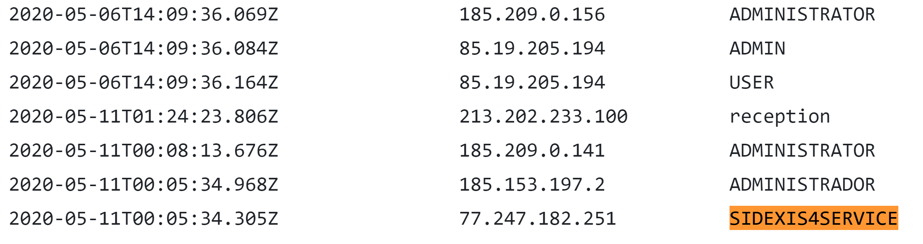
Example of Medical Systems Being Attacked
Honeypot Logs
Sidexis 4 Dentsply Service (Lightweight PACS)
© 2024 THE MITRE CORPORATION. Approved for public release; distribution unlimited. Public release case number 24-1708.

Slide 15
Understanding Challenges Facing Rural Hospitals
© 2024 THE MITRE CORPORATION. Approved for public release; distribution unlimited. Public release case number 24-1708.

Slide 16


Rural Hospitals are Acutely Vulnerable to Cyber Attacks
Rural hospitals are a target due to geographic isolation & limited resources
of hospitals are rural, serving 46M people (AHA)
~35%
Risks to patient data,
operations, and public health
50%
418
of rural hospitals are in the red
are at risk of closing in 2024
(Chartis)
IT Challenges: infrastructure, workforce shortages, razor-thin margins, outsourcing
Recent attacks (Scripps, Change) highlight the need for enhanced security & resiliency measures
10-35% drop in admissions/outpatient visits for 2-3 weeks after attack
Closest hospitals 4-7x further than non-rural
© 2024 THE MITRE CORPORATION. Approved for public release; distribution unlimited. Public release case number 24-1708.
Notes:
Source: https://experts.umn.edu/en/publications/what-happens-to-rural-hospitals-during-a-ransomware-attack-eviden
https://www.fiercehealthcare.com/health-tech/scripps-ransomware-post-mortem-shows-cybersecurity-regional-problem - scripps health
AHA stat: https://www.aha.org/system/files/media/file/2022/09/rural-hospital-closures-threaten-access-report.pdf

Slide 17
MITRE’s Outreach to Rural Hospitals
Purpose:
To understand existing efforts, including state cyber-capabilities, to provide U.S. rural and critical healthcare facilities with robust cybersecurity regimes.
To identify models that could benefit other healthcare facilities or states.
To understand gaps and opportunities that MITRE, working with our sponsors or others, could address.
Conducted >25 interviews
National, regional & state organizations (e.g., American Hospital Association, National Governors Association, state hospital associations)
IS leaders at hospitals varying in size (16 beds to > 600 beds) and geography (Arkansas, Iowa, Louisiana, Massachusetts, Michigan, Montana, Nebraska, Ohio, Oregon, Tennessee, Vermont, Wyoming)
Other organizations, e.g., non-profit IT service providers, academia, information sharing organizations
MITRE project leaders and site cyber experts working with key federal stakeholders or in rural states, respectively
© 2024 THE MITRE CORPORATION. Approved for public release; distribution unlimited. Public release case number 24-1708.

Slide 18
What’s Being Done?
© 2024 THE MITRE CORPORATION. Approved for public release; distribution unlimited. Public release case number 24-1708.

Slide 19



Healthcare Delivery Organization Operating Models
“HDO operating model” refers to how a rural hospital exists in the larger ecosystem and accesses cyber and other services. Various factors, including and beyond IT and cyber, may drive formation of these models.
Stand-Alone Hospital
Hub-and-Spoke Arrangements
Forming Health Systems
A single HDO that fosters an internal culture that prioritizes cybersecurity. This emphasis is often the result of internal champions such as the HDO’s CEO, Board of Directors, or CISO.
A larger HDO provides services for smaller regional HDOs that are independent entities. These larger organizations provide IT, financial, and other services, deepening collaborative ties with the regional HDOs.
A group of HDOs are subsumed within a larger health system. This often occurs when smaller HDOs are at risk of closing. Resources are shared between member HDOs. HIT infrastructure is often centralized.
© 2024 THE MITRE CORPORATION. Approved for public release; distribution unlimited. Public release case number 24-1708.

Slide 20


Service Models
Entity providing healthcare-specific cybersecurity services to hospitals that contract with them. Some service providers may have originally formed to provide other services, such as IT, and added cyber over time. Others may have formed solely to provide cyber security services.
Healthcare Networks (collaboratives, alliances)
Third-Party Service Providers
A non-profit, often funded through Federal grants that supplies health IT and cyber services at the local, state, and regional level
A for-profit entity
A larger healthcare organization
Independent HDOs form collaboratives or alliances. The network provides IT and cyber support to members to supplement their existing resources and expertise.
© 2024 THE MITRE CORPORATION. Approved for public release; distribution unlimited. Public release case number 24-1708.

Slide 21


Service Models: Strengths & Challenges
Healthcare Networks (collaboratives, alliances)
Third-Party Service Providers
Allows for connections between hospitals; shared resources & expertise
Can pool funding or share human resources (e.g., virtual CISO)
Can access joint purchasing agreements, and collective cybersecurity measures
Independence and heterogeneity of members and their systems create complexity
Lacks the cohesiveness of an enterprise security strategy
Focuses on providing healthcare-specific IT services
Work with many organizations; identify and implement best practices
Nonprofit service providers face uncertainty of sustained funding
A service entity may recruit the hospital’s skilled professionals
© 2024 THE MITRE CORPORATION. Approved for public release; distribution unlimited. Public release case number 24-1708.
Notes:
Clean this up

Slide 22
Third-Party Service Providers
Managed Service Provider (MSP) delivering health information technology services to rural hospital
By accessing services that an MSP is also delivering to other organizations at a regional or multi-state level, rural hospitals can benefit from shared resources and expertise
Example:
OCHIN
  Provides comprehensive health IT services to rural hospitals, including electronic health records, telemedicine solutions, and population health management tools
  Based in Oregon, a non-profit formed in 2000 to provide Health IT solutions
    Created through a grant funding program from Health Resources and Services Administration (HRSA)
  Serve 43 states, over 2,000 healthcare delivery sites, and 32,000 active providers
Notes:
Rename to non-profit service provider?

Slide 23
Healthcare Network Alliances & Collaboratives
Bring rural hospitals together to share resources, expertise, and best practices in cybersecurity
By participating in these networks, rural hospitals can access joint purchasing agreements and collective cybersecurity measures
Enhances rural hospitals’ ability to implement better health IT solutions and cybersecurity protocols which will help improve patient care and security
© 2024 THE MITRE CORPORATION. Approved for public release; distribution unlimited. Public release case number 24-1708.
Notes:
Examples:
Grand Columbia Health Alliance (GCHN)
Western Health Alliance (WHA)

Slide 24
Building Cyber Resiliency
© 2024 THE MITRE CORPORATION. Approved for public release; distribution unlimited. Public release case number 24-1708.

Slide 25



How to Build Cyber Resiliency with Limited Resources
Top 3 Topics:
Not Covered in This Talk:
Establishing an Advocate
Patching
Security and Recovery Tools
Inventory Management
Preparing Regional Responses
Running Cyber Table-Top Exercises (TTxs)
© 2024 THE MITRE CORPORATION. Approved for public release; distribution unlimited. Public release case number 24-1708.
Notes:
The things we don’t cover, namely steps to build cyber resiliency, are all things that are necessary
CREF Navigator: https://crefnavigator.mitre.org/navigator
NIST SP 800-160 Vol. 2 Rev. 1: Developing Cyber-Resilient Systems: A Systems Security Engineering Approach
https://csrc.nist.gov/pubs/sp/800/160/v2/r1/final

Slide 26
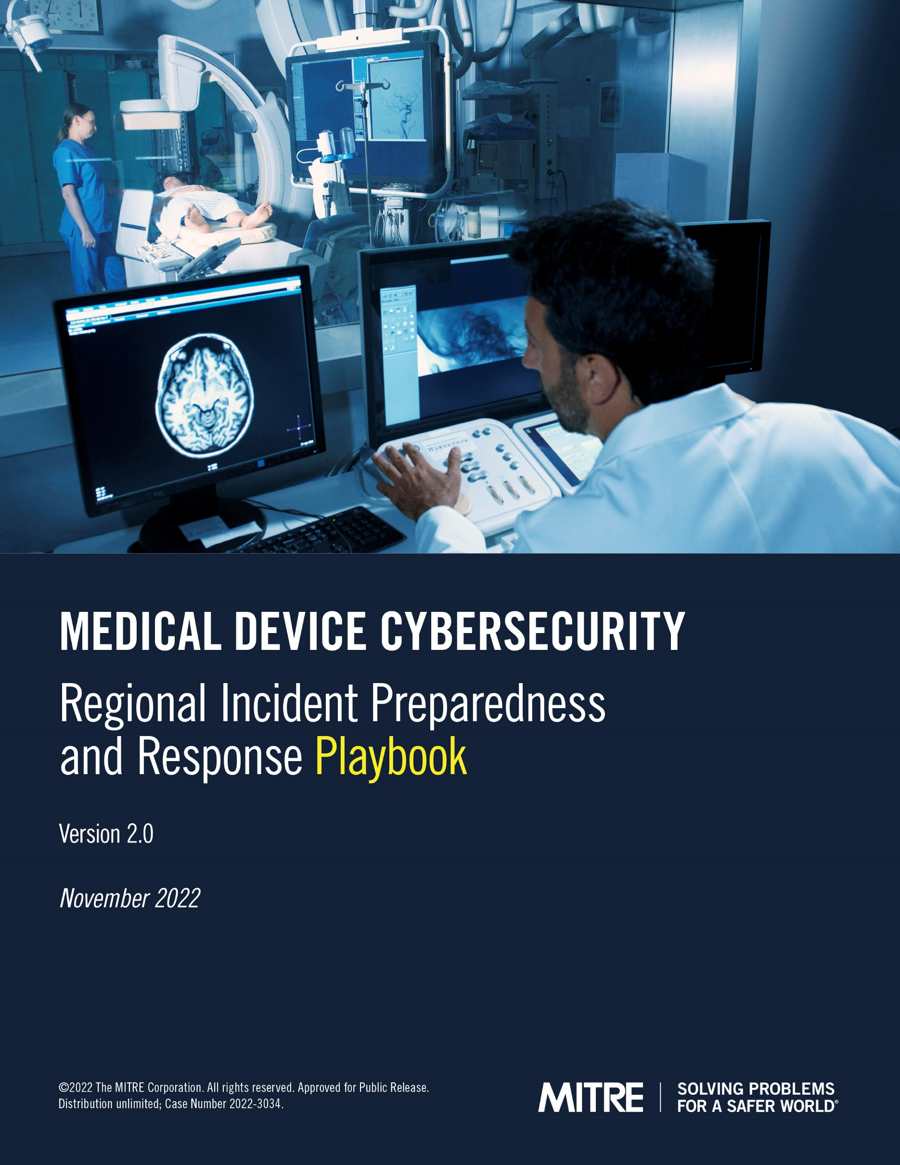
Regional Preparedness and Response Playbook
After the WannaCry attack in 2017, FDA asked MITRE to develop the Medical Device Cybersecurity Regional Incident Preparedness and Response Playbook
FDA asked MITRE to revise the playbook to better address the evolution of ransomware attacks, emerging medical device technologies (e.g., cloud), and cybersecurity initiatives across the health sector
Published November 2022
    https://www.mitre.org/news-insights/publication/medical-device-cybersecurity-regional-incident-preparedness-and-response
© 2024 THE MITRE CORPORATION. Approved for public release; distribution unlimited. Public release case number 24-1708.

Slide 27
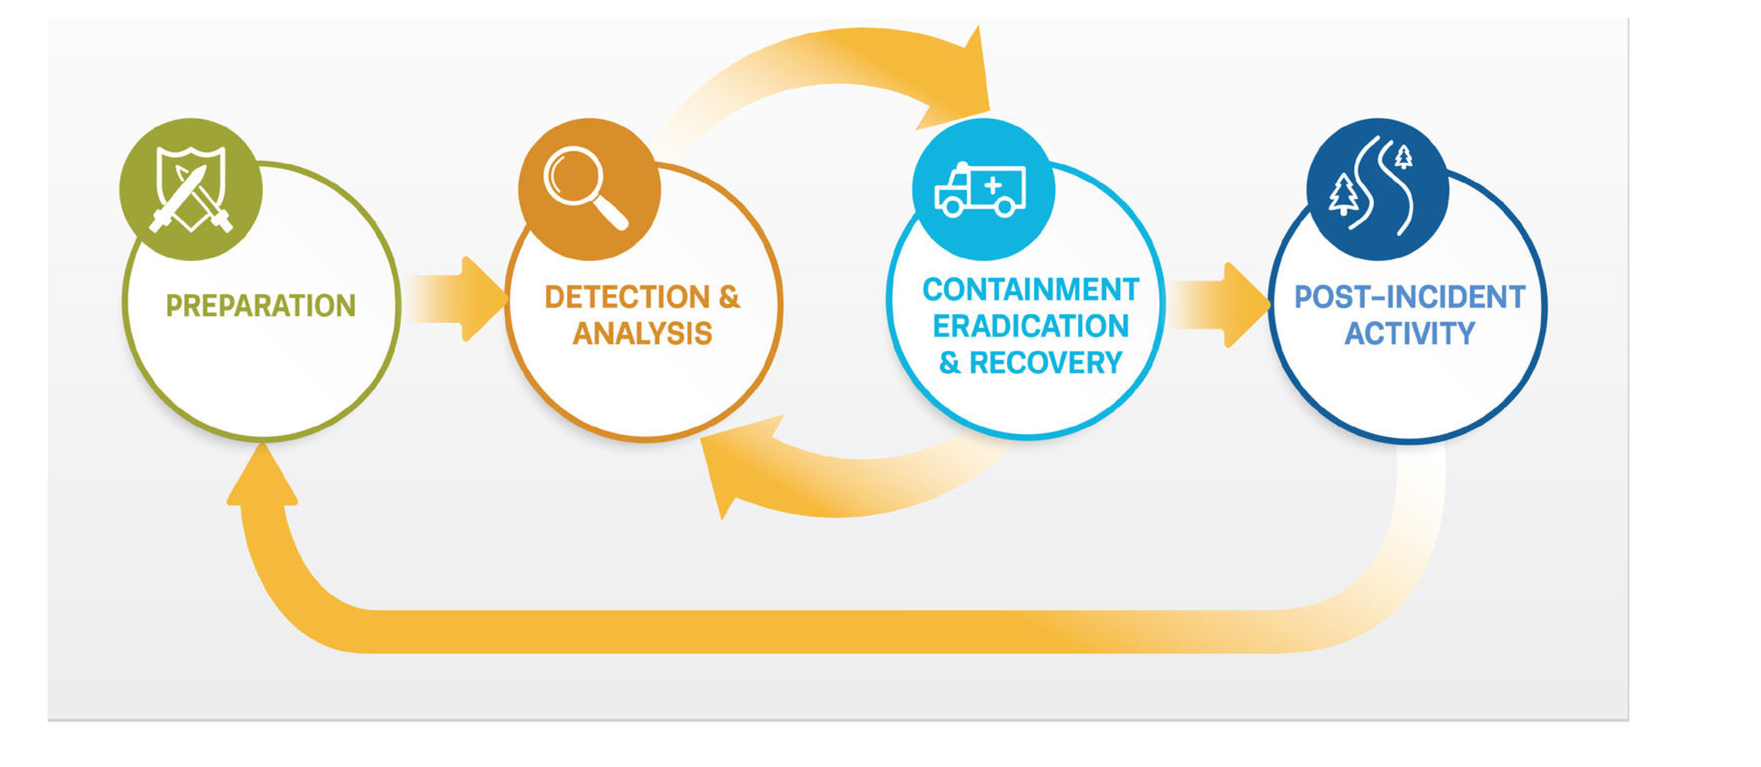
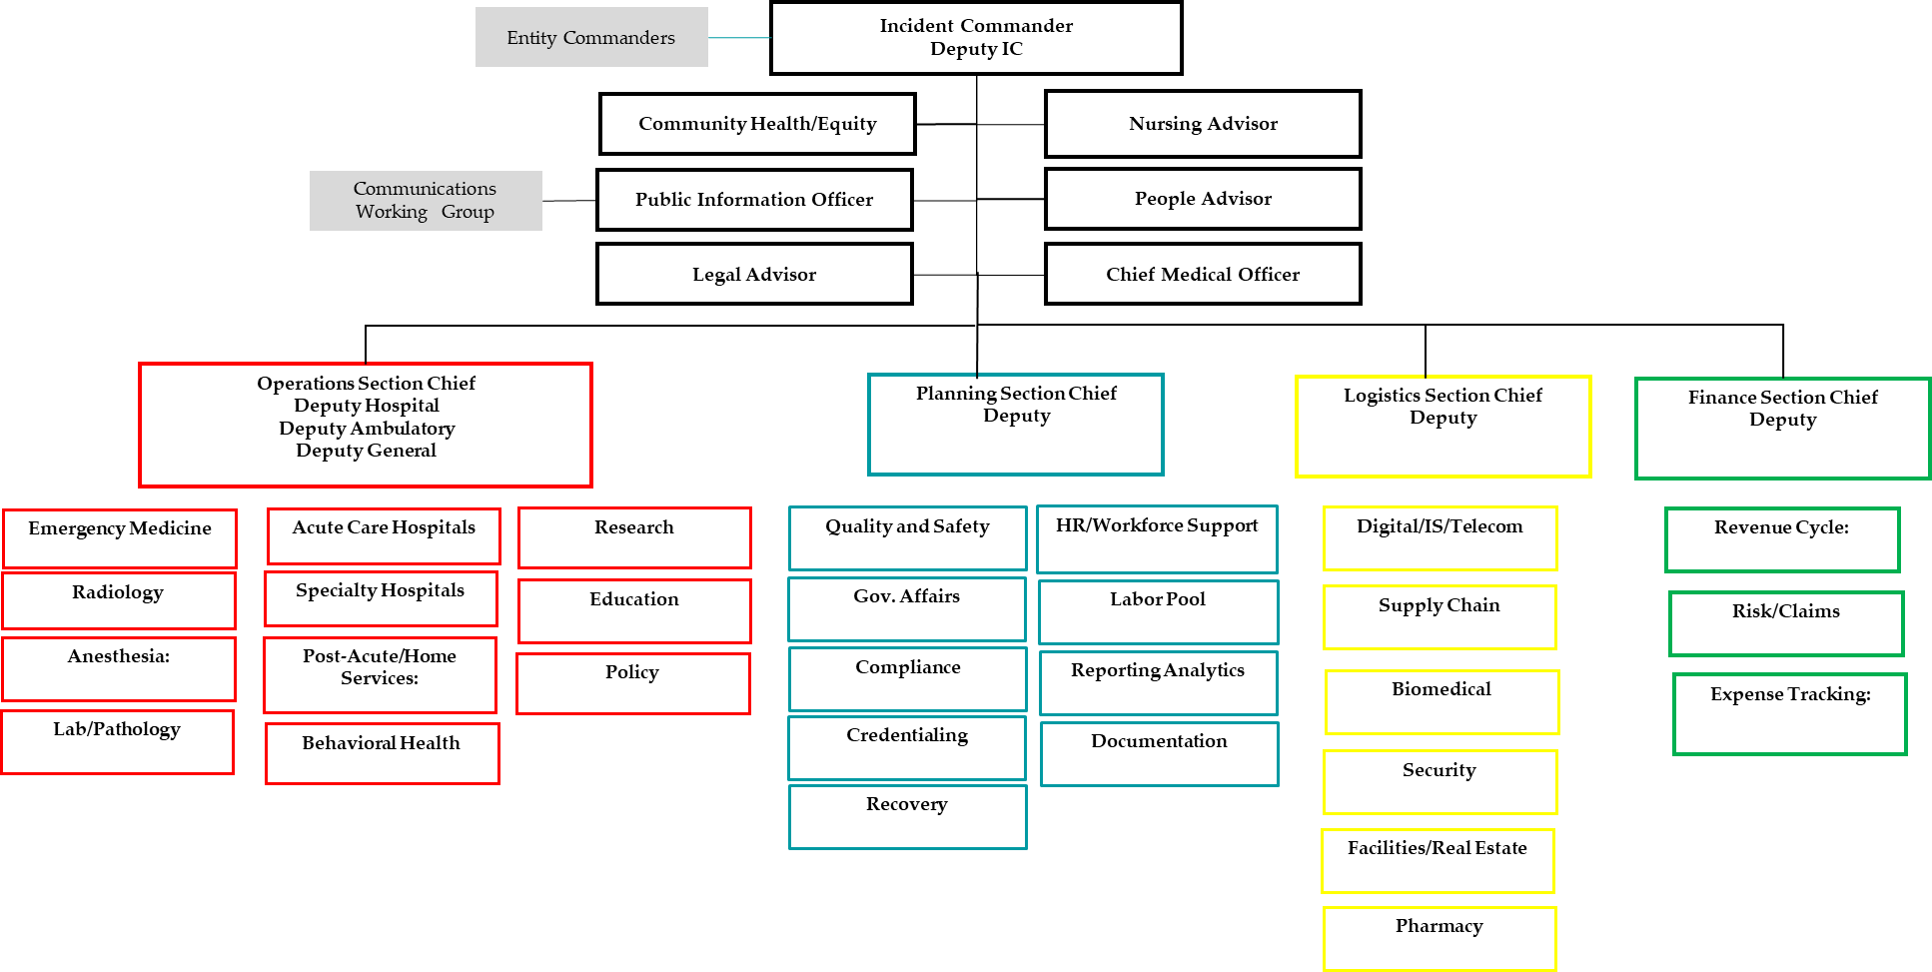
Playbook Overview
Based on NIST’s Computer Incident Response Handling Guide (NIST SP 800-61r2)
Integrates cyber response with Health Incident Command Structure
Emphasizes importance of regional relationships for response
Provides suggestions for developing and conducting cyber exercises
Includes list of resources for more detailed information and information on how to reach out to government resources (including state, HHS, DHS, and FBI)
Developed Quick Start Companion Guide to orient new playbook users and help all users quickly identify the key parts of the playbook to turn to during a cyber incident

Slide 28
Establishing an Advocate
Advocates are champions that maintain or support the long-term maintenance of your organization’s security
Advocates don’t have to be security professionals
  Motivated leadership
  IT professionals
Advocates can be homegrown within an organization, but also long-term external partners
  Reliable external contractors
  Partners within larger healthcare organizations
Advocates are your point of contact for information sharing and partnerships
Advocates are repositories for institutional knowledge
Notes:
Convey that expertise are needed and those can come from within or without.

Slide 29
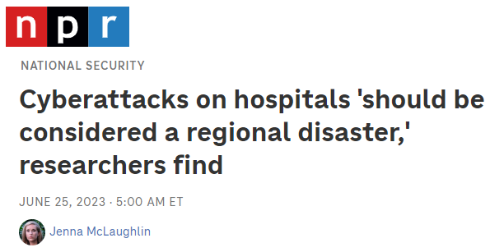
Preparing Regional Responses
Cybersecurity incidents are a regional risk
Recovering from them requires a regional response

Slide 30
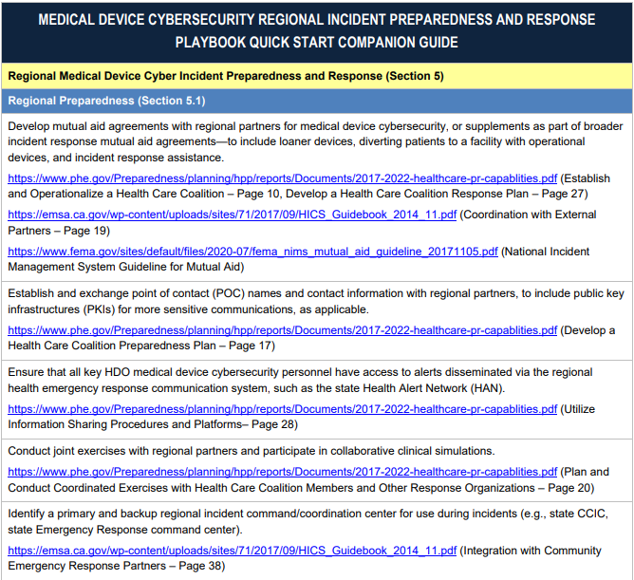
Quick Start Guide
…(Continues)…

Slide 31
Quick Start Guide
Establish and exchange point of contact (POC) names and contact information with regional partners, to include public key infrastructures (PKIs) for more sensitive communications, as applicable
…(Continues)…

Slide 32
Running Cyber Table-Top Exercises (TTxs)
From: HackU<exercise_redacted>@protonmail.com>
Sent: Friday, November 5, 202
To: <exercise redacted>
Subject: RE: Our ownership of all your systems
It’s good to communicate directly. We want to resolve this for everyone involved as quickly as possible. Upon payment we will help you get your systems operational as quickly as possible. We will also remove ourselves from your network. If you don’t pay us though, we can’t be held responsible if other things break. The longer you wait, the higher chance things go wrong. Maybe it requires more work on our end? If so, the price we’re charging you go up. Don’t try to mess with us. Just pay us and we can put this all behind us.
Remember, 1 million dollars in BTC to the wallet:
1CvBMSEYst<exercise_redacted>
If you have any problems buying bitcoin let us know. We offer top tier service and support. It’s in everyone’s best interest that we get paid! If you have any questions, please reach out to us. We hope to resolve this quickly for everyone involved. Once we have our money, we can get your systems back up and delete all these files.
--------FOR EXERCISE USE ONLY---------
- This is for a Cybersecurity Exercise -
--------FOR EXERCISE USE ONLY---------

Slide 33
Lessons Learned From Exercises (1 of 2)
Cyber exercises are emergency preparedness exercises!!!
  Clinical and Emergency Management experts are required

Slide 34
Lessons Learned From Exercises (2 of 2)
Understanding impacts of response actions is hard
  What happens when you lose internet connectivity?
Response coordination is hard
Exercises can help develop as sense of understanding about how different teams can partner together
It’s important to have a response plan before an event occurs, and update it based on the exercise findings
Notes:
If needed, we can discuss joint briefing on partnership/exercise with MGB

Slide 35
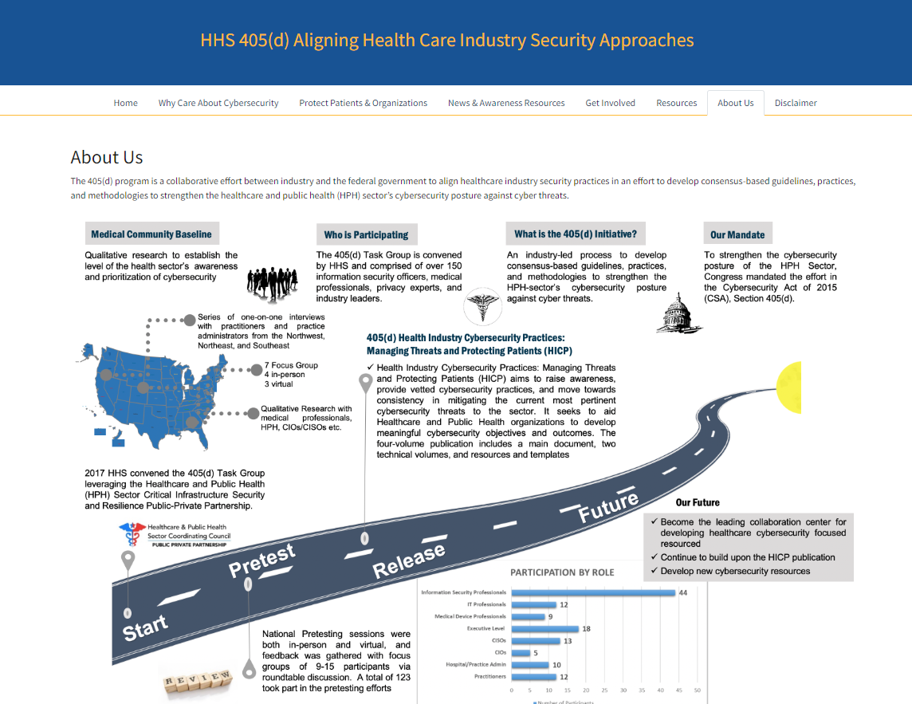
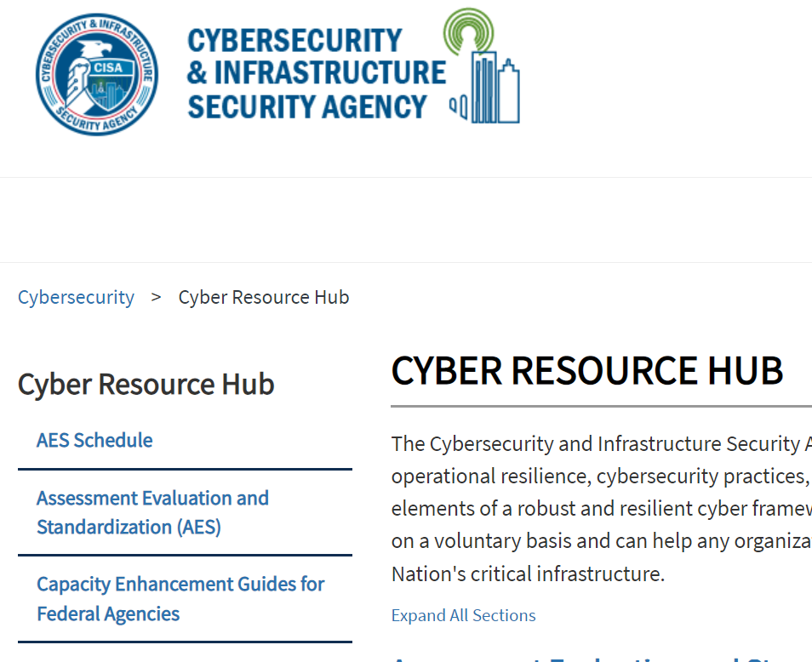

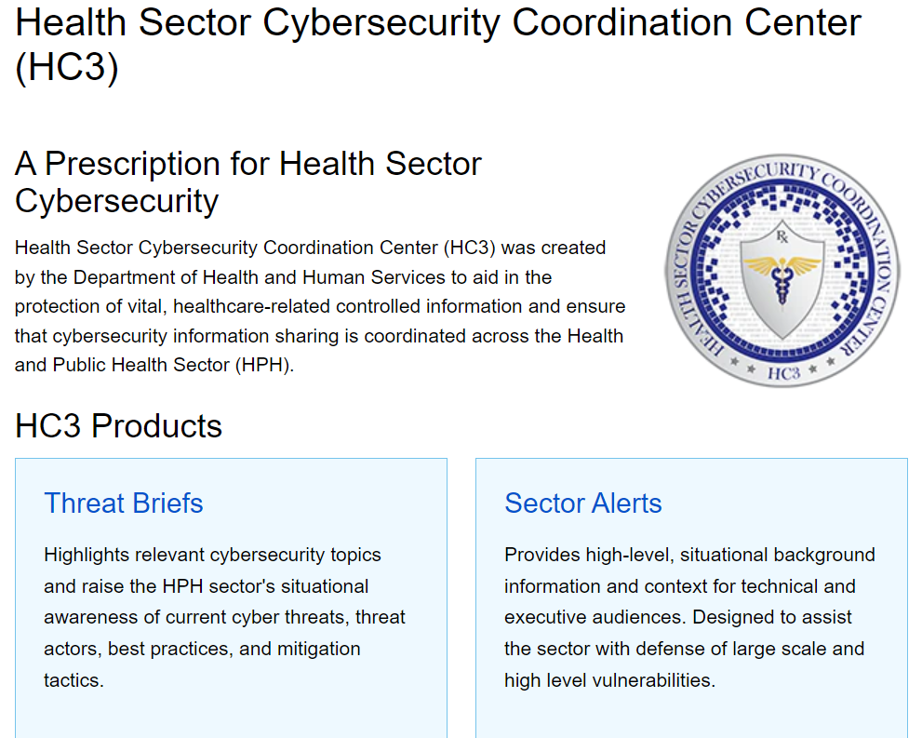
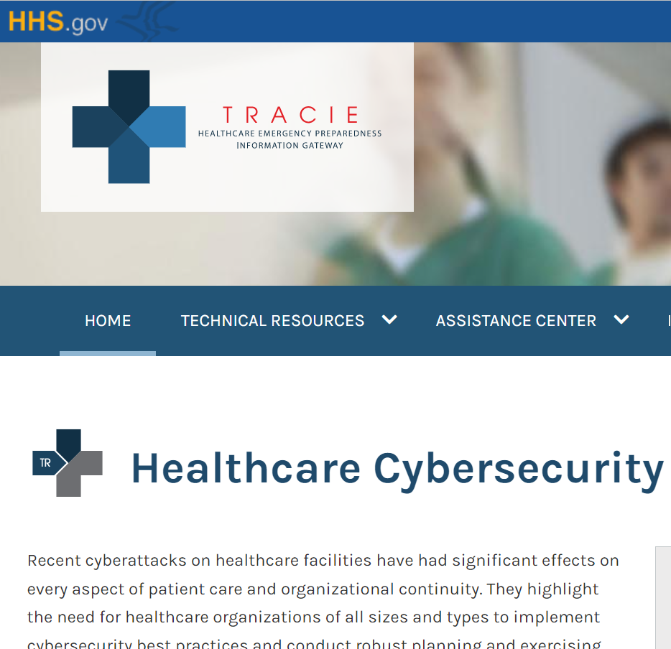

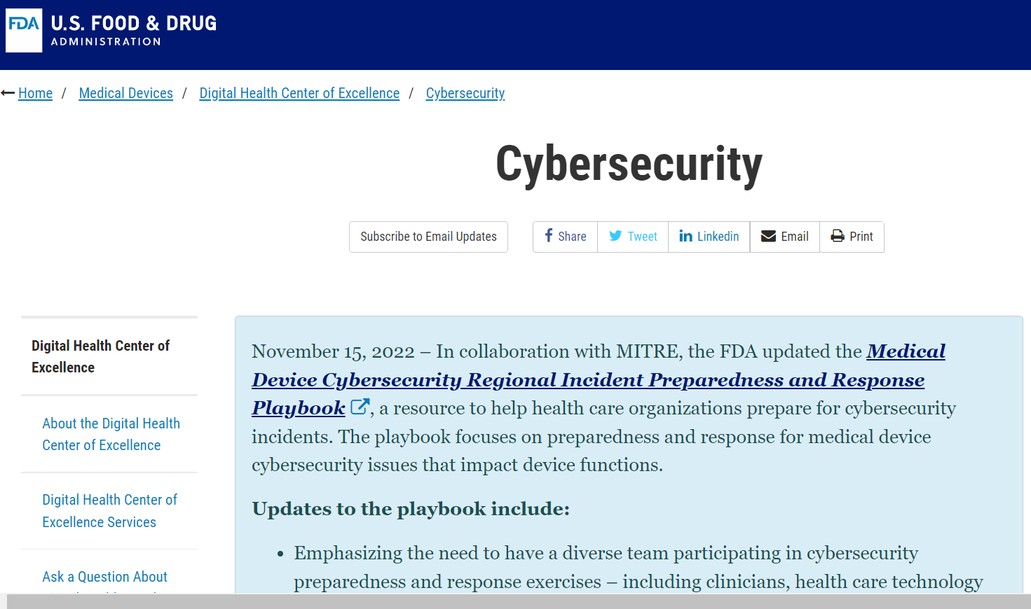
What resources are currently available?

Slide 36
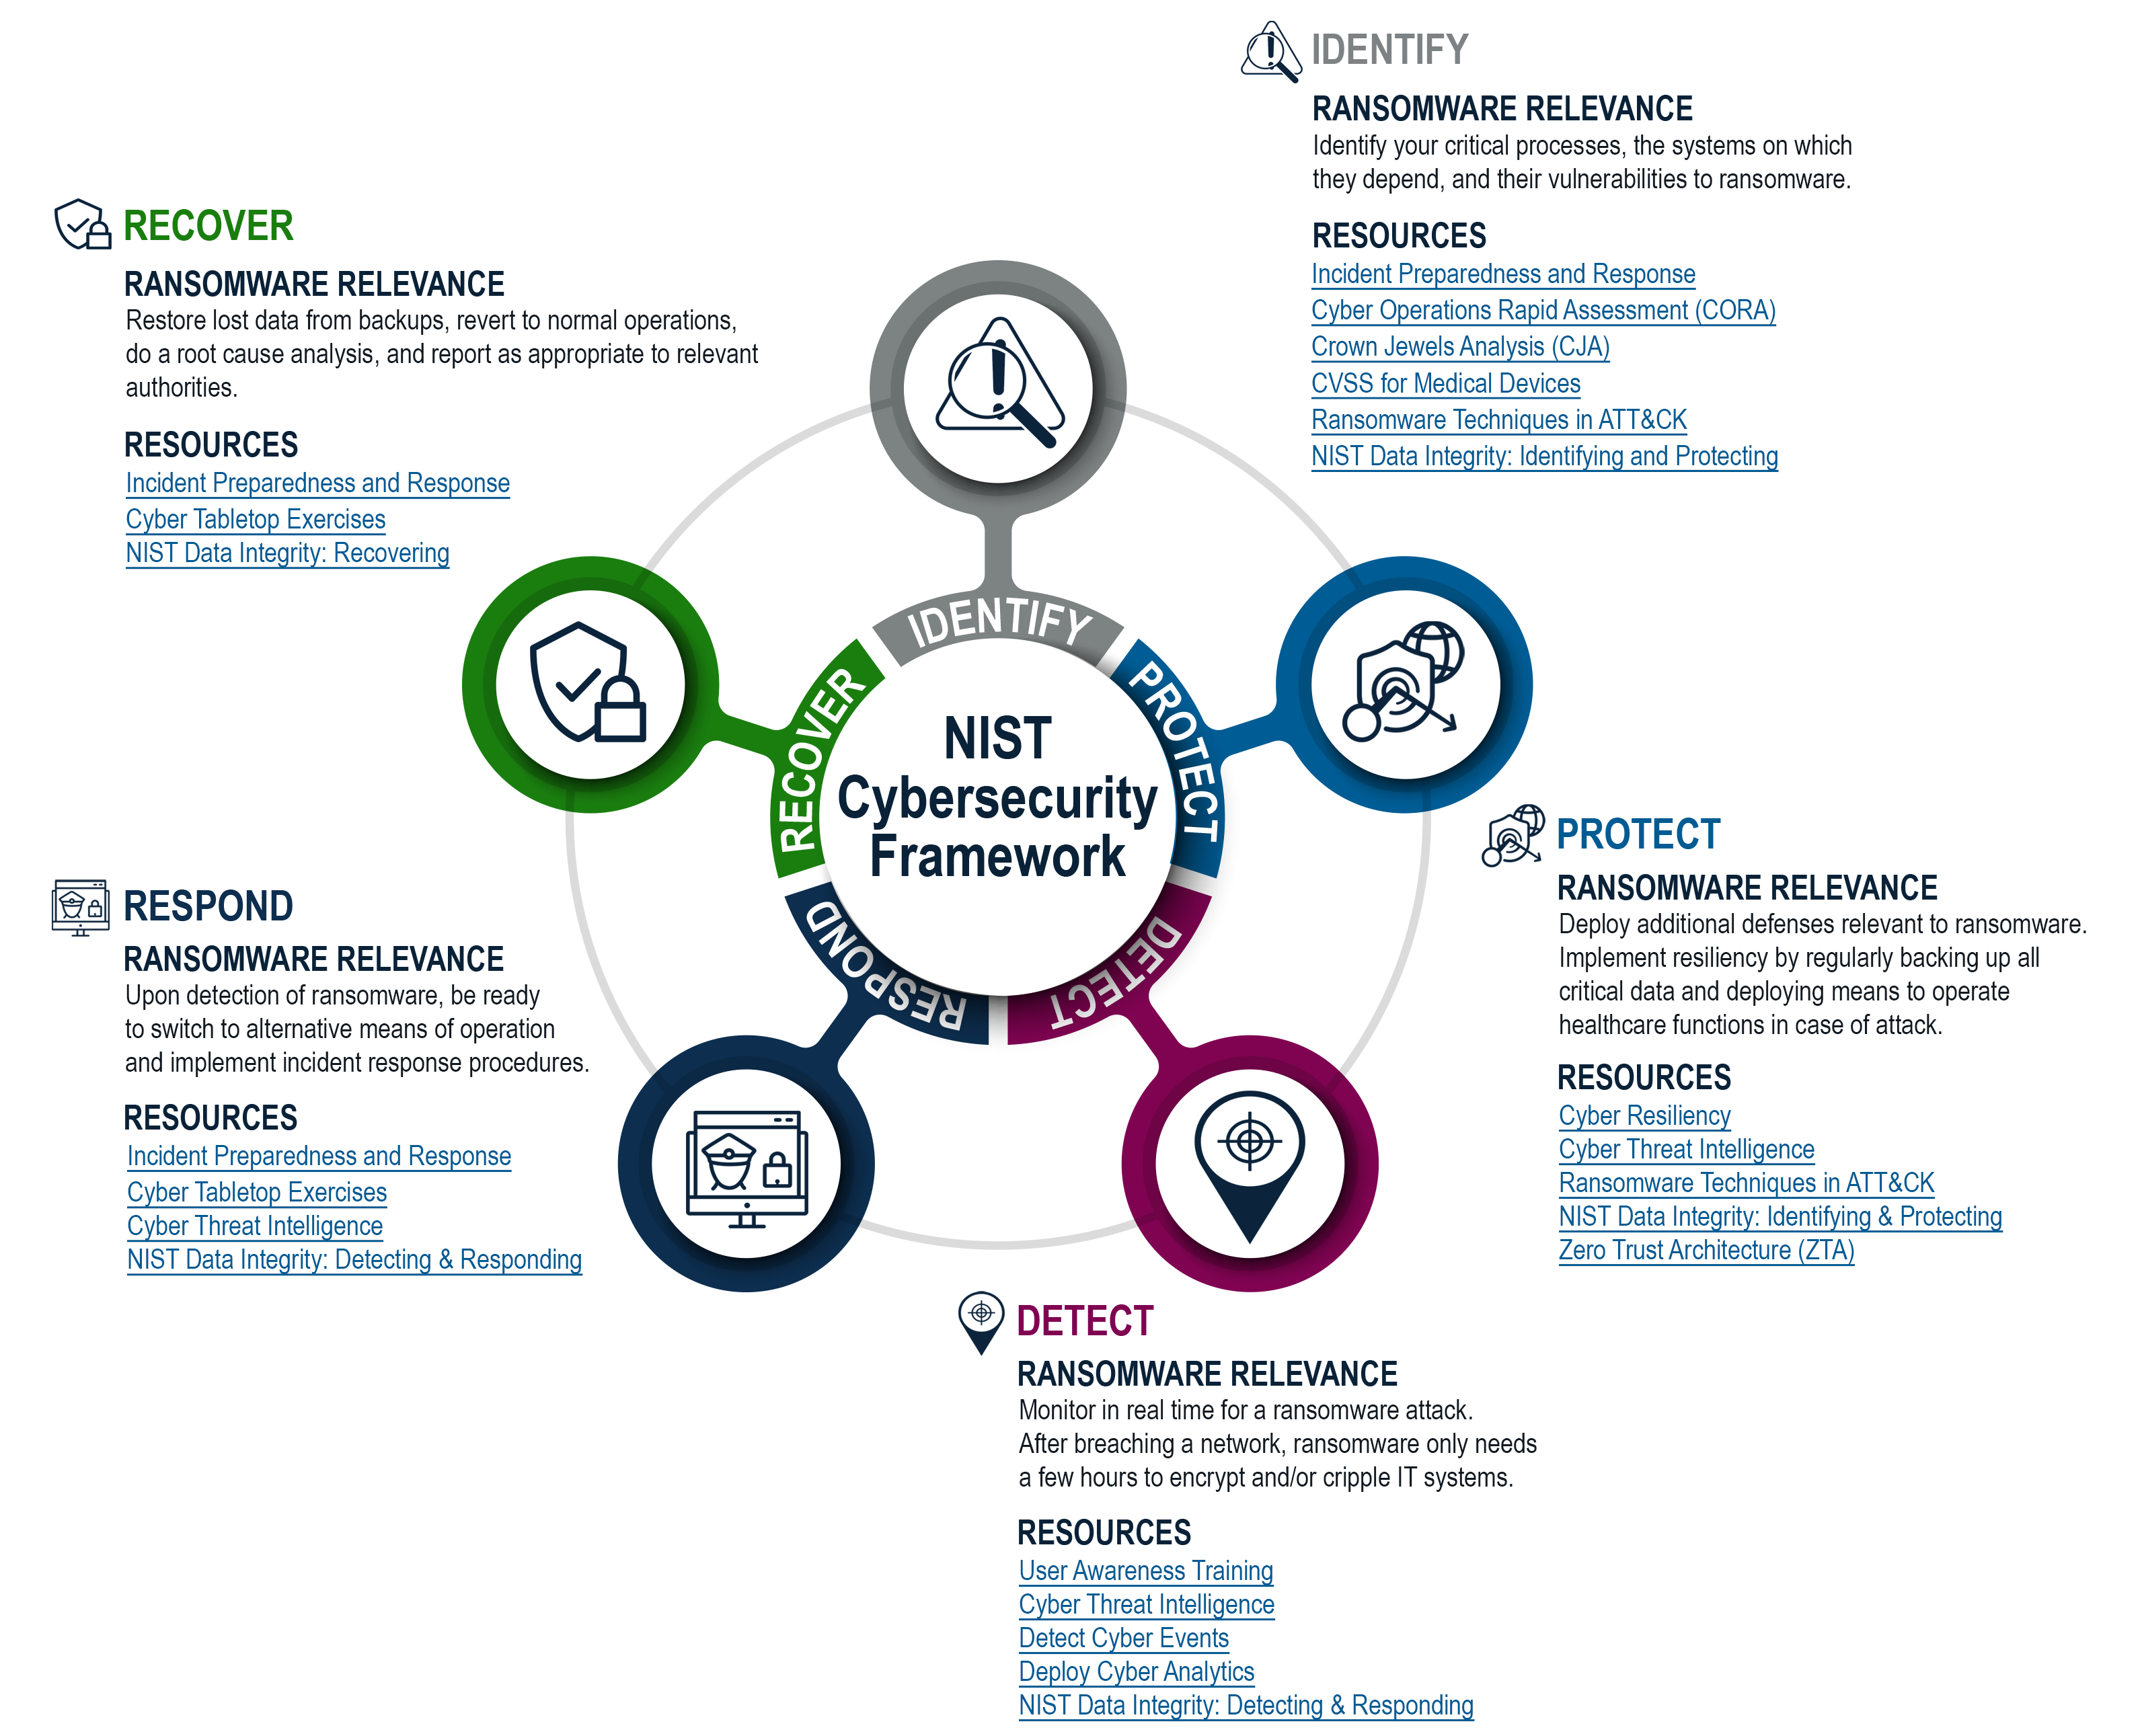
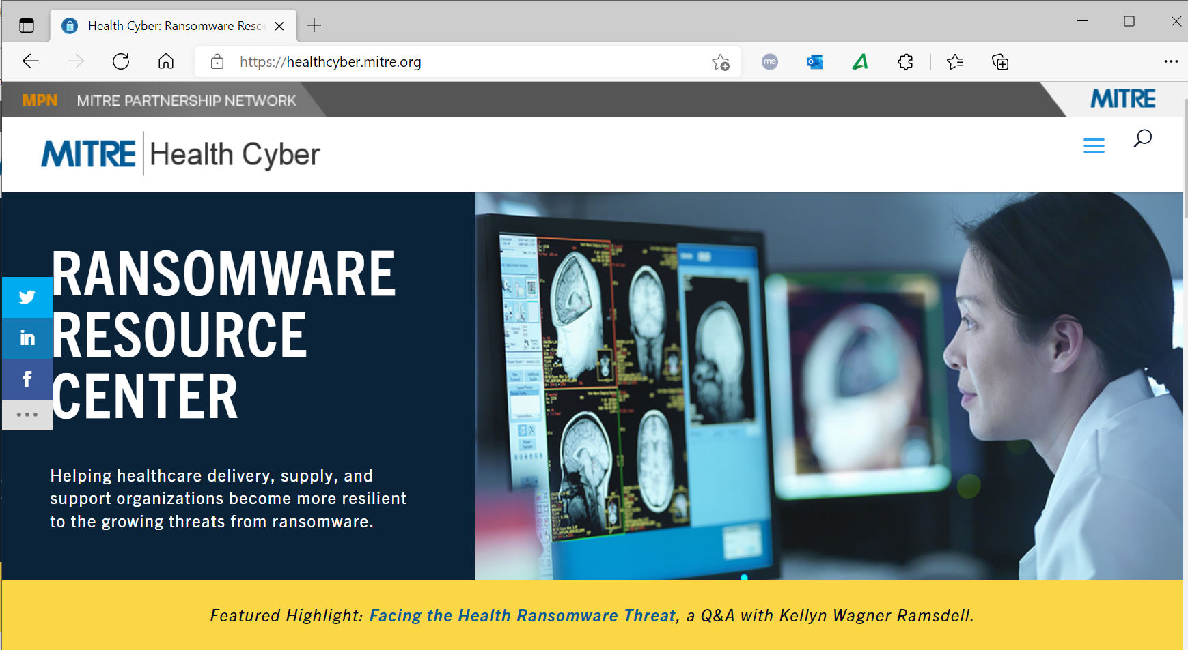
Ransomware Resource Center
https://healthcyber.mitre.org

Slide 37


Closing Slide
Questions?
Download the playbook:
Matt Weir
cweir@mitre.org
linkedin.com/in/matt-weir-54a2192
    https://www.mitre.org/news-insights/publication/medical-device-cybersecurity-regional-incident-preparedness-and-response
Ben Ballard
bballard@mitre.org
linkedin.com/in/wbenballard

Slide 38
Resources

Slide 39
Healthcare Cybersecurity Resources (1/5)
FDA
  Cybersecurity | FDA: https://www.fda.gov/medical-devices/digital-health-center-excellence/cybersecurity
  MITRE/FDA article - The Evolving State of Medical Device Cybersecurity | Biomedical Instrumentation & Technology (aami.org): https://array.aami.org/doi/10.2345/0899-8205-52.2.103
  MITRE products sponsored by FDA
    Playbook for Threat Modeling Medical Devices | MITRE: https://www.mitre.org/news-insights/publication/playbook-threat-modeling-medical-devices
    Medical Device Cybersecurity Regional Incident Preparedness and Response Playbook | MITRE: https://www.mitre.org/news-insights/publication/medical-device-cybersecurity-regional-incident-preparedness-and-response
    Rubric for Applying CVSS to Medical Devices | MITRE: https://www.mitre.org/news-insights/publication/rubric-applying-cvss-medical-devices

Slide 40
Healthcare Cybersecurity Resources (2/5)
HHS
  HPH Cybersecurity Gateway: HPH Cybersecurity Gateway (hhs.gov)
  ASPR TRACIE Cybersecurity: https://asprtracie.hhs.gov/cybersecurity
  HHS 405(d) - Health Care Industry Practices (HICP) and Hospital Resiliency Landscape Analysis: https://405d.hhs.gov/information
  Health Sector Cybersecurity Coordination Center (HC3): https://www.hhs.gov/about/agencies/asa/ocio/hc3/index.html
DHS Cybersecurity & Infrastructure Security Agency (CISA)
  Healthcare and Public Health Sector: Strengthen your Defenses and Mature your Cybersecurity Efforts | CISA
NIST National Cybersecurity Center of Excellence (NCCoE)
  Healthcare Projects: https://www.nccoe.nist.gov/healthcare

Slide 41
Healthcare Cybersecurity Resources (3/5)
Sector Activities
  Cybersecurity Information Sharing Act (CISA) of 2015 Health Care Industry Cybersecurity Task Force: https://www.phe.gov/Preparedness/planning/CyberTF/Pages/default.aspx
  Health Sector Coordinating Council (HSCC) Cybersecurity Working Group
    Home Page: https://healthsectorcouncil.org/
    2024 Task Groups: https://healthsectorcouncil.org/task-groups/

Slide 42
Healthcare Cybersecurity Resources (4/5)
Sector Activities
  Health Sector Coordinating Council (HSCC) Cybersecurity Working Group
    Publications – some selected ones:
        Cybersecurity for the Clinician Video Series: https://healthsectorcouncil.org/cyberclinicianvideos/
        HPH Cybersecurity Framework Implementation Guide: https://aspr.hhs.gov/cip/hph-cybersecurity-framework-implementation-guide/Pages/default.aspx
        Health Industry Cybersecurity Information Sharing Best Practices (HIC-ISBP): https://healthsectorcouncil.org/info-sharing-guide/
        Health Industry Cybersecurity Artificial Intelligence Machine Learning: https://healthsectorcouncil.org/wp-content/uploads/2023/02/Health-Industry-Cybersecurity-Artificial-Intelligence-Machine-Learning_1.pdfx

Slide 43
Healthcare Cybersecurity Resources (5/5)
Sector Activities
  Health Sector Coordinating Council (HSCC) Cybersecurity Working Group
    Publications – some selected ones:
        Incident Response and Business Continuity - Response Plan (HIC-CHIRP): https://healthsectorcouncil.org/wp-content/uploads/2023/07/HIC-CHIRP-FINAL_1.pdf
        Incident Response and Business Continuity - Incident Checklist (OCCI): https://healthsectorcouncil.org/wp-content/uploads/2022/05/Operational-Continuity-Cyber-Incident-OCCI.pdf
        Health Industry Cybersecurity Managing Legacy Technology Security (HIC-MaLTS): https://healthsectorcouncil.org/wp-content/uploads/2023/03/Health-Industry-Cybersecurity-Managing-Legacy-Technology-Security-HIC-MaLTS.pdf
        Model Contract-Language for Medtech Cybersecurity (MC2): https://healthsectorcouncil.org/model-contract-language-for-medtech-cybersecurity-mc2/

