Slide 1
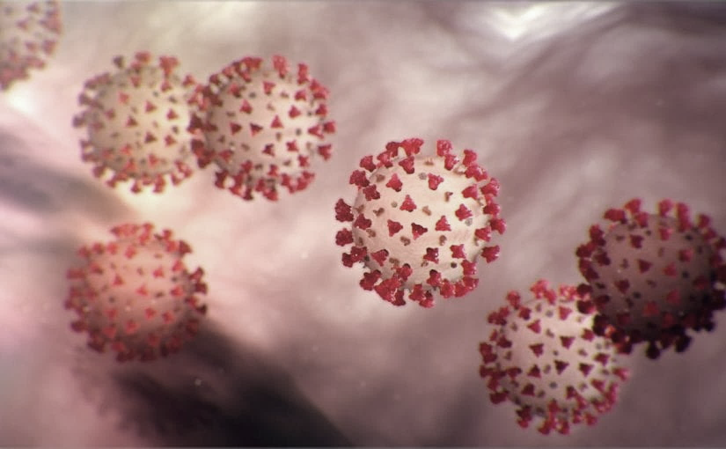
Covid-19 Webex Update
4-27-20
Maureen Tierney, MD, MSc.
Healthcare Associated Infections Medical Director
Tom Safranek, MD, State Epidemiologist

Slide 2
We are one in this fight
Frontline Heroes
Public Health Heroes
First Responder Heroes

Slide 3
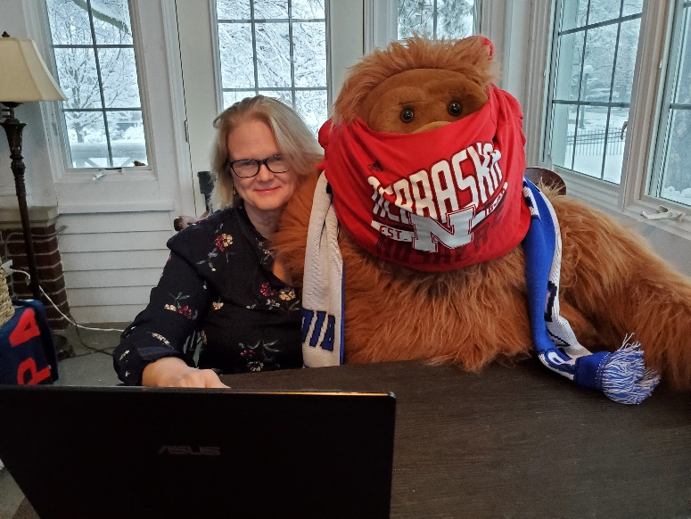
George’s Cloth Mask

Slide 4
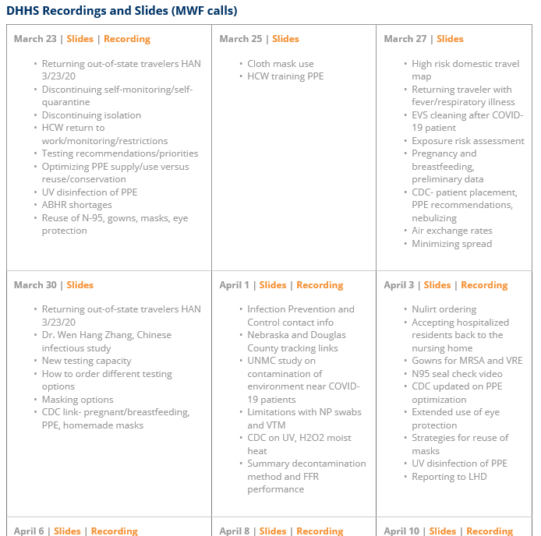
Thank you for joining us!
Slides and recording of today’s presentation will be available at
https://www.nebraskahospitals.org/coronavirus-covid-19-information.html
Scroll to the bottom of the page

Slide 5
Links to Nebraska webinars
Nebraska Acute Care Call every M,W, F at noon
previous calls can be found Nebraska Hospital Association
https://www.nebraskahospitals.org/coronavirus-covid-19-information.html
Nebraska ICAP Long Term Care Webinars every Thursday at noon
previous webinars and questions and answers found on ICAP website
https://icap.nebraskamed.com/
NEW
Nebraska ICAP Combined Critical Access and Outpatient Webinars every Tuesday at non
previous webinars and questions and answers found on ICAP website
https://icap.nebraskamed.com/

Slide 6
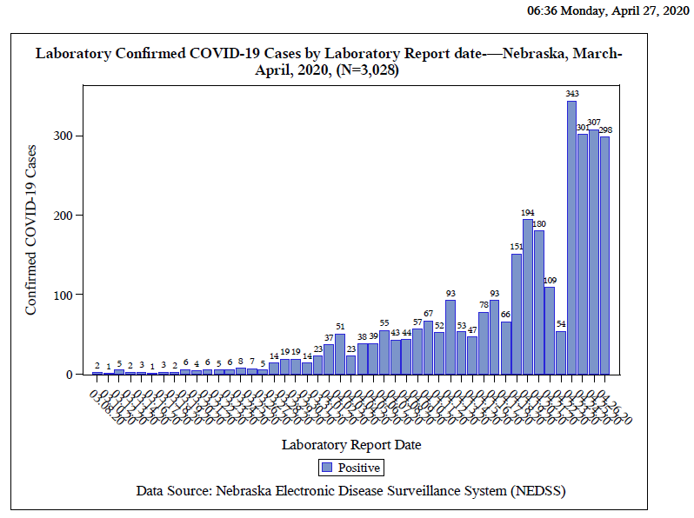
Notes:
Add the title of your presentation, your division, name, etc.

Slide 7
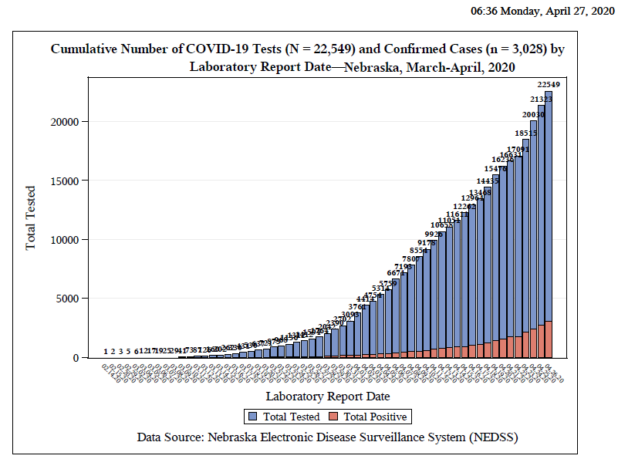
Notes:
Add the title of your presentation, your division, name, etc.

Slide 8
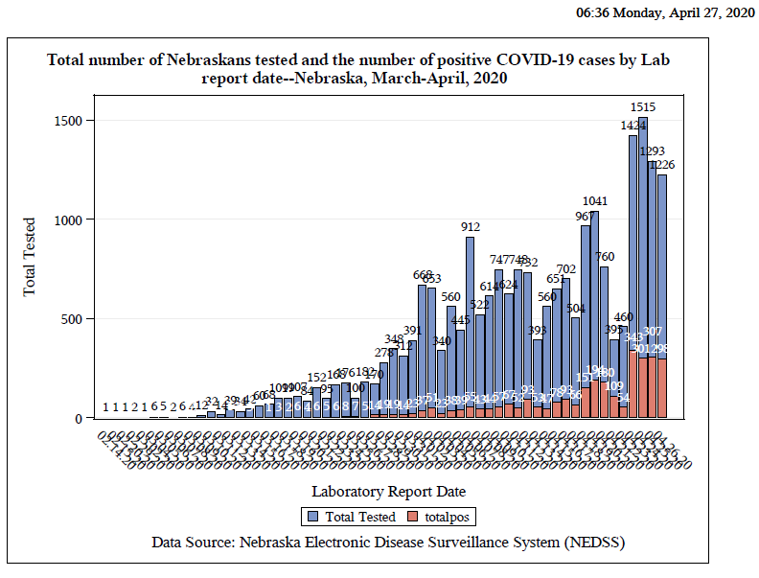
Notes:
Add the title of your presentation, your division, name, etc.

Slide 9
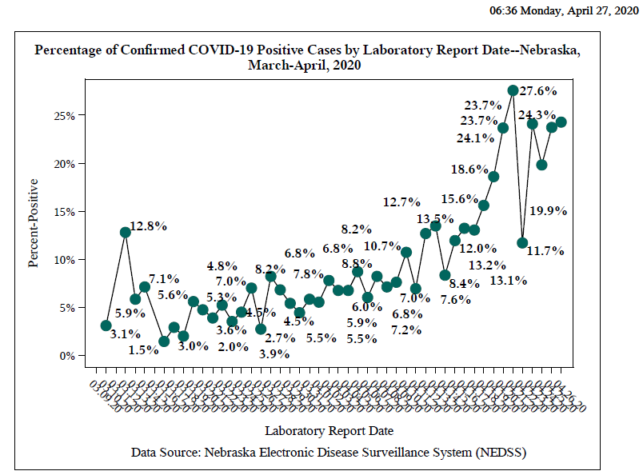
Notes:
Add the title of your presentation, your division, name, etc.

Slide 10
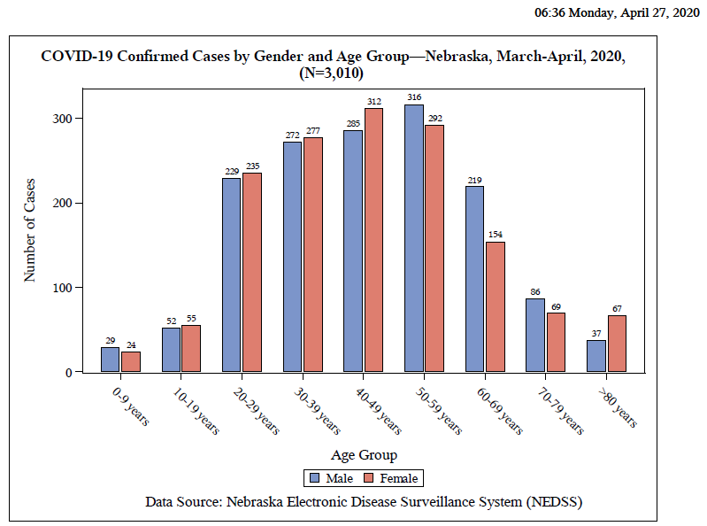
Notes:
Add the title of your presentation, your division, name, etc.

Slide 11
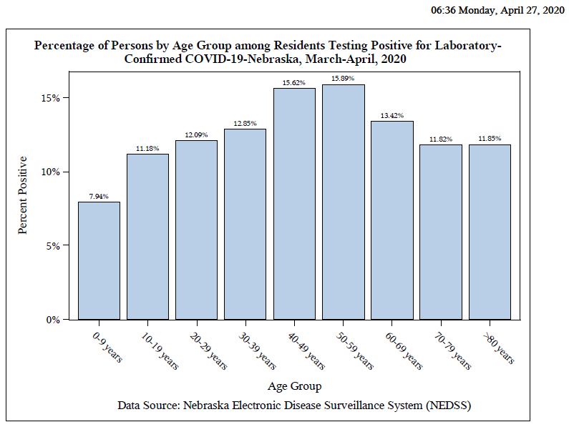
Notes:
Add the title of your presentation, your division, name, etc.

Slide 12
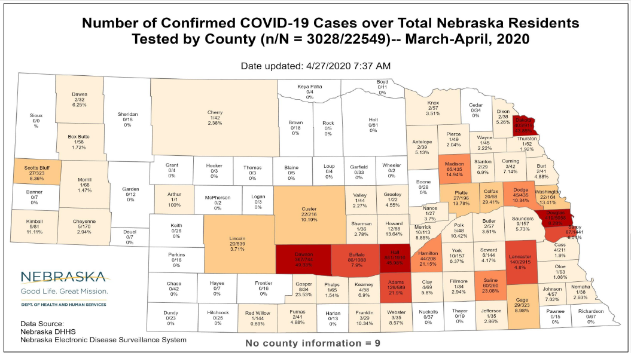
Notes:
Add the title of your presentation, your division, name, etc.

Slide 13
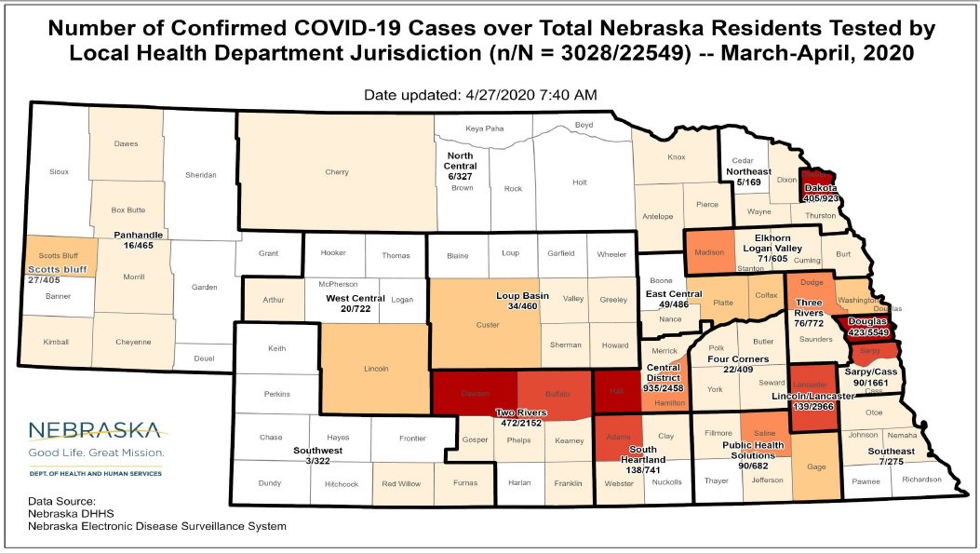
Notes:
Add the title of your presentation, your division, name, etc.

Slide 14
Bed and Vent Availability
https://nebraska.maps.arcgis.com/apps/opsdashboard/index.html#/4213f719a45647bc873ffb58783ffef3
49% hospital beds available
42% ICU beds available
77% ventilators available
In hardest hit communities, the hospitals still some ICU bed and Vent availability, Systems in place to transfer if necessary

Slide 15
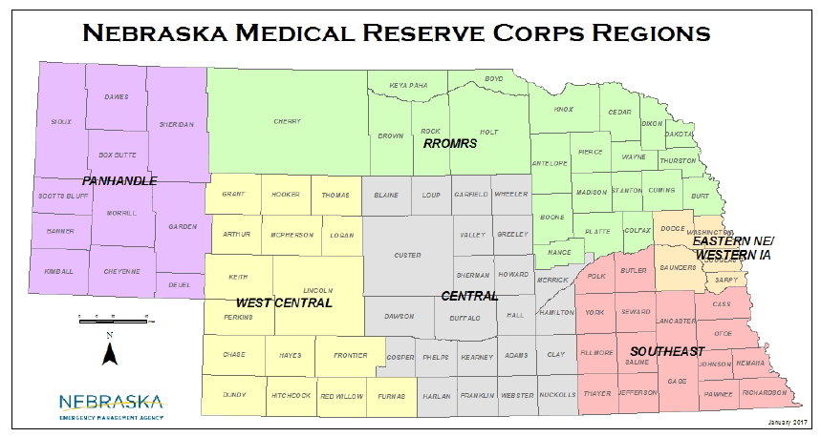
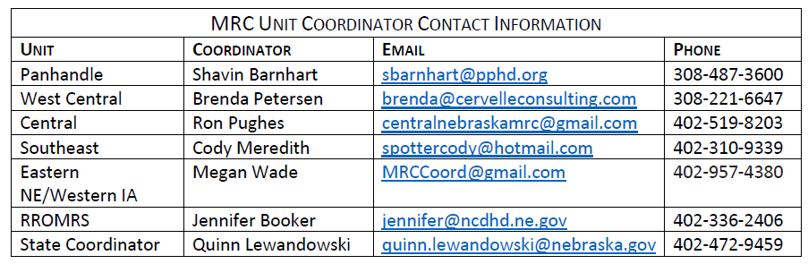

Slide 16
CDC Race Data
A recent CDC MMWR report included race and ethnicity data from 580 patients hospitalized with lab-confirmed COVID-19 found that
45% of individuals for whom race or ethnicity data was available were white, compared to 55% of individuals in the surrounding community.
However, 33% of hospitalized patients were black compared to 18% in the community and
8% were Hispanic, compared to 14% in the community.
These data suggest an overrepresentation of blacks among hospitalized patients. Among COVID-19 deaths for which race and ethnicity data were available, New York Citypdf iconexternal icon identified death rates among Black/African American persons (92.3 deaths per 100,000 population) and Hispanic/Latino persons (74.3) that were substantially higher than that of white (45.2) or Asian (34.5) persons. Studies are underway to confirm these data and understand and potentially reduce the impact of COVID-19 on the health of racial and ethnic minorities.

Slide 17
Meat Packing Plants and Their Communities
Conditions lead to close contact
Home conditions often lead to close contact
Higher community prevalence leads to staff for other environments being at risk
E/G. entrance into LTC such
Shelly Schwedhelm and Dr. Jim Lawler have been visiting Meat Packing Plants and have created
Recommendation son Best Practices, a Checklist and A Survey that can be viewed here:

Slide 18
Major Issues/Recommendations in Meat Packing
Engineering
Air Flow
Physical barriers work-stations, break rooms, hallways
Administrative Controls
Universal Masking
Comm. In multiple languages-HH, social distancing,
Environmental Cleaning
high touch differences, hand sanitizer available, common use tools
Social Distancing
staggered breaks, staggered shifts, more break areas
Flexible sick leave

Slide 19
Laboratory findings in COVID-19
Lymphopenia
elevated levels of d-dimer, lactate dehydrogenase, C-reactive protein, and ferritin.
At presentation, the procalcitonin level is typically normal.
Findings associated with poor outcomes in some series include an increasing white-cell count with lymphopenia, a prolonged prothrombin time, and elevated levels of liver enzymes, lactate dehydrogenase, d-dimer, interleukin-6, C-reactive protein, and procalcitonin.^{13,19,22-24}
When abnormalities are present on imaging, the typical findings are ground-glass opacifications or c
consolidation.²⁵
Mild or Moderate Covid-19
Rajesh T. Gandhi, M.D., John B. Lynch, M.D., M.P.H., and Carlos del Rio, M.D.
April 24, 2020
DOI: 10.1056/NEJMcp2009249

Slide 20
Prevalence by Serology
New York State-14%
New York City 21%
NYC-14% in Pregnant Women (Universal Screening for SARS-CoV-2 in Women Adm for Delivery NYC NEJM)
Santa Clara 1.5%

Slide 21
COVID-19 Serology Tests EUAs
EUA Date Issued | Company | Type of Test | comments
4/15 | Mt. Sinai Lab NYC | COVID-19 ELISA IgG Ab Test | Qualitative
4/14 | Chembio Diagnostic System, Inc. | DPP COVID-19IgM/IgG system | Qualitative IgG / IgM reported separately FS 20-30 min
4/14 | Ortho Clinical Diagnostics | VITROS Total Ab Immunodiagnostic Anti-SARS-CoV-2 Total Reagent Pak | Qualitative Total IgG and M
4/1 | Celley Inc. | SARS-CoV-2 IgG/IgM Rapid Test | 20 min Yes/No IgG or IgM

Slide 22
Other Serology
LabCorp home test-EUA approved
Many other serology tests without EUA-be very wary, unknown accuracy
Should have EUA approved tests available possible as early as next week in NE

Slide 23
Donating Plasma and Convalescent Plasma
Donating Plasma
People who have fully recovered from COVID-19 for at least two wks are encouraged to consider donating plasma, which may help save the lives of other patients. COVID-19 convalescent plasma must only be collected from recovered individuals if they are eligible to donate blood. Individuals must have had a prior diagnosis of COVID-19 documented by a lab test and meet other donor criteria. Individuals must have complete resolution of symptoms for at least 28 days before they donate, or alternatively have no symptoms for at least 14 days prior to donation and have a neg lab test for active COVID-19 disease.
~American Red Cross
~Innovative Blood resources (IBR) which is based out of the twin cities (MN) in con partnership with Nebraska Community Blood Bank NPCC
Convalescent Plasma
CHI facilities involved in Mayo Clinic Protocol-convalescent plasma
New development-6 labs working together to create super plasma

Slide 24
Testing Performance
Probably over 90% SE/SPEC\
How many false negatives?
Rapid 15 min test-60% to 70% sensitivity; Abbott’s Rapid Coronavirus Test Can Produce False Negatives When Following Company’s Initial Guidance, Experts Say
Some recent data about risks to test those preparing and reading test.
?Saliva test from Rutgers??-see next slide 60 test concordance
Cepheid testing
Can use saline if out of VTM, must be refrigerated , can be frozen

Slide 25
Updates to CDC Infection Prevention for HCP
Cloth face coverings should not be considered PPE and should NOT be worn instead of a respirator or facemask if more than source control is required.
Consider having patients or residents wear masks if they are able.
Healthcare personnel should consider continuing to wear their respirator or facemask (extended use) while in the healthcare facility instead of intermittently switching back to their cloth face covering, which could cause self-contamination.
Visitors and patients should be wearing at least a cloth face covering upon arrival to the

Slide 26
PPE Request Form
https://form.jotform.com/NebraskaDHHS/PPERequestForm

Slide 27
How to determine PPE needs
PPE Burn Rate Calculator
Personal Protective Equipment Burn Rate Calculator excel icon[XLS – 39 KB]
This spreadsheet can help healthcare facilities plan and optimize the use of personal protective equipment (PPE) for response to coronavirus disease 2019 (COVID-19). Get the Instructions
PPE Requests need to go to LHD, shipments go out to LHD and then from LHD to facilities as soon as possible. Often don’t know when shipments are arriving.

Slide 28
UV Disinfecting Stations around Nebraska
TRIMRS: CHI Good Samaritan, Kearney
PRIMRS: Region West, Scottsbluff
OMHCC: OrthoNE, Omaha
RROMRS: Avera, O’Neill
NPHCC: Chase County, Imperial
SENHCC: City of Lincoln / Transportation & Utilities, Lincoln

Slide 29
Home Healthcare Guidances
https://www.nahc.org/resources-services/coronavirus-resources/

Slide 30
Off Site Quarantine and Convalescence
HCPs and First Responders who wish to Q away from family in hotels- call 833 220 0018
(NEDHHS) will be expanding its pilot program to provide temporary accommodations to residents exposed to coronavirus disease (COVID-19) who need to quarantine or isolate. The program, coined NAP the Nebraska Accommodation Project, (on NE DHHS COVID 19 website)
The goal of this program is to offer temporary housing to Nebraskans that have been exposed to COVID-19 or are positive for COVID-19 and do not need any assistance with ADL and can mange their own health issues and are in need of a quarantine and/or isolation location outside of the normally defined household due to a high-risk household member. These accommodations will be available in a dormitory room setting and are open to anyone that meets the application criteria. Applications must be completed online at http://dhhs.ne.gov/Pages/Coronavirus look for the Nebraska Accommodation Project (NAP) header.
Initially, the University of Nebraska Omaha (UNO) will be used for NAP. UNL, UNK, and other campuses may come onboard later.

Slide 31
When a Testing-Based Strategy is Preferred
Hospitalized patients may have longer periods of SARS-CoV-2 RNA detection compared to patients with mild or moderate disease. Severely immunocompromised patients (e.g., medical treatment with immunosuppressive drugs, bone marrow or solid organ transplant recipients, inherited immunodeficiency, poorly controlled HIV) may also have longer periods of SARS-CoV-2 RNA detection and prolonged shedding of infectious recovery. These groups may be contagious for longer than others. In addition, placing a patient in a setting where they will have close contact with individuals at risk for severe disease warrants a conservative approach.
Hence, a test-based strategy is preferred for discontinuation of transmission-based precautions for patients who are
Hospitalized or
Severely immunocompromised or
Being transferred to a long-term care or assisted living facility
If testing is not readily available, facilities should use the non-test-based strategy for discontinuation of Transmission-Based Precautions or extend the period of isolation beyond the non-test-based-strategy duration, on a case by case basis in consultation with local and state public health authorities.
From CDC updated IP Guidance 4/15/20

Slide 32
LTC COVID 19 Data
21 Facilities with at Least one resident positive for COVID
10 have 2 or less cases (8-1 only)
8 have 10 or more
28 facilities have a staff member positive
11 only staff positive no residents
Deaths ?27

Slide 33
LTC Accepting Patients
When should a nursing home accept a resident who was diagnosed with COVID-19 from a hospital?
A nursing home can accept a resident diagnosed with COVID-19 and still under Transmission-Based Precautions for COVID-19 as long as the facility can follow CDC guidance for Transmission-Based Precautions. If a nursing home cannot, it must wait until these precautions are discontinued. CDC has released Interim Guidance for Discontinuing Transmission-Based Precautions or In-Home Isolation for Persons with Laboratory-confirmed COVID-19. Information on the duration of infectivity is limited, and the interim guidance has been developed with available information from similar coronaviruses. CDC states that decisions to discontinue Transmission-based Precautions in hospitals will be made on a case-by-case basis in consultation with clinicians, infection prevention and control specialists, and public health officials. Discontinuation will be based on multiple factors (see current CDC guidance for further details).

Slide 34
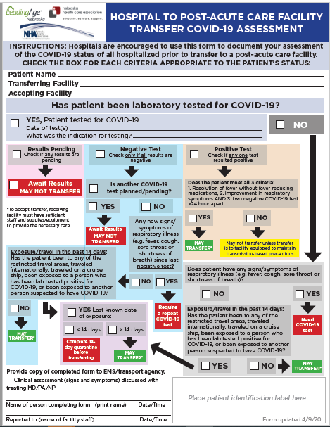

Slide 35

Figure: Cohorting Residents in the Long-Term Care Facilities
Red Zone (Isolation zone) | Dark Red | Residents with Positive COVID-19 test
 | Light Red | Symptomatic residents suspected of having COVID-19
Yellow Zone (Quarantine zone) |  | Asymptomatic residents who may have been exposed to COVID-19
Green Zone (COVID-19 free zone) |  | Asymptomatic residents without any exposure to COVID-19
Gray Zone (Transitional zone) |  | Residents who are being transferred from the hospital/outside facilities (but have no known exposure to COVID-19) are usually kept in this zone for 14 days and if remains asymptomatic at the end of 14 day will be moved to Green zone
https://icap.nebraskamed.com/wp-content/uploads/sites/2/2020/04/Cohorting-Plan-for-LTCF-4.16.20.pdf.

Slide 36
Staffing Needs
NE DHHS COVID Staffing Support Program
Caryn N Vincent, MPH | Interim Deputy Director, Public Health | Nebraska Department of Health and Human Services
Email: Caryn.Vincent@nebraska.gov
Phone: 402-471-1595 or 402-613-2377
Please provide facility name, type of professional support needed, and contact information. Someone will contact you regarding your request within 24 hours.

Slide 37
Post Mortem Guidance
Https://www.cdc.gov/coronavirus/2019-ncov/hcp/guidance-postmortem-specimens.html
Guidance for post mortem specimens (NP swabs)
Guidance for Funeral Directors

Slide 38
Infection Prevention and Control
Office Hours
Monday – Friday
7:30 AM – 9:30 AM Central Time
2:00 PM -4:00 PM Central Time
Call 402-552-2881

Slide 39
STOP Here

Slide 40
ICS* Guidance on Prone Positioning in COVID
Theoretical Benefits to Prone Positioning in the Conscious COVID 19 Patient
• Improved VQ matching and reduced hypoxaemia (secondary to more homogeneous aeration of lung and ameliorating the ventral-dorsal transpulmonary pressure gradient)
• Reduced shunt (perfusion pattern remaining relatively constant while lung aeration becomes more homogenous)
• Recruitment of the posterior lung segments due to reversal of atelectasis
• Improved secretion clearance
One local expert-try and lay prone for 1 hour-4 to 5 times a day, stretching, deep breaths.
*Intensive Case Society

Slide 41
CDC'S CURRENT LIST OF CORONAVIRUS SYMPTOMS
Previously
Fever
Cough
Shortness of Breath
This weekend, the CDC expanded its list to include the following signs:
Chills
Repeated shaking with chills
Muscle pain
Headache
Sore throat
New loss of taste or smell

Slide 42
Pet cats Positive
Until we know more, CDC recommends the following:
Do not let pets interact with people or other animals outside the household.
Keep cats indoors when possible to prevent them from interacting with other animals or people.
Walk dogs on a leash, maintaining at least 6 feet from other people and animals.
Avoid dog parks or public places where a large number of people and dogs gather.

Slide 43
Remdesivir Trials
Severe Disease 2400 at 132 sites
Moderate Disease 1600 at 169 sites
Clinical benefit of remdesivir in rhesus macaques infected with SARS-CoV-2
Conclusions Therapeutic remdesivir treatment initiated early during infection has a clear clinical benefit in SARS-CoV-2-infected rhesus macaques. These data support early remdesivir treatment initiation in COVID-19 patients to prevent progression to severe pneumonia.
Early Results from Study in China
13.8 vs 12.9 (?) results mortality; small trial, late in course

Slide 44
When home quarantine and isolation are over
• Discontinuation from self-isolation for a symptomatic case (confirmed or probable):
CDC guidance (https://www.cdc.gov/coronavirus/2019-ncov/hcp/disposition-in-homepatients.html) states that an individual can stop self-isolation if it has been at least 7 days since symptoms first appeared AND No fever for at least 72 hours (fever-free for 3 full days off fever-reducing medicine) AND All other symptoms have improved (e.g., cough has improved).
• Discontinuation from self-isolation for an asymptomatic laboratory-confirmed case.
•Persons with laboratory-confirmed COVID-19 who have not had any symptoms may discontinue isolation when at least 7 days have passed since the date of their first positive COVID-19 diagnostic test and have had no subsequent illness provided they remain asymptomatic. For 3 days following discontinuation of isolation, these persons should continue to limit contact (stay 6 feet away from others) and limit potential of dispersal of respiratory secretions by wearing a covering for their nose and mouth whenever they are in settings where other persons are present. In community settings, this covering may be a barrier mask, such as a bandana, scarf, or cloth mask. The covering does not refer to a medical mask or respirator.

Slide 45
When Home Q and Isolation are Over (continued)
Discontinuation of self-monitoring and self-quarantine:
  Self-quarantine and self monitoring may stop if after 14 days from most recent exposure, there has been NO development of respiratory illness symptoms. Symptoms may include: cough, shortness of breath, fever, sore throat, and fatigue, myalgias, diarrhea.
Discontinuation of quarantine for household members of a person with COVID-19 who is under self-isolation:
  Individuals who are at home with someone that has (or is suspected of having) COVID-19 should continue self-quarantine for 7 days after patient has been released from isolation AND then continue 7 more days with self-monitoring (total of 14 days).
These guidelines may not always pertain decisions regarding admission/discharge and transfer to/from healthcare facilities.

Slide 46
Tissue Plasminogen Activator (tPA) Treatment for COVID-19 Associated Acute Respiratory Distress Syndrome (ARDS): A Case Series.
J Thromb Haemost. 2020 Apr 8. doi: 10.1111/jth.14828. [Epub ahead of print]
Wang J¹, Hajizadeh N¹, Moore EE^{2,3}, McIntyre RC³, Moore PK⁴, Veress LA⁵, Yaffe MB^{6,7}, Moore HB³, Barrett CD^{6,7}.
Abstract
A hallmark of severe COVID-19 is coagulopathy, with 71.4% of patients who die of COVID-19 meeting ISTH criteria for disseminated intravascular coagulation (DIC) while only 0.6% of patients who survive meet these criteria (1). Additionally, it has become clear that this is not a bleeding diathesis but rather a predominantly pro-thrombotic DIC with high venous thromboembolism rates, elevated D-dimer levels, high fibrinogen levels in concert with low anti-thrombin levels, and pulmonary congestion with microvascular thrombosis and occlusion on pathology in addition to mounting experience with high rates of central line thrombosis and vascular occlusive events (e.g. ischemic limbs, strokes, etc.) observed by those who care for critically ill COVID-19 patients (1-7). There is evidence in both animals and humans that fibrinolytic therapy in Acute Lung Injury and ARDS improves survival, which also points to fibrin deposition in the pulmonary microvasculature as a contributory cause of ARDS and would be expected to be seen in patients with ARDS and concomitant diagnoses of DIC on their laboratory values such as what is observed in more than 70% of those who die of COVID-19 (8-10).

Slide 47
HCP Return to work
HCP with laboratory-confirmed COVID-19 who have not had any symptoms should be excluded from work until 10 days have passed since the date of their first positive COVID-19 diagnostic test assuming they have not subsequently developed symptoms since their positive test.
If HCP had COVID-19 ruled out and have an alternate diagnosis (e.g., tested positive for influenza), criteria for return to work should be based on that diagnosis.
for 3 days following discontinuation of isolation a cloth or surgical mask should be worn while near other people (https://www.cdc.gov/coronavirus/2019-ncov/hcp/ disposition-in-home-patients.html)
Emphasize the need for social distancing for 14 days or longer if possible
Follow guidelines on the prior 2 slides for the particular pertinent situation . Some medical systems follow 10 days since onset of symptoms and 5 days of being afebrile and symptom improvement.
Wear a facemask until all symptoms are resolved or 14 days after symptom onset whichever is longer
Be restricted from contact with severely immunocompromised patients
Adhere to HH and respiratory etiquette as recommended for control of COVID-19 in the interim guidance
Self monitor for worsening or recurrence of symptoms and notify employee health/occupational health/supervisor if occurs

Slide 48
What to Do When Large Numbers of Staff Exposed (Mostly LTC Issue, but also SCAH)
Evaluation including LHD, DHHS Epi, NE CMS, ICAP, to help determine level of exposure, staffing needs, support needed for staff and infection prevention.
When feasible keep HCPs who have been exposed at home for 14 days if staffing permits.
If cannot do #2, assess level of exposure, if can triage medium risk HCPs back to work but keep out high risk exposures in Q do so;
If #3 not possible, according to CDC and CMS “facilities could consider allowing asymptomatic HCP who have had an exposure to a COVID-19 patient to continue to work after options to improve staffing have been exhausted and in consultation with their occupational health program (or LHD, CMD, DHHS and/or ICAP)
These HCP should still report temperature and absence of symptoms each day prior to starting work. Facilities should have exposed HCP wear a facemask while at work for the 14 days after the exposure.
If HCP develop even mild symptoms consistent with COVID-19, they must cease patient care activities, don a facemask (if not already wearing), and notify their supervisor or occupational health services prior to leaving work.

Slide 49
ECMO?
Patient With COVID-19 Who Was Critically Ill Recovers After ECMO Treatment, Report Says
MedPage Today (4/16, Boyles) reports a 53-year-old man in Phoenix with COVID-19 who “was very near death” recovered after receiving extracorporeal membrane oxygenation (ECMO) therapy. Dr. Robert Riley, chief of cardiothoracic surgery at Honor Health Deer Valley Medical Center, said, “When we made the decision to use ECMO he probably had no more than 6 to 8 hours to live without it.” MedPage Today says a group of experts “recently published an ECMO treatment guideline in Annals of the American Thoracic Society.”

Slide 50
Extended Use (continued)
Discard N95 respirators following use during aerosol generating procedures.
Discard N95 respirators contaminated with blood, respiratory or nasal secretions, or other bodily fluids from patients.
Discard N95 respirators following close contact with, or exit from, the care area of any patient co-infected with an infectious disease requiring contact precautions.
Consider use of a cleanable face shield (preferred³) over an N95 respirator and/or other steps (e.g., masking patients, use of engineering controls) to reduce surface contamination.
Perform hand hygiene with soap and water or an alcohol-based hand sanitizer before and after touching or adjusting the respirator (if necessary for comfort or to maintain fit).
Extended use alone is unlikely to degrade respiratory protection.

Slide 51
Respirator Reuse Recommendations
There is no way of determining the maximum possible number of safe reuses for an N95 respirator as a generic number to be applied in all cases. Safe N95 reuse is affected by a number of variables that impact respirator function and contamination over time.(18, 19) However, manufacturers of N95 respirators may have specific guidance regarding reuse of their product.The recommendations below are designed to provide practical advice so that N95 respirators are discarded before they become a significant risk for contact transmission or their functionality is reduced. If no manufacturer guidance is available, preliminary data(19, 20) suggests limiting the number of reuses to no more than five uses per device
If reuse of N95 respirators is permitted, respiratory protection program administrators should ensure adherence to administrative and engineering controls to limit potential N95 respirator surface contamination (e.g., use of barriers to prevent droplet spray contamination) and consider additional training and/or reminders (e.g., posters) for staff to reinforce the need to minimize unnecessary contact with the respirator surface, strict adherence to hand hygiene practices, and proper PPE donning and doffing technique, including physical inspection and performing a user seal check.(16) Healthcare facilities should develop clearly written procedures to advise staff to take the following steps to reduce contact transmission:

Slide 52
Strategies for Re-Use of masks
The pathogens on the filter materials of the FFR may be transferred to the wearer upon contact with the FFR during activities such as adjusting the FFR, improper doffing of the FFR, or when performing a user-seal check when redoffing a previously worn FFR. A study evaluating the persistence of SARS-CoV-2 (the virus that causes COVID-19) on plastic, stainless steel, and carboard surfaces showed that the virus is able to survive for up to 72-hours [1]. One strategy to mitigate the contact transfer of pathogens from the FFR to the wearer during reuse is to issue five respirators to each healthcare worker who may care for patients with suspected or confirmed COVID-19.
The healthcare worker will wear one respirator each day and store it in a breathable paper bag at the end of each shift. The order of FFR use should be repeated with a minimum of five days between each FFR use. This will result in each worker requiring a minimum of five FFRs, providing that they put on, take off, care for them and store them properly each day. Healthcare workers should still treat the FFRs as though they are still contaminated and follow the precautions outlined in our reuse recommendations. If supplies are even more constrained and five respirators are not available for each worker who needs them, FFR decontamination may be necessary.

Slide 53
Re-Use of N-95s
Discard N95 respirators following use during aerosol generating procedures.
Discard N95 respirators contaminated with blood, resp or nasal secretions, or other bodily fluids
Discard N95 respirators after close contact with pt co-infected with an ID requiring contact prec.
Consider use of a cleanable face shield (preferred³) over an N95 respirator and/or other steps (e.g., masking patients, engineering controls), when feasible to reduce surface contamination
Hang used respirators in a designated storage area or keep them in a clean, breathable container such as a paper bag between uses. To minimize potential cross-contamination, store respirators so that they do not touch each other and the person using the respirator is clearly identified. Storage containers should be disposed of or cleaned regularly.
Clean hands with soap and water or an alcohol-based hand sanitizer before and after touching or adjusting the respirator (if necessary for comfort or to maintain fit).
Avoid touching the inside of the respirator. If inadvertent contact is made with the inside of the respirator, discard the respirator and perform hand hygiene as described above.
Use a pair of clean (non-sterile) gloves when donning a used N95 respirator and performing a user seal check. Discard gloves after the N95 respirator is donned and any adjustments are made to ensure the respirator is sitting comfortably on your face with a good seal.

Slide 54
Re Use continued
Follow the manufacturer’s user instructions, including conducting a user seal check.
Follow the employer’s maximum number of donnings (or up to five if the manufacturer does not provide a recommendation) and recommended inspection procedures.and post UV or H2O2 disinfection
Discard any respirator that is obviously damaged or becomes hard to breathe through.
Pack or store respirators between uses so that they do not become damaged or deformed.
Secondary exposures can occur from respirator reuse if respirators are shared among users and at least one of the users is infectious (symptomatic or asymptomatic). Thus, N95 respirators must only be used by a single wearer. To prevent inadvertent sharing of respirators, healthcare facilities should develop clearly written procedures to inform users to:
Label containers used for storing respirators or label the respirator itself (e.g., on the straps(11)) between uses with the user’s name to reduce accidental usage of another person’s respirator.

Slide 55
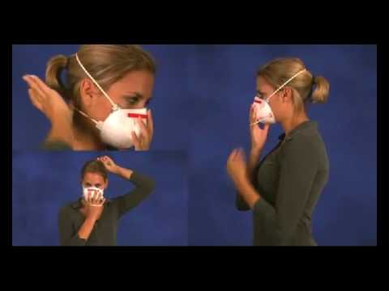
User seal check for N95 respirators
https://www.youtube.com/watch?v=pGXiUyAoEd8.

Slide 56
CDC Updates PPE Optimization Strategies
Alert facilities that updates have been made
Encourage review of guidance at https://www.cdc.gov/coronavirus/2019-ncov/hcp/ppe-strategy/index.html
Highlights:
  Extended use and limited re-use of facemasks
  “When no facemasks are available” guidance
  No resources for Crisis/Alternative Strategies for N95s
  Option for reprocessing eye protection
  Strategies to Allocate Ventilators from Stockpiles to Facilities
  Additional crisis strategies for gowns, including “when no gowns are available”
Notes:
We just want to alert people that the CDC has updated their PPE Optimization Strategies. Some highlights are included here. It is worth reading to see if this gives facilities any new ideas, but frankly catches CDC up to what has been under discussion in Nebraska for awhile- including strategies from NETEC and Nebraska Medicine.

Slide 57
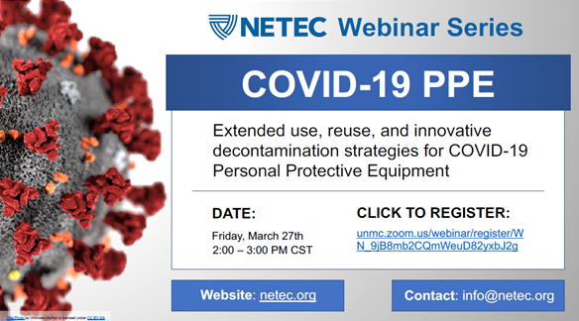
Registration link: https://unmc.zoom.us/webinar/register/WN_9jB8mb2CQmWeuD82yxbJ2g

Slide 58
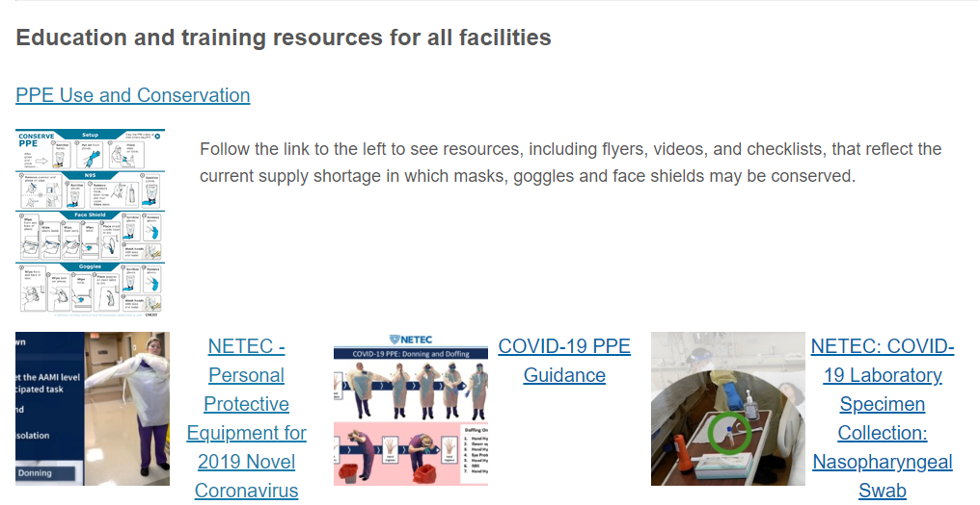
https://repository.netecweb.org/exhibits/show/ncov/ncov
Notes:
NETEC offers excellent training resources on COVID-19 PPE use, as well as conservation

Slide 59
Thanks to NM procedure sharing
https://www.nebraskamed.com/sites/default/files/documents/covid-19/surgical-mask-policy-and-faq-nebraska-med.pdf
For pictures on how to lay out mask on a paper towel go to above website

Slide 60
Resources (as of 8:00am 3/30/20)
Exposure Risk Assessment
https://www.cdc.gov/coronavirus/2019-ncov/hcp/guidance-risk-assesment-hcp.html
Guidance for pregnant and breastfeeding mothers
https://www.cdc.gov/coronavirus/2019-ncov/need-extra-precautions/pregnancy-breastfeeding.htmll
Guidance for PPE
https://www.cdc.gov/coronavirus/2019-ncov/hcp/ppe-strategy/index.html
  Regarding use of homemade masks
  https://www.cdc.gov/coronavirus/2019-ncov/hcp/ppe-strategy/face-masks.html

Slide 61
Presentation prepared by: Dr. Maureen Tierney and Dr. Tom Safranek
HAI/AR Epidemiologist
Ishrat.kamal-ahmed@Nebraska.gov
402-471-2937

