Slide 1
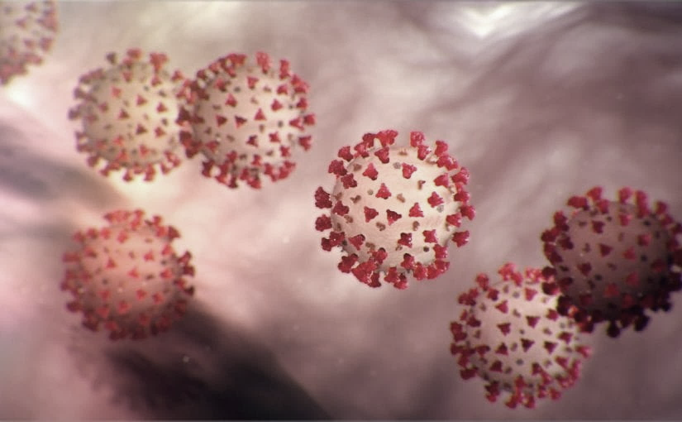
Covid-19 Webex Update on ACH for COVID-19 6-3-20
Tom Safranek, MD, State Epidemiologist
Louis Safranek, MD, PhD,
Board certified specialist, Infectious Disease

Slide 2
Thank you for joining us!
Slides and recording of today’s presentation will be available at
https://www.nebraskahospitals.org/coronavirus-covid-19-information.html
Scroll to the bottom of the page

Slide 3
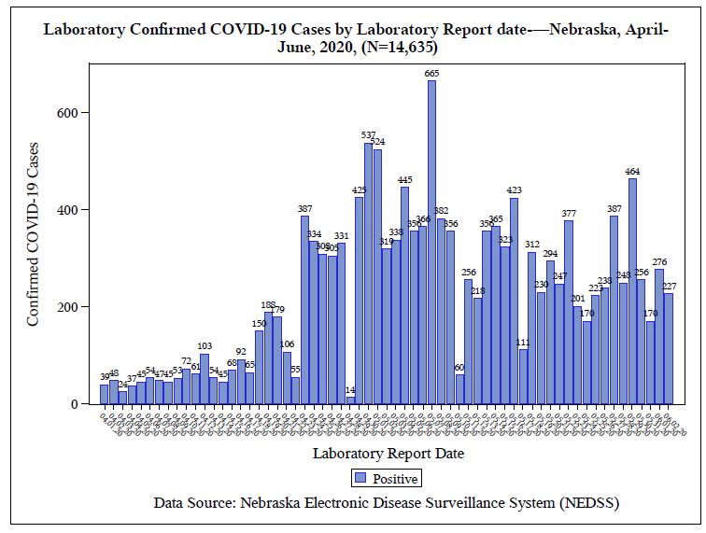

Slide 4
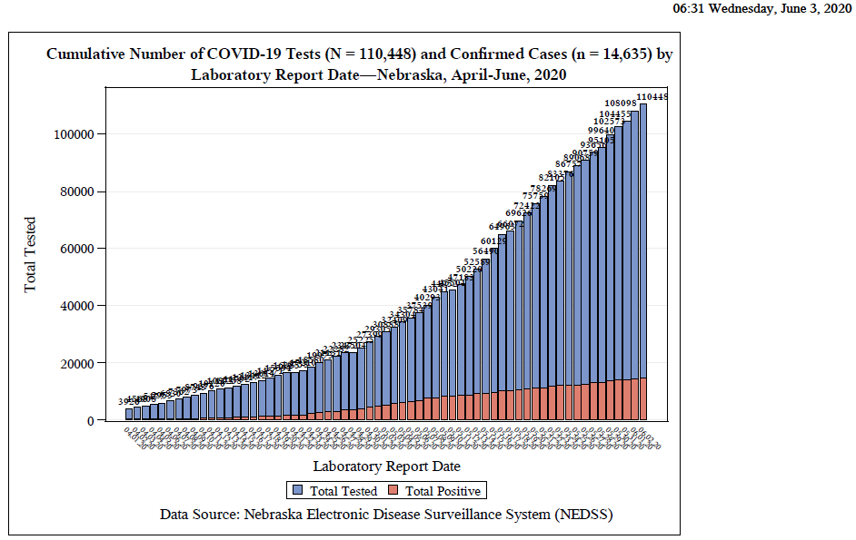

Slide 5
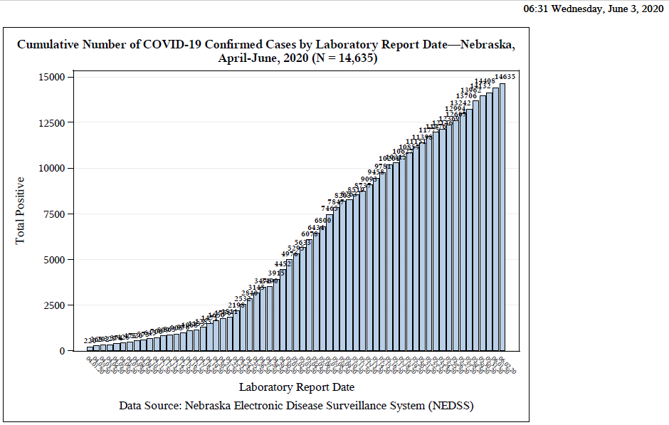

Slide 6
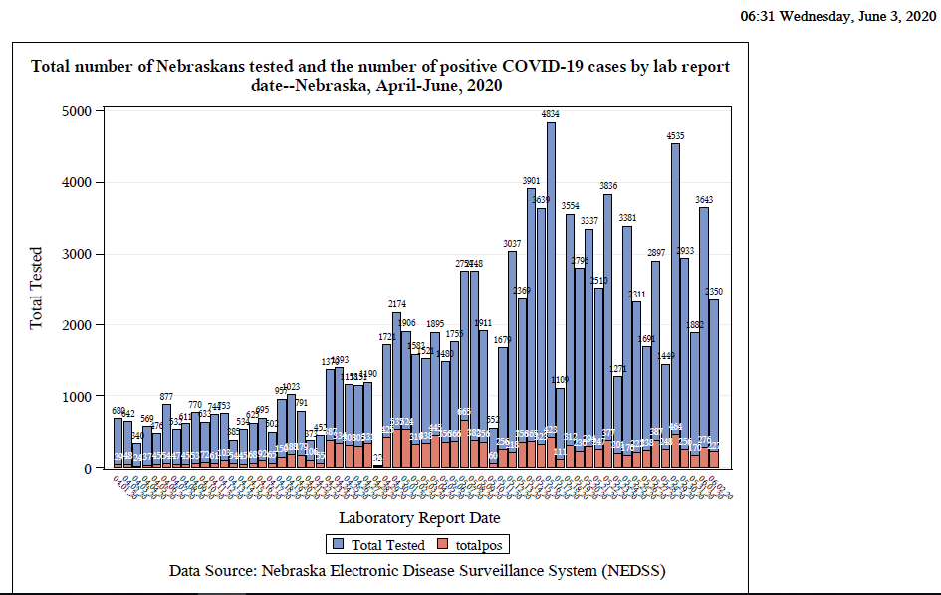

Slide 7
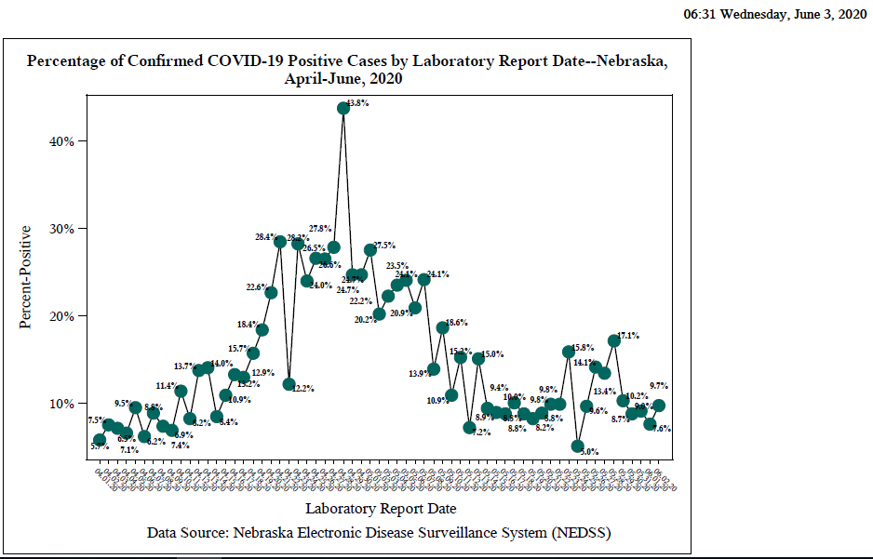

Slide 8
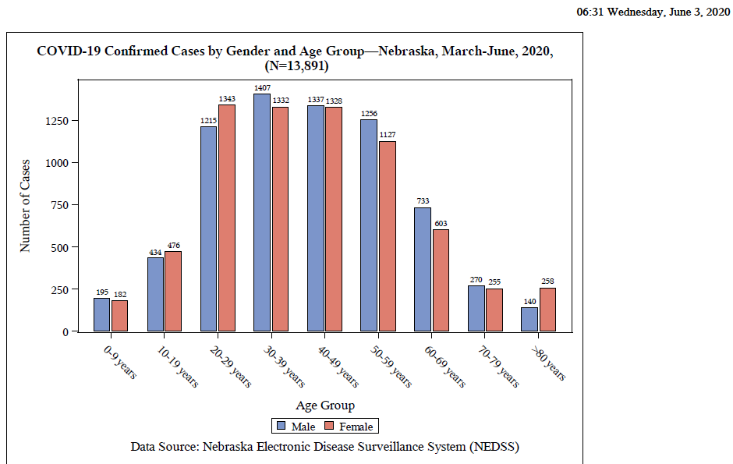

Slide 9
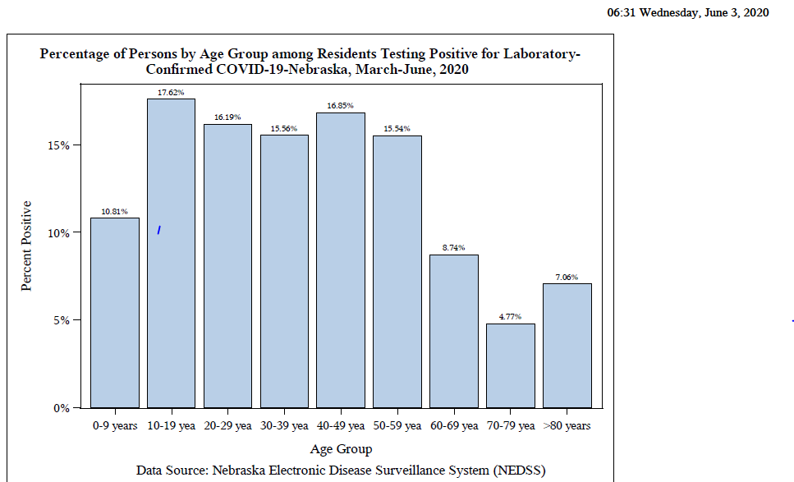

Slide 10
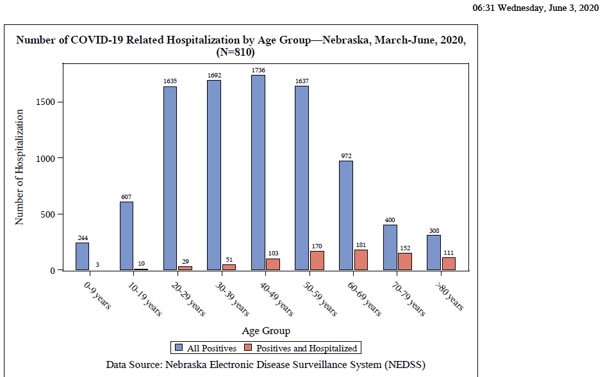

Slide 11
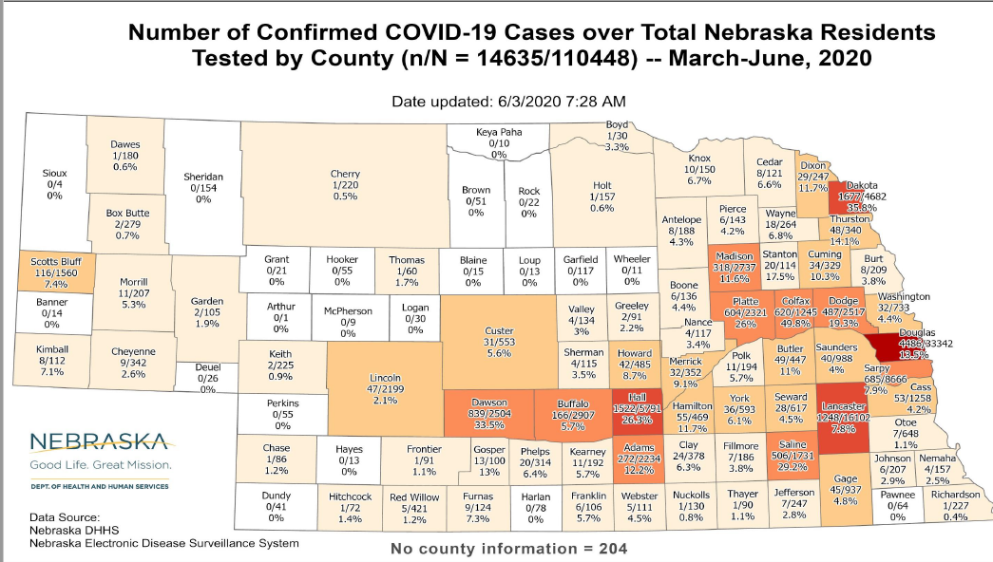

Slide 12
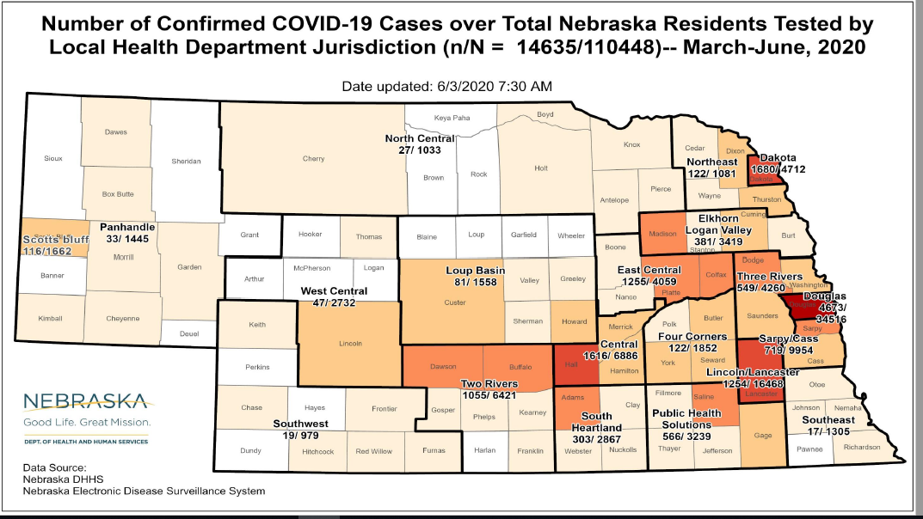

Slide 13
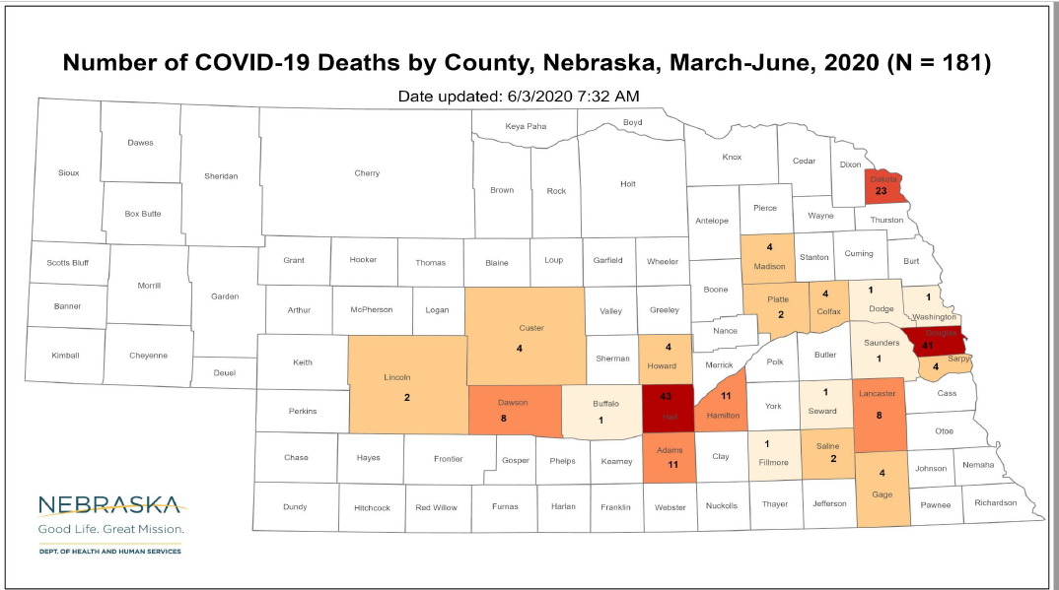

Slide 14
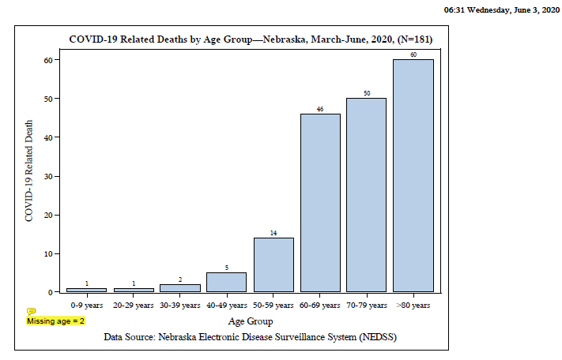

Slide 15
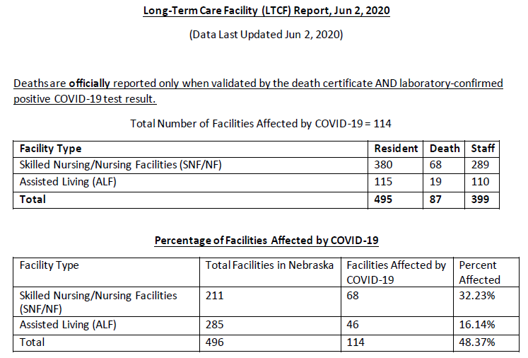

Slide 17
Do superspreaders exist?
Does a falling tree make a sound if no one is listening?
A “superspreader” can exist only if surrounded by many people who can be infected.
The spreader will encounter many people if he is within a large group. These groups often occur within confined spaces in which groups come together for prolonged periods.

Slide 18
Superspreaders?
Even a “regular” spreader may become a “superspreader” in an appropriate space where many attendees are confined for an extended period. In such a space, the viral load may progressively increase during the course of the gathering, causing naïve individuals themselves to encounter a high viral load.

Slide 19
Does intensity of exposure matter?
Pattern of Exposure and Measles Mortality in Senegal
Fatality was associated with degree of exposure to index case: highest for those living in the same hut, lower for those living in the same household but not in the same hut, lowest for those living in the same compound but not in the same household or hut. Case fatality rate mounted as the epidemic intensified.
JID 161:1088ff.

Slide 20
Does intensity of exposure matter?
Varicella Zoster in Guinea-Bissau: Intensity of Exposure and Severity of Infection
Incubation period, number of pox, magnitude of fever, and incidence of pneumonia were related to intensity of exposure (index case in household vs secondary cases, number of infected individuals in the household.
Pediatric Infectious Disease 24:102-107

Slide 21
Does intensity of exposure matter?
Intensive Exposure as a Risk Factor for Severe Polio: A Study of Multiple Family Cases
Retrospective study of 429 polio cases in Denmark
“A short incubation period is associated with severe disease and a prolonged incubation period with milder infections. Furthermore, intensive exposure from being infected within the household increased severity. These observations therefore suggest that intensity of exposure and dose of infection are important factors in the severity of poliomyelitis. “

Slide 22
Are superspreaders vampires, creating yet more superspreaders
If intensity of exposure leads to more severe disease, acquisition of a high dose of virus in a superspreading encounter may lead to a more severely infected person who themselves may be more likely to generate a superspreading encounter.

Slide 23
Evidence for the importance of intensity of exposure in Covid-19
Outbreaks associated with numerous cases and fatalities have been documented in nursing homes, prisons, packing houses, church choirs and additional confined settings occupied by many people for extended periods of time.

Slide 24
Intensity of infection matters
In a study by Liu et al., patients were stratified by severity of illness at presentation.
Viral load in nasal swabs was measured
The mean viral load of severe cases was found to be around 60 times higher than that of mild cases, suggesting that higher viral loads might be associated with severe clinical outcomes.
Lancet Infect Dis. 2020; pii: S1473-3099(20)30232-2. doi: 10.1016/S1473-3099(20)30232-2.

Slide 25
How can we reduce the intensity of exposure?
Face masks
Minimize large gatherings in enclosed spaces
Social distancing
Eye protection, surface sterilization

Slide 26
Face masks do make a difference!
Visualizing Speech-Generated Oral Fluid Droplets with Laser Light Scattering
https://www.nejm.org/doi/full/10.1056/NEJMc2007800

Slide 27
Face masks make a difference
Cochrane review from 2011:
Physical interventions to interrupt or reduce the spread of respiratory viruses
Review of 67 studies.
“Surgical masks or N95 respirators were the most consistent and comprehensive supportive measures. N95 respirators were non-inferior to simple surgical masks but more expensive, uncomfortable, and irritating to skin.

Slide 28
Surgical masks vs N95
Effectiveness of N95 Respirators Versus Surgical Masks in Protecting Health Care Workers From Acute Respiratory Infection: A Systematic Review and Meta-Analysis
Although N95 respirators appeared to have a protective advantage over surgical masks in laboratory settings, our meta-analysis showed that there were insufficient data to determine definitively whether N95 respirators are superior to surgical masks in protecting health care workers against transmissible acute respiratory infections in clinical settings
CMAJ. 2016 May 17; 188(8): 567–574.

Slide 29
Face masks make a difference
“Hand hygiene and risk of influenza virus infections in the community: A systematic review and meta-analysis”
“The combination of hand hygiene with facemasks was found to have statistically significant efficacy against laboratory confirmed influenza while hand hygiene alone did not.
Epidemiol. Infect. 2014 12:922

Slide 30
Face masks on the infected patient
“Surgical face masks worn by patients with multi-drug resistant tuberculosis”
Experience on MDR-TB ward in South Africa with evaluation of guinea pigs breathing ward air
“Surgical face masks on patients with MDR-TB significantly reduced transmission from infectious patients”
Am J Respir Crit Care Med 185:1104-1109 (2012)

Slide 31
Face masks are effective for Covid-19
“Physical distancing, face masks, and eye protection to prevent person-to-person transmission of SARS-CoV-2 and COVID-19”
Physical distancing of at least 1 meter, and ideally 2 or more meters is useful, as is eye protection.
“Face mask use could result in a large reduction in risk of infection.”
Lancet June 1, 2020

Slide 32
Masks are working in Hong Kong
“The role of community-wide wearing of face mask for control of coronavirus disease 2019 (COVID-19) epidemic due to SARS-CoV-2”
Hong Kong adopted community wide wearing of masks at the outset of the epidemic.
Compliance was 97%.
The COVID-19 incidence was significantly lower than that of other countries/communities worldwide.
11 COVID-19 clusters occurred in recreational mask-off settings vs 3 clusters in workplace mask-on settings.

Slide 33
Hong Kong Experience
“We believe that it is still advisable to encourage people to wear face masks in the public….Moreover, wearing a cloth mask with less filtration efficiency may still be better than no mask at all in communities of high transmission.”
J. of Infection Cheng et al., 2020

Slide 34
Experimental findings on masks
“Surgical mask partition reduces the risk of non-contact transmission in a golden Syrian hamster model for coronavirus disease 2019 (COVID-19)
COVID-19 infected hamsters were placed in cages adjoining uninfected hamsters with no direct contact. When a surgical mask was placed between the cages, spread of infection was diminished and delayed and severity of infection reduced.
CID

Slide 35
Reflections
“Stupidity always carries doggedly on, as people would notice if they were not always thinking about themselves. In this respect, the citizens of Oran were like the rest of the world, they thought about themselves, in other words, they were humanists: they did not believe in pestilence. A pestilence does not have human dimensions, so people tell themselves that it is unreal, that it is a bad dream which will end. But it does not always end and, from one bad dream to the next, it is people who end, humanists first of all because they have not prepared themselves.”
Camus, The Plague

Slide 36
Droplets and Aerosols in the Transmission of SARS-CoV-2
Aerosols from infected persons may therefore pose an inhalation threat even at considerable distances and in enclosed spaces, particularly if there is poor ventilation. The possible contribution of infective aerosols to the current pandemic suggests the advisability of wearing a suitable mask whenever it is thought that infected persons may be nearby and of providing adequate ventilation of enclosed spaces where such persons are known to be or may recently have been.
Matthew Meselson, Ph.D. Harvard University, Cambridge, MA
N Engl J Med 2020; 382:2063

Slide 37
