Slide 1

Maximizing Advertising Budgets
for Critical Access Hospitals

Slide 2





















Who We Are
Critical Marketing, a branch of Flood Communications is a local medical marketing agency specializing in serving Critical Access Hospitals.

Slide 3
Who We Are
Critical Marketing, a branch of Flood Communications is a local medical marketing agency specializing in serving Critical Access Hospitals.
We have a unique understanding of the healthcare landscape; providing tailored marketing and advertising strategies that not only bring in new patients but also enhance engagement with the current ones, as well as past patients.
Our team delivers comprehensive marketing solutions that spotlight your offerings across multiple channels and platforms, integrating a variety of strategies to help achieve your business objectives.
AND THE BEST PART IS…
We specialize in reimbursable marketing plans to maximize your advertising dollars, enabling you to invest more effectively in expanding your reach and impact.

Slide 4

FACT:
Most Critical Access Hospitals Are NOT
Getting Properly REIMBURSED
For Marketing Expenses

Slide 5
WHY:
Many do not know it is available
Not understanding what is allowable vs. nonallowable for advertising costs
Do not have the time and resources to research and fully understand how to execute
Fearing the risk of marketing expenses not being approved by Medicare

Slide 6
HOW:
To be successful at this on your own, you will need:
Time
Knowledge
Ad Design Team
Legal Support
Centers for Medicare & Medicaid Services (CMC)
Outlines costs related to Patient Care in the Provider Reimbursement Manual

Slide 7



HOW:
Centers for Medicare & Medicaid Services (CMC)
Outlines costs related to Patient Care in the Provider Reimbursement Manual
It’s best to work with a company that specializes in understanding allowable costs, and one that is backed by legal support.

Slide 8






OFFERING A FULL MARKETING APPROACH
The Right Time | The Right Place | The Right Person
Hospitals across the nation are consistently seeking strategies to reduce costs, enhance profitability, and improve patient experiences. With Critical Marketing, our team of experts are dedicated to maximizing advertising budgets for Critical Access Hospitals with simple, pre-made plans, easy reimbursement methods that go on your cost reports, and legal support.
We amplify your brand by creating high-quality content that grabs attention, establishing you as the trusted source and thought leader in healthcare. By leveraging demographic data, browsing trends, and search behaviors, we put you in front of your target audience at the right place and time.
Branding & Public Image
Informational Marketing
Recruitment Strategies
Data Analysis & Reporting

Slide 9
When Designing Ad Creative:
Ads should be focused on presentation of a good public image and related to patient care.
Ensure the ad contains general information about the provider.
Ads directed solely to educating patients.
Ensure the ad is deployed in a targeted manner.

Slide 10
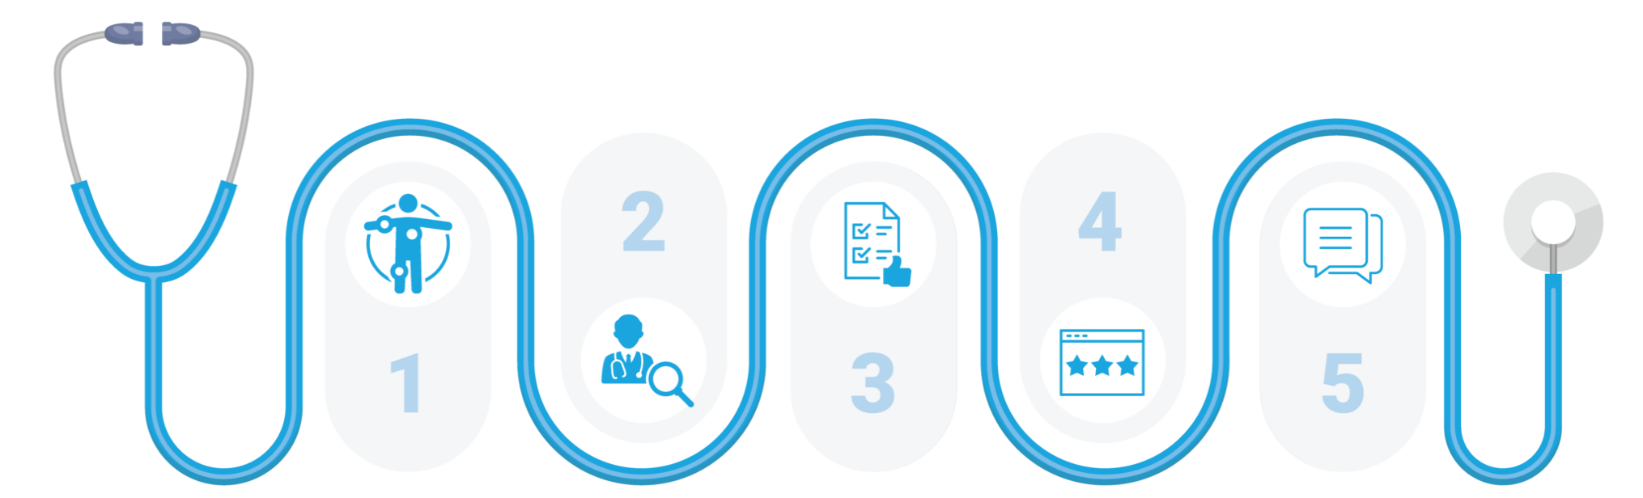
You Want to Own the Patient Journey
The healthcare industry is constantly changing…
and so are the ways that patients find new providers and facilities.
It’s vital that you find multiple ways to get in front of your target patients.
Googling
Symptoms
Hospital
Website &
Social Pages
Reading
Reviews
Testimonies,
Asking
Others
Searching
Options/
Reading Content
That’s where digital targeting comes into play.

Slide 11
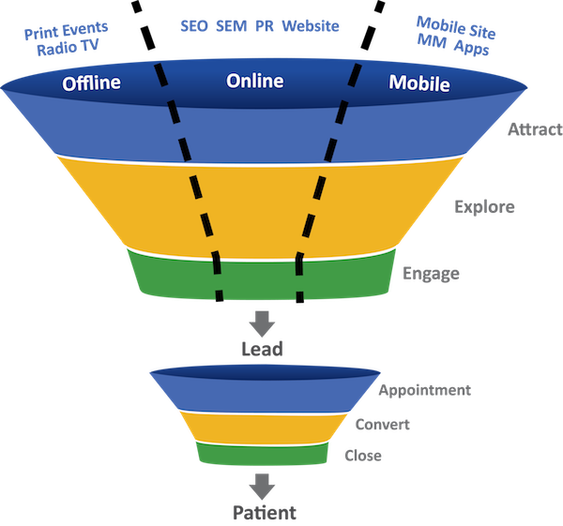
DIGITAL TARGETING
Digital targeting plays a significant role in attracting, engaging, and retaining patients.
The right digital content can help build trust, establish credibility, and position your healthcare organization as a thought leader in the industry.

Slide 12
DIGITAL TARGETING
WHY IS
TARGETED ADVERTISNG
BASED ON
DEMOGRAPHICS
AND BEHAVIOR
BENEFICIAL?

Slide 13
DIGITAL TARGETING
DEMOGRAPHICS
Audience Segments can help get one step closer to reaching those you believe are a potential patient.
Plus, these ads can inspire interest among these audiences even before there is intent.

Slide 14

DIGITAL TARGETING
DEMOGRAPHICS
Age
Education
Ethnicity
Gender
Language
Income Level
Occupation
Residence
New Movers
Interests & Hobbies
Life Events
Household Composition
Presence of Children & Ages
*When working with us, we have over 500 Demographic variables to choose from!

Slide 15
DIGITAL TARGETING
HOWEVER:
WHEN YOU TRY TO REACH YOUR AUDIENCE
SOLEY ON DEMOGRAPHICS
YOU RISK MISSING
MORE THAN 60%
OF POTENTIAL PATIENTS

Slide 16

DIGITAL TARGETING
Knowing what interests a person
BASED ON THEIR BEHAVIOR
is just as much if not more valuable than knowing WHO they are.

Slide 17



DIGITAL TARGETING
BEHAVIOR
Search/Keyword Targeting By leveraging keyword tracking solutions, you can target those searching for or reading related content online to what you provide.
Site Retargeting gives you the ability to retarget ads to users that have engaged with you before online, such as those viewing your contact page, your hospital services page, or went to your career tab to learn more about your facility.
Geofencing/Event Targeting leverages a virtual boundary around a specific location to target people in that zone using GPS. For example: Targeting those who are attending a health fair, career fair, or walking into a specific business location. This is a very powerful way to ensure you are reaching specific audiences in your service areas.
*When using our services, we are HIPAA and COPPA-compliant.
.

Slide 18

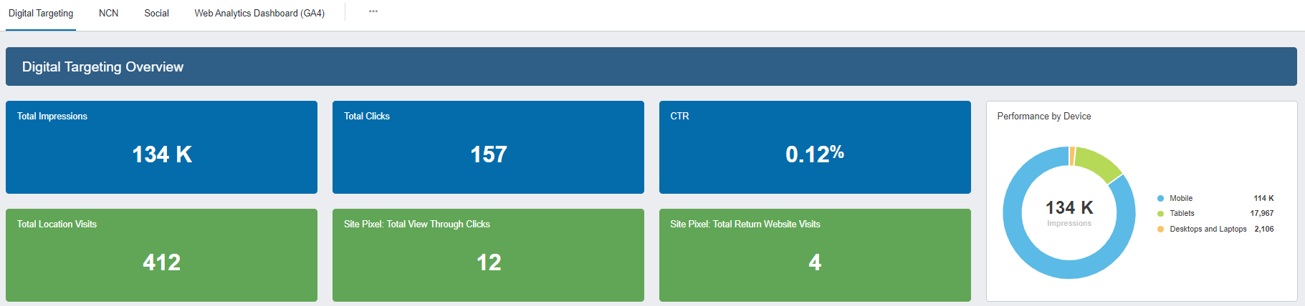
DIGITAL TARGETING
WHAT CAN BE MEASURED/REPORTED
Ad Impressions delivered
Clicks & Click-through-rate
View Throughs & Return Website Visits
Walk-in Conversions into your Facility

Slide 19
DIGITAL TARGETING
Say I am searching for Nursing Jobs online…
WHAT THEN? WHAT HAPPENS?

Slide 20
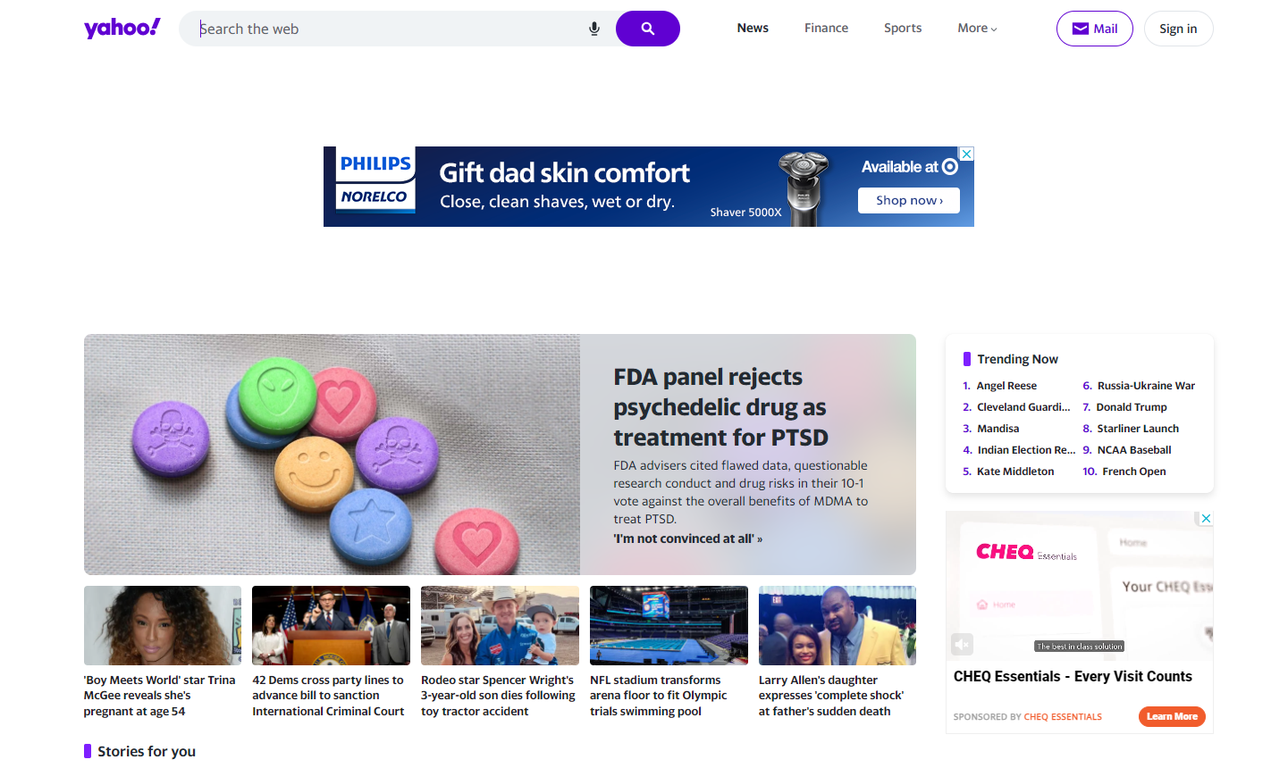


AD PLACEMENT EXAMPLES

Slide 21
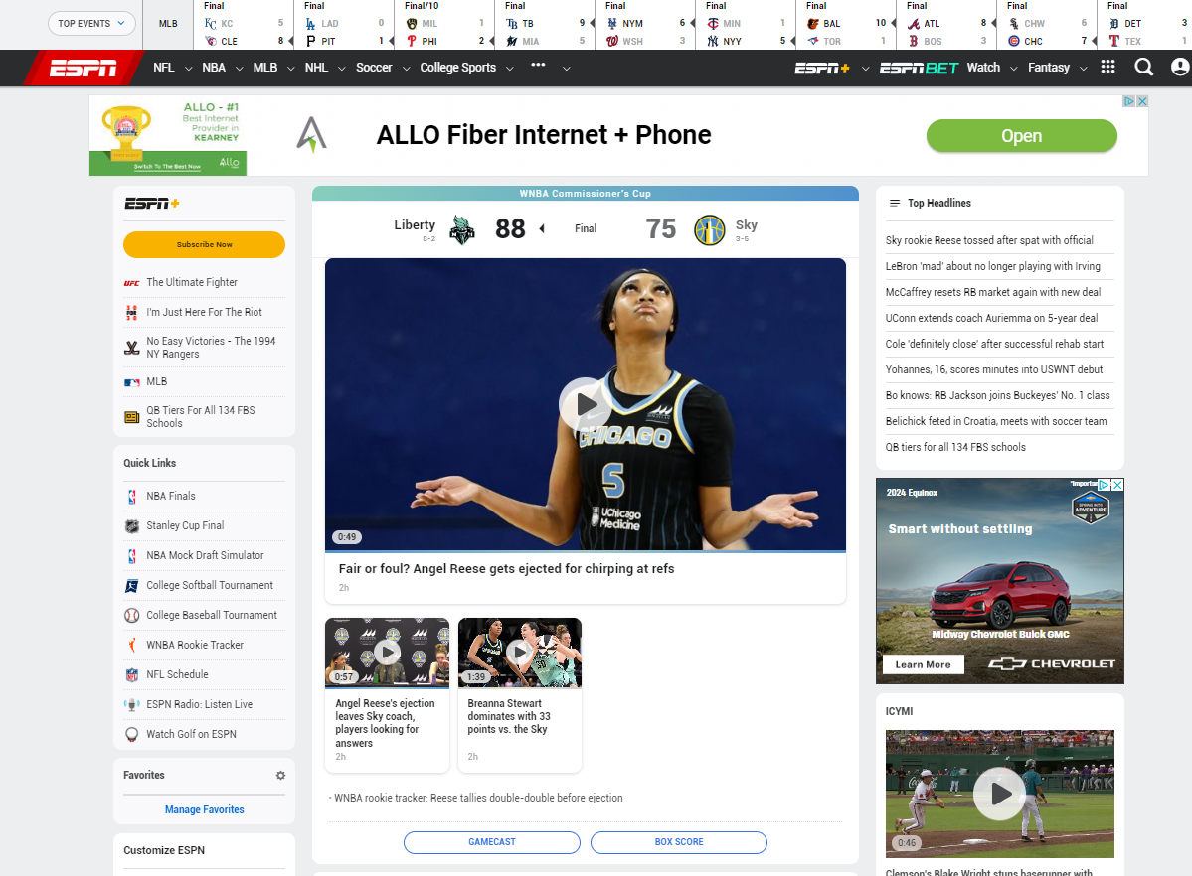
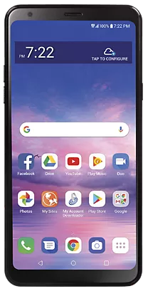
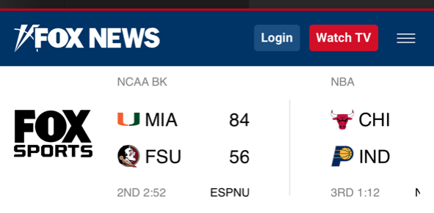

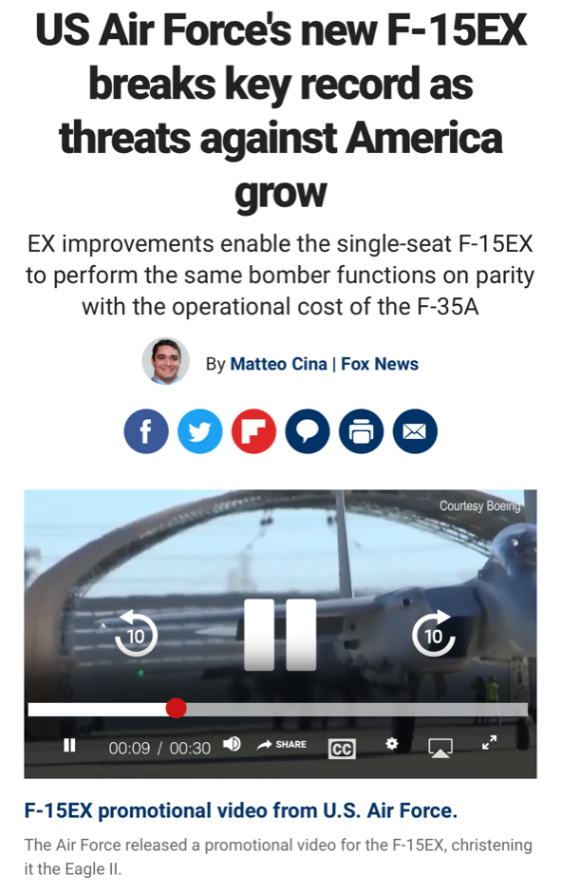

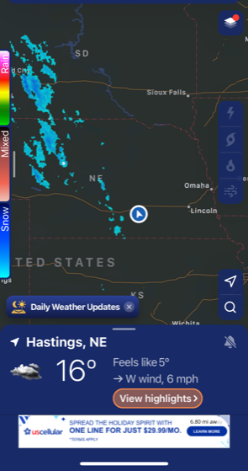
AD PLACEMENT EXAMPLES

Slide 22
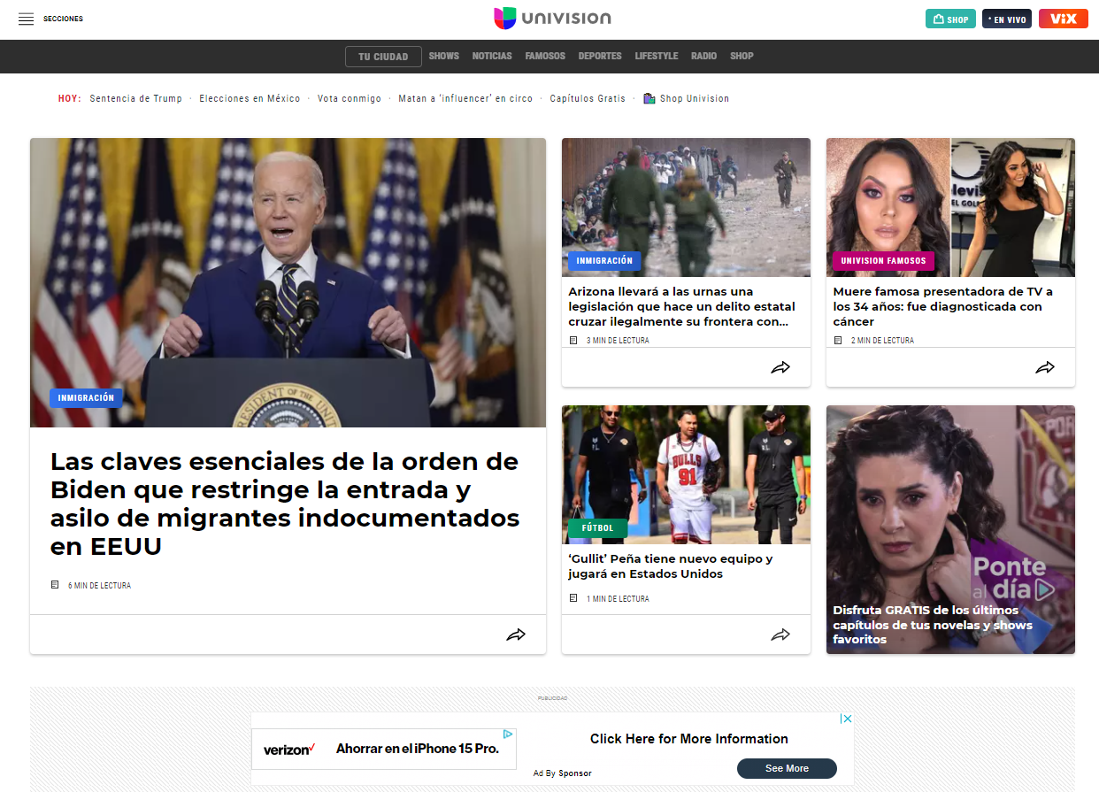
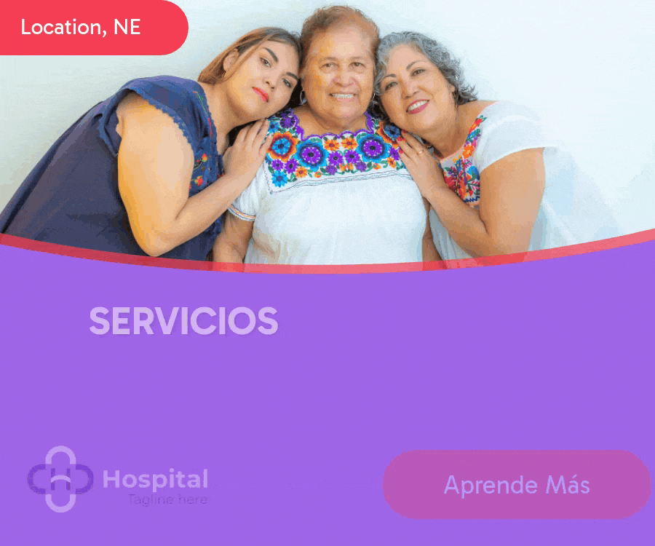

SPANISH AD PLACEMENT EXAMPLES

Slide 23
IMPORTANCE OF GOOD AD DESIGN
The Creative can be the most influential element of a successful or failed ad campaign.
Creative is that important!
Your Messaging Should:
Have a Powerful Message
Use Keywords
Keep It Simple ( Less is more)
Have a Clear Call-to-Action
Show of the Brand with Coloring and Logo
Keep it Fresh (Even if you run the same message for a while, change the look of the ad)

Slide 24
HOW TO JUDGE SUCCESS
What is Your Goal?
Generate More Website Visits?
Gain More Social Media Followers?
Get More Foot Traffic Through the Door?
Reach a Specific Area?
Reach a Specific Demographic?
Develop Brand Awareness?
Make sure your ad campaign is not only the right message, but it is delivered to the right person, at the right place and time.

Slide 25



HOW WE CAN HELP
Treat you as a collaborative partner, where we are both mutually invested in achieving success.
Provide clients with integrated digital and traditional marketing services.
Proactive in the healthcare industry by offering Critical Access Hospitals with cost saving strategies.
Offer our Experience & Expertise
Simple Invoicing for Reimbursements
Strategic Marketing Plans
Supported by Legal Counsel

Slide 26
MULTIPLE CATEGORIES
GENERAL HEALTH
WOMEN’S HEALTH
PUBLIC IMAGE
Flu Shot
Health Screening
Preventative Care / Wellness
Nutritional and Dietary Counseling
Diagnostic Imaging/Radiology
Colonoscopy
Mental Health Services
Behavioral health
Diabetes Awareness
Internal Medicine
Sports Physicals
Lab Wellness Clinics
General
Obstetrics
Breast Cancer
Mammograms
Imaging
Gynecology
Wellness Checks
Menopause Care
Urogynecology
Hormone Replacement Therapy
Plastic Surgery
Reproductive Health
Hormones / endocrinology
Branding (critical access hospital)
Emergency Service
Location Marketing
Acute Care
Pharmacy
ER
Business Office
Assisted Living
Long Term Care
Walk-in Clinic
Years of Service Awards
Caring Kind
Home Health
PHYSICAL THERAPY
SPECIALTY
ORTHO
RECRUITMENT
General
Pediatric
Geriatric
Cardiovascular
Pre & Post-Surgery Therapy
Pain Management
Occupational Therapy
Speech - Language Therapy
Sports Medicine
General Surgery
Cardiology
ENT/Audiology
Dermatology
Vascular/Wound
Pediatrics
Endoscopy
Pain Management
Podiatry
Pulmonology
Oncology
Ophthalmology
Spine/Back Surgery
Urology
Allergy & Immunology
Eye Surgery
Rheumatology
General
Sports Medicine
Spine
Hip & Knee
Shoulder & Elbow
Foot & Ankle
Nurses (RN, LPN, Nurse Practitioners)
Physicians
Radiology (X-ray tech)
Pharmacists
Therapists (Physical, Occupational, Speech)
Lab Technicians
Administrative & Management
ELDERLY
Memory Care
Diabetes Education
Dietary
Home Health (Hospice)

Slide 27
The Cost of Getting it Wrong
Without Our Services:
Advertising costs are deemed non-allowable = No reimbursement for these costs.
Recoupment of any funds previously reimbursed.
Potential for audit of prior cost reports.
Expenses associated with audit (time/resources, administrative costs, legal fees, etc.).
Costs incurred in connection with appeals.

Slide 28
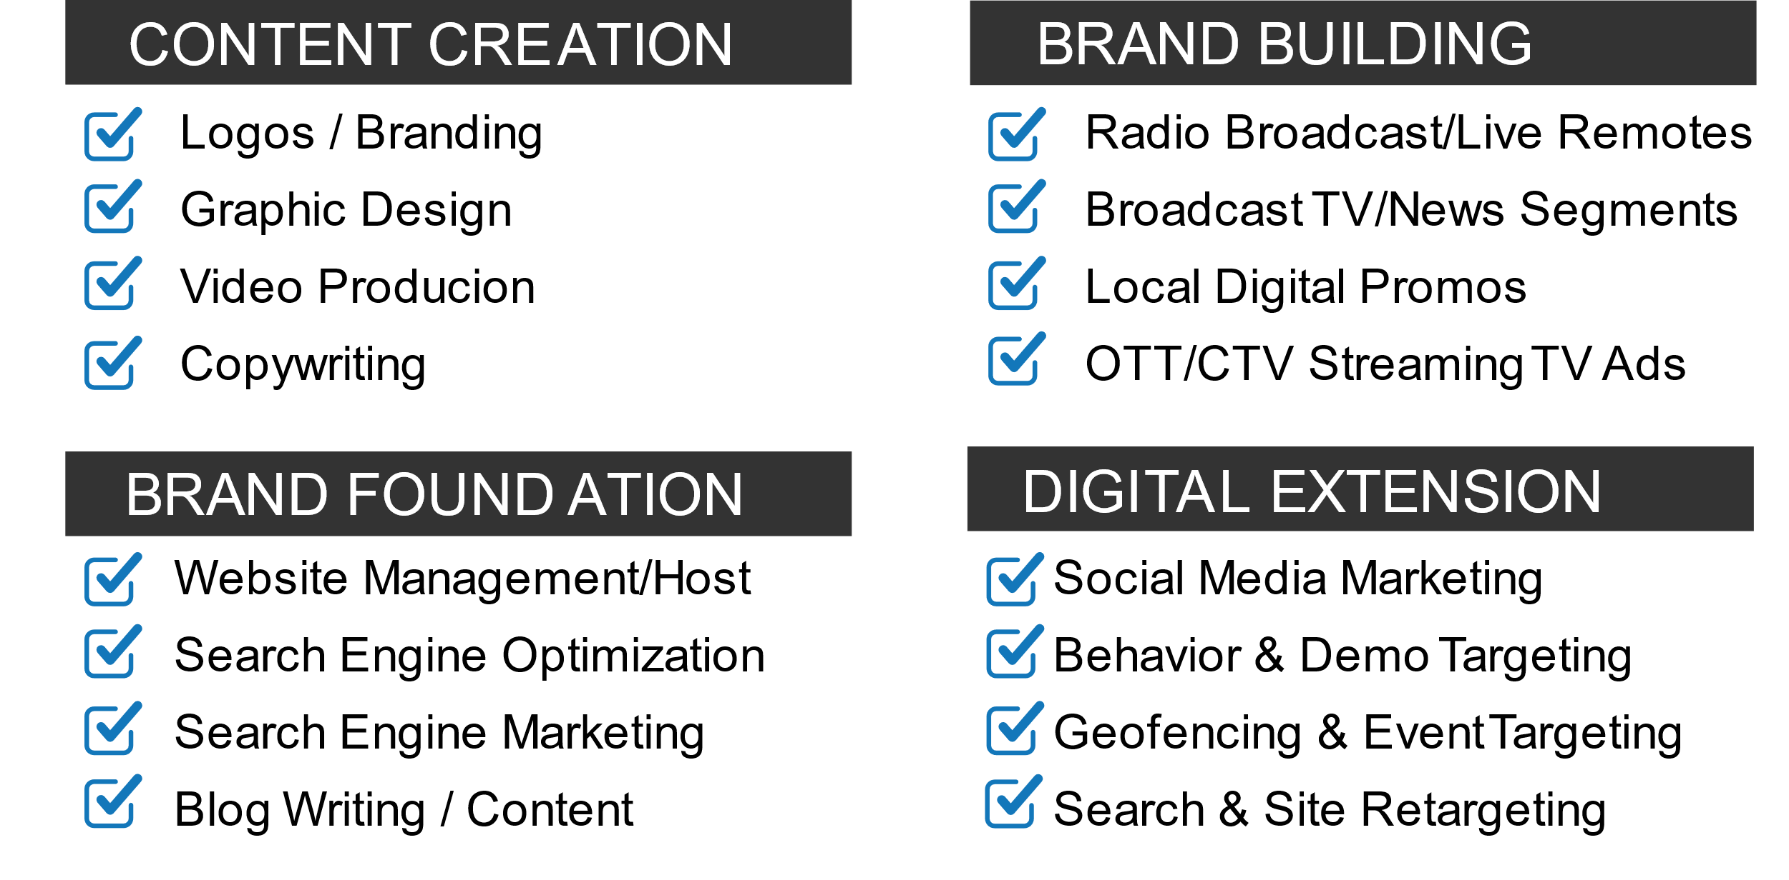
ADDITIONAL MARKETING SERVICES

Slide 29








OFFERING A FULL MARKETING APPROACH
The Right Time | The Right Place | The Right Person
Content Writing
Regularly posting relevant, high-quality content in the form of blogs on your website shows Google that you are an authority in your market.
Keyword Search Ads
Leveraging our keyword tracking solutions, we can target those searching for or reading about related content to what you offer online in multiple languages.
Geofencing
Leverage a virtual boundary to target people in a specific area with GPS. This a very powerful way to ensure we are reaching future customers.
Local Broadcast
Large local reach on Radio and TV. (Offering Radio ads, live radio remotes, local tv commercials and branding news segments, digital ads on local news platforms)
Captivating Graphics
Creating attention grabbing, personalized messages that carries the brand across all channels to create cohesion. (logo’s, info graphics, flyers, brochures etc.)
Website Retargeting Ads
We can capture those visiting your website, which gives us the ability to retarget to future patients that have engaged with you before online.
Addressable Household Geo-Fencing
Target specific audiences in zip codes you choose, with over 500 demographic and interests' variables.
OTT/CTV Streaming TV
Target video ads to specific audiences in specific areas on whatever device, channel, app, or network they are actively streaming.
Branding Videos
Capture your story, educate your audience and attract new customers by connecting with the viewer on a more intimate level.
Google Listing Ads
We get you in front of those doing Google searches at the top of search results by leveraging our keyword tracking and pay per click ad solutions.
CRM Targeting
Do you send out mailers or email blasts? Let us attract new customers and improve communication with existing ones by digitally targeting your current CRM list.
Social Media Ads/Posts
Social networks help you increase brand authority, trustworthiness, and engage. Let us help you create community connections.
(Facebook, Youtube, and LinkedIn)

Slide 30
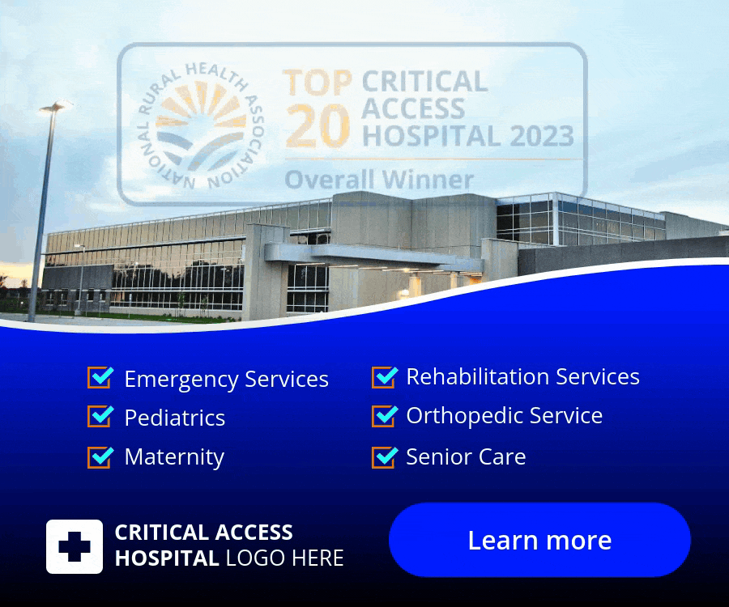


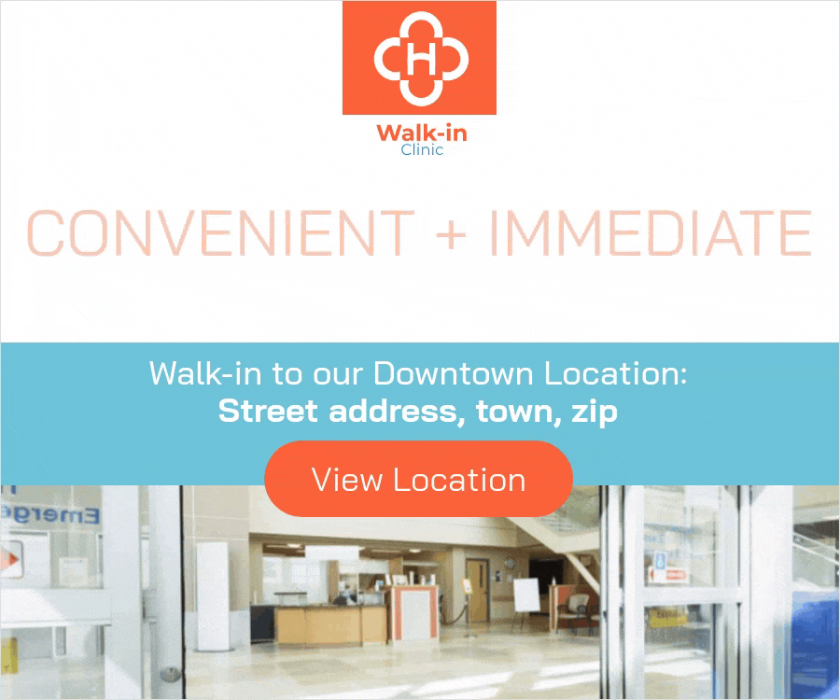

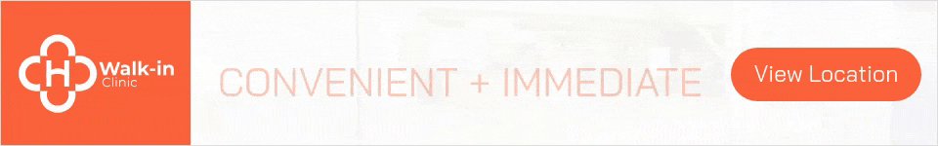
Allowable Ad Examples- Public Image

Slide 31







Allowable Ad Examples- Recruiting

Slide 32









Allowable Ad Examples- Informational

Slide 33






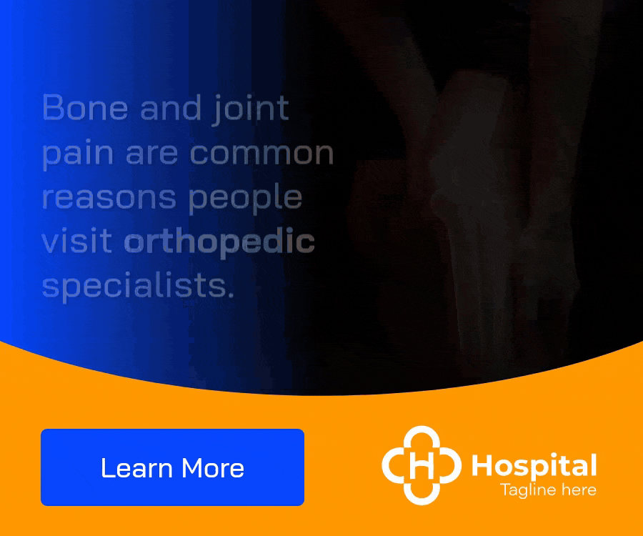
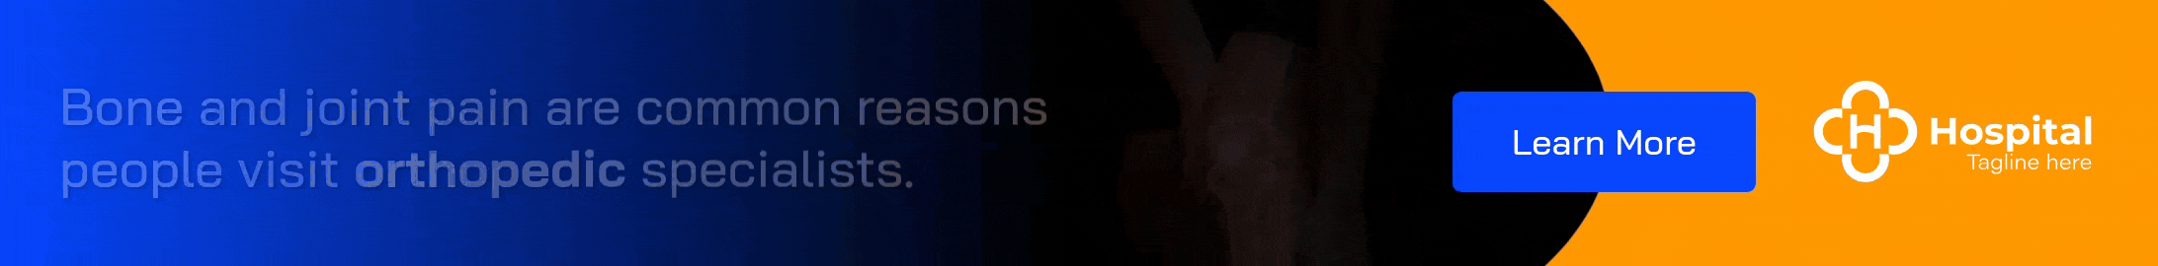

Allowable Ad Examples- Informational

Slide 34




Allowable Ad Examples- Hispanic

Slide 35
PLANNING THE MONTHLY STRATEGY
STEP 1 - Choose up to 3 campaign messages you would like to run for the month (Informational, Public Image, Recruiting)
-Our team can preselect your informational campaigns per month for you
STEP 2 - Tactic Development. Select target radius to reach, keywords, geofence locations and any other specifics for the campaign.
-Our team already has predetermined radius/keywords set for each campaign’s success; however, you can make changes as needed.
STEP 3 - Approval of Creative.
-We will provide ad copy with your branded logo and coloring for approval prior to campaign launch.
EXAMPLE AD TOPICS BELOW:
GENERAL HEALTH
WOMEN’S HEALTH
ORTHO
PUBLIC IMAGE
RECRUITMENT
Flu Shot
Health Screening
Preventative Care / Wellness
Nutritional and Dietary
Diagnostic Imaging/Radiology
Colonoscopy
Mental Health Services
Behavioral Health
Diabetes Awareness
Sports Physicals
General
Obstetrics
Breast Cancer/Mammograms
Imaging
Gynecology
Wellness Checks
Menopause Care
Urogynecology
Reproductive Health
Hormones / Endocrinology
General
Sports Medicine
Spine
Hip & Knee
Shoulder & Elbow
Foot & Ankle
Acute Care
Assisted Living
Branding-Critical Access
Caring Kind
Emergency Service
Event
Home Health
Intern Program
Location Marketing
Long Term Care
Pharmacy
Walk-in Clinic
Years of Service Awards
CNA
General Hiring
Lab Technicians
Nurses (RN, LPN, Nurse Practitioners)
Pharmacists
Physicians
Radiology (X-ray tech)
Support Roles(assistants, secretary, janitorial)
Therapists (Physical, Occupational, Speech)
SPECIALTY
Allergy & Immunology
Cardiology
Dermatology
Endoscopy
ENT/Audiology
General Surgery
Oncology
Pain Management
Pediatrics
Pulmonology
Respiratory Therapy
Urology
ELDERLY
PHYSICAL THERAPY
Extended Care
General
Memory Care
Home Health (Hospice)
General
Pediatric
Geriatric
Cardiovascular
Pre & Post-Surgery Therapy
Pain Management
Occupational Therapy
Speech - Language Therapy
Sports Medicine

Slide 36
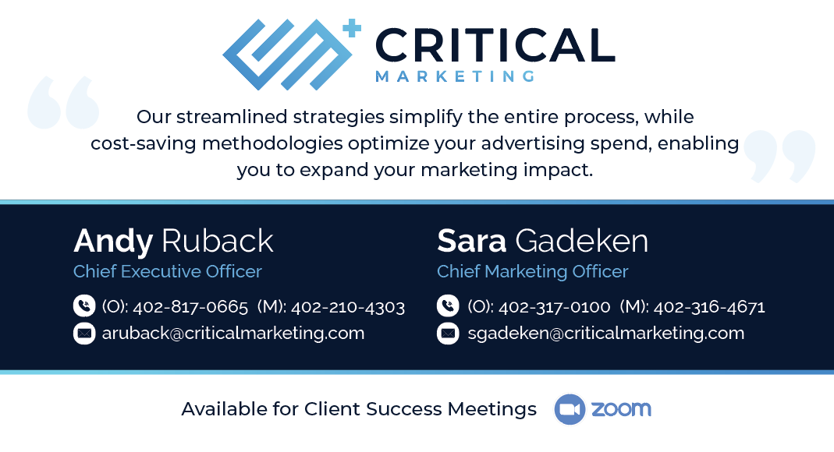
Contact

