Slide 1
Supporting Nebraskans with Applications for Long-Term Care
Nebraska Medicaid
Marnie Carr and Amanda Shannon
Social Service Supervisors
Medicaid & Long-Term Care

Slide 2
Today’s Discussion
Medicaid History and Overview
Medicaid Eligibility and Programs
Application Process
Designation of Authorized Representative vs Release of Information
Resource & Income Information
Renewal Information
Spousal Impoverishment
Notes:
Updated to list what the presentation is about

Slide 3
Medicaid History and Overview

Slide 4
What is Medicaid?
A jointly administered state and federal program that assists low-income, disabled, and other populations obtain health care
One of the State of Nebraska’s largest expenditures approx. $2 billion per year
Funding for Medicaid comes from both state and federal sources
Slightly over 50% comes from federal funds
Notes:
Source for budget: MLTC annual report 2021

Slide 5
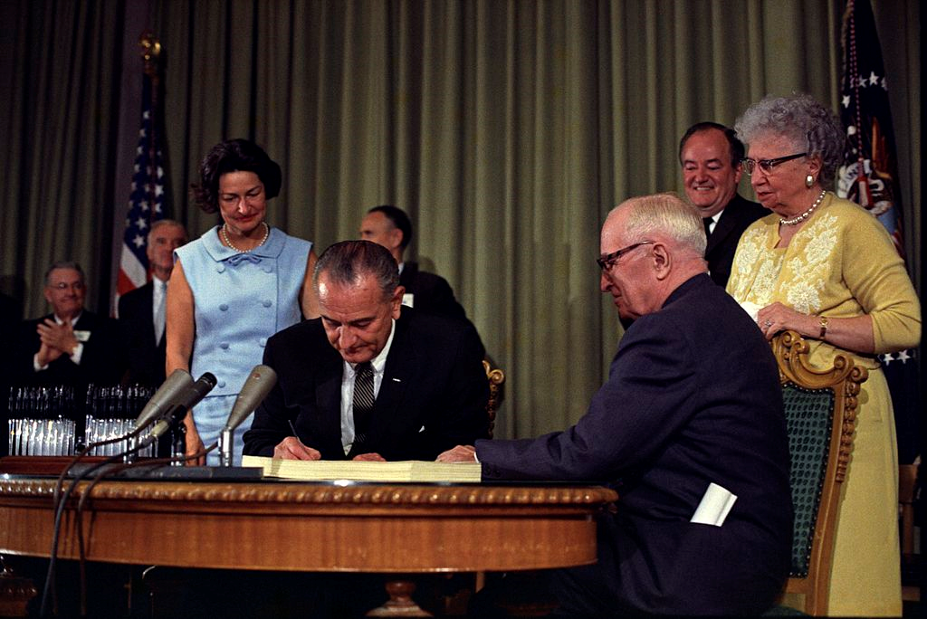
History of Medicaid
Created in 1965 via amendments to the Social Security Act of 1935
Title XVIII- Medicare
Title XIX- Medicaid
Patient Protection and Affordable Care Act (2010)
Increased funding to states for Medicaid and gave the states the option to expand Medicaid
About 76.5 million people on Medicaid nationally, vs 63.3 million on Medicare (source: CMS, July 2021)
Populations can overlap
Notes:
Enrollment numbers are average monthly enrollment nationally.
Source for enrollment figures: CMS fast facts, July 2020

Slide 6
Who is on Medicaid in Nebraska?
As of October 2022 there were 380,476 enrollees in Nebraska Medicaid- about 19 percent of Nebraska’s population
Children are more than half of enrollees (191,005)
The rest of the population is broken down accordingly:
Parents/Caretaker adults: 41,558
Aged: 21,643
Blind/Disabled: 36,802
Expansion: 76,091
Notes:
Source: Indicators Report
Form Facility Resident count of 4/4/23, 9872 total residents. 5721 are Medicaid and 4151 are non-Medicaid

Slide 7
Medicaid Expansion in Nebraska
In November 2018, Nebraska’s voters approved Initiative 427, extending Medicaid coverage to adults ages 19-64 who annually earn up to 138% of the federal poverty level
This is about $17,000 per year for an individual
In 2018, DHHS estimated about 90,000 people would be newly Medicaid eligible
In the past, low-income adults eligible for Medicaid either had to have children or have special medical needs
Adults may be eligible for Medicaid Expansion and in a facility.

Slide 8
Medicaid Eligibility and Programs

Slide 9
Primary Eligibility Requirements
Need to submit an application
Citizen of the United States
Nebraska Resident
Social Security Number
Let Medicaid know about household size
Assignment of Third Party medical payments
Income and Resource Requirements

Slide 10
Documents to provide
To complete an application there are a few documents to provide
Legal Documents (POA, Guardianship, Designation of Authorized Representative)
Immigration documents (if applicable)
Proof of income/resources
Pension Award Letter
Trust Documents
Bank statements, Investment statements
Real Property Deeds
Vehicle Titles
Current health insurance premiums
Notes:
Added to be more specific for LTC

Slide 11
How is Eligibility Determined?
Qualifications based on medical need are set in statute
Figures are for Aged and Disabled applicants
Income guidelines are based around the federal poverty level
Potential applicants can apply through our web portal, ACCESS Nebraska, via paper applications, or over the phone
Family Size | 2023 Income Numbers
For individuals | $14,580
For a family of 2 | $19,728
For a family of 3 | $24,864
For a family of 4 | $30,000
For a family of 5 | $35,148
For a family of 6 | $40,284

Slide 12
Many Ways to Qualify
This section of the presentation will touch on all the different ways someone could become eligible
There is a lot of detailed information about the program. Don’t worry about taking notes on every last detail – if you’re interested we can share this presentation for future reference
Social services workers at DHHS are ready to help those who are interested in applying navigate the process and find out how they may be eligible

Slide 13
Two Types of Medicaid: MAGI and Non-MAGI
MAGI- Modified Adjusted Gross Income
Eligibility for certain Medicaid programs are determined primarily by medical need, other programs are based primarily on income
MAGI programs include:
Children’s Medicaid
CHIP
Parent/Caretaker relatives
Pregnant women
599 CHIP
Hospital presumptive
Expansion
Non-MAGI programs include:
Aged, blind and disabled
Medicare Part B beneficiaries
Medically Needy
Transitional Medical Assistance
Former Foster Care
EMSA
Women’s Cancer Program
Notes:
Highlighted to discuss for LTC information

Slide 14
Aged, Blind, or Disabled
Age 65 or older
Anyone blind or disabled and receiving Social Security disability benefits
Disabled clients must be determined disabled by Social Security
Income guideline is 100 percent FPL
Clients can have private health insurance alongside Medicaid
Resource limit is $4,000 for one person, $6,000 for two
Notes:
[Source: ADRC ppt in external comms]

Slide 15
Medicare Premium Payment and MIWD
State of Nebraska will pay the Medicare premium for certain recipients. Medicaid eligible receive their Medicare premium paid.
Income under 135% FPL
Higher Resource and Income level Medicare payment programs are:
Medicare Savings Program (100% FPL / $9,090 for 1 / $13, 630 for 2) These clients may have a Share of Cost and State of Nebraska pays Medicare premium.
Specified Low Income Medicare Beneficiary (120% FPL / $4,000 for 1, $6,000 for 2)
Qualified Medicare Beneficiary and Medicare Savings Program (135% FPL / $9,090 for 1 / $13,630 for 2 )
Medical Insurance for the Working Disabled (200% FPL)
Disabled
Employed
Notes:
Slide added to talk about Medicare Premium payment and MIWD

Slide 16
Questions?

Slide 17
Application Process
Applications can be completed a variety of ways:
Call Customer Service Center:
Toll Free: 855-632-7633
From Omaha: 402-595-1178
From Lincoln: 402-473-7000
TDD: (402) 471-7256
Online:
iServe.Nebraska.gov
Paper application:
Search in public forms site: https://public-dhhs.ne.gov/forms
MILTC-64, Application for Nebraska Medicaid for Aged and Disabled
OR
MILTC-53, Medicaid and Insurance Affordability
and MILTC-51 for each additional person in the household.
Notes:
Review the new iServe site – how it’s a one app for many programs which may be beneficial if you have clients discharging home and may need help with meals, etc if they are not already getting it.
Note for paper application the MILTC-64 is preferred, as it reviews everything. For non-aged or disabled clients, they can do the MILTC-53
Also note clients can also visit local offices

Slide 18
Application Process - Guidance
Medicaid Long-Term Care Documentation Guide Fact Sheet
Comprehensive listing of what is needed when applying for Medicaid
Financial Preparedness for Long-Term Healthcare Needs Checklist
Overall Information document for preparing for LTC health needs
Location of Forms:
Search form name on public website, dhhs.ne.gov
Search in public forms site: https://public-dhhs.ne.gov/forms
Form MLTC-OTH-46 (guide)
Form MLTC-82 (checklist)
Notes:
For LTC individuals, these two documents were recently created and uploaded to DHHS forms website.

Slide 19
Resources
Cash
Resident Trust Fund
Bank Accounts
Investments
Life Insurance (available cash value)
Trusts
Real Property
Burial Plans
Notes:
Not an inclusive list
Discuss the Asset Verification System – now brings forward property and bank accounts established – 10 days to receive return

Slide 20
Life Insurance and Burial Trusts
Life Insurance – DHHS considers available cash value. Agency reviews if beneficiary has been Irrevocably Assigned and if so, to whom and when, cash surrender value at the time of transfer
Burial Trusts have limits that are increased each year. Currently $6,346
Some Items that may be excluded include:
Casket
Urn
Opening/Closing of Grave
Crypt / Mausoleum
Sales Tax
Marker
Notes:
Very technical process to look at these documents and compare to the regulatory allowances

Slide 21
Trusts, Life Estates, and Annuities
Trust- Document that established the trust
Current statement of all assets included in the trust
Documentation of trust income/expenses
Life Estate
Deed that moved property to life estate
Life estate income and expenses
Annuities
MLTC provides form to send to company
Retirement annuity – award letter
Notes:
Policy team in Lincoln has to review this information for the most part

Slide 22
Deprivation of Assets
Any action take by applicant or client or any other person or entity, which reduces or eliminates the applicant’s, client’s, or spouse’s recorded ownership or control of the asset for less than fair market value is a deprivation of resource.
Transfer of ownership of property
Purchase of irrevocable, non-assignable annuity if Medicaid is not the preferred beneficiary and the annuity was issued on or after February 6, 2006
Burial ownership – Irrevocable assignment over allowable level
Flagged transfers

Slide 23
Questions?

Slide 24
Eligibility
Application Received date – members have 90 days to provide DHHS with the information required
Failure to Provide – members have a 90 day grace period from renewal date to send in necessary information
Eligibility reason – People who lose coverage because their resources exceed standards will need to submit new application if an update is not provided within 90 days of closure to show now within eligibility requirement.
Verification Request – members have 30 days to provide information
Notice of Action – Defines the action taken by the worker. If we are aware of the facility, we add them as a Nursing Home Representative.
Notes:
Added slide so they can understand why some people have to reapply and some are given 90 days

Slide 25
Change Report
Facility has the ability to report changes through iServe Nebraska (https://iServe.Nebraska.gov)
Information good to have:
Admit Date and facility contact information
Long-Term or Short-term stay (if known)
Medicare Days involved and end date (if known)
POA/Case representative name, contact information
Waiver Services needed
Insurance information, both LTC and Medicare Supplement
Resident Trust Fund balance and date
Notes:
Added slide so they can see what information we are looking for from facilities

Slide 26
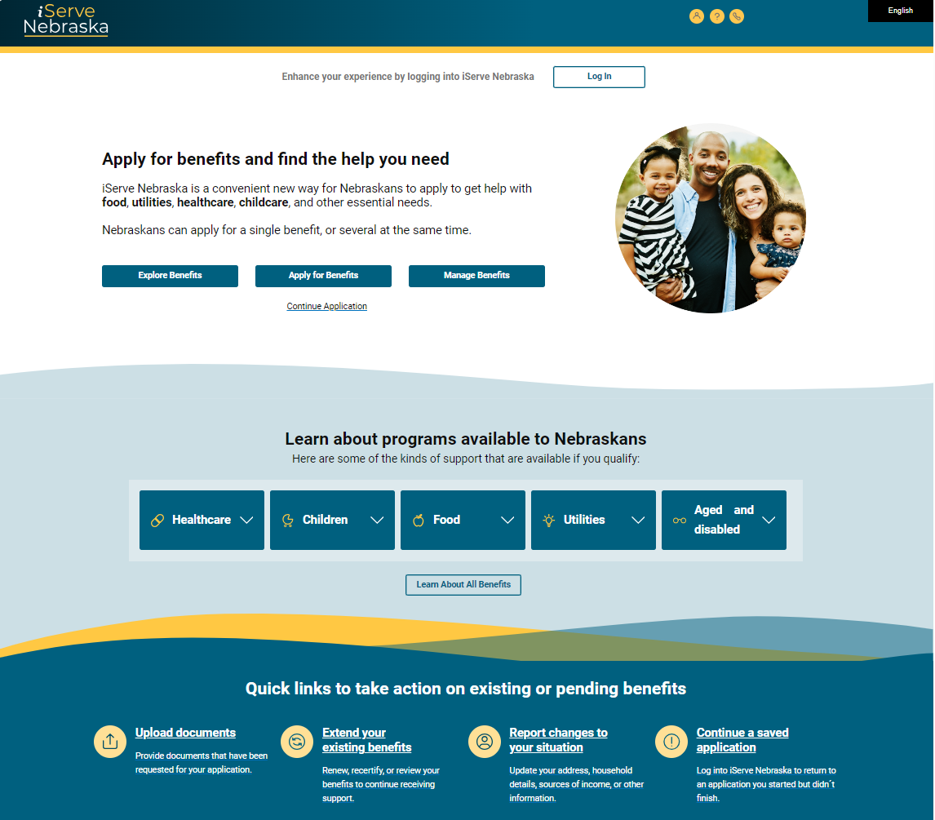
Change Report Option
Visit https://iServe.Nebraska.gov
Scroll down, you will see a link named “Report Changes to your situation”
Click on that box to make reported changes on a case.
A pop up will appear, follow prompts to report changes

Slide 27
Renewals
Nebraska Medicaid generally reviews all members’ eligibility once per year to see if they still qualify for coverage.
During the PHE, we have continued to review eligibility, but no Nebraskan has involuntarily lost coverage. Regular communication with many members has not happened during the pandemic.
On March 1, 2023, Nebraska Medicaid began the “unwind” of the continuous coverage requirement. As we return to normal operations, members may be required to provide information as part of the return to normal.

Slide 28
Conducting Renewals
On March 1, 2023, DHHS started completing renewals for all Medicaid members.
We will be spreading this work out over the following year (March 2023 to April 2024)
The federal government is allowing states up to 14 months to complete renewals following the end of the continuous coverage requirement.
Nebraska Medicaid’s aim is to prevent unnecessary loss of coverage.

Slide 29
Conducting Renewals
Nebraska Medicaid will begin by trying to automatically renew a member’s coverage. If we know a member has not moved and has not had a change in income, we can automatically renew.
For example: a long-term nursing home resident.
If we can’t complete an automatic renewal, we will mail a printed renewal form to the member.
These forms are mailed up to 60 days before the member’s renewal must be completed.

Slide 30
Conducting Renewals
If a member doesn’t respond, they can lose their coverage for failing to provide information. If we don’t have up-to-date information, we can’t be sure a member is actually eligible.
If a member loses coverage for this reason, they have up to 90 days after their coverage is ended to complete their renewal.
Their coverage will resume if they are still eligible after this renewal.

Slide 31
Medicaid Members Who are no Longer Eligible
If a member is no longer eligible for Medicaid, we will send them a notice and may also send their information to the federal marketplace.
This does not happen in cases that are closed for failure to provide information.
The marketplace will send the member a letter so they can complete an application and see if they qualify for financial assistance for coverage.
Health coverage through the marketplace covers prescription drugs, doctor visits, urgent care, hospital visits, and more.
Marketplace web site: https://www.HealthCare.gov/

Slide 32
Questions?

Slide 33
Medicaid Spousal Impoverishment Program

Slide 34
Why Talk About Medicaid?
70% of people who reach age 65 will need long-term services
24% will need those services for two years or more
In Nebraska, the average cost of a private nursing home room was $8,289 per month (2021)
$99,468 annually
Even with careful retirement planning, the cost of long-term care can quickly reduce your assets
Medicaid is the largest payer of long-term care
Nationwide, Medicaid pays 42.1% of all long-term care costs

Slide 35
What is the Spousal Impoverishment program?
The Spousal Impoverishment program was created to address the situation where one spouse needs nursing home care, but the other spouse is healthy enough to remain in the community.
Before Spousal Impoverishment, a couple would have to qualify as a single unit before they could receive Medicaid. Due to Medicaid’s means tested formula, this would often result in the community spouse being unable to provide for their own needs.
The Spousal Impoverishment program created a way to allow the spouse with medical needs to receive necessary care while allowing the healthy spouse to remain at home.

Slide 36
When is Spousal Impoverishment an option?
The program is available when one spouse needs nursing home level of care for more than 30 days.
The program also covers Home and Community Based Services (Waiver). If one spouse is likely to need in-home services through Medicaid for more than 30 days, then Spousal Impoverishment is an option. Home and Community Based Services can be received either at home or in an assisted living facility.
The couple can start the process any time that they meet the level of care and duration requirements, even if they are not qualified for Medicaid at the time.
Being separated does not negate the requirement of the SIMP regulations.

Slide 37
How does the program work?
When the level of care and duration requirements are met, a couple may request an Assessment of Resources.
The Assessment of Resources catalogs the assets owned by both spouses at the time that one entered long-term care.
The total assets are divided by two. The community spouse can reserve half of the total, subject to a minimum and maximum amount.
When the couple has spent down their resources to the determined amount, then they may qualify for the Spousal Impoverishment program.
The couple can designate which assets are held by the community spouse.

Slide 38
What is needed to qualify?
Meet general Medicaid eligibility requirements
US Citizen or a qualified non-citizen
Nebraska resident
Income is not sufficient to pay for medical needs
Resources must be within Spousal Impoverishment limits
Cannot have transferred or gifted any resources in the last five years

Slide 39
What are the program limits?
2023 Community spouse resource reserved amounts
Minimum of $29,724
Maximum of $148,620
Amounts are adjusted annually for inflation
Community Spouse maximum income allowance of $3,716 per month
Home Equity Maximum of $688,000

Slide 40
What is the process to qualify?
The Assessment of Resources can be requested at any time one spouse is likely to need 30 days or more of institutional level of care.
This can be done regardless of the level of resources at the time.
The Assessment is always considers the amount of resources owned at the time of the first entry into long-term care. If a couple does not qualify for Medicaid at the time of entry, it may still be to their advantage to request an Assessment.
Couple may need to spend down some of their resources before they can become eligible.
When resources are within program guidelines, the couple can apply for Medicaid.

Slide 41
Medicaid Application
Upon application, the couple’s resources are verified. This step may take some time, depending on the assets.
After eligibility is determined, a Designation of Resources is completed.
The Designation allows the couple to determine which spouse will keep each asset.
Some income of the Medicaid spouse can be allocated to the community spouse to ensure that their needs are met.
Notes:
Now allowed until next renewal to change ownership

Slide 42
Marnie Carr
Social Service Supervisor
Division of Medicaid & Long-Term Care
Marnie.Carr@nebraska.gov
308-865-5010
Amanda Shannon
Social Service Supervisor
Division of Medicaid & Long-Term Care
Amanda.Shannon@nebraska.gov
402-759-9221

