Slide 1
Challenges of Culture Change and Change Management
Chandra Anderson, MBA, MSN, RN, CNML
Notes:
Hello – Can you hear me all okay? I am going to discuss with you this session about Culture Change and Change Management.
So today in healthcare we all face several challenges when it comes to culture change and change management. The complexity of the healthcare system in itself is a challenge.
As you know everything in healthcare is constantly changing, being modified, and is ever evolving. Just when one change has been implemented or being digested, the next one is arriving bringing more challenges and requiring more effort from an already taxed team.
Many of you come from healthcare organizations that are large and some that are small, regardless it is still difficult to implement consistent change cross the board. We all have our struggles.
By adopting a thoughtful and inclusive approach to culture and change management, leaders can pave the way for successful change in healthcare organizations.

Slide 2
OBJECTIVES:
Describe
Culture Change and Change Management at the Facility.
State
Key Elements of Effective Culture Change.
Explain
Change Management Components.
Notes:
Today I am going to talk about these very things.
We will discuss my own journey and experiences with culture change.
Describe Culture Change and Change Management at the facility I currently reside.
State Key Elements of Effective Culture Change.
and Explain Change Management Components.

Slide 3
TIMELINE OF ORGANIZATION EVENTS
2019
2020
CEO retires after 27 years.
New CEO starts
2022
CEO leaves; Interim CEO
2023
Leadership Structure Change
Organization begins culture change
Several Changes C Suite Roles
2014
Organization begins using computers
2021
Pandemic Begins
2022
3 CEOs in 3 Years
3 Cultures in 3 Years
& a Pandemic!
Interim Hired
Notes:
Lets start with a review on my own organization.
As I share I want you to listen for key elements in my story that reference the culture and change management strategies.
I am going to frequently reference this timeline as it helps to illustrate the many key changes that occurred at my organization in recent years.
I have experienced parts of three different cultures in almost 3 years. So, I have a lot of experience with change management and cultures.
Prior to my arrival the former CEO had been at our facility for over 25 years and accomplished some amazing things for our Health System.
But as you can image after that many years things get a bit stagnant.
Things were so good that the facility was like its own private island with limited disruptions.
I think I am probably one of the the first CNOs you will ever say that felt like the nursing and organizational retention actually hindered the growth of the organization.
I know quality can be a bit sterile and structured so lets discuss culture and change management a bit informally.

Slide 4
No Change Island
Notes:
So as I stated prior to my arrival the former CEO had been at our facility for over 25 years. He made all the decisions for the island! It was a very centralized decision-making structure.
He was reserved and conservative, and practical in his thinking and future things like ACOs, HIE, and computers felt way out of his comfort zone and within the philosophy of his domain of health care practicality.
As I stated retention hindered the facility. SO metaphorically speaking no one left the island unless you completely left the island aka moved or you were voted off. If you stayed on the island, you felt comfort in knowing that this island everything would stay the same, without change. Meaning no growth with EBP and no big ideas. Everyone liked the way things were. After some time though without change and challenge the island started to get a bit run down......
On occasion, other visitors would come to this isolated island and try to bring suggestions or new ideas, but the CULTURE of the ISLAND did not welcome much change.

Slide 5
Progressive Islands
Notes:
So surrounding this No Change Island there were islands much more open to change – lets call them Progressive Islands. These islands welcomed change and visitors. They were progressive, competitive and always changing, by staying up to date.
They are change ready, prepared for the future and ATTRACTIVE to others as they have more to offer then NO CHANGE ISLAND.

Slide 6
No Change Island Gets a New CHIEF
Notes:
No CHANGE island goes though it’s first big change after over 25 years.
Eventually the island gets a new chief and this Chief LOVES change. In fact, the Chief enjoys coming to islands to make everything change! The chief is very progressive.
This created excitement for change from the island, and new leader, with great ideas... most of the island wanted a change.
They are just not prepared for what that means fully.

Slide 7
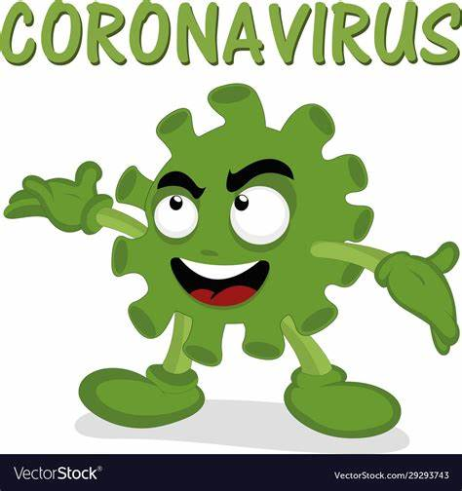
CHAOS ENSUES!
Notes:
So everything begins to go under construction - I mean everything – the organizational chart, the facility structure, everything is being evaluated... processes, procedures, operations..... And COVID hits!
The New Chief leads change through a very difficult time and from this uses the experience of current leaderships to determine who is joining the new c suite team the chief is putting into place.
A complete restructuring and change to the organization occurs, with disruption so great that the psyche of many is jeopardized and the Psychological Safety of the island has been turned completely upside down.
As I stated the organization was dealing with Covid there was already emotional panic - this made everything more traumatic for the leaders involved during this time.

Slide 8
TIMELINE OF ORGANIZATION EVENTS
2019
2020
CEO retires after 27 years.
New CEO starts
2022
CEO leaves; Interim CEO
2023
Leadership Structure Change
Organization begins culture change
Several Changes C Suite Roles
2014
Organization begins using computers
2021
Pandemic Begins
2022
3 CEOs in 3 Years
3 Cultures in 3 Years
& a Pandemic!
Interim Hired
Notes:
I enter here into the organization. Completely clueless to the dynamics of the organization.

Slide 9
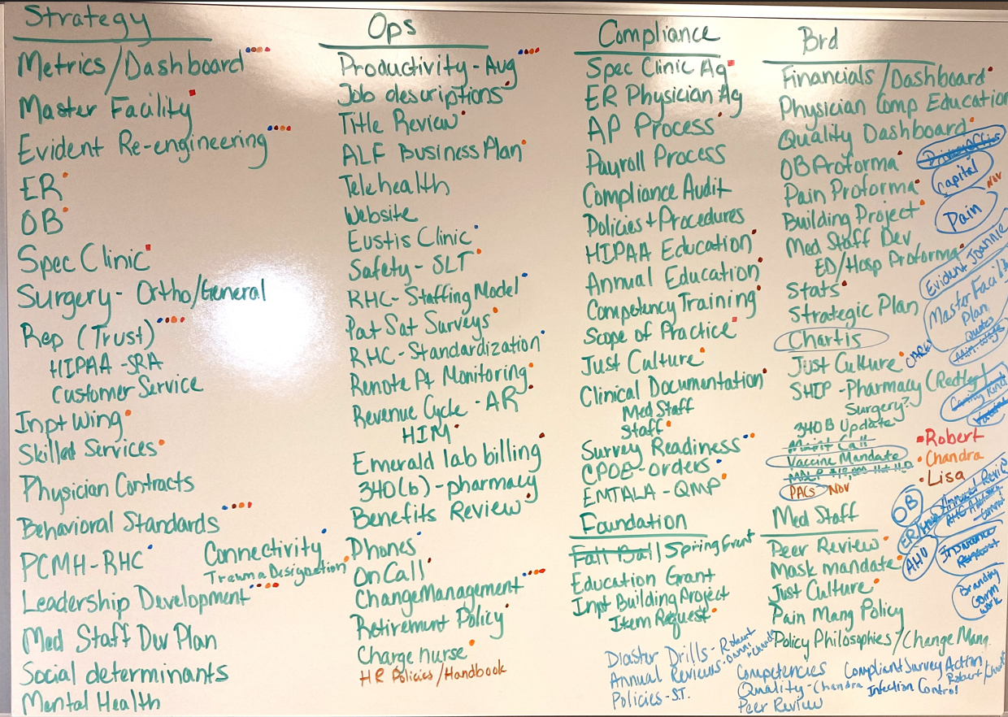
Notes:
This is a picture of the change that was needed by the new Chiefs recommendation.
Strategy, Operations, Compliance, Board Changes
Its overwhelming but the island had fallen so far behind that the to do list was large.
In the midst of a Pandemic – people were tired, burnt out, and resistant to change. Covid had really pushed this island to the point of exhaustion as they were not ready for all of the changed that occurred during that time.

Slide 10
No Change Island Gets another New CHIEF!
Notes:
The prior Chief doesn’t really work out and decides to move on, so No CHANGE island gets another Chief.
An interim Chief steps in. This Chief has lived on the island with the first no Change CEO. He is open to change but is a new leader! He has never been a chief before.
Everything is still in a bit of chaos, and there is still much work to do.
At this point, the work is needed for financial viability. As the pandemic comes to an end, many hospitals financially and operationally are a mess.

Slide 11
TIMELINE OF ORGANIZATION EVENTS
2019
2020
CEO retires after 27 years.
New CEO starts
2022
CEO leaves; Interim CEO
2023
Leadership Structure Change
Organization begins culture change
Several Changes C Suite Roles
2014
Organization begins using computers
2020
Pandemic Begins
2022
3 CEOs in 3 Years
3 Cultures in 3 Years
& a Pandemic!
Interim Hired
Notes:
The interim CEO is eventually hired as the 2nd CEO in 2 and half years. With the New CEO – more changes occur at the leadership level. The facility decides to add a CMO and a Compliance Officer.
During this time there were changes to pay structures and pay practices. Travelers were needed for nursing and other areas post covid.
Change was still occurring feverishly but there were old wounds of covid, and prior leadership that hindered culture change as well as implementing key strategy. The psychological safety of the organization was still recovering and each new changed caused more distress to many on the team.
The culture was struggling, and everyone was exhausted.
So, in review of my organization, you heard a lot of the struggle of culture and of all the changes that were trying to occur.
I want us to now begin to talk about what is culture and what is effective culture change.

Slide 12
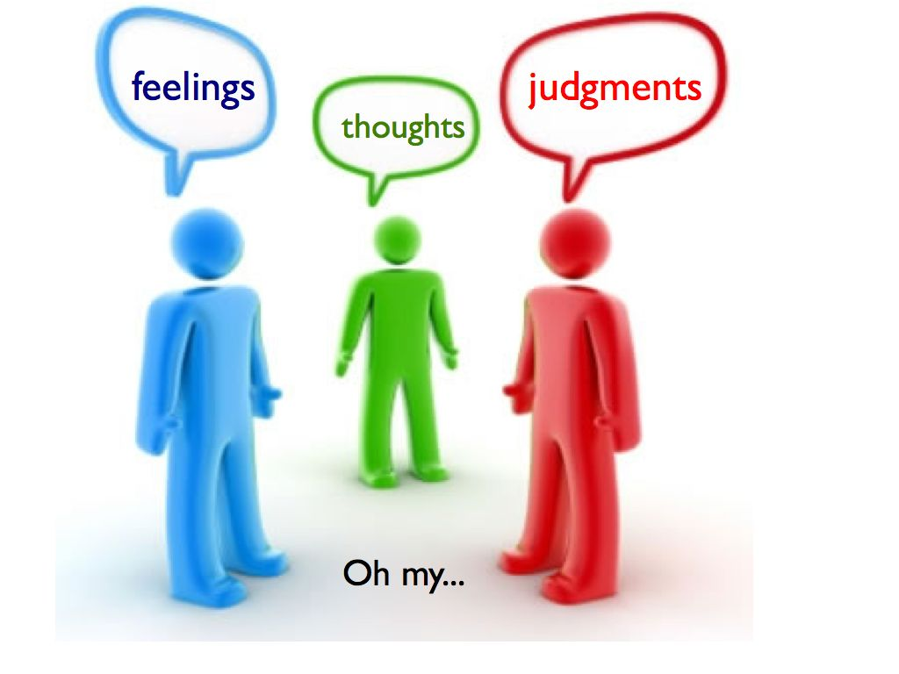
What is Culture?
Culture is a system of shared assumptions, values, and beliefs, which governs how people behave in organizations.
Notes:
Culture is a system of shared assumptions, values, and beliefs, which governs how people behave in organizations. Culture is often invisible and intangible. But it exerts a powerful influence on how employees think, feel, and act.
It is how people in organizations do things. It is the attitude of the people. It is also the unwritten rules and norms that employees follow. Just as every individual is unique, every organization has a unique culture. You all have a culture you are apart of. And if you have worked in other healthcare facilities you understand that cultures can be different.
Culture is also a set of shared automatic thoughts. Automatic thoughts are the thoughts that are instantaneous, habitual, and nonconscious. These are thoughts that have been so well learned and habitually repeated that they occur without cognitive effort. Certain experience trigger these automatic thoughts. Often it can be negative thinking.
For example, coming here today you dressed warm because conferences are always cold.
So to change these deeply engrained thoughts, you have to change the habits of how people think. And as we know habit change is also difficult.

Slide 13
Company Cultures = Operating System
Notes:
I want you to begin to think about your company cultures like an operating system.
We could refer to the values and principles as what makes up the operating system.
It’s like your phone’s operating system — it works invisibly in the background to connect your apps and help you get things done. You also expect it to be regularly updated with enhancements, performance improvements, and new features.
The same is true for company culture. The operating system needs to be updated to ensure that it’s staying current with where the company is and where it’s going.
As I discussed with earlier with No Change Island, the operating system of that culture was kinda still a DOS.

Slide 14
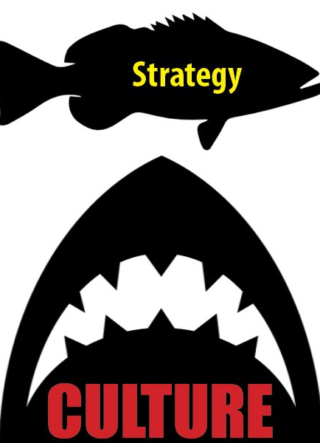
Culture Eats Strategy For Breakfast
Notes:
So how many of you have heard this famous saying - Culture eats strategy for breakfast or you may have also heard lunch.....
Culture is important. And a good strategy can, in fact, be consumed by a bad culture. You can have the best plan in the world, and if the culture isn’t going to let it happen, if you do not share the message just right. I see repeatedly organizations struggle as the culture is not in aligned with the strategy.
So how does culture specifically eat strategy for breakfast?
Culture has inertia and loves the status quo. It resists all attempts to change. Even if the strategy is brilliant, it cannot succeed without considering culture as a factor.
If the culture is supportive then the strategy has a good chance of getting implemented. Otherwise, it is quite likely that the culture will eat the strategy for breakfast!
Culture and strategy are two sides of the same coin. Often strategy gets attention, and culture doesn’t. Companies pay a heavy price for ignoring culture while working on their strategy.
Planning a strategy without considering the culture is like planting the seed without considering the type of soil. If you plant the right seed in the wrong soil, the seed will die.
Similarly, if you have a strategy for which the culture is not conducive, it will fail miserably.
Culture and strategy are interrelated, and they reinforce each other.

Slide 15
Culture Change Challenges
Resistance to Change
Lack of Leadership Alignment
Balancing Change Implementation
Limited Resources
Complexity of the Healthcare System
Notes:
But that is easier said than done Culture change and change management in healthcare can pose several challenges due to the complex nature of the industry and the impact it has on patients and healthcare professionals. Here are some common challenges:
We already mentioned the complexity of the healthcare system. There are multiple stakeholders, departments, and hierarchies. Coordinating and aligning all these components during culture change can be a significant challenge, requiring effective communication and collaboration.
Then there is the challenge if there is lack of leadership alignment: If leaders within the healthcare organization are not aligned or do not fully support the cultural change, it can create confusion and hinder progress. Consistent and visible support from leadership is essential to overcoming resistance and driving change.
Then you can have resource limitations. Healthcare organizations often face resource constraints, including time, budget, and staffing. Allocating resources for change management initiatives and providing adequate training and support can be challenging, potentially impacting the pace and effectiveness of the cultural transformation.
What about the biggest one - Resistance to change: Healthcare organizations often have long-established traditions, practices, and beliefs, making it challenging to introduce and implement new cultural norms. Resistance may stem from fear of the unknown, concern about the impact on patient care, or skepticism about the effectiveness of the change. Overcoming ingrained behaviors: Changing deeply ingrained behaviors and attitudes can be difficult.
Then you have Balancing the change implementation: Is too much changing happening at once. Implementing culture change while maintaining high-quality patient care can be a delicate balance. Teams must adapt to new processes and ways of working without compromising patient safety or outcomes. It is a fine balance.
But despite these challenges, addressing them with a thoughtful and comprehensive change management strategy, effective communication, and engagement with stakeholders can increase the likelihood of successful culture change in healthcare.

Slide 16
TIMELINE OF ORGANIZATION EVENTS
2019
2020
CEO retires after 27 years.
New CEO starts
2022
CEO leaves; Interim CEO
2023
Leadership Structure Change
Organization begins culture change
Several Changes C Suite Roles
2014
Organization begins using computers
2020
Pandemic Begins
2022
3 CEOs in 3 Years
3 Cultures in 3 Years
& a Pandemic!
Interim Hired
Notes:
So remember our island, I want to loop back into our timeline..... We are about here in the story between the end of 22 and 23.
Our organization struggled with those challenges I just discussed.
Things were only getting harder for everyone in the organization.

Slide 17
Meeting the Culture Where It Is At
Notes:
So at this point I start struggling with my own limitations as a leader with my current mindset as a leader.
My approach and behavior was one of the biggest changes I had to make as a leader. I am like many leaders had an EGO, a big one. I came from large health system rooted in EBP as well as very high patient care standards. The cultures I came from were mostly corporate so being progressively number one in the industry was survival amongst your competitors. So progressive forward thinking was how I was raised as clinician and leader.
This culture was the opposite, not progressive, computers started being used in 2014 (put that in perspective my daughter is 9) so they started using computers when my daughter was born. EBP was not a common term, in fact it was a bit of crazy talk.
To put this into perspective even more, We still use taped report at my facility. I struggled with this, even fought it .... and I lost with the nursing staff.
I could have demanded it, but I chose to really lean into the current culture, as if I did not, I would lose trust forever of the nursing team.
Remember that rocky bit of psychological safety I shared earlier and the burnout. I came from a place where bedside shift report was the standard. So, talk about a change for me and my automatic thoughts.
As leaders we need to recognizes that we are ‘a voice’ around the table, not ‘thee voice.’ This is a huge challenge, as leaders often see themselves as the only person capable and authorized to make decisions.
I chose that day to allow the voice of the nursing body to prevail, shared governance at its finest. Even though know one knew what that meant at the organization, I recognized in that very moment they had a powerful voice and I needed to get on the right side of that for to lead them effectively.
While it’s true that leaders make the decisions, we also need to listen honestly to other people’s opinions. I learned that it is so valuable to make sure people feel validated for their opinions, and when you make a decision, take those opinions into account.
As leaders you must change your mindsets to help change the culture. A bad leader will hinder the culture change. I had to change for my team. Meeting the culture where it is at can be a crucial piece to a successful culture change.

Slide 18
How We were Failing | How We Are Changing
Going too fast, poor timing. | We started slowing WAY DOWN!
Not properly explaining the why. | Started proactively communicating
Changing longstanding traditions and not recognizing the impact. | Discussing the change first, getting by in from the group.
Breaking trust – action speak louder than words – everyone is watching. | Being very mindful of the timing, communication, and behaviors around the change.
Notes:
So, as I stated I was struggling as a leader and as a team we were as well and as organization we continued to struggle with our culture and we began saying frequently that the Culture is eating our strategy for Breakfast, Lunch, and Dinner... This just kept reappearing. To the point we decided to seek out a culture change program for the organization and started really working on how as leaders we were contributing to the culture problems.
Here are a few examples on how we were failing and how we had to change.
Going too fast, poor timing.
We started slowing WAY DOWN! Remember balancing change – we started to do that.
Not properly explaining the why.
Started proactively communicating – Sending out the whys of a job posting.
Changing longstanding traditions and not recognizing the impact.
Discussing the change first, getting by in from the group. Make it their voice, listening to staff
Breaking trust – action speak louder than words – everyone is watching.
Being very mindful of the timing, communication, and behaviors around the change.
How did we get there with team trust being an issue?, we had to really examine key components of how we were being ineffective as leaders with change management.

Slide 19
Components of Change Management
Emotional Awareness
Education
Celebrating
Communication
Notes:
So as a team we came to realize that we needed to change how we were approaching change so we could be effective with change management.
Remember I discussed the trust aspect. We were not very emotionally aware. Change management involves managing the emotions and responses of individuals during periods of change more than anything. It is composed of several components, all of which have their own significance.
So as leaders we had to start developing Emotional Awareness: We had to recognize, understand, and acknowledging the emotions of healthcare team and patients during change. Being emotionally aware helps in predicting possible reactions and planning strategies to handle them. We also had to have better empathy: understanding and addressing the concerns and fears of those affected by the change. By showing empathy, you can gain the trust and support for the change.
We had to also start communicating better. Clear and regular communication is crucial in managing change effectively. It reduces uncertainty and fear, thereby making the change more acceptable. It includes informing about what the change entails, why it is necessary, and how it will be implemented.
We also started educating our team on culture and change. This included providing necessary training to the healthcare team to adapt to the change and continuous support to help them overcome any challenges they face during the transition. As I stated our organization has invested in a three-year culture change program that all employees are required to participate in. We also became more open to feedback and making necessary adjustments in the change process based on the feedback received. Sometimes that wasn’t easy but we started really leaning in.
We also began recognizing and rewarding the efforts of those who adapt to the change encourages others to do the same. It created ,more positivity and change became more acceptable.
This year we receive the Best of for Dawson and Gosper County in several key categories. That meant more to me than the accolade itself. It meant after the 3 years of all that chaos and change as a health system we were going in one direction together.

Slide 20
HEALTH CARE 10 STEP CHANGE MODEL
2. Assess
3. Team Collaboration
4. Vision
5. Strategy
8. Implementation
1. Identify
6. Communication
9. Evaluate
7. Support
10. Sustain
Notes:
So we have discussed culture change and components of effective change management but now lets talk about how you make change happen.
Through my experience in health care, I've developed a systematic model to achieve successful change management.
Each step of the model highlight concepts within the change models of Lewin’s change management, Tuckmans, Kotter’s change management theory and ADKAR change theory. I have added a few more steps.
The ten-step model helps to ensure that regardless of skill-level, any staff member can be a change agent and facilitate change.
Each step is required to achieve successful change systematically and empower and guide staff through the process.
I am breaking these down pretty elementary so for some of you these steps can be down in twos and threes. But if you are going to do change right you have to have these elements.

Slide 21
HEALTH CARE 10 STEP CHANGE MODEL
1. IDENTIFY the Change
What needs change?
Notes:
The first step in the Change Model is to identify the need for a change.
There must be the question what needs to change?

Slide 22
HEALTH CARE 10 STEP CHANGE MODEL
2. ASSESS the type of Change
Proactive/ Reactive Change
Cost/Energy/Resource Requirement
Notes:
The second step is to assess what change is exactly required.
This step is required as the assessment brings clarity to the depth of the change needed and what will be required to achieve the change.
If the change is proactive the organization is looking to make active improvements before a major situation or event occurs. The benefit of proactive change is that it can often be planned out leisurely and sensibly.
The other type of change is reactive change. With reactive change a sense of urgency occurs and quick decisions are made in regard to what changes need to be made often from a crisis, serious event, or when obligatory requirements exist.
During this step the financial implications of the change will be determined, the time required along with what resources are needed for the change to occur.
Assessing the change leads into the next step of determining the right team and elements required to build a collaborative steering team for change.

Slide 23
HEALTH CARE 10 STEP CHANGE MODEL
What participation is needed?
Who are the experts?
Is the team diverse?
HEALTH CARE 10 STEP CHANGE MODEL
3. TEAM COLLABORATION
Notes:
In the third step you have team collaboration. You need to chose a team to help guide and facilitate the change. This could be a large or small team and it is best if it is diverse.
Team members will operate as a steering committee or change champions and bring support to the change identified.
Depending on what is needed to be changed, will depend on what members are invited to participate on the steering team.
It is important that the steering team has executive decision-making abilities and executive support so that they can make decisions on the needed change.
This team carries an important role as they are responsible for the success or failure of the determined change.
Many of you are probably familiar with the Forming Storming idea.
This is key with your steering committee to have a strong partnership as they lead the change. During your change your steering committee will go through these stages. This also can mirror the depth of the culture and the different stages of the change different pockets of employees are experiencing.

Slide 24
HEALTH CARE 10 STEP CHANGE MODEL
4. VISION for Change
What will the change look like?
Notes:
After the steering committee develops the fourth step is to create a vision for the change.
In this step the deep why for the change is discovered along with what the outcome goal will be determined by the steering team.
The vision will guide the strategy for change management as well as help to influence others to accept the change.
The vision will also help to determine change objectives that will lead to the next step involving strategy.
Creating a vision which everyone in the company can understand and remember is crucial along with setting goals or milestones.

Slide 25
HEALTH CARE 10 STEP CHANGE MODEL
5. STRATEGY for Change
How will change happen systematically?
Notes:
In the fifth step, the strategy for the change will be developed by the steering team.
Strategy will encompass the needed structure and a systematic approach for the change to be a success.
Education, resources, and communication can also be apart of the strategy. Timelines, action plans and an execution strategy will also support the needed change.
Remember culture eats strategy so be mindful in this step.
You might want to undergo the change in phases. I recommend this as it can keep the process at the right pace and you can maintain better control of the change.

Slide 26
HEALTH CARE 10 STEP CHANGE MODEL
6. COMMUNICATION
The why for change
Strategy and vision
Build engagement/ support
Notes:
In the sixth step of the change model, communication is key for explaining strategy and the vision for the change.
During communication, the why is explained behind the change and timelines are shared.
It is important for the change committee to communicate the change in an influential manner to help strengthen the engagement on change.
The goal of the communication is to adequately prepare and communicate to all involved about the oncoming change. How will this be communicated, what mediums and venues will be used to share the vision of the change.
Once communication occurs, staff then determine how they will approach the change on an emotional level. At this phase of the process, staff might become resistant to the change or the new process.
The next step in the change model is support which helps others to leverage the change in a healthy manner and accept the change instead of resisting.
Be transparent about the changes you’re trying to achieve, address employees’ concerns and let them express those concerns. No matter how advanced we become, there is nothing more powerful than communication that is clear, honest and consistent. This type of communication builds trust and would engage employees in the process.

Slide 27
HEALTH CARE 10 STEP CHANGE MODEL
7. SUPPORT
Indirect/Direct
Emotional
Notes:
In the seventh step of the change model, support is required.
After strategy has been determined and communication has occurred, support will be needed for those involved with the change.
Indirect support of making sure resources are available for a successful change along with direct support of making sure staff are handling the change with a positive approach and are prepared to overcome barriers and understand that challenges will lie ahead.
Change is hard for many so having the proper support to guide staff during change will help the culture of the organization with future change.
I am often asked ‘what do we do with the person who just doesn’t want to change’. In my experience some of the people who have been identified as ‘never will change’ often have the greatest epiphanies and become extraordinary advocates for the change. This epiphany is often a combination of insight and peer pressure (as other peers start to change the individual becomes more and more uncomfortable staying in the old way). My advice is this, suspend your judgement and give people a chance to change.
At the end of 6 months, you will know those that will not and willfully choose not to change; those that are struggling to change but making an effort and those that are starting to become your role models.
During this time, I often use the phrase, lets try this for 90 days or pilot this change to see if this is a change we should stick with. This often reduces anxiety with the situation as those involved fill like they have an option or say if it doesn't work.

Slide 28
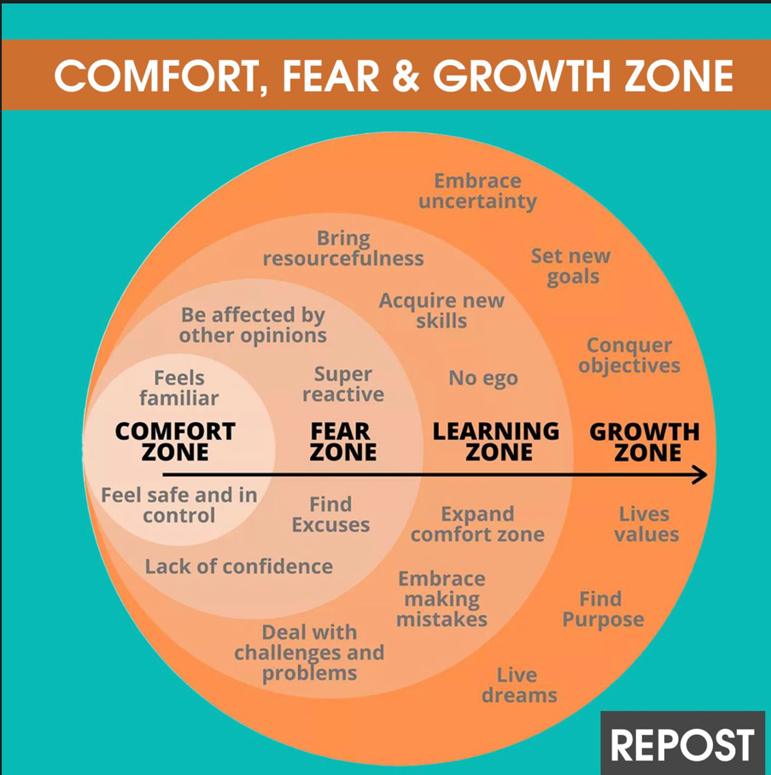
Notes:
So, this is the Learning Zone Model which was originally developed by psychologist Lev Vygotsky, but has since been popularized by many other educational professionals.
We look at this a lot in our organization.
So, you first have the comfort zone which is a place of security and familiarity.
The fear zone is a place of fear and stress.
At the beginning of the change the comfort and fear zone are the longest and hardest zones to push through.
The learning zone is a place of exploration and discovery and the growth zone is a place of challenge and change.
This is a great tool to use throughout your change to check in on where everyone is with the change. When you start having more in the Learning Zone the energy shift and momentum usually pulls everyone over.

Slide 29
HEALTH CARE 10 STEP CHANGE MODEL
8. IMPLEMENTATION
Execution of strategy
Include Change Champions
Notes:
So at the eighth step of the model, you begin to implement your change.
You have strategized, shared the vision through great communication, offered support of the change and now you are ready to begin.
During implementation, the strategy for change is fully executed.
Change Champions/ and your steering team play a key role in the transformation process during this time.
Change Champions begin multiplying as implementation goes on as employees at all levels within the organization begin to promote the change process formally and informally.
During implementation you need to make sure you focus on overcoming the barriers during your implementation of change
Be emotionally awareness, give support, listen.

Slide 30
HEALTH CARE 10 STEP CHANGE MODEL
9. EVALUATE
Successful?
Unsuccessful?
Additional changes needed?
Notes:
In the ninth step of the change model, evaluation is required.
Evaluation of the change can determine the success of the chain and is required prior to sustaining the change.
During this step, the change is evaluated and determined if additional time or change is still needed to reach the preferred outcome.
Do you need to change strategy or process.
Don’t be so blind by your investment to the project that your ego gets in the way of seeing the truth of the progress.
If it is unsuccessful that is okay, learn from it and pivot.
If successful don’t forget to celebrate and reflect on the change.

Slide 31
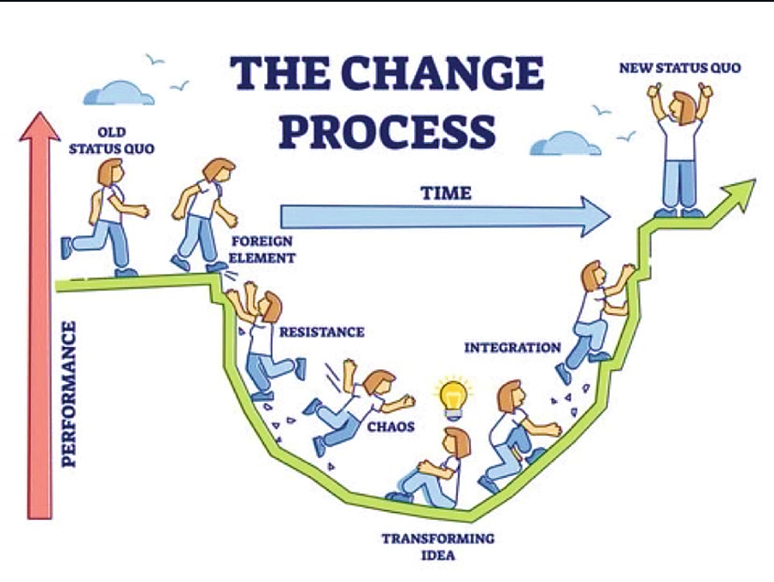
Notes:
The change process in full view. Visuals are always helpful as it helps you to see where you are and how close you are to the New Status Quo.
How is everyone doing where are they at?

Slide 32
HEALTH CARE 10 STEP CHANGE MODEL
10. SUSTAIN
Hardwiring change
Notes:
So sustaining is the final step of the Model. In this step chosen strategies are used to hardwire the change.
Strategies such as auditing, tracking and trending, accountability and coaching to sustain the new change occur during this step. This is often the hardest step as the team falls off here. The work has been done and hardwiring the change doesn’t care much momentum as you are securing the change.
But remember a true effective change is change that is sustained and hardwired for long term success.
For sustained change, you need to treat the transformation as a continuous process and work on reinforcing it further by recognizing the positive effects of the change.

Slide 33
Notes:
Cultural transformation is a long-term effort, but the results are rewarding and well worth the investment.
Ongoing change becomes a new muscle for the organization. The more change is effectively occurring, the easier it becomes for the team to manage change.
Change can create a more positive and supportive work environment, which can increase job satisfaction and reduce turnover directly supporting your overall culture.
Change can lead to better patient care as healthcare professionals who are more comfortable with change can focus on leading or supporting future projects to improve patient outcomes or encourage more ideas for better healthcare services.

Slide 34
3 Take Aways
Meet the culture where it is.
Culture eats strategy at every meal.
Change management requires a good strategy and plan.
Notes:
So, in closing 3 takeaways....
Remember to meet the culture where it is. That might involve you as leader changing your style and behaviors.
Culture eats strategy at every meal, so to be an effective organization you must have a culture where everyone is rowing the same way.
Change management needs to occur in a structured manner rooted in good strategy.
Thank you all for your time. I am available at the conference if you have any questions, please seek me out.
Enjoy the rest of your conference.

