Slide 1
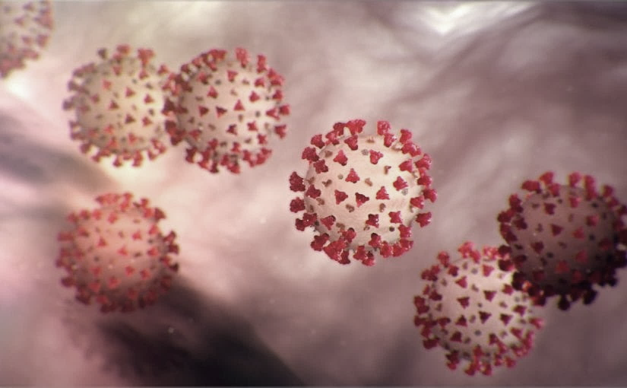
Covid-19 Webex Update
4-17-20
Maureen Tierney, MD, MSc.
Healthcare Associated Infections Medical Director
Tom Safranek, MD, State Epidemiologist

Slide 2
We are one in this fight
Frontline Heroes
Public Health Heroes
First Responder Heroes

Slide 3

George’s Cloth Mask

Slide 4
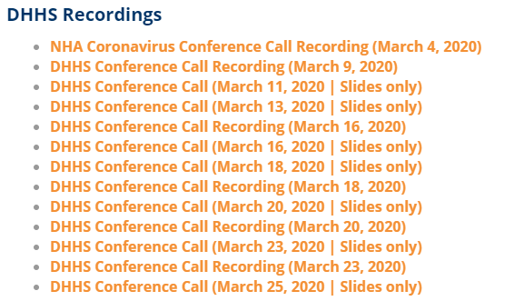
Thank you for joining us!
Slides and recording of today’s presentation will be available at
https://www.nebraskahospitals.org/coronavirus-covid-19-information.html
Scroll to the bottom of the page

Slide 5
Links to Nebraska webinars
Nebraska Acute Care Call every M,W, F at noon
previous calls can be found Nebraska Hospital Association
https://www.nebraskahospitals.org/coronavirus-covid-19-information.html
Nebraska ICAP Long Term Care Webinars every Thursday at noon
previous webinars and questions and answers found on ICAP website
https://icap.nebraskamed.com/
NEW
Nebraska ICAP Combined Critical Access and Outpatient Webinars every Tuesday at non
previous webinars and questions and answers found on ICAP website
https://icap.nebraskamed.com/

Slide 6
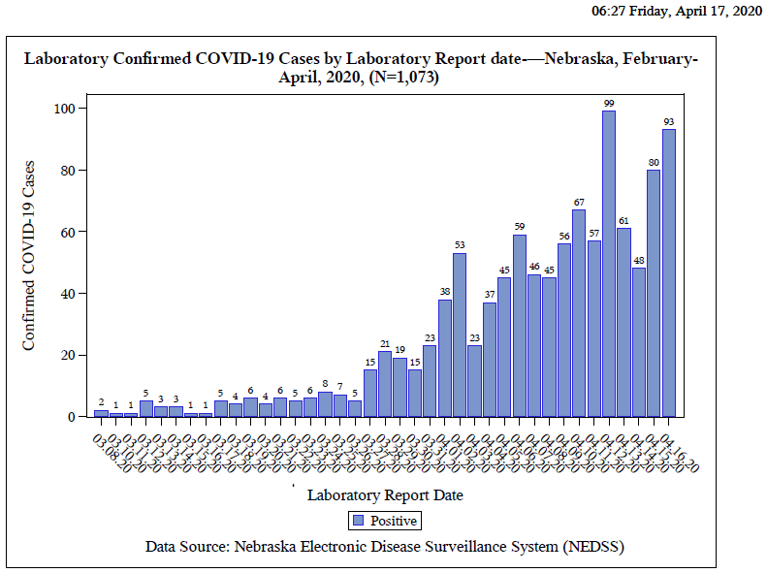

Slide 7
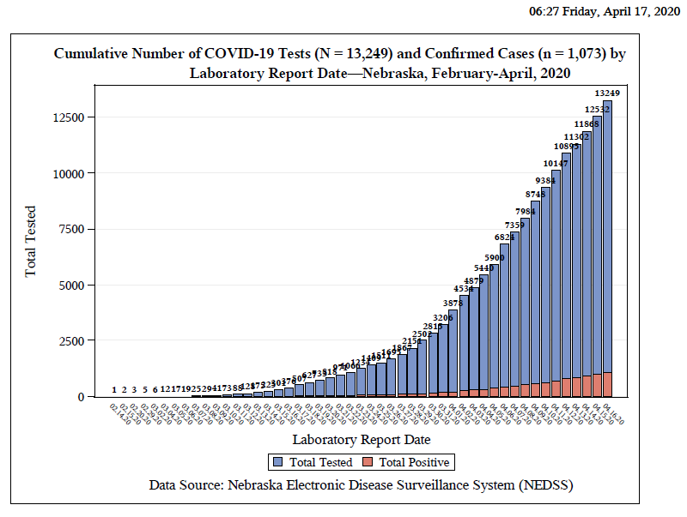

Slide 8
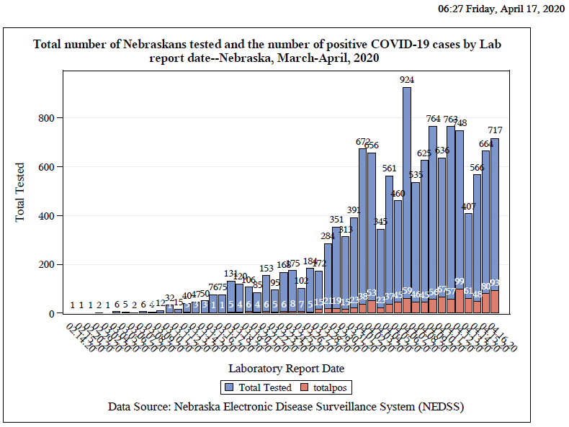

Slide 9
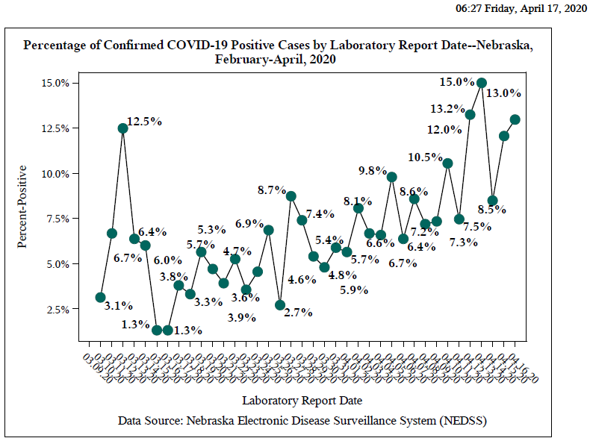

Slide 10
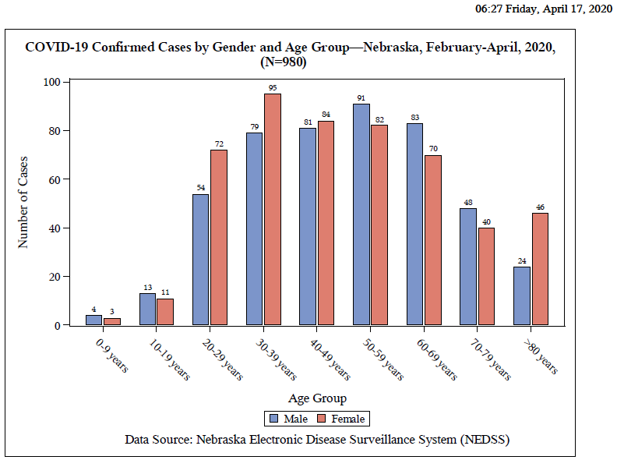

Slide 11
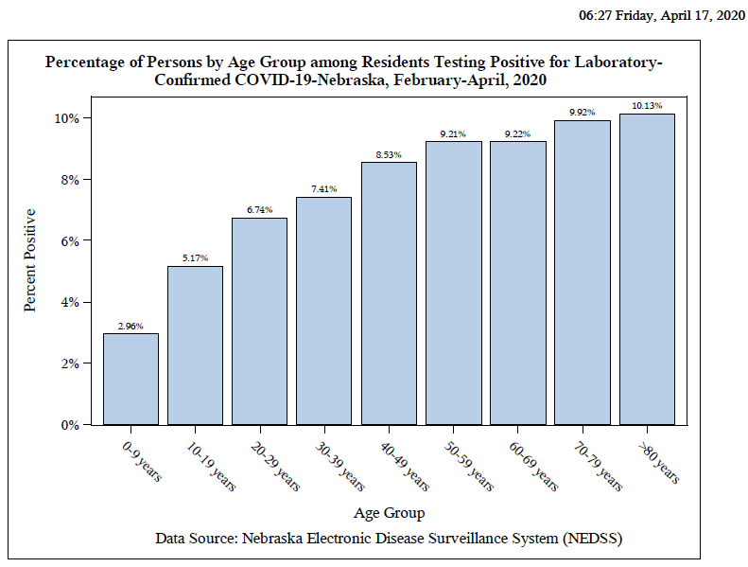

Slide 12
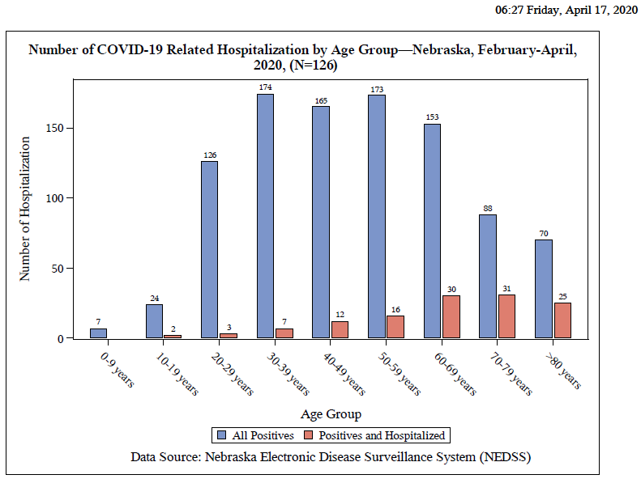

Slide 13
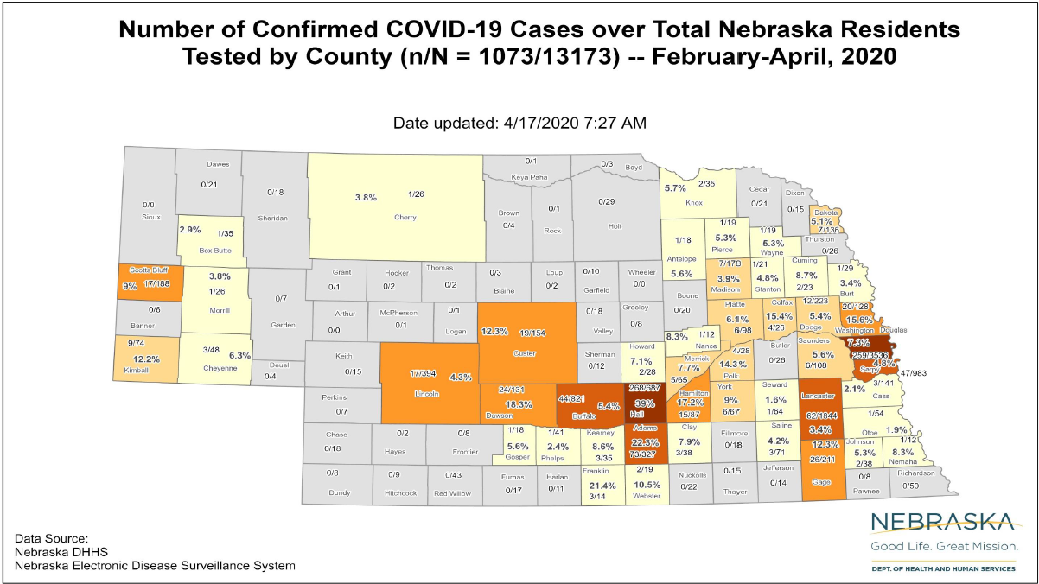

Slide 14
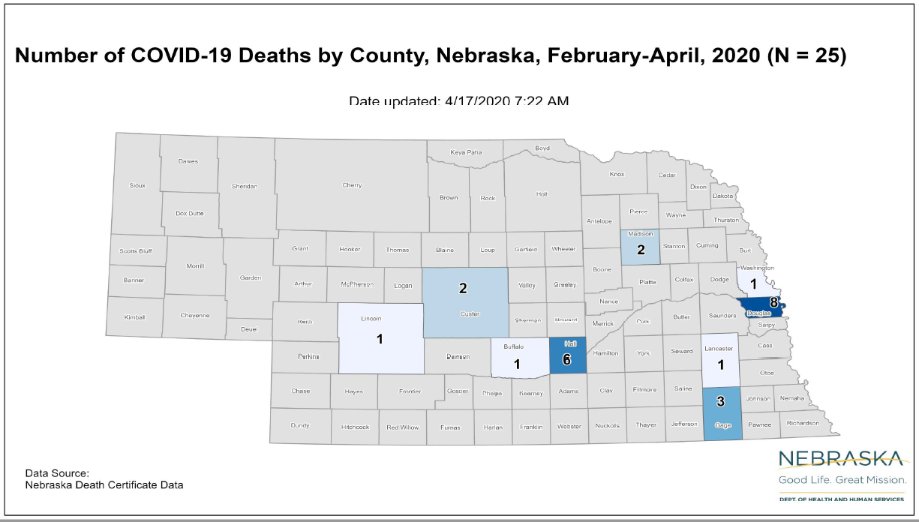

Slide 15
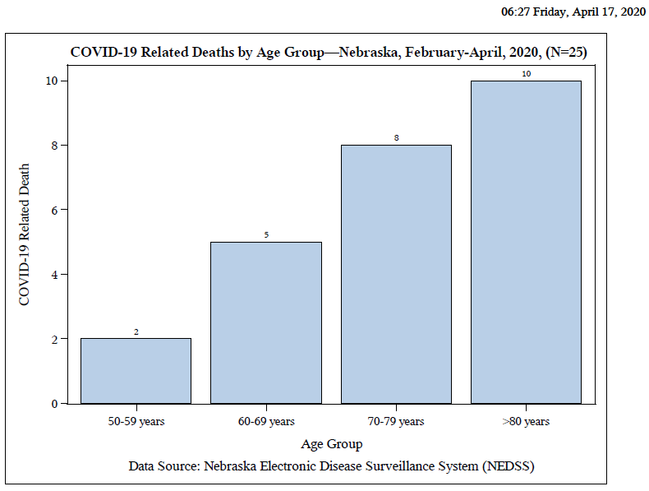

Slide 16
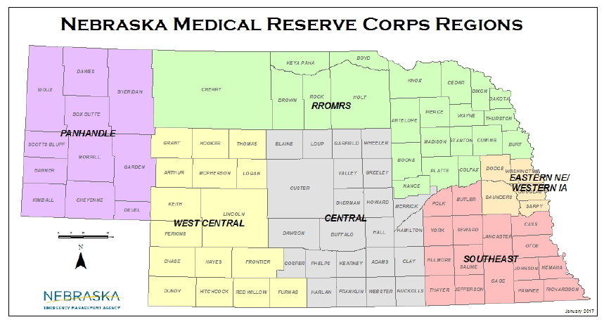
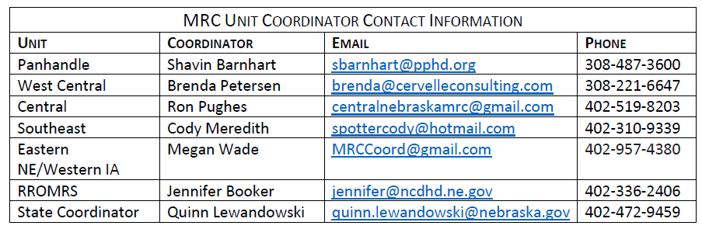

Slide 17
Race and Obesity as Risk Factors
Johns Hopkins University School of Medicine Associate Professor of Adult and Pediatric Infectious Diseases Allison Agwu, M.D., ScM “discusses disparities in the impacts of COVID-19 in the community she serves.” Of “the 6,116 COVID-19 cases in Maryland for which race data was available (around 20% of cases were missing data), as of April 10 African Americans represented 49% of cases and 51% of deaths while representing only 30% of Maryland residents. Whites represented 35% of cases and 40% of deaths while representing 56% of Maryland residents.”
CIDRAP (4/10) reported that a new letter published in Clinical Infectious Diseases “from researchers at New York University shows that obesity is a risk factor for COVID-19 hospitalization in patients under the age of 60.” For the study, “researchers looked at 3,615 patients admitted to their hospital from Mar 4 to Apr 4.” They found “patients aged less than 60 years with a BMI from 30 to 34 were 2.0 times...and 1.8 times...more likely to be admitted to acute and critical care, respectively...compared with individuals with a BMI under 30.” Meanwhile, “for patients in the same age-group with a BMI over 35, the risk was 2.2 and 3.6 times higher, respectively”

Slide 18
https://www.cdc.gov/coronavirus/2019-ncov/hcp/inpatient-obstetric-healthcare-guidance.html
Considerations for Inpatient Obstetric Healthcare Settings
Summary of Recent Changes
Revisions were made on April 4, 2020, to reflect the following:
Guidance has been updated to clarify the following:
Considerations related to visitors and essential support persons to pregnant women who have known or suspected COVID-19 infection
Prioritized testing of pregnant women with suspected COVID-19 at admission or who develop symptoms of COVID-19 during admission
Isolation of infants with suspected COVID-19 from other healthy infants
Determination of whether to keep a mother with known or suspected COVID-19 and her infant together or separated after birth on a case-by-case basis, using shared decision-making between the mother and the clinical team

Slide 19
Universal Screening for SARS-CoV-2 in Women Adm for Delivery NYC NEJM
Between March 22 and April 4, 2020, a total of 215 pregnant women delivered infants at the New York–Presbyterian Allen Hospital and Columbia University Irving Medical Center .
All the women were screened on admission for symptoms of Covid-19.
Four women (1.9%) had fever or other symptoms of Covid-19 on admission, and all 4 women tested positive for SARS-CoV-2 (Figure 1).
Of the 211 women without symptoms, all were afebrile on admission.
Nasopharyngeal swabs were obtained from 210 of the 211 women (99.5%) who did not have symptoms of Covid-19; of these women, 29 (13.7%) were positive for SARS-CoV-2.
Thus, 29 of the 33 patients who were positive for SARS-CoV-2 at admission (87.9%) had no symptoms of Covid-19 at presentation.

Slide 20
https://www.idsociety.org/COVID19guidelines
Recommendation 1. Among patients who have been admitted to the hospital with COVID-19, the IDSA guideline panel recommends hydroxychloroquine/chloroquine in the context of a clinical trial. (Knowledge gap)
Recommendation 2. Among patients who have been admitted to the hospital with COVID-19, the IDSA guideline panel recommends hydroxychloroquine/chloroquine plus azithromycin only in the context of a clinical trial. (Knowledge gap)
Recommendation 3. Among patients who have been admitted to the hospital with COVID-19, the IDSA guideline panel recommends the combination of lopinavir/ritonavir only in the context of a clinical trial. (Knowledge gap)
Recommendation 4. Among patients who have been admitted to the hospital with COVID-19 pneumonia, the IDSA guideline panel suggests against the use of corticosteroids. (Conditional recommendation, very low certainty of evidence)
Recommendation 5. Among patients who have been admitted to the hospital with ARDS due to COVID-19, the IDSA guideline panel recommends the use of corticosteroids in the context of a clinical trial. (Knowledge gap)
Recommendation 6. Among patients who have been admitted to the hospital with COVID-19, the IDSA guideline panel recommends tocilizumab only in the context of a clinical trial. (Knowledge gap)
Recommendation 7. Among patients who have been admitted to the hospital with COVID-19, the IDSA guideline panel recommends COVID-19 convalescent plasma in the context of a clinical trial. (Knowledge gap)

Slide 21
Remdesivir Trials
Severe Disease 2400 at 132 sites
Moderate Disease 1600 at 169 sites
University of Chicago
125 patients in a Phase 3
113 patiets severe
2 deaths
“mot patietns have been discharges to home.”
More specific results to follow

Slide 22
Prone Positioning References
1) Wu Z, McCoogan, JM. Characteristics of and important lessons from the Coronavirus Disease 2019 (COVID-19) outbreak in China: summary of a report of 72314 cases from the Chinese center for disease control and prevention. JAMA 2020.
2) Alhazzani W, Moller M, Rhodes A et al. Surviving Sepsis Campaign: guidelines on the management of critically ill adults with Coronavirus Disease 2019 (COVID-19). Intensive Care Medicine 2020.
3) Guérin, C., Reignier, J., Richard, JC. Et al. PROSEVA Study Group. Prone Positioning in Severe Acute Respiratory Distress Syndrome. N Engl J Med (2013); 368: 2159–2168.
4) Sud, S., Friedrich, J., Adhikari, N. et al. Effect of prone positioning during mechanical ventilation on mortality among patients with acute respiratory distress syndrome: a systematic review and meta-analysis. CMAJ (2014); 186 (10): 381-390. 5) Bloomfield, R., Noble, D., Sudlow, A. (2015) Prone position for acute respiratory failure in adults. Cochrane database of systematic reviews. CD008095.pub2
tPA and similar products

Slide 23
ICS* Guidance on Prone Positioning in COVID
Theoretical Benefits to Prone Positioning in the Conscious COVID 19 Patient
• Improved VQ matching and reduced hypoxaemia (secondary to more homogeneous aeration of lung and ameliorating the ventral-dorsal transpulmonary pressure gradient)
• Reduced shunt (perfusion pattern remaining relatively constant while lung aeration becomes more homogenous)
• Recruitment of the posterior lung segments due to reversal of atelectasis
• Improved secretion clearance
*Intensive Case Society

Slide 24
Tissue Plasminogen Activator (tPA) Treatment for COVID-19 Associated Acute Respiratory Distress Syndrome (ARDS): A Case Series.
J Thromb Haemost. 2020 Apr 8. doi: 10.1111/jth.14828. [Epub ahead of print]
Wang J¹, Hajizadeh N¹, Moore EE^{2,3}, McIntyre RC³, Moore PK⁴, Veress LA⁵, Yaffe MB^{6,7}, Moore HB³, Barrett CD^{6,7}.
Abstract
A hallmark of severe COVID-19 is coagulopathy, with 71.4% of patients who die of COVID-19 meeting ISTH criteria for disseminated intravascular coagulation (DIC) while only 0.6% of patients who survive meet these criteria (1). Additionally, it has become clear that this is not a bleeding diathesis but rather a predominantly pro-thrombotic DIC with high venous thromboembolism rates, elevated D-dimer levels, high fibrinogen levels in concert with low anti-thrombin levels, and pulmonary congestion with microvascular thrombosis and occlusion on pathology in addition to mounting experience with high rates of central line thrombosis and vascular occlusive events (e.g. ischemic limbs, strokes, etc.) observed by those who care for critically ill COVID-19 patients (1-7). There is evidence in both animals and humans that fibrinolytic therapy in Acute Lung Injury and ARDS improves survival, which also points to fibrin deposition in the pulmonary microvasculature as a contributory cause of ARDS and would be expected to be seen in patients with ARDS and concomitant diagnoses of DIC on their laboratory values such as what is observed in more than 70% of those who die of COVID-19 (8-10).

Slide 25
ECMO?
Patient With COVID-19 Who Was Critically Ill Recovers After ECMO Treatment, Report Says
MedPage Today (4/16, Boyles) reports a 53-year-old man in Phoenix with COVID-19 who “was very near death” recovered after receiving extracorporeal membrane oxygenation (ECMO) therapy. Dr. Robert Riley, chief of cardiothoracic surgery at Honor Health Deer Valley Medical Center, said, “When we made the decision to use ECMO he probably had no more than 6 to 8 hours to live without it.” MedPage Today says a group of experts “recently published an ECMO treatment guideline in Annals of the American Thoracic Society.”

Slide 26
Donating Plasma
People who have fully recovered from COVID-19 for at least two weeks are encouraged to consider donating plasma, which may help save the lives of other patients. COVID-19 convalescent plasma must only be collected from recovered individuals if they are eligible to donate blood. Individuals must have had a prior diagnosis of COVID-19 documented by a laboratory test and meet other donor criteria. Individuals must have complete resolution of symptoms for at least 28 days before they donate, or alternatively have no symptoms for at least 14 days prior to donation and have a negative lab test for active COVID-19 disease.

Slide 27
Co-Infection
In a small sample in Northern California, 20.7% of respiratory specimens positive for SARS-CoV-2, the virus that causes COVID-19, were also positive for one or more additional pathogens, reported James Quinn, MD, of Stanford University School of Medicine in Stanford, California, and colleagues, writing in a research letter in JAMA.
Quinn and colleagues examined 1,217 nasopharyngeal specimens from symptomatic patients reporting, for example, cough, fever, and shortness of breath, and found 9.5% were positive for SARS-CoV-2, with 24 of those testing positive for additional pathogens, such as influenza, respiratory syncytial virus, and non-SARS-CoV-2 Coronaviridae.
The most common co-infections were rhinovirus/enterovirus (7%), respiratory syncytial virus (5%), and non-SARS-CoV-2 Coronaviridae (4%).
. "The presence of a non-SARS-CoV-2 pathogen may not provide reassurance that a patient does not also have SARS-CoV-2."

Slide 28
Updates to CDC Infection Prevention for HCP
CDC recently updated its infection prevention and control interim guidance for PUIs in healthcare settings. SHEA members should note the following key points in the updated guidance:
Cloth face coverings should not be considered PPE and should NOT be worn instead of a respirator or facemask if more than source control is required.
Healthcare personnel should consider continuing to wear their respirator or facemask (extended use) while in the healthcare facility instead of intermittently switching back to their cloth face covering, which could cause self-contamination. Healthcare personnel should remove their respirator or facemask and put on their cloth face covering when leaving the facility at the end of their shift.
Visitors and patients should be wearing their own cloth face covering upon arrival to the facility per CDC recommendations to the general public. If they are not, they should be offered a facemask or cloth face covering, as supplies allow, and instructed to wear it while in the facility.

Slide 29
Cloth Masks for the Public
Nebraskans Protecting Other Nebraskans
In light of this new evidence, CDC recommends wearing cloth face coverings in public settings where other social distancing measures are difficult to maintain (e.g., grocery stores and pharmacies) especially in areas of significant community-based transmission.
It is critical to emphasize that maintaining 6-feet social distancing remains important to slowing the spread of the virus. CDC is additionally advising the use of simple cloth face coverings to slow the spread of the virus and help people who may have the virus and do not know it from transmitting it to others.
NM creating masks for non clinical staff made out of the surgical wrap material that has a high filtration capacity

Slide 30
3D Mask Printing FAQs from FDA
Will 3D-printed masks provide the same fluid barrier protection and air filtration as FDA-cleared surgical masks and N95 respirators?
A. 3D-printed masks may look like conventional PPE. However, they may not provide the same level of barrier protection, fluid resistance, filtration, and infection control. The CDC has recommendations for how to optimize the supply of face masks.
Q. What should health care providers do if using a 3D-printed mask?
A. Health care providers should:
Check the 3D-printed mask's seal for leaks.
Confirm that they can breathe through any makeshift filter materials.
Exercise caution in surgical environments where the need for liquid barrier protection and flammability is a concern.
Recognize that the mask may not provide air filtration enough to prevent transmission of infectious agents.
Safely dispose of infectious materials and disinfect any part they intend to reuse.

Slide 31
FDA Approves First 3D Printed Mask
FDA approved the first 3D-printed mask to meet its regulatory standards to protect clinical health care professionals against COVID-19. The announcement comes from a tweet issued by the Veterans Health Administration Innovation Ecosystem.
Created by the VHA team, the 3D-printed Stopgap face mask is a personal protective mask health care workers can use for liquid barrier protection to the novel coronavirus.
The mask works by securely fitting around the mouth and nose, strapping to the ears. The mask is also easy to disinfect and includes a disposable filter piece for reuse.
According to the issued instructions for use, the mask should not be used as a replacement to traditional respirator masks approved as personal protective equipment (PPE), such as N95 masks, and is not suitable against airborne protection in high-level, inhalation-exposure clinical areas.

Slide 32
Thanks to NM procedure sharing
https://www.nebraskamed.com/sites/default/files/documents/covid-19/surgical-mask-policy-and-faq-nebraska-med.pdf
For pictures on how to lay out mask on a paper towel go to above website

Slide 33
Off Site Quarantine and Convalescence
1. for HCPs and First Responders who wish to Q away from family in hotels-
call 833 220 0018
2. Information forthcoming UNO dorms
Quarantine post exposures
Convalescence

Slide 34
PPE Request Form
https://form.jotform.com/NebraskaDHHS/PPERequestForm

Slide 35
How to determine PPE needs
PPE Burn Rate Calculator
Personal Protective Equipment Burn Rate Calculator excel icon[XLS – 39 KB]
This spreadsheet can help healthcare facilities plan and optimize the use of personal protective equipment (PPE) for response to coronavirus disease 2019 (COVID-19). Get the Instructions
PPE Requests need to go to LHD, shipments go out to LHD and then from LHD to facilities as soon as possible. Often don’t know when shipments are arriving.

Slide 36
What to Do When Large Numbers of Staff Exposed (Mostly LTC Issue, but also SCAH)
Evaluation including LHD, DHHS Epi, NE CMS, ICAP, to help determine level of exposure, staffing needs, support needed for staff and infection prevention.
When feasible keep HCPs who have been exposed at home for 14 days if staffing permits.
If cannot do #2, assess level of exposure, if can triage medium risk HCPs back to work but keep out high risk exposures in Q do so;
If #3 not possible, according to CDC and CMS “facilities could consider allowing asymptomatic HCP who have had an exposure to a COVID-19 patient to continue to work after options to improve staffing have been exhausted and in consultation with their occupational health program (or LHD, CMD, DHHS and/or ICAP)
These HCP should still report temperature and absence of symptoms each day prior to starting work. Facilities should have exposed HCP wear a facemask while at work for the 14 days after the exposure.
If HCP develop even mild symptoms consistent with COVID-19, they must cease patient care activities, don a facemask (if not already wearing), and notify their supervisor or occupational health services prior to leaving work.

Slide 37
UV Disinfection of PPE
“A team led by John Lowe, PhD, UNMC assistant vice chancellor for inter-professional health security training and education has developed a safe and effective method to decontaminate N95 respirators so they can be used multiple times, instead of just once. It involves using ultraviolet light towers to irradiate high numbers of N95 respirators.
The decontamination of these items works like this: groups of N95s are safely bagged and transported to a room inside Nebraska Medical Center, which is equipped with two ultraviolet light towers. The N95 respirators are hung on wires stretching the length of the room and then decontaminated when the lights are powered on. They are then removed and returned to the original owners for reuse.”
This is public facing now on the NETEC site.
https://repository.netecweb.org/files/original/fe9a813e5643ab774a62b4b1778117e0.pdf
UV sights around the state 4-5 places outside the metro-will have more info Wed

Slide 38
Six Sites Statewide for UV Disinfection
Omaha
Lincoln
O’Neill
Scottsbluff
Imperial
Kearney

Slide 39
NP Swab shortage; ? Other Options
The U.S. Food and Drug Administration announced a further expansion of COVID-19 testing options through the recognition that spun synthetic swabs – with a design similar to Q-tips – could be used to test patients by collecting a sample from the front of the nose.
As part of this effort, U.S. Cotton, the largest manufacturer of cotton swabs and a subsidiary of Parkdale-Mills, developed a polyester-based Q-tip-type swab that is fully synthetic for compatibility with COVID-19 testing. Harnessing its large-scale U.S.-based manufacturing capabilities, U.S. Cotton plans to produce these new polyester swabs in large quantities to help meet the needs for coronavirus diagnostic testing.

Slide 40
Testing Performance
Over 90% SE/SPEC\(probably over 95 % in good lab hands-which NPHL, UNMC, and CHI labs are.
Rapid 15 min test-60% to 70% sensitivity; Abbott’s Rapid Coronavirus Test Can Produce False Negatives When Following Company’s Initial Guidance, Experts Say
STAT (4/16, Herper) reports Abbott Laboratories’ rapid coronavirus test that “has already been used hundreds of thousands of times can falsely produce negative results in patients who are infected, according to clinicians and laboratory experts.” STAT says that the 13-minute test usually “works properly,” but the company’s initial guidance, which was approved by the FDA, “could lead to an unspecified number of false negative results.”
?Saliva test from Rutgers??
Cepheid testing
Serology- now FDA approved-not for use in clinical diagnosis-timing of IgM in the acute setting will be past most infectious period
IgG prior infection-able to go back to work??? How long does immunity last??
Can use saline if out of VTM, must be refrigerated , can be frozen

Slide 41
LTC Accepting Patients
When should a nursing home accept a resident who was diagnosed with COVID-19 from a hospital?
A nursing home can accept a resident diagnosed with COVID-19 and still under Transmission-Based Precautions for COVID-19 as long as the facility can follow CDC guidance for Transmission-Based Precautions. If a nursing home cannot, it must wait until these precautions are discontinued. CDC has released Interim Guidance for Discontinuing Transmission-Based Precautions or In-Home Isolation for Persons with Laboratory-confirmed COVID-19. Information on the duration of infectivity is limited, and the interim guidance has been developed with available information from similar coronaviruses. CDC states that decisions to discontinue Transmission-based Precautions in hospitals will be made on a case-by-case basis in consultation with clinicians, infection prevention and control specialists, and public health officials. Discontinuation will be based on multiple factors (see current CDC guidance for further details).

Slide 42
LTC accepting patients continued
Note: Nursing homes should admit any individuals that they would normally admit to their facility, including individuals from hospitals where a case of COVID-19 was/is present. Also, if possible, dedicate a unit/wing exclusively for any residents coming or returning from the hospital. This can serve as a step-down unit where they remain for 14 days with no symptoms (instead of integrating as usual on short-term rehab floor, or returning to long-stay original room).
If a test is pending state guidance recommends waiting for result before transferring.

Slide 43
Long Term Care Accepting Patients from the Hospital
Patients coming from the hospital without any COVID-19 symptoms or specific COVID-19 exposure
  No need to have a test sent in order to transfer
  Accept patient into transition zone if possible
Patient in hospital COVID test pending-
  Await result before transfer
Patient in hospital COVID-19 ruled out via testing
  Accept patient into transition zone if possible
Covid-19 positive patient
  Next slide

Slide 44

Hospital to Post-Acute Care Facility Transfer – COVID-19 Assessment Form
With us today to discuss this transfer tool is:
Jenifer Acierno, JD, President and CEO of
Leading Age, Nebraska

Slide 45
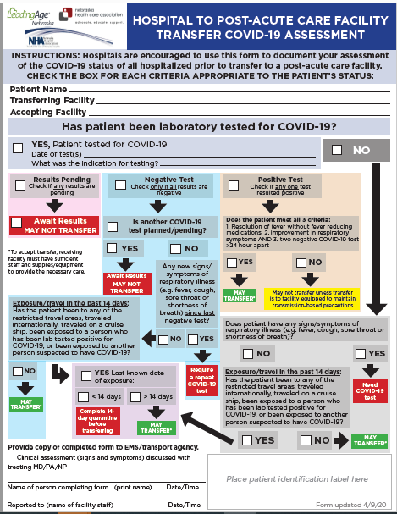

Slide 46
Managing COVID 19 in LTC
Patient from LTC in ACH ready to go back to LTC
1. Stay in Acute Care (stays lengthened)-until bed utilization goes up
2. Go to a separate convalescent site
3. Accept back in your facility if transmission-based precautions can be implemented
Patients in LTC-
1. If possible, keep in facility if can implement transmission-based precautions, preferably in a cohorted area
2. Decision made on a case by case basis based on # of cases, capacity of staffing, risk to to other residents and bed availability
3. Cohort patients within LTCF - creating COVID unit or section-LTC Webinar 4-16-20
ICAP provides guidance for each LTC that has a case of COVID-19 now.
Some onsite evaluations being done-5 teams of 2 to be deployed

Slide 47
Establishing Transitional (Gray) Zones:
All nursing homes should consider establishing a transitional zone for new admissions, returning residents from the hospital or those who are travelling in and out of the nursing home (such as the residents who are on dialysis). Transitional zones/units are established to quarantine those residents who are at somewhat higher risk of getting exposed to COVID-19 but have no known exposure to COVID-19.
  Facilities should also consider dedicating separate staff to take care of residents in transitional (gray) zone/unit.
  Facilities may consider implementing COVID-level precautions for the residents admitted to the transition unit based on individual risk assessment.
  These units should be established even when no COVID-case is identified at the facility and may consist of dedicating a geographically distinct area/unit/rooms to returning residents.
  The residents are usually kept in this zone for 14 days and if remains asymptomatic at the end of 14 day will be moved to the Green zone.

Slide 48
Figure: Cohorting Residents in the Long-Term Care Facilities
Red Zone (Isolation zone) | Dark Red | Residents with Positive COVID-19 test
 | Light Red | Symptomatic residents suspected of having COVID-19
Yellow Zone (Quarantine zone) |  | Asymptomatic residents who may have been exposed to COVID-19
Green Zone (COVID-19 free zone) |  | Asymptomatic residents without any exposure to COVID-19
Gray Zone (Transitional zone) |  | Residents who are being transferred from the hospital/outside facilities (but have no known exposure to COVID-19) are usually kept in this zone for 14 days and if remains asymptomatic at the end of 14 day will be moved to Green zone
https://icap.nebraskamed.com/wp-content/uploads/sites/2/2020/04/Cohorting-Plan-for-LTCF-4.16.20.pdf.

Slide 49
When home quarantine and isolation are over
• Discontinuation from self-isolation for a symptomatic case (confirmed or probable):
CDC guidance (https://www.cdc.gov/coronavirus/2019-ncov/hcp/disposition-in-homepatients.html) states that an individual can stop self-isolation if it has been at least 7 days since symptoms first appeared AND No fever for at least 72 hours (fever-free for 3 full days off fever-reducing medicine) AND All other symptoms have improved (e.g., cough has improved).
• Discontinuation from self-isolation for an asymptomatic laboratory-confirmed case.
Isolation should continue until at least 7 days have passed since the date of the positive test, and for 3 days following discontinuation of isolation a cloth or surgical mask should be worn while near other people (https://www.cdc.gov/coronavirus/2019-ncov/hcp/ disposition-in-home-patients.html)
Emphasize the need for social distancing for 14 days or longer if possible
•

Slide 50
When Home Q and Isolation are Over (continued)
Discontinuation of self-monitoring and self-quarantine:
  Self-quarantine and self monitoring may stop if after 14 days from most recent exposure, there has been NO development of respiratory illness symptoms. Symptoms may include: cough, shortness of breath, fever, sore throat, and fatigue, myalgias, diarrhea.
Discontinuation of quarantine for household members of a person with COVID-19 who is under self-isolation:
  Individuals who are at home with someone that has (or is suspected of having) COVID-19 should continue self-quarantine for 7 days after patient has been released from isolation AND then continue 7 more days with self-monitoring (total of 14 days).
These guidelines may not always pertain decisions regarding admission/discharge and transfer to/from healthcare facilities.

Slide 51
HCP Return to work
Follow guidelines on the prior 2 slides for the particular pertinent situation . Some medical systems follow 10 days since onset of symptoms and 5 days of being afebrile and symptom improvement.
Wear a facemask until all symptoms are resolved or 14 days after symptom onset whichever is longer
Be restricted from contact with severely immunocompromised patients
Adhere to HH and respiratory etiquette as recommended for control of COVID-19 in the interim guidance
Self monitor for worsening or recurrence of symptoms and notify employee health/occupational health/supervisor if occurs

Slide 52
Infection Prevention and Control
Office Hours
Monday – Friday
7:30 AM – 9:30 AM Central Time
2:00 PM -4:00 PM Central Time
Call 402-552-2881

Slide 53
Extended Use Update from CDC Guidance
A key consideration for safe extended use is that the respirator must maintain its fit and function. Workers in other industries routinely use N95 respirators for several hours….can function within their design specifications for 8 hours of continuous or intermittent use…... Thus, the maximum length of continuous use in non-dusty healthcare workplaces is typically dictated by hygienic concerns (e.g., the respirator was discarded because it became contaminated) or practical considerations (e.g., need to use the restroom, meal breaks, etc.), rather than a pre-determined number of hours.
If extended use of N95 respirators is permitted, respiratory protection program administrators should ensure adherence to administrative and engineering controls to limit potential N95 respirator surface contamination (e.g., use of barriers to prevent droplet spray contamination) and consider additional training and reminders (e.g., posters) for staff to reinforce the need to minimize unnecessary contact with the respirator surface, strict adherence to hand hygiene practices, and proper Personal Protective Equipment (PPE) donning and doffing technique. Healthcare facilities should develop clearly written procedures to advise staff to take the following steps to reduce contact transmission after donning:

Slide 54
Extended Use (continued)
Discard N95 respirators following use during aerosol generating procedures.
Discard N95 respirators contaminated with blood, respiratory or nasal secretions, or other bodily fluids from patients.
Discard N95 respirators following close contact with, or exit from, the care area of any patient co-infected with an infectious disease requiring contact precautions.
Consider use of a cleanable face shield (preferred³) over an N95 respirator and/or other steps (e.g., masking patients, use of engineering controls) to reduce surface contamination.
Perform hand hygiene with soap and water or an alcohol-based hand sanitizer before and after touching or adjusting the respirator (if necessary for comfort or to maintain fit).
Extended use alone is unlikely to degrade respiratory protection.

Slide 55
HCW Masking
Dr. Gary Anthone is recommending that all Healthcare Professionals with Patient Contact
wear a facemask.
Sample Policy
A surgical face mask may be issued at the start of each shift,
Your mask will be used throughout the shift.
In the event that the mask becomes visibly soiled, saturated or damaged, a new mask must be obtained. Stock will be securely stored in each clinical setting.
Should you need a replacement mask, you must request one from supervisory personnel
Nonclinical staff do not need to wear a surgical grade facemask but should consider wearing cloth masks as per the CDC guidelines for the general public.

Slide 56
Respirator Reuse Recommendations
There is no way of determining the maximum possible number of safe reuses for an N95 respirator as a generic number to be applied in all cases. Safe N95 reuse is affected by a number of variables that impact respirator function and contamination over time.(18, 19) However, manufacturers of N95 respirators may have specific guidance regarding reuse of their product.The recommendations below are designed to provide practical advice so that N95 respirators are discarded before they become a significant risk for contact transmission or their functionality is reduced. If no manufacturer guidance is available, preliminary data(19, 20) suggests limiting the number of reuses to no more than five uses per device
If reuse of N95 respirators is permitted, respiratory protection program administrators should ensure adherence to administrative and engineering controls to limit potential N95 respirator surface contamination (e.g., use of barriers to prevent droplet spray contamination) and consider additional training and/or reminders (e.g., posters) for staff to reinforce the need to minimize unnecessary contact with the respirator surface, strict adherence to hand hygiene practices, and proper PPE donning and doffing technique, including physical inspection and performing a user seal check.(16) Healthcare facilities should develop clearly written procedures to advise staff to take the following steps to reduce contact transmission:

Slide 57
Strategies for Re-Use of masks
The pathogens on the filter materials of the FFR may be transferred to the wearer upon contact with the FFR during activities such as adjusting the FFR, improper doffing of the FFR, or when performing a user-seal check when redoffing a previously worn FFR. A study evaluating the persistence of SARS-CoV-2 (the virus that causes COVID-19) on plastic, stainless steel, and carboard surfaces showed that the virus is able to survive for up to 72-hours [1]. One strategy to mitigate the contact transfer of pathogens from the FFR to the wearer during reuse is to issue five respirators to each healthcare worker who may care for patients with suspected or confirmed COVID-19.
The healthcare worker will wear one respirator each day and store it in a breathable paper bag at the end of each shift. The order of FFR use should be repeated with a minimum of five days between each FFR use. This will result in each worker requiring a minimum of five FFRs, providing that they put on, take off, care for them and store them properly each day. Healthcare workers should still treat the FFRs as though they are still contaminated and follow the precautions outlined in our reuse recommendations. If supplies are even more constrained and five respirators are not available for each worker who needs them, FFR decontamination may be necessary.

Slide 58
Re-Use of N-95s
Discard N95 respirators following use during aerosol generating procedures.
Discard N95 respirators contaminated with blood, resp or nasal secretions, or other bodily fluids
Discard N95 respirators after close contact with pt co-infected with an ID requiring contact prec.
Consider use of a cleanable face shield (preferred³) over an N95 respirator and/or other steps (e.g., masking patients, engineering controls), when feasible to reduce surface contamination
Hang used respirators in a designated storage area or keep them in a clean, breathable container such as a paper bag between uses. To minimize potential cross-contamination, store respirators so that they do not touch each other and the person using the respirator is clearly identified. Storage containers should be disposed of or cleaned regularly.
Clean hands with soap and water or an alcohol-based hand sanitizer before and after touching or adjusting the respirator (if necessary for comfort or to maintain fit).
Avoid touching the inside of the respirator. If inadvertent contact is made with the inside of the respirator, discard the respirator and perform hand hygiene as described above.
Use a pair of clean (non-sterile) gloves when donning a used N95 respirator and performing a user seal check. Discard gloves after the N95 respirator is donned and any adjustments are made to ensure the respirator is sitting comfortably on your face with a good seal.

Slide 59
Re Use continued
Follow the manufacturer’s user instructions, including conducting a user seal check.
Follow the employer’s maximum number of donnings (or up to five if the manufacturer does not provide a recommendation) and recommended inspection procedures.and post UV or H2O2 disinfection
Discard any respirator that is obviously damaged or becomes hard to breathe through.
Pack or store respirators between uses so that they do not become damaged or deformed.
Secondary exposures can occur from respirator reuse if respirators are shared among users and at least one of the users is infectious (symptomatic or asymptomatic). Thus, N95 respirators must only be used by a single wearer. To prevent inadvertent sharing of respirators, healthcare facilities should develop clearly written procedures to inform users to:
Label containers used for storing respirators or label the respirator itself (e.g., on the straps(11)) between uses with the user’s name to reduce accidental usage of another person’s respirator.

Slide 60
New Testing Capacity
CHI Health-Creighton Core Lab (Omaha): •
ABBOTT M2000: 94/tests/run; up to three runs/day
Regional Pathology Service (RPS) Laboratory, affiliated with Nebraska Medicine: •
UDT TEST: 100 tests/ day •
ROCHE COBAS 6800: 180 tests/day • TOTAL: 280 tests/day
Nebraska Public Health Laboratory (NPHL) based at UNMC in Omaha: •
CDC-public health test: up to 400 tests/day
Commercial labs (LabCorp, Quest, Mayo Clinic, ARUP, etc.): •
Currently reporting approximately 100 total tests /day; future capacity, unknown. These labs accept orders for COVID-19 tests without restrictions or prescreening.

Slide 61
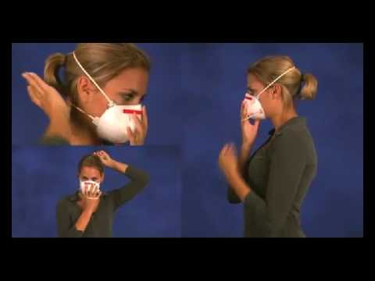
User seal check for N95 respirators
https://www.youtube.com/watch?v=pGXiUyAoEd8.

Slide 62
CDC Updates PPE Optimization Strategies
Alert facilities that updates have been made
Encourage review of guidance at https://www.cdc.gov/coronavirus/2019-ncov/hcp/ppe-strategy/index.html
Highlights:
  Extended use and limited re-use of facemasks
  “When no facemasks are available” guidance
  No resources for Crisis/Alternative Strategies for N95s
  Option for reprocessing eye protection
  Strategies to Allocate Ventilators from Stockpiles to Facilities
  Additional crisis strategies for gowns, including “when no gowns are available”
Notes:
We just want to alert people that the CDC has updated their PPE Optimization Strategies. Some highlights are included here. It is worth reading to see if this gives facilities any new ideas, but frankly catches CDC up to what has been under discussion in Nebraska for awhile- including strategies from NETEC and Nebraska Medicine.

Slide 63
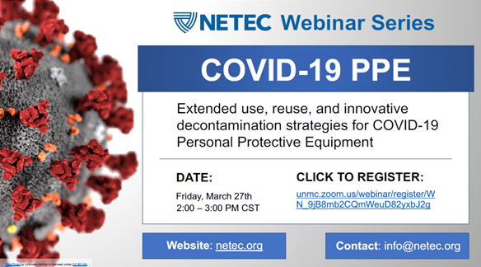
Registration link: https://unmc.zoom.us/webinar/register/WN_9jB8mb2CQmWeuD82yxbJ2g

Slide 64
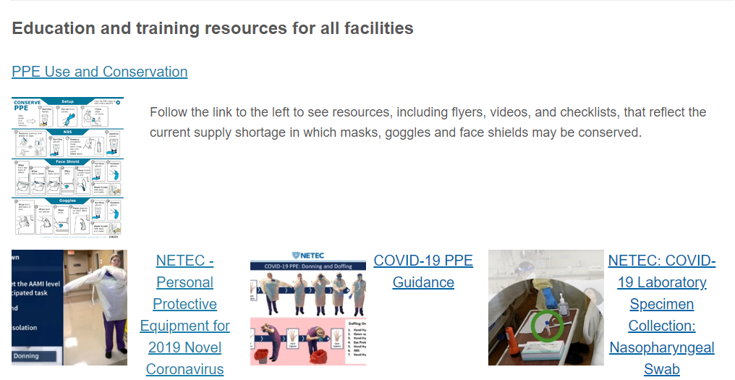
https://repository.netecweb.org/exhibits/show/ncov/ncov
Notes:
NETEC offers excellent training resources on COVID-19 PPE use, as well as conservation

Slide 65
Resources (as of 8:00am 3/30/20)
Exposure Risk Assessment
https://www.cdc.gov/coronavirus/2019-ncov/hcp/guidance-risk-assesment-hcp.html
Guidance for pregnant and breastfeeding mothers
https://www.cdc.gov/coronavirus/2019-ncov/need-extra-precautions/pregnancy-breastfeeding.htmll
Guidance for PPE
https://www.cdc.gov/coronavirus/2019-ncov/hcp/ppe-strategy/index.html
  Regarding use of homemade masks
  https://www.cdc.gov/coronavirus/2019-ncov/hcp/ppe-strategy/face-masks.html

Slide 66
Presentation prepared by: Dr. Maureen Tierney and Dr. Tom Safranek
HAI/AR Epidemiologist
Ishrat.kamal-ahmed@Nebraska.gov
402-471-2937

