Slide 1
Don't Relax Yet: The Ongoing Threat of Ransomware in Healthcare
RICHARD P. JEFFRIES
MARISSA J. SALBER

Slide 2
Change Healthcare HACKED
Ransomware attack on Change Healthcare’s network
US Dept. of Health and Human Services calls it an “Unprecedented attack on patient care and privacy”
Up to 1/3 of Americans had data stolen

Slide 3
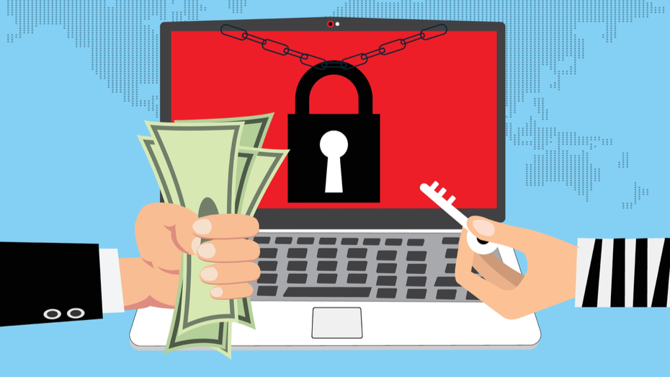
The Effects of the Ransomware Attack
Stolen protected health information (PHI)
HHS Investigation
Mandatory reports to HHS
Severe disruption to revenue cycle
Notes:
The attack impacted a wide range of critical services used by healthcare providers across the U.S., including payment processing, prescription writing, and insurance claims, and caused financial damages estimated at $872 million. (Bleep).

Slide 4
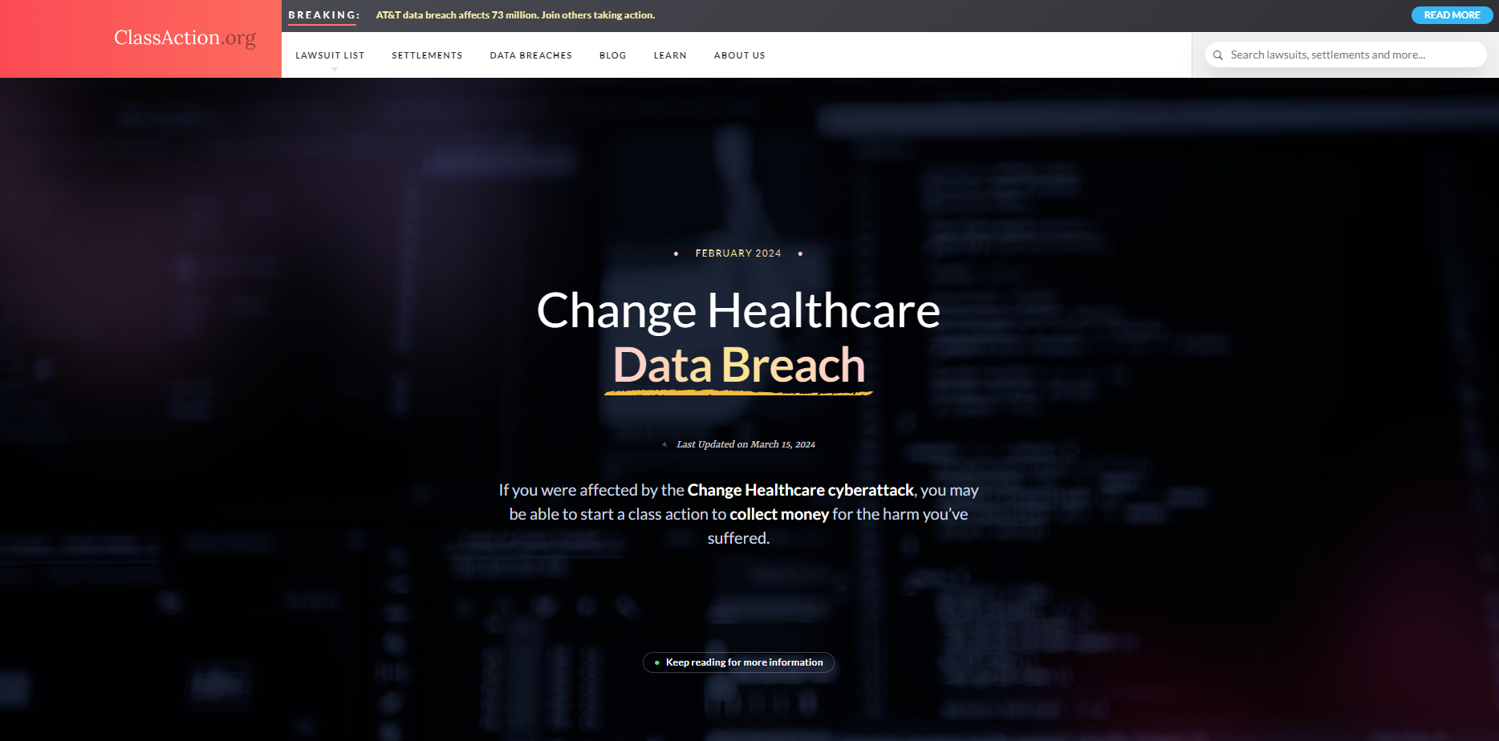
…and, of course, class action suits!

Slide 5
The Evildoers: BlackCat Cyber Gang
BlackCat, or ALPHV, is a prominent Russian ransomware group
Targeted the computer networks of over 1,000 victims globally
May 2022 $5 million in ransom attack on European government
U.S. Dept. of State is offering rewards of up to $10 million to locate gang leaders
Notes:
Over the past 18 months, ALPHV/Blackcat has emerged as the second most prolific ransomware-as-a-service variant in the world based on the hundreds of millions of dollars in ransoms paid by victims around the world. Due to the global scale of these crimes, multiple foreign law enforcement agencies are conducting parallel investigations. (US Dept. of Justice)

Slide 6
The Method
Stolen Employee Credentials
Remote Desktop Access
An “easy break-in”: NO multi-factor authentication on the remote access
Notes:
-Andrew Witty, United Health CEO, confirmed that the attacker had access to the company’s network for 10 days before deploying their encryptors
-With no multifactor authentication to a remote desktop access portal, hackers only needs compromised credentials to access it

Slide 7
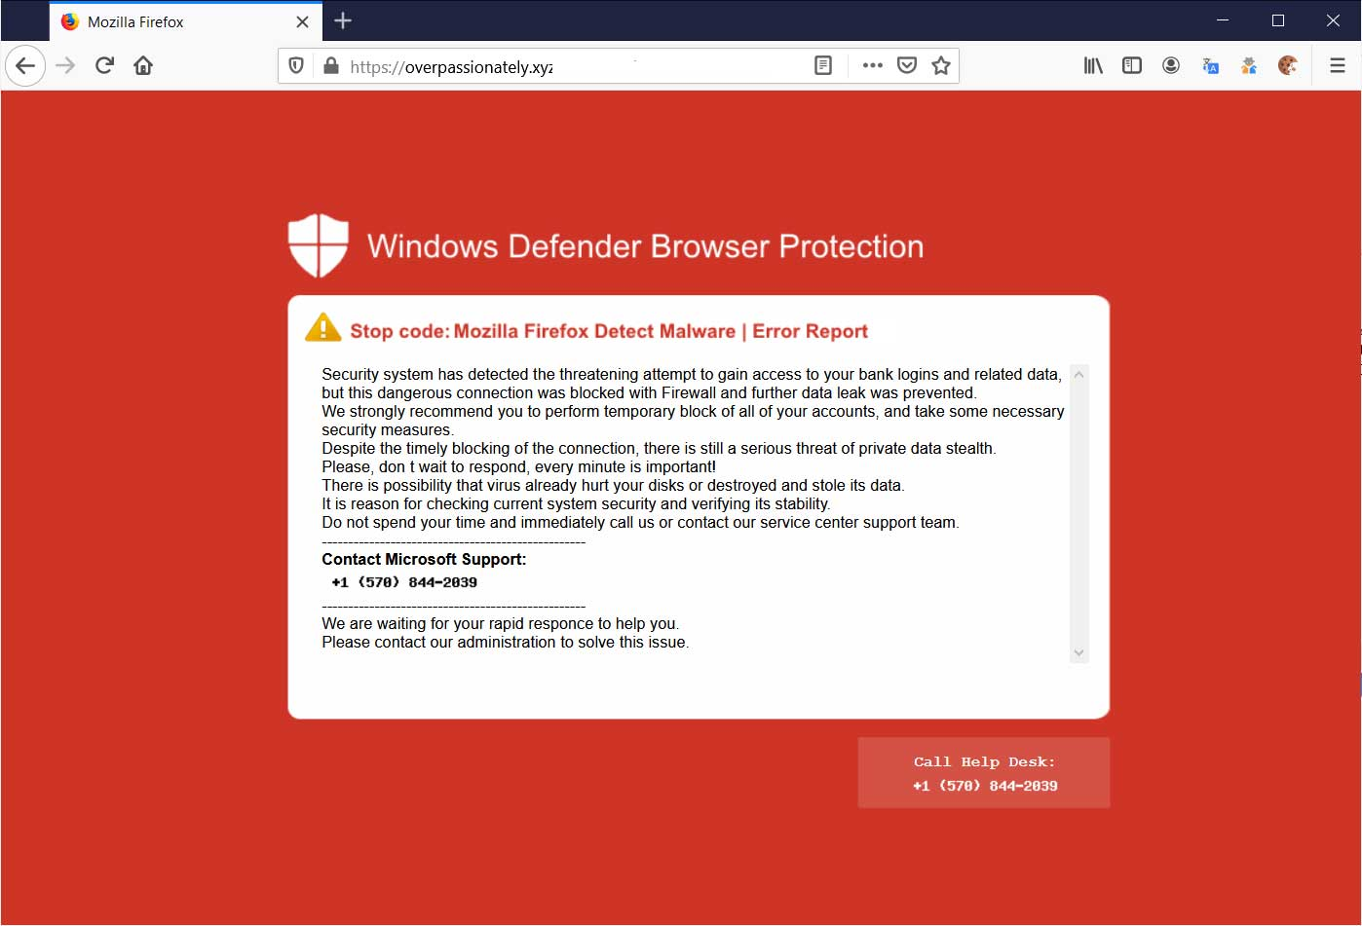
Source: Bleeping Computer

Slide 8
About Multifactor Authentication
The things you use to prove you are that person are authentication
Your username is your identification
Multifactor Authentication (MFA) = using more than one thing to prove you are who you say

Slide 9
Authenticating Factors
Something you know
e.g., password
Something you have
e.g., physical key, number token
Something you are
e.g., Biometrics—face scan, fingerprint

Slide 10
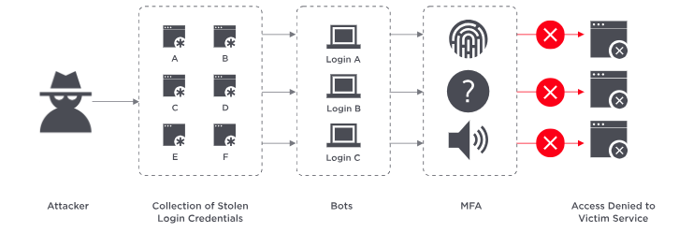
How Does MFA Reduce Ransomware Risk?
Greatly reduces the effect of stolen credentials
An attacker may find credentials with brute force, but without other authentication factors, they cannot access the system
MFA adds an additional layer of protection against social engineering scams as it relies on more than one factor, such as passwords, to verify the customer’s identity.
Source:
OneLogin

Slide 11
Managing the Risks of Ransomware

Slide 12
Dark Clouds: The Vendor Problem
There is no such thing as “The Cloud”, only other people’s computers
Other peoples’ computers can be hacked too
What do you know about their security regime?
What do they promise in case of an incident?

Slide 13
Mitigation Strategies: Vendor Contract Management Disclaimers?
Limitations of Liability?
“Gross Negligence” clauses?
Business Associate Agreements in place and up to date?

Slide 14
Mitigation Strategies: Insurance
Limits and Sublimits: Enough?
01
Many policies limit recovery for incidents at vendors
02
Business interruption insurance?
03
How long is the “waiting period”
Are cyber risks excluded?

Slide 15
Mitigation Strategies: Keeping Your Own Systems Secure
Password hygiene
Length > complexity
Only force change when necessary
Multifactor authentication
Permit access only as needed
Segregate PHI whenever possible
Authority and Access: Janitors have keys!

Slide 16
Mitigation Strategies: Continuous Training
Employees are a line of protection against ransomware threats
Constantly teach them what the threat looks like and how it works
Build a culture of trust and reporting
Make your people your best infosec allies
Notes:
According to Verizon’s “2023 Data Breach Investigations Report,” 74% of breaches involve a human factor, whether through negligence, stolen passwords, or falling prey to phishing scams. With the average overall cost of a ransomware breach is $5.13 million, companies must undergo ransomware training to assist employees in recognizing and mitigating the threat.

Slide 17
Mitigation Strategies: Self-Assessment
Penetration tests and audits
HIPAA Security Risk Analysis [link]
Cyber Insurance Application

Slide 18
Mitigation Strategies: Financial Stress Test
Are your vendors solvent?
Can you withstand 30 days without:
Treating patients?
Being paid?

Slide 19
Mitigation Strategies: Incident Response Plan—“The Red Binder”
Have a physical recovery plan
If your system is hacked, you do not want your plan to require an operative system to access
Comprehensive checklist
Have someone in charge

Slide 20
Questions?
Richard P. Jeffries
rickjeffries@clinewilliams.com

