Slide 1
Remotely Improving Physical Activity in Rural Communities
Rashelle Hoffman, PT, DPT, PhD

Slide 2
Objectives
Describe the modifiable risk factors leading to elevated risk of Alzheimer’s Disease and Related Dementias in rural areas
Discover the feasibility of a physical activity behavioral intervention based on rural community partner perspectives data
Outline steps forward to enhance physical activity promotion in Nebraska’s health system and in rural communities
Notes:
Understand and define dementia and Alzheimer’s
Have a basic understanding of changes in the brain that accompany Alzheimer’s
Understand the causes and risk factors for Alzheimer’s disease
Understand the signs and symptoms of dementia and be able to differentiate between normal aging and concerning signs/symptoms
Understand the benefits of early detection
Know the difference between screening and diagnosis
Understand the difference between a treatment and a cure and identify Alzheimer’s treatments
Identify actions that support brain health
Know about local and national resources available to people with Alzheimer’s
Understand benefits of participating in clinical research
Expand to address these areas…

Slide 3
Vevox Poll
Notes:
What is one word you wrote down that you think of regarding dementia?

Slide 4
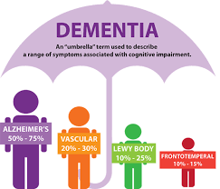
Alzheimer’s Disease (AD)
Most common cause of dementia
Nearly 7 Million Americans are living with AD
1 in 3 seniors die from AD or another dementia
From 2000 to 2021 deaths from heart disease have decreased by 2.1% while deaths from AD have increased 141%
Expected costs for AD and other dementias is estimated to be $360 Billion
Marked by early memory impairment, executive dysfunction
Dementia is NOT a normal part of aging
Alzheimer’s Association
https://www.alz.org/alzheimers-dementia/facts-figures
Notes:
Greatest risk factor for dementia is age but NOT a normal part of aging
https://www.alz.org/media/Documents/alzheimers-facts-and-figures-infographic.pdf

Slide 5
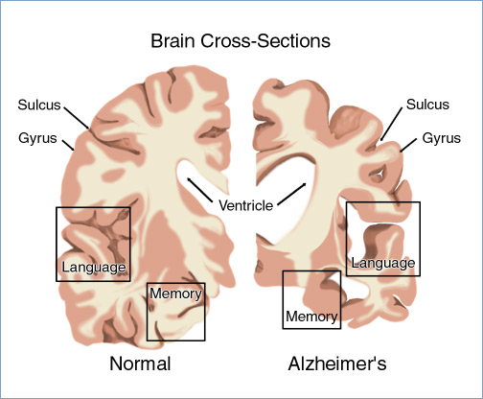
What causes dementia?
As we age our brain loses cells and build up toxic compounds
These changes take place faster in people with dementia, in addition to other structural and chemical changes.
The exact cause of Alzheimer’s disease is unknown.
Amyloid plaques
Tau tangles
Notes:
Our brain does not clean up toxicity as well

Slide 6
Notes:
Cortical tissue atrophy
Ventricular enlargement

Slide 7
Living with Dementia
Life expectancy:
AD usually 8-10 years after diagnosis
Vascular dementia: 5 years
Lewy Body Dementia: 6 years
Frontotemporal: 6 years
Depression vs Dementia
Overlap in attention and concentration
Dementia is associated with memory, speaking, or motor impairment
Notes:
AD dx: depends at what age diagnosed could not be a consideration of shortening of life, some reported to live over 25 years with a AD diagnosis, end of life care may not be necessary initially upon dx

Slide 8
There is hope!
Researchers have identified 6 key lifestyle behaviors that reduce personal risk of AD.
Cognitive Engagement
Social Engagement
Stress
Sleep
Nutrition
Physical Activity and Exercise
And when you reduce your risk for AD, you also reduce your risk for all forms of dementia, CVD, type II diabetes, many forms of cancer and MORE!
Notes:
-Cognitive Engagement-stimulating activities, use it or lose it, passive (i.e., documentaries)is good but active engagement is best (learn something new!)
-social engagement (reduce risk of cognitive decline, combat stress levels, reduce risk of depression, encourage PA and cognitive stimulation) can see how these are related vs social isolation
-Stress: linked with smaller hippocampal volume (important for memory storage)
-Sleep: Quantity and Quality (repairs tissue, builds and repairs muscle tissue/cells, transfers short term to long term memories
-Nutrition: change from restriction/diet to nourish mindset

Slide 9
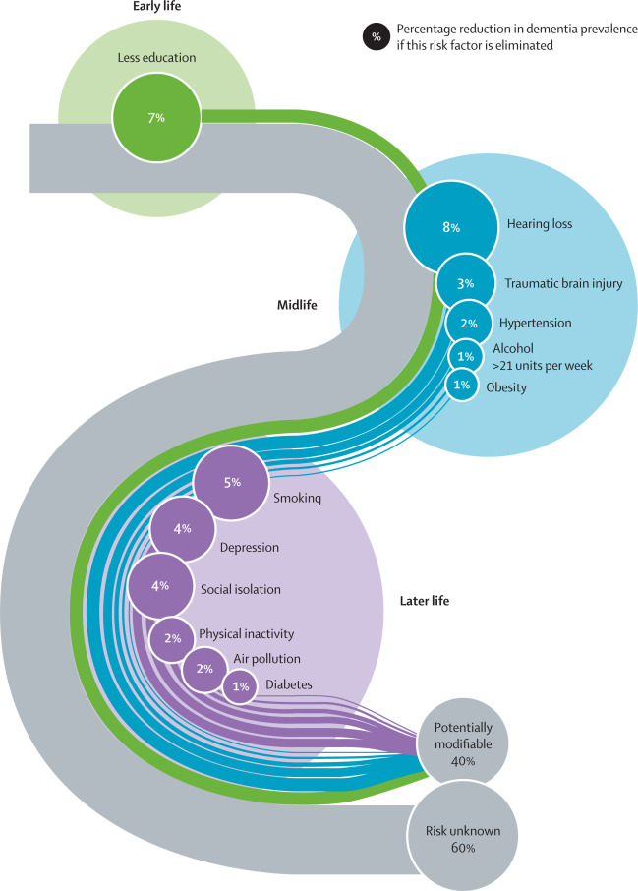
Physical Activity and Exercise
Livingston, 2020, Lancet
One in five Americans live in rural areas and have a two-fold increase in dementia mortality due to modifiable factors such as physical inactivity
Improving physical activity can reduce further cognitive decline by 35-45% and improve current mobility (some mobility deficits noted early in cognitive decline)
Ideal to intervene during early stages of cognitive impairment
Communication becomes more challenging with advanced cogntivie impairment (often less verbal communication
Reduced problem solving
Notes:
-Dementia specifically AD is the one of higher causes of death in the US specifically 6th
-Individuals in rural areas have a two-fold increase but thankfully this increase is mainly a result of modifiable factors (or things that we can change/address). Rural high mortality is due to sedentary behavior, decreased access to health services, increased obesity
-Physical activity is the modifiable risk factor we targeted with the proposed intervention
-mobility changes early on with Timed up and Go and gait speed
-gestures as a way of communicating and response to irritants in their environment
-may want to help correct a person with more severe cognitive impairment

Slide 10
Adapting a Physical Activity Intervention for Rural Areas: People with MCI and Care Partner Dyads
The Telerehabilitation Physical Activity Behavioral (TPAB) Intervention is effective to improve daily steps in older adults
Rural dwelling individuals with cognitive impairment have unique needs (i.e., reduced social support and cognitive impairment) justifying adaptations to TPAB
Table 3. Telerehabilitation Physical Activity Behavioral (TPAB) Intervention Outline
Behavior Change Technique | Application
Self-monitoring of Behavior (1) | Utilize Fitbit for daily step monitoring
Action Planning (2) | Weekly action planning based on participant step count/identified individual targets
Graded Tasks (3) | Connection to self-monitoring and noted differences with higher/lower step count days
Restructuring the Physical (4)/ Social Environment (5) | Discussion of personal barriers/facilitators to exercise and discussion of environmental components that can change
Problem-Solving (6) | Discussion of reducing personal barriers and leveraging personal facilitators to increase daily steps
Prompts/Cues (7) | Identification of cues that will be useful in self-management of daily steps moving forward and long-term
Notes:
TPAB is a behavioral intervention that has shown to be effective at improving daily stepping
Unique needs include greater social support, reduced access to exercise facilities, cognitive challenges with remember the program)

Slide 11
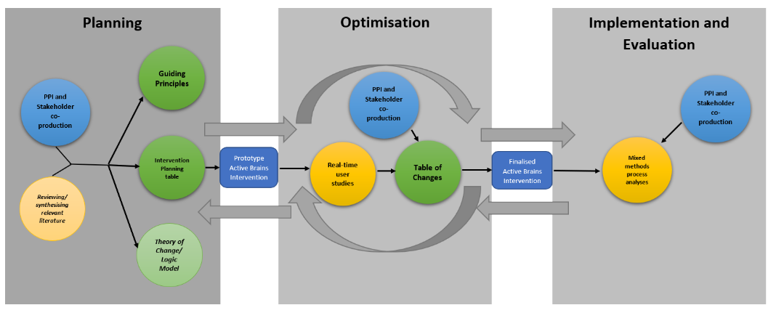
Adapting a Physical Activity Intervention for Rural Areas: People with MCI and Care Partner Dyads
Person Based Approach for Intervention Development
https://www.personbasedapproach.org/pba_diagram.html
Notes:
Within the PBA for Intervention Development we are specifically within the planning stage where we have read related literature and collecting stakeholder input for eventual co-production/design with stakeholders
This project specifically focuses on the gap identified in the literature of a physical activity intervention for individuals with MCI/early-stage dementia and care givers in rural areas. The goal of the project was to obtain initial input from stakeholders and understand perspectives to move towards co-designing the intervention

Slide 12
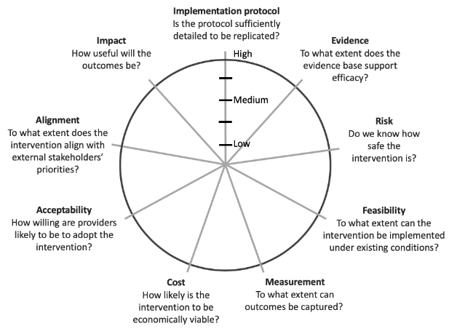
Adapting a Physical Activity Intervention for Rural Areas: People with MCI and Care Partner Dyads
Readiness Assessment for Pragmatic Trials (RAPT) model
Focus Groups
Currently Practicing Rural Medical Providers (n=3)
Community Dwelling Older Adults (n=4)
Care Partners of Individuals with Cognitive Impairment (n=4)
https://www.brown.edu/academics/public-health/qandi/RAPT
Notes:
The RAPT is a model to assess if the intervention is sufficiently ready to move forward with a pragmatic trial. A pragmatic trail is simply testing the intervention’s effectiveness under real-world conditions.
The data I will present today was from one rural community in Nebraska and we specifically targeted the domains outlined in red to help initially gauge the current state of the intervention and what may need to be changed to progress to the next step of co-designing this intervention with dyads and medical providers
Implementation protocol: do we have enough detail about the intervention to actually use it
Evidence: are there RCTs to support to establish the efficacy
Feasibility: can we implement it in its current state or do we need to make modifications/adaptations
Acceptability: How willing is the staff and providers to recommend/accept the intervention? Does it address a need?
Alignment: Does the intervention aim to address a stakeholder priority?
Impact: Does the PCT’s results (impact/improvement in physical activity) meaningful and useful? Not a justification for the intervention itself
Review the number of people in each category and specify that each group was a separate focus group interview

Slide 13
Adapting a Physical Activity Intervention for Rural Areas: People with MCI and Care Partner Dyads
Results
Implementation Protocol: TPAB protocol was well documented and ideally structured with the care partner
Evidence: TPAB Evidence for other older adult populations but not specifically determined yet for individuals with MCI and care partners
Feasibility: It was determined that modifications are needed to enable implementation.
Local champion/facilitator to overcome the barrier of physical distance between the research team and participants
Deadlines for recruitment windows
Past participating community members to share their feedback and recruit other members
Primary care provider communicating support and encouragement for the study
Emphasizing how the program is tailored for each participant to enhance recruitment, and 6) understanding and incorporating local resources during the intervention.
Notes:
Tailored: not the same step goals for each person but individualized conversations discussing personal stepping goals, personal barriers and facilitators and individual problem solving strategies

Slide 14
Adapting a Physical Activity Intervention for Rural Areas: People with MCI and Care Partner Dyads
Results (cont’d)
Acceptability/Impact:
Medical providers accepted the intervention based on the substantial impact on reducing cognitive impairment and for additional health benefits such as reduced risk of comorbidities, anxiety, and depression.
All focus groups expressed how physical activity is important to the community and there is a demand to improve it.

Slide 15
Adapting a Physical Activity Intervention for Rural Areas: People with MCI and Care Partner Dyads
Focus Group Sample Quotations
Dimension | Sample Quotations
Implementation Protocol | “I like the fact that it’s couples rather than individuals, I think that’s a good program thought. Then you’ve got somebody you’re accountable to or somebody pushing you”
Feasibility | “And Fitbit you know that’s big deal for <Name>. I think you give people that that's a huge motivator. They gave me this deal I better use it. I think you’ve got good incentives”
Acceptability | “I think it would be accepted very well as long as especially they just hear it from their provider or their physical therapist or their kid that you know sometimes their kids can get on them or their spouse can get on for doing but if they're hearing it from a lot of different people in general, they’re more apt to.”
Alignment | “So, the way you have put this program together I think is it really points towards success for people. It's just giving them a framework to get started and get moving and doing it with a person that they trust and somebody that they care about. I think that makes a big difference.” “I think there's always a need to improve physical activity. I think we have set people that are very into it and you’re always gonna have some that could benefit from more. So, I think programs like this would be great to maybe try to get more people involved.”
Impact | “You know I could see where a couple women are doing this together maybe and then they're talking to their friends and then you see all eight of them walking together. I mean that's just how small town is, so different than big city.” “So many people with mild stages of cognitive impairment they feel like there's just so much that they can't do about the situation. This is something they can do as an encouraging kind of thing.”
Notes:
There is hope! There are steps forward

Slide 16
Vevox Poll
Notes:
Motivational Interviewing activity

Slide 17
Thank you! Please remember to fill out your post-survey.

