Slide 1
Emergent Obstetrical Delivery
Katherine Feagler RN BSN OCN
MSN/MBA Student
Nebraska Wesleyan University
July 2020

Slide 2
Background
Rural hospitals or Critical Access Hospitals have stopped their Obstetrical services due to cost, malpractice issues, and/or low volume, high risk situations.
Hospitals must be able to handle emergent obstetrical deliveries in the event the delivery risk outweighs the transfer risk to mother and fetus.
Notes:
Review this slide as to the objectives of the PowerPoint

Slide 3
Hospital Obstetrics in Rural Counties 2004-2014 (Centers for Medicare & Medicaid, 2019)
Notes:
Many rural hospitals have remained open or became critical access hospitals. The problem is specialty service lines have been discontinued including obstetrics and gynecologic services. Some of the reasons include: low birth volumes, low revenue due to the payer mix, difficulty in recruiting and maintain the skill of providers and staff, concerns with high cost of malpractice insurance.
Nebraska has a mixture of hospital obstetrics for full closure to no services as displayed by the different colors of blue. White areas represent a more urban or metropolitan region.
Centers for Medicare & Medicaid. (2019, June). Improving access to maternal health care in rural communities. Retrieved from https://www.cms.gov/About-CMS/Agency-Information/OMH/equity-initiatives/rural-health/09032019-Maternal-Health-Care-in-Rural-Communities.pdf

Slide 4
Challenges in Rural Hospitals
Lack of obstetrical services have affected women’s access to and timeliness in maternal health care.
Less than 50% of rural women have access to perinatal services within a 30-minute drive.
More than 10% of rural women drive over 100 miles for perinatal services.
Social services and Behavioral services are inadequate to promote healthy pregnancies and outcomes.
(Center for Medicare & Medicaid, 2019)
Notes:
Challenge is women in rural areas have less access to OB care as well as their travel time increase in order to travel to receive OB-GYN care.
In the statistics from 2004-2014, complied for the issue brief “Improving Access to Maternal Health Care in Rural Communities” by the Center of Medicare & Medicaid in 2019, nearly half of the rural counties in the US had no hospital that offered obstetric services.
Challenges with social services and behavioral services were even greater in counties that had a high population of racial and ethnic minority women. This is true due to those hospital service line closures happened in communities with a higher percentage of Black, Hispanic, and unemployed residents.
The gaps in maternal care (obstetrical and gynecological) affected the women's access to labor and delivery services, as well as to prenatal and postpartum care that is associated with a wide range of infant and maternal health outcomes in the United States.
Centers for Medicare & Medicaid. (2019, June). Improving access to maternal health care in rural communities. Retrieved from https://www.cms.gov/About-CMS/Agency-Information/OMH/equity-initiatives/rural-health/09032019-Maternal-Health-Care-in-Rural-Communities.pdf

Slide 5
Position Statement on Rural Obstetric Settings
According to The American College of Obstetricians and Gynecologists (2018), “The provision of safe obstetric care requires a commitment to lifelong learning and maintenance of knowledge and skills. Rural settings, low-volume settings, or both may present challenges in maintain clinician and nursing skills because of limited volume and, therefore limited opportunity to participate in various aspects of care” (para. 1).
Notes:
The American College of Obstetricians and Gynecologist released the position statement on “Practice Considerations for Rural and Low-Volume Obsteric Settings” in May of 2016 and reaffirmed in July 2018.
The American College of Obstetricians and Gynecologists. (2018, July). Practice considerations for rural and low-volume obstetric setting. Retrieved from https://www.acog.org/clinical-(Kozhimannil et al. , 2018) information/policy-and-position-statements/position-statements/2018/practice-considerations-for-rural-and-low-volume-obstetric-settings

Slide 6
ACOG Position, continued
Maximize the number of health care providers (nursing and providers) in a delivery to leverage the available experience.
Periodically rotate health care providers to larger, higher volume, regional facilities to gain and maintain clinical experience.
Provide a structured orientation program for all health care providers who are new to the rural practice setting. Include local and regional practices and standards for delivery.
Conduct structured multidisciplinary drills and simulations based on hospital policy.
(The American College of Obstetricians and Gynecologists, 2018)
Notes:
The ability to maintain the skills of the providers and nursing staff and provide patient safety in a low volume obstetric facility can be enhanced by the activity as listed here.
The American College of Obstetricians and Gynecologists. (2018, July). Practice considerations for rural and low-volume obstetric setting. Retrieved from https://www.acog.org/clinical-(Kozhimannil et al. , 2018) information/policy-and-position-statements/position-statements/2018/practice-considerations-for-rural-and-low-volume-obstetric-settings

Slide 7
ACOG Position, continued
Partner with healthcare systems to ready access to consultation and referral when needed, outreach education, and analysis and evaluation of regional data (facilitated by the healthcare system’s perinatal centers).
Have established agreements with policies and procedures for timely transport, where a woman who needs urgent or emergent delivery (cesarean delivery) can be expeditiously transported to an accepting physician and facility.
Have essential obstetric medications and supplies available (such as magnesium sulfate, antenatal corticosteroids, and tocolytics).
(The American College of Obstetricians and Gynecologists, 2018)
Notes:
The ability to maintain the skills of the providers and nursing staff and provide patient safety in a low volume obstetric facility can be enhanced by the activity as listed here.
Additional options as listed by the position statements that could be implemented to improve a patient’s safety and provide clinical support to the healthcare team is telemedicine or teleconsultation capabilities.
Supporting the healthcare providers in rural settings or low volume settings must be a shared responsibility of the community, the government (local, state, and federal), the payers and each healthcare facility.
The American College of Obstetricians and Gynecologists. (2018, July). Practice considerations for rural and low-volume obstetric setting. Retrieved from https://www.acog.org/clinical-(Kozhimannil et al. , 2018) information/policy-and-position-statements/position-statements/2018/practice-considerations-for-rural-and-low-volume-obstetric-settings

Slide 8
Consequences of Lack of Obstetrical Services
If labor progresses rapidly, the following can happen:
The woman gives birth at the closest hospital
Experiences an unplanned out-of-hospital birth
Plans an out-of-hospital birth
Successful management of either type of birth, requires preparation and readiness of the local providers and hospitals.
(Kozhimannil et al., 2018)
Notes:
On this slide, the woman can experience any of the following. An important thing to remember that even if the woman plans an out of hospital birth, if complications arises during the labor, more times than not, the woman will arrive in the emergency department of the closet healthcare facility. This reinforces the need to be prepared to handle emergent obstetrical deliveries and immediate postpartum care to the mother and infant.
Kozhimannil, K. B., Hung, P., Henning-smith, C., Casey, M. M., & Prasad, S. (2018). Association between loss of hospital-based obstetric services and birth outcomes in rural counties in the United States. Journal of the American Medical Association, 319(12), 1239-1246. https://doi.org/10.1001/jama.2018.1830

Slide 9
Emergency Medical Treatment and Labor Act (EMTALA)
Legal requirement related to obstetric care:
An individual deemed qualified by hospital policy must perform an appropriate medical screening to determine of an emergency conditions exists. In relation to a woman in labor, this must take into consideration the health of both mother and baby.
If the emergency condition exists, stabilize the patient for transfer only if the benefit of transfer outweighs the risks. Written certification is required.
(The American College of Obstetricians and Gynecologists, 2016)
Notes:
Pregnant women can present for care to any healthcare facility that provides urgent or emergent care. OB patients are best served when those facility have policies and protocols in place. The best scenario is to transfer the pregnant woman to the facility where her physician practices. With transferring a patient, all guideline and regulations from local and national organizations (such as the State of NE depart of health, the Joint Commission, CMS) must be followed.
The American College of Obstetricians and Gynecologists. (2016, July). Committee Opinion No. 667: Hospital-based triage of obstetric patients. Retrieved from https://www.acog.org/clinical/clinical-guidance/committee-opinion/articles/2016/07/hospital-based-triage-of-obstetric-patients 202007161600231359672904

Slide 10
EMTALA, continued
A woman in labor is unstable for transfer from laten phase of labor through the delivery of the placenta IF:
Inadequate time to transfer before delivery of the fetus
Transfer poses a threat to the laboring woman or fetus’s health or safety
(The American College of Obstetricians and Gynecologists, 2016)
Notes:
In the event transfer is deemed too risky to mother and fetus, an emergent delivery may happen in your facility.
Examination is critical by a certified professional, the physician, is necessary as transfer of the laboring patient is recommended fi there is time, even if the membranes have ruptured, as antenatal transfer is associated with improved neonatal outcomes as compared to the transfer after the birth.
The American College of Obstetricians and Gynecologists. (2016, July). Committee Opinion No. 667: Hospital-based triage of obstetric patients. Retrieved from https://www.acog.org/clinical/clinical-guidance/committee-opinion/articles/2016/07/hospital-based-triage-of-obstetric-patients 202007161600231359672904

Slide 11
Triage Guideline to Determine a Safe Transfer (The American College of Obstetricians and Gynecologists, 2016)
Notes:
This is a guideline that could be placed in policy and protocol at the healthcare system to help physicians and nurses with decision making.
I would review the slide and walk through the yes and no answers.
The American College of Obstetricians and Gynecologists. (2016, July). Committee Opinion No. 667: Hospital-based triage of obstetric patients. Retrieved from https://www.acog.org/clinical/clinical-guidance/committee-opinion/articles/2016/07/hospital-based-triage-of-obstetric-patients 202007161600231359672904

Slide 12
Emergent Obstetrical Delivery
Non-delivery hospitals must be prepared to handle an emergent delivery through the following:
Policy to address emergent obstetrical delivery
Yearly education and competency of clinical staff on birthing process
Basic equipment and supplies on hand to handle a delivery
Agreements in place with adjacent healthcare systems to accept the mom/baby transfer
Notes:
This is the slide where I would stop the PowerPoint and review the policy on emergent obstetrical delivery, and the education plan developed for CNO’s to use to provide training within their facility.

Slide 13
Educational Plan
The goal of the educational plan is to provide a guide for rural and critical access hospitals to base their facilities education for staff on the delivery of an emergent obstetric patient. The plan will be documented within each facility per their policy and procedure
Notes:
OBJECTIVE : To be able to safely delivery baby by an emergency vaginal delivery.
BACKGROUND
An emergent vaginal delivery or precipitous delivery occurs quickly and typically under 3 hours of labor.
The nurse needs to be prepared to assist the physician with the delivery.
The goals of an emergent delivery are :
Establish a clean, safe, private area for the birth
Facilitate a controlled delivery
Prevent maternal and fetal complications
After delivery, transport mother and neonate to the appropriate level of care
EQUIPMENT
Have on hand and in working condition:
Vital signs monitoring equipment; blood pressure cuffs available for mother and neonate
Stethoscope, adult and pediatric
Sterile gloves
Sterile gowns
PPE: shoe coverings, caps, mask with face shield or mask and googles, gloves
Fluid impermeable pads
Sterile towels
Sterile Kelly clamps or cord clamps, minimum of 2
Sterile scissors
Bulb syringe
Warm blankets
Basins
Neonatal hat, gown, blankets
Adult and Neonatal resuscitation equipment
Identifications bracelets for mother, father, and neonate
Peri bottle with warm water; perineal pads; ice packs
Facility approved cleansing solution or wipes
Bedpan
Additional linens and towels
Facility approved antiseptic solution
Blood sampling supplies
Optional but nice to have:
additional light source, sterile gauze, oxytocin, IV administration equipment and supplies, doppler device
The facility may have on hand a pre-packaged Obstetrics delivery kit that would have necessary supplies and equipment
Equipment and supplies need to be inspected on a routine schedule to make sure it is not compromised or expired.
DELIVERY
Confirm patient’s identity using facility approved policy
Perform hand hygiene
Have another team member call the physician and other emergency personnel; you should always remain with the patient
The other team member gathers equipment and supplies and readies the room for delivery
Explain the procedure to the patient and the significant other
Complete history as time allows to include estimated due date, prenatal care received, any pregnancy complications, the time of membrane rupture and a description of the amniotic fluid, pertinent medical conditions to include group B streptococcus status, number of pregnancies, and types of previous deliveries
Assist the patient to pant during contractions and to rest and breath normal between contractions
Assist the patient into a gown and remove any clothing that obscures the perineum
Position the patient on the bed or cart in a dorsal recumbent, squatting, or side-lying position; this will promote uteroplacental blood flow; do not place patient in supine position as this will compromise blood flow
Assess the patient for signs of an imminent delivery which can include a bulging perineum, vaginal bleeding, urgency to push, and crowning of the presenting part; if the cord presents before the head, the cord has prolapsed; if the presenting fetal part if not a head, the fetus may be in a breech position
Assess feta heart tones using either the stethoscope or doppler device
Monitor patient vital signs, if possible
As delivery draws closer, don in the PPE to include gloves, cap, shoe covers, and mask with googles or mask with face shield
Cleanse the perineum with the approved antiseptic solution
Remove gloves and perform hand hygiene and don in sterile gown and gloves; assist physician with sterile donning of PPE prior to donning in your sterile gown and gloves
If the delivery is progressing faster than anticipated and the physician is not present at the time the fetus is coming, complete the following:
As the fetal head descend in the birth canal, instruct the patient to pant or blow through the contractions; instruct patient not to forceful bear down to help avoid with tearing
Place one of your hands on the perineum to help support the fetal head and control the speed of the expulsion; do not stop fetal descent as this can cause injury
As the head begins to emerge, support the head with one hand and support the perineum with the other hand using a sterile towel or gauze; as the fetus emerges cover the faces with the towel or gauze to prevent fecal contamination to the face
Carefully support the head of the fetus with both hands at the head rotates to one side
If the amniotic sac is intact, break the sac by inserting your finger into the fetus’s mouth or snipping it with sterile scissors at the nape of the fetus neck; carefully pull the membrane away for the fetus’s face
Locate the umbilical cord by placing one or two fingers along the back of the emerging head to make sure the cord is not around the neonate’s neck
If the cord is loosely around the neck, slip it gently over the head; if the cord is tightly wrapped around the neck, the cord must be clamped in 2 places using the Kelly clams and then using the sterile scissors to the cut the cord between the clamps
Instruct the patient to bear down with the next contraction to aid in the delivery of the shoulders; position your hand on either side of the head and support the neonate’s neck; exert a gently downward pressure to deliver the anterior shoulder, then exert a gently upward pressure to deliver the posterior shoulder
Use a sterile towel to receive the neonate; the neonate will be slippery due to the amniotic fluid and vernix; take extra care to securely support the neonate’s body after the shoulders are freed
Note the time of delivery
Position the neonate in a slightly head down position to facilitate drainage of mucus; wipe the excess mucus from the face; if the neonate doesn’t spontaneously breathe, flick the bottom of the feet or rub the back to stimulation the neonate; do not suspend the neonate by the feet
If warranted, use the bulb syringe to suction the neonate’s mouth and then nares; do not deep suction the neonate
Pat the neonate’s back and hair with a towel and place the hat the on the head
If time allows, place the neonate on the mother’s abdomen and cover with a warm blanket to foster bonding and thermoregulation of the neonate
Maintain the neonate at the level of the maternal uterus until the umbilical cord stops pulsating; delay cord clamping for at least 30 seconds
To clamp the cord, place a clamp in the umbilical cord several inches from the neonate’s abdomen and place a second clamp several inches closer to the mother; cut the umbilical cord between the 2 clamps using sterile scissors
Collect blood sample from the placental end of the cord in the appropriate blood collection tube and arrange for transfer to the laboratory to determine neonate’s blood type
Assess the neonate’s Apgar score at 1- and 5-minute intervals and document
Monitor for signs of placenta separation such as a gush of vaginal blood, cord lengthening, and a firm uterus rising in the mother’s abdomen; the placenta will usually separate within 5 to 30 minutes after delivery
When placenta separation is noted, instruct the mother to bear down to expel the placenta; if needed gentle traction can be applied to the cord to aid in delivery
Assess the placenta for intactness; place the placenta in a basin or container for later examination
After delivery of the placenta, gently massage the patient’s fundus with one hand while supporting the uterus with the other hand to contract the uterus and prevent maternal hemorrhage; the uterus will feel like a grapefruit and be palpable at the umbilicus when contracted
Assess the perineum for lacerations; if noted, apply pressure until bleeding slows and they can be repaired
Cleanse the area with the peri bottle filled with warm water and apply the ice pack and perineal pad
Apply the identification bands to mother, neonate, and father before prepping them for transport
Encourage and assist with breastfeeding if time allows; this will also help with uterine contraction and prevent maternal hemorrhage
Monitor maternal vital signs, fundal status, and vaginal bleeding every 15 minutes or at the frequency determined by facility policy until mother is transferred to the appropriate level of care
Monitor neonate vital signs, color, tone, activity, and respiratory effort every 30 minutes or at a frequency determined by facility policy until neonate is transferred to the appropriate level of care
Prepare mother, neonate, documents, and placenta for transfer and provide hand off communication to the transfer team and the receiving facility on the mother and neonate.
Clean up the room per facility policy
POSSIBLE COMPLICATIONS AFTER BIRTH
If the neonate doesn’t have good tone or isn’t breathing or crying, move the neonate from mother to a radiant warmer; make sure the airway is clear of secretions and nothing is blocking the airway; dry and stimulate the neonate; if the neonate fails to breathe spontaneously after birth, ventilate and oxygenate thee neonate and initiate chest compressions
Maternal complications could include infection, retained placenta, postpartum hemorrhage, amniotic fluid embolism, and/or cervical, vaginal, or perineal lacerations
Neonate complications could include meconium aspiration, a birth injury, hypovolemia, hypervolemia, and/or respiratory distress
DOCUMENTATION
Document the care and delivery per your facility policy
Items that must be documented are:
Initial time of maternal presentation
Initial and ongoing assessment and findings
Presentation and position of fetus
Characteristics of amniotic fluid
Record time of delivery and any complications
Note time of placenta expulsion, placenta appearance and intactness, amount of postpartum bleeding, status if uterine tone, contractions, and lacerations
Interventions provided and patient’s response to interventions
Medications administered; document all details on the medication administration record
Evidence of maternal bonding
Neonate’s gender, Apgar scores, assessment findings, and if any resuscitation measures were used
Breastfeeding
Teaching provided to patient, family, and their understanding of the teaching

Slide 14
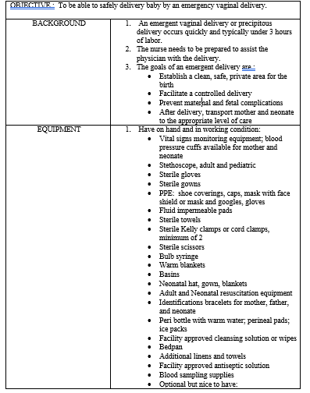
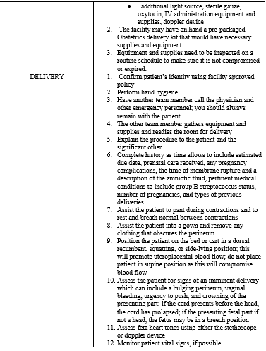

Slide 15
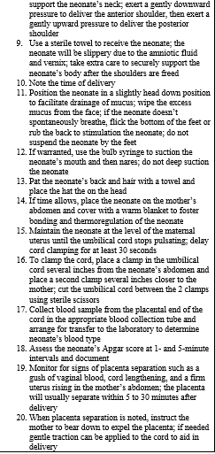
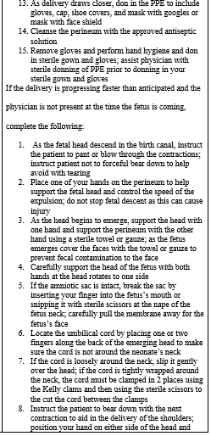

Slide 16
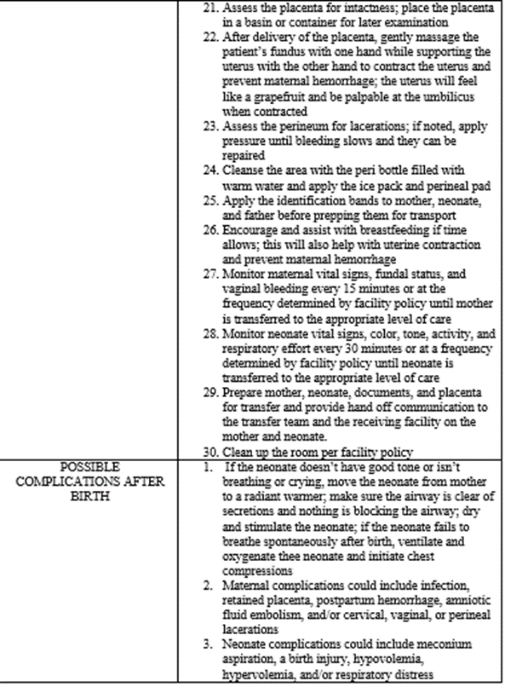
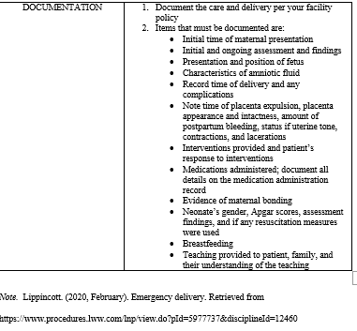

Slide 17
Available on Request
Policy to address an emergent delivery that can customized to your institution
Notes:
The Nebraska Hospital Association (NHA) is responsible providing guidance to hospitals within the Nebraska Hospital Association on emergent delivery of an obstetrical patient in a non-delivery hospital. The NHA Quality Department will act as a steering committee in the release and dissemination of such guidance.
PURPOSE:
To define the role and responsibilities of the staff during an emergent vaginal delivery.
POLICY STATEMENT:
The hospital must provide safe obstetric care to any patient that presents where a transfer to a delivering healthcare system will not be possible before the delivery.
Triage of the patient will include assessment of the following. See Appendix A for the tool.
Maternal vital signs
Fetal heart rate
Uterine contractions
Chief concern
Status of labor that includes presence of uterine contractions, vaginal bleeding, and status of membranes
Maternal perception of fetal movement
High-risk medical or obstetric conditions
Preparation for the delivery will be initiated as dictated by the patient’s parity, status of labor, fetal presentation, and high-risk medical or obstetric conditions.
The physician on call will be notified of the imminent delivery. The patient’s obstetrician or receiving hospital will be notified of the imminent delivery after it has been determined that a transfer will not happen until after the delivery.
A registered nurse will be in attendance to:
Provide all nursing care to mother/baby
Assure patient and newborn safety
Complete all legal records and identifying procedures
Assist the physician
Encourage bonding with mother/infant
Facilitate transfer of mother/baby
PROCEDURE:
Set up the room for delivery
Gather the equipment for delivery
PPE to include protective eyewear, shoe coverings, gowns, and gloves
Sterile gloves in various sizes
Delivery instruments or OB delivery pack
Sutures
Stirrups or footrests
Portable lighting
Anesthetic agents and equipment
Resuscitation equipment
Supplies to obtain lab specimens and for preserve placenta
Gather equipment for baby
Resuscitation equipment
Emergency drugs for a pediatric patient
Bulb syringe
Identification bracelets
Eye prophylaxis
Infant warmer and transport isolette
Critical Care equipment to be on hand
ECG Monitor
Crash Cart for adult and pediatrics
Defibrillator
All fluids (e.g., sterile water, etc.) out of original container to be labeled
An initial count of sponges will be performed concurrently, visually, and audibly by registered nurse and one other staff.
Verify infant warmer and resuscitation equipment is functioning.
Monitor and record fetal heart tones, mother vital signs, cervical dilation and effacement, fetal presentation, and status of membranes as ordered by physician and indicated by maternal status.
When delivery is imminent, position mother by placing her legs in the stirrups and positioning her buttocks over edge of table and prepare for delivery.
Notify second nurse to be present
Assist the physician in gowning
Prep the perineum with prep solution as ordered by physician starting with the pubic area, the outer labia, vaginal opening, and inner thighs.
Following delivery of baby, the physician will clamp the umbilical cord and cut the umbilical cord.
Allow bonding of mother and baby by placing baby skin to skin with the mother if baby’s condition allows.
Monitor maternal vital signs, fundal status, and vaginal bleeding every 15 minutes or at the frequency determined by facility policy until mother is transferred to the appropriate level of care.
Monitor neonate Apgar scores, vital signs, color, tone, activity, and respiratory effort every 30 minutes or at a frequency determined by facility policy until neonate is transferred to the appropriate level of care. See appendix B for Apgar scoring tool.
Prepare mother, neonate, documents, and placenta for transfer and provide hand off communication to the transfer team and the receiving facility on the mother and neonate.
DOCUMENTATION:
Delivery summary of mother and delivery
Initial and ongoing assessment of baby
Label specimens and prepare to transfer with mother and baby:
Placenta
Cord Blood
Cord pH and/or blood gases
REFERENCES:American Academy Of Pediatrics The American College of Obstricians and Gynecologists 2017 Guidelines for Perinatal Care20200709145816353743791
The American College of Obstetricians and Gynecologists, & American Academy of Pediatrics. (2015). Committee Opinion No. 644: the Apgar score. Obstet. Gynecol., 126(4), e52-55. https://doi.org/10.1097/AOG.0000000000001108
American Academy of Pediatrics, & The American College of Obstetricians and Gynecologists. (2017). Guidelines for Perinatal Care (8 ed.). AAP Committee on Fetus and Newborn and ACOG Committee on Obstetric Practice.
Bock S F Brengman S L 1986 delivery room you can set up anywhere.Bock, S. F., & Brengman, S. L. (1986). A delivery room you can set up anywhere. RN, 49(4), 28-30. 20200709155549354654908
Chi Health 202005 Vaginal delivery--Staff roles and responsibilitiesChi Health. (2020, May). Vaginal delivery--Staff roles and responsibilities. 20200709162627845634937
Lippincott. (2020, February). Emergency delivery. Retrieved from https://www.procedures.lww.com/lnp/view.do?pId=5977737&disciplineId=12460

Slide 18
For more information contact:
Margaret Woeppel, MSN, RN, CPHQ
VP of Quality & Data
402-742-8145
mwoeppel@nebraskahospitals.org
Katherine Feagler, RN, BSN, OCN
MSN/MBA Student
kfeagler@nebrwesleyan.edu

Slide 19
References
The American College of Obstetricians and Gynecologists. (2016, July). Committee Opinion No. 667: Hospital-based triage of obstetric patients. Retrieved from https://www.acog.org/clinical/clinical-guidance/committee- opinion/articles/2016/07/hospital-based-triage-of-obstetric-patients
Centers for Medicare & Medicaid. (2019, June). Improving access to maternal health care in rural communities. Retrieved from https://www.cms.gov/About-CMS/Agency- Information/OMH/equity-initiatives/rural-health/09032019-Maternal-Health-Care-in- Rural-Communities.pdf
Kozhimannil, K. B., Hung, P., Henning-smith, C., Casey, M. M., & Prasad, S. (2018). Association between loss of hospital-based obstetric services and birth outcomes in rural counties in the United States. Journal of the American Medical Association, 319(12), 1239-1246. https://doi.org/10.1001/jama.2018.1830
The American College of Obstetricians and Gynecologists. (2018, July). Practice considerations for rural and low-volume obstetric setting. Retrieved from https://www.acog.org/clinical-information/policy-and-position-statements/position- statements/2018/practice-considerations-for-rural-and-low-volume- obstetric-settings

