Slide 1
Quality Residency
Capstone Project
nebraskahospitals.org
Name, Date, Organization

Slide 2
Introduction to the Organization, Project, Team
Tell us a little bit more about your organization. i.e. size, services, location, changes
Give an overview of the project. i.e. what project did you choose, why did you choose this project, which unit did you focus on. Brief elevator speech – tell us why is this work important in 1 minute.
Describe your team. i.e. who is on the team, why did you select those members, has the team make-up changed throughout the project (added or removed members), discuss C-Suite support

Slide 3
AIM Statement
Share your AIM Statement:
The aim of this project is to (increase/decrease – what metric are you changing and how is it measured – by what amount – in what timeframe).
*** you can include the baseline data and what the goal metric will be i.e. we will decrease fall rate per 1000 patient days by 10% from 4.2 to 3.78.
*** if you are looking at a specific patient type or unit – include that in your AIM statement
AIM Statement Example:
The aim of this project is to decrease the number of ED admissions at XYZ hospital with a primary diagnosis of uncontrolled hypertension by 50% from 110 to 55 within 1 year from January 2022-December 2022..

Slide 4
Measuring Success
The team will use quantitative metrics to determine if the specific changes are leading to improvement.
Describe how you will know if your project is creating the change that you are working towards.
Describe what you will measure, how you will measure it, who will measure it
i.e. Metrics:
Total number of ED admissions
Stratified by primary diagnosis
Run report from EHR
Filter by diagnosis

Slide 5
Selecting Changes
What changes will be made to work towards improvement goals?
Brainstorm change options with team
Assess feasibility of implementation
Create a plan for education and support of change management
PDSA Cycles

Slide 6
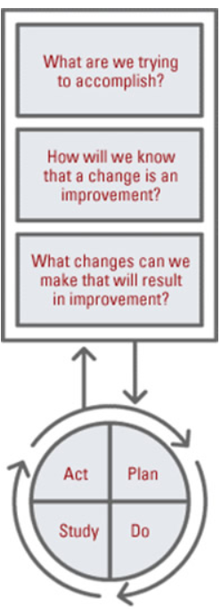
Plan ~ Do ~ Study ~ Act
Plan
I plan to:
I hope this produces:
Steps to execute:
Do
How long will you observe new changes?
What did you observe?
Are the changes creating consequences – intended or unintended?
Study
What did you learn?
Did you meet your measurement goal?
Do you need more observation time?
Act
What did you conclude from this cycle?
Will you sustain the changes?
Does the change need adjusted or removed?
***Each project will likely require more than 1 PDSA cycle.

Slide 7
Data and Trends
Include actual data collected
Include at least 1 run chart
Note baseline data – improvement or worsening after intervention

Slide 8
Return on Investment (ROI)
Explore the financial implications of the project:
Will costs/expenses be incurred to make noted changes?
Additional staff?
Additional hours?
Equipment?
IT expense?
What savings/revenue will be noted?
Decreased harms?
Increased billable codes?
Decreased staff hours?
Total Savings/Revenue – Total Costs/Expenses = Total ROI
Positive ROI = Dollars Earned ~~ Negative ROI = Dollars Lost

Slide 9
Spreading / Sustaining / Maintaining / Replicating
Ensure successful changes is spread to all units, staff, appropriate areas
Audits and spot checks to assess sustainability and maintenance
Can the program be replicated in other areas or organizations?

Slide 10
THANK YOU/Questions
Name and Contact Information
nebraskahospitals.org

