Slide 1
Behavioral Health Integration
Rob Bloom, CPA
Nicole Thorell RN, MSN, FNP-C

Slide 2
Objectives
Discuss the impact and integration of behavioral health in rural healthcare
State recent federal changes and the opportunities related to these changes
List opportunities related to services and provider types
Examine strategy opportunities for implementation of behavioral health

Slide 3
Overview

Slide 4

Environment
Behavioral Health is one of the most underserved needs in rural communities due to lack of access to care and confusion surrounding how care should be provided
Treatment modalities
Qualified professional staff
Regulatory environment
Reimbursement
Stigma
Scalability
Local Patient
Population
Cultural Bias
Government
Workforce
Primary Care
Community
Programs

Slide 5
Conflicts and Confusion
Drivers of health are dominated by behavioral health factors, and providers increasingly are paid based on population health – but our strategies and systems of care are misaligned
Conflicts
Confusion
What happens when the most important and effective means of manufacturing community-based health and wellness does not have a direct, explicit nor defensible business proposition?
What happens when an arcane, opaque and fluid regulatory environment meets with a mission-based service line that has chronic provider shortages and impenetrable reimbursement models?
The net result has been rural providers that don’t know where to start, how to expand nor link behavioral health delivery to growth and profitability

Slide 6



Providers and Sites
Outcomes and Wellness
Primary Care
Inpatient
Outpatient
Education fosters knowledge, skills, integration, and reduces stigma
Inpatient services assist those individuals whose need for help requires full time intervention, for both mental health and substance abuse
Outpatient services provide the access to care to prevent escalation of problems that may impact work and home life
Community

Slide 7
Providers and Sites
Any one individual can have as their professional portfolio more than one discipline and ability to provide more than one service
Provider Types
Treatment Sites
A broad variety of provider types are required and can be utilized as the build blocks of an effective BH Program
Primary Care Physicians
Psychiatrist
Psychologist
Counselors/Therapists
Social Workers
Nurse Practitioners/Physician Assistants
Registered Nurses
Clerical Support
Similarly, diverse treatments sites are both needed and available
Hospitals
Provider Based Clinics/RHCs
Independent RHCs/Community Clinics
Outpatient Substance Abuse Centers
Residential Treatment Facilities

Slide 8
Provider Imperatives
A
Depression/Anxiety
… Strengthen or grow?
Are we providing the right services?
B
Substance Abuse
… Strengthen or grow?
Do we get paid for the service we provide?
C
… Strengthen or grow?
You are here
Trauma/PTSD
Are we in compliance?
D
Dementia
… Strengthen or grow?
How’s our provider depth chart?
E
Childhood Disorders
… Strengthen or grow?
Are we set up for future growth and scalability?
What will competitors do?
Assessment tool built into RHC intake process
(PHQ-2, PHQ-9, GAD-7, CAGE, AUDIT, etc.)
Rural provider organizations must assess and strengthen existing programs as well as determine supply:demand for service growth

Slide 9
Get Into Behavioral Health
BH integration into the care continuum represents an opportunity for increased value.
Physical healthcare costs can be favorably impacted by appropriate BH intervention
Ensure payers know the intent to bring efficiency to the table as part of a holistic approach to care.

Slide 10
BH Fits with Rural
Behavioral health is an ancillary feeder service similar to other service lines
  Labs
  340b
  GI
  Primary Care
Value based contracts- up to 50% of ER high utilizers have BH issues
BH has an expected growth rate of 9% according to SG2, profitable if people practice at the top of their license
According to SG2, there has been a 25% increase in addiction
BH is health, it affects everything else related: decision making, medication compliance, home life, employment, etc. Organizations cannot do value based/pop health contracts without it.
Behavioral Health
Community Value
Organizational Value
Employee Value
Payor Value

Slide 11
Recent Federal Changes

Slide 12
New Billable RHC Providers
The Consolidated Appropriations Act of 2023 included provisions allowing RHCs to bill for Marriage and Family Therapists (MFTs) and Mental Health Counselors (MHCs) beginning January 1, 2024
MFTs and MHCs becoming qualified RHC providers means they can generate a Medicare encounter that is reimbursable at the RHC’s All-Inclusive Rate (AIR). MFTs and MHCs are subject to the same policies and supervision requirements as other non-physician RHC providers
Mental health practitioners who meet all of the applicable statutory qualifications for the mental health counselor benefit category but are licensed by their State under a different title, are eligible to enroll in Medicare under the “Mental Health Counselor” category
MFTs and MHCs will not be subject to a productivity standard in RHCs
MFTs and MHCs were added to the regulations 491.8(a)(3) and 481.8(a)(6), allowing these provider types to serve as the RHC owner or an employee, or be under contract
Additionally, MFTs and MHCs can fulfill the requirement that a provider must be available to furnish care at all times the clinic is open

Slide 13
Telehealth Services
Pandemic-era telehealth flexibilities have only gained momentum in the past few years
Starting in 2022, RHCs could bill and be reimbursed by Medicare for mental health services provided via telehealth and receive the RHC All-Inclusive Rate (AIR) on a permanent basis
Permanent Medicare Changes:
  RHCs can serve as a distant site provider for behavioral/mental telehealth services
  There are no geographic restrictions for originating site for behavioral/mental telehealth services, including the home
  Behavioral/mental telehealth services can be delivered using audio-only communication platforms
  Expansion of telehealth practitioners to include Marriage and Family Therapists (MFTs) and Mental Health Counselors (MHCs)
  Social Determinants of Health Risk Assessments added to Medicare Telehealth Services List
CY2024 Temporary Changes (through 12/31/24):
  RHCs can serve as a distant site provider and there are no geographic restrictions for originating site for non-behavioral/mental telehealth services, allowing patients to be located at anywhere in the US during the telehealth service, including a patient’s home
  Delays the in-person requirement for mental health visits furnished via telehealth (within 6 months prior and annually thereafter)
  Physician or practitioner “direct supervision” of incident-to services to be performed via two-way, real time-audio visual technology, as opposed to immediately available in the physical space of the RHC
  Added health and well-being coaching services to the Medicare Telehealth Services List

Slide 14
Expansion of RHC Care Management Services
Historically, RHCs have only been allowed to bill and be reimbursed for Care Management Services, including Remote Patient Monitoring, Remote Therapeutic Monitoring, or using CPT code G0511 or G0512 once per month per beneficiary
Starting January 1, 2024, an RHC may bill code G0511 multiple times in a calendar month as long as all requirements are met and services are not double counted. In addition, G0511 will include coverage for the following service areas:
  Behavioral Health Integration (BHI)
  Chronic Care Management (CCM)
  Principal Care Management (PCM)
  Principal Illness Navigation (PIN)
  Remote Patient Monitoring (RPM)
  Remote Therapeutic Monitoring (RTM)
  Community Health Integration (CHI)
Notes:
The new rule states that FQHCs and RHCs can bill the code multiple times in a calendar month if they meet requirements for underlying services. There also cannot be any double counting. For instance, those providing TCM (transitional care management) services and complying with all the rules while meeting the RPM criteria can bill G0511 twice.
FQHCs and RHCs can provide all the services G0511 captures as long as they meet underlying requirements for each service and bill for all of them separately. The G codes allow certain non qualified healthcare professionals to furnish services allowed under general supervision of the provider.
G0511 allows for RHC or FQHC to provide 20mins or more per calendar month of clinic staff time for RPM, RTM, chronic care management services or behavioral health integration services directed by an provider, while meeting all the requirements for the service billed
G0512 allows for RHC and FQHC only to provide the psychiatric collaborative care model, with 60mins or more of clinical staff time for psychiatric cocm services directed by an RHC or FQHC provider and includes services furnished by a behavioral health care manager and consultation with a psychiatric consultant, per calendar month

Slide 15
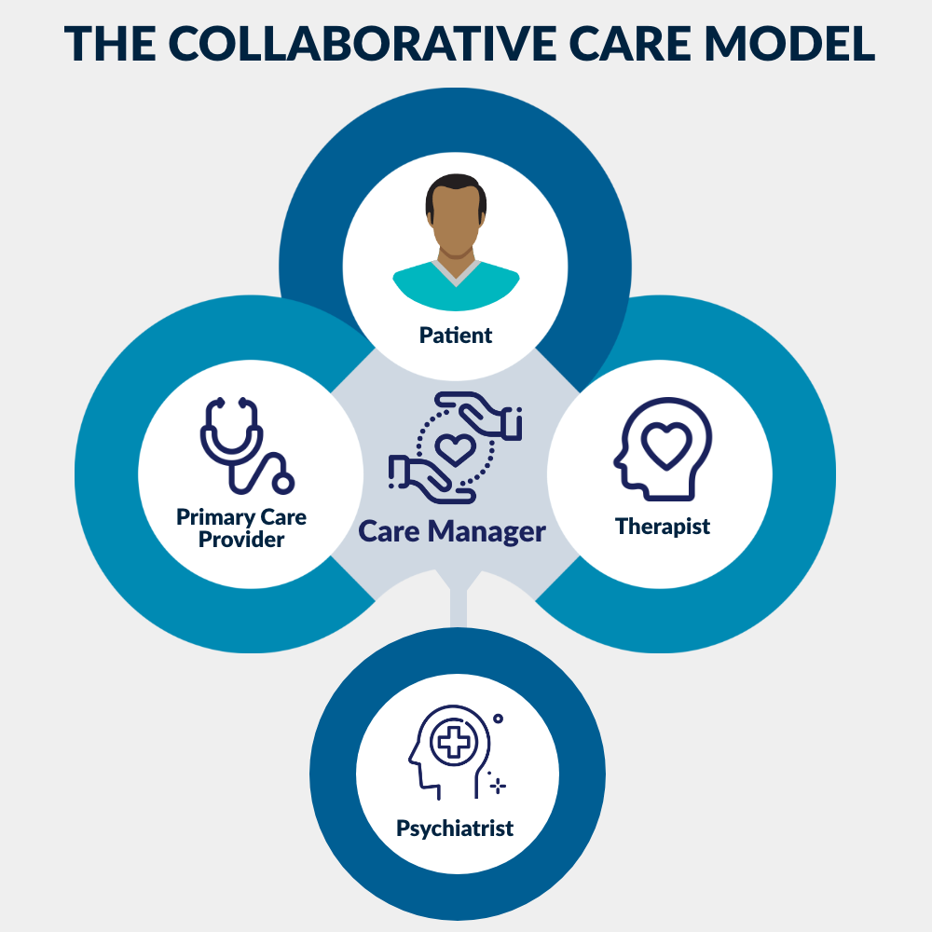
Care Management Services
  General Behavioral Health Integration (BHI)
    BHI is a team-based, collaborative approach to care that focuses on integrative treatment of patients with primary care and mental or behavioral health conditions
      RHCs can receive payment when at least 20 minutes of qualifying BHI services are provided during a calendar month
    General BHI services include:
        An initial assessment and ongoing monitoring using validated clinical rating scales;
        Behavioral health care planning in relation to behavioral/psychiatric health problems, including revision for patients who are not progressing or whose status changes;
        Facilitating and coordinating treatment such as psychotherapy, pharmacotherapy, counseling and/or psychiatric consultation; and
        Continuity of care with a designated member of the care team
Notes:
Behavioral Health Integration is an effective strategy for improving outcomes for patients dealing with mental or behavioral health outcomes.
BHI is a form of care management service for patients with a behavioral health diagnosis. BHI can be billed monthly for service elements such as systematic assessment and monitoring, care plan revision for patients whose condition isn’t improving adequately, and continuous relationship with an appointed care team member.
In my previous practice we had a psych NP and 3 counselors. The nurse spent many hours on the phone coordinating care, scheduling and reminding of appointments, following up on medication adherence etc.. BHI services cover all of those additional coordination hours that going in to caring for this patient population outside of the clinic visit.

Slide 16
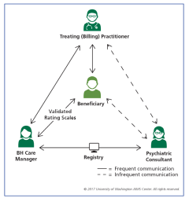
Care Management Services
  Psychiatric Collaborative Care Model (CoCM)
    Psychiatric CoCM is a specific model of care provided by a primary care team consisting of a primary care provider and a health care manager who work in collaboration with a psychiatric consultant to integrate primary health care services with care management support for patients receiving behavioral health treatment and includes the following:
      Regular psychiatric inter-specialty consultations with primary care team
      Regular review of treatment plan by primary care team
      Specific requirements for the RHC providers, behavioral health care manager, and psychiatric provider
    At least 70 minutes in the first calendar month, and at least 60 minutes in subsequent calendar months, of psychiatric CoCM services must have been furnished in order to bill for this service
      Only services furnished by an RHC or FQHC practitioner or auxiliary personnel that are within the scope of service elements can be counted toward the minimum 60 minutes
        Does not include administrative activities such as transcription or translation services
      Psychiatric CoCM services furnished on or after January 1, 2019, are paid at the average of the national non-facility PFS payment rate for CPT codes 99492 and CPT code 99493 when psychiatric CoCM HCPCS code, G0512, is on an RHC claim, either alone or with other payable services
Notes:
The psychiatric care model is an extension of the behavioral health integration services.
The goal of these services is to extend the capabilities of primary care practices to identify and treat customers with low to moderate behavioral health needs.
CoCM is a covered service for customers whose diagnosed behavioral health disorder requires systematic management, regular monitoring, and the provision of brief interventions to improve their behavioral health symptoms. CoCM services must be recommended by the patients' PCP or treating physician and must be delivered consistent with the person-centered goals established on the customer’s care plan. It is intended for customers with common behavioral health conditions that require systematic follow-up due to their persistent nature, including but not limited to mild to moderate depression, anxiety, post-traumatic stress disorder (PTSD), and substance use disorders (SUD). Customers who need help engaging in treatment, Eff. 7.1.22 2 have not responded to care delivered in a traditional primary care setting, or who require further assessment and engagement prior to consideration of a referral to more specialized behavioral health services may particularly benefit from CoCM services. These services are not intended to manage complex, severe, and/or persistent conditions which may require more specialized care from a Community Mental Health Center (CMHC), Behavioral Health Clinic (BHC), or licensed SUD provider
The CoCM team consist of a behavioral health manager, psychiatric consultant and treating (billing) provider

Slide 17
Care Management Services
  Chronic Care Management (CCM)
    CCM is for members with two or more chronic conditions and includes the management of medications, appointments, and services managed by one healthcare provider
      Providers can receive payment when at least 20 minutes of qualifying CCM services are provided during a calendar month
    General CCM services furnished outside of face to face include:
Continuous patient relationship with chosen care team member
Supporting patients with chronic diseases in achieving goals
24/7 patient access to care and health information
Patient receiving preventative care
Patient and caregiver engagement
Prompt sharing and using patient health information
CCM
Structured recording of patient health information
Keeping comprehensive electronic care plans
Managing care transitions and other care management services
Coordinating and sharing patient health information promptly within and outside the practice
Notes:
Wheen we discuss behavioral health integration we need to remember the linkage between chronic conditions and behavioral health disorders and treat the patient as a whole. Chronic care management is similar to PCM but is for Medicare members with 2 or more chronic conditions services offer a multitude of benefits for patients including improved health outcomes, enhanced patient engagement and empowerment, reduced hospitalization and emergency department visits, increased medication adherence, increased coordination of care and comprehensive care planning.
Provider can receive payment when providing at least 20mins of qualifying activities per month. Some example of qualifying services are communication with patient and caregivers, providing education regarding care, reviewing medication compliance, ensuring follow-up visits are scheduled, loop closure for exam results and coordination with specialist.
CCM play a crucial role in improving outcomes, enhancing patient experience and reducing healthcare costs by providing comprehensive coordinated and patient-centered care for individual with chronic conditions.

Slide 18

Care Management Services
  Principal Illness Navigation
    Covers principal illness navigation services for patients with a serious condition that is expected to last at least 3 months and puts them at high risk for one or more of the following:
      Hospitalization
      Nursing home placement
      A sudden worsening of preexisting symptoms
      Physical or mental decline
      Death
    PIN is a type of care management service that helps patients understand their medical condition or diagnosis and guides them through the healthcare system, examples of conditions applicable:
      Severe mental illness
      Substance abuse disorders
      Chronic conditions such as COPD, CHF, and cancer
Notes:
Principal illness navigation is similar to PCM but is intended to help patients with serious conditions navigate their health care treatment. CMS finalized 4 time based HCPCS codes in Jan 2024 to help the patient and caregiver to identify appropriate practitioners for care needs and support, especially when multiple specialties are involved in caring for the patient and delaying care may have detrimental effects.
This can service can be provided by trained auxiliary personnel under the direction of the billing provider. The patient must agree to the services and provide consent with an initiating visit.
Services can not be provided in a facility setting.
Examples of condition when PIN services could be reasonable and necessary include cancer, chronic obstructive pulmonary disease, congestive heart failure, dementia, HIV/AIDs, severe mental illness, and substance use disorders.

Slide 19

Remote Patient Monitoring/Therapeutic Monitoring
RPM
Collection and analysis of patient physiologic data that is used to develop and manage a treatment plan related to a chronic or acute health illness or condition
  For example, weight loss related to behavioral health medications
RTM
Use of Medical devices to monitor a patient’s health response to treatment using non-physiological data
  For example, monitoring medication adherence and response treatment in behavioral health patients
Notes:
RPM and RTM may not be billed together. Even when multiple medical devices are provided to a patient,” CMS explained, “the services associated with all the medical devices can be billed by only one practitioner, only once per patient, per 30-day period, and only when at least 16 days of data have been collected.” CMS also reemphasizes that remotely monitored monthly services should be reported only when reasonably necessary.
CMS reiterates practitioners may bill RPM or RTM (but not both RPM and RTM) concurrently with the following care management services for the same patient as long as time or effort are not counted twice: Chronic Care Management (CCM), Transitional Care Management (TCM), Behavioral Health Integration (BHI), Principal Care Management (PCM), or Chronic Pain Management (CPM) codes.
The coupling of RPM and CCM makes sense because they are highly complementary; RPM has the doctor access and analyze data real-time throughout the month, and CCM has the doctor intervene and guide the patient’s care throughout the month (ideally drawing on the A more reasonable reading of the code descriptor and intent is what is set forth in the Fact Sheet, i.e., that the interactive communication with the patient is part of the 20 minute minimum, but the practitioner can also include care management time, such as time spent reviewing and analyzing the patient’s RPM data and determining how to change the care management accordingly.
RTM refers to the use of medical devices to monitor a patient’s health or response to treatment using non-physiological data. RTM can be used to monitor medication adherence, response to therapy, musculoskeletal activity, and respiratory activity. This means that RTM can be used, for example, to monitor treatment specific to pain, functional status, and adherence and response to therapy.

Slide 20
Community Health Integration
Medicare Part B covers community health integration services to address needs and help the provider diagnosis and treat medical conditions when it is determined by a healthcare provider through a social determinants of health risk assessment that there are social needs that are impacting the patient's health or access to care
Some community health integration services include:
An assessment to better understand the patient’s life story
Care coordination
Health education
Patient self-advocacy training
Health system navigation
Social and emotional support
Notes:
During an initiating visit the provider would assess and identify any SDOH needs that limit the providers ability to diagnosis and treat the patient’s medical condition. The provider will establish a treatment plan that would specific how addressing the SDOH unmet needs would help in the diagnosis and treatment.
The work of the CHI services would be completed by a community health worker or other ancillary personnel. These services would then be billed by the provider who initiated the service.
CHI are time-based services that can be performed monthly if medically necessary.
The initial code G0019 can be used for 60min per month in activities to address social determinants of health. G0022 can be used for an additional 30min of service per month.
Some example of services that could be provided are :
-conducting a patient centered assessment to understand the patient’s life story, strengths, needs, goals, preferences, desired outcomes, including understanding cultural and linguistic factors
-providing tailored support to the patient as needed to accomplish the provider’s treatment plan
-Facilitating access to community based social services (housing, transportation, utilities, food assistance etc., to address the SDOH needs

Slide 21
IOP Details

Slide 22

Intensive Outpatient Program (IOP)
Starting January 1, 2024, Section 4124(c) of the Consolidated Appropriations Act of 2023 (CAA, 2023) establishes Medicare coverage and payment for IOP services that FQHCs and RHCs provide for people with mental health needs.
An IOP is a distinct and organized outpatient program of psychiatric services provided for patients who have an acute mental illness, which includes, but isn’t limited to, conditions such as depression, schizophrenia, and substance use disorders.
CMS will pay for IOP services provided at the same payment rate as if it were provided by a hospital. Also, costs associated with IOP services you provide won’t be used to determine payment amounts under the RHC all-inclusive rate (AIR) methodology.

Slide 23
Intensive Outpatient Program (IOP)
Services eligible to be provided and reimbursed under an IOP may include:
  Individual and group therapy with physicians, psychologists, and other mental health professionals as available under state law
  Occupational therapy
  Furnishing of drugs and biologicals for therapeutic purposes that are not self-administered
  Family counseling (as part of treatment of the patient’s condition)
  Patient training and education
  Individualized activity therapies
  Diagnostic services
  Other related services for diagnosis and active treatment intended to improve or maintain the patient’s condition and function

Slide 24
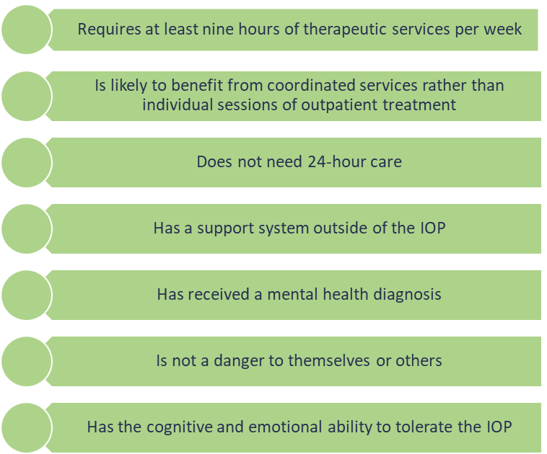
Intensive Outpatient Program (IOP)
Qualifications for IOP Services
  To quality a patient for IOP services, a physician is required to certify that a patient needs behavioral health services for at least nine, but no more than 19 hours per week
  That certification must be completed by a physician at least once every other month for the patient to continue to qualify for services and the plan of care must demonstrate that the patient:

Slide 25
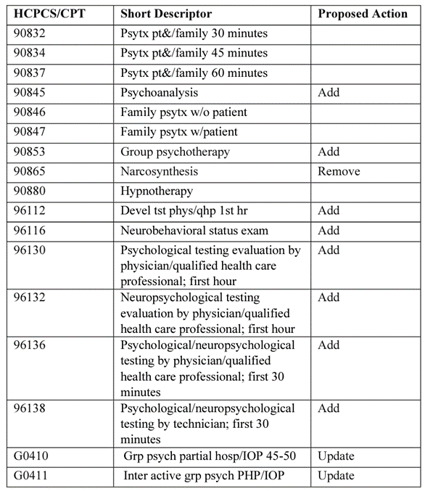
Intensive Outpatient Program (IOP)
IOP services are not reimbursed at the RHC’s AIR, but rather under a special rule that would allow for a flat payment currently at $259.13 (note, this is the hospital 3 services per day rate).
RHCs are allowed to perform up to three services per day and, to qualify for the special payment, at least one of the three services must be from the Partial Hospitalization and Intensive Outpatient Primary Services table shown at right.
Costs associated with IOP services are not currently used to determine payment under the AIR. There will be revisions to cost reporting instructions.
IOP services are separately payable if a patient has a medical visit on the same day.

Slide 26
New Provider Type Opportunity

Slide 27
Address Upper Payment Limit Challenges
Trended UPL Comparison
  The following table presents the adjusted cost-based rates (applying the annualized cost-based increases seen by each of the RHCs from FY17 – FY21) and compares to the new UPL established through the CAA of 2021 from 2021 through 2028
    The MEI used was 2.1% from 2022 – 2028 and a variation in the MEI will impact actual net impact
    Wintergreen used an average cost increase for each cohort
    The green-shaded rates reflects the average rate used for each cohort for 2021 through 2028
Data Source: December 2022 Medicare Cost Report release for hospital and RHC fiscal year 2021; and December
2022 CMS Provider of Services (POS) data file.

Slide 28
Smoothing the AIR
Therapist based positions are generally lower cost that many legacy provider types:
  PA
  NP
  MD
Providers can drive down per visit costs by leveraging access to new provider types and service additions.
BH telehealth visits currently count as a visit.
Primary Care
BHI
BHI/Telemedicine

Slide 29
On The Horizon

Slide 30

Access Challenges Are on the Radar
On the Horizon
Addition of Clinical Psychologists and Licensed Clinical Social Workers as specialty eligible for the 10-percentage point telehealth credit.
Amend general access to services standards to include explicitly behavioral health services
Clarify that emergency behavioral health services must not be subject to prior authorization
Require MA organizations to establish care coordination programs, including coordination of community, social, and behavioral health services to help move towards parity between behavioral health and physical health services and advance whole-person care.

Slide 31
Glimpse into the Future
Upcoming insights
Innovation in Behavioral Health (IBH) Model
  Address Medicare/Medicaid disproportionately high rates of mental health conditions and substance use disorder
  Increase access to care
  Promote interoperability
  Notice of Funding Opportunity Spring of 2024
CMS Behavioral Health Strategy
  SUD prevention
  Effective pain treatment and management
  Improving mental healthcare and services
Workforce impacts present and future
Increased ability to use Mental Health Counselors etc. in addition to Social Workers
  Bends the cost curve through substation effect
  Increases growth opportunity
Imperative to ensure substance use is an integrated part of treatment
  Future need for Recovery Coaches?
  Expansion of Medication Assisted Treatment capabilities?
  Even more demand for workforce?

Slide 32
Adjusting the Model

Slide 33
Stratification Matters
Proper staffing models are essential to financial viability. All to often, the model on the right is the norm. This forces medical providers to practice below their license and all licensed professionals to perform clerical work.
Sustainable Staffing Model
Unsustainable Staffing Model
Med Providers
Support Staff
Therapy Providers
Med Providers
Therapy Providers
Support Staff

Slide 34
Breaking Down Costs
Typical model found in rural settings result in less-than-optimal efficiency as many providers are not working at the top of licensure.
  Prescribers performing large amounts of verbal therapy (Psychiatrist, PA, NP)
  All providers performing significant amounts of clerical work
Total volume potential is limited, and payment is thus not optimized, particularly for commercial payers.
This decreases the ability to generate margin by controlling per visit costs
Common failures include:
  Too few therapists to keep a prescriber at capacity
  Underinvestment in clerical support staff

Slide 35
Breaking Down Costs
As verbal therapy providers are added, the verbal therapy burden of prescribers can be decreased to create capacity for medication therapy, driving the cost per visit lower.

Slide 36
Breaking Down Costs
Optimal results can be obtained by maximization of clinical availability and licensure.
Versus the second model on the prior slide, note that annual visit potential increases while costs decrease.
  More clerical staff
  Fewer therapists
Consider recruiting challenges within the model; non licensed personnel are in higher supply.
The same principles will apply when adding in nurses, MAs, etc.

Slide 37
Key Strategy Considerations

Slide 38
Assessing Current Processes
Inventory nonclinical tasks
Reassign as appropriate
Recruit and Retrain
Perform an inventory of nonclinical tasks
  Components of Quality Review
  Correspondence
  Insurance Coordination
  Client Advocacy Support Items
  Schedule Management and Coordination
Determine the appropriate level of staff necessary and adjust policies and procedures
Recruit and retrain to fill gaps in resources

Slide 39
Addressing the HR Challenge
Work to develop competitive wage and benefit packages that offer incentives not common in the market
Partner with university programs to reach prospective employees early
Update work-flows to increase the potential applicant pool

Slide 40
Staff Care
One of the leading causes of failure is turnover due to lack of programs to protect staff from burnout and negative impact to their own wellbeing
The Harsh Reality
Behavioral health providers are exposed to vicarious trauma which can lead to:
  Staff burnout
  Staff mental health challenges
  Decreased treatment efficacy
  Costly turnover (staff and patient panel)
Coping Mechanisms
Stable organizations employ a variety of strategies to protect stability:
  Effective supervision
  Duress monitoring and staff safety plans
  Adequate time off
  Continuing education and training

Slide 41
Strategies for Growth (People)
Education must be a core competency
  SUD education
  De-escalation training
  Physical health coordination training
  Industry trends
  Regulatory changes
  Department of Health Advocacy
  Reimbursement competency
  Strategic plan education
Staffing models must be deliberately designed
  Profit requires practicing at the top of a provider’s license
  Evaluate staffing stratification to ensure efficiency
Employees
Strategy
Contracts
Community

Slide 42

Rob Bloom, Principal rbloom@wintergreenme.com c: (315) 405-1535
Nicole Thorell, Senior Consultant
nthorell@wintergreenme.com
c: (308) 325-0201
Notes:
May require more than one slide

