Slide 1
HOW TO START A QUALITY PROGRAM IN A RURAL HEALTH CLINIC
KRYSTAL NOVOTNY, BSN, RN, CRHCP
VALLEY COUNTY HEALTH SYSTEM

Slide 2
INTRODUCTION
Currently serve as the Director for 3 RHC’s and the VCHS Radiology Department
RN with experience mostly in ER and Med/Surg, some L&D and LTC
Certified RHC professional through the NARHC
MSN/MBA student through NE Wesleyan University
Graduate of the NHA QI Residency Program

Slide 3
Objectives
How to choose a meaningful quality project for your clinic
Review what a PDSA cycle is and how to best utilize it
How to engage staff and providers in a QI project

Slide 4
Understanding Quality Improvement
Can be difficult to put together if you are not a clinic run by an ACO or work with any other entity.
RHCs operate separate from parent hospitals (if you have one). Develop projects that are meaningful to the clinic patient
Most important thing to remember is that Quality is about focusing on the patient and providing the right type of care at every single visit

Slide 5
Choosing a project
Things to consider:
What are we doing well vs. where could we improve
Look at state regulations for a starting point
Look at strategic plans for ideas
Go back to the basics!
Get input from your team
Start small – Don’t shoot for the stars right away!
Seek out other programs/clinics for assistance along the way
POND
Bryan Health Connect
Take ideas to a provider/med staff meeting
Provider Champion is important

Slide 6
Choosing a project
Involve your IT team if you need assistance with data pulling – This is a good way to start a project to see what information is already available to be pulled or can be pulled easily
If working with POND/LAKE program involve your CFO to get information about provider compensation, RVU’s etc – will also utilize this information for ROI
Look at statistical demographic reports for ideas (example Medicare Wellness Visits)

Slide 7
What to do now?
AIM statement: What are we trying to accomplish? What do we want the outcomes to be? How long will we measure this?
Work on pulling baseline data
Start on a PDSA cycle
Plan
Do
Study
Act

Slide 8
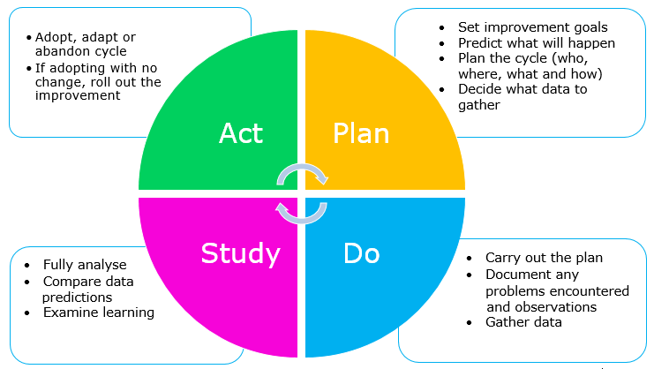
PDSA
A PDSA cycle is nothing more than testing out your interventions. Many QI projects have several PDSA cycles
Working through the cycles let’s you have failures and experiment and revamp interventions
It’s a good communication tool as well so the whole team is involved in the cycles
Plan Do Study Act Cycle (PDSA) | Whāraurau (wharaurau.org.nz)

Slide 9
My first QI project and PDSA
Staff chose to go review accurate BP monitoring with up to date AHA guidance
We didn’t have any data that had been monitored, but we were able to build the project into our CPM program
Enrolled the help of Bryan Health Connect and their “Measure Accurately Program”
Goal: The aim of this project is to have 75% of all medical clinic patients with a diagnosis of hypertension be adequately controlled by end of year 2023. Adequately controlled is a BP of 139/89 or less. HTN is defined as 140/90 or greater (for purposes of this project and recommended by AHA)

Slide 10
PDSA
Plan
I plan to: improve technique on BP measurement
I hope this produces: A decrease in patients with uncontrolled HTN by end of the year
Steps to execute: Work w/ CPM, training for nurses on proper techniques, create policy/procedure
Do
How long will you observe new changes? 1 year
What did you observe? Audits were necessary to find areas for improvement, staff needed refresher on basic procedures
Study
What did you learn? First PDSA cycle we were not following guidelines on proper BP measurement, not alerting providers of high BP, not averaging BP and not retaking BP when high.
Did you meet your measurement goal? We are seeing improvement
Do you need more observation time? Project will continue
Act
What did you conclude from this cycle? Difficulties with CPM, nurses were eager to learn and correct any bad habits and implement positive changes
Will you sustain the changes? Yes
Does the change need adjusted or removed? Continuous cycle of changes, especially with CPM system

Slide 11
Continued: What we did during our cycles
January 2023 – Had Bryan Health Connect present to nursing staff during staff meeting
February 2023 – Completed a GAP analysis w/ staff audits – Setup CPM system to pull data
April 2023 – Identified errors within CPM system – worked with IT to navigate
May 2023 – Had CPM vendor on-site for additional training
July 2023 – Bryan Health onsite to complete additional audits (noted major technique improvement). Brought new policy and procedure to Med Staff for approval
September 2023 – Review of full policy and procedure w/nursing staff. Providers watched “Tune in for 2” video about BP importance and practice suggestions

Slide 12
Continued:
Things we implemented/improved
Laminated reminder cards for all monitor towers
Removed manual equipment from rooms
Ordered foot stools, pillows in every room, additional sizing of BP cuffs
Quarterly audits to be implemented
Discuss updates/data at monthly staff meetings
Reminders for patients & staff posted in exam rooms

Slide 13
Engaging Staff
Get input – but give options/ideas - not everyone is a QI expert
Set up meetings/learning activities that are meaningful to their job and their patients
Get a good provider champion!
Get involved w/ community! EX: LBPHD BP table, Burwell Health Fair w/ BP readings and coupons for f/u BP measurements (if high)
Make sure that you talk through the PDSA cycles, interventions and data often! Ask for ideas on other interventions if something isn’t working
Develop audit tools and involve them in the process of auditing each other
Put involvement on yearly evals / Reward staff and department
If able to be involved w/ another entity, see if staff is able to obtain CEU/CME
With Bryan Health Connect my providers were able to turn in participation to the AFBM

Slide 14
Conclusion
Start small and then work up!
Utilize all resources available to you and don’t be afraid to ask for help and create a team
Reward your staff and team for being active in the QI project
Get help from other places that are experts! Ex: Greg Wolf w/ POND/LAKE; Bryan Health Connect; NHA; Other QI Leaders

Slide 15
Thank you!
Contact info:
Krystal Novotny, BSN, RN
knovotny@vchsne.org
308-728-4312

