Slide 1
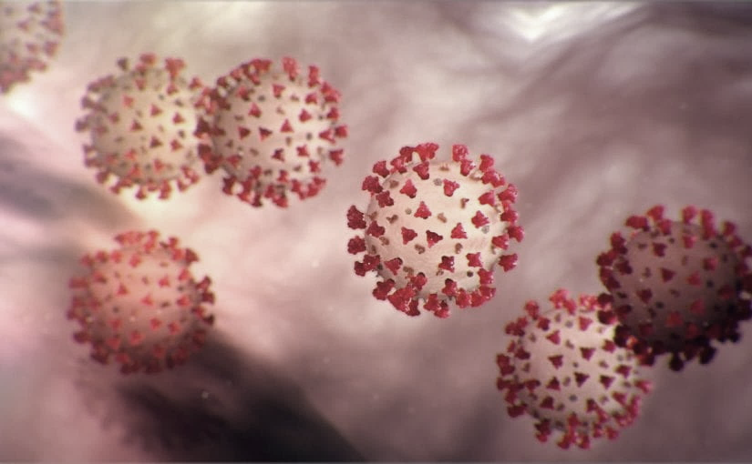
Covid-19 Webex Update 4-13-20
Maureen Tierney, MD, MSc.
Healthcare Associated Infections Medical Director
Tom Safranek, MD, State Epidemiologist

Slide 2
We are one in this fight
Frontline Heroes
Public Health Heroes
First Responder Heroes

Slide 3
Happy Birthday to Liffey

Slide 4
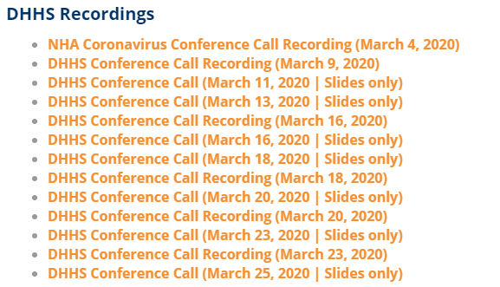
Thank you for joining us!
Slides and recording of today’s presentation will be available at
https://www.nebraskahospitals.org/coronavirus-covid-19-information.html
Scroll to the bottom of the page

Slide 5
Links to Nebraska webinars
Nebraska Acute Care Call every M,W, F at noon
previous calls can be found Nebraska Hospital Association
https://www.nebraskahospitals.org/coronavirus-covid-19-information.html
Nebraska ICAP Long Term Care Webinars every Thursday at noon
previous webinars and questions and answers found on ICAP website
https://icap.nebraskamed.com/
NEW
Nebraska ICAP Combined Critical Access and Outpatient Webinars every Tuesday at non
previous webinars and questions and answers found on ICAP website
https://icap.nebraskamed.com/

Slide 6
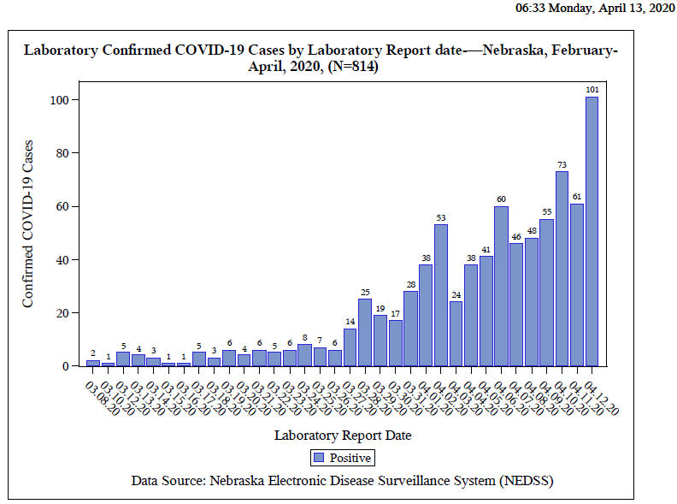

Slide 7
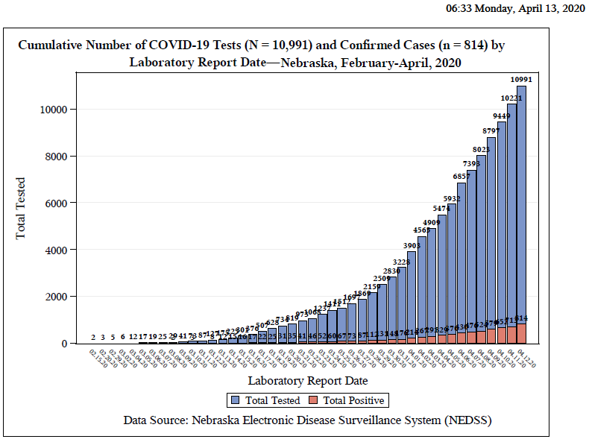

Slide 8
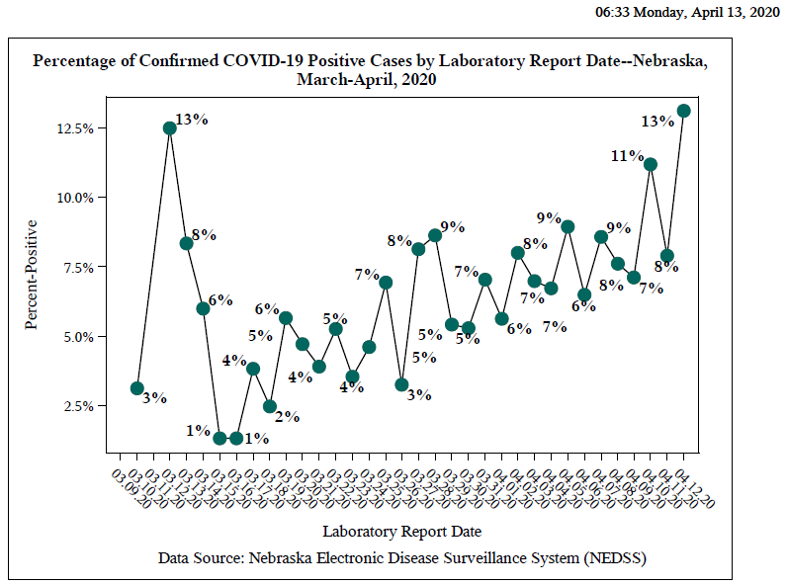

Slide 9
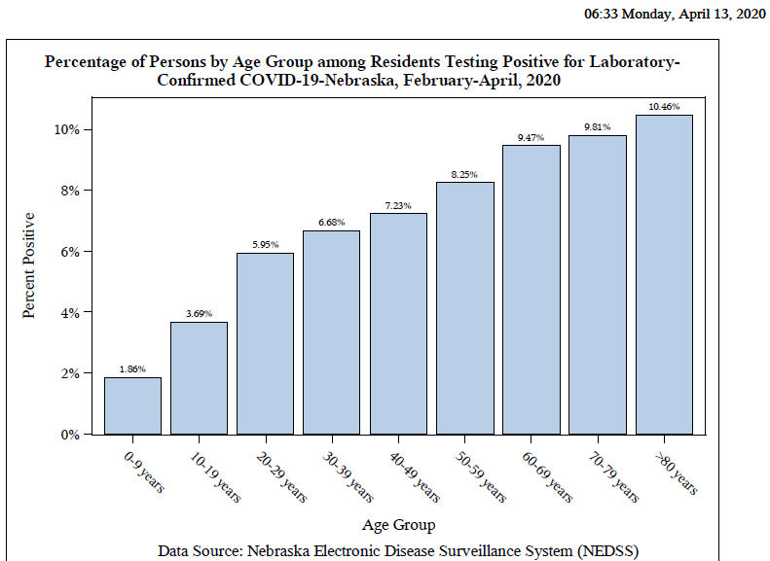

Slide 10
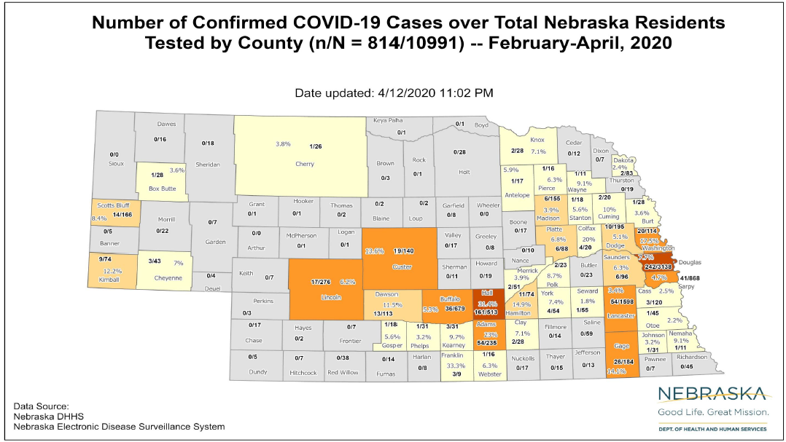

Slide 11
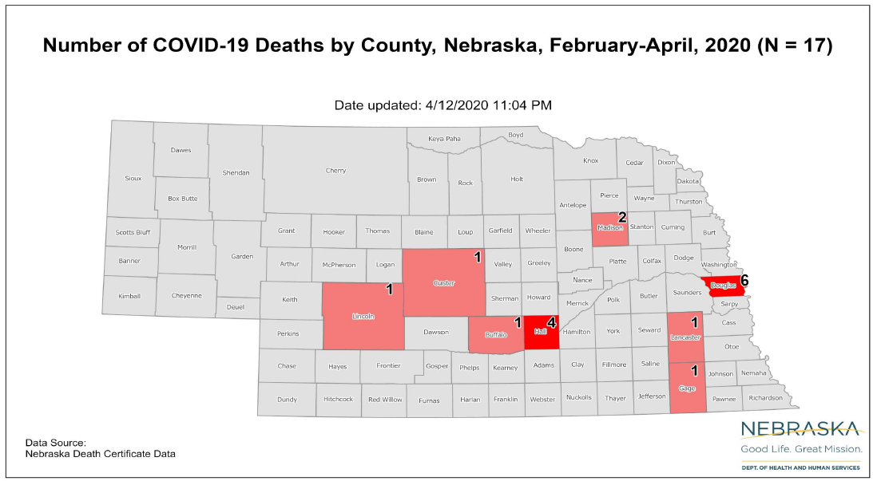

Slide 12
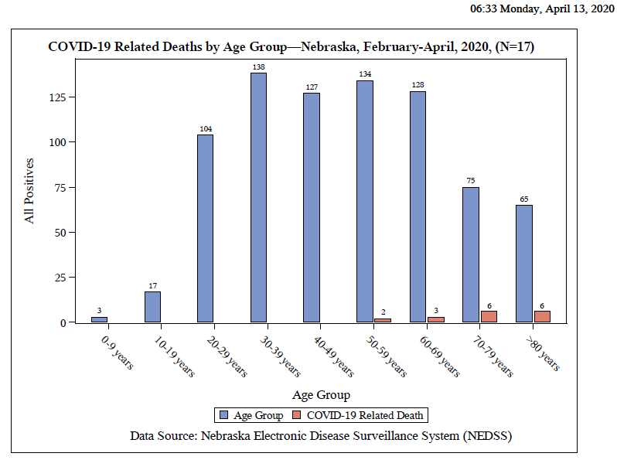

Slide 13
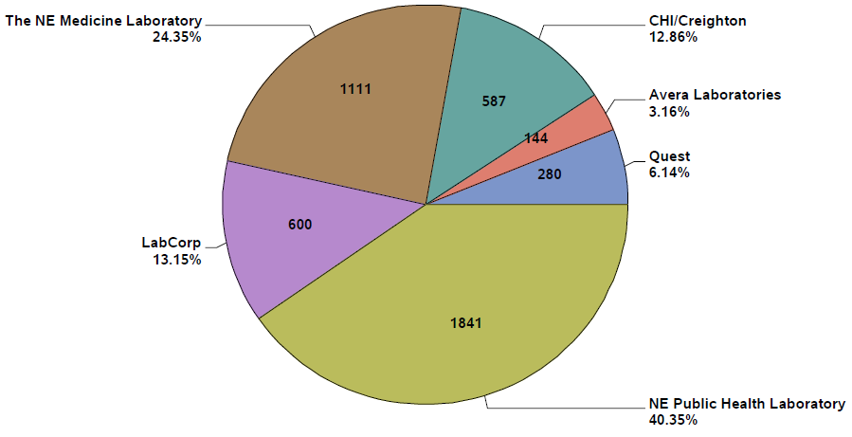

Slide 14
New Reports
WHO “confirmed on Saturday it is investigating reports of some recovered coronavirus patients testing positive for the illness after initially testing negative.” The investigation “is in response to a report from South Korea on Friday that 91 patients who had been cleared of COVID-19 and were being prepared for discharge tested positive again.” Officials have said “that rather than be reinfected, patients may be suffering from a ‘reactivated’ coronavirus.” The WHO said, “We are aware of these reports of individuals who have tested negative for COVID-19 using PCR (polymerase chain reaction) testing and then after some days testing positive again. We are closely liaising with our clinical experts and working hard to get more information on those individual cases. It is important to make sure that when samples are collected for testing on suspected patients, procedures are followed properly.”

Slide 15
Race and Obesity as Risk Factors
Johns Hopkins University School of Medicine Associate Professor of Adult and Pediatric Infectious Diseases Allison Agwu, M.D., ScM “discusses disparities in the impacts of COVID-19 in the community she serves.” Of “the 6,116 COVID-19 cases in Maryland for which race data was available (around 20% of cases were missing data), as of April 10 African Americans represented 49% of cases and 51% of deaths while representing only 30% of Maryland residents. Whites represented 35% of cases and 40% of deaths while representing 56% of Maryland residents.”
CIDRAP (4/10) reported that a new letter published in Clinical Infectious Diseases “from researchers at New York University shows that obesity is a risk factor for COVID-19 hospitalization in patients under the age of 60.” For the study, “researchers looked at 3,615 patients admitted to their hospital from Mar 4 to Apr 4.” They found “patients aged less than 60 years with a BMI from 30 to 34 were 2.0 times...and 1.8 times...more likely to be admitted to acute and critical care, respectively...compared with individuals with a BMI under 30.” Meanwhile, “for patients in the same age-group with a BMI over 35, the risk was 2.2 and 3.6 times higher, respectively”

Slide 16
Environmental Contamination Study from China
ISSN: 1080-6059 EID Journal Volume 26 Early Release
Volume 26, Number 7—July 2020
Aerosol and Surface Distribution of Severe Acute Respiratory Syndrome Coronavirus 2 in Hospital Wards, Wuhan, China, 2020
Abstract
To determine distribution of severe acute respiratory syndrome coronavirus 2 in hospital wards in Wuhan, China, we tested air and surface samples. Contamination was greater in intensive care units than general wards. Virus was widely distributed on floors, computer mice, trash cans, and sickbed handrails and was detected in air ≈4 m from patients.

Slide 17
UNMC Study on Contamination of Environment near COVID 19 Patients
https://www.unmc.edu/news.cfm?match=25339
IMPORTANT context about this information: Our findings DO NOT confirm that this virus spreads in an airborne fashion. The identification of genetic material from the virus that causes COVID-19 in air samples found in this study provides limited evidence that some potential for airborne transmission exists. More study is underway to determine if live culturable virus was captured in this study and additional evidence is needed to determine the risk of SARS-CoV-2 transmission via the airborne route. A study by UNMC/Nebraska Medicine/NSRI researchers recently posted on the open pre-publication site BioRxiv, provides new evidence of SARS-CoV-2 environmental contamination in COVID-19 patient care areas. …The study found high levels of the virus contamination by PCR on commonly used surfaces and in the air of rooms of COVID-19 patients. Air samplers from hallways outside of rooms where staff were moving in and out of doors were also positive.
“Air samples that were positive for viral RNA by RT-PCR were examined for viral propagation in Vero E6 cells. Cytopathic effect was not observed in any sample, to date, and immunofluorescence 15 and western blot analysis have not, so far, indicated the presence of viral antigens suggesting viral replication. However, the low concentrations of virus recovered from these samples makes finding infectious virus in these samples difficult. Further experiments are ongoing to determine viral activity in these samples. “
From https://www.medrxiv.org/content/10.1101/2020.03.23.20039446v2

Slide 18
3D Mask Printing FAQs from FDA
Will 3D-printed masks provide the same fluid barrier protection and air filtration as FDA-cleared surgical masks and N95 respirators?
A. 3D-printed masks may look like conventional PPE. However, they may not provide the same level of barrier protection, fluid resistance, filtration, and infection control. The CDC has recommendations for how to optimize the supply of face masks.
Q. What should health care providers do if using a 3D-printed mask?
A. Health care providers should:
Check the 3D-printed mask's seal for leaks.
Confirm that they can breathe through any makeshift filter materials.
Exercise caution in surgical environments where the need for liquid barrier protection and flammability is a concern.
Recognize that the mask may not provide air filtration enough to prevent transmission of infectious agents.
Safely dispose of infectious materials and disinfect any part they intend to reuse.

Slide 19
04102020, 1121, www.governor.Nebraska.gov/press

Slide 20
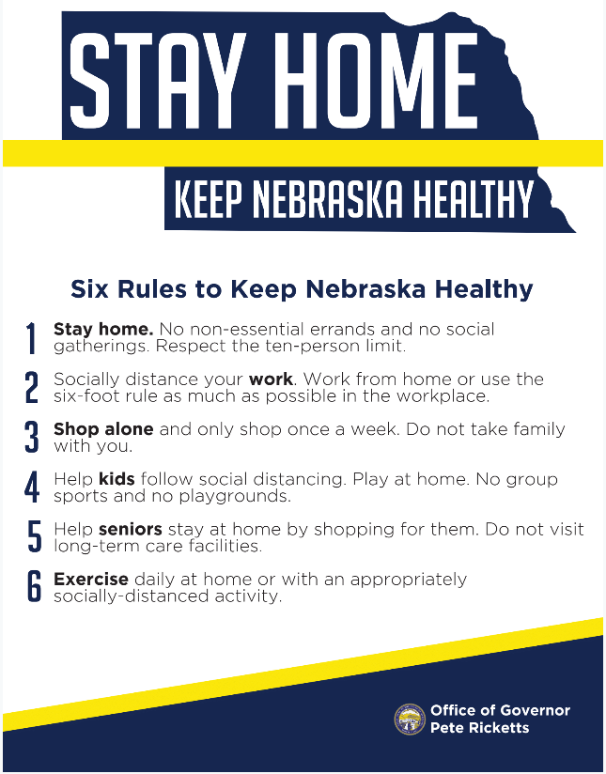

Slide 21
Off Site Quarantine and Convalescence
1. for HCPs and First Responders who wish to Q away from family in hotels-
call 833 220 0018
2. Information forthcoming on
Quarantine post exposures
Convalescence

Slide 22
What to Do When Large Numbers of Staff Exposed (Mostly LTC Issue, but also SCAH)
Evaluation including LHD, DHHS Epi, NE CMS, ICAP, to help determine level of exposure, staffing needs, support needed for staff and infection prevention.
When feasible keep HCPs who have been exposed at home for 14 days if staffing permits.
If cannot do #2, assess level of exposure, if can triage medium risk HCPs back to work but keep out high risk exposures in Q do so;
If #3 not possible, according to CDC and CMS “facilities could consider allowing asymptomatic HCP who have had an exposure to a COVID-19 patient to continue to work after options to improve staffing have been exhausted and in consultation with their occupational health program (or LHD, CMD, DHHS and/or ICAP)
These HCP should still report temperature and absence of symptoms each day prior to starting work. Facilities should have exposed HCP wear a facemask while at work for the 14 days after the exposure.
If HCP develop even mild symptoms consistent with COVID-19, they must cease patient care activities, don a facemask (if not already wearing), and notify their supervisor or occupational health services prior to leaving work.

Slide 23
HCW Masking
Dr. Gary Anthone is recommending that all Healthcare Professionals with Patient Contact
wear a facemask.
Sample Policy
A surgical face mask may be issued at the start of each shift,
Your mask will be used throughout the shift.
In the event that the mask becomes visibly soiled, saturated or damaged, a new mask must be obtained. Stock will be securely stored in each clinical setting.
Should you need a replacement mask, you must request one from supervisory personnel
Nonclinical staff do not need to wear a surgical grade facemask but should consider wearing cloth masks as per the CDC guidelines for the general public.

Slide 24
For Daily Surgical Mask Use
Infection Prevention Guidance on Procedure/Surgical Mask Use and Re-Use
To Doff facemask with intent to reuse
Perform hand hygiene
Remove mask
Remove procedure mask by holding the ear loops. The front is contaminated, so remove slowly and carefully.
Remove surgical mask by untying lower ties FIRST. Untie upper ties last. The front is contaminated, so remove slowly and carefully. Ensure ties do not fall into clean interior side of mask.
After removing facemask, visually inspect for contamination, distortion in shape/form. If soiled, torn, or saturated the mask should be discarded.
If the facemask is NOT visibly soiled, torn, or saturated, carefully store on a paper towel exterior side down. Note: units utilizing methods for short term storage and reuse compliant with extended use and reuse can continue to use such system. More information on this method can be found at: https://www.nebraskamed.com/sites/default/files/documents/covid19/COVID-Extended-Use-Reuse-of-PPE-and-N95.pdf?date03212020
Perform Hand Hygiene

Slide 25
One Mask per day Policy Continued
To Re-Don Mask
1. Perform hand hygiene
2. Grasp mask
o Pinch procedure mask at the ear loops or
o Grasp upper ties on surgical mask
3. Place over face
o For procedure mask: Secure ear loops behind the ears. Secure mask.
o For surgical mask: Secure upper ties first, behind head. End by securing lower ties behind head
4. Perform hand hygiene
A disposable facemask can be worn throughout your shift if not visibly soiled, torn or saturated, and NOT touched while delivering patient.
https://www.nebraskamed.com/sites/default/files/documents/covid-19/surgical-mask-policy-and-faq-nebraska-med.pdf

Slide 26
Thanks to NM procedure sharing
https://www.nebraskamed.com/sites/default/files/documents/covid-19/surgical-mask-policy-and-faq-nebraska-med.pdf
For pictures on how to lay out mask on a paper towel go to above website

Slide 27
UV Disinfection of PPE
“A team led by John Lowe, PhD, UNMC assistant vice chancellor for inter-professional health security training and education has developed a safe and effective method to decontaminate N95 respirators so they can be used multiple times, instead of just once. It involves using ultraviolet light towers to irradiate high numbers of N95 respirators.
The decontamination of these items works like this: groups of N95s are safely bagged and transported to a room inside Nebraska Medical Center, which is equipped with two ultraviolet light towers. The N95 respirators are hung on wires stretching the length of the room and then decontaminated when the lights are powered on. They are then removed and returned to the original owners for reuse.”
This is public facing now on the NETEC site.
https://repository.netecweb.org/files/original/fe9a813e5643ab774a62b4b1778117e0.pdf
UV sights around the state 4-5 places outside the metro-will have more info Wed

Slide 28
Cloth Masks for the Public
Nebraskans Protecting Other Nebraskans
In light of this new evidence, CDC recommends wearing cloth face coverings in public settings where other social distancing measures are difficult to maintain (e.g., grocery stores and pharmacies) especially in areas of significant community-based transmission.
It is critical to emphasize that maintaining 6-feet social distancing remains important to slowing the spread of the virus. CDC is additionally advising the use of simple cloth face coverings to slow the spread of the virus and help people who may have the virus and do not know it from transmitting it to others.
NM creating masks for non clinical staff made out of the surgical wrap material that has a high filtration capacity

Slide 29
LTC Accepting Patients
When should a nursing home accept a resident who was diagnosed with COVID-19 from a hospital?
A nursing home can accept a resident diagnosed with COVID-19 and still under Transmission-Based Precautions for COVID-19 as long as the facility can follow CDC guidance for Transmission-Based Precautions. If a nursing home cannot, it must wait until these precautions are discontinued. CDC has released Interim Guidance for Discontinuing Transmission-Based Precautions or In-Home Isolation for Persons with Laboratory-confirmed COVID-19. Information on the duration of infectivity is limited, and the interim guidance has been developed with available information from similar coronaviruses. CDC states that decisions to discontinue Transmission-based Precautions in hospitals will be made on a case-by-case basis in consultation with clinicians, infection prevention and control specialists, and public health officials. Discontinuation will be based on multiple factors (see current CDC guidance for further details).

Slide 30
LTC accepting patients continued
Note: Nursing homes should admit any individuals that they would normally admit to their facility, including individuals from hospitals where a case of COVID-19 was/is present. Also, if possible, dedicate a unit/wing exclusively for any residents coming or returning from the hospital. This can serve as a step-down unit where they remain for 14 days with no symptoms (instead of integrating as usual on short-term rehab floor, or returning to long-stay original room).
If a test is pending state guidance recommends waiting for result before transferring.

Slide 31
Long Term Care Accepting Patients from the Hospital
Patients coming from the hospital without any COVID-19 symptoms or specific COVID-19 exposure
No need to have a test sent in order to transfer
Accept patient into transition zone if possible
Patient in hospital COVID test pending-
Await result before transfer
Patient in hospital COVID-19 ruled out via testing
Accept patient into transition zone if possible
Covid-19 positive patient
Next slide

Slide 32
Managing COVID 19 in LTC
Patient from LTC in ACH ready to go back to LTC
1. Stay in Acute Care (stays lengthened)-until bed utilization goes up
2. Go to a separate convalescent site
3. Transfer to St. Es/ Midlands
4. Accept back in your facility if you an handle transmission v=based precautions that are necessary
Patients in LTC-but cannot be managed or need to protect other patients
1. Decision made on a case by case basis based on # of cases, capacity of staffing, risk to to other residents and bed availability
2. Cohort patients withing the LTCF -creating COVID unit or section
ICAP provides guidance for each LTC that has a case of COVID-19 now.
Some onsite evaluations being done

Slide 33
Outbreaks in Healthcare
HCW worked when ill-16 residents in an ALF
HCW pre-symptomatic; 6 HCP+; 13+ patients in a SNF
Now 11 facilities with COVID+ residents
8 with transmission to others, 3 with several positive staff and residents
Major focus LTC Task Force inc, DHHS, CMS, LHD, ICAP, all major med systems
Any signs or symptoms in a HCP-STAY HOME

Slide 34
Pathways for the Use of Convalescent Plasma
1. Clinical Trials
Investigators wishing to study the use of convalescent plasma in a clinical trial should submit requests to FDA for investigational use under the traditional IND regulatory pathway (21 CFR Part 312). CBER’s Office of Blood Research and Review is committed to engaging with sponsors and reviewing such requests expeditiously.
2. Expanded Access
An IND application for expanded access is an alternative for use of COVID-19 convalescent plasma for patients with serious or immediately life-threatening COVID-19 disease who are not eligible or who are unable to participate in randomized clinical trials (21 CFR 312.305). FDA has worked with multiple federal partners and academia to open an expanded access protocol to facilitate access to COVID-19 convalescent plasma across the nation. For patients with serious or immediately life-threatening COVID-19 who are not eligible for or who are unable to participate in randomized clinical trials, access to this investigational product may be available through participation of acute care facilities in an investigational expanded access protocol under an IND that is already in place.
Currently, the following protocol is in place: National Expanded Access Treatment ProtocolExternal Link Disclaimer .

Slide 35
Convalescent Plasma Continued
3. Single Patient Emergency IND
Although participation in clinical trials or an expanded access program are ways for patients to obtain access to convalescent plasma, for various reasons these may not be readily available to all patients in potential need. Therefore, given the public health emergency that the COVID-19 pandemic presents, while clinical trials are being conducted and an expanded access protocol is available, FDA also is facilitating access to COVID-19 convalescent plasma for use in patients with serious or immediately life-threatening COVID-19 infections through the process of the patient’s physician requesting a single patient emergency IND (eIND) for the individual patient under 21 CFR 312.310. This process allows the use of an investigational drug for the treatment of an individual patient by a licensed physician upon FDA authorization, if the applicable regulatory criteria are met. Note, in such case, a licensed physician seeking to administer COVID-19 convalescent plasma to an individual patient must request the eIND (see 21 CFR 312.310(b)).
To Obtain a Single Patient Emergency IND
For requests between 8am EST and 8pm EST (Mon-Sun), the requesting physician may contact FDA by completing Form FDA 3926 (https://www.fda.gov/media/98616/download) and submitting the form by email to CBER_eIND_Covid-19@FDA.HHS.gov. For eiND requests submitted via email during this time frame, FDA will respond within 4 hours.

Slide 36
How to determine PPE needs
PPE Burn Rate Calculator
Personal Protective Equipment Burn Rate Calculator excel icon[XLS – 39 KB]
This spreadsheet can help healthcare facilities plan and optimize the use of personal protective equipment (PPE) for response to coronavirus disease 2019 (COVID-19). Get the Instructions
PPE Requests need to go to LHD, shipments go out to LHD and then from LHD to facilities as soon as possible. Often don’t know when shipments are arriving.

Slide 37
Strategies for Re-Use of masks
The pathogens on the filter materials of the FFR may be transferred to the wearer upon contact with the FFR during activities such as adjusting the FFR, improper doffing of the FFR, or when performing a user-seal check when redoffing a previously worn FFR. A study evaluating the persistence of SARS-CoV-2 (the virus that causes COVID-19) on plastic, stainless steel, and carboard surfaces showed that the virus is able to survive for up to 72-hours [1]. One strategy to mitigate the contact transfer of pathogens from the FFR to the wearer during reuse is to issue five respirators to each healthcare worker who may care for patients with suspected or confirmed COVID-19.
The healthcare worker will wear one respirator each day and store it in a breathable paper bag at the end of each shift. The order of FFR use should be repeated with a minimum of five days between each FFR use. This will result in each worker requiring a minimum of five FFRs, providing that they put on, take off, care for them and store them properly each day. Healthcare workers should still treat the FFRs as though they are still contaminated and follow the precautions outlined in our reuse recommendations. If supplies are even more constrained and five respirators are not available for each worker who needs them, FFR decontamination may be necessary.

Slide 38
Masking-Options, with Best Alternatives
N-95 fitted with eye protection is best-goggles or face-shield (especially for aerosol gen procedures inc. NP swab) if available
N-95 unfitted (seal checked) with eye protection-face-shield might provide protection better than goggles if available
Face mask with eye protection may be used if no aerosol generating procedures, if possible face-shield might provide more protection than goggles esp if it necessary to get NP swab or give nebulizers, if available
All HCPs should wear surgical facemasks for patient encounters

Slide 39
CDC Guidance on Nebulizing Treatments
Yes, nebulization is considered aerosol generating. However, the role it plays in the transmission of SARs-CoV-2 is not absolutely known at this point. In settings like nursing homes, where N95s are not readily available, we have been encouraging the following:
If patient can tolerate, switch to metered-dose inhalers with a dedicated spacer.
HCW should wear a facemask during the procedure if a respirator is unavailable. Eye protection, gloves, and gowns are also recommended.
Close patient door when providing nebulizer treatment.
Upon set-up of nebulizer, have HCW maintain a safe distance (6 feet or greater), possibly outside the door.
While our guidance does state that AGPs should ideally be conducted in a negative pressure room, given the limit of these rooms conducting all nebs in a negative pressure room is not feasible. would suggest prioritizing negative pressure rooms for other AGPs such as intubation, extubation, open suction, and bronchoscopy.

Slide 40
Extended Use Update from CDC Guidance
A key consideration for safe extended use is that the respirator must maintain its fit and function. Workers in other industries routinely use N95 respirators for several hours….can function within their design specifications for 8 hours of continuous or intermittent use…... Thus, the maximum length of continuous use in non-dusty healthcare workplaces is typically dictated by hygienic concerns (e.g., the respirator was discarded because it became contaminated) or practical considerations (e.g., need to use the restroom, meal breaks, etc.), rather than a pre-determined number of hours.
If extended use of N95 respirators is permitted, respiratory protection program administrators should ensure adherence to administrative and engineering controls to limit potential N95 respirator surface contamination (e.g., use of barriers to prevent droplet spray contamination) and consider additional training and reminders (e.g., posters) for staff to reinforce the need to minimize unnecessary contact with the respirator surface, strict adherence to hand hygiene practices, and proper Personal Protective Equipment (PPE) donning and doffing technique. Healthcare facilities should develop clearly written procedures to advise staff to take the following steps to reduce contact transmission after donning:

Slide 41
Extended Use (continued)
Discard N95 respirators following use during aerosol generating procedures.
Discard N95 respirators contaminated with blood, respiratory or nasal secretions, or other bodily fluids from patients.
Discard N95 respirators following close contact with, or exit from, the care area of any patient co-infected with an infectious disease requiring contact precautions.
Consider use of a cleanable face shield (preferred³) over an N95 respirator and/or other steps (e.g., masking patients, use of engineering controls) to reduce surface contamination.
Perform hand hygiene with soap and water or an alcohol-based hand sanitizer before and after touching or adjusting the respirator (if necessary for comfort or to maintain fit).
Extended use alone is unlikely to degrade respiratory protection.

Slide 42
Respirator Reuse Recommendations
There is no way of determining the maximum possible number of safe reuses for an N95 respirator as a generic number to be applied in all cases. Safe N95 reuse is affected by a number of variables that impact respirator function and contamination over time.(18, 19) However, manufacturers of N95 respirators may have specific guidance regarding reuse of their product.The recommendations below are designed to provide practical advice so that N95 respirators are discarded before they become a significant risk for contact transmission or their functionality is reduced. If no manufacturer guidance is available, preliminary data(19, 20) suggests limiting the number of reuses to no more than five uses per device
If reuse of N95 respirators is permitted, respiratory protection program administrators should ensure adherence to administrative and engineering controls to limit potential N95 respirator surface contamination (e.g., use of barriers to prevent droplet spray contamination) and consider additional training and/or reminders (e.g., posters) for staff to reinforce the need to minimize unnecessary contact with the respirator surface, strict adherence to hand hygiene practices, and proper PPE donning and doffing technique, including physical inspection and performing a user seal check.(16) Healthcare facilities should develop clearly written procedures to advise staff to take the following steps to reduce contact transmission:

Slide 43
Re-Use of N-95s
Discard N95 respirators following use during aerosol generating procedures.
Discard N95 respirators contaminated with blood, resp or nasal secretions, or other bodily fluids
Discard N95 respirators after close contact with pt co-infected with an ID requiring contact prec.
Consider use of a cleanable face shield (preferred³) over an N95 respirator and/or other steps (e.g., masking patients, engineering controls), when feasible to reduce surface contamination
Hang used respirators in a designated storage area or keep them in a clean, breathable container such as a paper bag between uses. To minimize potential cross-contamination, store respirators so that they do not touch each other and the person using the respirator is clearly identified. Storage containers should be disposed of or cleaned regularly.
Clean hands with soap and water or an alcohol-based hand sanitizer before and after touching or adjusting the respirator (if necessary for comfort or to maintain fit).
Avoid touching the inside of the respirator. If inadvertent contact is made with the inside of the respirator, discard the respirator and perform hand hygiene as described above.
Use a pair of clean (non-sterile) gloves when donning a used N95 respirator and performing a user seal check. Discard gloves after the N95 respirator is donned and any adjustments are made to ensure the respirator is sitting comfortably on your face with a good seal.

Slide 44
Re Use continued
Follow the manufacturer’s user instructions, including conducting a user seal check.
Follow the employer’s maximum number of donnings (or up to five if the manufacturer does not provide a recommendation) and recommended inspection procedures.
Discard any respirator that is obviously damaged or becomes hard to breathe through.
Pack or store respirators between uses so that they do not become damaged or deformed.
Secondary exposures can occur from respirator reuse if respirators are shared among users and at least one of the users is infectious (symptomatic or asymptomatic). Thus, N95 respirators must only be used by a single wearer. To prevent inadvertent sharing of respirators, healthcare facilities should develop clearly written procedures to inform users to:
Label containers used for storing respirators or label the respirator itself (e.g., on the straps(11)) between uses with the user’s name to reduce accidental usage of another person’s respirator.

Slide 45
Testing Performance
Over 90% SE/SPEC\(probably over 95 % in good lab hands-which NPHL, UNMC, and CHI labs are.
Rapid 15 min test-60% to 70% sensitivity; difficulty with reagents acc. To local lab experts
Serology- now FDA approved-not for use in clinical diagnosis-timing of IgM in the acute setting will be past most infectious period
IgG prior infection-able to go back to work???
How long does immunity last??
Can use saline if out of VTM, must be refrigerated , can be frozen

Slide 46
HCP Return to work
Wear a facemask until all symptoms are resolved or 14 days after symptom onset whichever is longer
Be restricted from contact with severely immunocompromised patients
Adhere to HH and respiratory etiquette as recommended for control of COVID-19 in the interim guidance
Self monitor for worsening or recurrence of symptoms and notify employee health/occupational health/supervisor if occurs

Slide 47
Infection Prevention and Control Office Hours
Monday – Friday
7:30 AM – 9:30 AM Central Time
2:00 PM -4:00 PM Central Time
Call 402-552-2881

Slide 48
New Testing Capacity
CHI Health-Creighton Core Lab (Omaha): •
ABBOTT M2000: 94/tests/run; up to three runs/day
Regional Pathology Service (RPS) Laboratory, affiliated with Nebraska Medicine: •
UDT TEST: 100 tests/ day •
ROCHE COBAS 6800: 180 tests/day • TOTAL: 280 tests/day
Nebraska Public Health Laboratory (NPHL) based at UNMC in Omaha: •
CDC-public health test: up to 400 tests/day
Commercial labs (LabCorp, Quest, Mayo Clinic, ARUP, etc.): •
Currently reporting approximately 100 total tests /day; future capacity, unknown. These labs accept orders for COVID-19 tests without restrictions or prescreening.

Slide 49
New HAN on Testing 4-2-10
In-patients: Any in-patient will be tested.
Out-patients: Persons in these groups with a clinical or rule-out diagnosis of COVID-19 can be tested at NPHL. •
Healthcare workers •
Public Safety/First Responders (EMS, law enforcement, firefighters) •
Residents and staff at nursing homes • Residents and staff at group homes, homeless shelters, and daycare facilities • Individuals > 65 years old, and patient with serious underlying conditions
Providers can seek NPHL testing for patients who fail to meet these requirements based on special circumstances that warrant rapid turnaround time.
Contact a state/local public health authority for telephone pre-authorization. For all other patients, order COVID-19 testing through either in-state or national commercial laboratories.
To maximize throughput at NPHL, the lab is group-testing pooled specimens. Pools are created using five individual specimens. If the pool tests negative, all five contributors are considered negative. If the pool tests positive, the individual contributors to the pool are retested separately. This conserves reagents and allows more persons to be tested. To optimize this method, we request that ordering providers indicate on the order form if the provider believes the likelihood of a positive test to be high or low. The low likelihood specimens will be pooled to help save on scarce kits and reagents used to run the test.

Slide 50
Gowns for MRSA and VRE
The use of gowns as part of Contact Precautions in the context of MDROs has been implemented primarily to reduce the risk of transmission to other patients rather than to protect healthcare personnel (HCP). Facilities with shortages could consider suspending the use of gowns for the care of patients with endemic MDROs, such as MRSA, VRE, and ESBL-producing Gram-negative bacilli except as required for Standard Precautions. Facilities should assess their local epidemiology to determine which MDROs are considered endemic. Regardless of the use of gowns, HCP at facilities should continue to wear gloves for contact with these patients and their environment. Hand hygiene should continue to be emphasized. Facilities should also attempt to place patients colonized or infected with an MDRO in a private room, if available.

Slide 51
Other PPE Preserving Strategies
Caring for patients who have highly resistant Gram-negative organisms (e.g., carbapenem-resistant Enterobacteriacae) and other MDROs (e.g., Candida auris) that are not considered endemic: Rather than gowns being donned for every room entry, they should be reserved for use as part of Standard Precautions and also prioritized for high-contact patient care activities that pose highest risk for transfer of pathogens from the patient to HCP. Examples of such high-contact care activities include dressing, bathing/showering, transferring, providing hygiene, changing linens, changing briefs or assisting with toileting, device care or use (central line, urinary catheter, feeding tube, tracheostomy/ventilator), and wound care. To further preserve gowns, HCP are recommended to bundle high-contact care activities as part of individual care encounters. Regardless of the use of gowns, HCP at facilities should continue to wear gloves for contact with these patients and their environment. Hand hygiene should continue to be emphasized. Facilities should also attempt to place patients colonized or infected with an MDRO in a private room, if available.
Caring for patients with Clostridioides difficile infections (CDI): Facilities should continue using Contact Precautions (putting on a gown and gloves upon entry into the patient’s room and placing the patient in a private room) for the care of symptomatic patients with CDI. As part of a supplemental strategy to prevent transmission of CDI,

Slide 52
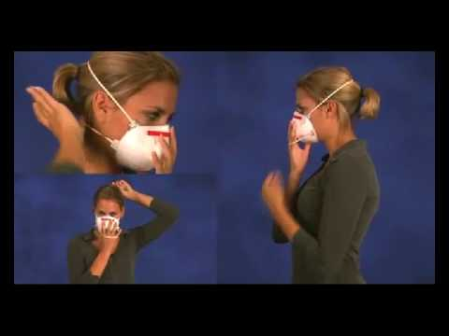
User seal check for N95 respirators
https://www.youtube.com/watch?v=pGXiUyAoEd8.

Slide 53
CDC Updates PPE Optimization Strategies
Alert facilities that updates have been made
Encourage review of guidance at https://www.cdc.gov/coronavirus/2019-ncov/hcp/ppe-strategy/index.html
Highlights:
Extended use and limited re-use of facemasks
“When no facemasks are available” guidance
No resources for Crisis/Alternative Strategies for N95s
Option for reprocessing eye protection
Strategies to Allocate Ventilators from Stockpiles to Facilities
Additional crisis strategies for gowns, including “when no gowns are available”
Notes:
We just want to alert people that the CDC has updated their PPE Optimization Strategies. Some highlights are included here. It is worth reading to see if this gives facilities any new ideas, but frankly catches CDC up to what has been under discussion in Nebraska for awhile- including strategies from NETEC and Nebraska Medicine.

Slide 54
Other Decontamination Strategies
On March 28, 2020, FDA issued an Emergency Use Authorization (EUA) permitting the Battelle Decontamination Systemexternal icon at Battelle Memorial Institute to be authorized for use in decontaminating “compatible N95 respirators.”
University of Iowa has shown that possible dropin filtration capacity of 2% post H2O2, so recommend only 2 4 times
Because ultraviolet germicidal irradiation (UVGI), vaporous hydrogen peroxide (VHP), and moist heat showed the most promise as potential methods to decontaminate FFRs, researchers, decontamination companies, healthcare systems, or individual hospitals should focus current efforts on these technologies.

Slide 55
Reporting to LHD
Reporting to LHD should primarily be by providers not patients. The LHD staff screening for who to test need the providers to have done some clinical screening/evaluating first (which may all be by phone)
Do NOT need to report all tests just positives and any probable cast that is pending (epi link)-
Any general questions by the public can be answered by the general COVID 19 hotlines at various LHDs
Listing of the local health departments and contacts:
http://dhhs.ne.gov/CHPM%20Documents/contacts.pdf

Slide 56
Registration link: https://unmc.zoom.us/webinar/register/WN_9jB8mb2CQmWeuD82yxbJ2g

Slide 57
https://repository.netecweb.org/exhibits/show/ncov/ncov
Notes:
NETEC offers excellent training resources on COVID-19 PPE use, as well as conservation

Slide 58
From the CDC –ABHR Shortages
If “severe shortages of ABHR (and have exhausted supply chain access to efficacious products) may consider local production of formulations as described by the FDA Policy for Compounding of Certain Alcohol-Based Hand Sanitizer Productsexternal icon. This policy remains in effect through April 30, 2020. Formulations included in the FDA guidance are consistent with World Health Organization production guidance. These locally produced products are intended for routine healthcare personnel hand cleaning, must not contain active ingredients other than those specified in the FDA guidance, and should not take the place of other regulated skin antiseptics (e.g. surgical hand rub). To avoid contamination with spore-forming organisms, WHO formulations require a 72-hour post-production quarantine. Organizations should revert to the use of commercially produced, FDA-approved product once such supplies again become available.”
Here is the link to The World Health Organization's hand rub directions:https://www.who.int/gpsc/5may/Guide_to_Local_Production.pdf
Here is the FDA one:https://www.fda.gov/news-events/press-announcements/coronavirus-covid-19-update-fda-provides-guidance-production-alcohol-based-hand-sanitizer-help-boost

Slide 59
Resources (as of 8:00am 3/30/20)
Exposure Risk Assessment
https://www.cdc.gov/coronavirus/2019-ncov/hcp/guidance-risk-assesment-hcp.html
Guidance for pregnant and breastfeeding mothers
https://www.cdc.gov/coronavirus/2019-ncov/need-extra-precautions/pregnancy-breastfeeding.htmll
Guidance for PPE
https://www.cdc.gov/coronavirus/2019-ncov/hcp/ppe-strategy/index.html
Regarding use of homemade masks
https://www.cdc.gov/coronavirus/2019-ncov/hcp/ppe-strategy/face-masks.html

Slide 60
Presentation prepared by: Dr. Maureen Tierney and Dr. Tom Safranek; Kate Tyner and Margaret Drake
HAI/AR Epidemiologist
Ishrat.kamal-ahmed@Nebraska.gov
402-471-2937

