Slide 1
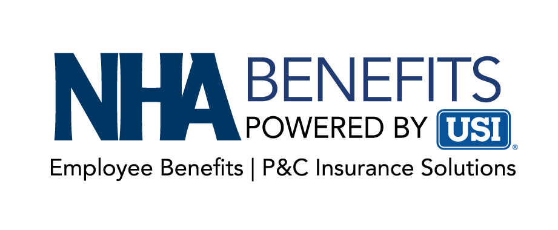


Pharmacy – Addressing the Fastest Line Item for Most Employer’s Plan
Kirk Swartzbaugh, Partner | Consultant, USI
Paul Becker, Regional Vice President, Truveris

Slide 2
Meeting Objectives
1
Intros
2
Issue: Pharmacy Benefit Manager Ownership / Moving Towards Fiduciary Standard?
3
GLP-1 and Diabetes Industry News
4
Biosimilar Industry News
5
USI & Truveris Partnership
6
Clear Options Rx and Clear Guard Rx Platform
7
Gene Therapies Considerations
8
Q & A

Slide 3


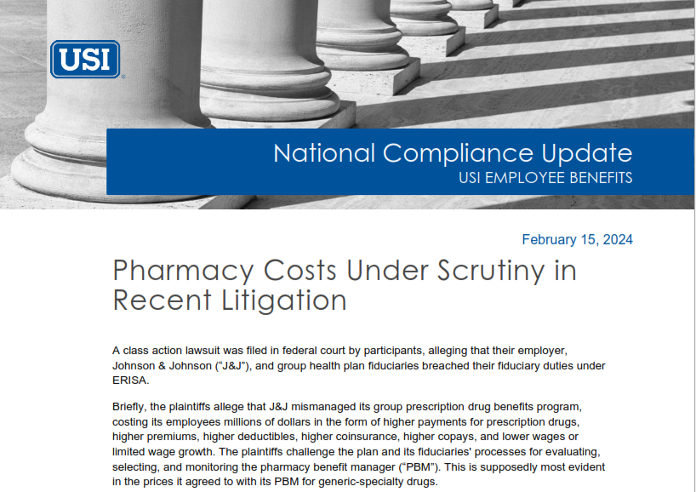
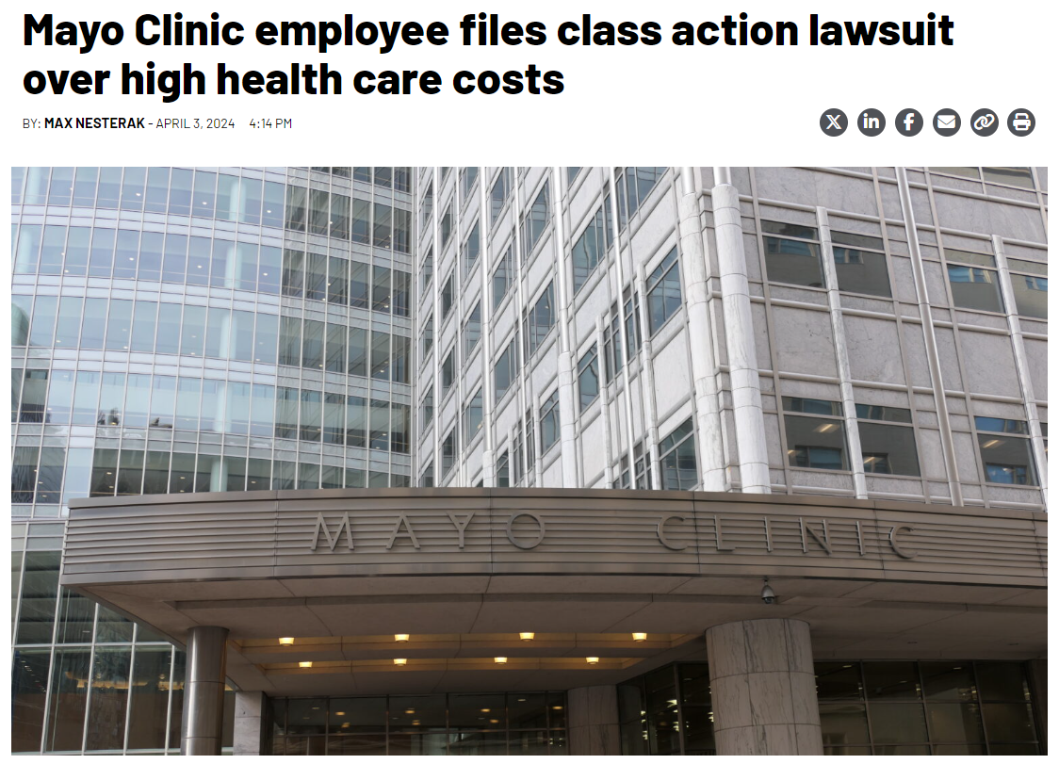
Marketplace Topics of Interest
Fiduciary Standard for Employee Benefits?
Add a Footer With an Impactful Summary Message

Slide 4
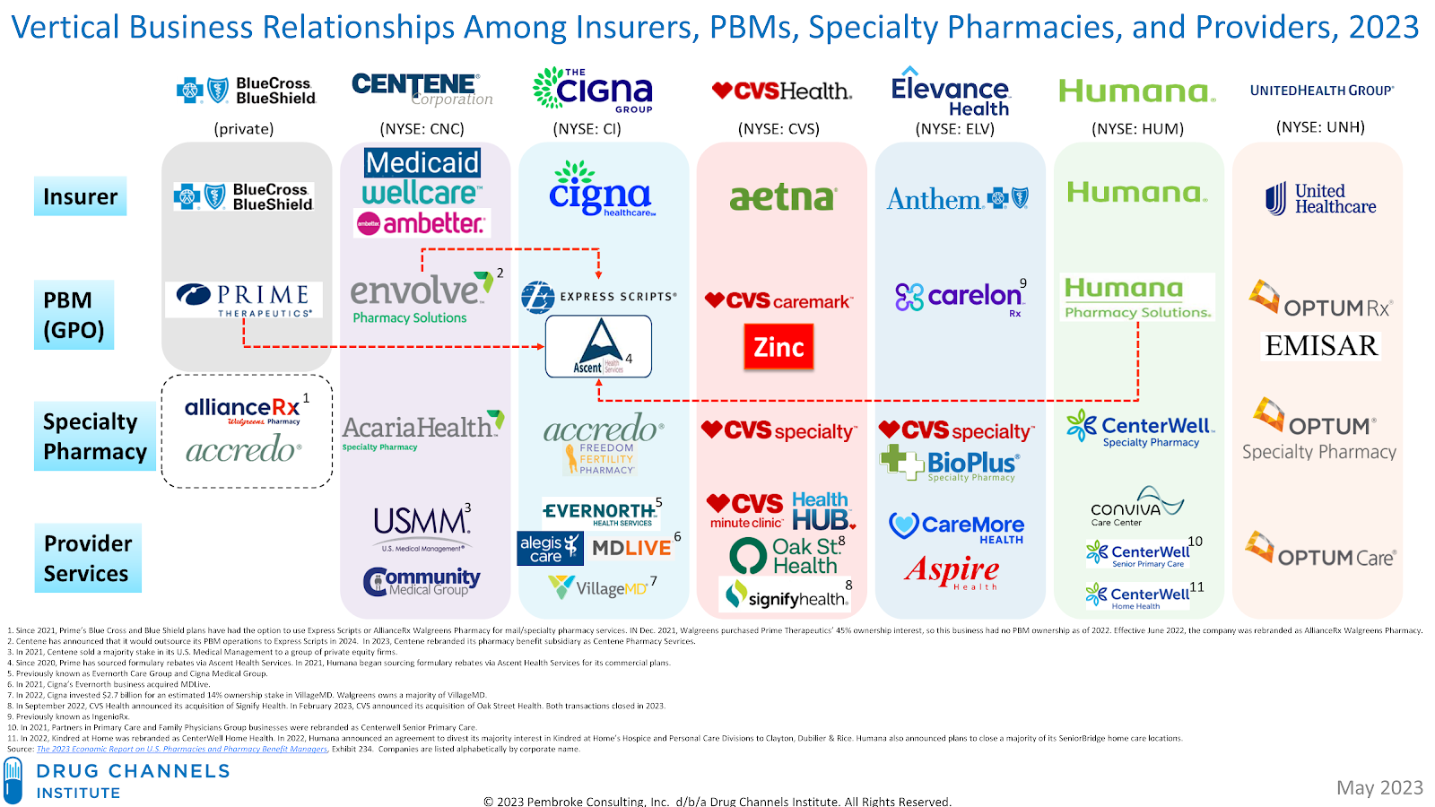


Pharmacy
PHARMACY
USI Clear Options Rx
Market Update
Prescription drug costs are growing at three times the rate of inflation and represent an area of increasing concern by most employer sponsored benefit plans.
Annual U.S. Prescription Drug Spending
3,132% Increase!
²⁰²²
¹⁹⁸⁴
$633.5 billion ³
$19.6 billion ²
2022 Specialty Spending:
$323.7 billion ³
Avg Annual Plan Cost:
Specialty Drug Claimant $38,000
Non-Specialty Drug Claimant $492
(factor of 77x)
Sources:
Vertical Integration - Drug Channels Institute
Kaiser Family Health Spending Explorer, U.S. Health Expenditures from 1984-2014;
American Journal of Health System Pharmacy (AJHP)
Notes:
First column represents 19 BCBS Plans which own the PBM Prime Therapeutics. In late 2022 Prime acquired MagellanRx which operates as a separate business unit within Prime.
Centene is a large healthcare enterprise that owns the PBM Envolve, AcariaHealth specialty pharmacy and others.
Cigna rebranded with The Cigna Group being the global holding company w/ Cigna Healthcare, Evernorth Health Services includes the PBM ESI, Ascent Health GPO/rebate aggregation, Accredo Specialty pharmacy and others.
CVS Health owns Aetna, CVS Caremark, CVS Specialty, Zinc GPO/rebate aggregation, Cordavos – a biosimilar manufacturer, CVS retail pharmacies and numerous provider services.
Anthem rebranded as Elevance Health and owns Blue Plans in accross13 states; IngenioRx, CareMore, Aspire Health, AIM Specialty and Beacon Health have rebranded under Carelon
UnitedHealth Group owns UHC, OptumRx, Optum specialty pharmacy, Emisar GPO/rebate aggregation, Surest (formerly BIND) and numerous provider services
There are at least 73 full service PBMs in the US. The big 3 administer 80%-89% of scripts in the U.S. The 7 on this slide administer 94%+ of all prescriptions filled in the U.S. That leaves 66 PBMs fighting for less than 6% market share.
Drug Pipeline – an estimated 7k drugs in development; 70%-75% could be categorized as specialty drugs, and up to 50% of those might be LDDs.

Slide 5







Key Challenges/Cost Drivers
Pharmacy
PHARMACY
USI Clear Options Rx
  MARKET CONSOLIDATION
  Vendor consolidation and vertical integration has adversely impacted competition and transparency
  CARRIER/PBM PROFITS
  Pharmacy represents a significant revenue stream for Health Plans/TPAs/PBMs
  MISALIGNMENT OF GOALS
  PBM profit is often tied to drug spend and contracts are aligned with the needs of the vendor, not the client
  LACK OF TRANSPARENCY Pharmacy contracts are often vague with weak definitions, undisclosed revenue streams, undefined terms and limited audit rights
  PRICING OPTICS
  What you see may not be what you get. Due to conflicting goals, many PBMs are use optics to retain and win business
  MEDICAL ADVANCEMENTS
  People live longer due to advancements in medical care and earlier diagnosis of chronic conditions requiring lifelong medication
  SPECIALTY DRUGS
  Expensive specialty drugs are replacing older less effective/lower cost medications; breakthrough gene and cell therapies (2% of scripts drive 50% of drug spend)

Slide 6
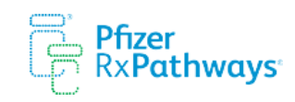





PHARMACY
Manufacturer Pharmacy Assistance Programs (PAPs)
USI evaluates strategies to assists employees in obtaining PAP
while simultaneously reducing employers’ net cost
  Specialty drug costs account for up to 10% of overall healthcare costs and are rising rapidly
  Manufacturers contribute $20 billion through 10,000+ PAPs that serve to keep prices artificially high for employer-paid programs
  Manufacturer PAPs may be accessed by the employee and employer to subsidize and reduce employer specialty drug costs
  USI evaluates PAPs implementation strategies for costs and compliance adherence
  Impact and Benefits:
  Typical savings of 2-4% of total health plan costs.
  Healthcare Costs: $10,000 PEPY
  RX Costs: $2,500 PEPY
  Avg. Specialty Spend: $833 PEPY
  Avg. Net PAP: 40%
  Total Avg. Savings: $333 PEPY or ~3%
  Reduce employee OOP expense for specialty drugs
Reduce Specialty Drug Net Costs
© 2014-2024 USI Insurance Services. All rights reserved

Slide 7
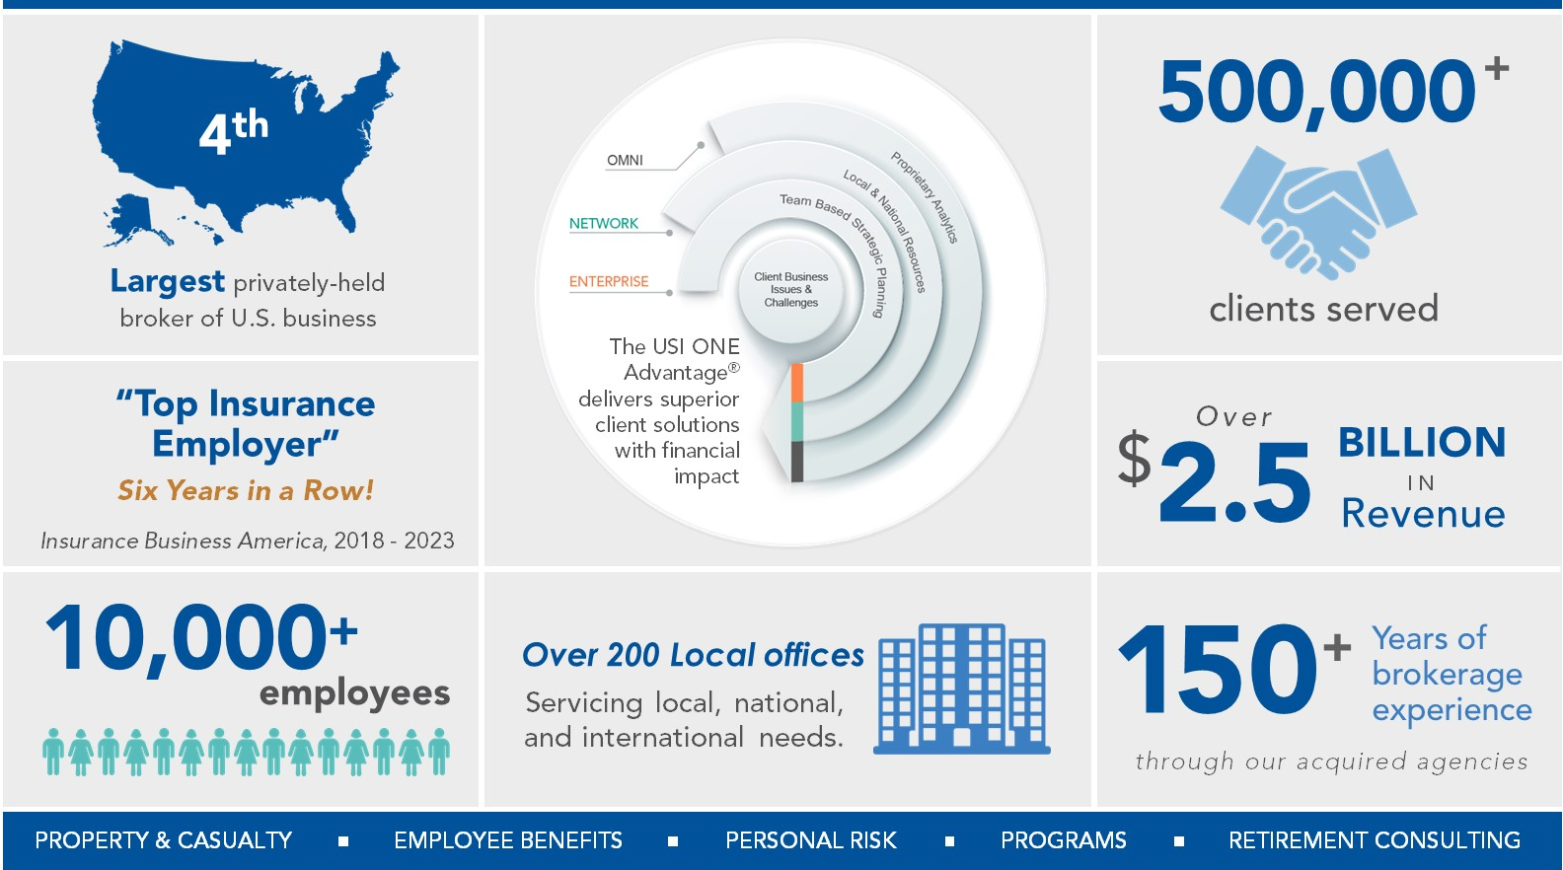
USI at a Glance | Leading Global Brokerage

Slide 8






USI ONE® Network Provides Deep Expertise
Unmatched Breadth and Depth of Local and National Employee Benefit Resources
Dedicated technical experts networked nationally and embedded in local offices, with
10,000+ professionals nationwide to build integrated client centered account teams.
Customized
Team
Broad
Expertise
Worldwide Connectivity
Personalized in-house employee benefits team for Nebraska Hospital Association Members
Curated team is collaboratively connected with other disciplines at no additional cost
Deeply connected nationally with locally based experts so you get industry wide expertise whenever you need it

Slide 9



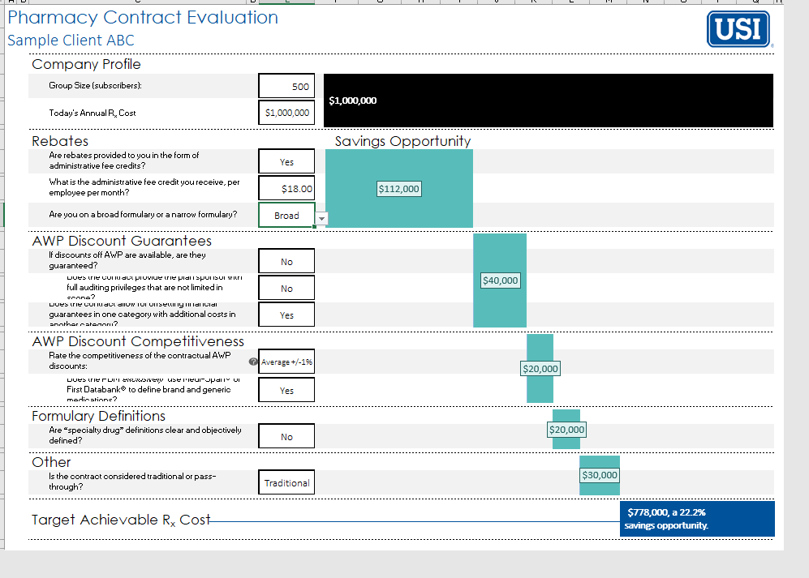
PHARMACY FOR HOSPITALS
Pharmacy Management & Purchasing
USI optimizes a hospitals in-house pharmacy and quantifies opportunities for improvement of contractual terms within a PBM contract
  Pharmacy expenses in a hospital’s employee benefit plan are unique in that within hospital infrastructure there is an opportunity to provide employees with a domestic network option, driving employee savings and hospital revenue.
  USI’s proprietary tool identifies opportunities for optimization in acquisition costs, including own use pricing, GPO, and 340b programs - reducing PBM profit.
  USI contract analysis identifies financial opportunities within rebates, spread pricing for non-domestic pharmacy, formulary optimization and contractual definitions.
  Impact and Benefits:
  Drives revenue to the hospital and savings to employees. A 10% improvement in domestic utilization yields ~$250/PEPY.
  Savings related to acquisition optimization include:
  Own Use Pricing 6-10%
  GPO Rates 15-20%
  340b Rates 25-60%
  Additional savings relative to script pricing is demonstrated through evaluation of preferred drug listing.
USI Pharmacy Contract Evaluation
Optimize Pharmacy Domestic Network & Make Sure Contract Keeps Pace with Trends

Slide 10

Partnering to Grow & Manage Your
Clients with Pharmacy
Prepared for: Nebraska Hospital Association

Slide 11


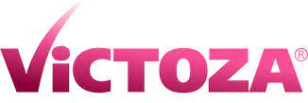
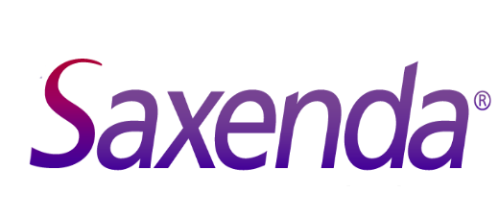
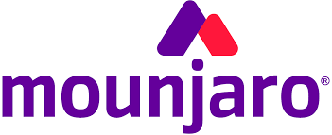

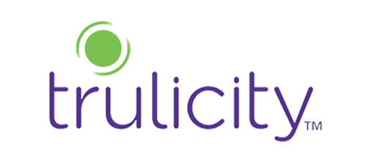
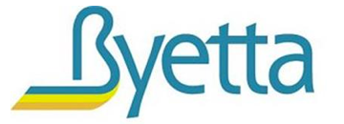
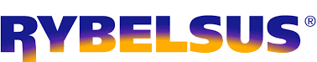
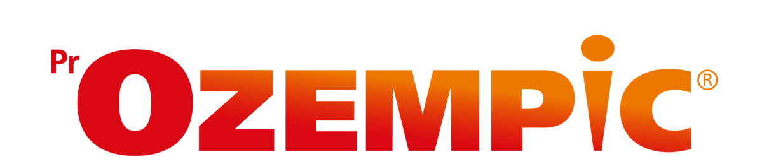

Glucagon-like Peptide-1 (GLP-1) Agonists
GLP-1s are a class of medications that are FDA-approved for type 2 diabetes (T2D) or obesity that help regulate blood sugar in the body.
GLP-1 Market Size Prediction (2032):
$72 B
US Diabetes Population:
37 M
US Obesity Prevalence:
41.9%
GLP-1 Growth:
6.5%
per year*
*compounded annual growth rate
Notes:
There are currently 10 FDA-Approved GLP1s.
Market size –
Growth in utilization of this medication class
A recent study on diabetes suggests that 1 in 10 people will have diabetes by 2050. While this is a staggering statistic, it creates a financially ripe opportunity for manufacturers of diabetic medications. Perhaps, none more so than those who manufacturer GLP-1 medications. With that in mind, and all of the industry wide attention already surrounding this class of medications, I thought it would be ideal to take a closer look at utilization and costs specific to the plan for these medications.
GLP-1 Receptor Agonist Market to reach USD 55.8 billion by (globenewswire.com)
-So what are GLP-1's? Essentially, they are a revolutionary class of medications that are FDA-approved for type 2 diabetes (T2D) and/or obesity. Originally, they were only being approved for Type 2 DM, however it was quickly unveiled that weight loss was a prominent “side effect” and I say that with quotation marks because at that point manufacturers realized that this could be so much more. Like the quote... “When life gives you lemons, make lemonade” And that is exactly what they did. This was the pivotal turning point when the GLP-1 landscape became a game changer.
-State the facts on the hexagons..... The GLP market size in 2023 was 12Billion and the US Diabetes population is 37 million people. 41.9% of the US population is considered obese.

Slide 12
Relevant Industry News
Managing Increased Diabetes Spend
Diabetes Background
Fast Facts
38 million people (1 in 10 people) have diabetes
National healthcare costs attributable to diabetes have increased by $80B in the past 10 years
$413B in total medical costs/lost work/wages for people with diagnosed diabetes
$1 out of every $4 in US healthcare costs is spent on diabetes
Insulin costs have increased by ~26% over the last 5 years
Diabetes Management
  Diabetes is a top 5 therapeutic cost driver and #1 non-specialty cost driver
  Brand dominated therapeutic class
  Complex and costly disease - more costly if unmanaged.
  Multifaceted care approach given frequent comorbidities (hypertension, high cholesterol, weight management)
Managing Diabetes Spend
Cost Strategies
Clinical Management Strategies
1. Formulary
  Preference of certain diabetes medications over others
  Tiering medications
  Often multiple choices of formulary types based on restrictiveness
2. Prior Authorizations
  Clinical criteria to ensure the medication is appropriate for the patient
  Requirement of documentation from provider allows for clinical proof of necessity of medication
  May add time for patient to get on therapy
3. Step therapy
  Requires patients to try a lower cost, higher tiered medication before moving to a higher-cost one
4. Quantity limits
  Ensures appropriate utilization by limiting quantities per days supply based on a medication’s FDA approved package insert
  Helpful for high-cost medications
1. PBM diabetes care programs
  Clinical programs connecting patients with clinicians (i.e. RN, HCP) to support disease and medication management
2. Adherence programs
  Ability to leverage Rx fill metrics to improve diabetes medication adherence
  These can be paired with Medication Therapy Management (MTM) or Polypharmacy management
3. Integrated/whole health programs
  Coordinated care programs that manage patient’s pharmacy and medical benefits
  Supported by integrating PBM and medical carrier benefits
Notes:
Sources
https://www.cdc.gov/chronicdisease/programs-impact/pop/diabetes.htm
https://diabetesjournals.org/care/article/47/1/26/153797/Economic-Costs-of-Diabetes-in-the-U-S-in-2022

Slide 13
Relevant Industry News
Innovative GLP-1 Weight Loss Coverage Strategies
As the rise of GLP-1s continue, employers are feeling pressured to navigate coverage of this drug class for weight loss. Below are three unique and innovative strategies that plan sponsors have recently implemented to address weight loss coverage amidst rising costs.
Strategy 1:
State of North Carolina
Strategy 2:
Mayo Clinic
Strategy 3:
Medicare
Strategy: Removing coverage entirely for GLP-1s treating weight loss
How It Works:
Effective April 1st, 2024, North Carolina State Health Plan has discontinued coverage of GLP-1 and GIP-GLP-1 agonist medications for weight loss within the State Health Plan.
The State plan will still cover weight loss as a therapeutic class, including medications such as phentermine, Adipex-P, or Orlistat.
Diabetic GLP-1s are still covered on the health plan and have not been discontinued.
Desired Impact: This change is projected to save the State of North Carolina nearly $100 million in the first year alone.
      Strategy: Implementing a member lifetime coverage limit
How It Works:
      The Mayo Medical Plan has limited the use of GLP-1s for weight loss starting in 2024.
      Medica, the administrator of the Mayo Medical Plan, has implemented a lifetime limit of $20,000 for coverage of weight loss medications (GLP-1s and other weight loss classes)
      This lifetime limit does not apply to diabetic GLP-1s (Ozempic, Trulicity, or Mounjaro)
      Lifetime limits on medications have previously been used in other therapeutic classes, such as infertility.
Desired Impact: Deliver some support and coverage while still containing costs
Strategy: Covering GLP-1s to support additional disease prevention
How it Works:
CMS had previously excluded weight loss medications from coverage.
In March 2024, CMS announced it would allow Medicare Part D plans to cover weight loss medications if the drug has received an additional medically accepted indication (i.e. heart attack or stroke)
Wegovy coverage was approved by CMS in March to reduce the risk of major cardiovascular events in adults who are obese or overweight.
Part D sponsors may consider using prior authorizations to ensure they are being used appropriately.
Desired Impact: Better coverage for high-risk patients
Notes:
Intro
GLP-1 medications continue to be one of the most talked about topics within the healthcare industry. Due to their popularity and cost, plan sponsors are exploring different approaches to covering GLP-1s for the weight loss indication.
Strategy 1: North Carolina
The State Health Plan of North Carolina recently decided to discontinue the coverage of weight loss GLP-1s due to rising costs, effective April 1st, 2024.
The plan will still cover other weight loss medications, as well as GLP-1s that are indicated for diabetes.
Strategy 2: Mayo Clinic
Mayo Clinic has implemented a lifetime limit of $20,000 for coverage of weight loss medications filled after January 1st, 2024.
This lifetime limit will include all weight loss medications but will not include GLP-1s indicated for diabetes.
A lifetime limit refers to a defined dollar amount or limit on what the plan sponsor would spend for a covered benefit (drug class in this case) during the entire duration that the member is enrolled in the plan.
Strategy 3: Medicare
CMS announced it would allow Part D plans to cover weight loss medications if they receive an additional indication.
On March 8th, 2024 Wegovy was approved to reduce the risk of cardiovascular events in overweight or obese adults with established cardiovascular disease.
CMS had previously excluded weight loss medications and stated that Part D sponsors may consider using PAs to ensure Wegovy is used appropriately.
Resources
North Carolina State Workers' Health Plan Ending Coverage for Certain Weight-Loss Drugs (usnews.com)
https://www.shpnc.org/blog/2024/03/07/statement-regarding-glp-1-coverage
https://www.beckershospitalreview.com/finance/mayo-clinic-moves-to-limit-weight-loss-drug-coverage-for-employees.html
The projection indicates that maintaining coverage for this medication category for weight loss purposes would lead to a premium hike of $48.50 per subscriber per month, regardless of medication utilization.
https://www.healthline.com/health-news/medicare-wegovy-lower-heart-disease

Slide 14
Coverage Determination:
GLP-1s for Weight Loss
Coverage Considerations
Industry Trends
Job satisfaction
Employee engagement
Increased productivity
Improved health
Cost implications
~40% of plan sponsors cover weight loss medications
Coverage higher among plan sponsors with 5,000 or more covered lives
Due to rising costs, coverage has decreased over the past year
Notes:
Per Employers Health: 60% of clients exclude obesity drugs, 25% cover them after prior authorization, and the remainder (15%) allow access without any restrictions.
International Foundation of Employee Benefit Plan survey: 22% offer coverage for weight loss drugs, 45% cover bariatric surgery, 32% cover weight management programs. Coverage for weight loss drugs higher among plan sponsors with 5,000 or more covered lives.

Slide 15
GLP-1s Growing Pipeline
Manufacturer’s response:
Substantial investment in the development of new GLP-1s
Enhanced GLP-1s
Administration
Indications
GIP receptor
Glucagon receptor
Amylin analogues
Daily tablet
Weekly injections
Monthly injections
T2D
Obesity
NASH
CV Health
Addiction
Alzheimer’s

Slide 16
What are Biosimilars?
Biosimilars are:
A biosimilar is a biological product that is highly similar to and has no clinically meaningful differences from an existing FDA-approved biologic reference product.
Large, complex molecules derived from living cells
Expensive to manufacture
Often used to treat highly complicated diseases such as Rheumatoid Arthritis, Crohn’s Disease, and cancer
Similar modes of administration and dosing as the reference product
Notes:
First, I wanted to provide a little background on what exactly biosimilars are but before we talk about biosimilars we have to define what a biological product is.
Biologics differ from the common oral medications we normally think about when you go to a pharmacy. Drugs such as Tylenol or Lipitor that are considered small-molecule drugs.
Biologics are large, complex molecules that are derived from living cells. Because of this they are expensive to manufacture and they treat complicated specialty disease states such as RA or cancer. Examples of biologics include Humira or Lantus.
A biosimilar is a biologic product that is highly similar to and has no clinically meaningful differences from the reference biologic product. So if we use the Humira example, a biosimilar for Humira will elicit the same response and be just as effective as Humira in treating a patient.

Slide 17
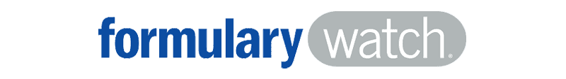
Humira Biosimilars Timeline
August
CVS launches Cordavis, contracted with Sandoz to commercialize Hyrimoz biosimilar
November
CVS announces changes to 2024 formulary, adding Hyrimoz as preferred product along with Humira, effective Jan 1
January
Amjevita launched
2023
2024
July
Yuflyma, Idacio, Yusimry, Hulio, Hadlima, Hyrimoz, and Cyltezo launched
January
CVS announces removal of Humira as preferred product on some of its formularies, effective April 1
October
Abrilada launched
CVS Caremark to Remove Branded
Humira from Formularies
Jan 4, 2024
Notes:
Here we have a timeline of the last 12 months regarding Humira and its biosimilars. Over the past year there have been nine Humira biosimilar launched, one last January, 7 in July, and one more recently in October.
Wanted to call out some interesting developments you may have heard about regarding CVS. Last August, CVS Health launched Cordavis, a subsidiary that will coproduce or commercialize biosimilar products. Cordavis has contracted with Sandoz to commercialize a private label version of Hyrimoz.
In November when CVS announced their formulary changes for 1/1/24 they listed Hyrimoz, the Cordavis biosimilar, and Humira as preferred agents. Because of this we didn’t really expect there to be a lot of shift in utilization from Humira to its biosimilars, especially since Optum and ESI also kept Humira as a preferred product.
However, due to the launch of Cordavis and partnership with Sandoz, the writing was on the wall that CVS would eventually attempt to move Humira utilization towards the Sandoz products and now they’ve done just that. Last week CVS announced that effective April 1 they would remove Humira as a preferred agent on some but not all of their formularies.
This could potentially lead to a fair amount of member disruption as Hyrimoz does not have that interchangeable status we talked about earlier, but CVS has pulled off significant formulary changes like this before and will probably be able to do the same here.
Pause for questions

Slide 18




Plan Sponsors: Pillars of Rx Management
Contract
Plan Design
Utilization
Delivery Channel
|
Confirm contractual terms related to biosimilars are present and valuable to the Plan
|
Financially incentivize members toward biosimilars?
|
Ensure utilization management protocols for access are based on clinical appropriateness
|
Benefit coverage rules
1
1
1
1
|
|
Narrow vs. broad pharmacy network
|
Determine how shift toward biosimilars may impact financial picture
2
Add additional coverage tier(s)?
|
Understand the complete “order of operations” of which and when biosimilars will be used
2
2
2
2
Validate contract terms are being upheld regardless of biosimilar strategy
|
Which coverage tier should biosimilars fall?
Assess metrics to verify management strategies are driving toward lowest net cost and positive patient outcomes
|
3
|
3
3
Notes:
When thinking about biosimilars, it is important to understand the impact that they have across each stakeholder.
Contracting
From a contracting perspective, it is vital to have language included that clearly defines biosimilars and their guarantees across all channels.
This also includes oversight into how a shift in volume from the reference product to a biosimilar will affect the financials.
Plan Design/UM
For plan design, there are ways to incentivize patients to switch over to the biosimilar product including placement of biosimilars into a lower tier with reduced out of pocket expenses.
As we discussed with CVS earlier, this is not the strategy they have begun to employ and have instead chosen to outright remove Humira as a preferred product from some of their formularies.
Additionally, step therapies requiring a patient to try a biosimilar before the reference product or inclusion of a prior authorization could also steer patients to a biosimilar.
Member Experience
I did want to go back to the member experience, which is often overlooked when talking about biosimilars.
If you do end up removing a reference product from a preferred status or change tiers or delivery channel, you’re going to cause member disruption which can lead to employee dissatisfaction with their employer. In my experience, patients really don’t like to rock the boat when it comes to their medication and if something is working for them they’d very much prefer to stick with it.
However, if there are changes like I just mentioned it is vital to have adequate communication and be as proactive as possible with any formulary change. This includes mail or emails notifying patients about formulary changes. In the CVS example, I would encourage pharmacies to get new prescriptions for the biosimilar products in advance of the change so that there isn’t disruption come April 1.

Slide 19

USI Clear Options, Clear Guard, & the Truveris Partnership

Slide 20





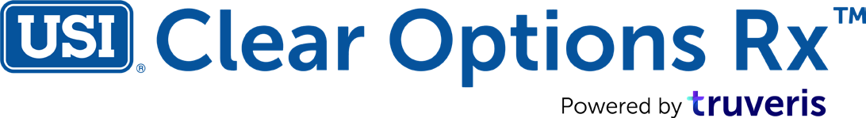


Strategic Partnership for Rx Improvement
Truveris helps position USI
to deliver to your clients the best pharmacy:
pricing
contracts
program oversight

Slide 21




~600+ mutual clients,
Fast Facts
transforms and reduces pharmacy spend
is XXX
~$5B in savings generated
Who we are:
Comprehensive, data led, fully independent PBM management and cost-containment platform.
What we do:
Create complete PBM pricing transparency and drive competition to reduce costs for employers. Truveris replaces the traditional procurement and renewal models for self-insured employers.
150 + life groups
20%+ savings and ongoing insights
How we do it:
A patented, data driven SaaS platform that reduces pharmacy spend through deep insights and comparative procurement, program analytics, 100% claims oversight, and member engagement solutions.
Market facing SaaS solution
21
Proprietary and Confidential © 2024 Truveris, Inc.

Slide 22








Important FAQs
What are typical savings?
We average ~20% improvement in PBM contracts, net of our fees. Timing impacts results.
1
What does it cost?
All Truveris fees are fully transparent and disclosed as an annual flat fee based on number of covered lives.
2
Who pays for the platform?
Fees are typically negotiated into the pharmacy bid and paid by the winning PBM.
3
Does this work for carved-in pharmacy contracts?
As long as the group is self-funded with 100 enrolled employees or more, we can support pharmacy programs with procurement and oversight solutions.
4

Slide 23
Clear Options Rx:
Pharmacy Procurement

Slide 24
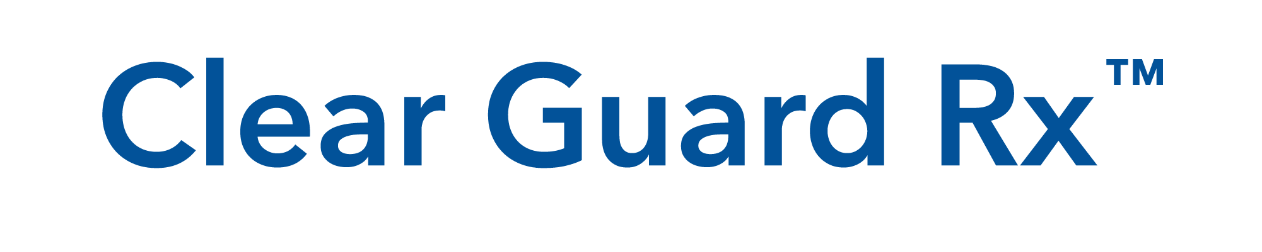

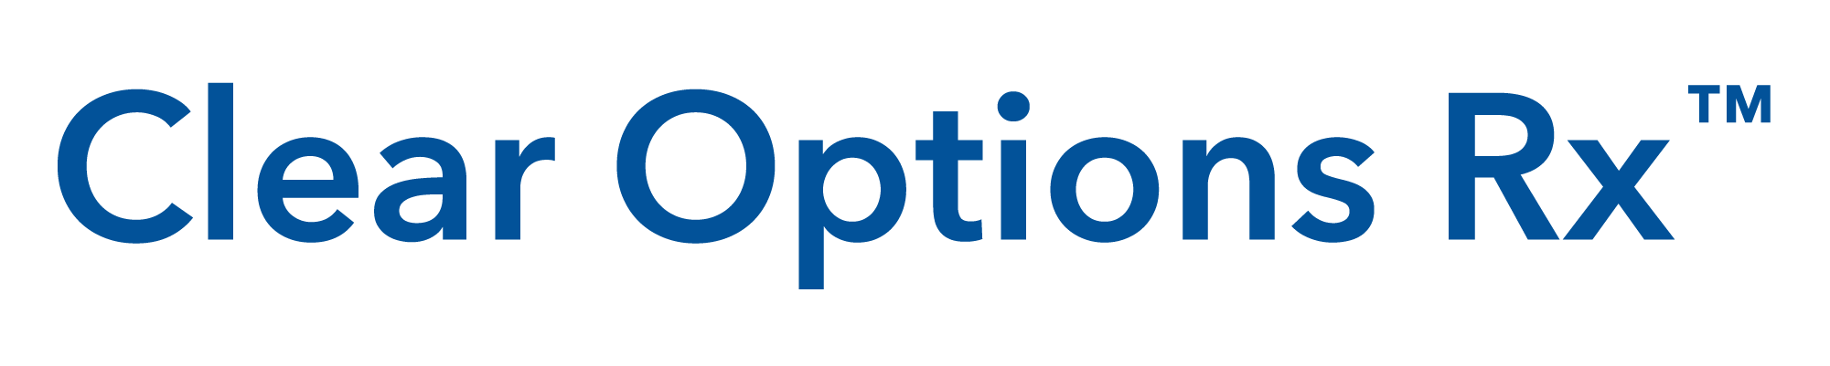
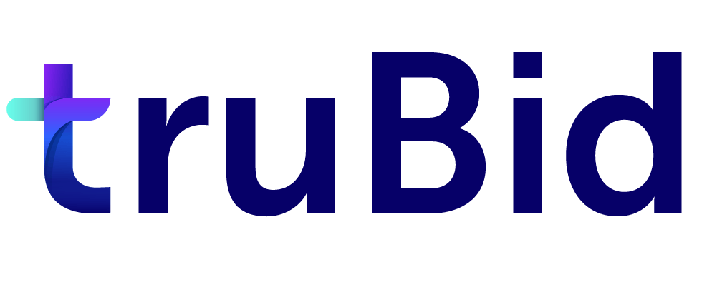
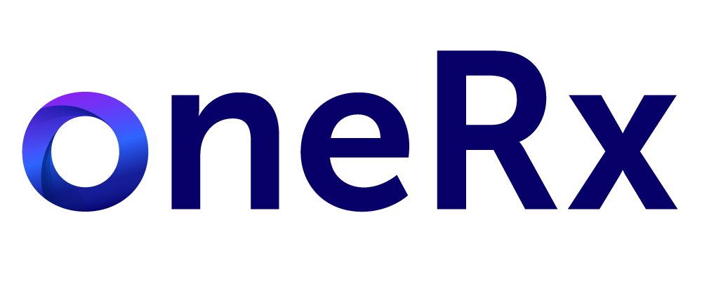
A comprehensive, data-led, and fully independent pharmacy platform
TECHNOLOGY
EXPERTISE
REPORTING
OVERSIGHT
We replace traditional PBM management and renewal models with innovative solutions focused on pinpointing and disrupting the areas that have the greatest impact on improving pharmacy cost containment and program performance.
PROCUREMENT
MEMBER
ENGAGEMENT
Notes:
Purpose: First opportunity to reinforce who we are and what our platform does to support the broker. This should start to show how we are innovative and purposeful with our solutions to support areas where both clients and brokers have opportunities to impact their current approach.
Talk Track:
You may know us for Clear Options Rx, but through this partnership there is a broader value we can bring to you and your portfolio through the use of our full platform.
Ok so what is the Truveris platform? We’ve designed the platform to pinpoint areas of the greatest impact for you and your clients when it comes to pharmacy. In addition to delivering competitive rates and terms on the pharmacy contracts through dynamic and tech-enabled procurement, we ensure that the contract is performing as intended throughout the contract terms through oversight, and lastly, we have rolled out a value-add solution that helps make an impact on cost and transparency on individual member-level.

Slide 25


Truveris’ patented platform with ability to evaluate any vendor that agrees to procurement
requirements and terms
Under 1,500 Employees
Over 1,500 Employees
Managed Carved-In
Truveris MarketplaceTM
truBid Custom
Defined carved-in carriers, efficient process, defined criteria, and preferred Truveris pricing
Eligibility Threshold**
Aetna/Meritain: 250-1,500 Employees (New 10/1/2023)
Anthem: 0-1,500 Employees
BCBS IL, OK, & TX: 151-1,500 Employees
BCBS NC: 50-1,000 Employees
(New 10/1/23)
Cigna: 250-1,500 Employees (pro-claim only)
UMR: 0-1,500 Employees
Standing offers based on up to 30+ variable contract terms on Truveris’ Marketplace based on members*
Negotiated annually and refreshed as needed throughout the year
Includes assessment of pricing offers and key pricing terms
Ability to solicit client specific offers
Planning Window:
4-8 months from effective date
Fully customized procurement solution that solicits client-specific offers including contract review
An RFP that includes up to 400 variable contract terms that enables an unparalleled apples-to-apples comparison of terms
Ability to streamline process but requires a longer lead time
Planning Window:
10-12 months from effective date
*Pricing is based on total members (bellybuttons).
** Max 3,000 total covered lives for Managed Carved-In

Slide 26

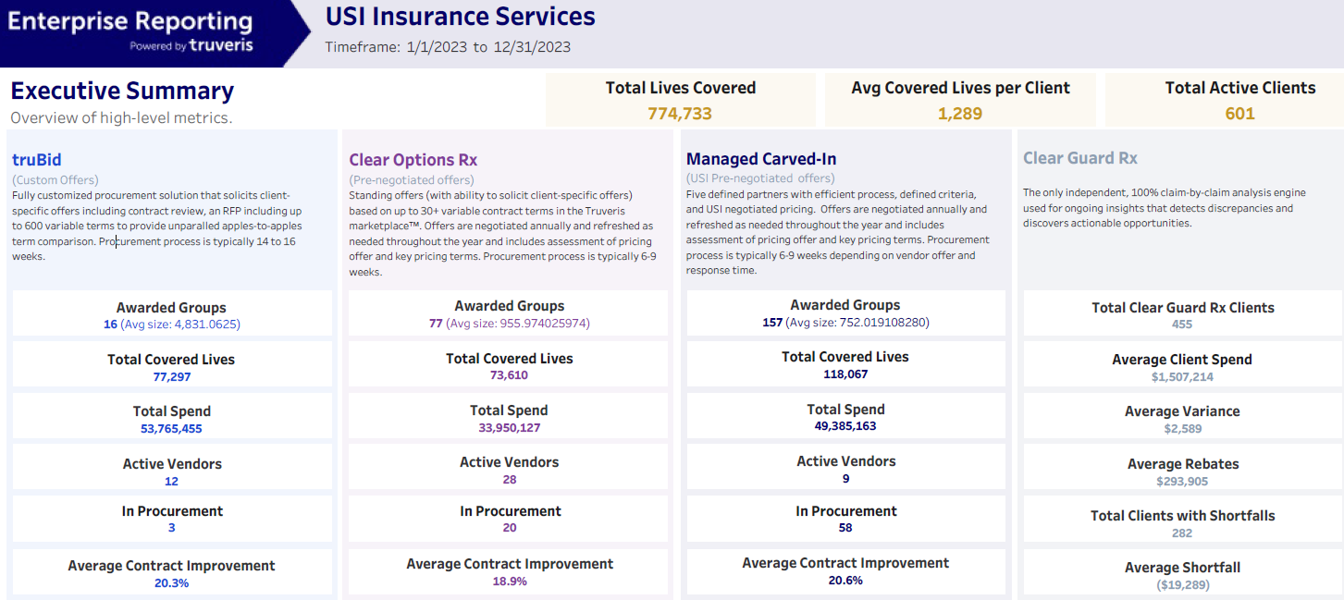
Clear Options & Clear Guard Rx

Slide 27
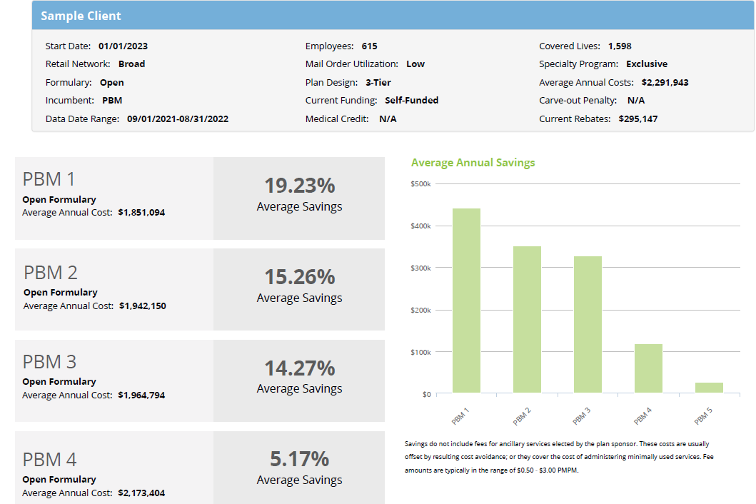
Optimize Contracts
and Maximize Savings
Easy access to pre-negotiated transparent, competitive PBM offers
Objective, data-driven procurement
Unbiased side-by-side comparisons
Incumbent-inclusive solution
3-page analysis of each PBM that includes:
  Financials
  Exclusions
  Top drug utilization
  Disruption analysis

Slide 28
Clear Guard Rx:
Oversight and Monitoring

Slide 29

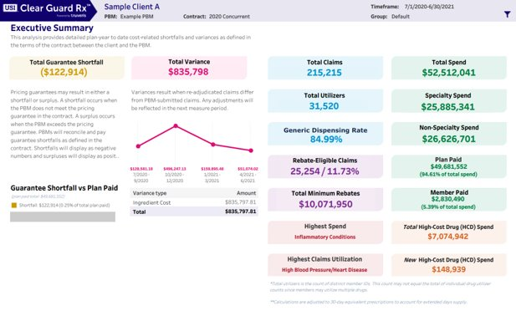

Clear Guard Oversight & Monitoring
The only independent, fully automated solution that reviews 100% of pharmacy claims throughout the life of the contract to monitor contract performance and compliance, helping plan sponsors uphold their fiduciary duty.
With an oversight solution that can be implemented at any point of your pharmacy contract, employers can better monitor their pharmacy program performance for:
Rebate performance
Term compliance
New high-cost drugs
Performance guarantees/pricing
Powered by
Errors/opportunities for change
PBM report validation
Plan sponsor advocate
Variance Detection:
More than 90% of pharmacy contract reviews detect some level of variance from the existing contract.
Shortfall Identification:
More than half of reviewed contracts have some level of shortfall.
Notes:
Purpose: Demonstrate how procurement leads to insights that we provide today and fuels insights that we will continue to develop. Why it’s not a set it and let it.
Talk track: We can deliver to you what you’re not getting by relying on PBM annual reports. We have 100% claim review, meaning that we can detect any discrepancies in adjudication. We hold the PBM accountable to those disrecpancies. We’ve caught hundreds of thousands of errors (erroneous charges, waste, incorrect coding) which have saved our clients billions, and we review over 46M in claims annually. We deliver that reporting to you monthly, so you can get that money back as soon as possible. We
Questions – Can you say with certainty, how confident are you that every one of your claims are being processed accurately and are being honored by your PBM contract?

Slide 30
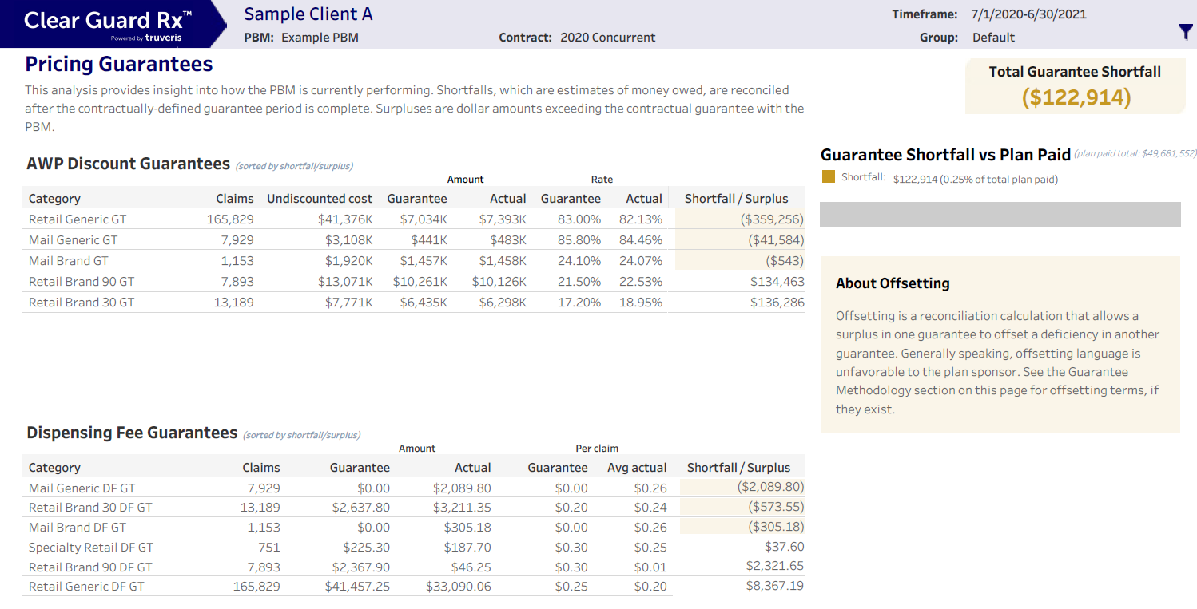
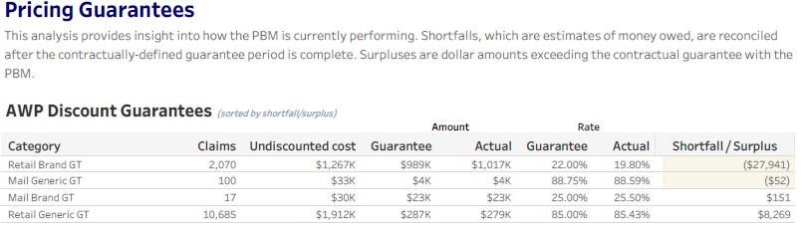
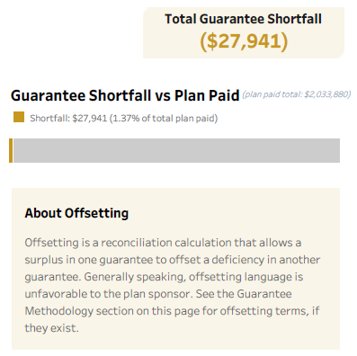
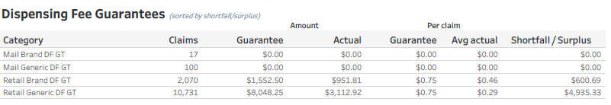
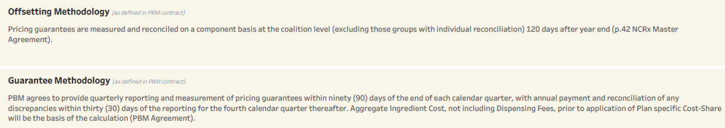
Sample View of Clear Guard Rx Report

Slide 31
Pricing & Rebate Guarantee Reconciliations
What it is:
Review of alignment between PBM reported data Clear Guard Rx report guarantees
Identification of material discrepancies
Available by request, typically when there is a discrepancy > 5%
What it isn’t:
Claim by claim audit of PBM report
An audit of any pass-through guarantee
A review of alignment between what the PBM actually paid and Clear Guard Rx Expected
Timing on Pricing Reconciliation:
PBM report is requested once Q4 Clear Guard Rx report has been generated
PBM report received date is dependent upon contractual language; typically between 90-210 days following the close of the guarantee period.
Truveris reconciliation is completed typically within 30-60 days of receipt of all data/information needed to complete the reconciliation
Timing on Rebate Reconciliation:
PBM report is requested once rebate reconciliation is requested by USI or client
PBM report received date is dependent upon contractual language; typically between 180-270 days following the close of the guarantee period.
Truveris reconciliation is completed typically within 30-60 days of receipt of all data/information needed to complete the reconciliation

Slide 32
Implementation and
Next Steps

Slide 33
Pharmacy Contract Timeline
Step-by-Step Process For Groups Under 3,000 Members
Discovery
Procurement
Implementation
Ongoing Support
1
2
3
4
5
6
Goal-Setting
Documentation
Kick Off
Award Contract
Contract Implementation
Performance Reporting
  Identify groups
  Discuss goals
  Discuss renewal options & client specific concerns
  Complete CSA
  Define objectives
  Request carrier data
  RFP discovery call with Truveris analyst
  Launch RFP
  Initial results presentation
  Final results presentation
  Award contract to winning vendor
  Contract signature
  New contract terms implemented with PBM by: 90 days prior to new contract required (some require 120)
  Clear Guard monitoring and insights
  Delivery Dates:
    MCI = 8/1; 2/1
    Non-MCI = 6/15, 8/15, 2/15
Contract Renewal:
July 1
December Jan 1 Jan 1- Jan 20 March 15 April 1 July 1
October 1
March April 1 April 1- April 20 June 15 July 1 October 1
January 1
April May 1 May 1 – May 20 July 15 September 1 January 1
Note: Timelines are estimates. Each individual contract will have its own timeline defined during our discovery meetings.

Slide 34
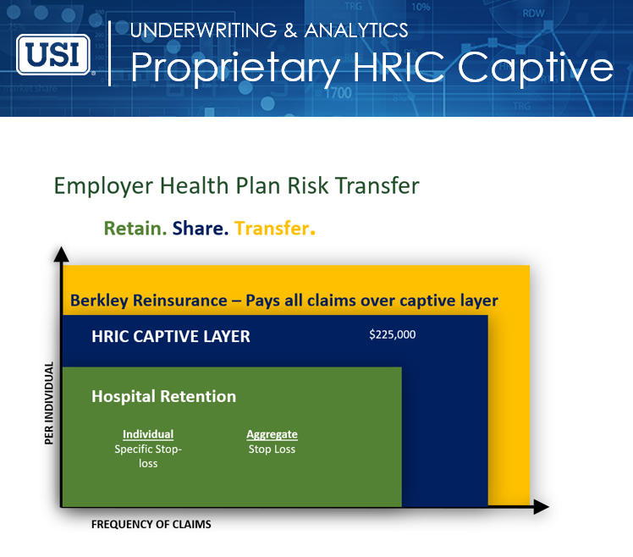
Cell and Gene Therapy Step-Down Deductible
THE SOLUTION

Slide 35
13th largest
property/casualty
insurance group¹
THE PROBLEM
Cell and Gene Therapy by the Numbers
Past
The first therapy was approved in 2017. At the end of 2022, there were 18 approved therapies.
Present
The FDA is set to approve 5-10 new therapies per year.
Future
There are 1,500+ ongoing clinical trials for cell and gene therapies registered with ClinicalTrials.gov.
Expected
Source: Emerging Therapy Solutions, actual 2017-2022 approvals and expected approvals for 2023-2024, internal data used with permission, April 2023, https://emergingtherapies.com/

Slide 36
13th largest
property/casualty
insurance group¹
THE PROBLEM
Cell and Gene Therapy by the Numbers
Hemgenix
Approved 2022
for Hemophilia B
Casgevy
Approved 2023
for Sickle Cell Disease
Roctavian
Approved 2023
for Hemophilia A
Elevidys
Approved 2023
for Duchenne Muscular Dystrophy
$3.5 mil.
Estimated cost
per patient
$2.2 mil.
Estimated cost
per patient
$2.9 mil.
Estimated cost
per patient
$3.2 mil.
Estimated cost
per patient
As more therapies come to market, the risk of a high-dollar claim increases.
Source: Emerging Therapy Solutions, internal data used with permission, https://emergingtherapies.com/ and Reuters, US FDA approves
two gene therapies for sickle cell disease, December 2023, https://www.reuters.com/business/healthcare-pharmaceuticals/us-approves-two-gene-therapies-sickle-cell-disease-2023-12-08/#:~:text=The%20Vertex%2DCRISPR%20therapy%20has,be%20available%20in%20early%202024.

Slide 37
Berkley Accident and Health’s Solution
THE SOLUTION
We want to help customers address one of the
biggest challenges facing self-funded plans today.
Cell and gene therapies are rare, but extremely costly.
If you do have a claim, you have peace of mind knowing our Stop Loss policy includes our Cell and Gene Therapy Step-Down Deductible as a standard benefit.
Notes:
Alternate headlines:
Your Partner in Risk Management
Count on us to be your risk partner
We help manage risk so your organization can thrive
Third icon: direction, navigation, vision

Slide 38

How it Works
The solution
Employer ensures the plan:
Berkley reduces the Specific deductible:
Includes pre-certification for cell and gene therapy and treats
ETS’ Centers of Excellence¹ as in-network in its plan
Requires its TPA and provider network to allow the patient to access ETS’ Centers of Excellence
Advises the patient that they can access ETS’ Centers of Excellence if they qualify for C&GT
Agrees to waive any exclusion under its plan that would conflict with any contracted arrangement (including procurement fees that may be included in the negotiated arrangement)
Notifies its TPA and medical management vendor
Reimburses for the ETS access fee
Lowers the Specific deductible for the patient by the following:
Specific Deductible Reduced by²
$10,000-$100,000 50%
$100,001-$250,000 35%
$250,001 and over 30%
Up to a $75,000 maximum reduction
Refer to policy endorsement for complete details
¹ Or other Centers of Excellence network approved by Berkley Accident and Health
² Subject to any state minimum allowable deductible requirements
Notes:
Alternate headlines:
Your Partner in Risk Management
Count on us to be your risk partner
We help manage risk so your organization can thrive
Third icon: direction, navigation, vision

Slide 39
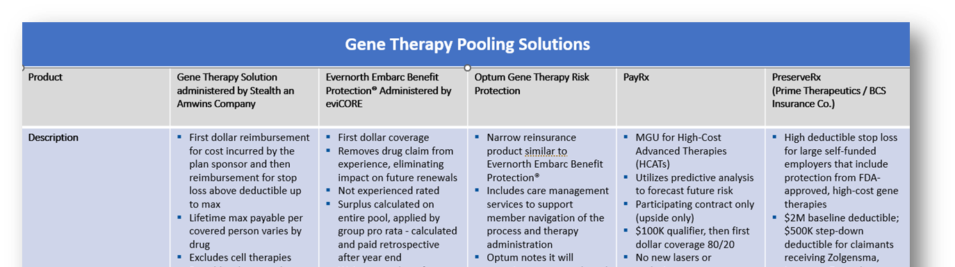
PHARMACY
Gene Therapy Pools and Exclusions
Emerging genetic therapies offer meaningful advancements in the treatment of chronic, life limiting conditions but also have the potential to bankrupt a health plan.
  With 8 currently approved genetic therapies and over 50 expected in the next four years, employers face unprecedented exposure to high-cost claims
  Gene therapies range in cost from $1M - $3.5M per claim and although approved by the FDA have typically only demonstrated effectiveness based on small sample sizes.
  Many re-insurance carriers will limit their liability by either excluding coverage or shifting the bulk of the claim to employers. Emerging reinsurance pools provide coverage for specific gene therapies and may offer employers an opportunity to provide coverage.
  USI recommends evaluating exclusion of all other gene therapies to reduce health plan exposure.
  Impact and Benefits:
  Existing genetic therapies are available to less than 0.5% of the population.
  As therapies expand it is expected that ~1.2% of the population will be impacted.
  At that time, expected cost to the industry will be $16 PMPM, with some employers exposed to millions of dollars in claims.
Identifying Your Exposure and Offering Solutions

Slide 40
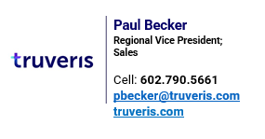

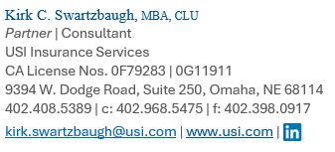
Thank you!
Questions?

