Slide 1

From Regulations to Rural Excellence
Nebraska Rural Health Association

Slide 2

Kate Hill, RN
Vice President, Client Success
The Compliance Team

Slide 3
Learning Objectives
Avoiding Deficiencies.
Putting Regulations
to Work.

Slide 4

Survey
Surveyor arrives unannounced.
Short meeting. Tour of clinic.
Place for surveyor to work.
Evaluating HR files, PT files and Policies.
Exit conference.

Slide 5

Let’s
Get
Started!

Slide 6

Organization is Key
Develop a Survey Readiness Binder.
  - Policies
  - Reports
  Other evidence of compliance
Determine who will attend/how to inform.
Keep the Clinic “Company Ready”.
Staff should know where everything is stored.
Reminder
This is an open book test. There should be no surprises.

Slide 7
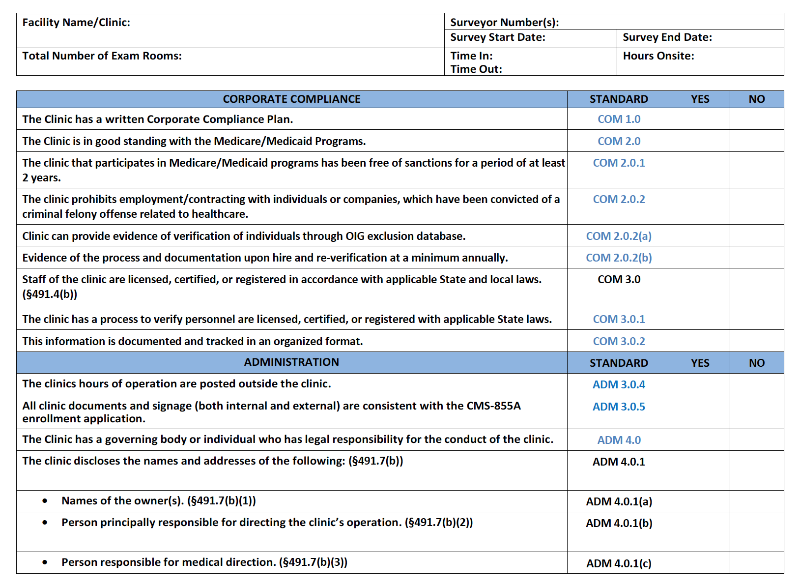
Checklist

Slide 8

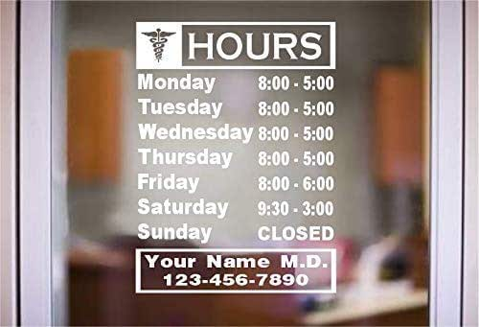
Clinic Information
Established clinics check it on:
QCOR CMS Data Base
https://qcor.cms.gov/main.jsp
Does your name match what is on your 855a?
Are your clinic hours posted near or on the door?

Slide 9
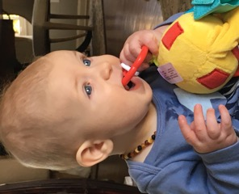
Waiting Room
How secure
is your clinic?

Slide 10
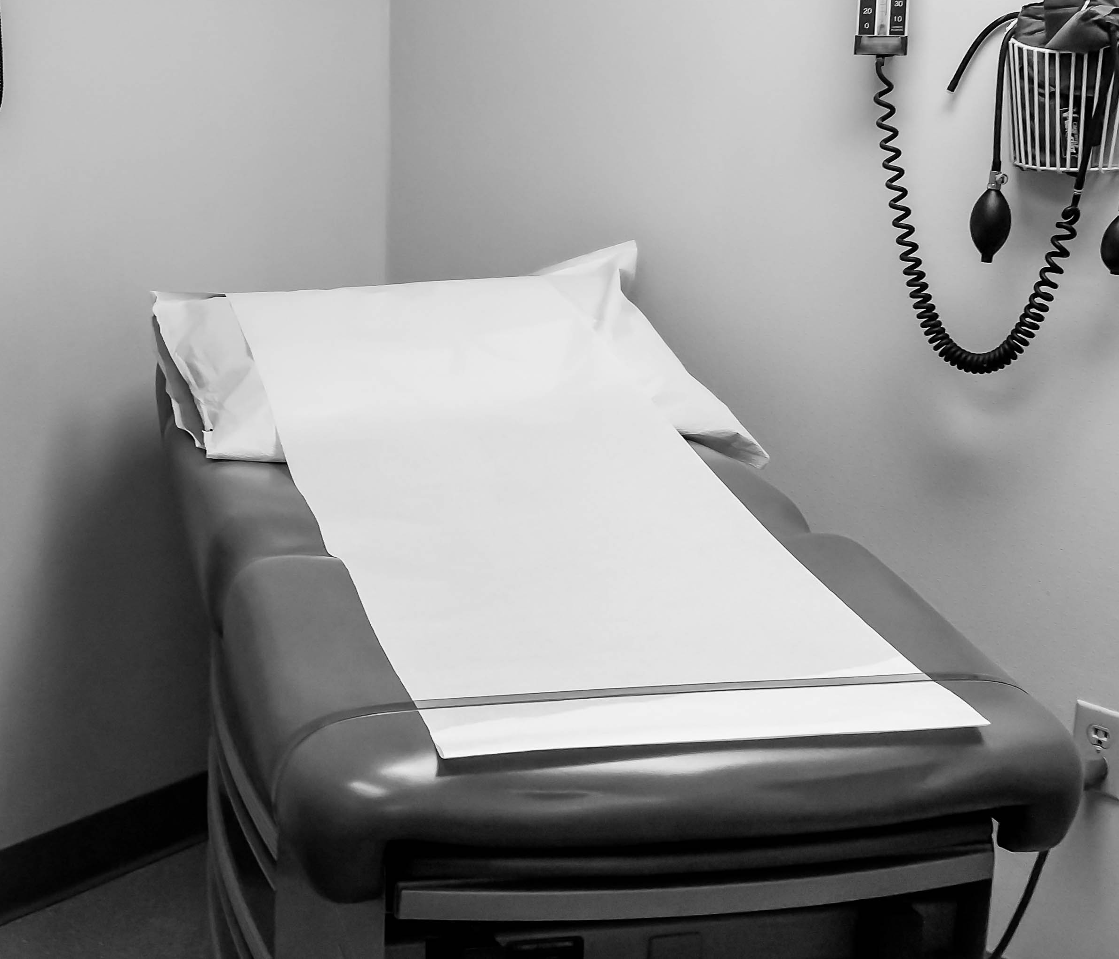
Exam Tables
How do you clean this table?
Wet time
Health grade disinfectant
Can a torn table be disinfected?
Needs to be repaired

Slide 11
Manufacturer’s Instruction for Use (IFU)
Equipment.
Is there documentation that mechanical and electrical equipment is regularly inspected, tested, and …
Is all your equipment on a list?
Maintained in accordance with manufacturer’s recommendations?
Review the manufacturer’s instructions for each piece of equipment.
Do you know what needs calibration and what needs preventative maintenance?
Is there a process in place for tracking due dates for PM?
Equipment not in use is labeled as such and stored away.

Slide 12
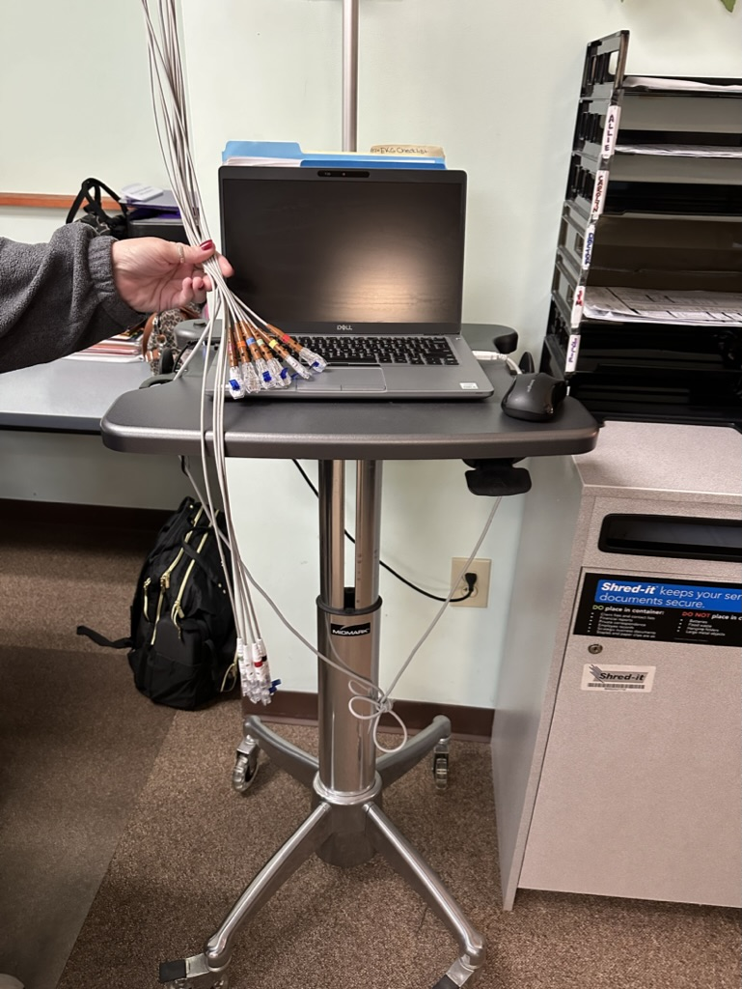
What Needs Calibration?
Does your EKG/ECG machine need to be calibrated?
Always check Manufacturer’s IFUs.
Most do except for the Welch Allyn CPWS and CP150.

Slide 13

Medication Management
Is there a robust medication policy?
All drugs secured in the clinic?
Drugs stored according to Manufacturer’s instructions?
All medications delivered to the clinic properly documented in the EMR?
Are we noting the 5 rights?
1. Right patient 2. Right medication 3. Right dose 4. Right route 5. Right time
Everyone dealing with drugs trained on vials?
Everyone trained on safe injection practices?
Is there proper recording for receipt and disposition of scheduled drugs?

Slide 14
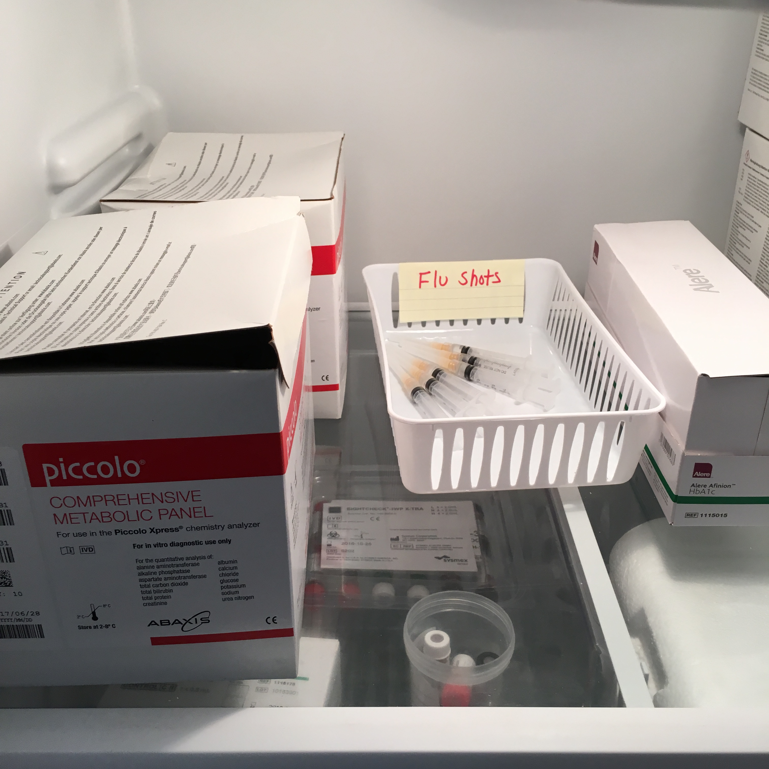
Pre-Filled Syringes
Once vaccine is inside syringe, difficult to tell which vaccine is which. This may lead to administration errors.
Most syringes designed for immediate administration, not for vaccine storage.
Bacterial contamination and growth can occur in syringes prefilled with vaccines that do not contain bacteriostatic agents, such as vaccines supplied in single-dose vials.
No stability data available for vaccines stored in plastic syringes. With time, vaccine components may interact with plastic syringe components, reducing vaccine potency.
Prefilling syringes is a violation of medication administration guidelines, which state - an individual should only administer medications they have prepared and drawn up.

Slide 15
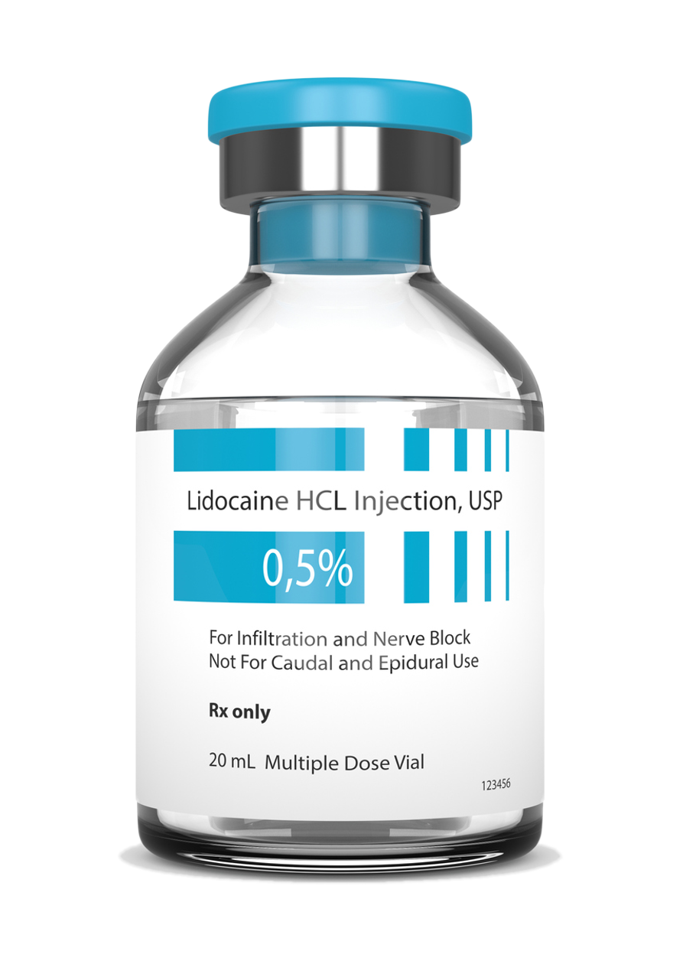
Survey: Vials
Possible…
Staff member does not know the difference between a single- dose or multi-dose vial.
Drug always comes as an MDV; but supplier sent a shipment where the drug was an SDV.
Store MDVs and SDVs together making it easy to confuse.
What to do:
Train all staff to always look at the vial to verify if an SDV or MDV and to check the date.
Train staff that SDVs do not have a preservative in the vial and why that’s important.
Separate MDVs from SDVs in the drug closet
Label all SDVs with a sticker
Single-Dose Vial
Don’t assume
all staff know the difference between SDVs and MDVs.
Multi-Dose Vial
Ensure Single-Dose Vials (SDVs) are never used for more than one patient.

Slide 16
Survey: Vials
Multi-Dose Vials
Single-Dose Vial
Never dated
Dated for 28 Days

Slide 17
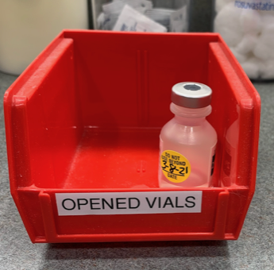
Survey: Vials
Ensure Single-Dose Vials (SDVs) are never used for more than one patient.
One and done. Discard!

Slide 18
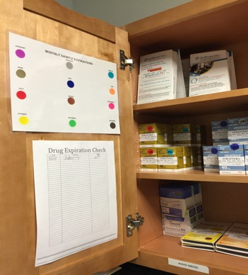
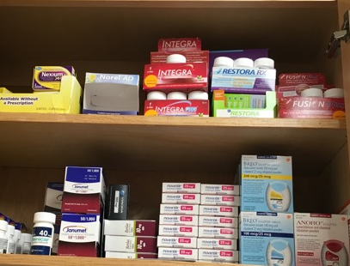
Sample Closet
Colored dots system. Smart!
Secured/Organized
in original containers
Reminder
Sample meds need a log.

Slide 19

Staff Education
What do they know?
Train them.
Document that training.

Slide 20

What’s Posted?
State and Federal Posters required in places visible to the staff.
Provider based clinics must have postings in the clinic; even if clinic is in the hospital building.
Rights and Responsibilities
Privacy Notice

Slide 21
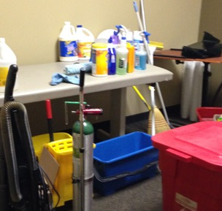
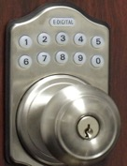
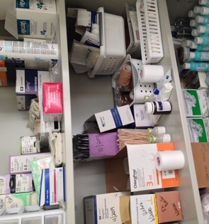
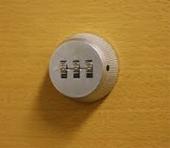
What’s Secured?

Slide 22

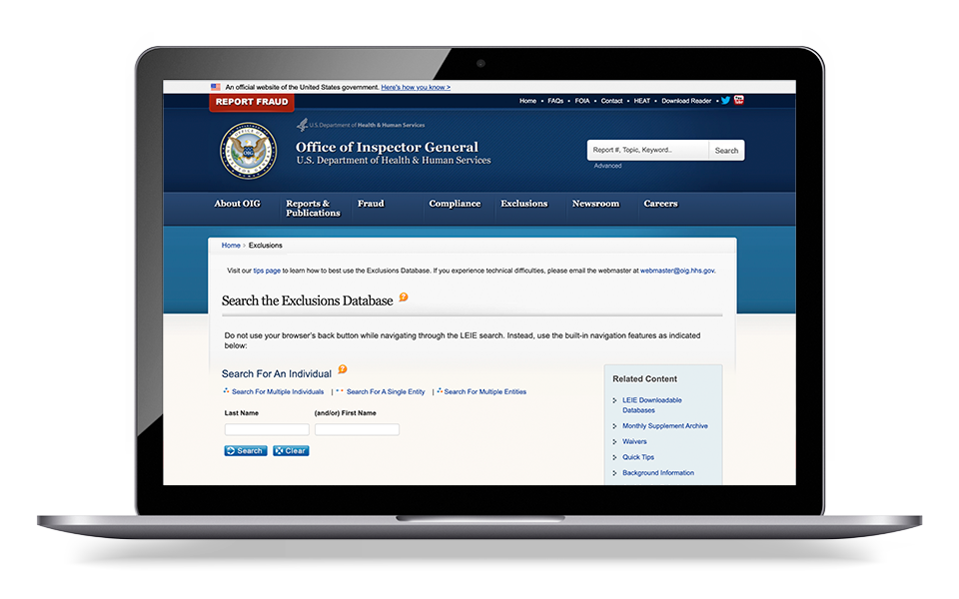
Are HR Files Complete?
Application
I-9 (keep filed separate)
W-4
OIG Exclusion
Signed Job Description
Standards of Conduct
Performance evaluations, according
to your clinic schedule
Annual Training
Competency
Background checks as appropriate
TB screening on hire
Hep B for those who work with patients
https://exclusions.oig.hhs.gov

Slide 23

Medical Direction
The Medical Director must be an MD or DO.
He/she must be licensed in the state where the clinic resides.
Duties:
Collaborate with non physician providers
Do chart review
Sign off on policies
The Medical Director is a reportable event.
    Reported on a CMS 29 to the state or to your accreditor.

Slide 24

Infection Prevention
Is the clinic appropriately monitoring house keeping?
How does the clinic prevent the spread of infection:
    Hand hygiene for staff.
    Are single use devices only used once?
    How are the clinic surfaces cleaned?
    Does the person know the wet/kill time?
    How is medical waste disposed?
    Are we certain instruments are sterile?
    Is the staff trained on point-of-care devices?

Slide 25
Sterilizing Instruments: Mfr’s IFUs
What is your process?
Reminder
Compare your process to manufacturer’s IFUs.

Slide 26

Staffing
NP/ PA Waivers
An existing RHC may request a waiver from the state after 90 days for one year on the loss of an NP or PA.
During that 90 days, the RHC must demonstrate it has been unable, despite reasonable efforts, to hire an NP or PA in the 90-day period.
Waivers are requested from the State Survey Agency. They are the only ones that can grant them.

Slide 27
Staffing
An NP, PA or Certified nurse midwife is available to furnish patient care at least 50% of the operating hours.
50%
How do you document this time?
All time spent in the clinic counts toward the 50%.
Time spent in a patient’s home, swing bed or SNF rounds, counts toward the 50%.

Slide 28

Staffing
Medical Record Review
If your State is silent, then you must determine how many and how often this occurs.
What is your policy on record review by a physician?
What is your documentation to show the record review has been done?
How do you document the NP/PA collaborated with the physician?

Slide 29
Surveyed Measured
51%
51% of a clinic’s health services are primarily engaged in providing outpatient health services.
Appendix G
“The services of these practitioners are those commonly furnished in a physician’s office or at the entry point into the health care delivery system. These services include taking complete medical histories, performing complete physical examinations, assessments of health status, routine lab tests, diagnosis and treatment for common acute and chronic health problems and medical conditions, immunization programs and family planning.”

Slide 30
Services: Primarily Engaged
RHC services include the services of Physicians, NPs, PAs, CNM, Clinical Psychologists, Clinical Social Workers. Now includes Marriage and Family Therapists and Mental Health Counselors. The services of these practitioners are those commonly furnished in a physician’s office or at the entry point into the health care delivery system.
RHCS are not prohibited from furnishing other services but cannot be primarily engaged in specialty services.
  - Does your website reflect the types of services you offer?
  - Does it include specialty services?
  Review the hours that specialty services are offered to determine the number of hours that is the majority of time.

Slide 31
Policies
Keep policies organized.
Review a few policies each staff meeting.
Keep your policies simple. Don’t lock yourself into a tight corner.
Know what requires a policy.
    Patientcare Policies
    Biennial Review of Policies by Advisory Group
    Storage, Handling, & Dispensing of Drugs & Biologicals
    Emergency Preparedness
    Health Records
    HIPAA
    Scope of Services Provided and Referred
    Lines of Authority
    Equipment Management
    Infection Prevention
    Hiring, Training and Orienting
    Quality Improvement

Slide 32
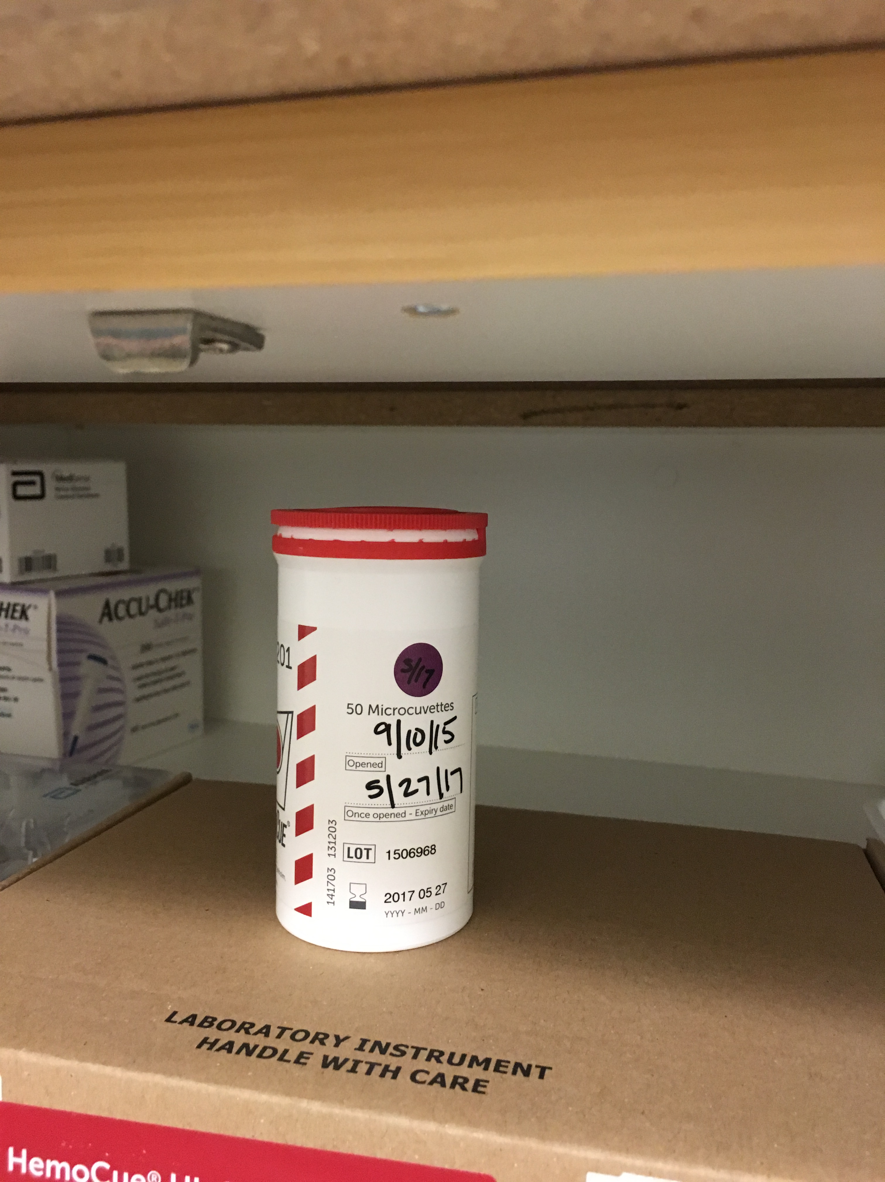
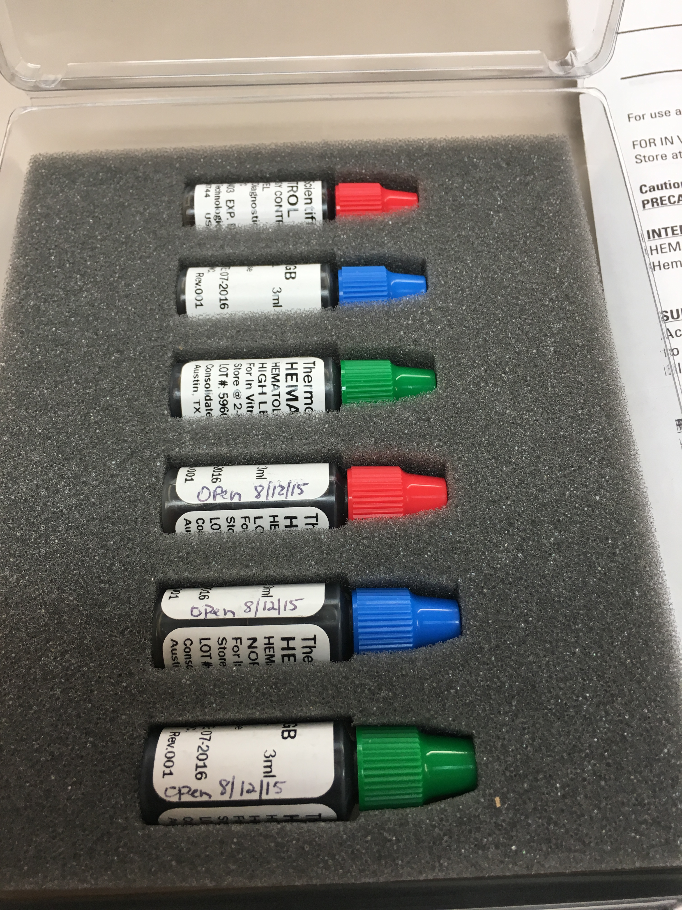
The Lab: Point-of-Care Tests
    Labs are for immediate diagnosis!
    Clinic must have ability to do all six required tests.
    Most common two missing are Hemoglobin or Hematocrit and Examination of stool specimens for occult blood.
    All reagents, strips, controls, etc., must be within date.
    CLIA Certificate is current and posted.

Slide 33
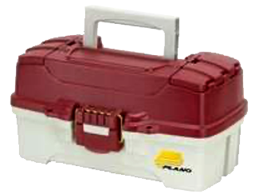
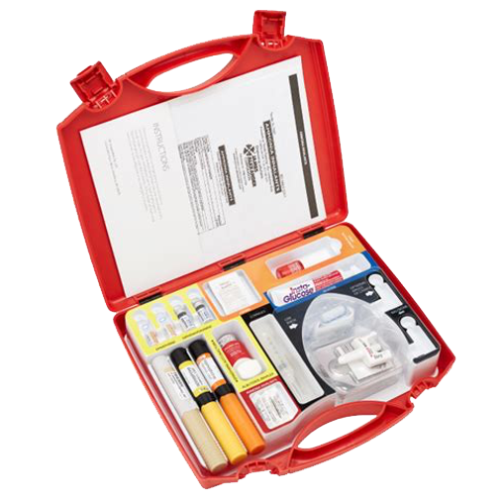
Emergency Services
    RHC ensures staff is available, at all times the clinic operates, to appropriately handle medical emergencies as a first response to common, life-threatening injuries and acute illnesses.
    Must supply a complete list of drugs and biologicals it stocks.
      What does your emergency service policy say?
      Does it match your process?
      How did the RHC decide what is in that box?
      Is the box checked regularly for outdates?
Reminder
Is the list of emergency drugs in the emergency services policy?

Slide 34
Patient Records
Consents For a minor patient, is there a relationship to patient on the consent?
Medications Is the EMR capturing the medication, lot number, route of administration, dose, and date?
Abnormal Labs Have abnormal labs been reported to patients?
        The notes should reflect the patient has been notified of the lab results and the plan moving forward.
        What instructions are given to the patient?

Slide 35
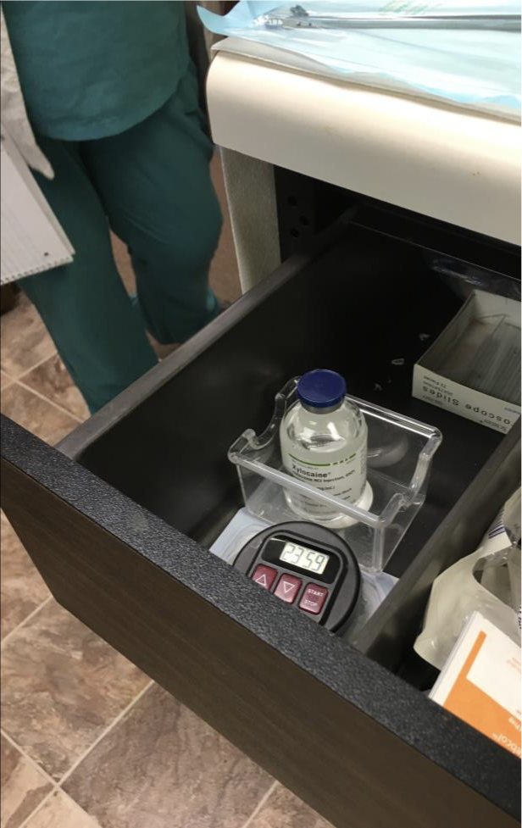
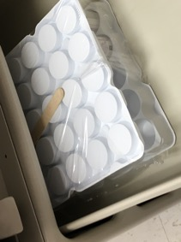
Risk
No medications or hazardous material in this lower exam table drawer.
ThinPrep: a preservative with the following warnings:
Inhaled: May cause depression of the Central Nervous System resulting in weakness, nausea, drowsiness, and possibly blindness.
Skin Contact: May cause irritation and or dermatitis.
Ingestion: May cause intoxication, CMS
depression, nausea and dizziness. May damage
liver, kidneys, and nervous system.

Slide 36

Policies Match Procedures
Clinics can be cited if a policy does not match their process/procedure.
Example #1
Some clinics call for an annual consent even though it’s not a requirement.
So, if the surveyor reviews files and there is no new consent, but the policy says annual, they will receive a deficiency.
Example #2
Several policies recently still say Annual Evaluation, while the reg says Biennial.

Slide 37
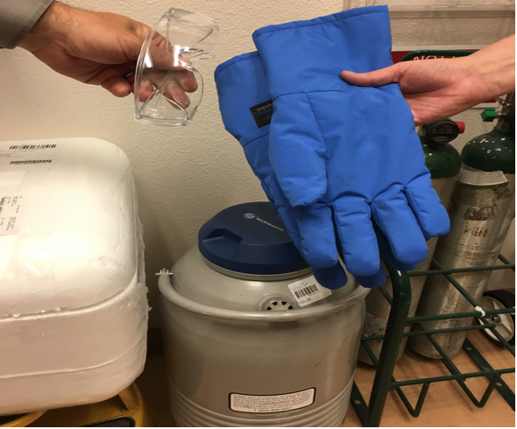
Protective Equipment
Personal protective equipment for staff
who handle liquid nitrogen.
Heavy duty gloves and
goggles for safety.

Slide 38

Work Safety
Proper PPE
SDS Sheets

Slide 39
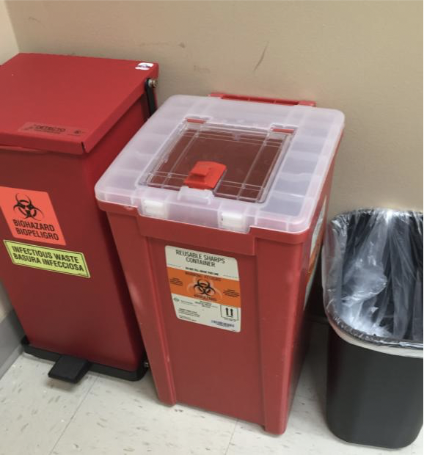
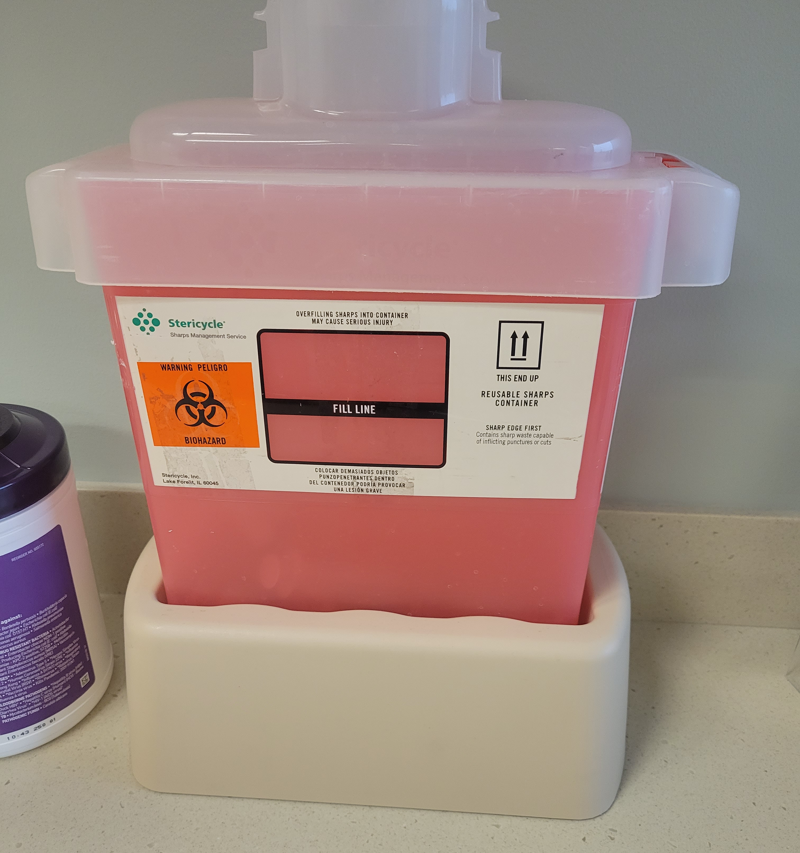
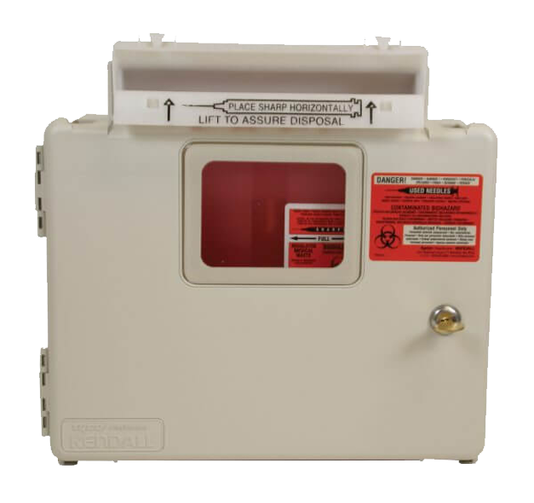
Biohazard Sharps Containers
Sharps containers cannot be easily accessible.
Several states require specific times for emptying sharps containers.
Must be marked with a Bio-Hazard sticker.

Slide 40
Biennial Evaluation
Lack of a Biennial review of the clinic.
Must be done every two years.
There is no waiver for this.
Look at date of the last one; make sure it’s not more than two years old.
This is a failed survey if not completed.
Policy review sheet: Who signed?
  - Must be an MD, NP/PA and an outside person.
  - Is the date within two years?

Slide 41



Emergency Preparedness (EP)
Power Grid Failure
Refrigerated Medications
PHI/EMR
Natural Disasters
Clinic Closure
Disruption of Services
Emerging Infectious Disease
Protocols
Risks

Slide 42

Survey: Emergency Preparedness (EP)
Hazard Vulnerability Analysis (HVA) must include Emerging Infectious Disease (EID)
Your exercise must be one of your listed items on your HVA, unless it’s an event.
Training and testing program is reflecting risks and hazards identified within the facility’s program (refer to facility’s risk assessment to determine) .
  - This means you can’t use something as an exercise unless it’s on your hazard list.
Communication plan is complete, including name and contact information for all staff and local, regional, state, tribal, and federal emergency staff.
Volunteers must be addressed in the EP Policy.
Address how refrigerated medications are handled in a power outage.
Helpful Tip
Training: Have a log to document the staff trained, with signatures, and dated every 2 years.

Slide 43
Survey: Emergency Preparedness Testing
Must participate in a full-scale exercise that is community-based or when not accessible, an individual, facility-based exercise.
If one year is full-scale exercise, then other can be tabletop. Every other year full-scale or at least a clinic-based exercise.
Analyze the clinic’s response to exercise or activation of plan.
Exercise or tabletop must be one of your hazard assessments.
Should not test same thing year after year. Intent is to identify gaps in the facility’s EP program, as it relates to responding to various emergencies, and ensure staff are knowledgeable on the facility’s program.

Slide 44
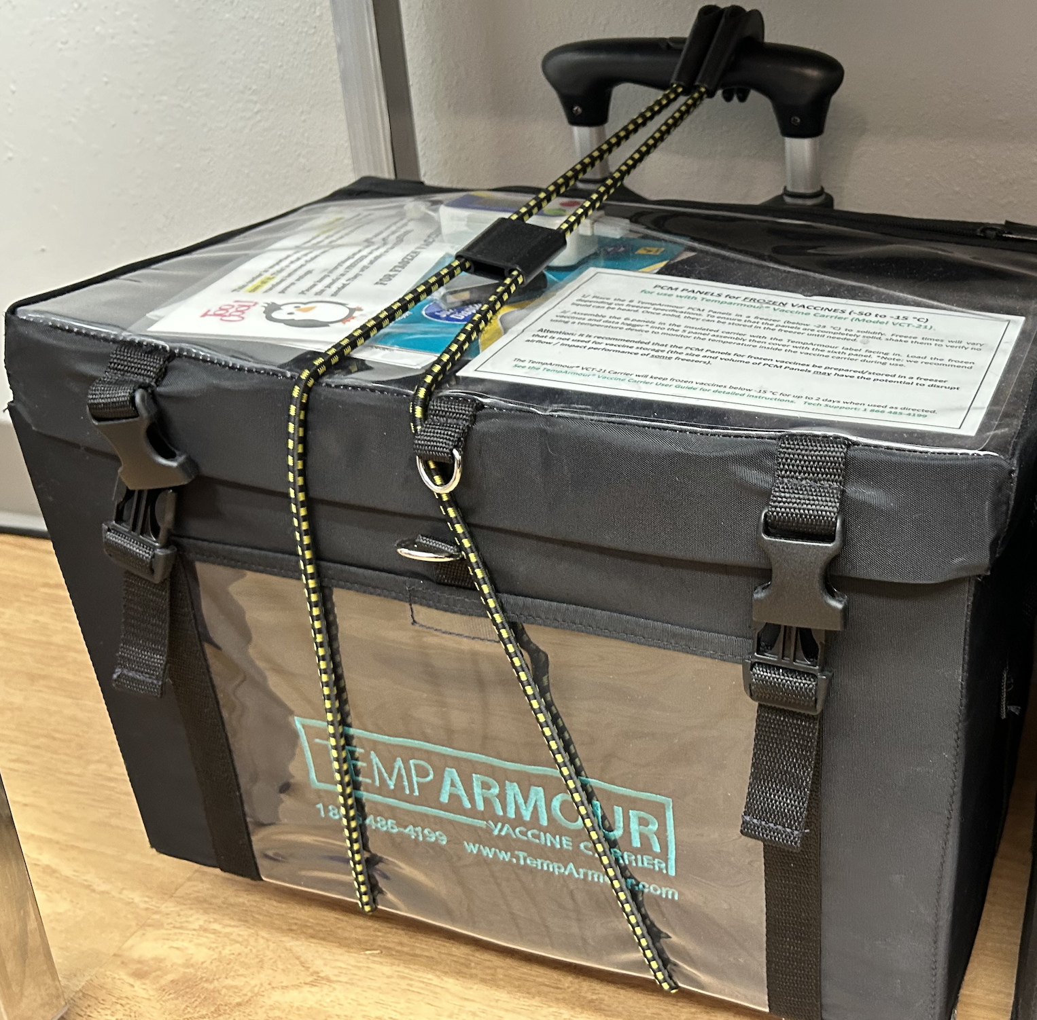
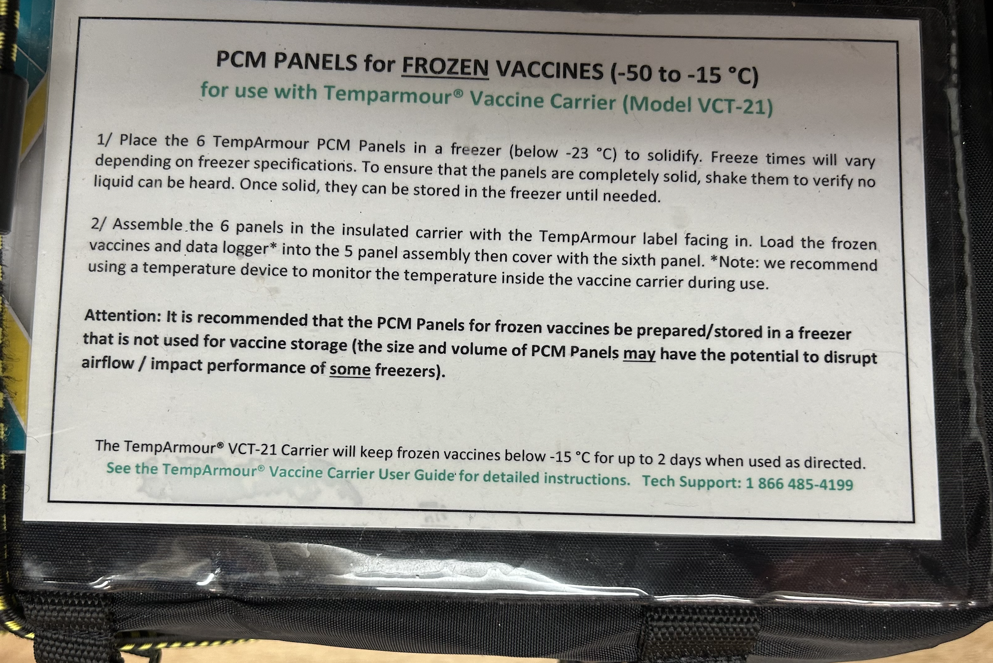
Survey: Emergency Preparedness Testing
Keeps vaccines frozen for two days!

Slide 45
Analysis for Event, Table-Top, or Exercise
Purpose of this report.
Analyze event results.
Identify strengths to be maintained and built upon.
Identify potential areas for further improvement.
Support development of corrective actions that will guide future emergency preparedness initiatives and advance overall emergency preparedness within your clinic.
  - Report reviewed with staff
  - Assignments given
  - Attendance log at AAR meeting

Slide 46
Common Deficiencies
Vials, single-dose dated.
Expired supplies in the clinic, i.e., iodoform, gloves, blood glucose supplies, etc.
Drugs not secured.
NP/PA or outside person not signing off on policies.
No analysis of an emergency event or exercise.
Not having all contact information in EP binder.
No documentation of chart review.
Not abiding by the wet time of your disinfectant.
Signage not matching the name you told CMS when you were called.
Incomplete patient records, both labs and consent.
Top 10
Deficiencies

Slide 47
Staff Interviews
Can staff articulate procedures they are responsible for?
If asked: “What do you have to do to get fired here?” Do they know the answer?
If asked: “What do you do if you have to evacuate the clinic?” Do they know the protocol or have easy access to the emergency preparedness information for evacuation procedures?
Staff should be prepared to answer questions related to their job responsibilities, clinic policies, and emergency protocols.
Reminder
Train your staff on corporate compliance and standards of conduct.

Slide 48
Deficiencies
Regulation at 42 CFR 488.26(b) says:
The decision as to whether there is compliance depends on manner and degree.
Standard or Condition level:
How serious is the deficiency in terms of its potential or actual harm to patients.
The extent of noncompliance e.g., How many or how widespread?
One incidence of noncompliance that poses a serious threat to patient health and safety is CONDITION.
Or many instances of a standard level deficiency could lead to a CONDITION level citation e.g., 15 of 20 charts have no consent.

Slide 49

Plan of Correction (PoC)
Must contain the following:
The process or lack of process that led to the deficiency.
Action that will be taken to correct each deficiency.
Description of how the actions will correct and or improve the issue.
Monitoring procedures to ensure the plan is effective to keep the RHC in compliance.
Title of person responsible (no names) for implementing the PoC.
Signature of an administrator.

Slide 50
What to Expect on Survey Day
RHC surveys are unannounced. Be prepared!
Managers, share your knowledge with staff.
Most surveys take between 6 - 8 hours per clinic, depending on the size and number of providers/staff.
Remember, having easy access to policies, personnel records, and medical records as they are requested, will allow the survey to proceed without delay.
Once complete, the surveyor will conduct an exit interview to discuss the findings.

Slide 51

Questions
Kate Hill, RN, Vice President, Client Success
khill@thecomplianceteam.org
Office: 215-654-9110

