Slide 1
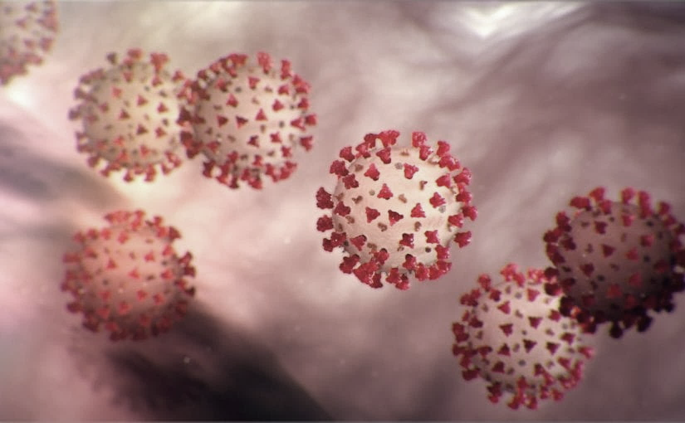
Covid-19 Webex Update 5-27-20
Maureen Tierney, MD, MSc.
Healthcare Associated Infections Medical Director
Tom Safranek, MD, State Epidemiologist

Slide 2
We are one in this fight
Frontline Heroes
Public Health Heroes
First Responder Heroes

Slide 3
CU 2020 George

Slide 4
Future ACH Calls
Wednesday beginning June 1
12:00-1:00pm
New calendar invite will be sent this week.
In addition:
Clinical Webinars from NM in partnership with DHHS should be starting soon

Slide 5
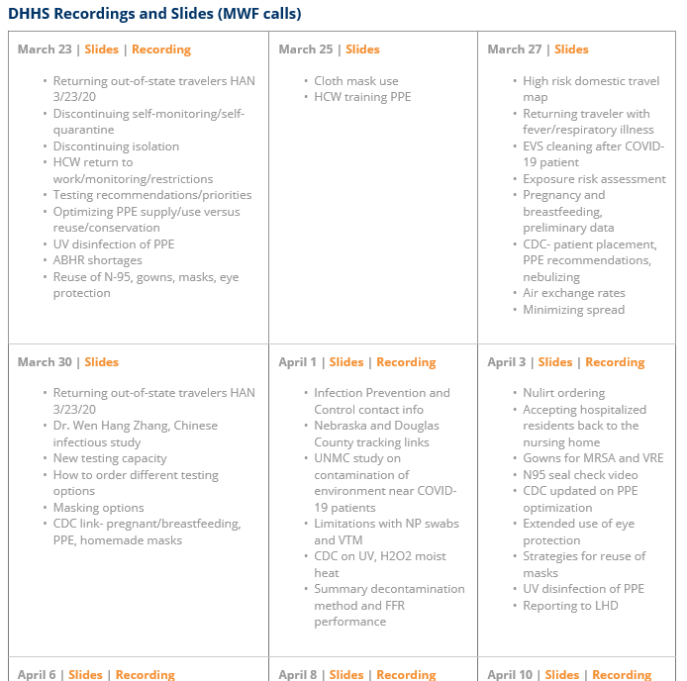
Thank you for joining us!
Slides and recording of today’s presentation will be available at
https://www.nebraskahospitals.org/coronavirus-covid-19-information.html
Scroll to the bottom of the page

Slide 6
Links to Nebraska webinars
Nebraska Acute Care Call every W at noon
previous calls can be found Nebraska Hospital Association
https://www.nebraskahospitals.org/coronavirus-covid-19-information.html
Nebraska ICAP Long Term Care Webinars every Thursday at noon
previous webinars and questions and answers found on ICAP website
NEW
https://icap.nebraskamed.com/
Nebraska ICAP Combined Critical Access and Outpatient Webinars every Tuesday at non
previous webinars and questions and answers found on ICAP website
https://icap.nebraskamed.com/

Slide 7
US Wide
Close to 1.7 million cases
Close to 99,000 deaths
20 States had increase in rate of cases over past week
Close watch over Memorial Day weekend gatherings
NYC-restaurants, hotels, transit biggest spreaders pre-lockdown
Masks, masks, masks!!

Slide 8
Testing in Nebraska
Up to about 2500 tests per day-
20,000 over past 7 days
Part Test Nebraska, part NG, part testing at facility sites
Test NE in this week
Omaha
S.Omaha
Hastings
Kearney
Lexington
Beatrice
Grand Island

Slide 9
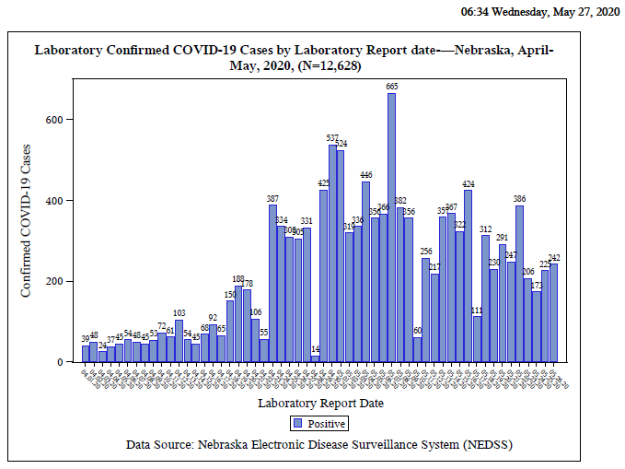
Notes:
Add the title of your presentation, your division, name, etc.

Slide 10
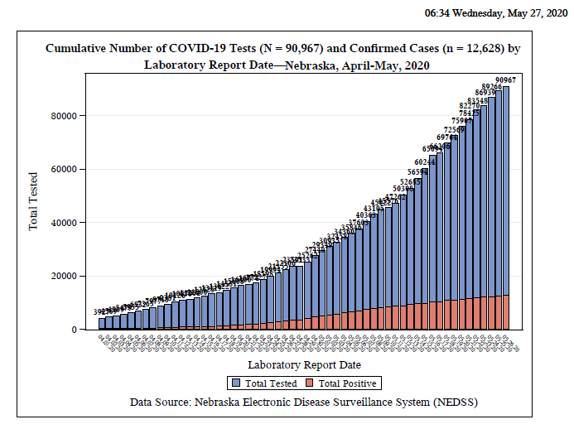
Notes:
Add the title of your presentation, your division, name, etc.

Slide 11
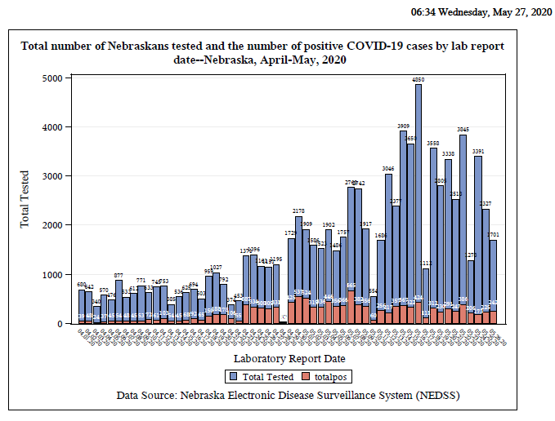
Notes:
Add the title of your presentation, your division, name, etc.

Slide 12
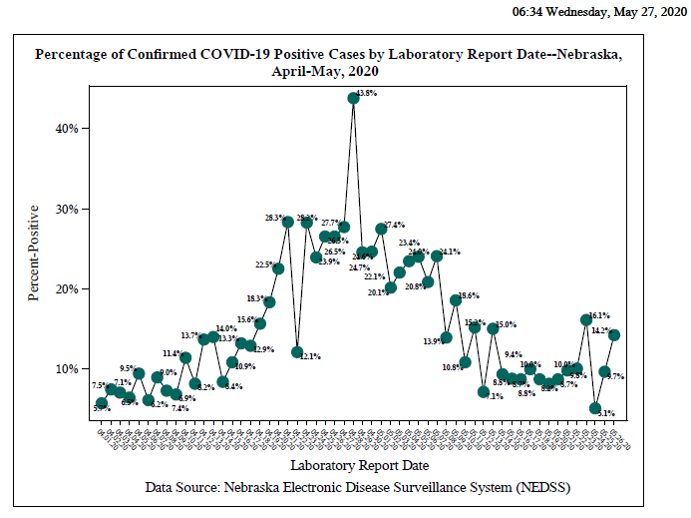
Notes:
Add the title of your presentation, your division, name, etc.

Slide 13
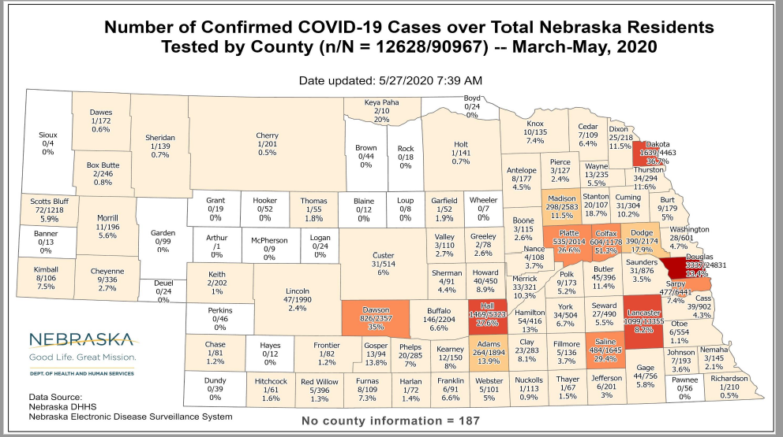
Notes:
Add the title of your presentation, your division, name, etc.

Slide 14
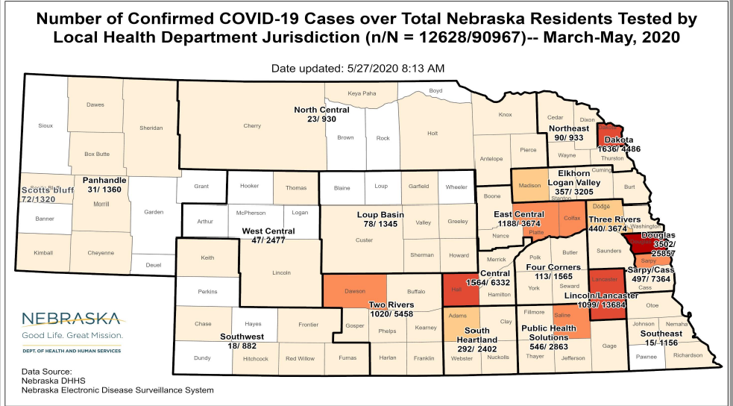
Notes:
Add the title of your presentation, your division, name, etc.

Slide 15
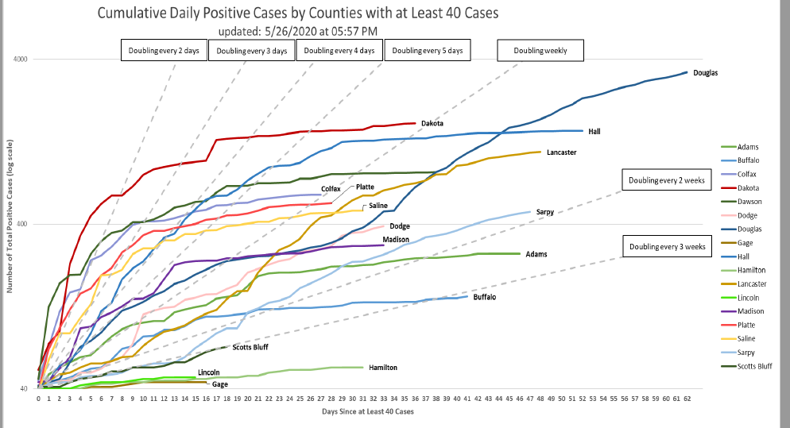
Notes:
Add the title of your presentation, your division, name, etc.

Slide 16
LTC COVID 19 Data (as of 5.6.20)
102 Facilities with at least one resident or staff positive for COVID-19
38 LTCF have at least one resident positive
Over 400 positive residents
LHD and ICAP available for help
Every facility with a positive resident and most with a positive staff member have a virtual ICAP visit
NETEC- over 35 onsite visits
Over 40 CDC Tele ICAR visits
Recovery Plan under development-LTC Webinars on Thursday requirements

Slide 17
Bed and Vent Availability as of 5-13-20
https://nebraska.maps.arcgis.com/apps/opsdashboard/index.html#/4213f719a45647bc873ffb58783ffef3
44% hospital beds available (41%) Douglas Co
43% ICU beds available
77% ventilators available
Transfer Center supported by CHI-not just to/from CHI hospitals
Increased use of Hospital and ICU beds in Douglas Co.
Douglas Co. -around 30% beds available but over 60% vents available
Lowered hospitalization in the other counties
Slightly over 200 patients hospitalized statewide and approximately 30% ventilated

Slide 18
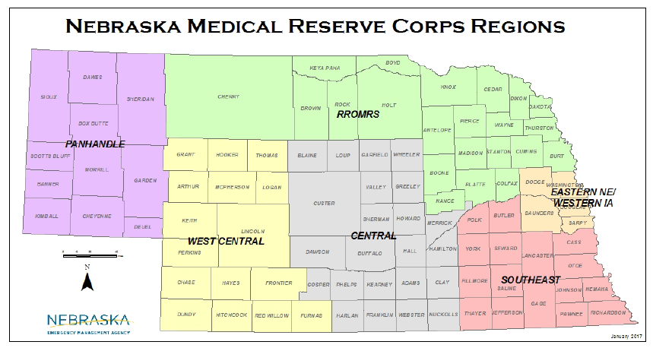

Slide 19
Vaccine Trials
124 vaccine candidates via 8 different platforms
Phase I in China
Adenovirus carried vaccine
Good antibody response
Good T cell response
Moderna-in phase 2
Merck -2 vaccine candidates
Novavax candidate entering Phase 1
Will likely need more than 1 vaccine

Slide 20
Anti-malarials in Therapy of COVID
Chloroquine or hydroxychloroquine (HCQ), with or without an antibiotic, in hospitalized COVID-19 patients were associated with increased risk of death in the hospital and higher rates of arrhythmias, analysis of outcomes in nearly 100,000 patients indicated.
The 15,000 patients who received HCQ or chloroquine were about twice as likely to die compared to controls who did not receive these agents after adjusting for covariates (18.o% for hydroxychloroquine and 16% for chloroquine versus 9.3% for controls), reported Mandeep Mehra, MD, of Brigham and Women's Hospital in Boston, and colleagues.
The drug was also associated with a higher risk of ventricular arrhythmia during hospitalization (6.1% for hydroxychloroquine, 4.3% for chloroquine versus 0.3% for controls), the authors wrote in The Lancet.
Moreover, risks for both in-hospital mortality and ventricular arrhythmia were even higher compared to controls when either drug was combined with a macrolide antibiotic, they noted. From Medpage Today 5.26.20

Slide 21
Anti-malarials for COVID, continued
Matthew Spinelli, MD, of the University of California San Francisco, commented separately that despite in vitro activity against many viruses, the drug has "not shown a clear clinical benefit" in the animal and human studies that have been completed. In fact, he said, its effects on the immune system might make COVID-19 worse.
"It is conceivable that these immunomodulatory effects could also lead to worse outcomes with COVID-19 disease, given that the immune response drives its most lethal complication, severe acute respiratory syndrome or SARS," Spinelli said.
Experts previously contacted by MedPage Today said that theoretically, hydroxychloroquine, an antimalarial also used in certain autoimmune conditions, blocks or interferes with the acidification process that could inhibit the attachment of the virus before it engages the ACE2 receptor.
But that's still just a hypothesis that needs confirmation in human studies.
One clinical trial for prevention is underway at the University of Minnesota. For its rationale, study leaders cited a 2005 study showing that chloroquine had in vitro activity against the original SARS coronavirus.
From Medpage Today 5.26.20

Slide 22
COVID Lung Pathology
Histology showed simialr diffuse alveolar damage with perivascular T-cell infiltration in the lungs of seven people who died with acute respiratory distress syndrome (ARDS) from COVID-19 as in those from seven decedents with ARDS from influenza A (H1N1).
The vascular damage was different. COVID-19 lungs showed "severe endothelial injury associated with the presence of intracellular virus and disrupted cell membranes."
Evidence of virus in endothelial cells implicates a direct cause and effect of the virus in the profound inflammatory response and thrombosis response.Pulmonary vessels in the COVID-19 autopsies also showed widespread thrombosis with microangiopathy: Capillaries in lung alveoli had nine times more microthrombi as in patients with influenza (P<0.001).
As well, COVID-19 lungs showed 2.7-fold more new vessel growth as seen in the influenza cases (P<0.001).
NEJM May 21.2020

Slide 23
Burden of COVID-19 Among Children
Pediatric cases of coronavirus disease 2019 (COVID-19), caused by severe acute respiratory syndrome coronavirus 2 (SARS-CoV-2), have been reported. However, there are relatively fewer cases of COVID-19 among children compared to cases among adult patients.
In the United States, 2% of confirmed cases of COVID-19 were among persons aged <18 years.⁴
In China, 2.2% of confirmed cases of COVID-19 were among persons aged <19 years old.¹
In Italy, 1.2% of COVID-19 cases were among children aged <18 years.²
In Spain, 0.8% of confirmed cases of COVID-19 were among persons aged < 18 years.⁵

Slide 24
Clinical presentation in Children
Fever
Cough
Nasal congestion or rhinorrhea
Sore throat
Shortness of breath
Diarrhea
Nausea or vomiting
Fatigue
Headache
Myalgia
Poor feeding or poor appetite

Slide 25
COVID-19 in Neonates
Mostly from respiratory droplets, limited reports of placental or intrapartum transmission
May be at increased risk for more severe disease
Reported signs include fever, lethargy, rhinorrhea, cough, tachypnea, increased work of breathing, vomiting, diarrhea, and feeding intolerance or decreased intake.
The majority of term infants (≥37 wks Gestational Age) in these case reports had asymptomatic or mild disease and recovered
Severe disease requiring mechanical ventilation has been reported.

Slide 26
Testing recommendations for Neonates
Recommended for all neonates born to women with confirmed or suspected COVID-19, regardless of whether there are signs of infection in the neonate. Recommended testing
Diagnosis should be confirmed by testing for SARS-CoV-2 RNA by reverse transcription polymerase chain reaction (RT-PCR). Detection of SARS-CoV-2 viral RNA can be collected using nasopharynx, oropharynx or nasal swab samples.
Serologic testing is not recommended at this time to diagnose acute infection in neonates.
When to test
Both symptomatic and asymptomatic neonates born to mothers with confirmed or suspected COVID-19, regardless of mother’s symptoms, should have testing performed at approximately 24 hours of age. If initial test results are negative, or not available, testing should be repeated at 48 hours of age.
For asymptomatic neonates expected to be discharged <48 hours of age, a single test can be performed prior to discharge, between 24-48 hours of age.

Slide 27
Clinical Course and Complications in Children
The largest study of pediatric patients (>2,000) with COVID-19 from China reported that illness severity ranged from asymptomatic to critical:¹⁶
Asymptomatic (no clinical signs or symptoms with normal chest imaging): 4%
Mild (mild symptoms, including fever, fatigue, myalgia, cough): 51%
Moderate (pneumonia with symptoms or subclinical disease with abnormal chest imaging): 39%
Severe (dyspnea, central cyanosis, hypoxia): 5%
Critical (acute respiratory distress syndrome [ARDS], respiratory failure, shock, or multi-organ dysfunction): 0.6%

Slide 28
CDC Case Definition for Multisystem Inflammatory Syndrome in Children (MIS-C)
An individual aged <21 years presenting with fever^{i}, laboratory evidence of inflammation^{ii}, and evidence of clinically severe illness requiring hospitalization, with multisystem (>2) organ involvement (cardiac, renal, respiratory, hematologic, gastrointestinal, dermatologic or neurological); AND
No alternative plausible diagnoses; AND
Positive for current or recent SARS-CoV-2 infection by RT-PCR, serology, or antigen test; or COVID-19 exposure within the 4 weeks prior to the onset of symptoms
^{i}Fever >38.0°C for ≥24 hours, or report of subjective fever lasting ≥24 hours ^{ii}Including, but not limited to, one or more of the following: an elevated C-reactive protein (CRP), erythrocyte sedimentation rate (ESR), fibrinogen, procalcitonin, d-dimer, ferritin, lactic acid dehydrogenase (LDH), or interleukin 6 (IL-6), elevated neutrophils, reduced lymphocytes and low albumin
Additional comments
Some individuals may fulfill full or partial criteria for Kawasaki disease but should be reported if they meet the case definition for MIS-C
Consider MIS-C in any pediatric death with evidence of SARS-CoV-2 infection

Slide 29
CDC COCA Call from Tuesday 5/19/20
Reports from UK, NYC on MIS-C and
Immunomodulating Pathophysiology and Therapy
Excellent Review
https://emergency.cdc.gov/coca/calls/2020/callinfo_051920.asp

Slide 30
MIS-C vs KS vs TSS
Other hyper-inflammatory responses
Kawasaki
Staph/Strep Toxic Shock
Hem. Shock and encephalopathy
SLE Vaculitis
Also seeing increase in KD like and FIS (febrile inflammatory syndromes)

Slide 31
MIS-C
Close to 90% + serology; 10-20 % +PCR
No Staph/Strep evidence
More GI symptoms (over 90%); older
Higher incidence of shock
Higher incidence of aneurysm higher at presentation (?presenting later)
Neurocognitive findings-
Markedly higher inflammatory markers
Troponin
D-dimer
CRP
BNP
Ferritin

Slide 32
Acute heart failure in multisystem inflammatory syndrome in children (MIS-C) in the context of global SARS-CoV-2 pandemic. Circulation 5.17.20
Multisystem Inflammatory Syndrome in Children (MIS-C) is a new syndrome that appears to be temporally related to previous exposure to SARS-CoV-2.
MIS-C shares similarities with atypical Kawasaki disease, but prominent clinical signs are largely different.
Myocardial involvement with acute heart failure is likely due to myocardial stunning or edema rather than to inflammatory myocardial damage.
Whereas the initial presentation may be severe with some patients requiring circulatory and respiratory mechanical assistance, rapid recovery with the use of immune globulin and steroids is currently observed.
Early diagnosis and management appear to lead to favorable outcome using classical therapies.
Additional study is needed to determine the full spectrum of the illness and whether long-term cardiac complications may arise.
Authors are Zahra Belhadjer, M.D

Slide 33
Phases of COVID
Phase I-early disease
Viral response phase
Fever, dry cough, HA, etc
Most recover here
Phase II Pulmonary Phase
Continuation of viral response phase moving into host inflammation response
SOB, Hypoxia
Can move quickly into phase 3
Phase III Hyperinflammmatory Phase
ARDS
Marked increase inflammatory markers
Multi-system involvement
Coagulopthy-inc. stroke

Slide 34
Immunomodulating Therapies
Not in Phase 1
IL6/R Blockade-Tocilizumab, Sacrilumab
IL1 Blockers-Anakinra
GM-CSF-JAK-B Baracitnib
Anti-TNF

Slide 35
Remdesivir Trials
ACTT2
Remdesivir plus Baricitnib versus Remdesivir alone
800 -1000 patients
100 sites
UNMC a site

Slide 36
Three-Drug Cocktail Appears To Help Patients With Mild To Moderate COVID-19 In Hong Kong Study
Researchers at the University of Hong Kong and six public hospitals in Hong Kong found “patients with mild to moderate” COVID-19, “appeared to improve more quickly if they were treated with a three-drug cocktail, compared with a group receiving just a two-drug combination.” The findings were published in The Lancet.
The three-drug cocktail was made of HIV drug Kaletra (lopinavir-ritonavir), general antiviral
drug ribavirin, and multiple sclerosis drug beta-interferon, while the control group was only
given lopinavir-ritonavir.

Slide 37
Interleukin-1 blockade with high-dose anakinra in patients with COVID-19, acute respiratory distress syndrome, and hyperinflammation: a retrospective cohort study
Cavalli, G et al. The Lancet Rheumatology et al May 7
Small retrospective study in Milan, Italy
Standard treatment was lopinavir plus ritonavir + hydroxychloroquine
29 standard + anakinra (IL1 blocker)
16 standard alone
At 21 days 90% survival vs 50% survival

Slide 38
Antibody Development-next 7 slides from CDC new serologic testing guidance
Antigenic targets
The two major antigenic targets of SARS-CoV-2 virus against which antibodies are detected are spike glycoprotein (S) and nucleocapsid phosphoprotein (N). While S protein is essential for virus entry and is present on the viral surface, N protein is the most abundantly expressed immunodominant protein that interacts with RNA. Multiple forms of S protein — full-length (S1+S2) or partial (S1 domain or receptor binding domain [RBD]) — are used as antigens. The protein target determines cross-reactivity and specificity because N is more conserved across coronaviruses than S, and within S, RBD is more conserved than S1 or full-length S.

Slide 39
Choice of test and testing strategy
Serologic assays that have Emergency Use Authorization (EUA) are preferred for public health or clinical use since their test performance data have been reviewed by FDA.
Serologic test results should be interpreted in the context of the predictive values, positive and negative.
Positive predictive value should be optimized, particularly if results are returned to individuals, in the following ways:
Assure a high positive predictive value (e.g., 95%) by choosing tests with sufficiently high specificity and testing persons or populations with a high pre-test probability of having antibodies (e.g., persons with a history of symptoms compatible with COVID-19 or who are exposed to areas or institutions experiencing outbreaks), OR
If a high positive predictive value cannot be assured with a single test, use an orthogonal testing algorithm. See Table 1 for examples of using one or two tests in populations with various prevalences of SARS-CoV-2 antibodies.

Slide 40
Antibody Testing Selection continued
No performance advantage of assays whether they test for IgG, IgM and IgG, or total antibody.
The detection of IgM antibodies may indicate a more recent infection, but the dynamics of the IgM antibody response are not well defined at present.
Serologic testing should not be used to determine immune status in individuals until the presence, durability, and duration of immunity is established.
Serologic testing can be support diagnosis of acute COVID-19 illness for persons who present late. 9-14 days after illness onset, serologic testing can be offered in addition to direct detection methods such as PCR. This will max Se as the Se of nucleic acid detection is decreasing and serologic testing is increasing.
Serologic testing should be offered as a method to help establish a diagnosis when patients present with late complications of COVID-19 illness, such as multisystem inflammatory syndrome in children

Slide 41
Recommendations for persons who test positive for anti-SARS-CoV-2 antibodies
Although the presence of anti-SARS-CoV-2 antibodies when detected using a testing algorithm with high positive predictive value for the context of use likely indicates at least some degree of immunity, until the durability and duration of immunity is established, it cannot be assumed that individuals with truly positive antibody test results are protected from future infection.
Asymptomatic persons who test positive by serologic testing and who are without recent history of a COVID-19 compatible illness have a low likelihood of active infection and should follow general recommendations to prevent infection with SARS-CoV-2 and otherwise continue with normal activities, including work.
Persons who have had a COVID-19-compatible or confirmed illness should follow previous guidance regarding resumption of normal activities, including work.
There should be no change in clinical practice or use of personal protective equipment (PPE) by health care workers and first responders who test positive for SARS-CoV-2 antibody.

Slide 42
Additional considerations on the use of serologic tests
Serologic test results should not be used to make decisions about grouping persons residing in or being admitted to congregate settings, such as schools, dormitories, or correctional facilities.
Serologic test results should not be used to make decisions about returning persons to the workplace.
Until more information is available about the dynamics of IgA detection in serum, testing for IgA antibodies is not recommended.

Slide 43
Improving Predictive Value
Table 1: Predictive value positive using one test or two orthogonal tests, by the background prevalence in the population tested.
2% | 26.9% | 86.9%
5% | 48.6% | 94.5%
10% | 66.7% | 97.3%
30% | 88.5% | 99.3%

Slide 44
Donating Plasma and Convalescent Plasma
Donating Plasma
People who have fully recovered from COVID-19 for at least two wks are encouraged to consider donating plasma, which may help save the lives of other patients. COVID-19 convalescent plasma must only be collected from recovered individuals if they are eligible to donate blood. Individuals must have had a prior diagnosis of COVID-19 documented by a lab test and meet other donor criteria. Individuals must have complete resolution of symptoms for at least 28 days before they donate, or alternatively have no symptoms for at least 14 days prior to donation and have a neg lab test for active COVID-19 disease.
~American Red Cross
~Innovative Blood resources (IBR) which is based out of the twin cities (MN) in con partnership with Nebraska Community Blood Bank NPCC
Convalescent Plasma
CHI facilities involved in Mayo Clinic Protocol-convalescent plasma

Slide 45
Infection Prevention and Control Office Hours
Monday – Friday
7:30 AM – 9:30 AM Central Time
2:00 PM -4:00 PM Central Time
Call 402-552-2881

Slide 46
Future ACH Calls
Wednesday May 20 and May 27
12:00-1:00pm
New calendar invite will be sent this week.
Reassess June 1

Slide 47
STOP HERE

Slide 48
When Home Quarantine can be discontinued
Discontinuation of self-monitoring and self-quarantine:
Self-quarantine and self monitoring may stop if after 14 days from most recent exposure, there has been NO development of respiratory illness symptoms. Symptoms may include: cough, shortness of breath, fever, sore throat, and fatigue, myalgias, diarrhea.
Discontinuation of quarantine for household members of a person with COVID-19 who is under self-isolation:
Individuals who are at home with someone that has (or is suspected of having) COVID-19 should continue self-quarantine for 7 days after patient has been released from isolation AND then continue 7 more days with self-monitoring (total of 14 days), masking when outside and social distancing if possible.
These guidelines may not always pertain decisions regarding admission/discharge and transfer to/from healthcare facilities.

Slide 49
Changes in CDC Guidance regarding Isolation
Extended the home isolation period from 7 to 10 days since symptoms first appeared for the symptom-based strategy in persons with COVID-19 who have symptoms and from 7 to 10 days after the date of their first positive test for the time-based strategy in asymptomatic persons with laboratory-confirmed COVID-19. This update was made based on evidence suggesting a longer duration of viral shedding and will be revised as additional evidence becomes available. This time period will capture a greater proportion of contagious patients; however, it will not capture everyone.
Also extended the transmission-based precaution in healthcare settings based on a symptom or time based approach to be 10 days from symptom onset or test results in an asymptomatic person

Slide 50
When home isolation is over
• Discontinuation from self-isolation for a symptomatic case (confirmed or probable):
CDC guidance (https://www.cdc.gov/coronavirus/2019-ncov/hcp/disposition-in-homepatients.html) states that an individual can stop self-isolation if it has been at least 10 days since symptoms first appeared AND No fever for at least 72 hours (fever-free for 3 full days off fever-reducing medicine) AND All other symptoms have improved (e.g., cough has improved).
• Discontinuation from self-isolation for an asymptomatic laboratory-confirmed case.
•Persons with laboratory-confirmed COVID-19 who have not had any symptoms may discontinue isolation when at least 10 days have passed since the date of their first positive COVID-19 diagnostic test and have had no subsequent illness provided they remain asymptomatic. For 3 days following discontinuation of isolation, these persons should continue to limit contact (stay 6 feet away from others) and limit potential of dispersal of respiratory secretions by wearing a covering for their nose and mouth whenever they are in settings where other persons are present. In community settings, this covering may be a barrier mask, such as a bandana, scarf, or cloth mask. The covering does not refer to a medical mask or respirator.

Slide 51
Discontinuation of Transmission-Based Precautions for patients with COVID-19:
Symptomatic patients with COVID-19 should remain in Transmission-Based Precautions until either:
Symptom-based strategy
At least 3 days (72 hours) have passed since recovery defined as resolution of fever without the use of fever-reducing medications and improvement in respiratory symptoms (e.g., cough, shortness of breath); and,
At least 10 days have passed since symptoms first appeared
Test-based strategy
Resolution of fever without the use of fever-reducing medications and
Improvement in respiratory symptoms (e.g., cough, shortness of breath), and
Negative results of an FDA Emergency Use Authorized COVID-19 molecular assay for detection of SARS-CoV-2 RNA from at least two consecutive respiratory specimens collected ≥24 hours apart (total of two negative specimens) [1]. See Interim Guidelines for Collecting, Handling, and Testing Clinical Specimens for 2019 Novel Coronavirus (2019-nCoV). Of note, there have been reports of prolonged detection of RNA without direct correlation to viral culture.

Slide 52
Asymptomatic Patients
Patients with laboratory-confirmed COVID-19 who have not had any symptoms should remain in Transmission-Based Precautions until either:
Time-based strategy
10 days have passed since the date of their first positive COVID-19 diagnostic test, assuming they have not subsequently developed symptoms since their positive test. Note, because symptoms cannot be used to gauge where these individuals are in the course of their illness, it is possible that the duration of viral shedding could be longer or shorter than 10 days after their first positive test.
Test-based strategy
Negative results of an FDA Emergency Use Authorized COVID-19 molecular assay for detection of SARS-CoV-2 RNA from at least two consecutive respiratory specimens collected ≥24 hours apart (total of two negative specimens). Note, because of the absence of symptoms, it is not possible to gauge where these individuals are in the course of their illness. There have been reports of prolonged detection of RNA without direct correlation to viral culture.
Note that detecting viral RNA via PCR does not necessarily mean that infectious virus is present.

Slide 53
Return to Work Criteria for HCP with Confirmed or Suspected COVID-19
Symptomatic HCP with suspected or confirmed COVID-19:
Symptom-based strategy. Exclude from work until:
At least 3 days (72 hours) have passed since recovery defined as resolution of fever without the use of fever-reducing medications and improvement in respiratory symptoms (e.g., cough, shortness of breath); and,
At least 10 days have passed since symptoms first appeared
Test-based strategy. Exclude from work until:
Resolution of fever without the use of fever-reducing medications and
Improvement in respiratory symptoms (e.g., cough, shortness of breath), and
Negative results of an FDA Emergency Use Authorized COVID-19 molecular assay for detection of SARS-CoV-2 RNA from at least two consecutive nasopharyngeal swab specimens collected ≥24 hours apart (total of two negative specimens

Slide 54
Return to Work Criteria for HCP with Confirmed or Suspected COVID-19 (Continued)
HCP with laboratory-confirmed COVID-19 who have not had any symptoms:
Time-based strategy. Exclude from work until:
10 days have passed since the date of their first positive COVID-19 diagnostic test assuming they have not subsequently developed symptoms since their positive test. If they develop symptoms, then the symptom-based or test-based strategy should be used. Note, because symptoms cannot be used to gauge where these individuals are in the course of their illness, it is possible that the duration of viral shedding could be longer or shorter than 10 days after their first positive test.
Test-based strategy. Exclude from work until:
Negative results of an FDA Emergency Use Authorized COVID-19 molecular assay for detection of SARS-CoV-2 RNA from at least two consecutive nasopharyngeal swab specimens collected ≥24 hours apart (total of two negative specimens). Note, because of the absence of symptoms, it is not possible to gauge where these individual are in the course of their illness. There have been reports of prolonged detection of RNA without direct correlation to viral culture.
Note that detecting viral RNA via PCR does not necessarily mean that infectious virus is present.Consider consulting with local infectious disease experts when making decisions about discontinuing Transmission-Based Precautions for individuals who might remain infectious longer than 10 days (e.g., severely immunocompromised).
If HCP had COVID-19 ruled out and have an alternate diagnosis (e.g., tested positive for influenza), criteria for return to work should be based on that diagnosis.

Slide 55
Return to Work Practices and Work Restrictions
After returning to work, HCP should:
Wear a facemask for source control at all times while in the healthcare facility until all symptoms are completely resolved or at baseline. A facemask instead of a cloth face covering should be used by these HCP for source control during this time period while in the facility. After this time period, these HCP should revert to their facility policy regarding universal source control during the pandemic.
A facemask for source control does not replace the need to wear an N95 or higher-level respirator (or other recommended PPE) when indicated, including when caring for patients with suspected or confirmed COVID-19.
Of note, N95 or other respirators with an exhaust valve might not provide source control.
Self-monitor for symptoms, and seek re-evaluation from occupational health if respiratory symptoms recur or worsen
https://www.cdc.gov/coronavirus/2019-ncov/hcp/return-to-work.html

Slide 56
When a Testing-Based Strategy is Preferred
Hospitalized patients may have longer periods of SARS-CoV-2 RNA detection compared to patients with mild or moderate disease. Severely immunocompromised patients (e.g., medical treatment with immunosuppressive drugs, bone marrow or solid organ transplant recipients, inherited immunodeficiency, poorly controlled HIV) may also have longer periods of SARS-CoV-2 RNA detection and prolonged shedding of infectious recovery. These groups may be contagious for longer than others. In addition, placing a patient in a setting where they will have close contact with individuals at risk for severe disease warrants a conservative approach. From CDC updated IP Guidance 4/15/20:
Hence, a test-based strategy is preferred for discontinuation of transmission-based precautions for patients who are
Hospitalized or
Severely immunocompromised or
Being transferred to a long-term care or assisted living facility
DCD Updated Guidance 4.30.20 above changed to:
Consider consulting with local infectious disease experts when making decisions about discontinuing Transmission-Based Precautions for patients who might remain infectious longer than 10 days (e.g., severely immunocompromised).

Slide 57
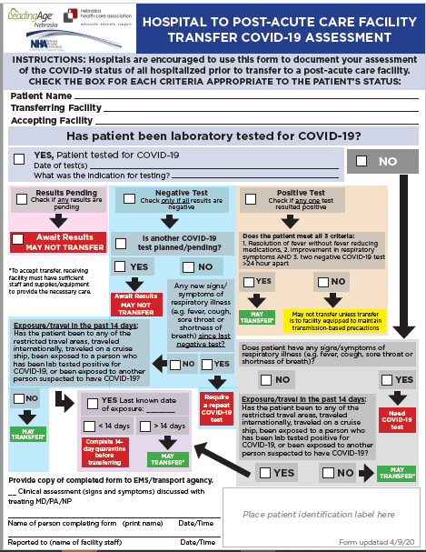

Slide 58
Figure: Cohorting Residents in the Long-Term Care Facilities
Red Zone (Isolation zone) | Dark Red | Residents with Positive COVID-19 test
 | Light Red | Symptomatic residents suspected of having COVID-19
Yellow Zone (Quarantine zone) |  | Asymptomatic residents who may have been exposed to COVID-19
Green Zone (COVID-19 free zone) |  | Asymptomatic residents without any exposure to COVID-19
Gray Zone (Transitional zone) |  | Residents who are being transferred from the hospital/outside facilities (but have no known exposure to COVID-19) are usually kept in this zone for 14 days and if remains asymptomatic at the end of 14 day will be moved to Green zone
https://icap.nebraskamed.com/wp-content/uploads/sites/2/2020/04/Cohorting-Plan-for-LTCF-4.16.20.pdf.

Slide 59
PPE Request Form
https://form.jotform.com/NebraskaDHHS/PPERequestForm

Slide 60
How to determine PPE needs
PPE Burn Rate Calculator
Personal Protective Equipment Burn Rate Calculator excel icon[XLS – 39 KB]
This spreadsheet can help healthcare facilities plan and optimize the use of personal protective equipment (PPE) for response to coronavirus disease 2019 (COVID-19). Get the Instructions
PPE Requests need to go to LHD, shipments go out to LHD and then from LHD to facilities as soon as possible. Often don’t know when shipments are arriving.

Slide 61
Presentation prepared by: Dr. Maureen Tierney;
Panelist: Dr. Tom Safranek
HAI/AR Epidemiologist
Ishrat.kamal-ahmed@Nebraska.gov
402-471-2937

