Slide 1
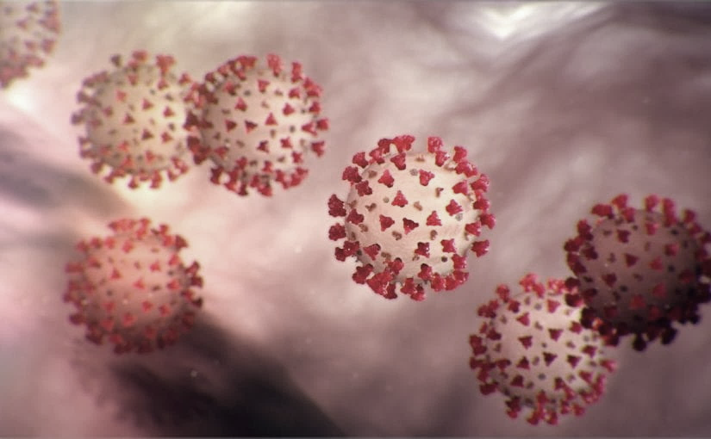
Covid-19 Webex Update 5-20-20
Maureen Tierney, MD, MSc.
Healthcare Associated Infections Medical Director
Tom Safranek, MD, State Epidemiologist

Slide 2
We are one in this fight
Frontline Heroes
Public Health Heroes
First Responder Heroes

Slide 3
CU 2020 George

Slide 4
Future ACH Calls
Wednesday May 20 and May 27
12:00-1:00pm
New calendar invite will be sent this week.
Reassess June 1

Slide 5
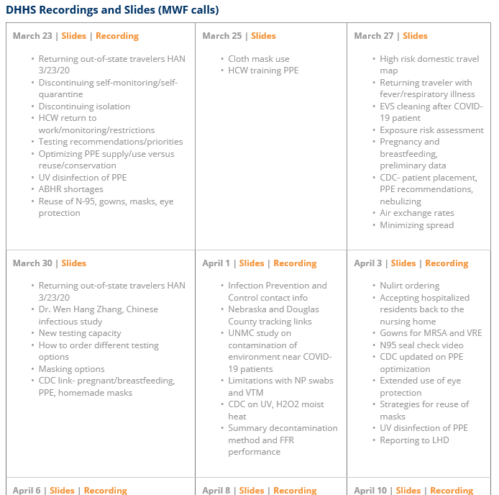
Thank you for joining us!
Slides and recording of today’s presentation will be available at
https://www.nebraskahospitals.org/coronavirus-covid-19-information.html
Scroll to the bottom of the page

Slide 6
Links to Nebraska webinars
Nebraska Acute Care Call every W at noon
previous calls can be found Nebraska Hospital Association
https://www.nebraskahospitals.org/coronavirus-covid-19-information.html
Nebraska ICAP Long Term Care Webinars every Thursday at noon
previous webinars and questions and answers found on ICAP website
NEW
https://icap.nebraskamed.com/
Nebraska ICAP Combined Critical Access and Outpatient Webinars every Tuesday at non
previous webinars and questions and answers found on ICAP website
https://icap.nebraskamed.com/

Slide 7
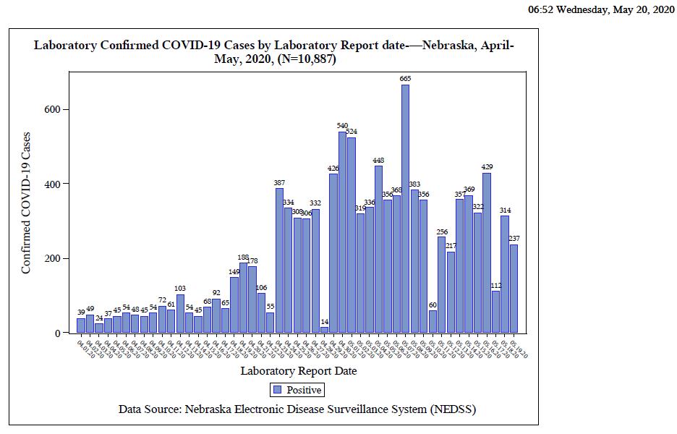

Slide 8
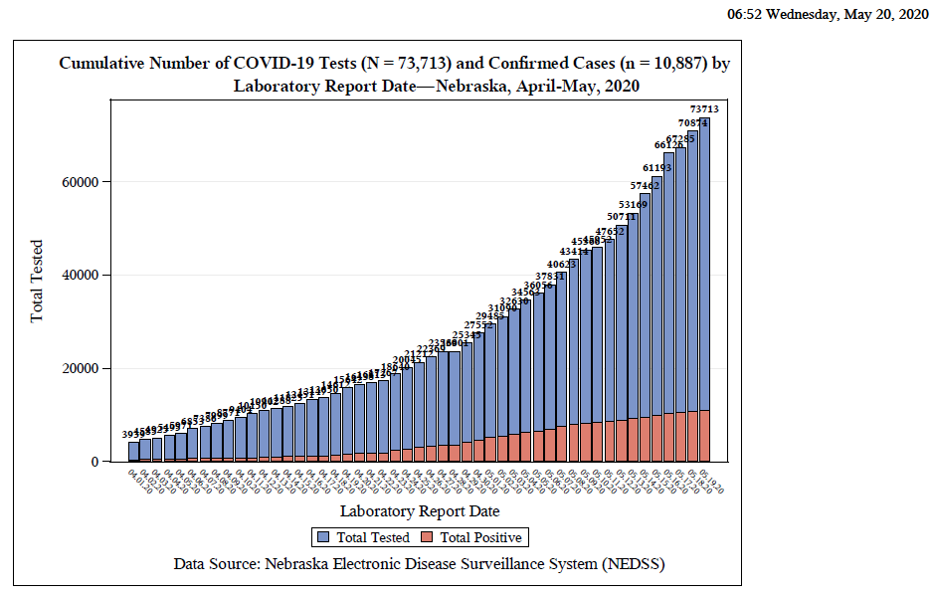
Notes:
Add the title of your presentation, your division, name, etc.

Slide 9
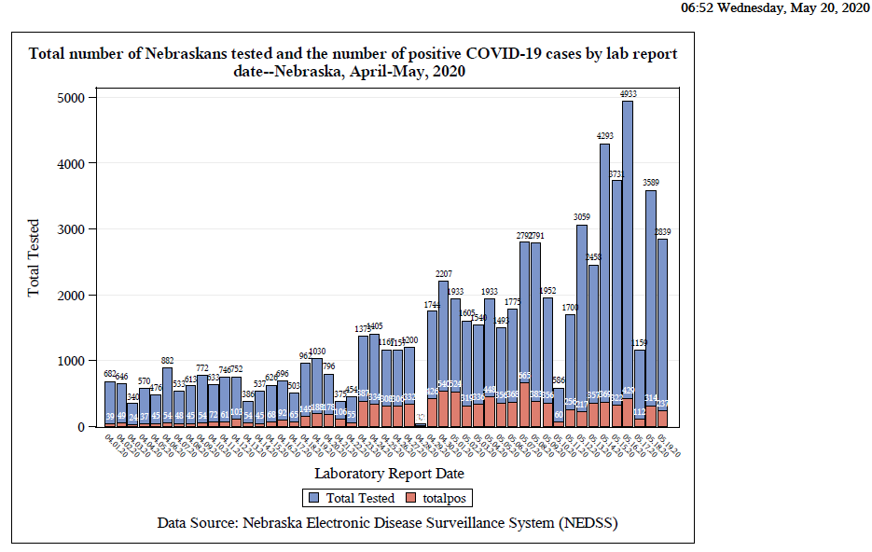

Slide 10
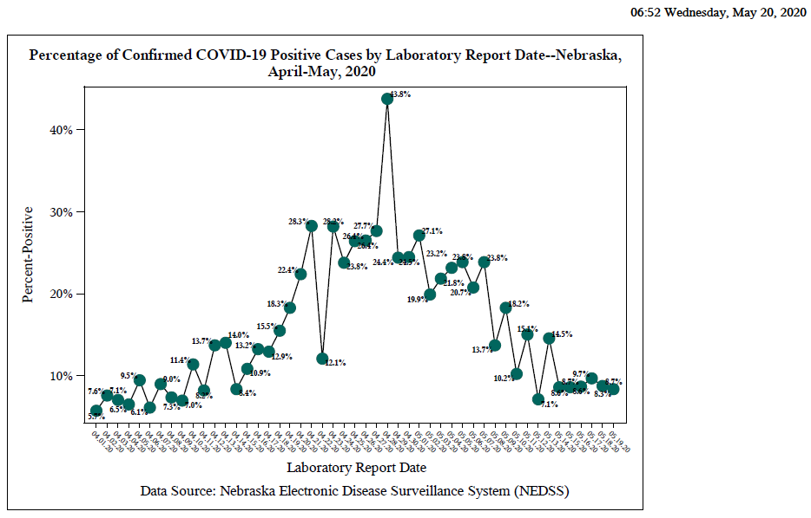

Slide 11
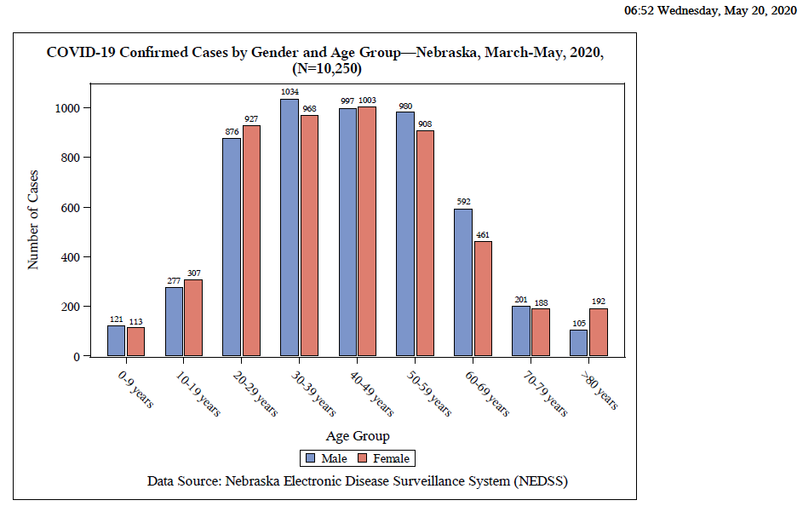

Slide 12
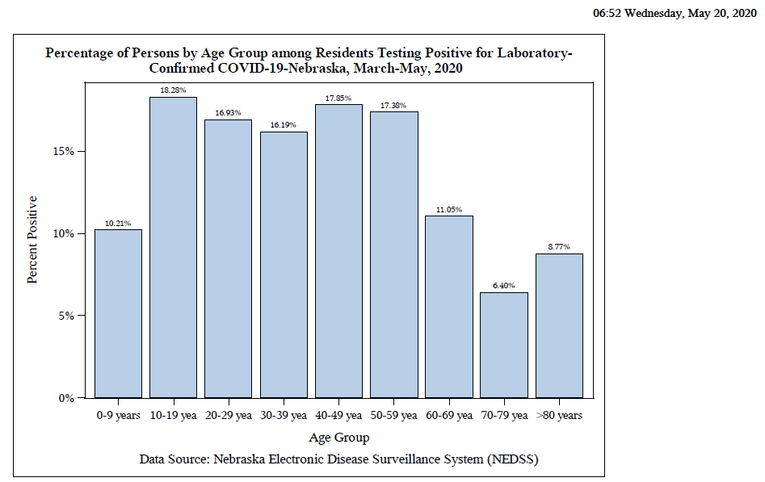

Slide 13
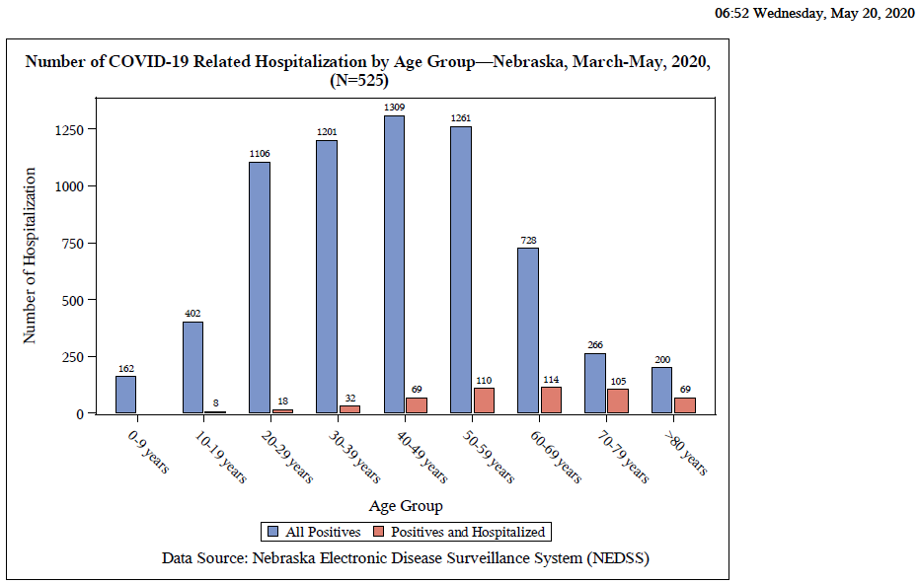

Slide 14
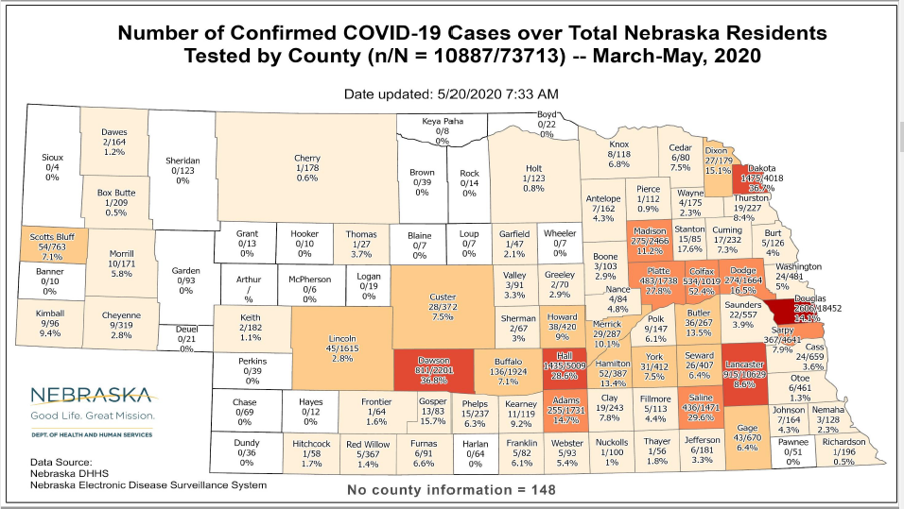

Slide 15
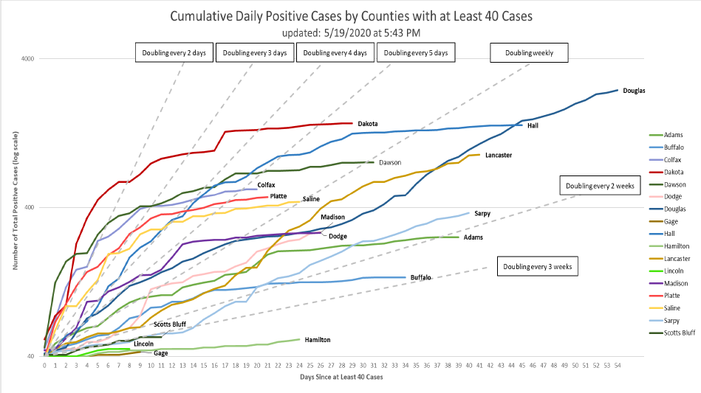

Slide 16
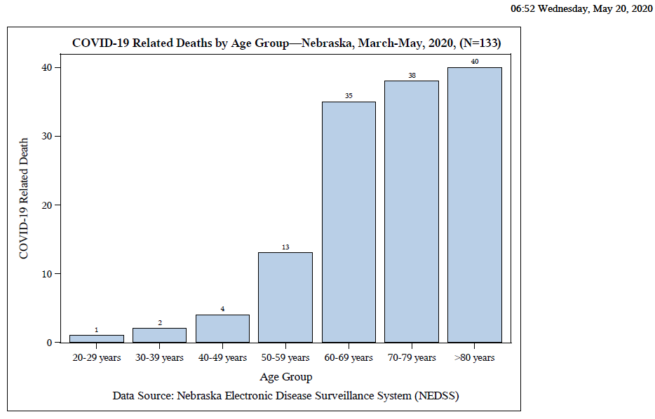

Slide 17
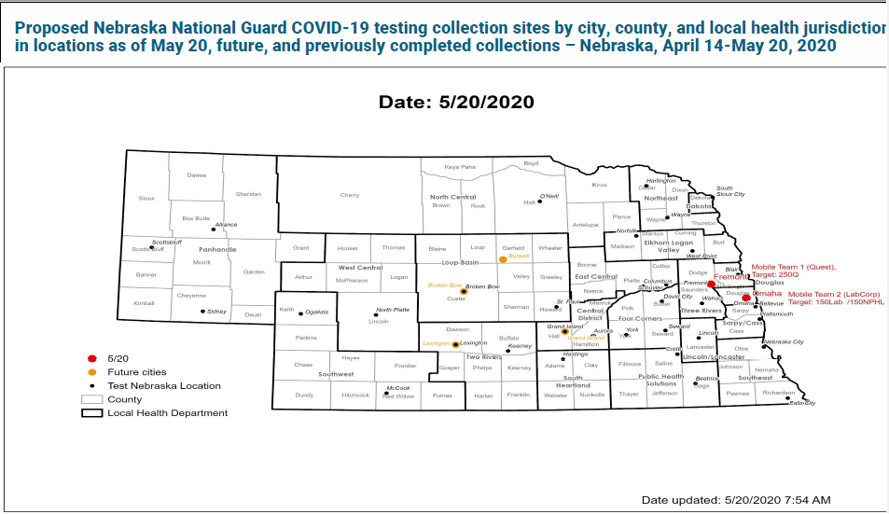

Slide 18
Bed and Vent Availability as of 5-13-20
https://nebraska.maps.arcgis.com/apps/opsdashboard/index.html#/4213f719a45647bc873ffb58783ffef3
44% hospital beds available (41%) Douglas Co
38% ICU beds available
78% ventilators available
Transfer Center supported by CHI-not just to/from CHI hospitals
Increased use of regular and ICU beds in Douglas Co. (although still plenty of capacity)
Lowered hospitalization in the other counties
About 200 patients hospitalized statewide and approximately 30% ventilated

Slide 19
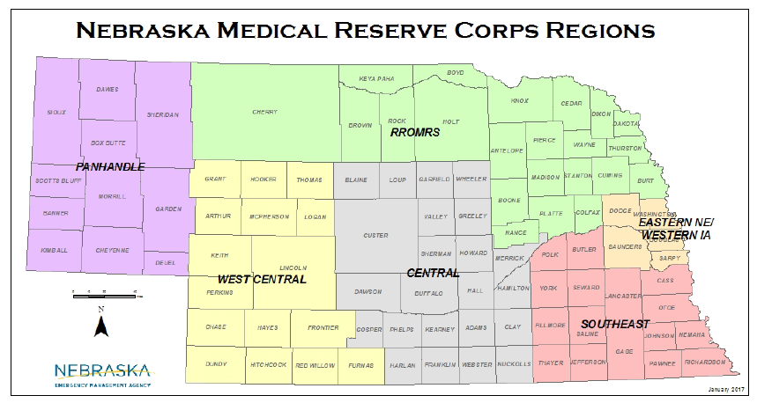

Slide 20
CDC Case Definition for Multisystem Inflammatory Syndrome in Children (MIS-C)
An individual aged <21 years presenting with fever^{i}, laboratory evidence of inflammation^{ii}, and evidence of clinically severe illness requiring hospitalization, with multisystem (>2) organ involvement (cardiac, renal, respiratory, hematologic, gastrointestinal, dermatologic or neurological); AND
No alternative plausible diagnoses; AND
Positive for current or recent SARS-CoV-2 infection by RT-PCR, serology, or antigen test; or COVID-19 exposure within the 4 weeks prior to the onset of symptoms
^{i}Fever >38.0°C for ≥24 hours, or report of subjective fever lasting ≥24 hours ^{ii}Including, but not limited to, one or more of the following: an elevated C-reactive protein (CRP), erythrocyte sedimentation rate (ESR), fibrinogen, procalcitonin, d-dimer, ferritin, lactic acid dehydrogenase (LDH), or interleukin 6 (IL-6), elevated neutrophils, reduced lymphocytes and low albumin
Additional comments
Some individuals may fulfill full or partial criteria for Kawasaki disease but should be reported if they meet the case definition for MIS-C
Consider MIS-C in any pediatric death with evidence of SARS-CoV-2 infection

Slide 21
CDC COCA Call from Tuesday 5/19/20
Reports from UK, NYC on MIS-C and
Immunomodulating Pathophysiology and Therapy
Excellent Review
https://emergency.cdc.gov/coca/calls/2020/callinfo_051920.asp

Slide 22
MIS-C vs KS vs TSS
Other hyper-inflammatory responses
Kawasaki
Staph/Strep Toxic Shock
Hem. Shock and encephalopathy
SLE Vaculitis
Also seeing increase in KD like and FIS (febrile inflammatory syndromes)

Slide 23
MIS-C
Close to 90% + serology; 10-20 % +PCR
No Staph/Strep evidence
More GI symptoms (over 90%); older
Higher incidence of shock
Higher incidecen of aneurysm higher at presentation
Neurocognitive findings-
Markedly higher inflammatory markers
Troponin
D-dimer
CRP
BNP
Ferritin

Slide 24
Acute heart failure in multisystem inflammatory syndrome in children (MIS-C) in the context of global SARS-CoV-2 pandemic. Circulation 5.17.20
Multisystem Inflammatory Syndrome in Children (MIS-C) is a new syndrome that appears to be temporally related to previous exposure to SARS-CoV-2.
MIS-C shares similarities with atypical Kawasaki disease, but prominent clinical signs are largely different.
Myocardial involvement with acute heart failure is likely due to myocardial stunning or edema rather than to inflammatory myocardial damage.
Whereas the initial presentation may be severe with some patients requiring circulatory and respiratory mechanical assistance, rapid recovery with the use of immune globulin and steroids is currently observed.
Early diagnosis and management appear to lead to favorable outcome using classical therapies.
Additional study is needed to determine the full spectrum of the illness and whether long-term cardiac complications may arise.
Authors are Zahra Belhadjer, M.D

Slide 25
Phases of COVID
Phase I-early disease
Viral response phase
Fever, dry cough, HA, etc
Most recover here
Phase II Pulmonary Phase
Continuation of viral response phase moving into host inflammation response
SOB, Hypoxia
Can move quickly into phase 3
Phase III Hyperinflammmatory Phase
ARDS
Marked increase inflammatory markers
Multi-system involvement
Coagulopthy-inc. stroke

Slide 26
Immunomodulating Therapies
Not in Phase 1
IL6/R Blockade-Tocilizumab, Sacrilumab
IL1 Blockers-Anakinra
GM-CSF-JAK-B Baracitnib
Anti-TNF

Slide 27
IBD Patients and COVID
Surveillance Epidemiology of Coronavirus Under Research Exclusion for Inflammatory Bowel Disease (SECURE-IBD) database, which includes data from 33 countries and 28 U.S. states.
As the investigators described in their study online in Gastroenterology, they calculated age-standardized mortality ratios (SMRs) to identify factors associated with severe COVID-19, defined as admission to an intensive care unit, use of a ventilator, or death.
Risk factors for severe COVID-19 among IBD patients included the following:
Systemic corticosteroids: aOR 6.9 (95% CI 2.3-20.5)
Sulfasalazine or 5-aminosalicylate use: aOR 3.1 (95% CI 1.3-7.7)
Two or more comorbidities: aOR 2.9 (95% CI 1.1-7.8)
Increasing age: aOR 1.04 (95% CI 1.01-1.02)

Slide 28
LTC COVID 19 Data (as of 5.6.20)
88 Facilities with at least one resident or staff positive for COVID-19
35 LTCF have at least one resident positive
Over 350 positive residents
LHD and ICAP available for help
Every facility with a positive resident and most with a positive staff member have a virtual ICAP visit
NETEC- over 30 onsite visits
Over 40 CDC Tele ICAR visits
Plans to consider certain relaxation, CMS and CDC requirements

Slide 29
Meat Packing Plants; Shelters
Hall County, Dakota County, Dawson over 1000 cases in NE
In some counties over ¼ of cases; Hall CO drop in cases, Dougls increasing
Shelly Schwedhelm, Dr. Lawler and team -have visited 15 Meat Packing Plants so far
Continuing multiple a week
Closures as necessary to close outbreaks made on case by case basis
Recommendations on Best Practices, a Checklist and A Survey
http://dhhs.ne.gov/Pages/Post-acute-and-Other-Facilities.aspx
More attention and visits to shelters to occur-first was to Open Door Mission
Second with 100s of residents visited yesterday

Slide 30
Report of Placental Infection
A pregnant woman in Switzerland delivered a stillborn infant at 19 weeks' gestation after testing positive for COVID-19, reported David Baud, MD, PhD, of the Lausanne University Hospital in Switzerland, and colleagues.
"This case of miscarriage during the second trimester of pregnancy in a woman with COVID-19 appears related to placental infection with SARS-CoV-2, supported by virological findings in the placenta," Baud's group wrote in a research letter in JAMA.
After delivery, swabs and biopsies of the placenta tested negative for bacterial infection, but positive for SARS-CoV-2. The placenta remained positive at 24 hours after delivery. No other causes of fetal demise were found.
Second case confirmed in Canada in a baby bor at 36 weeks by C-section

Slide 31
Remdesivir Availability
Gilead Sciences, the drug’s manufacturer, has committed to donating 607,000 vials of remdesivir to treat roughly 78,000 patients in the next six weeks, the department said.
HHS reported the delivery of nearly 23,000 vials to New York, nearly 5,000 to Massachusetts, 4,400 to New Jersey, 5,600 to Illinois, 1,600 to Michigan, 1,200 to Connecticut and Maryland, and 400 to Iowa, 400 to Nebraska and smaller allotments to Indiana, Virginia, Rhode Island, and Tennessee.
All 50 states will eventually receive doses of Remdesivir
Gilead has contracted with 5 generic companies in India and Pakistan

Slide 32
Remdesivir Trials
ACTT2
Remdesivir plus Baricitnib versus Remdesivir alone
800 -1000 patients
100 sites
UNMC a site

Slide 33
NEJM May 7,2020
Observational Study of Hydroxychloroquine in Hospitalized Patients with Covid-19
List of authors.Joshua Geleris, M.D., et al.
CONCLUSIONS
In this observational study involving patients with Covid-19 who had been admitted to the hospital, hydroxychloroquine administration was not associated with either a greatly lowered or an increased risk of the composite end point of intubation or death. Randomized, controlled trials of hydroxychloroquine in patients with Covid-19 are needed. (Funded by the National Institutes of Health.)

Slide 34
Hydroxychloroquine +/- Azithromycin
Original Investigation May 11, 2020 JAMA online
Association of Treatment With Hydroxychloroquine or Azithromycin With In-Hospital Mortality in Patients With COVID-19 in New York State
Eli S. Rosenberg, PhD¹; Elizabeth M. Dufort, MD²; Tomoko Udo, PhD¹; et al
1438 randomized
735 H&A; 211 H alone, 211 A alone, 211 nether
Higher rate of cardia arrest in H&A group

Slide 35
Three-Drug Cocktail Appears To Help Patients With Mild To Moderate COVID-19 In Hong Kong Study
Researchers at the University of Hong Kong and six public hospitals in Hong Kong found “patients with mild to moderate” COVID-19, “appeared to improve more quickly if they were treated with a three-drug cocktail, compared with a group receiving just a two-drug combination.” The findings were published in The Lancet.
The three-drug cocktail was made of HIV drug Kaletra (lopinavir-ritonavir), general antiviral
drug ribavirin, and multiple sclerosis drug beta-interferon, while the control group was only
given lopinavir-ritonavir.

Slide 36
Interleukin-1 blockade with high-dose anakinra in patients with COVID-19, acute respiratory distress syndrome, and hyperinflammation: a retrospective cohort study
Cavalli, G et al. The Lancet Rheumatology et al May 7
Small retrospective study in Milan, Italy
Standard treatment was lopinavir plus ritonavir + hydroxychloroquine
29 standard + anakinra (IL1 blocker)
16 standard alone
At 21 days 90% survival vs 50% survival

Slide 37
Donating Plasma and Convalescent Plasma
Donating Plasma
People who have fully recovered from COVID-19 for at least two wks are encouraged to consider donating plasma, which may help save the lives of other patients. COVID-19 convalescent plasma must only be collected from recovered individuals if they are eligible to donate blood. Individuals must have had a prior diagnosis of COVID-19 documented by a lab test and meet other donor criteria. Individuals must have complete resolution of symptoms for at least 28 days before they donate, or alternatively have no symptoms for at least 14 days prior to donation and have a neg lab test for active COVID-19 disease.
~American Red Cross
~Innovative Blood resources (IBR) which is based out of the twin cities (MN) in con partnership with Nebraska Community Blood Bank NPCC
Convalescent Plasma
CHI facilities involved in Mayo Clinic Protocol-convalescent plasma

Slide 38
Infection Prevention and Control Office Hours
Monday – Friday
7:30 AM – 9:30 AM Central Time
2:00 PM -4:00 PM Central Time
Call 402-552-2881

Slide 39
Future ACH Calls
Wednesday May 20 and May 27
12:00-1:00pm
New calendar invite will be sent this week.
Reassess June 1

Slide 40
STOP HERE

Slide 41
When Home Quarantine can be discontinued
Discontinuation of self-monitoring and self-quarantine:
Self-quarantine and self monitoring may stop if after 14 days from most recent exposure, there has been NO development of respiratory illness symptoms. Symptoms may include: cough, shortness of breath, fever, sore throat, and fatigue, myalgias, diarrhea.
Discontinuation of quarantine for household members of a person with COVID-19 who is under self-isolation:
Individuals who are at home with someone that has (or is suspected of having) COVID-19 should continue self-quarantine for 7 days after patient has been released from isolation AND then continue 7 more days with self-monitoring (total of 14 days), masking when outside and social distancing if possible.
These guidelines may not always pertain decisions regarding admission/discharge and transfer to/from healthcare facilities.

Slide 42
Changes in CDC Guidance regarding Isolation
Extended the home isolation period from 7 to 10 days since symptoms first appeared for the symptom-based strategy in persons with COVID-19 who have symptoms and from 7 to 10 days after the date of their first positive test for the time-based strategy in asymptomatic persons with laboratory-confirmed COVID-19. This update was made based on evidence suggesting a longer duration of viral shedding and will be revised as additional evidence becomes available. This time period will capture a greater proportion of contagious patients; however, it will not capture everyone.
Also extended the transmission-based precaution in healthcare settings based on a symptom or time based approach to be 10 days from symptom onset or test results in an asymptomatic person

Slide 43
When home isolation is over
• Discontinuation from self-isolation for a symptomatic case (confirmed or probable):
CDC guidance (https://www.cdc.gov/coronavirus/2019-ncov/hcp/disposition-in-homepatients.html) states that an individual can stop self-isolation if it has been at least 10 days since symptoms first appeared AND No fever for at least 72 hours (fever-free for 3 full days off fever-reducing medicine) AND All other symptoms have improved (e.g., cough has improved).
• Discontinuation from self-isolation for an asymptomatic laboratory-confirmed case.
•Persons with laboratory-confirmed COVID-19 who have not had any symptoms may discontinue isolation when at least 10 days have passed since the date of their first positive COVID-19 diagnostic test and have had no subsequent illness provided they remain asymptomatic. For 3 days following discontinuation of isolation, these persons should continue to limit contact (stay 6 feet away from others) and limit potential of dispersal of respiratory secretions by wearing a covering for their nose and mouth whenever they are in settings where other persons are present. In community settings, this covering may be a barrier mask, such as a bandana, scarf, or cloth mask. The covering does not refer to a medical mask or respirator.

Slide 44
Discontinuation of Transmission-Based Precautions for patients with COVID-19:
Symptomatic patients with COVID-19 should remain in Transmission-Based Precautions until either:
Symptom-based strategy
At least 3 days (72 hours) have passed since recovery defined as resolution of fever without the use of fever-reducing medications and improvement in respiratory symptoms (e.g., cough, shortness of breath); and,
At least 10 days have passed since symptoms first appeared
Test-based strategy
Resolution of fever without the use of fever-reducing medications and
Improvement in respiratory symptoms (e.g., cough, shortness of breath), and
Negative results of an FDA Emergency Use Authorized COVID-19 molecular assay for detection of SARS-CoV-2 RNA from at least two consecutive respiratory specimens collected ≥24 hours apart (total of two negative specimens) [1]. See Interim Guidelines for Collecting, Handling, and Testing Clinical Specimens for 2019 Novel Coronavirus (2019-nCoV). Of note, there have been reports of prolonged detection of RNA without direct correlation to viral culture.

Slide 45
Asymptomatic Patients
Patients with laboratory-confirmed COVID-19 who have not had any symptoms should remain in Transmission-Based Precautions until either:
Time-based strategy
10 days have passed since the date of their first positive COVID-19 diagnostic test, assuming they have not subsequently developed symptoms since their positive test. Note, because symptoms cannot be used to gauge where these individuals are in the course of their illness, it is possible that the duration of viral shedding could be longer or shorter than 10 days after their first positive test.
Test-based strategy
Negative results of an FDA Emergency Use Authorized COVID-19 molecular assay for detection of SARS-CoV-2 RNA from at least two consecutive respiratory specimens collected ≥24 hours apart (total of two negative specimens). Note, because of the absence of symptoms, it is not possible to gauge where these individuals are in the course of their illness. There have been reports of prolonged detection of RNA without direct correlation to viral culture.
Note that detecting viral RNA via PCR does not necessarily mean that infectious virus is present.

Slide 46
Return to Work Criteria for HCP with Confirmed or Suspected COVID-19
Symptomatic HCP with suspected or confirmed COVID-19:
Symptom-based strategy. Exclude from work until:
At least 3 days (72 hours) have passed since recovery defined as resolution of fever without the use of fever-reducing medications and improvement in respiratory symptoms (e.g., cough, shortness of breath); and,
At least 10 days have passed since symptoms first appeared
Test-based strategy. Exclude from work until:
Resolution of fever without the use of fever-reducing medications and
Improvement in respiratory symptoms (e.g., cough, shortness of breath), and
Negative results of an FDA Emergency Use Authorized COVID-19 molecular assay for detection of SARS-CoV-2 RNA from at least two consecutive nasopharyngeal swab specimens collected ≥24 hours apart (total of two negative specimens

Slide 47
Return to Work Criteria for HCP with Confirmed or Suspected COVID-19 (Continued)
HCP with laboratory-confirmed COVID-19 who have not had any symptoms:
Time-based strategy. Exclude from work until:
10 days have passed since the date of their first positive COVID-19 diagnostic test assuming they have not subsequently developed symptoms since their positive test. If they develop symptoms, then the symptom-based or test-based strategy should be used. Note, because symptoms cannot be used to gauge where these individuals are in the course of their illness, it is possible that the duration of viral shedding could be longer or shorter than 10 days after their first positive test.
Test-based strategy. Exclude from work until:
Negative results of an FDA Emergency Use Authorized COVID-19 molecular assay for detection of SARS-CoV-2 RNA from at least two consecutive nasopharyngeal swab specimens collected ≥24 hours apart (total of two negative specimens). Note, because of the absence of symptoms, it is not possible to gauge where these individual are in the course of their illness. There have been reports of prolonged detection of RNA without direct correlation to viral culture.
Note that detecting viral RNA via PCR does not necessarily mean that infectious virus is present.Consider consulting with local infectious disease experts when making decisions about discontinuing Transmission-Based Precautions for individuals who might remain infectious longer than 10 days (e.g., severely immunocompromised).
If HCP had COVID-19 ruled out and have an alternate diagnosis (e.g., tested positive for influenza), criteria for return to work should be based on that diagnosis.

Slide 48
Return to Work Practices and Work Restrictions
After returning to work, HCP should:
Wear a facemask for source control at all times while in the healthcare facility until all symptoms are completely resolved or at baseline. A facemask instead of a cloth face covering should be used by these HCP for source control during this time period while in the facility. After this time period, these HCP should revert to their facility policy regarding universal source control during the pandemic.
A facemask for source control does not replace the need to wear an N95 or higher-level respirator (or other recommended PPE) when indicated, including when caring for patients with suspected or confirmed COVID-19.
Of note, N95 or other respirators with an exhaust valve might not provide source control.
Self-monitor for symptoms, and seek re-evaluation from occupational health if respiratory symptoms recur or worsen
https://www.cdc.gov/coronavirus/2019-ncov/hcp/return-to-work.html

Slide 49
When a Testing-Based Strategy is Preferred
Hospitalized patients may have longer periods of SARS-CoV-2 RNA detection compared to patients with mild or moderate disease. Severely immunocompromised patients (e.g., medical treatment with immunosuppressive drugs, bone marrow or solid organ transplant recipients, inherited immunodeficiency, poorly controlled HIV) may also have longer periods of SARS-CoV-2 RNA detection and prolonged shedding of infectious recovery. These groups may be contagious for longer than others. In addition, placing a patient in a setting where they will have close contact with individuals at risk for severe disease warrants a conservative approach.
Hence, a test-based strategy is preferred for discontinuation of transmission-based precautions for patients who are
Hospitalized or
Severely immunocompromised or
Being transferred to a long-term care or assisted living facility
If testing is not readily available, facilities should use the non-test-based strategy for discontinuation of Transmission-Based Precautions or extend the period of isolation beyond the non-test-based-strategy duration, on a case by case basis in consultation with local and state public health authorities.
From CDC updated IP Guidance 4/15/20

Slide 50
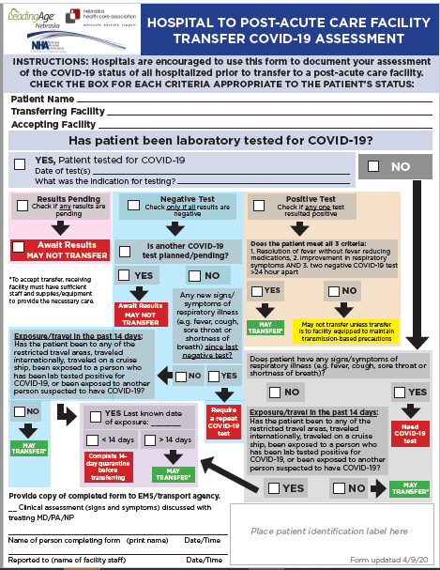

Slide 51
Figure: Cohorting Residents in the Long-Term Care Facilities
Red Zone (Isolation zone) | Dark Red | Residents with Positive COVID-19 test
 | Light Red | Symptomatic residents suspected of having COVID-19
Yellow Zone (Quarantine zone) |  | Asymptomatic residents who may have been exposed to COVID-19
Green Zone (COVID-19 free zone) |  | Asymptomatic residents without any exposure to COVID-19
Gray Zone (Transitional zone) |  | Residents who are being transferred from the hospital/outside facilities (but have no known exposure to COVID-19) are usually kept in this zone for 14 days and if remains asymptomatic at the end of 14 day will be moved to Green zone
https://icap.nebraskamed.com/wp-content/uploads/sites/2/2020/04/Cohorting-Plan-for-LTCF-4.16.20.pdf.

Slide 52
PPE Request Form
https://form.jotform.com/NebraskaDHHS/PPERequestForm

Slide 53
How to determine PPE needs
PPE Burn Rate Calculator
Personal Protective Equipment Burn Rate Calculator excel icon[XLS – 39 KB]
This spreadsheet can help healthcare facilities plan and optimize the use of personal protective equipment (PPE) for response to coronavirus disease 2019 (COVID-19). Get the Instructions
PPE Requests need to go to LHD, shipments go out to LHD and then from LHD to facilities as soon as possible. Often don’t know when shipments are arriving.

Slide 54
Staffing Needs
NE DHHS COVID Staffing Support Program
Caryn N Vincent, MPH | Interim Deputy Director, Public Health | Nebraska Department of Health and Human Services
Email: Caryn.Vincent@nebraska.gov
Phone: 402-471-1595 or 402-613-2377
Please provide facility name, type of professional support needed, and contact information. Someone will contact you regarding your request within 24 hours.

Slide 55
Presentation prepared by: Dr. Maureen Tierney and Dr. Tom Safranek
HAI/AR Epidemiologist
Ishrat.kamal-ahmed@Nebraska.gov
402-471-2937

