Slide 1
ED Follow Up Calls
WHAT’S THE POINT?

Slide 2
ED F/U Calls-What's the Point
OBJECTIVES
Participants will be able to describe the steps in developing an ED follow up call program
At the end of this session, participants will be able to identify achieved outcomes from an ED follow up program.

Slide 3
In the beginning…
To do better in the future, you must learn from the past
Why haven’t we been successful with follow up calls?
Why
Inconsistency
Lack of buy in
What were we trying to achieve
Didn’t recognize the risks
Patient Satisfaction…who cares?

Slide 4
Why change?
WHO-WHY-HOW-WHEN
‘Lost’ the old process in the transition-was not a priority
New Building
New Providers
New Leaders & Staff
New Process

Slide 5
New Beginning
Identify the Why
Risk Management
Incidental findings
Quality
Repeat ED admissions
Repeat Hospitalizations
Patient Satisfaction
Early intervention

Slide 6
Why: Risk Management
Informal Auditing
Incidental findings
Are these getting addressed
Did the patient even know
Who is responsible?

Slide 7
Why: Quality
Can we do better?
Repeat ED admissions
How can we reduce our "well-known customer utilization"
Initiate F/U appointments
Repeat Hospitalizations
Follow Up appointment process
Initiate TCM

Slide 8
Why: Patient Satisfaction
There is a strong correlation between positive ratings of patient experience and improved clinical outcomes and care quality and reduced medicolegal risk. (1)
Early and open communication helps mitigate risk and promotes a sense of caring, sometimes even helps with the bill.

Slide 9
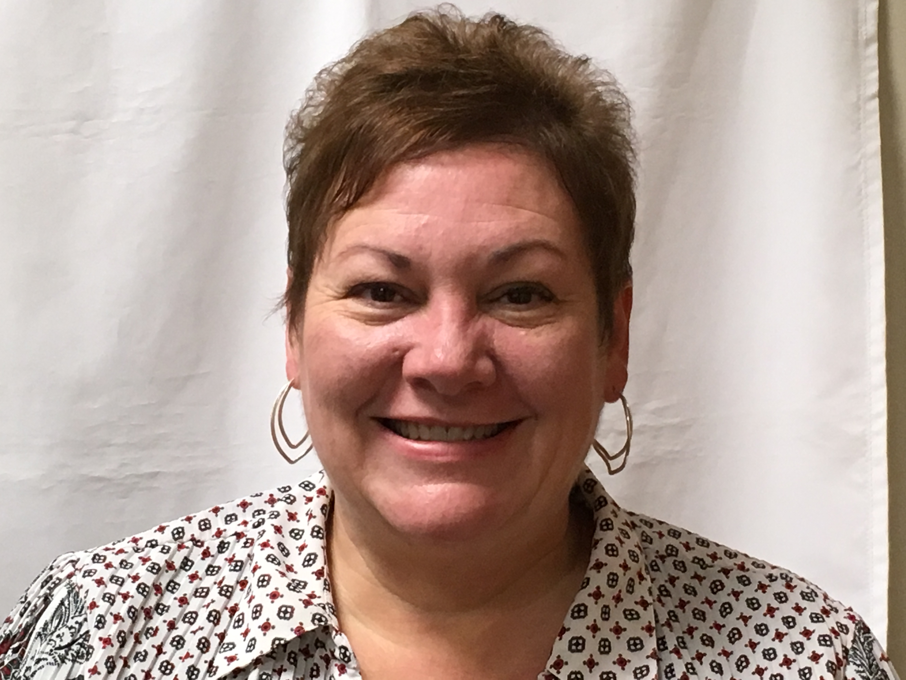
Identify the Who
Different Approach
Patient Relations and Community Outreach position
Sandi Rippe
Attributes/Skills
Patient Advocate
Non-clinical; limited bias
Empathetic
Strong active listening skills
Mental Strength
Know when to refer to clinician

Slide 10
How: Call Process
Have a backup plan
Attempt to call EVERY patient 24-48 hours after ED Visit
Use EMR reports to keep on track
Care Coordinators are back up when Sandi is out; same process is followed.
Inquire about follow up visit during call and if not made, make it.
Ask about patient experience-what could we have done better for you.
Were there any results you were waiting on?
Add to appointment or forward to care coordinators
Transferred patients to acute care facilities are called by Care Coordinators to establish TCM visit if needed.
Residents of care facilities are called, usually speak to social worker for follow up.

Slide 11
How: Follow Up Process
Engaged ED providers
Standard is to schedule follow up DURING ED visit (if able) before patient is discharged.
ED providers sent secure messages to PCP's regarding incidental findings AND to registration to ensure patient got scheduled for follow up appointments. Effective handoffs are a must.(2)
Patients with NO PCP's were forwarded to Sandi

Slide 12
Outcomes
The good, the bad & the ugly
Marketing
New Patients
Patient Satisfaction
Follow Up Visits
Complaints
Risk

Slide 13
Marketing---an inadvertent outcome
Identified those who did not have a primary care provider. --Estimated at about 1/8th did not have PCP
May or may not have needed a follow up appointment
BUT did encourage establishment with one of our Rural Health Clinics—57 new established patients (Just over ½ who did not have a PCP listed)
Singles & Families establishing care with our PCP team
Numerous comments: "I can't believe you called just to check up on me"

Slide 14
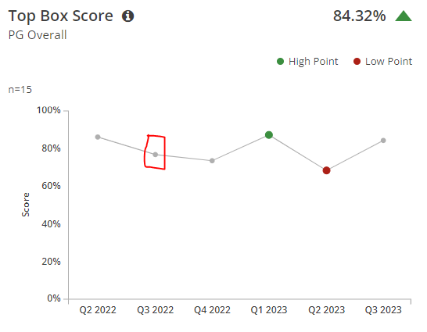
Patient Satisfaction
Achieving and Believing
Up and down...but overall improvement seen in comments
Significant change in ED staff: providers and nurses. Q4-Q1 providers, Q1-Q2 agency RN's
Change in Leadership, one agency RN-Culture Q2

Slide 15
F/U--C/O--RISK--BAH
One Year Review
Out of 1760 visits, 661 follow up visits were scheduled either at the ED visit or during the follow up call.
11 vs 13 complaints received from 2023 vs 2022 FY
Were we doing better at harvesting complaints during calls?
Should we have seen them reduce more?
Did we receive 'gifts' to address and improve upon?
One case to Risk company compared to Zero cases after implementation. Result in no litigation.

Slide 16
References
Sonis JD, Aaronson EL, Castagna A, White B. A Conceptual Model for Emergency Department Patient Experience. J Patient Exp. 2019 Sep;6(3):173-178. doi: 10.1177/2374373518795415. Epub 2018 Aug 21. PMID: 31535004; PMCID: PMC6739687.
https://www.callcopic.com/resource-center/proactively-protect-your-practice

Slide 17
Thank You!
Donna Armknecht 402-269-7652
darmknecht@syracuseareahealth.com

