Slide 1
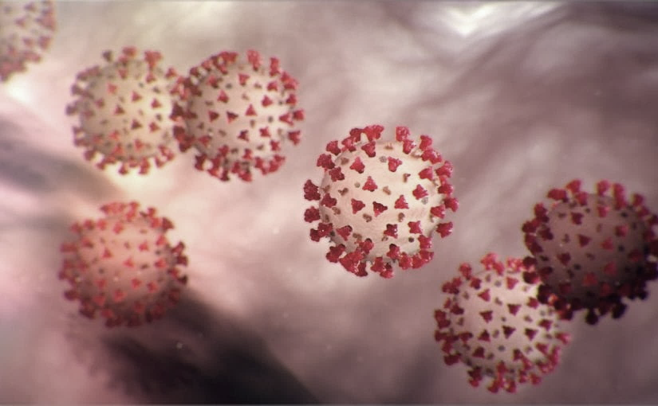
Covid-19 Webex Update 12-16-2020
​​
Tom Safranek, MD, State Epidemiologist
Louis Safranek, MD, PhD
Board certified specialist, Infectious Disease
E-mail: idmd4u-corona.2020@yahoo.com

Slide 2
Epidemiology
Shedding of infectious virus in hospitalized patients with coronavirus disease-2019 (COVID-19): duration and key determinants
Infectious virus shedding was detected in 23 of the 129 patients (17,8%), most in ICU, correlating with magnitude of the viral load and the level of neutralizing antibody.
The median duration of shedding was 8 days post onset of symptoms (IQR 5-11) and the probability of detecting infectious virus dropped below 5% after 15 days post onset of symptoms (95% confidence interval (CI) 13,4-17,2).
One patient harbored infectious virus on day 20 of illness.
Patients who are severely ill may shed infectious virus for longer periods of time than mildly ill patients.
doi: https://doi.org/10.1101/2020.06.08.20125310

Slide 3
Epidemiology
COVID-19 Test Strategy to Guide Quarantine Interval in University Student
Asymptomatic University of Kentucky students who were contacts of a PCR confirmed case were quarantined for 14 days, tested on days 3 or 4, day 5, day 7, day 10, day 14.
Overall, 14 of 90 (16%) had at least one positive test while in quarantine.
Of the 14 students testing positive, 7 individuals tested positive initially on day 3 or 4, 5 individuals on day 5, and 2 individuals on day 7. No students tested positive initially on day 10 or 14.
Duration of unmasked exposure was the major risk factor.
If the indication for quarantine was exposure to an asymptomatic individual (33/90), the risk of infection was low (1/33, 3%).
"Since quarantine times are poorly adhered to, with only 10.9% of quarantining individuals remaining at home in one report, a testing strategy that allows for a reduction in quarantine time could lead to improved compliance. "
https://doi.org/10.1101/2020.12.09.20246785

Slide 4
Treatment
Aspirin Use is Associated with Decreased Mechanical Ventilation, ICU Admission, and In-Hospital Mortality in Hospitalized Patients with COVID-19
After adjusting for 8 confounding variables, aspirin use was independently associated with decreased risk of mechanical ventilation, ICU admission, and in-hospital mortality.
There were no differences in major bleeding or overt thrombosis between aspirin users and non-aspirin users. DOI: 10.1213/ANE.0000000000005292

Slide 5
Treatment
Association of Mortality and Aspirin Prescription for COVID-19 Patients at the Veterans Health Administration
Among COVID-19 positive Veterans, preexisting aspirin prescription was associated with a statistically and clinically significant decrease in overall mortality at 14-days and at 30-days cutting the odds of mortality by more than half.
Findings demonstrated that pre-diagnosis aspirin prescription was strongly associated with decreased mortality rates for Veterans diagnosed with COVID-19.
doi: https://doi.org/10.1101/2020.12.13.20248147

Slide 6
Indomethacin
Efficacy and Safety of Indomethacin in Covid -19 patients
Indomethacin 75 mg SR
Only one out of 72 patients in the Indomethacin arm of the first group required supplementary oxygen while 28 of the 72 patients required supplementary oxygen in the paracetamol arm.
No one in the second group deteriorated enough to require mechanical ventilation.
There was no evidence of adverse reaction to indomethacin or deterioration of renal or liver function.

Slide 7
Treatment
Azithromycin in Hospitalised Patients with COVID-19 (RECOVERY): a randomised, controlled, open-label, platform trial
In patients hospitalised with COVID-19, azithromycin did not provide any clinical benefit.
Azithromycin use in patients hospitalised with COVID-19 should be restricted to patients where there is a clear antimicrobial indication.
doi: https://doi.org/10.1101/2020.12.10.20245944

Slide 8
Treatment
Impact of Convalescent Plasma Transfusion (CCP) In Patients With Previous Circulating Neutralizing Antibodies (nAb) to COVID-19
Administration of CCP after 10 days of symptom onset was associated with increases in ICU length of stay (p<0.001). doi: https://doi.org/10.1101/2020.12.08.20246173

Slide 9
Treatment
A Randomized Trial of Convalescent Plasma in Covid-19 Severe Pneumonia
No significant differences were observed in clinical status or overall mortality between patients treated with convalescent plasma and those who received placebo.
DOI: 10.1056/NEJMoa2031304

Slide 10
Treatment
Convalescent plasma or hyperimmune immunoglobulin for people with COVID-19: a living systematic review (july)
We are very uncertain whether convalescent plasma is beneficial for people admitted to hospital with COVID-19.
There is only very low-certainty evidence for safety of convalescent plasma for COVID-19.
doi: 10.1002/14651858.CD013600.pub2.

Slide 11
Treatment
Kinetics of SARS-CoV-2 antibody responses pre- and post- COVID-19 convalescent plasma transfusion in patients with severe respiratory failure: an observational case-control study
Hospitalized COVID-19 patients with severe respiratory failure transfused with CCP presented with high titers of SARS-CoV-2 IgG antibodies before transfusion and did not show improved survival at 30 days. https://doi.org/10.1101/2020.12.10.20247007

Slide 12
Monoclonal antibody therapies
Bamlanivimab is authorized for patients with positive results of direct SARS-CoV-2 viral testing who are 12 years of age and older weighing at least 40 kilograms (about 88 pounds), and who are at high risk for progressing to severe COVID-19 and/or hospitalization.
This includes those who are 65 years of age or older, or who have certain chronic medical conditions

Slide 13
Monoclonal antibody therapy
Casirivimab/imdevimab
Fort treatment of mild to moderate COVID-19 in adults and pediatric patients (12 years of age or older weighing at least 40 kilograms [about 88 pounds]) with positive results of direct SARS-CoV-2 viral testing and who are at high risk for progressing to severe COVID-19.
This includes those who are 65 years of age or older or who have certain chronic medical conditions.

