Slide 1
Nebraska HFMA & NHA-NeRHA Rural Health Conference
Hot Topics in Revenue Cycle Today
Martie Ross, PYA
Kathy Reep, PYA
June 4, 2024

Slide 2




Medicare Advantage
Price Transparency
A Word about Change Healthcare
NHA RCR
Medicare Appeal Rights: Proposed Rule

Slide 3

Medicare Advantage
Image Source: Shutterstock

Slide 4
MedPAC 2024 Status Report on Medicare Advantage
Commission strongly supports the inclusion of private plans in Medicare
MedPAC estimates that Medicare spends approximately 22% more for MA enrollees than if those same beneficiaries were enrolled in FFS
Equivalent to $83B in 2024
Some of these dollars are used for supplemental benefits and better financial protection for MA enrollees
Originally, risk-based payment for private plans set at 95% of FFS; averages 122% today
Calls for “a major overhaul” of MA policies

Slide 5
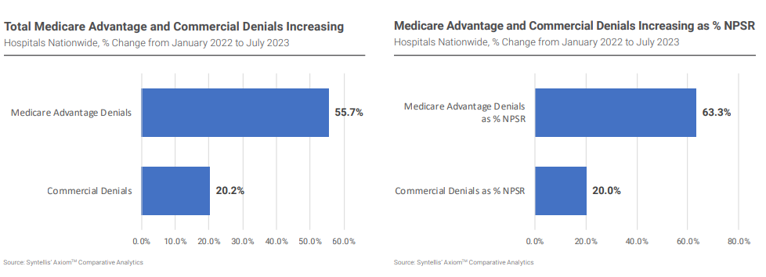
Hospital Vitals: Financial and Operational Trends
Syntellis & American Hospital Association
https://www.syntellis.com/sites/default/files/2023-11/aha_q2_2023_v2.pdf

Slide 6
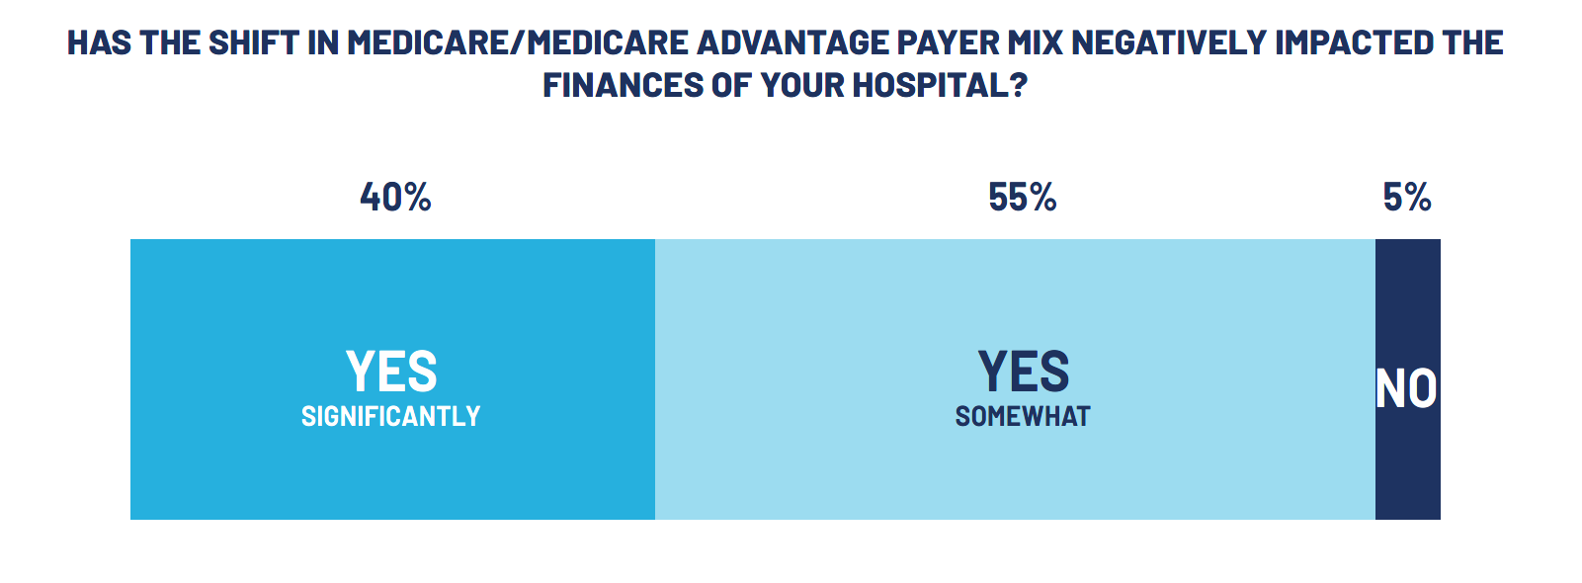
And in Nebraska …
NHA Medicare Advantage Report and Survey 2023

Slide 7
Coverage Criteria
Effective January 1, 2024
MA plans must comply with traditional Medicare NCDs, LCDs applicable to the plan’s service area, and general coverage and benefit conditions
    Including coverage criteria for inpatient, IRF, and SNF admissions and HHA services
    Admissions for surgeries on inpatient only list
    Admissions meeting two-midnight benchmark/expectation of the admitting physician (but not the two-midnight presumption applied for medical review purposes that stays crossing two midnights are
    “presumed” appropriate for payment )

Slide 8
Coverage Criteria
  If (and only if) coverage criteria not fully defined by above, may establish internal coverage criteria
    Must be based on current evidence in widely used treatment guidelines or clinical literature
      Those developed by organizations representing clinical medical specialties for the treatment of specific diseases or conditions
    Must be publicly accessible (including summary of evidence)
      Accessible via website and not behind a paywall or require subscription for access
    Plan must demonstrate additional criteria provide clinical benefits highly likely to outweigh any harm (including delayed/decreased access to care)

Slide 9
Additional Clarification from CMS
FAQs to plans issued February 6, 2024
Addresses questions about the Coverage Criteria and Utilization Management Requirements in CMS-4201-1 issued April 2023
Recommend keeping copy for dealing with plan issues (contact kreep@pyapc.com if needed)

Slide 10
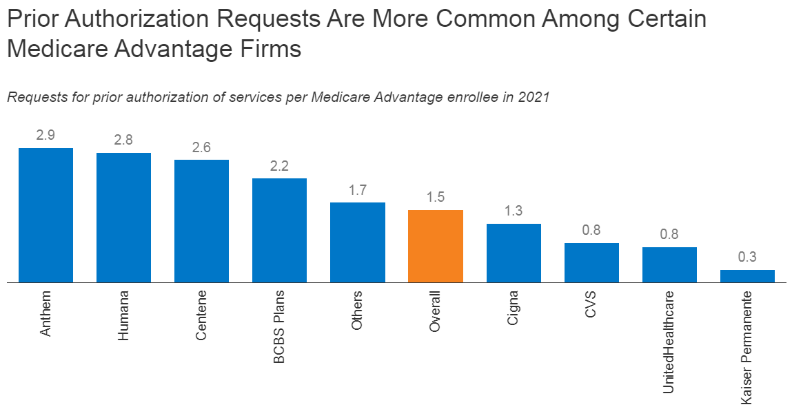
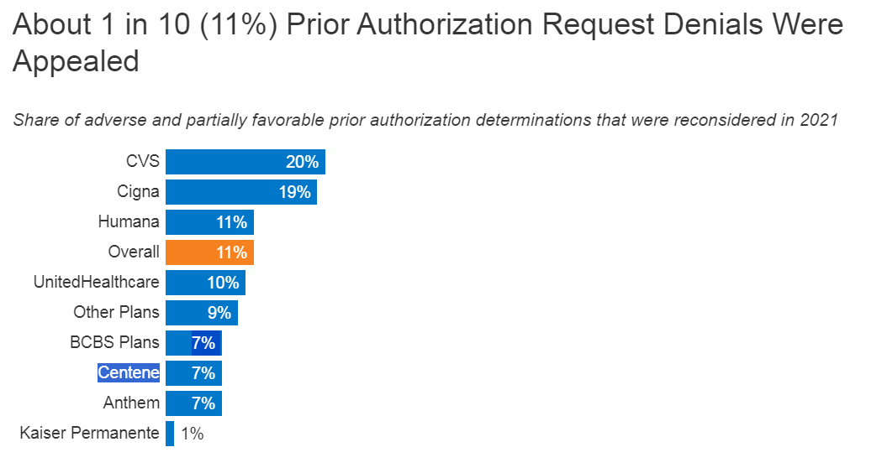
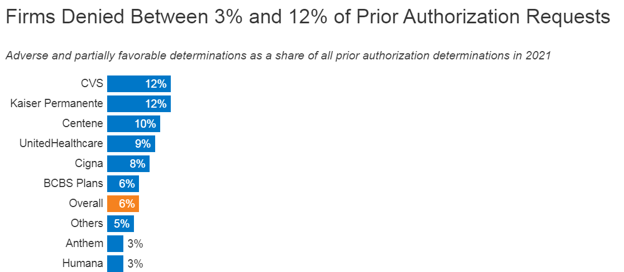
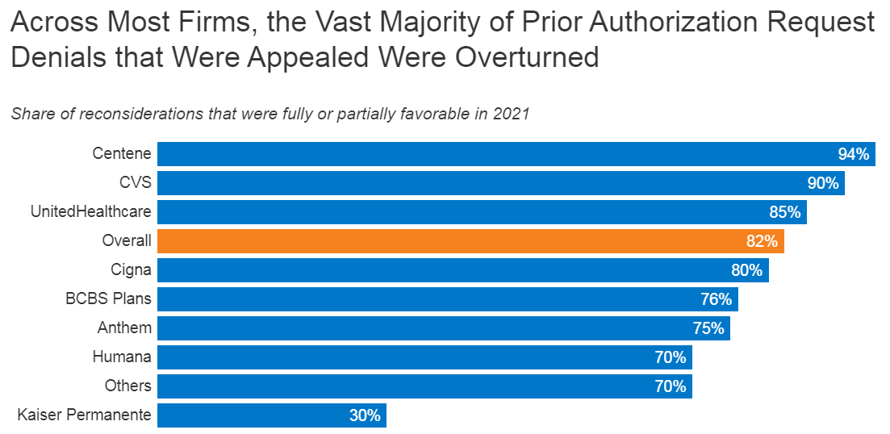
Prior Authorization Statistics - 2021
https://www.kff.org/medicare/issue-brief/over-35-million-prior-authorization-requests-were-submitted-to-medicare-advantage-plans-in-2021/

Slide 11
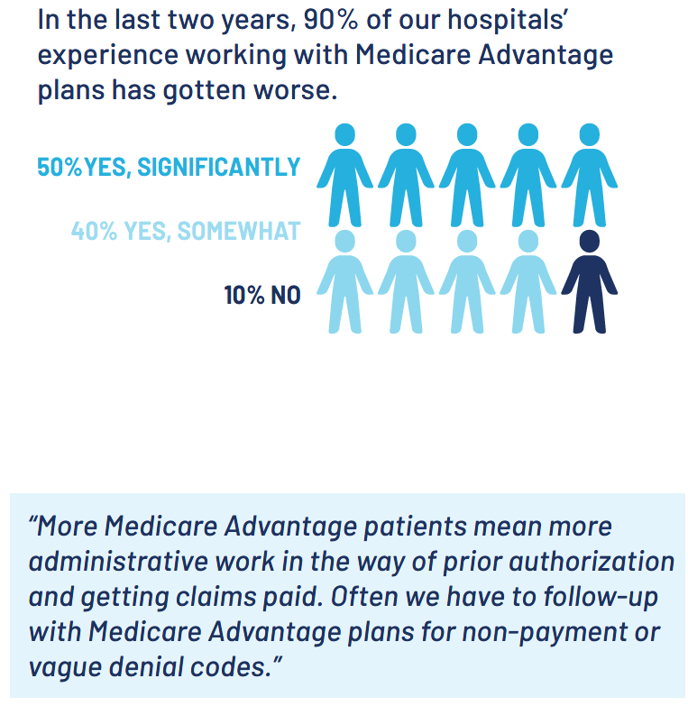
And in Nebraska…
NHA Medicare Advantage Report and Survey 2023

Slide 12
Prior Authorization Requirements/Timelines
Effective January 1, 2026
Timeframe for responding to prior authorizations
  Expedited requests – 72 hours; Standard requests – 7 days
Plan must provide specific reason for denial

Slide 13
Price Transparency: Review and Update on Recent Regulation
Image Source: Shutterstock

Slide 14

Review of the Requirements
Compliance required January 1, 2021
  45 CFR Part 180, November 27, 2019, Federal Register following Executive Order, June 24, 2019
    Requires charge data to be posted in a single machine-readable file (MRF)
      Five types of “standard charges”
          Gross charge (regular rate established by the hospital for an item or service provided to a specific group of paying patients)
          Payer-specific negotiated charge
          De-identified minimum negotiated charge
          De-identified maximum negotiated charge
          Discounted cash price
    Requires consumer-friendly list of standard charges for a limited set of shoppable services
      In lieu of posting standard charges for shoppable services, hospital may maintain internet-based price estimator tool
    Both files updated at least annually and show date of last update on file

Slide 15
New/Revised Requirements – Required 1/1/24
Good faith effort to ensure that the information encoded in the MRF is truly accurate and complete as of the date indicated in the MRF
Requires hospitals to establish and maintain txt file as specified
  Requires link in the footer on hospital’s website, including but not limited to the homepage, labeled “Price Transparency”
  A TXT file must be located at the root of the public website that hosts your MRF
    www.yourhospital.com/cms-hpt.txt

Slide 16
New/Revised Requirements – Required 07/01/24
Modified standard charge display requirements
  Encoding of required data elements including –
    The hospital name(s), license number, and location name(s) and address(es)
    All standard charge information corresponding to each required data element in the MRF
      CMS templates allow for a comma-separated values (CSV) “wide” format, a CSV “tall” format, or a JSON schema

Slide 17
New/Revised Requirements – Required 07/01/24
Modified standard charge display requirements
  The type of method used to establish the standard charge
    Location/setting (inpatient/outpatient/both)
    Codes used for billing such as modifiers and code type (HCPCS, CPT, NDC, DRG, etc.)
    Payer and plan (separate data elements)
      Plans may be shown as categories (such as ‘‘all PPO plans’’) when the established payer-specific negotiated charges are applicable to each plan in the indicated category
    Identify whether the standard charge is a dollar amount, or if the standard charge is based on a case rate, fee schedule, per diem, percentage or algorithm
      If the standard charge is based on a percentage or algorithm, the MRF must also describe the percentage or algorithm that determines the dollar amount for the item or service

Slide 18
Requirement to Certify Completeness and Accuracy of MRF
Compliance Statement
To the best of its knowledge and belief, this hospital has included
all applicable standard charge information in accordance with
the requirements of 45 C.F.R. §180.50 and the information encoded
in this machine-readable file is true, accurate and complete as of
the date indicated in this file.
Effective date July 1, 2024
Value of “true” or “false” entered by the hospital

Slide 19
New/Revised Requirements – Required 01/01/25
Report an “estimated allowed amount” when the payer negotiated rate is based on an algorithm or percentage
Estimated allowed amount: The average reimbursement in dollars that has been received from the payer in the past for an item or service
Drug unit and type of measurement
Modifiers impacting the “standard” charge, including a description of the modifier and how it would change the standard charge

Slide 22
Validate Your Data
CMS V2.0 Online Validator (https://cmsgov.github.io/hpt-tool/online-validator/)
  Allows you to review your uploaded MRF against the required CMS template layout and data specifications
  If your MRF does not conform to the form and manner requirements, the Online Validator will generate an output consisting of “errors” and “warnings”

Slide 23
A Word on Change Healthcare
Image Source: Shutterstock

Slide 24

Redundancy
Source: Reuters

Slide 25
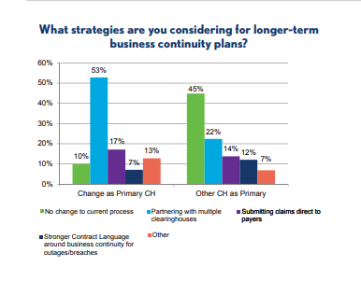
Developing Redundancy
Source: HFMA Change Healthcare Impact: Market Pulse #3

Slide 26
NHA Revenue Cycle Residency
Image Source: Shutterstock

Slide 27

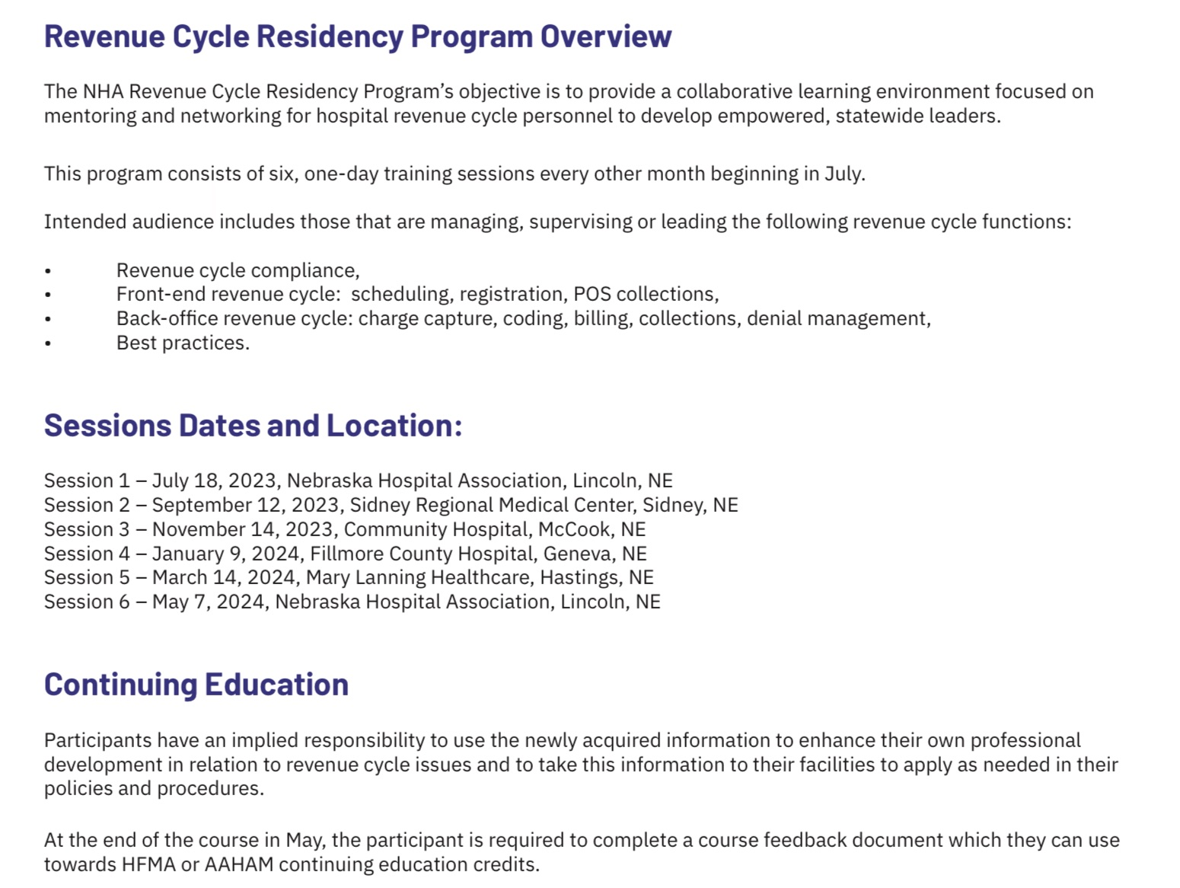
NHA RCR 2023-2024

Slide 28
NHA RCR 2023-2024
Sessions focused on revenue cycle challenges and successes
Feedback indicated series provided deeper understanding of the revenue cycle
  Attendees appreciated “connections” and networking
    Sharing of tools and processes
Plans for 2024-2025
THANKS TO MIKE FEAGLER AND NHA FOR INVITING PYA TO BE PART OF THE JOURNEY!

Slide 29


